Slide 1
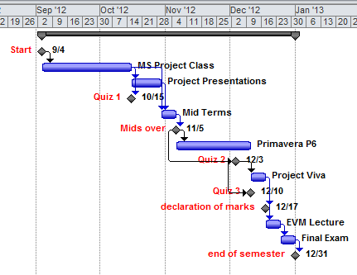
Project Management Software Applications
Course Code: PRM 705
Mian Wasim Irshad P.E. PMP®
Manager (P & C), at
A PUBLIC SECTOR ORGANIZATION
Project Management Consultant
Trained hundreds of professionals at
Heurixtics (Pvt.) Ltd.
National Institute of Design & Analysis
Project Planning & Management Institute
National Institute of Management
Pakistan Postal Staff College
COMSATS Islamabad

Slide 2
Education & Trainings
Project Management Professional (PMP) Certified
Master in Project Management (MPM) from COMSATS Islamabad
Bachelor of Software Engineering (BSE) from BAHRIA UNIVERSITY Islamabad
Primavera P6 Certification, SDC
Oracle 10g training from PETTS
FEA training from ISEN, France
ISO 9001:2008 Training, Islamabad
ISMS 27001:2005 Training, Islamabad (Member of implementation team)
OHSAS 18001 Training, Islamabad
Training on Improving Personal Effectiveness, STI , Islamabad
Certification in Java, RBMS, C#
Image ware certification

Slide 3
Major Projects
Establishment of Project Management Office (PMO) at Public sector organization with capacity of handling more than twenty different projects simultaneously.
Senior Architect for HoneyCombERP® deployed at more than fifteen major industries in Pakistan.
Pioneer successful deployment of HC-ERP at HICO Surgical, one of big surgical manufacturing industries in Sialkot, Pakistan
Deployment of HC-ERP at Tariq Glass, the biggest glass ware manufacturing industry of Pakistan. The most renowned products TOYO NASIC and OMROC
Deployment of HC-ERP at ELMED Surgical, big surgical equipment manufacturer and exporter.
Implementation ERP at LIBRA Pharmaceutical, a renowned medicine industry of Peshawar, Pakistan
Implementation of HC-ERP in National Furnishers, a hug furniture manufacturer and distributor of Gujjrat, Pakistan

Slide 4
Major Projects
Automation of Khyber Match Factory.
Implementation of Supply Chan Management System at AYS Supply Chain, hug departmental chain of KPK, Pakistan
Implementation of Inventory Management System and Batch Production System at Al-Hafiz Crysto Plast.
Deployment of HC-ERP at DURRANI Surgical ,Sialkot, Pakistan
Implementation of HC-ERP at Medical Devices, a hug unit in Sialkot industry.
Development and implementation of PRMS: A complete management information system deployed at MSL. The system is capable to communicate with MS Project Plans and extract required data. This data was further processed and used for even better project management.
Paperless Document Management System: Office Automation System based on concept of paperless office deployed at Military College Jehlum. This was a complete electronic office concept based on slogan “Paper free environment”.

Slide 5
Major Projects
Edusol: Complete Educational Management Suit deployed at Quid-e-Awam University Nawabshah, Civil Sevices Academy, Military College Academy, Gomal University DI Khan
Netwatch: Video Surveillance system and motion detection deployed at Burraq LLC, iPhonica and Agger Tech.

Slide 6
Importance of this course
This course is practical implementation of your whole project management theoretical knowledge

Slide 7
Course Outline

Slide 8
Deliverables
There will be
  4 Quizzes
  4 Assignments
  1 Mid Term Exam
  1 Final Exam

Slide 9
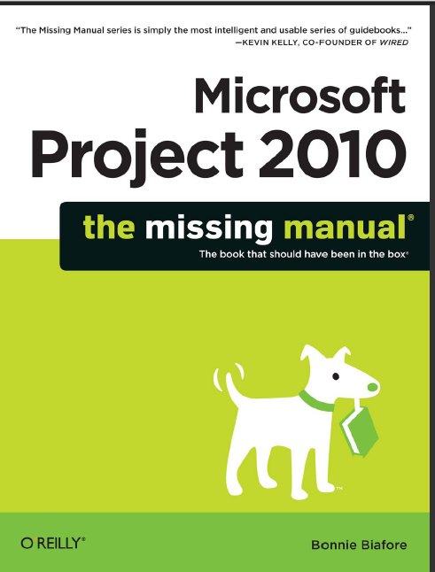

Reference Books
Microsoft Project 2010 – The Missing Manual by Bonnie Biafore
Step by Step Microsoft Project 2010 by Carl Chartfield

Slide 10


Reference Books
Microsoft Project 2010 Inside Out by Terese S Stover
MS Project 2010 for dummies by Cynthia Synder, Nancy Muir

Slide 11


Slide 12


Slide 13
Example Project

Slide 14
Example Project

Slide 15
Example Project

