Slide 1
Quick Recap

Slide 2
PMBOK Scope Management Processes
Scope Management Process | Description
Scope Planning | The development of a scope management plan that defines the project’s scope and how it will be verified and controlled throughout the project.
Scope Definition | A detailed scope statement that defines what work will and will not be part of the project and will serve as a basis for all future project decisions
Create Work Breakdown Structure (WBS) | The decomposition or dividing of the major project deliverables into smaller and more manageable components.
Scope Verification | Confirmation and formal acceptance that the project’s scope is accurate, complete, and supports the project’s MOV.
Scope Change Control | Ensuring that controls are in place to manage proposed scope changes once the project’s scope is set. These procedures must be communicated to all project stakeholders.

Slide 3
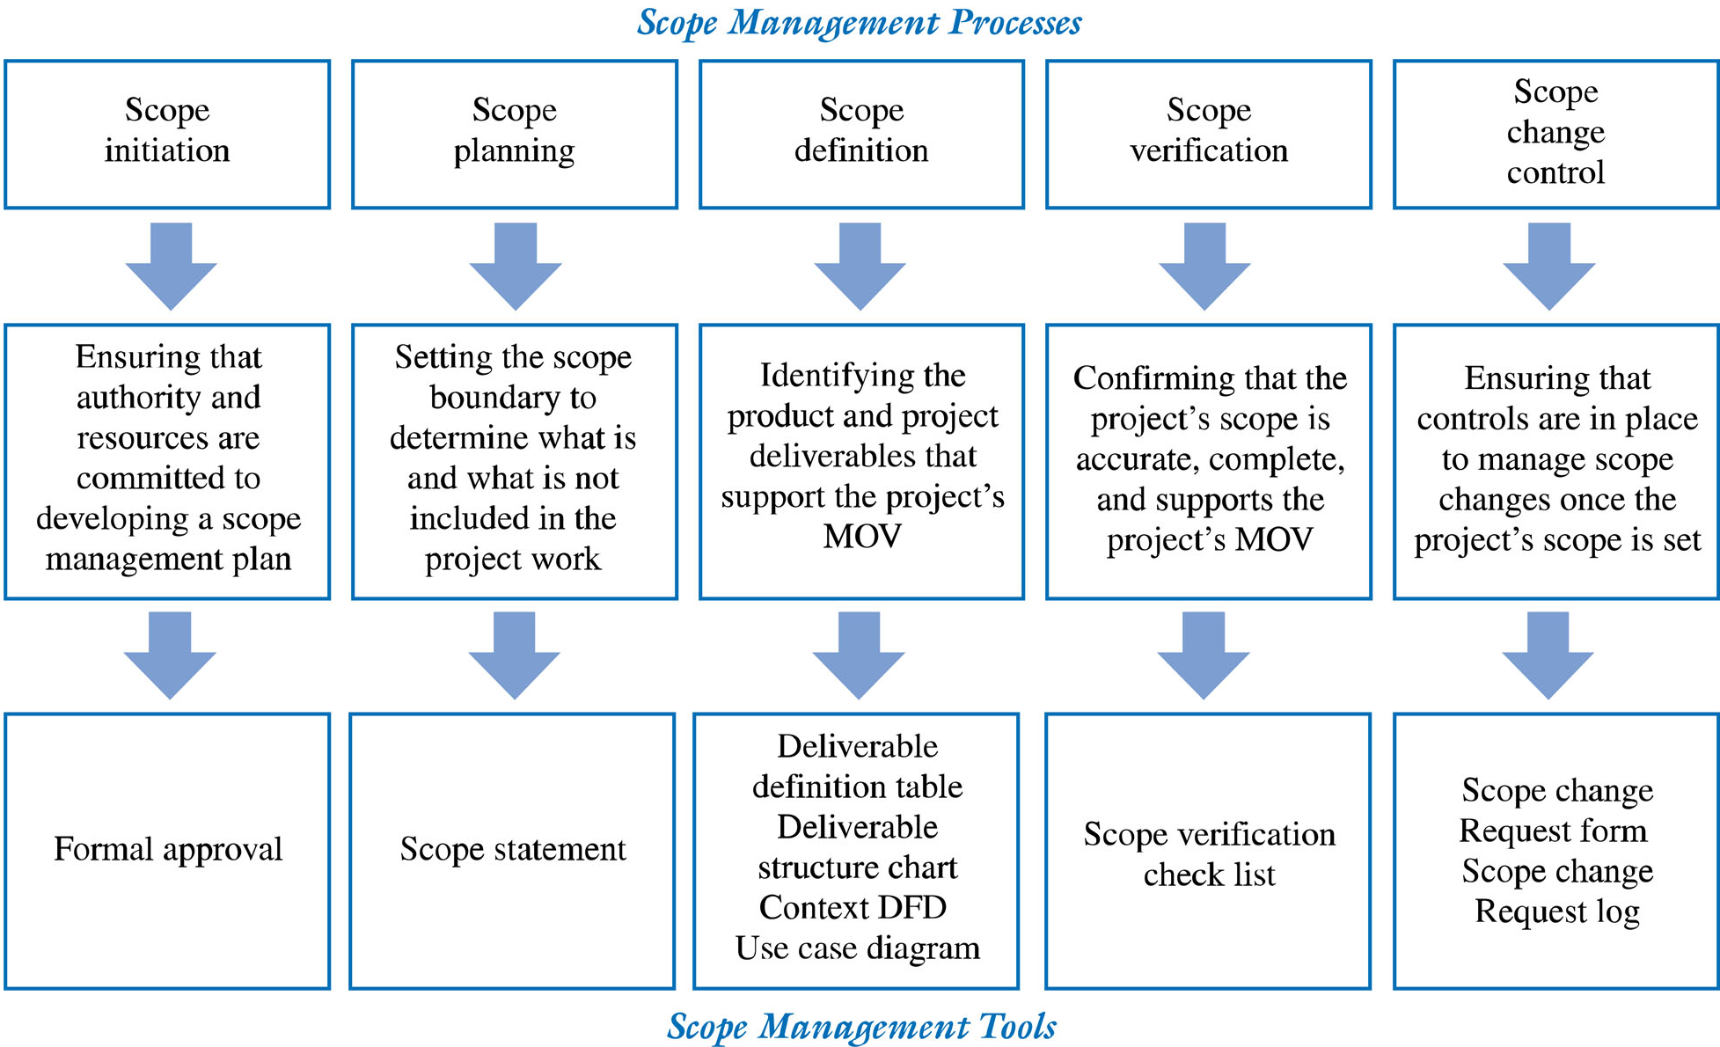
Summary of Scope Management Processes

Slide 4
Lesson 3: Planning Project Work
Topic 3D: Develop a Work Breakdown Structure

Slide 5

Work Breakdown Structures
Based on the CONCEPT of PROJECT MONETORING AND CONTROLLING
Camp III
Camp II
Camp I

Slide 6
Outline
In this lecture we focus on:
  Anatomy of Work Breakdown Structures
  Developing a Work breakdown structure (WBS)
  Dependencies between tasks
  Scheduling
Notations for visualizing dependencies
Many heuristics and examples
  How detailed should a WBS be?
  How can you plan a long project when things are unknown or changing all the time?

Slide 7
Anatomy of Work Breakdown Structures
What is a WBS?
The 100% Rule
Three Types of WBS Structures
Four Types of WBS Elements
Two Types of Programs
Use of WBS to Define Activities

Slide 8
Anatomy of Work Breakdown Structures
What is a WBS?
The 100% Rule
Three Types of WBS Structures
Four Types of WBS Elements
Two Types of Programs
Use of WBS to Define Activities

Slide 9
Work Breakdown Structure
Formal Definition per the PMBOK® Guide:
A Deliverable - Oriented Grouping of Project Elements that Organizes and Defines the Total Scope of the Project.
Each Descending Level Represents an Increasingly Detailed Definition of the Project Work.
Notes:
The PMBOK® Guide also says that work not in the WBS is outside the scope of the project. (pg 60)

Slide 11
WBS CONCEPT
Outline of the Work to be Performed
Provides a Framework for Defining the Work on the Project - SOW
Provides a Framework for Planning
(Work Not in the WBS is Work Not in the Project)

Slide 12
Definitions
A WBS Consists of Elements
The Lowest Level Element in the WBS is Often Referred to as a Work Package
A Work Package Consists of Tasks or Activities
Elements are Described by Nouns
Activities Contain Verbs

Slide 13
Sample Partial WBS
Level 1
SOFTWARE
PROJECT
TRAINING
MATERIALS
USER
DOCUMENTS
SOFTWARE
SYSTEM
SYSTEM
ANALYSIS
PROJECT
MGT
MODULE 1
MODULE 2
MODULE 3
SYSTEM
TEST
Level 3
CODING
TEST

Slide 14
Anatomy of Work Breakdown Structures
What is a WBS?
The 100% Rule
Three Types of WBS Structures
Three Types of WBS Elements
Two Types of Programs
Use of WBS to Define Activities

Slide 15
100 % Rule
The next level decomposition of a WBS element (child level) must
represent 100% of the work applicable to the next higher (parent) element.
Notes:
Remember, the primary reason to have a WBS is to ensure that all the work packages and activities that must be accomplished for a successful project are identified. The 100% rule also applies at the activity level: the work represented by the activities in each work package must add up to 100% of the work necessary to complete the work package. In this manner, the project manager can be reasonably assured that all the work necessary for successful completion of the project has been planned and scheduled.
This is an important rule. It helps the person developing the WBS to constantly question himself or herself on the breadth and depth of their understanding of the project work. It is recommended, and common for the project team to collegially develop or at least review the WBS in detail. Subject matter experts will always look to make sure their specialty is included in the work, and they can contribute to make sure the WBS is complete and as accurate as possible.

Slide 16
SAMPLE WBS - GARAGE
Level 1
GARAGE
PROJECT
PERMITS/
INSPECTIONS
GROUNDS
GARAGE
CONSTR.
PLANS
PROJECT
MGT
ASSEMBLY
FOUNDATION
WALLS
ROOF
UTILITIES
DRY WALL/
PANELING
DOORS/
WINDOWS
ASSEMBLY
FRAME
DOORS/
WINDOWS
Level 4

Slide 17

100 % Rule Importance
If you follow the 100% rule, and define the WBS elements as nouns,
you have won the battle to get an effective WBS.

Slide 18
Anatomy of Work Breakdown Structures
What is a WBS?
The 100% Rule
Three Types of WBS Structures
Four Types of WBS Elements
Two Types of Programs
Use of WBS to Define Activities

Slide 19
Three Types of WBS Structures
PMBOK® Guide Definition of a Project:
“A temporary endeavor undertaken to create a unique product, service or result.”

Slide 20
Product Breakdown
Decomposition of the Natural, Physical Structure of the Deliverable
Follows a Framework
The Deliverable is a Tangible Product
Most Common Example Used
Notes:
1. Product Breakdown - the subdivision based on the physical structure of the product(s) being delivered is the most common basis for a WBS and the easiest WBS to develop. These projects have a tangible output product: software, a building, a dam, an airplane, a user’s manual, etc.; and all have a natural structure.
See Chart 5 for the Software Example, or Chart 9 for the Garage

Slide 21
SAMPLE WBS - GARAGE
Level 1
GARAGE
PROJECT
PERMITS/
INSPECTIONS
GROUNDS
GARAGE
CONSTR.
PLANS
PROJECT
MGT
ASSEMBLY
FOUNDATION
WALLS
ROOF
UTILITIES
DRY WALL/
PANELING
DOORS/
WINDOWS
ASSEMBLY
FRAME
DOORS/
WINDOWS
Level 4
Notes:
The garage that we just looked at is a product WBS – so are most DoD and NASA projects

Slide 22
Service Breakdown
No Tangible Output Product
Main Event or “Service”
Decomposition Based on a Logical Grouping (not Physical Structure)
Often Developed Bottom-up
Detailed Activities May be Checklists
Lend Themselves to Templates
Notes:
Service Breakdown – service projects do not have a tangible, structured deliverable. The output is a defined body of work done for others: conference, party, wedding, vacation trip, etc. The work breakdown is a logical collection of related work areas.
These types of WBSs are frequently developed initially from the bottom up, starting with a list of activities and grouping them into logical categories or functions.

Slide 23
Service Project Breakdown
International
Conference
Project
Level 1
Attendees
Transport-
ation
Facilities
Program
Displays
Project
Management
Level 3
Receptions
Spouse
Activities
Presentations
Tours
Level 4
Papers
Speakers
Translators
Notes:
The basis for each Level 2 element is that it represents a logical grouping of tasks that can be discretely described. Further, each element at every level lends itself to being assigned to a single person or organization for performing or coordinating the group of work described in the element descriptor.
The decomposition of the Level 2 and lower elements is based on the criteria that the child elements are related to the parent, and the key word is “grouping”. For example, the breakdown of “Transportation” could be 1. Airport; 2. Hotel-Conference Shuttle; 3. Tour Buses; etc, all related to transportation. Also, note that the breakdown of “Presentations” in Level 3 includes Level 4 elements that all relate to the presentations. This is different from a product WBS where the next level breakdown would be parts of the Presentation, not just simply related items.
Adding elements at Level 2 also focuses attention on the function and can improve the planning. For example, in Figure II-4, if security is a concern, it should be added at Level 2, rather than being spread at Level 3 or lower in other elements. In this manner, all aspects of security would be grouped and focused, and it is more likely that all important security tasks would be identified.
It is important to remember the 100% rule applies, and the WBS needs to be analyzed for completeness at every level by the project team. Every task needs a WBS parent; in the process of brainstorming the task list, additional WBS elements may need to be added. Getting stakeholders involved in developing the WBS for a new class of service project is more important in a service project than in a product or results project since there is no natural structure or sequence of elements to provide a hierarchy. However, if you worked for an events management firm, you would have a template or normal hierarchy based on previous projects.
Frequently, a large number of detailed activities need to be performed under each work package, much like a checklist. The planning and scheduling document may be a combination of a network to identify sequential relationships of major tasks and checklists to make sure all the small details are identified and assigned.
The WBS for a service project works well as a template for future similar projects. All big weddings are similar in the major functions: they need a church (or synagogue, mosque, etc.), attendants, receptions, showers, invitations, etc. Likewise the WBSs for all conferences, parties, vacation trips, etc. are similar at least at Level 2 and perhaps at Level 3.

Slide 24
Results Project Breakdown
Project Does not have a Well-Structured Primary Product as a Deliverable
May Have Several Products that Collectively Achieve the Planned “Result”
The Projects are Process-Based
Notes:
3. Results Breakdown – results projects do not have a tangible, structured deliverable. The output is the consequence of a process that “results” in a product or a conclusion: cancer research, new drug development, culture change, etc. The work breakdown is a series of structured, accepted steps.

Slide 25
Results Project WBS
Level 1
HSE
PROJECT
1. Work Plan
2. Product &
Process
Analysis
3. Hazard
Analysis
4. Q.A.
Process
5.
Plan
Process
6.
Implement-
ation
7. Project
Management
Notes:
Figure II-5 is the WBS for a project whose result is the implementation of a Hazard Analysis Critical Control Point (HACCP) system in a food processing plant. The objective of this project is to convert a traditional food processing line from one where quality is achieved by inspection of the end product to one where quality is planned in through process controls applied at various critical control points
In this type of project, where the result is the successful implementation of a HACCP system, the same 6 steps are performed for each processing line or project. It is the same whether it is frozen seafood cakes or packaged chicken parts or canned soup. There are also a series of steps at Level 3 and below that are prescribed and performed. Because every plant is different and every project is unique, the intermediate outputs from each step, while similar in name, are quite different in content.
For similar “results-type” projects, the WBS for the top levels are the same or very similar if the same result is to be achieved, i.e., a HACCP system for safe processed food.
In another example, the Level 2 and 3 elements (or steps) for a project to develop a new drug to be approved by the Food and Drug Administration are similarly required and controlled, as are many of the Level 3 elements.
The acceptable or required process to be followed by each class of project establishes the elements at Level 2; and the Level 3 elements may also be prescribed. The decomposition is based on the process steps necessary to achieve the project objectives.
Again, the 100% rule applies, and the team must carefully review the child elements of each parent at each level to ensure that all the work is identified. Persons familiar with or expert in the process should be utilized in this analysis. The goal is the same as with any WBS: to ensure that all the work that needs to be performed to meet the project objectives is identified.

Slide 26
Anatomy of Work Breakdown Structures
What is a WBS?
The 100% Rule
Three Types of WBS Structures
Four Types of WBS Elements
Two Types of Programs
Use of WBS to Define Activities

Slide 27
Four Types of WBS Crosscutting Elements
Integrative
Analytical
Process
Project Management

Slide 28
Four Types of WBS Crosscutting Elements
1. Integrative
New Technology
Bicycle Project
Level 1
Level 2
Preliminary
Design
Bicycle
Project
Management
Frame
Seat
Assembly
Pedals &
Gears
Handlebars
Assembly
Notes:
The Product Breakdown includes the frame, seat assembly, Pedals & Gears and handlebars. The “Assembly” work element is integrative since it involves the work of combining the other four elements into a complete bicycle. This work element is often missed when first developing a WBS or is implicitly assumed to be work that is part of the next higher or parent element. This assumption violates the 100% rule.

Slide 29
Four Types of WBS Crosscutting Elements
2. Analytical
Level 1
New PC
Development
Project
Management
Documentation
Personal
Computer
System Test
System
Analyses
Structure
Circuit
Boards
Hard
Disk
Power
Supply
Assembly
Notes:
An Analytical Element represents analytical activity that spans the work elements of a common parent. This is illustrated graphically in Figure II-7 in the sample WBS for a project that included development of a personal computer.
In the example above, “System Analyses” is a cross-cutting analytical element in the WBS. This element cuts across all the other elements at the same level and below in the WBS. The system analyses affect the development and content of the other WBS elements. Information flows from the analytical element to the other elements and impacts their design, development or content. If the project were to write a book or prepare a report, a WBS element “Research” at Level 2 would be an Analytical-type element with the information flowing from the research work performed to affect the contents of the other elements of the book.
The next level of decomposition below an analytical element is often a set of work elements that are of a similar type as the parent, such as occurs in a parent element in a service project. For example, the next level below a “System Engineering” element may be a group of similar engineering functions such as Reliability Engineering, Maintainability Engineering, Value Engineering and the like. The outputs of these functions are often data deliverables such as a Reliability Plan or a Reliability Analysis and would be specified in the contract statement of work or a contract data requirements list.
The Level 2 element may be even more general, such as simply “Analyses”; and include such items as Needs Analysis, Economic Analysis, Demand Analysis and so on, depending on the nature of the project. This type of element is t like the elements in a Service project and represents a grouping of similar or related work that is necessary for the project.

Slide 30
Four Types of WBS Crosscutting Elements
3. Process
Level 1
Aircraft
System
Project
Management
Manuals &
Data
Support
Equipment
Air
Vehicle
Facilities
Test &
Evaluation
Notes:
A Process Element represents a next step in a work progression. It is similar to an Integrative element but is more related to the flow of work than the grouping or combination of several elements.
The WBS element “Test and Evaluation” is cross-cutting and the next step in a development process. At the level shown above the Test and Evaluation element cuts across the other elements at the same level, its peers, and would require manuals, support equipment, the air vehicle (airplane) and maintenance facilities to do the testing work. The work flows into the direction of the process. Note that the other four Level 2 items are product “deliverables”.

Slide 31
Four Types of WBS Crosscutting Elements
3. Process
Level 1
New PC
Development
Level 2
Project
Management
Documentation
Personal
Computer
System Test
System
Analyses
Structure
Circuit
Boards
Hard
Disk
Power
Supply
Assembly
Design
Procure-
ment
Fabrication
Subsystem
Test
Notes:
In the Figure, “System Test” is a process element since it is the next step in the process of preparing a Personal Computer for delivery to the customer. The work flows along the steps in the process.
Also, the shaded work packages of the parent “Circuit Boards” are all process WBS elements leading to the intermediate deliverable Circuit Boards.

Slide 32
Four Types of WBS Crosscutting Elements
4. Project Management
A Special Type of WBS Element
All Projects have a PM Element
May be Looked-at Conceptually as an “Overhead” Element

Slide 33
Four Types of WBS Crosscutting Elements
4. Project Management
PROJECT MANAGEMENT (Level 2)
Level 3 | Level 4 Work Packages
PROJECT START AND FINISH | Contract Award Complete Project
MEETINGS AND REVIEWS | Kick-off Meeting Monthly/Quarterly Project Reviews Corporate Reviews In-Process Reviews Close-out Meeting Action Item Tracking System
REPORTS | Monthly Progress Report Annual Report Budget/Financial Status Report
PLANS | Project Charter Master Schedule Project Plan (Current and Future Phases Risk Management & etc
Notes:
While all WBS’s have one or more of the first four types of WBS elements, they do not always occur in every WBS. However, “Project Management” is a special category of cross-cutting element that does occur universally and can have characteristics of the integrative, analytical or process elements within it at lower levels. The reason is that all projects have Project Managers, and they perform work in support of the project.
The 100% rule requires the sum of the WBS elements at each level to represent 100% of the work of the parent. Since the project manager expends resources, work is involved and must be included. The labor cost and other expenses of the Project Manager and the Project Management Office may or may not be charged to the project as a direct cost, but resources are consumed, and there are project management activities that are performed. Figure II-10 contains a listing of typical work packages and activities performed in “Project Management”.
Level 4 in Figure II-10 consists mostly of work packages. The exceptions are the two zero duration activities, “Contract Award” and “Complete Project”, that are useful milestones to have in schedules. The advantages of their inclusion in this list and their usage are explained in Chapter II. H.
Frequently, some of the Level 4 items listed above are routinely furnished by the parent organization and may not appear in the project WBS. In addition, some items, may warrant their own Level 2 status if there is a significant amount of work that is performed and it is deemed important to focus attention on it through the WBS. In any event, if work and resources are involved in any of the elements, those resources and the work should be reflected in the project plans. In addition, one of the rules of planning is to include the item if it will not automatically be performed.
The 100% rule applies to all the work at Level 3 and 4, and all important work packages or activities must be included. There is a lot of work involved in managing a project, and this needs to be addressed in the planning and resource allocations.

Slide 34
Four Types of WBS Crosscutting Elements
4. Project Management
Project Management WBS Element Decomposition
PROJECT MANAGEMENT (Level 2)
Level 3 | Level 4 Work Packages
CONTROL | Schedule Tracking Cost Tracking Earned Value Management Analysis Variance Analysis Corrective Action Work-Arounds
ADMINISTRATIVE | Project Management Office Space/Relocation Correspondence Control System
PROJECT SUPPORT | Procurement/Purchasing Subcontract Management Contract Management
Notes:
Frequently, some of the Level 4 items listed above are routinely furnished by the parent organization and may not appear in the project WBS. In addition, some items, may warrant their own Level 2 status if there is a significant amount of work that is performed and it is deemed important to focus attention on it through the WBS. In any event, if work and resources are involved in any of the elements, those resources and the work should be reflected in the project plans. In addition, one of the rules of planning is to include the item if it will not automatically be performed.
The 100% rule applies to all the work at Level 3 and 4, and all important work packages or activities must be included. There is a lot of work involved in managing a project, and this needs to be addressed in the planning and resource allocations.

Slide 35
Anatomy of Work Breakdown Structures
What is a WBS?
The 100% Rule
Three Types of WBS Structures
Four Types of WBS Elements
Two Types of Programs
Use of WBS to Define Activities

Slide 36
Two Types of Programs
Life Cycle Phases – Process Projects
Program Areas – Series of Projects
PMBOK® GUIDE:
A group of related projects managed in a coordinated way. Programs usually include an element of ongoing work.
Notes:
Have you ever realized there are two different types of programs? Maybe more?
Each has a Program Management cross-cutting element at level 1 (Level 0 is the Program)

Slide 37
A Program Life Cycle Phases
Feasibility, Conceptual or Initiation
Planning
Execution or Implementation
Close-Out
Operations and Maintenance
(Program Management)
Notes:
I. Feasibility, Conceptual or Initiation Phase – conduct feasibility analyses, economic analyses, establish preliminary project objectives, prepare a preliminary WBS and a preliminary statement of work, and a project charter.
II. Planning Phase – firm up objectives and scope statement, define the work, develop the WBS, schedule the work and schedule the resources, budget and prepare the Project Plan
III. Execution or Implementation Phase – perform the work, develop the products, services or results
IV. Close-out Phase – obtain final acceptance of deliverables,, complete all financial, administrative, contractual and personnel activities (project ends)
V. Operations and Maintenance Phase – the customer or sponsor uses the output of the project

Slide 38
Example Program Areas
Nanotechnology
Alcohol and Drug Abuse
Cancer Research
Anti-Terrorism
Notes:
Program Areas are generally broad topics that have a focus in a particular subject area. The programs consist of a series of projects all with the same theme.
There may be a Program Office at Level I, the top level is Level 0 so that each project has a top level WBS at Level 1
Let us focus on the life cycle programs and point out some different aspects of the WBS in the Management area.

Slide 39
PM WBS Elements in a Program
Traditional PM Elements at Level 1
Level 2 PM Elements for each Phase/Project
Level 2 PM Elements that Relate to Subsequent Phases
  Cross-cutting Analytical Elements
  Outputs for Future Phases
Notes:
There are three types of project management WBS elements in a program that is organized and managed by life cycle phases.
1. The traditional project management activities at Level 1, relabeled “Program Management” apply to activities that are “overhead” to the entire program and crosscut all phases;
2. Project Management activities that relate to the management of each phase as an independent Level 2 project; and
3. Project Management activities that are performed in one phase but relate to subsequent phases; these are unique to life cycle subprojects within a larger program framework.
The Program Management category, number 1, may not always exist. A project may evolve into a program and all project management elements are at Level 2. The existence of a “Program Management” level also implies that some effort is performed prior to the “Project Definition” phase or the outcome of the Project Definition phase may be the establishment of a Program Management function that provides program management support and performs project management functions for all phases.
The second category is the “normal” project management element of the WBS as described in Chapter II. B. 5.
The third category is somewhat different since it includes specific deliverables within the project management element that relate to later phases of the program. It is no longer just an “overhead” type of element but includes cross-cutting analytical elements as discussed in the Anatomy chapter. In each phase of the museum example above, there are analytical WBS elements that relate to the planning of the subsequent phase and require input from the other work in the phase. For example, outputs of the project management element in the Project Definition phase are the WBS and scope statement for the Planning phase and the preliminary WBS, schedule and resource plans for the later phases.
Similarly, the Project Management element for the Planning phase would include those elements that related to management of the Planning phase and in addition would include the important output of the planning activity that results in a Project Plan for the subsequent Development and Production phase of the project where most of the money and resources will ultimately be spent.

Slide 40
Level 1 PM Decomposition
Program
Management
Level 1
Administration
& Budget
Communications
Program
Support
Program
Control
Etc.
Notes:
The Program Management element at Level 1 is neither a subproject nor a phase; it is a normal project management element. A possible decomposition of this element, as shown includes only total program elements
This is not the only possible decomposition, and various organizations may approach the structuring of the program management element of the WBS differently. For example, all of the planning for the various phases could be included in the Program Management element rather than a part of each project management element within each phase. The important factor is to get all of the work identified.

Slide 41
Anatomy of Work Breakdown Structures
What is a WBS?
The 100% Rule
Three Types of WBS Structures
Four Types of WBS Elements
Two Types of Programs
Use of WBS to Define Activities

Slide 42
Time Sharing System (TSS) Project WBS
TSS
PROJECT
Level 1
Project
Management
Requirements
Specification
Design
Specification
TSS
Software
Project Start
Project Meetings
Project Reports
Initial Specification
Final Specification
Initial Specification
Final Specification
Module 1
Module 2
Integrate Modules
Notes:
Step 1 – prepare the Project WBS Note that PM is on the Left and the Level 2 elements approximate the project flow.

Slide 43
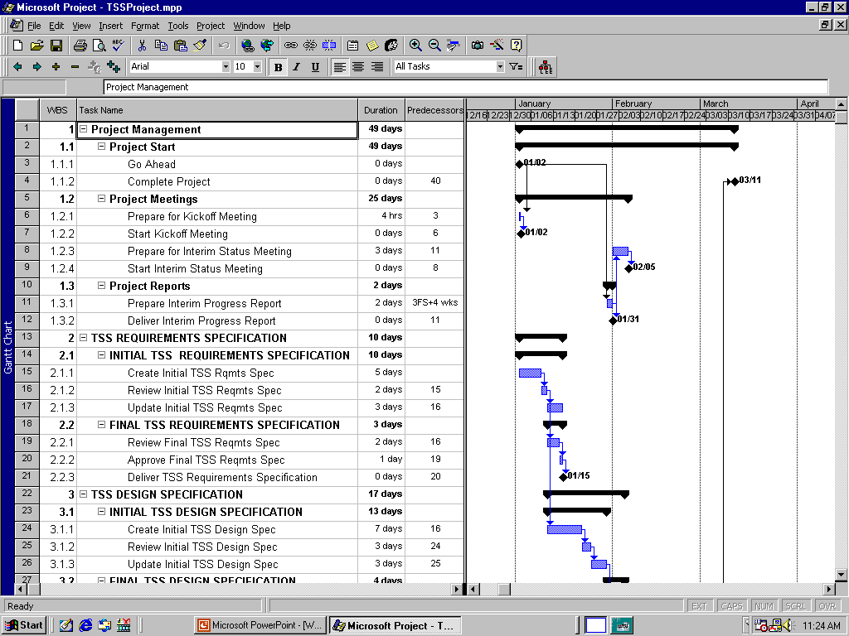
WBS and Activities in MS Project
Notes:
Add the activities under each WBS element – as fast as you can type
Add durations and predecessors or do this after you enter the activities
Add resources as convenient. Suggest have the notes column open to enter assumptions, etc.

Slide 44
Summary
Generic WBS Elements
Level 0
PROGRAM
Level 1
Program
Management
Phase/
Project
Project
A
Phase/
Project
Ongoing
Work
1. Product
Breakdown
Elements
2. Service
Breakdown
Elements
3. Results
Breakdown
Elements
4. Crosscutting
Elements
5. Project
Management
Elements
Level 2
Product
Structure
Groupings
Steps
Integrative,
Analytical, or
Process
Support
and
Management
Notes:
This chart summarizes several of the concepts – Program Level PM at Level 1
Level 2 is examples of different type of elements.
Don’t forget the 100% rule

Slide 45

Effective Work Breakdown Structures
Thank You

