Slide 2
Quick Recap

Slide 3
The Project Plan
Plan Your Work, then Work Your Plan

Slide 4
Lesson 3: Planning Project Work
Topic 3B: Document Stakeholder Requirements
Topic 3C: Create a Scope Statement

Slide 5
Key stakeholders Requirements
Project Manager – the individual responsible for handling the project
Customer – the individual or organisation who will use the project’s product
Performing Organisation – the enterprise whose employee’s are most directly involved in doing the work of the project
Project Team Members - the group that is performing the work of the project
Project Sponsor- the individual or group that provides the resources for the project
Regulatory or government agencies
Sellers and contractors
Individual citizens or groups of citizens

Slide 6
Key stakeholders Requirements
Each requirement will act as a Monitoring device for any change
Requirements should be clearly defined
If any change in requirement, Change control system should be followed
Requirements will be a baseline for scope development
Interviews, Questioners, project charter, meetings etc. will be used for requirements gathering

Slide 7
Scope
The deliverables or work products that must be completed in order to achieve the project’s MOV.
Provides a boundary so that what needs to get done – gets done.
  Otherwise, schedule and budget are increased
Defines what is part of the project team’s work and what is not.
Provides a link between the project’s MOV and the project plan.

Slide 8
Project Planning Framework
MOV
Scope
Phases
Sequence
Schedule
Tasks
Resources
Time
Budget
Estimates

Slide 9
PMBOK Scope Management Processes
Scope Management Process | Description
Scope Planning | The development of a scope management plan that defines the project’s scope and how it will be verified and controlled throughout the project.
Scope Definition | A detailed scope statement that defines what work will and will not be part of the project and will serve as a basis for all future project decisions
Create Work Breakdown Structure (WBS) | The decomposition or dividing of the major project deliverables into smaller and more manageable components.
Scope Verification | Confirmation and formal acceptance that the project’s scope is accurate, complete, and supports the project’s MOV.
Scope Change Control | Ensuring that controls are in place to manage proposed scope changes once the project’s scope is set. These procedures must be communicated to all project stakeholders.

Slide 10
Scope Management Plan
Scope Planning
Scope Definition
Create WBS
Scope Verification
Scope Control
Documents how team will define & develop project scope.
Builds upon preliminary scope stmt to define all project and product deliverables
Project planning tool subdivides the scope into deliverable hierarchy
Formalized acceptance from appropriate stakeholders tat defined scope complete
Defined process for managing changes & impact to budget & schedule
Scope management plan
Detailed scope
WBS
Verification checklist
Change control process

Slide 11
Problems with Scope
Ambiguous
Ambiguity in scope leads to confusion and unnecessary work.
Incomplete
Incomplete scope leads to schedule slips and hence finally cost overrun.
Transient
Transient scope leads to what is known as scope creep which is the primary cause of late deliveries and potentially "never ending" projects.
Un-collaborative
A scope that is not collaborated leads to misinterpretations in requirements and design.

Slide 12
Capture Project Scope Success
Define the project need
Identify key stakeholders
Identify project drivers
Develop operational concepts
Identify external interfaces

Slide 13
Project Scope Initiation & Planning
A beginning process that formally authorizes the project manager and team to develop the scope management plan
This entails
  Conceptualizing the Scope Boundary
  Developing the Scope Statement

Slide 14
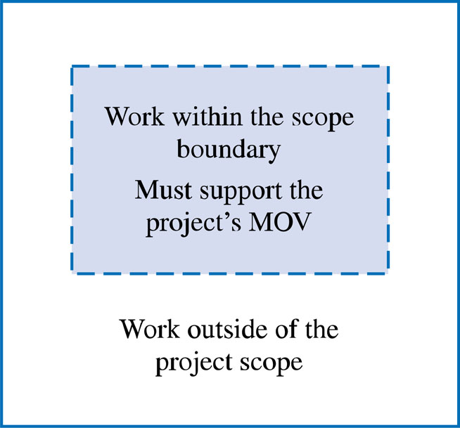
The Scope Boundary
“Failure to define what is part of the project, as well as what is not, may result in work being performed that was unnecessary to create the product of the project and thus lead to both schedule and budget overruns.”
- Olde Curmudgeon, 1994

Slide 15
The Scope Statement
Provides a way to define the scope boundary.
A narrative of what deliverables or work-products the project team will and will not provide throughout the project.
A first step that provides a high-level abstraction of the project’s scope that will be defined in greater detail as the project progresses.

Slide 16
Scope Statement Example – Work within the scope boundary
Develop a proactive electronic commerce strategy that identifies the processes, products and services to be delivered through the World Wide Web.
Develop an application system that supports all of the processes, products and services identified in the electronic commerce strategy.
The application system must integrate with the bank’s existing enterprise resource planning system.

Slide 17
Scope Statement Example – Work outside the scope boundary
Technology and organizational assessment of the current environment
Customer resource management and data mining components

Slide 18
Project Scope Definition
Project-Oriented Scope
  Deliverables that support the project management and IT development processes defined in the Information Technology Project Methodology (ITPM).
  Examples : Business case, project charter and project plan, etc.
Product-Oriented Scope
  High-level features and functionality of the application system
  First cut for requirements definition that will be defined in greater detail during the systems development life cycle (SDLC)
  Examples : Add new customer, look up customer balance, print daily sales report by region, etc.

Slide 19
Project-Oriented Scope Definition Tools
Deliverable Definition Table (DDT)
Deliverable Structure Chart (DSC)

Slide 20
Deliverable Definition Table
Deliverable | Structure | Standards | Approval Needed By | Resources Required
Business Case | Document | As defined in project methodology | Project Sponsor | Business Case team & OA tools
Project charter & project plan | Document | As defined in project methodology | Project Sponsor | Project manager, sponsor, & OA tools
Technology & Org. assessment | Document | As defined in project methodology | Project manager & Sponsor | Bank’s syst. analyst, OA & case tools
Requirements definition | Document | As defined in project methodology | Project manager | Syst. analyst programmer Case & OA

Slide 21
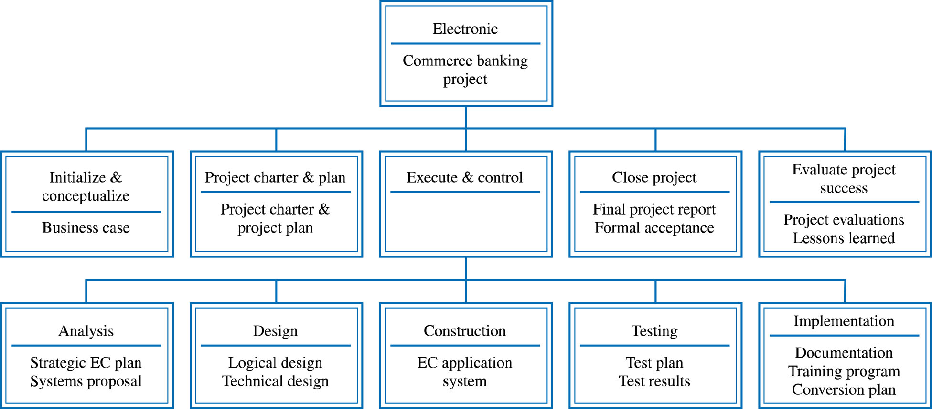
Deliverable Structure Chart

Slide 22
Product-Oriented Scope Definition Tools
Context Dataflow Diagram (DFD)
Use Case Diagram (USD)

Slide 23
Scope Verification
Ensures:
  That the project’s scope is well-defined, accurate and complete
  The project’s scope is acceptable to the project stakeholders
  That standards exist so that the project’s scope will be completed correctly
  That the project’s MOV will be achieved if the project scope is completed
Tools
  Scope Verification Checklist

Slide 24
Scope Verification Check List
MOV – Has the project’s MOV been clearly defined and agreed upon?
Deliverables – Are the deliverables tangible and verifiable? Do they support the project’s MOV?
Quality Standards - Are controls in place to ensure that the work was not only completed but also completed to meet specific standards?
Milestones – Are significant events that mark the acceptance of a deliverable and give the project manager and team the approval to begin working on the next deliverable
Review and Acceptance

Slide 25
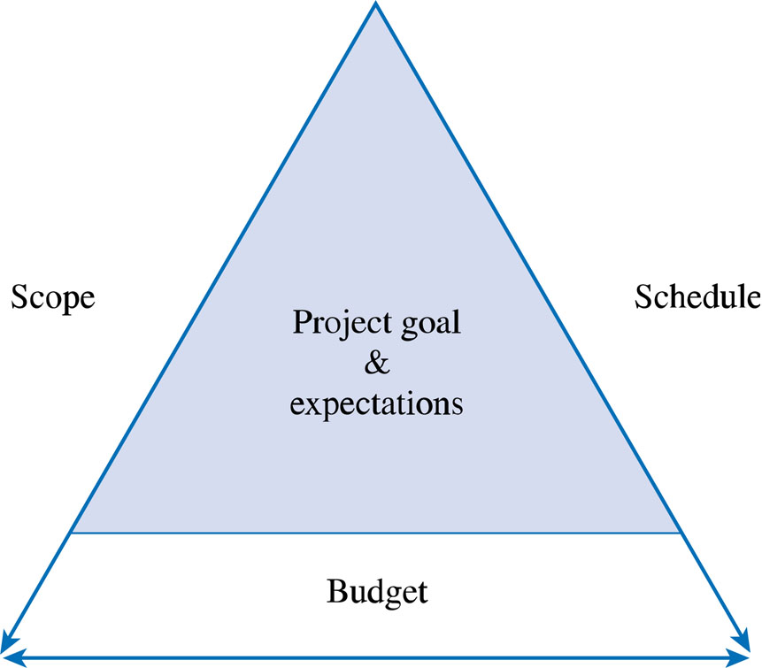
Scope Change Control
Ensures that any changes to the project’s scope will help the project achieve its MOV.
Keeps the “triple constraint” in balance.

Slide 26
Scope Change Control
Mitigates:
  Scope Grope – i.e., scope poorly defined
  Scope Creep – i.e., increasing featurism
  Scope Leap – i.e., drastic change in project direction or the project’s MOV
Tools:
  Scope Change Request Form
  Scope Change Request Log

Slide 27
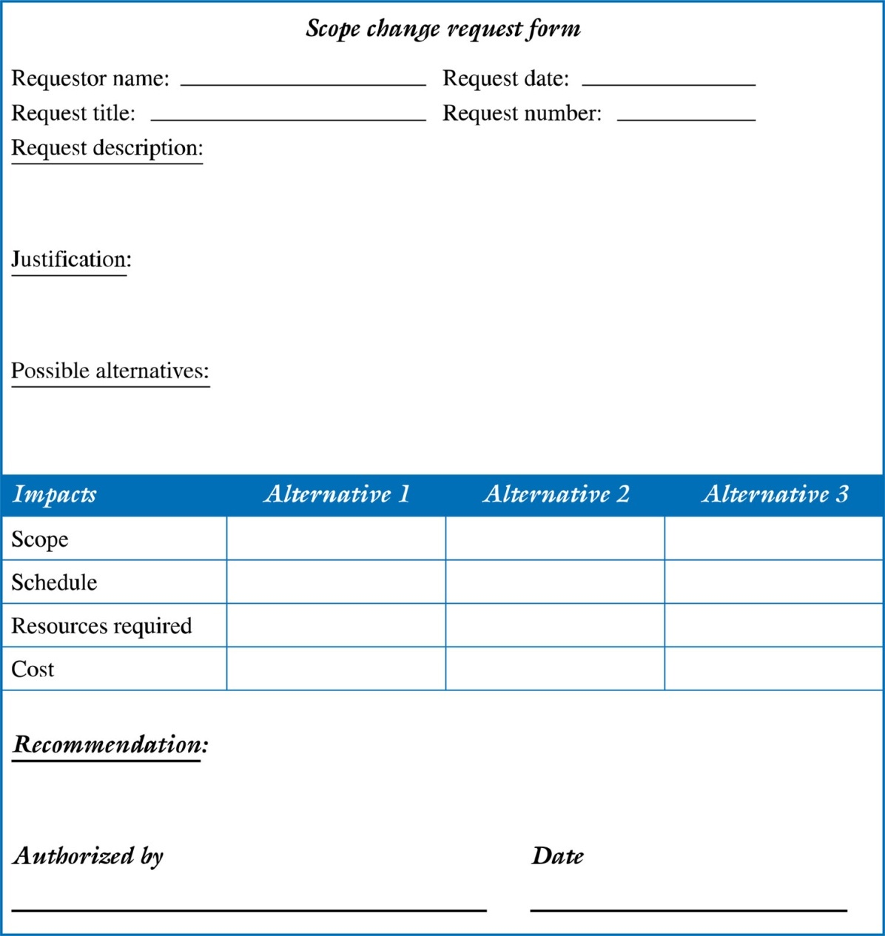
Example of a Scope Change Request Form

Slide 28
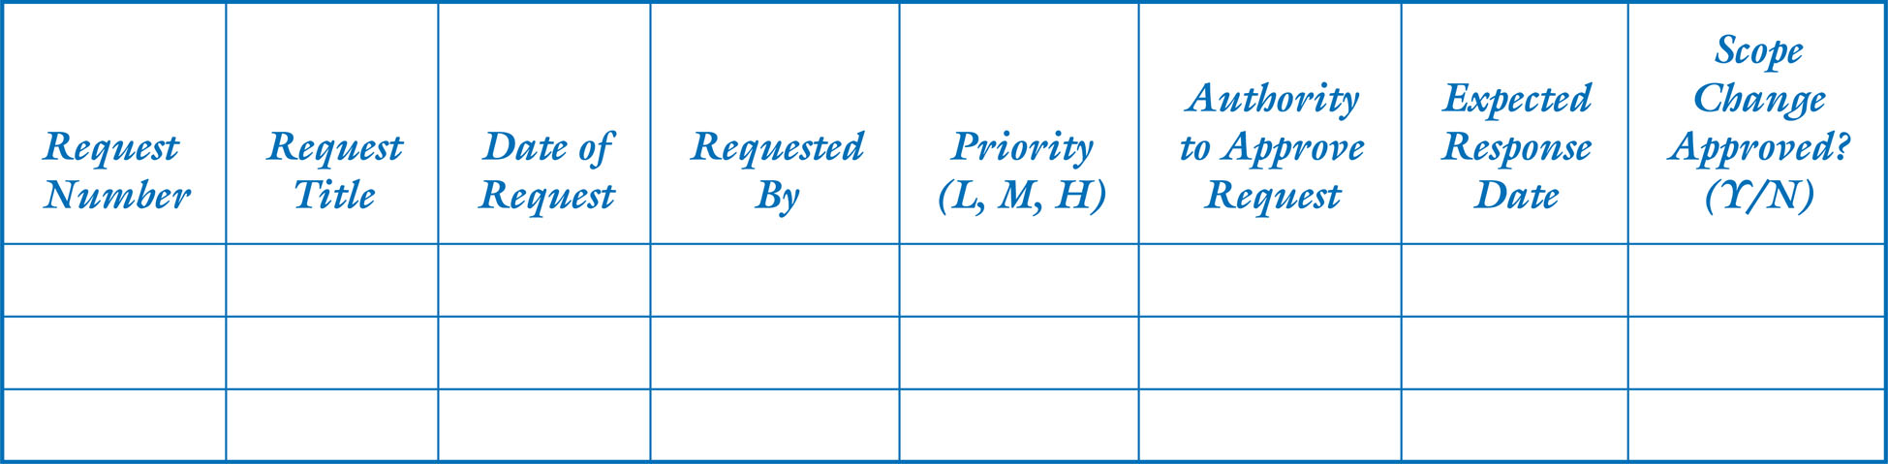
Example of a Scope Change Request Log

Slide 29
Benefits of Scope Control
Keeps the project manager in control of the project.
  Gives the project manager the authority to manage and control the project’s schedule and budget. Otherwise she or he may ‘feel” pressured by the client or upper management to accept scope changes
Allows the project team to stay focused and on track
  Do not have to perform unnecessary work

Slide 30
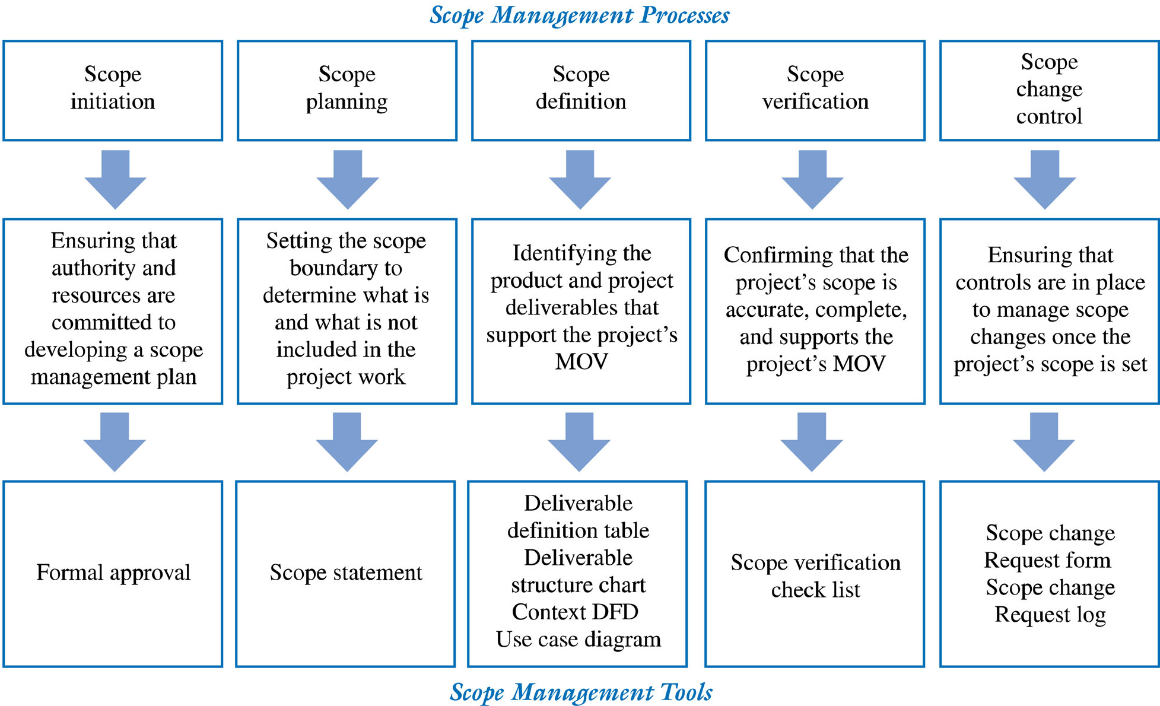
Summary of Scope Management Processes

