Slide 1
Quick Recap

Slide 2
Project Initiation overview
Awareness of the need for change (situation, context) and recognition by stakeholders that only a project can bring about the desired change
Consideration of project options
Collection of basic information to perform a preliminary project feasibility assessment and determine possible project costs and outcomes (positive and negative)
Preparation of a formal project proposal for consideration by the project sponsors
Undertake a detailed project feasibility study if required
Decide whether project should be pursued, put on-hold for a future time or rejected
Make contracts with key stakeholders, issue project charter and assign resources for the project
Move the project into the (detailed) planning phase

Slide 3
Lesson 3: Planning Project Work
Topic 3A: Identify the Elements of a Project Management Plan

Slide 4
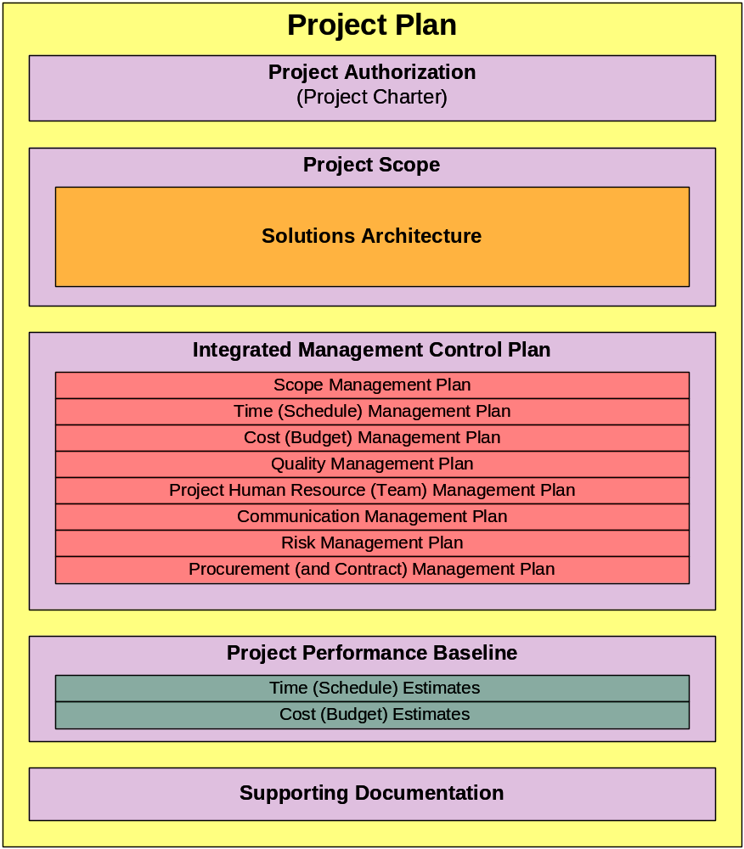
The Project Plan
Plan Your Work, then Work Your Plan

Slide 5
What, Who, Why, How and When ?
  What is a Project Plan?
  Why do we need a Project Plan?
  How is a Project Plan used?
  When is a Project Plan used?
  Who uses the Project Plan?
  What makes up a project plan?
  Where does it come from?
  How does architecture play into the project plan?

Slide 6
Project Plan Standards
Project Management Body Of Knowledge
(PMBOK)

Slide 7
The Project Plan
Why do we need a Project Plan? How is a Project Plan used?
The project plan is a consistent and coherent document that guides both project execution and project control. The plan is used to:
Guide the project’s through execution and control.
Document the planning assumptions.
Document planning decisions regarding alternatives choices.
Communicate with stakeholders.
Define management reviews (as to content, extent, and timing).
Establish project baselines for progress measurements and control.

Slide 8
The Project Plan
What is a Project Plan? Formal Definitions
PMBOK Definition: The project management plan defines how the project is executed, monitored and controlled, and closed. The project management plan documents the collection outputs of the planning processes of the Planning Process Group, including:
Project management processes selected by the project management team
Level of implementation of each selected process
Tools and techniques descriptions selected to accomplish the selected processes
Description of how the selected process will be used for the specific project
Description of how work will be executed to accomplish the project objectives
Description of how change will be monitored and controlled
Description of how configuration management will be performed
Description of how the performance baseline will be maintained and used
Stakeholder communication requirements and plan
Selected project life cycle for multi-phase project
Management reviews processes for content, extent, and timing to address open issues and pending decisions
PMBOK Glossary Definition: a project plan is a “formal, approved document that defines how the project is executed, monitored and controlled. It may be summary or detailed and may be composed of one or more subsidiary management plans and other planning documents.”

Slide 9
The Project Plan
What is a Project Plan? Informal Definitions
The project plan is a consistent and coherent document that guides both project execution and project control. The plan is a product of the iterative planning process. The plan addresses the following questions in the following sections:
  What is to be done? Project Scope
  Who’s authority? Authorization/Chartering
  How it is to done? Integrated Management Plan
  What time and dollars are needed? Resource Estimates (Baseline)

Slide 10
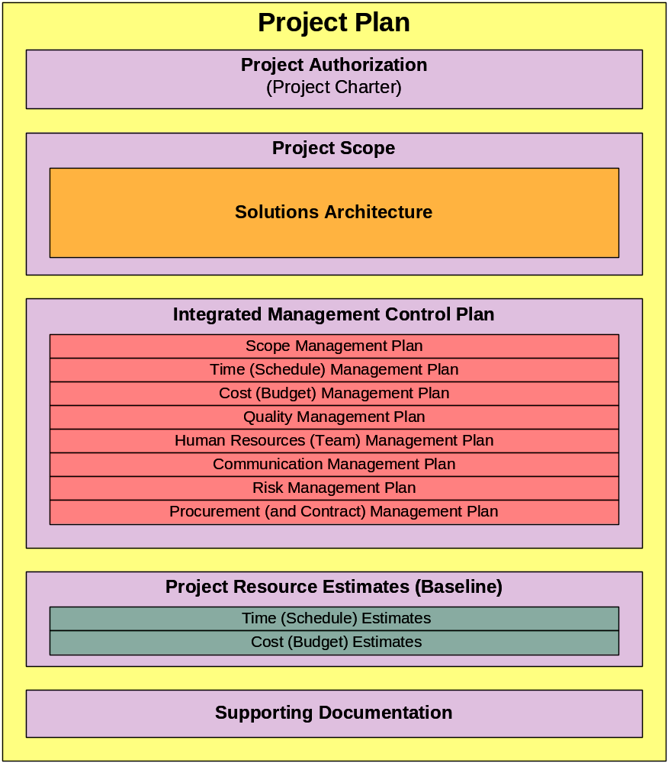
The Project Plan’s Key Elements
What makes up a project plan?
Authorization
Project Scope
Integrated Management Plan
Resource Estimates (Baseline)

Slide 11
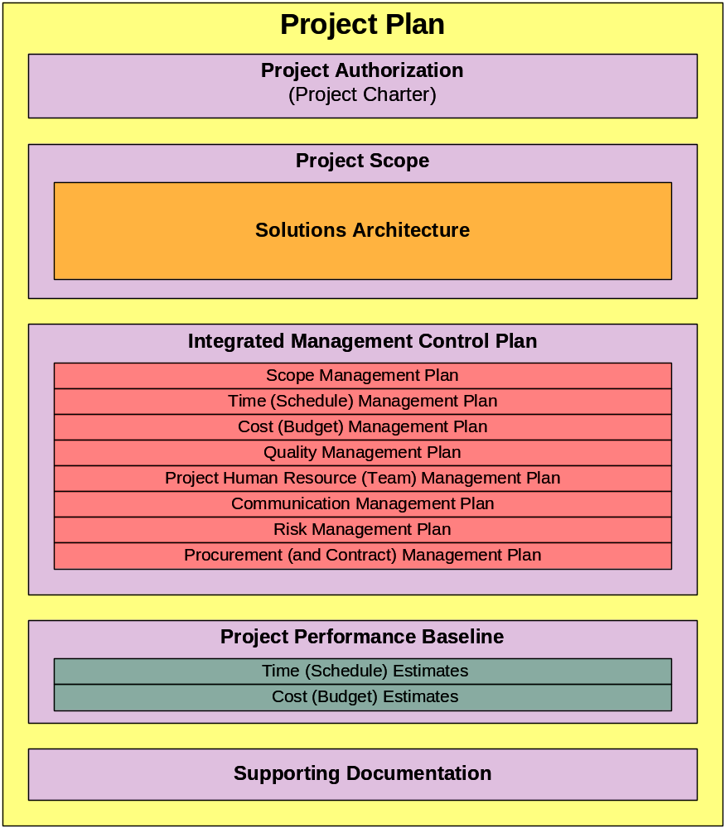
The Project Plan’s Key Elements
What makes up a project plan? A Collection of Artifacts
Threaded within the document, major artifacts (PMBOK reference) make up the plan, include:
Project Authorization or Charter (Section 4.1)
Scope Statement (Section 5.2.3.1)
Work Breakdown Structure, WBS (Section 5.3.3.2)
- Project Schedule Network Diagram (Section 6.2.3)
Project Management Approach (Section 4.3)
Integrated Management Control Plan
- Scope Management Plan (Section 5.1.3.1)
- Schedule (Management Plan) (Section 6.5.3.8)
- Cost (Budget) Management Plan (Section 7.1.3.4)
- Quality Management Plan (Section 8.1.3.6)
- Staffing (HR) Management Plan (Section 9.1.3.3)
- Communication Management Plan (Section 10.1.3.1)
Risk Management Plan (Section 11.1.3.1)
Risk Register (Section 11.2.3.1)
Procurement (and Contract) Management Plan
(Section 12.1.3.1)
Performance (Measures) Baseline
- Schedule Estimates (Selection 6.5.3)
- Major Milestones (Section 6.1.3.3)
- Cost Estimates (Selection 7.1.3.1)
- Cost Baseline (Selection 7.2.3.1)

Slide 12
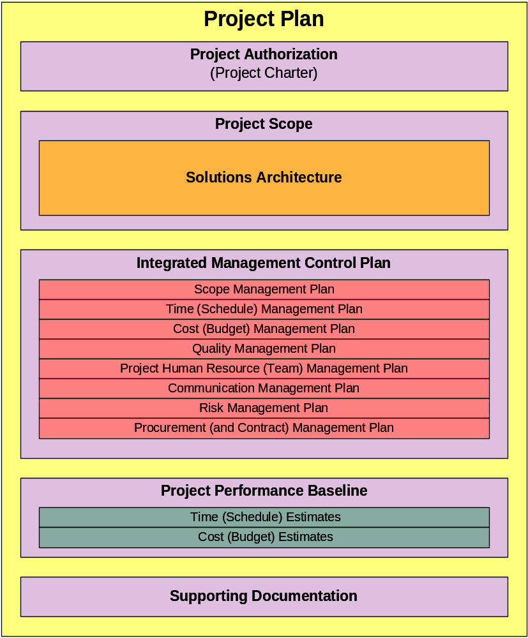
The Project Plan’s Key Elements
Authorization
Project Scope
Integrated Management Plan
Resource Estimates (Baseline)

Slide 13
Project Authorization
The project charter is the document that formally authorizes a project.
Chartering links the project to ongoing work of the organization.
The project sponsor external to the project organization authorizes the project.
Key Elements of a Project Charter:
  Business Needs (Statement)
  Project Scope Statement and Product Scope Description
  Strategic Plan
  “Enterprise Environmental Factors” (Organizational Factors & Constraints)

Slide 14
The Project Plan’s Key Elements
Authorization
Project Scope
Integrated Management Plan
Resource Estimates (Baseline)

Slide 15
Project “MOV”
Overview of Measurable Organizational Value (MOV)
Measurable Organizational Value or MOV is a term coined by “Jack Marchewka” as an alternative tool to the more popular “Return on Investment” or ROI concept which has become a buzzword within the industry over the last ten years and has existed for many more. Marchewka defines measurable organizational value as being “the project’s overall goal and measure of success.”
Marchewka further breaks down the term MOV and says that it must implicitly include the following: be measurable, provide value to the organization, be agreed upon and be verifiable. Let’s look at each of these.

Slide 16
What is Scope Statement?
It is a relatively brief and precise description of the system to be developed. It is derived from customer meeting documents and/or use-case scenarios. Among others, it includes the followings information:
- Need/justification/background statement
- input and output data
- Basic functionality of the system (obvious requirements)
- Constraints and limitations that may be applicable to data
and functions
- Deliverables and Project Plan (Gantt chart and timetable of
milestones and deliverables)

Slide 17
The Project Plan’s Key Elements
Authorization
Project Scope
Integrated Management Plan
Resource Estimates (Baseline)

Slide 18
Integrated Management Control Plan
Integrated Management Control Plan or what is often referred to as Control Account Plan (CAP) is all of the defined (authorized), risk adjusted, scheduled and planned work. The sum of all the integrated management control plans constitutes and defines the management of the total project scope. The scope management section details the verification and control processes, including formal acceptance process, configuration and change controls. The management control plans include:
Scope Management Plan
Schedule (Time) Management Plan
Cost (Budget) Management Plan
Quality Management Plan
Human Resource Management Plan
Communication Management Plan
Risk Management Plan
Procurement (and Contract) Management Plan

Slide 19
Scope Management Plan
Scope Management Plan: Scope management identifies and addresses the project deliverables and how the related work is accomplished.
Includes: 1) solutions architecture work (that include the technical product specifications and related activities) and 2) all the project’s management activities. This management section summarizes how the project scope will be/was determined, including its planning methodology, assumptions and decisions. The scope management section underpins the verification and control processes, including formal acceptance process, configuration and change controls.
Major Artifacts:
Scope Statement
Product Definition.
Project Objectives
Scope Management (and control) Plan
Management Processes, include: 1) scope planning, 2) scope definition, 3) create the WBS, 4) scope verification and 5) scope change control.
Note: Scope verification, a part of the formal acceptance process, is tightly coupled with integration and quality management’s acceptance criteria.

Slide 20
Time (Schedule) Management Plan
Time (Schedule) Management Plan: Time management addresses the schedule issues and schedule needed complete project objectives.
Includes: Descriptions of how the project schedule will be/was determined, including its planning methodology, assumptions and decisions.
Major Artifacts: produced in this section are the:
Schedule Management (and control) Plan
Project Schedule (including project network diagram, “Gantt” chart, milestone chart, updated WBS)
Management Processes, include the 1) activity definition, 2) activity sequencing, 3) activity resource estimating, 4) activity duration estimating, 5) schedule development, and 6) schedule control.

Slide 21
Cost Management Plan
Cost Management Plan: Cost management addresses the cost of the resources needed to complete project activities. Additionally, project cost management should also consider the effect of project decisions on the cost of using the product, often referred to as the life-cycle costing.
Includes: Descriptions of how the project cost estimates and baseline will be/was determined, including its planning methodology, assumptions and decisions.
Major Artifacts: produced in this section are:
Resource Requirements
Cost Estimates (and cost baseline)
Updated WBS
Cost Management (and control) Plan.
Management Processes, includes 1) cost estimating, 2) cost budgeting, and 3) cost control.

Slide 22
Quality Management Plan
Quality Management Plan: Quality management addresses the assurance that the defined product characteristics meet the stakeholders’ expectations and how the project management processes realize the stakeholders’ expectations.
Includes: Descriptions of how the work quality will be/was planned, determined and assured, including assumptions and decisions.
Major Artifacts: produced in this section are the
Quality Management (and control) Plan
Quality Metrics
Quality Checklists
Process Improvement Plan
Quality Baseline
Management Processes, includes 1) quality planning, 2) quality assurance, and 3) quality control.

Slide 23
Project Human Resource Management Plan
Project Human Resource (Team) Management Plan: Human resource (HR) management addresses what appropriate human resources (internal staffing and external stakeholders) are needed and how to use them to accomplish project objectives.
Includes: Descriptions of how the team members and (all) stakeholders will be/were identified for and effectively used/involved with the project, including its planning methodology, assumptions and decisions.
Major Artifacts: produced in this section are:
Stakeholder Analysis
Role & Responsibility Assignments (Responsibility Matrix)
Project Organization Charts (and project directories)
Staffing Management Plan
Management Processes, includes 1) human resource planning, 2) acquiring project team, 3) team development, and 4) managing project team.

Slide 24
Communication Management Plan
Communication Management Plan: addresses how the project ensures timely and appropriate generation, collection, dissemination, storage, and disposition of project information.
Includes: Descriptions of how project stakeholder communications requirements will be/were determined and met, including its planning methodology, assumptions and decisions. Special attention should be given to earned value management (EVM) as an integrating practice and technique for project control and performance reporting.
Major Artifacts: Based on a stakeholders’ needs analysis, the major artifacts are the
Control Data & Reporting Requirements
Performance Reporting Specifications
Communications Management Plan.
Management Processes, include 1) communication planning, 2) information distribution, 3) performance reporting, and 4) managing stakeholders.

Slide 25
Risk Management Plan
Risk Management Plan: addresses how risks are systematically identified analyzed and responded to throughout the project.
Includes: Descriptions of how the project risks will be/were determined, including its planning methodology, assumptions and decisions.
Major Artifacts:
Risk Management (and control) Plan, including:
- Risk Inventory with Thresholds
- Prioritized Probability-Impact Ranking (matrix)
- Response Plan (Workarounds and Corrective Actions)
Management Processes, include 1) risk management planning, 2) risk identification, 3) qualitative risk analysis, 4) quantitative risk analysis, 5) risk response planning, and 6) risk monitoring and control.
Note: Projects baselines are developed via the time (schedule), cost, and risk processes.

Slide 26
Procurement (and Contract) Management Plan
Procurement Management Plan: addresses how goods and service are attained from outside the performing organization.
Includes: Descriptions of how the project procurement strategies and actions will be/were determined, including its planning methodology, assumptions and decisions.
Major Artifacts: include:
Acquisition strategy
Procurement Management Plan
Statement of Work (SOW)
Make-or-Buy Decisions
Request for changes
Evaluation criteria
Request for Proposal (RFP) and Others (RFI and RFC)
Contract
Contract Change Process
Formal Acceptance and Contract Closure Procedures
Management Processes, include 1) plan purchases and acquisitions, 2) plan contracting, 3) request seller responses, 4) select sellers, 5) contract administration, and 6) contract closure.

Slide 27
The Project Plan’s Key Elements
Authorization
Project Scope
Integrated Management Plan
Resource Estimates (Baseline)

Slide 28
Project Resource Estimates (Baseline)
Schedule Estimate: The schedule estimate is primarily the product of the Time (Schedule) Management processes. This section summarizes the risk-adjusted schedule estimate, estimate assumptions and methodologies.
Cost (Budget) Estimate: The cost (budget) estimates are primarily the products of the Cost (Budget) Management processes. This section summarizes the risk-adjusted cost estimate, estimate assumptions and methodologies.
This section should summarize how these performance baselines (estimates) are used within the integrated control process and by its primary control tool, earned value management (EVM). The work breakdown structure (WBS) is used to develop (planning) cost & scheduled work baseline estimates, guide the scheduled-work (executing), and monitor (controlling) the cost & scheduled-work baseline estimates. Estimating involves primarily scope, time, cost and risk management processes.

Slide 29
Supporting Documentation
The supporting documentation section quotes, summarizes and/or references documentation that gives more meaning, understanding, context, authority to the project plan. Supporting documentation may include:
      Mission or Strategic Plans
      Organizational Policies
      Legal Mandates and Legislation
      Technical and Management Standards
      Lessons Learned
      Business Issues Details (resulting in a formal project)
      Project Manager’s and Team Credentials
      Prior Business and Technical Studies
      Issues Paper on Business or Project Assumptions and Limitations
Formatting: If possible and appropriate, the supporting documentation should be a verbatim. All documentation should be accurately concisely summarized and authoritatively referenced. If available, all documentation should include authoritative internet addresses. If applicable, all supporting documentation should reference the applicable project plan section.

