Slide 1
Lesson 15: Closing the Project
Topic 15A: Close Project Procurements
Topic 15B: Close the Project or Phase Administratively

Slide 2
CLOSE PROJECT OR PHASE

Slide 3
CLOSE PROJECT/PHASE PROCESS
This Process involves finalizing all activities across all the Project Management Process Groups to formally close the project or phase.
This include finalizing all activities across all the Process Groups to formally close the project or phase and transfer the completed or cancelled project as appropriate.

Slide 4
Close Project or Phase
The Close Project or Phase process also establishes the procedures to coordinate activities needed to verify and document the project or phase deliverable, to coordinate and interact to formalize acceptance of those deliverables by the customer or sponsor and to investigate and document the reasons for actions taken if a project is terminated before completion.

Slide 5
CLOSE PROJECT/PHASE PROCESS
In multi-phase projects, the process closes the portion of the project scope and associated activities applicable to the given phase.

Slide 6
CLOSE PROJECT OR PHASE
Monitor and Control Project Work
JUBILEE HOUSE PROJECT
Product, Result or Service
Inputs
Project Management Plan
Accepted deliverables
Organizational Process Assets
Outputs
Final product, service or result
Organizational Process Assets (updates)
Transformation
Expert Judgment
6
Notes:
6

Slide 7
Close Project or Phase: Inputs
Project Management plan
Accepted Deliverable: Those deliverables that have been accepted through the verify scope process
Organizational Process Assets
    Project closure guidelines and requirements (e.g. final project audits, project evaluations, product validations, and acceptance criteria etc.)
    Historical information and lessons learned knowledge base

Slide 8
CLOSE PROJECT OR PHASE: Tools & Techniques
1. Expert Judgment
These experts provide expertise to ensure the project or phase closure is performed to the appropriate standards

Slide 9
CLOSE PROJECT OR PHASE: OUTPUTS
Final Product, Service or Result Transition
  This is a formal acceptance and handover of the final product, service or result that the project was authorized to produce. E.g. receipt of a formal statement that the terms of the contract have been met

Slide 10
CLOSE PROJECT OR PHASE: OUTPUTS
2. Organizational Process Assets Updates These include:
i. Formal acceptance documentation (customer or sponsor confirmation that specifications have been met)
ii. Project files: (e.g. updated project management plan, scope, cost, schedule and quality baselines, project calendars, etc.)

Slide 11
CLOSE PROJECT OR PHASE: OUTPUTS
3. Project or phase closure documents: Formal documentation that indicates completion of the project or phase and the transfer of the completed project or phase to others.
4. Historical Information: Historical information and lessons learned information are transferred to the lessons learned knowledge base for use by future projects or phases

Slide 12
CLOSE PROCUREMENT

Slide 13
CLOSE PROCUREMENT
The close procurement process supports the close project process, since it involves verifications that all work and deliverables were acceptable.
This process also involves administrative activities, such as updating records to reflect final results and archiving such information for future use.
Close procurement addresses each contract applicable to the project or project phase.

Slide 14
CLOSE PROCUREMENT
In multiphase project, the term of a contract may only be applicable to a given phase of the project. In these cases, the close procurement process closes the contract (s) applicable to that phase of the project.
Unresolved claims may be subjected to litigation after close procurement process.
The contract terms and conditions can prescribe specific procedures for the close procurement process.

Slide 15
CLOSE PROCUREMENT
Early termination of a procurement contract is a special case of close procurement, and can result from a mutual agreement of the parties or from the default of one of the parties.
The right and the responsibilities of the parties in the event of an early termination are contained in a termination clause of the contract.

Slide 16
CLOSE PROCUREMENT
Base upon those contract terms and conditions, the buyer may have the right to terminate the whole contract or a portion of the project for cause or convenience at any time.
However, based upon those contract terms or conditions, the buyer may have to compensate the sellers for seller’s preparations and for any completed and accepted work related to the terminated part of the contract.

Slide 17
CLOSE PROCUREMENT
Product, results or service and Documentations
Monitor and Control Project Work
XYZ PROJECT
Inputs
Project Management Plan
Procurement Documentation
Outputs
Closed Procurement
Organizational Process Assets (updates)
Transformation
Procurement Audits
Negotiated settlements
Records Management System
17
Notes:
17

Slide 18
CLOSE PROCUREMENT
Procurement Documentation
Procurement Documentation includes but not limited to the procurement contract with all supporting schedules, requested unapproved contract changes, approved change requests.
Procurement Documentation also includes any seller-developed technical documentation and other work performance information, such as deliverables, seller performance reports, financial documents including invoices and payment records, and the results of contract-related inspections.

Slide 19
CLOSE PROCUREMENT: Tools & Techniques
Procurement Audit
A procurement Audit is a structured review of the procurement process from the Plan Procurements process through Administer Procurements.
The objective of the procurement audit is to identify success and failures that warrant recognition in the preparation or administration of other procurement contracts on the project, or on other projects within the performing organization.

Slide 20
CLOSE PROCUREMENT: Tools & Techniques
Negotiated Settlements
This is the final equitable settlement of outstanding issues, claims and disputes.
Where negotiation fails the alternative disputes resolution (ADR) such as mediation or arbitration after which litigation may proceed in the courts.

Slide 21
CLOSE PROCUREMENT: Tools & Techniques
Record Management System
A Records Management System is a specific set of processes, related control functions, and automation tools that are consolidated and combined into a whole, as part of the project management information system.
A records management system is used by the project manager to manage contract documentation and records.
The system is used to maintain an index of contract documents and correspondence, and assist with retrieving and archiving that documentation.

Slide 22
Close Procurements: Outputs
1. Closed Procurement
Buyer’s authorized procurement administrator provides seller with formal written notice that, the contract has been completed

Slide 23
Close Procurements: Outputs
2. Organization Process Assets Updates
Procurement File: Indexed contract documentation including the closed contract is prepared for inclusion in the final project files
Deliverable acceptance: Formal documents indicating that the deliverables have been accepted or rejected
Lessons Learned:

Slide 24
A Summary………
Key Attributes of
“Project Monitoring and Control”

Slide 25
What Is Project Management?
“Project management is the application of knowledge, skills, tools, and techniques to project activities in order to meet or exceed stakeholder needs and expectations.”
Source: Project Management Institute
Notes:
Instructor Do
Read through the slide.
Indicate that PMI stands for the Project Management Institute, a nonprofit professional organization established to serve the project management profession. For further information, participants can call PMI at (610) 734-3330 (in the US).

Slide 26
Project Manager
“The person who is responsible for the project and will be held accountable for its success or failure.”
Notes:
Instructor Do
Read through the slide.
Indicate that the role of the project manager has been defined by PMI in the Code of Ethics for the project management professional, which will be discussed in a later section of the course.

Slide 27
The Triple Constraint
Project Scope
Cost
Quality
Within Available Resources
Schedule

Slide 28

Balancing the “Project Success Triangle”
A clear understanding of customer priorities
“People” skills
Thorough planning
An organized, structured process
Notes:
Instructor Say
To achieve success by balancing this triangle, it might seem that black magic is what is needed. But that’s not true. What we need are:
A clear understanding of customer priorities
“People” skills for yourself and your team
Thorough planning
An organized, structured method to manage and control the project
Another way to look at the triangle is by using travel as an example.
There are several ways to get from one part of the country to another (New York to Los Angeles for vacation)
How do these methods compare on cost, quality (scenic travel), delivery (how much time it will take)?
Car (low cost, high quality, slow delivery)
Train (moderate cost, high quality, moderate delivery)
Airplane (high cost, low quality, fast delivery)
We make trade offs everyday on how we try to balance the magic triangle.

Slide 29
Project Management Process
Source: PMBOK
Initiation
Planning
Execution
Controls
To help guide you through the process you need a roadmap of some type …
Closeout

Slide 30
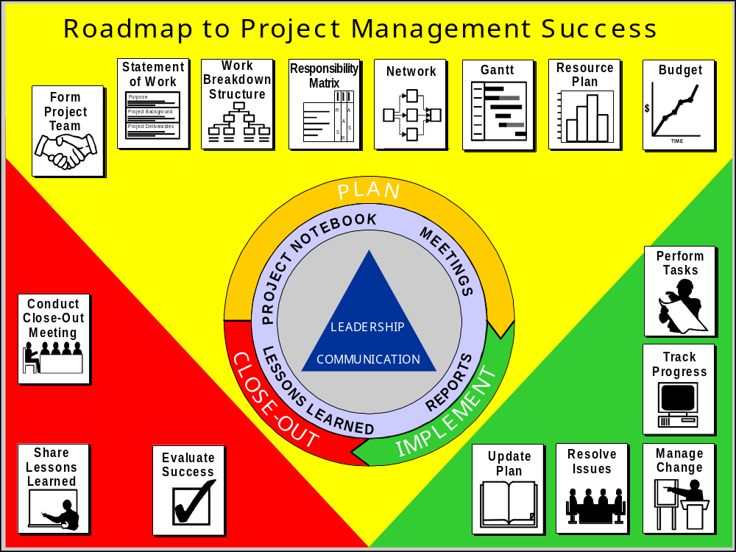
Notes:
Instructor Say
Congratulations! You’ve learned the skills along the Roadmap to Project Management Success.
Does anyone have any questions on any of the topics discussed?

Slide 31

Key Project Stakeholders
Customer/client
Project sponsor
Project manager
Project team
Notes:
Instructor Say
The project team is made up of its “stakeholders.” These are the people who have a “stake” in the project or win if the project is successful and lose if it’s not.
Transition
Each stakeholder has a set of responsibilities to fulfill for the project to be a success.

Slide 32
Project Team Members
Identify work tasks
Estimate the duration of work tasks
Help prepare the project network diagram
Honestly report work status
Keep the project manager informed on project issues
Attend scheduled progress review meetings
Raise issues important to the project’s success
Keep their functional managers updated
Participate in the project close-out
Notes:
Instructor Say
Core project team members are those individuals who actually perform the tasks necessary to complete work on the project.
They have several responsibilities including “honestly” reporting work status. (Why is “honestly” in quotes?)

Slide 33
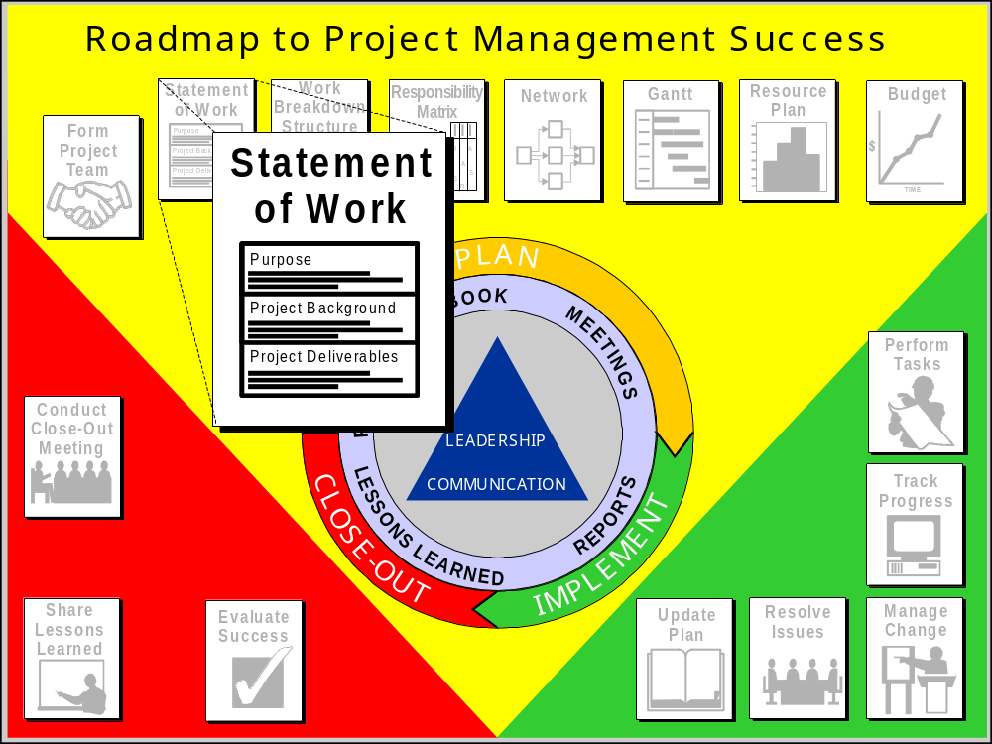
Notes:
Instructor Say
Our second stop on the roadmap is the statement of work.
The statement of work is the first key planning document prepared.

Slide 34
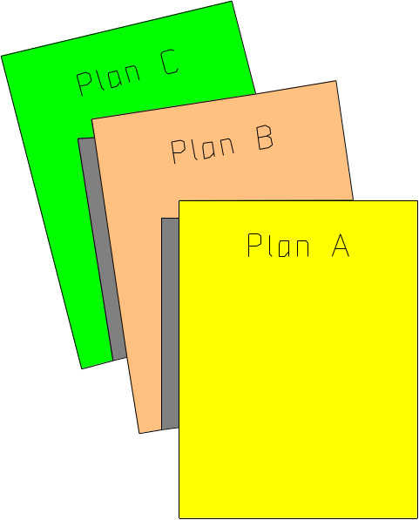
Project Plan Contents
Statement of work (SOW)
Work breakdown structures (WBS)
Responsibility assignment matrices
Project schedule
Resource plans/histograms
Budget
Risk management plan
Communications plan
Quality plan
Verification and validation plan
Notes:
3
Instructor Say
The project plan consists of all of the information and documents prepared in the planning phase.
Instructor Do
Read through the slide.
Instructor Say
It also represents the first major section of the project notebook.

Slide 35
Statement of Work — Purpose
Define the scope of the project
Establish customer expectations
Serve as a “contract” if necessary
Notes:
Instructor Say
The statement of work is prepared in order to:
Define the scope of the project
Establish customer expectations
Serve as a “contract” if necessary
Since it represents the foundation document upon which the rest of the plan is built, time should be taken to prepare a well-written, clear statement of work for the project.

Slide 36
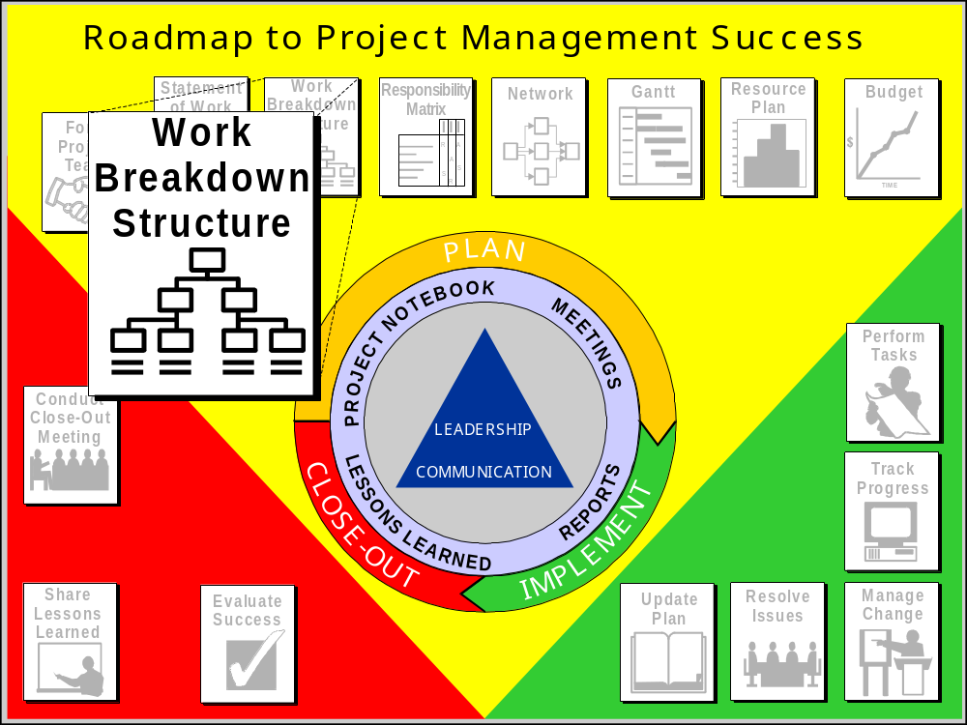
Notes:
Instructor Do
Refer to page 3-4-1 in the participant manual.
Instructor Say
Work breakdown structure
The next stop in the planning phase on our Roadmap to Project Management Success is the work breakdown structure.
The work breakdown structure is a systematic, graphical approach for dividing the project into the tasks required to complete the project.

Slide 37
Work Breakdown Structure—Purpose
Identify all of the work that needs to be done to complete the project.
Structure the work into logical components and subcomponents.
Define the work to a level of detail so individual responsibilities can be assigned.
Summarize and report project data.
Notes:
Instructor Say
The work breakdown structure (WBS) is a key planning tool for showing work organization. It helps the project team:
Identify all of the work that needs to be done to complete the project.
Structure the work into logical components and subcomponents.
Define the work to a level of detail that allows individual responsibilities to be assigned.
Determine how project data can be reported and summarized

Slide 38
WBS — Outlining Approach
3-4-10
Level 1
I. Main Project Deliverable
A. Major Element
1. Activity
2. Activity
a. task
b. task
c. task
3. Activity
B. Major Element
1. Activity
2. Activity
Level 2
Level 3
The outline approach is used by Microsoft® Project®
Level 4
Level 3
Level 2
Level 3
Notes:
Instructor Say
An alternative WBS format follows an outlining approach. One reason this method is becoming more common is because many project management software packages use an outlining approach.
The outlining approach shows the WBS elements in a tabular listing format.
Indentations are used to show the different levels.

Slide 39
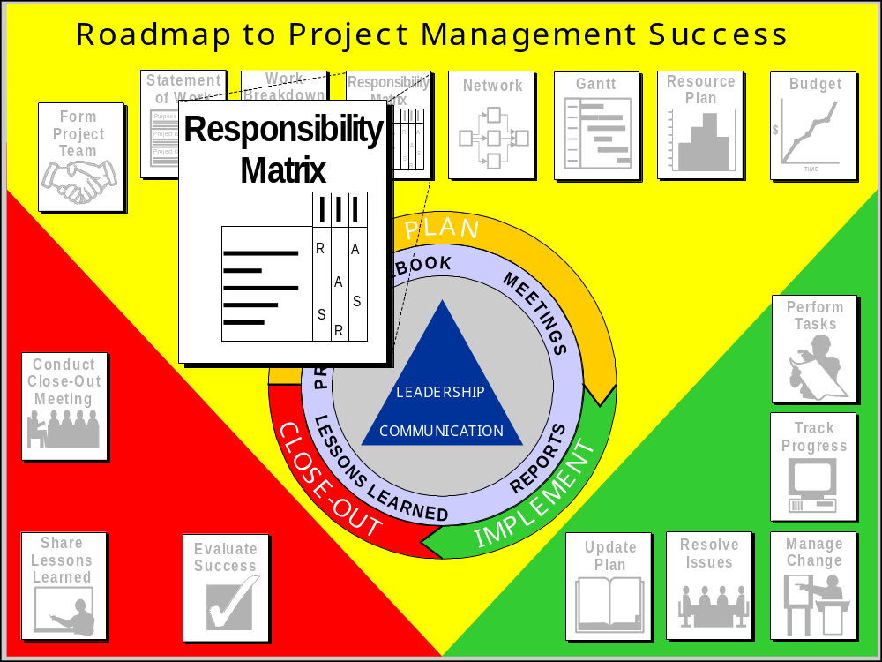
Notes:
Instructor Say
The responsibility matrix or RASIC chart is the next stop in the Roadmap to Project Management Success.

Slide 40
Responsibility Assignment Matrix
RASIC Method
TEAM
MEMBER
SENIOR
MANAGEMENT
PROJECT
MANAGER
CUSTOMER
SUPPORT
STAFF
MARKETING STUDY
IDENTIFY POTENTIAL MARKET
IDENTIFY SURVEY POPULATION
DEVELOP SURVEY
TEST SURVEY ON SAMPLE
FINALIZE SURVEY
CONDUCT SURVEY
COLLECT SURVEY
ANALYZE DATA
REPORT RESULTS AND SUGGESTION
C
C
R
R
R
R
R
R
R
I
I
A
I
I
A
S
S
S
S
S
S
S
R/S
S
R
I
I
I
I
A
S
S
S
I
S
LEGEND
R - RESPONSIBLE
A - APPROVE
S - SUPPORT (DOES THE WORK)
I - INFORM
C - CONSULT
Notes:
Instructor Say
For this example, the responsibilities associated with the marketing study are charted against the associated project team members.
For activity, “Develop Survey”
The project manager is responsible for making sure the survey is developed
The customer and senior management are kept informed regarding the development of the survey.
A team member actually does the work (support) to develop the survey.
Instructor Information
The RASIC or responsibility matrix can be used anytime after the SOW and WBS are completed to begin to evaluate resource issues.

Slide 41
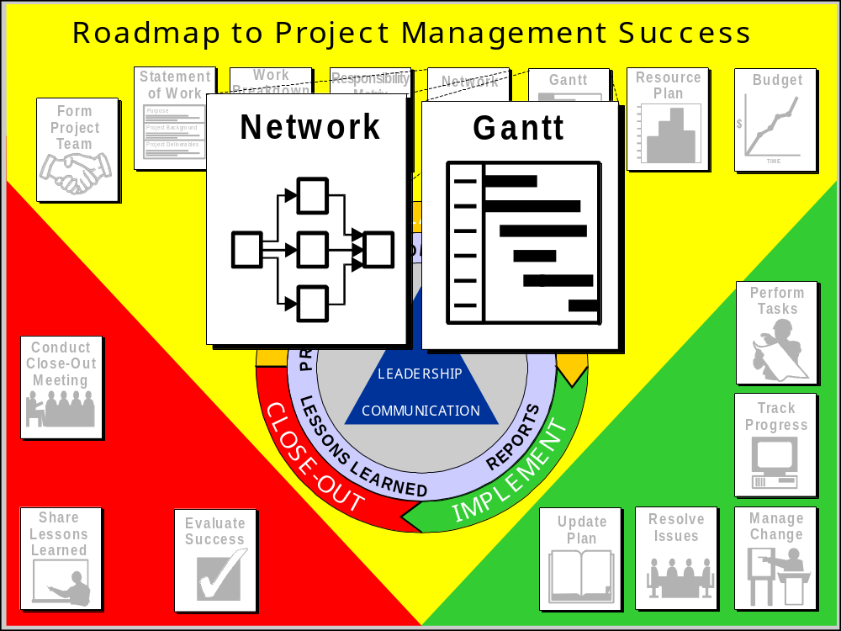
Notes:
Instructor Say
Ask the class if there are any questions on material covered during day 1.
Introduction to Project Scheduling
The next two stops on our Roadmap to Project Management Success address project scheduling.
The project schedule is developed to help determine how to make the best use of human and physical resources within a project’s cost and time constraints.

Slide 42
Project Schedule — Purpose
Determine if requested completion date is possible.
Identify start and completion dates of all work.
Determine the controlling sequence of activities.
Provide data for resource allocation.
Track progress by providing a baseline.
Notes:
Instructor Say
A project schedule assists the project manager and team to:
Determine if the requested completion date is possible.
Identify the start and completion dates of all work.
Determine the controlling sequence of activities.
Provide data for resource allocation by identifying activities with float time.
Track progress by providing a baseline to measure against.

Slide 43
WBS/Network Diagram Linkage
a
b
c
d
e
f
g
h
i
j
b
d
e
i
a
c
h
j
f
g
Notes:
Instructor Say
As discussed earlier, the work breakdown structure is used to identify all project work.
As shown in this slide, the detail elements of the work breakdown structure become tasks in a network diagram.

Slide 44
Network Diagram Methods
C
A
B
J
D
E
F
G
Arrow Diagram Method
H
I
C
J
A
B
D
E
F
G
Precedence Diagram
Method
H
I

Slide 45
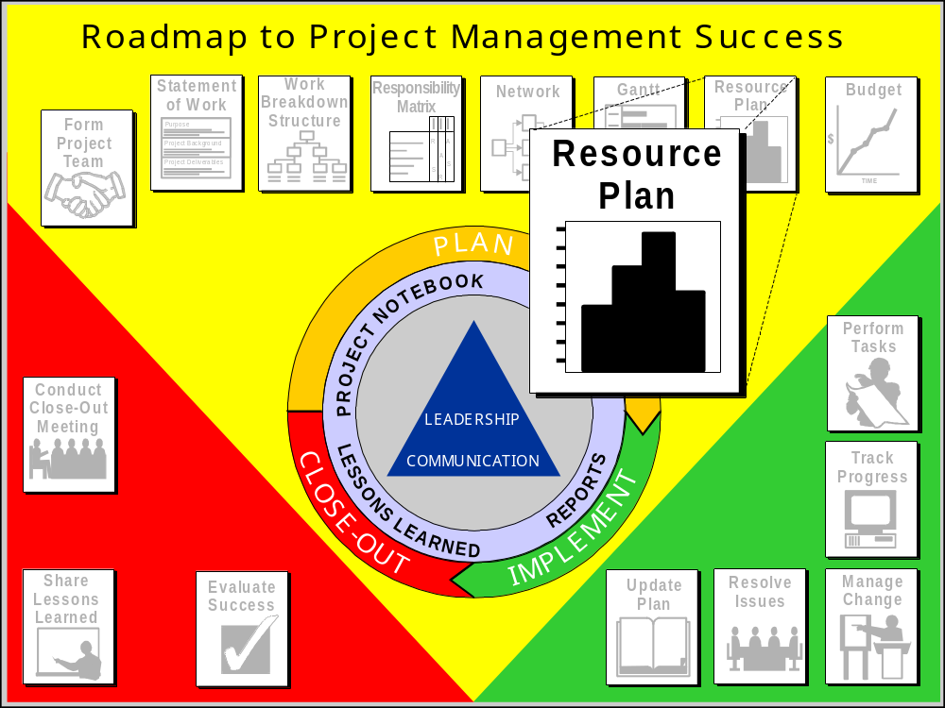
Notes:
Instructor Say
Now we will move on to the resource planning stop on our Roadmap to Project Management Success.
Resource planning techniques are used to plan the scheduling of available resources so that the project deliverables are produced on time and within budget.

Slide 46


Assigning Resources
A schedule is not complete until all the resources necessary to complete the project have been committed or assigned.

Slide 47
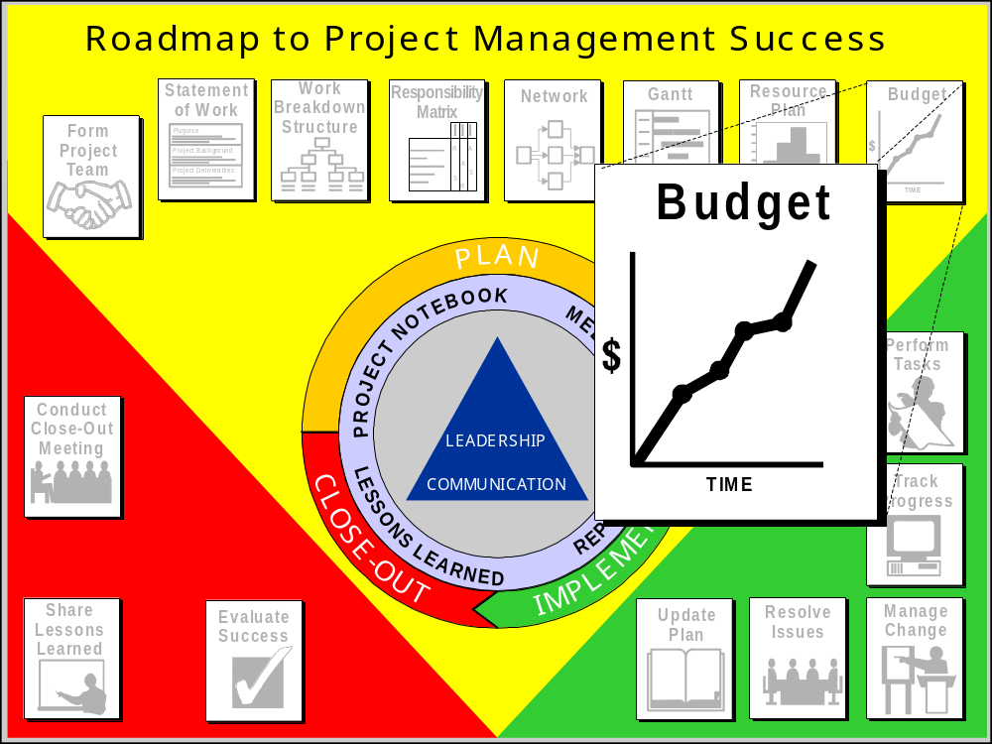
Notes:
Instructor Say
Discussion: Project Budgeting
The next stop in the planning phase on our Roadmap to Project Management Success is project budgeting.
When we first started talking about project management, we noted that the planning phase is the most important part of the process.
We also said that the more details you know about the project, the better your project plan will be.
This holds true for project budgeting as well.

Slide 48
Cost Budgeting
Cost Budgeting involves allocating overall cost estimates to individual work items in order to establish a cost baseline for measuring project performance. Using cost estimates, the WBS, the project schedule, and cost estimating tools, the project team develops a time-phased budget. This budget will be used to measure and monitor cost performance on the project.”
Source: PMI
Notes:
Instructor Say
Read the slide discussing the cost budgeting process.

Slide 49
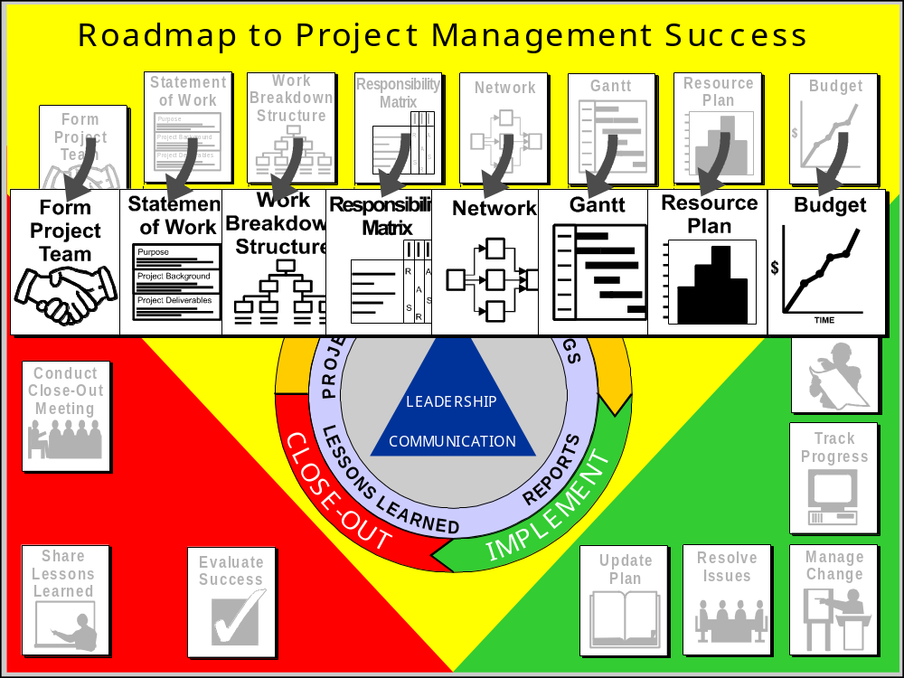
Notes:
Instructor Say
At this point in the Roadmap to Project Management Success, all of the essential elements of the project plan have been developed:
Statement of work
Work breakdown structure
Responsibility matrix
Project schedule
Resource plan
Budget
Before moving on to the implementation phase, this is a good time to take another look at project risk.
Preliminary risk planning was done when the statement of work was written.
However, at that time, only limited project information was available.
Now a more thorough analysis can be done based on the results of the planning we’ve done.
Instructor Do
Emphasize that risk management is not a one-time act. It is a continuous process that takes place throughout the project life cycle.

Slide 50
What Is Risk?
Risk can be defined as:
“Any threat to project success.”
Notes:
Instructor Say
Risk exists in all projects.
There is always a chance that something can go wrong. (100%)
Risk can be defined as:
“Any threat to project success”

Slide 51
Project Scope
Cost
Quality
Within Available Resources
Schedule
Project Risk

Slide 52
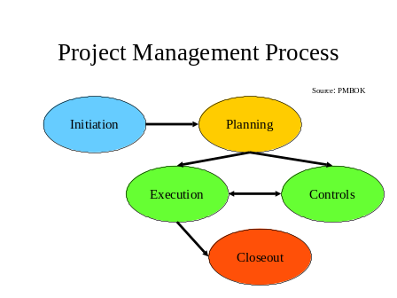
Project Implementation

Slide 53
Notes:
Instructor Say
The next phase on the Roadmap to Project Management success is project implementation.
The implementation phase is the time when the project team actually completes all of the tasks in the project.
As you can see, the project manager has several responsibilities associated with implementing the project.
These responsibilities are in addition to any project activities that the project manager has as a team member.

Slide 54
Implementation Model
Step 1
Perform Tasks
Step 4
Update the Plan
Step 2
Track Progress
Resolve Issues
Step 3
Manage Change

Slide 55
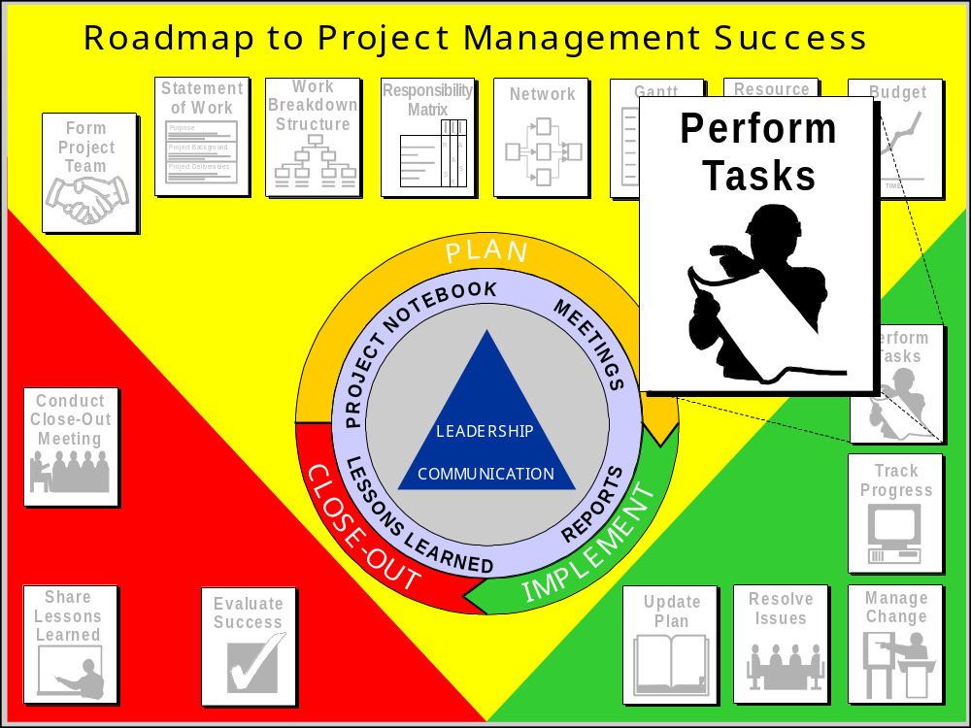
Notes:
Instructor Say
As mentioned earlier, one of the key activities of the project team during implementation is to perform all of the tasks that make up the project.
In order to be successful, team members need to know their work assignments, work authorization procedures, communication lines, reporting procedures, the project schedule, etc.
All of these items need to be addressed early in the implementation phase as part of project start-up.

Slide 56

Reporting Project Progress
Progress review meeting
Project reports
Notes:
Instructor Say
Progress review meetings and project status reports are the two most common ways of reporting project status.

Slide 57
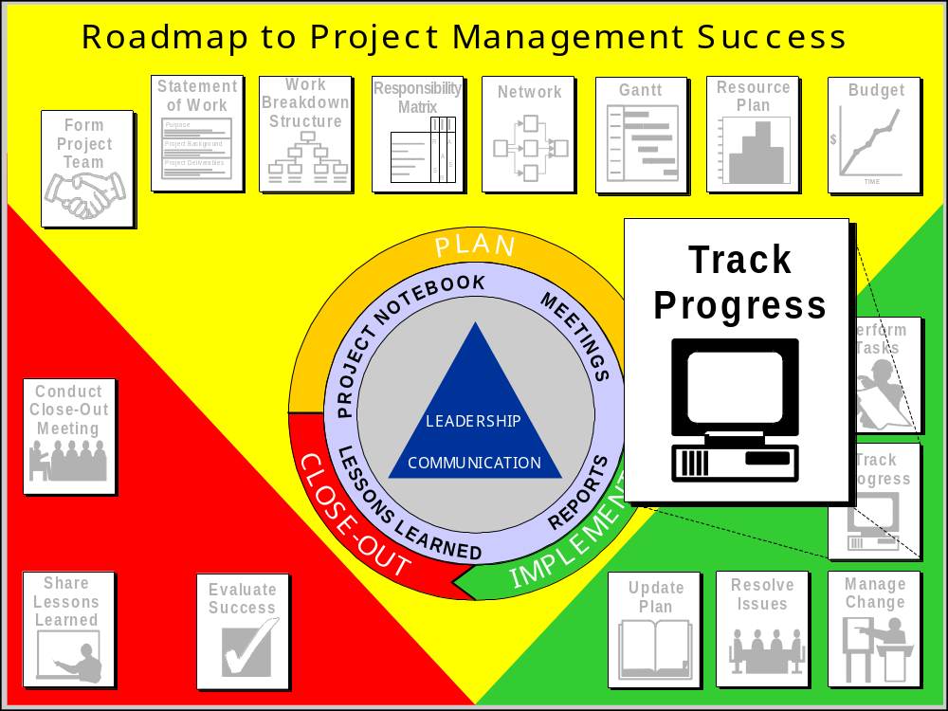
Notes:
Instructor Say
The next stop on the Roadmap to Project Management Success is tracking progress.
The objective of project tracking and control is to evaluate project progress against the original plan and take corrective action to minimize deviation.

Slide 58
Project Tracking and Control
Step 1
Perform Tasks
Step 4
Update the Plan
Step 2
Track Progress
Resolve Issues
Step 3
Manage Change

Slide 59
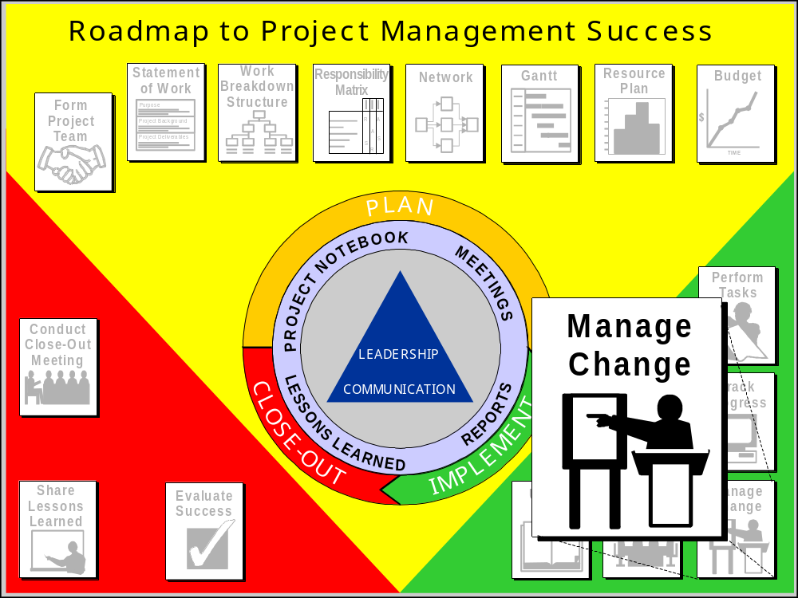
Notes:
Instructor Say
Managing change is the next stop on the Roadmap to Project Management Success.

Slide 60
Managing Project Change
Step 1
Perform Tasks
Step 4
Update the Plan
Step 2
Track Progress
Resolve Issues
Step 3
Manage Change

Slide 61
Addressing Project Changes
Call a team meeting.
Explain what the change is.
Obtain feedback from team members.
Identify alternative corrective options.
Prepare a decision matrix.
Select a recommended option(s).
Present information to upper management/customer.
Implement the approved course of action.
Notes:
Instructor Say
In some cases, you cannot effectively deal with a change without the support of upper level management.
In other cases, it is upper level management that mandates the change.
For example, a program may need to go to the market sooner, so your deadline is moved up.
Or, global budgetary cut-backs are required, which impacts your project budget. In other words—you must do the same project for less money.
For either situation, you must present information to management so they can help you decide on the best course of action.
You must be able to present the right information so that the “best” decision can be made.

Slide 62
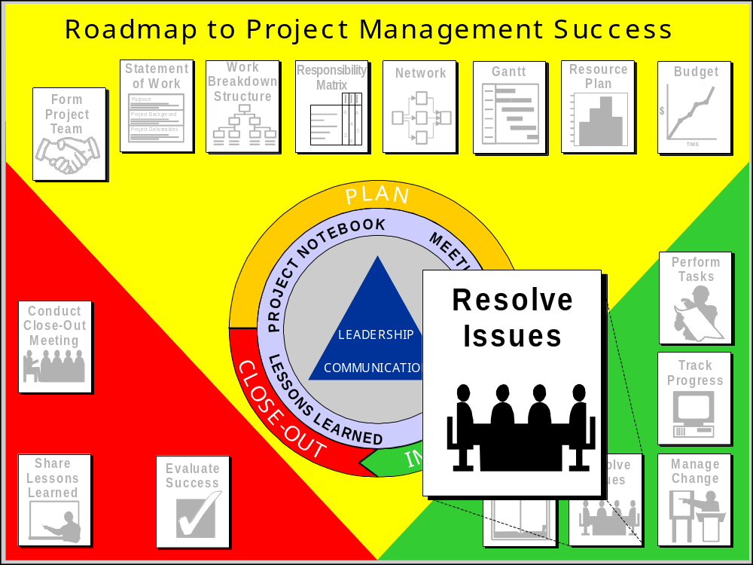
4-5-1
Notes:
Instructor Say
Throughout the implementation phase, issues can occur which will seriously impact project success if not addressed in a timely fashion.
An issue is any unresolved item that needs to addressed.
It can be as simple as a request for information or as serious a loss of key personnel.
It is the responsibility of the project manager to make sure issues are identified, assigned, and resolved.

Slide 63

Issue Resolution
Disagreements that should be …
  Documented
  Assigned
  Scheduled
  Tracked
  Escalated
  Resolved
Notes:
Instructor Say
A single process for resolving issues is to:
1.Document the issue.
Assign a number for tracking.
Assign a priority (low, medium, or high).
Describe the issue.
2. Assign the issue to someone for resolution.
3. Schedule its completion.
4. Track its status.
5. Escalate the issue to senior management if their involvement is required.
6. Once the issue is resolved, close it out by recording the actual completion date.

Slide 64
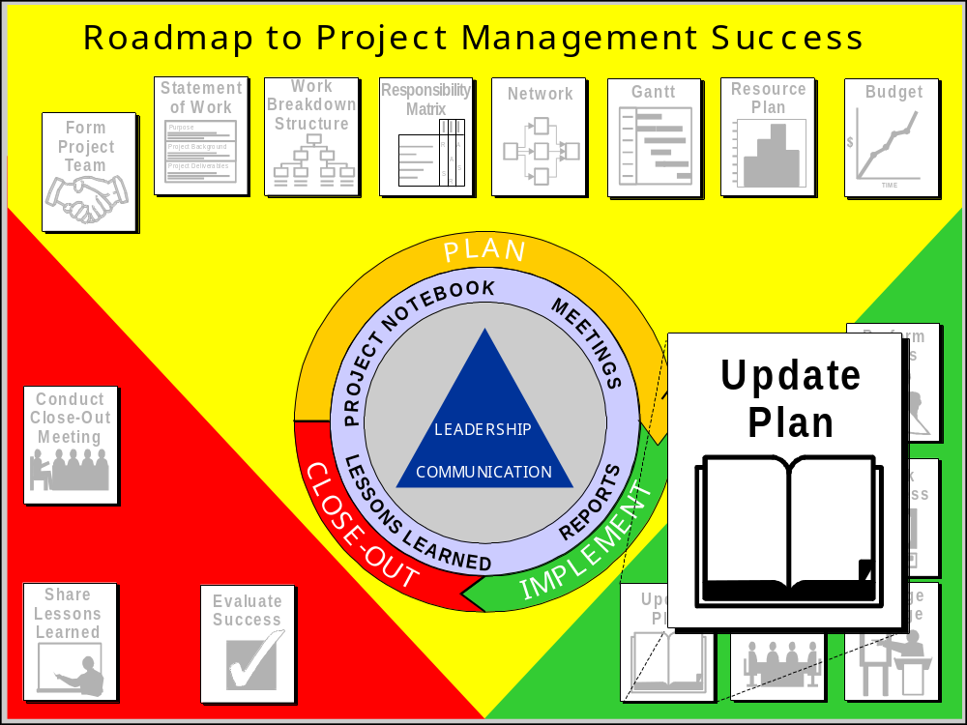
4-6-1
Notes:
Instructor Say
Once project status has been determined and change management decisions made, the project plan needs to be updated and project progress reported. This is the next stop on the Roadmap to Project Management Success.

Slide 65
Plan Updates
Step 1
Perform Tasks
Step 4
Update the Plan
Step 2
Track Progress
Resolve Issues
Step 3
Manage Change

Slide 66
Closeout
Notes:
Unit: Close-out
Learning Objective: To understand the steps necessary to successfully close-out a project.
Time: 20 minutes
Materials: Overhead projector, transparencies, flipcharts, and markers.

Slide 67
Notes:
Instructor Say
The final phase of our Roadmap to Project Management Success is project Close-out.
The overall purpose of this phase is to bring the project to an orderly and formal end.

Slide 68
Project Manager’s Role During Project Close-Out
Ensure that all project deliverables have been completed and formally accepted by the customer.
Determine if the measurable success indicators were achieved.
Conduct project close-out meetings, both internal and external.
Write the final project report.
Document and share lessons learned.
Notes:
Instructor Say
The project manager plays an important role during project close-out.
The project manager should:
Ensure that all project deliverables have been completed and formally accepted by the customer.
Determine if the measurable success indicators were achieved.
Conduct project close-out meetings, both internal and external.
Write the final project report.
Document and share lessons learned.
Transition
Let’s take a closer look at what’s involved.

Slide 69
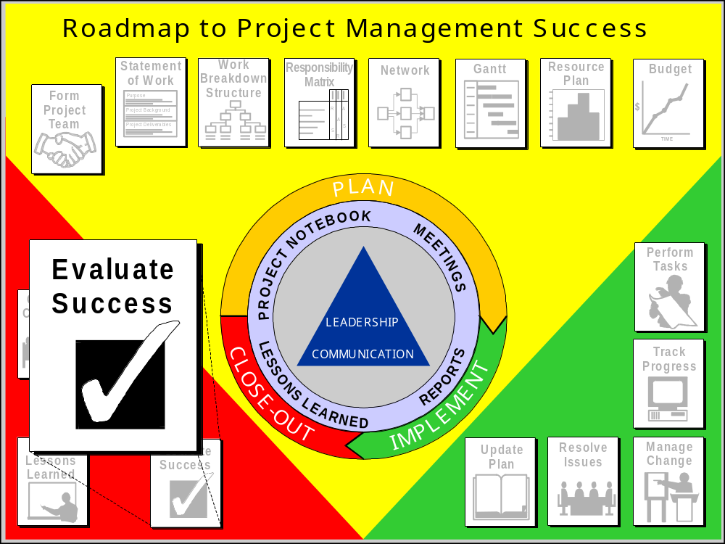
Notes:
Instructor Say
Evaluating success is a key activity that needs to be done during project close-out.

Slide 70
Evaluating Project Success
Project purpose
Deliverables
Measurable success indicators
  Quality
  Schedule
  Cost
Notes:
Instructor Say
Measuring Project Success
Before your final meeting with the customer, you need to check that the customer’s needs have been met.
Check the deliverables against the project’s measurable success indicators.
For many projects you will deliver some of the project elements before the close-out phase.
If so, review that those deliverables met the specifications and the measurable success indicators.
Also for many projects, the success of the project will not be determined until long after the close of the project.
For example, the success of an automotive part, as specified by the success indicators, won’t be evident until after that part is in regular production and is being used on the road.

Slide 71
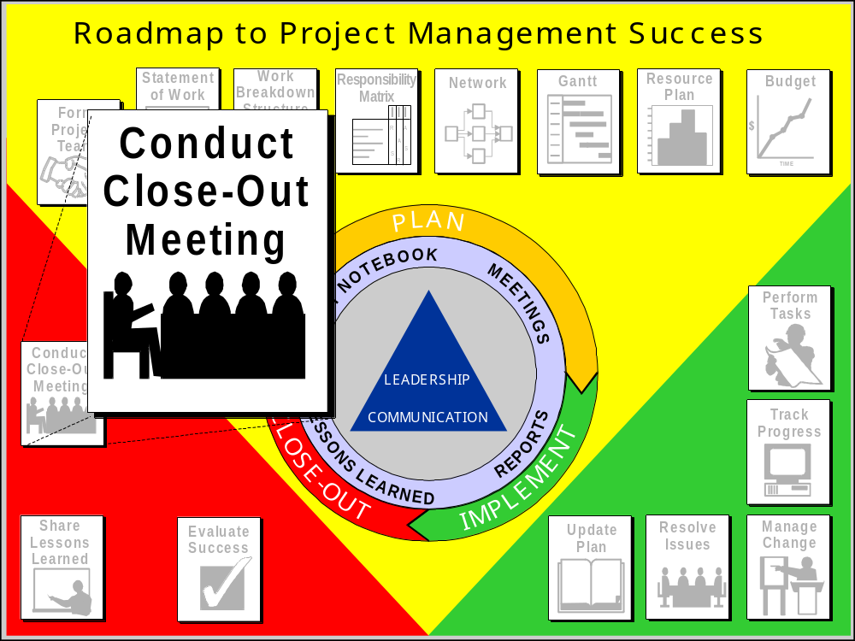
Notes:
Instructor Say
Close-out Meeting
Once you have reviewed the measurable success indicators, the close-out meeting can be conducted.
Attendees at the close-out meeting should be the project stakeholders.
It’s not always necessary for all project team members to be there.

Slide 72
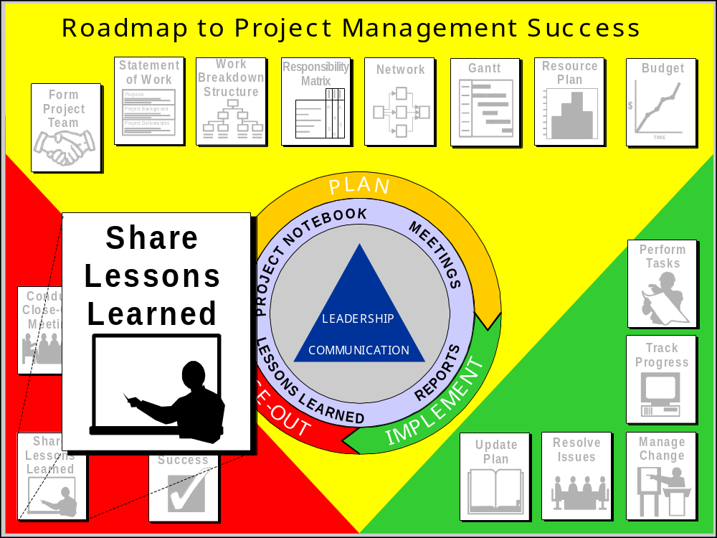
Notes:
Instructor Say
Sharing lessons learned is probably one of the most important things to do to improve project success.

Slide 73
Sharing Lessons Learned
Lessons Learned Database
  Categorized electronic project information database
Continuous Improvement Recommendations
  Project Management Process
  Forms
  Standards
Notes:
Instructor Say
In order to make lessons more readily accessible, some organizations store final project reports in an electronic data base.
Another way to share lessons learned is to modify the project management process through the implementation of continuous improvement recommendations.

Slide 74
Notes:
Instructor Say
Congratulations! You’ve learned the skills along the Roadmap to Project Management Success.
Does anyone have any questions on any of the topics discussed?

Slide 75

Thank You!!!!
Notes:
Instructor Do
Thank the participants for attending the course.
Wish them well on their next projects and reinforce the use of good project management skills.
Instructor Say
Project management is the key to project success.

