Slide 1
Quick Recap

Slide 2
Phases of Quality Assurance
Figure 10.1
Inspection and
corrective
action during
production
Inspection
before/after
production
Quality built
into the
process
Acceptance
sampling
Process
control
Continuous
improvement
The least
progressive
The most
progressive

Slide 3
Lesson 14: Monitoring and Controlling Project Risks and Procurements
Topic 14A: Monitor and Control Project Risks
Topic 14B: Administer Project Procurements

Slide 4
Monitor and Control Risks
“Repeat the Process in Execution”
Tools & Techniques
Outputs
Risk reassessment
Risk audits
Variance and trend analysis
Technical performance measurement
Reserve analysis
Status meetings
Risk Register Updates
Organizational Process Assets
Risk Register
Project Management Plan
Work Performance Information
Performance Reports
Inputs
Change Requests
Project Management Plan Updates
Project Document Updates
Plan Risk Management
Identify Risks
Perform Qualitative Risk Analysis
Perform Quantitative Risk Analysis
Plan Risk Responses
Monitor and Control Risk s

Slide 5
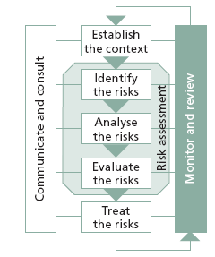
Monitor and review
Monitor and review is an essential and integral step in the risk management process.
A business owner must monitor risks and review the effectiveness of the treatment plan, strategies and management system that have been set up to effectively manage risk.

Slide 6
Risks need to be monitored periodically to ensure changing circumstances do not alter the risk priorities. Very few risks will remain static, therefore the risk management process needs to be regularly repeated, so that new risks are captured in the process and effectively managed.
A risk management plan at a business level should be reviewed at least on an annual basis. An effective way to ensure that this occurs is to combine risk planning or risk review with annual business planning.

Slide 7
How Do We Manage Risk?
Use the six risk management processes
  Plan Risk Management
  Identify Risks
  Perform Qualitative Risk Analysis
  Perform Quantitative Risk Analysis
  Plan Risk Responses
  Monitor and Control Risks
Plan Risk Management
Identify Risks
Perform Qualitative Risk Analysis
Perform Quantitative Risk Analysis
Plan Risk Responses
Monitor and Control Risk s

Slide 8
Plan Risk Management
Tools & Techniques
Project Scope Statement
Cost Management Plan
Schedule Management Plan
Enterprise Environmental Factors
Organizational Process Assets
Planning Meetings and Analysis
Inputs
Outputs
Risk Management Plan
Plan Risk Management
Identify Risks
Perform Qualitative Risk Analysis
Perform Quantitative Risk Analysis
Plan Risk Responses
Monitor and Control Risk s

Slide 9
Risk Breakdown Structure
Lists categories and subcategories where risks may arise
Project
Technical
Organizational
Project Management
Limited Design Time
Funding
Estimates
Specifications Adherence
Prioritization
Scheduling
Resource Availability
Communication

Slide 10
Identify Risks
Risk Management Plan
Activity Cost Estimates
Activity Duration Estimates
Scope Baseline
Stakeholder Register
Cost Management Plan
Schedule Management Plan
Quality Management Plan
Project Documents
Enterprise Environmental Factors
Organizational Process Assets
Tools & Techniques
Documentation Reviews
Information Gathering Techniques
Checklist Analysis
Assumption Analysis
Diagramming Techniques
SWOT Analysis
Expert Judgment
Inputs
Outputs
Risk Register
Plan Risk Management
Identify Risks
Perform Qualitative Risk Analysis
Perform Quantitative Risk Analysis
Plan Risk Responses
Monitor and Control Risk s

Slide 11
Information Gathering Techniques
Brainstorming
Delphi technique
  Successive anonymous questionnaires on project risks with responses summarized for further analysis
Interviewing
Root cause identification
Strengths, weaknesses, opportunities, and threats (SWOT) analysis

Slide 12
Diagramming Techniques
Cause and Effect Diagrams
  Also known as Ishikawa or fishbone
Testing
Inadequate Time
Project Prioritization
Product Delivered Late
Personnel
Materials
Insufficient Resources
Bad Specs
Potential Causes
Effect

Slide 13
Risk Register
List of
  Identified risks
  Potential responses
  Root causes
Updated risk categories (if required)

Slide 14
Perform Qualitative Risk Analysis
Tools & Techniques
Risk Register
Risk Management Plan
Project Scope Statement
Organizational Process Assets
Inputs
Risk probability and impact statement
Probability and impact matrix
Risk data quality assessment
Risk categorization
Risk urgency assessment
Expert Judgement
Outputs
Risk Register Updates
Plan Risk Management
Identify Risks
Perform Qualitative Risk Analysis
Perform Quantitative Risk Analysis
Plan Risk Responses
Monitor and Control Risk s

Slide 15
Methodologies
Probability and Impact Matrix
  Based on Failure Modes and Effects Analysis (FMEA)
  From 1950’s analysis of military systems

Slide 16
Probability and Impact Matrix
Define Probability Scale & Impact Scale
Impact Scale
Probability Scale
Consequence | Health and Safety
Extreme | Fatality or multiple fatalities expected
High | Severe injury or disability likely; or some potential for fatality
Moderate | Lost time or injury likely; or some potential for serious injuries; or small risk of fatality
Low | First aid required; or small risk of serious injury
Negligible | No concern
Likelihood Class | Likelihood of Occurrence (events/year)
Not Likely (NL) | <0.01% chance of occurrence
Low (L) | 0.01 - 0.1% chance of occurrence
Moderate (M) | 0.1 - 1% chance of occurrence
High (H) | 1 - 10% chance of occurrence
Expected (E) | >10% chance of occurrence

Slide 17
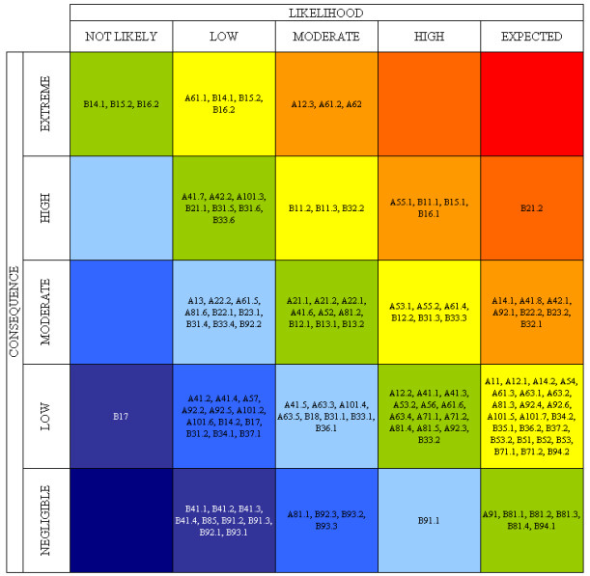
Probability and Impact Plots
Rate each risk on scales then plot on matrix
Develop mitigation technique for risks above tolerance

Slide 18
Risk Register Update
Add
  Probability and Impact Matrix results
  Perform quality check on results
  Categorize the risks to make them easier to handle
  Perform urgency assessment to determine which risk need immediate attention

Slide 19
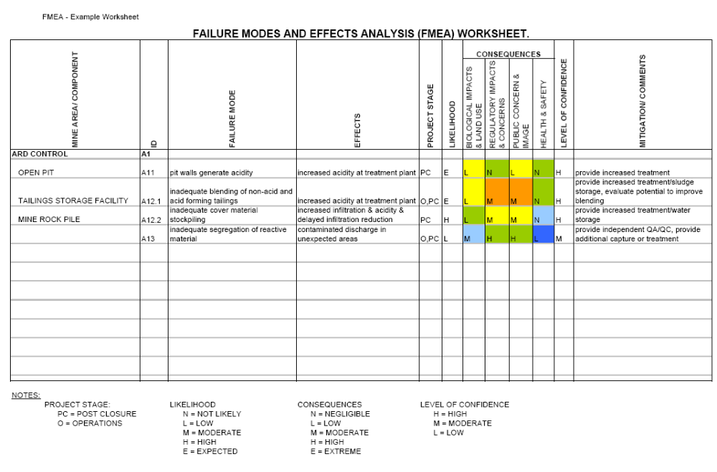
Risk Register

Slide 20
Perform Quantitative Risk Analysis
Inputs
Tools & Techniques
Data gathering and representation techniques
Quantitative risk analysis and modeling
Expert Judgment
Risk Register
Risk Management Plan
Cost Management Plan
Schedule Management Plan
Organizational Process Assets
Outputs
Risk Register Updates
Plan Risk Management
Identify Risks
Perform Qualitative Risk Analysis
Perform Quantitative Risk Analysis
Plan Risk Responses
Monitor and Control Risk s

Slide 21
Quantitative Risk Analysis
Analyze numerically the probability and consequence of each risk
Monte Carlo analysis popular
Decision Tree analysis on test
  Diagram that describes a decision and probabilities associated with the choices
Expected Monetary Value Analysis (EMV)

Slide 22
Expected Monetary Value (EMV)
 | Building Cost | Probability
Optimistic Outcome | $150K | 0.2 | $30K
Likely Outcome | $225K | 0.5 | $113K
Pessimistic Outcome | $300K | 0.3 | $100K
Expected Value |  |  | $243K

Slide 23
Decision Tree Analysis
Decision Definition
Decision Node
Chance Node
Net Path Value
65%
$200
Strong Demand
$80
EMV of New Bldg Node = $41.5!
New Plant
-$120
35%
$90
Weak Demand
-$30
Build or Upgrade Plant
65%
$120
Upgrade Plant
-$50
Strong Demand
$70
EMV of Upgrade Node = $49!
35%
$60
Weak Demand
$10

Slide 24
Plan Risk Responses
Tools & Techniques
Inputs
Strategies for negative risks or threats
Strategies for positive risks or opportunities
Contingent response strategy
Expert Judgment
Outputs
Risk Register
Risk Register Updates
Risk Management Plan
Risk-related Contract Decisions
Project Management Plan Updates
Plan Risk Management
Identify Risks
Perform Qualitative Risk Analysis
Perform Quantitative Risk Analysis
Plan Risk Responses
Monitor and Control Risk s

Slide 25
Monitor and Control Risks
“Repeat the Process in Execution”
Tools & Techniques
Outputs
Risk reassessment
Risk audits
Variance and trend analysis
Technical performance measurement
Reserve analysis
Status meetings
Risk Register Updates
Organizational Process Assets
Risk Register
Project Management Plan
Work Performance Information
Performance Reports
Inputs
Change Requests
Project Management Plan Updates
Project Document Updates
Plan Risk Management
Identify Risks
Perform Qualitative Risk Analysis
Perform Quantitative Risk Analysis
Plan Risk Responses
Monitor and Control Risk s

Slide 26
Administering the Contract
Ensures that the seller’s performance meets contractual requirements.
Contracts are legal relationships, so it is important that legal and contracting professionals be involved in writing and administering contracts.
Many project managers ignore contractual issues, which can result in serious problems.

Slide 27
Suggestions for Change Control in Contracts
Changes to any part of the project need to be reviewed, approved, and documented by the same people in the same way that the original part of the plan was approved.
Evaluation of any change should include an impact analysis. How will the change affect the scope, time, cost, and quality of the goods or services being provided?
Changes must be documented in writing. Project team members should also document all important meetings and telephone phone calls.

Slide 28
Suggestions for Change Control in Contracts (cont’d)
Project managers and teams should stay closely involved to make sure the new system will meet business needs and work in an operational environment.
Have backup plans.
Use tools and techniques, such as a contract change control system, buyer-conducted performance reviews, inspections and audits, and so on.

