Slide 1
Quick Recap

Slide 2
Lesson 11: Monitoring and Controlling Project Work
Topic 11A: Identify the Monitor and Control Project Work Process
Topic 11B: Develop an Integrated Change Control System
Topic 11C: Utilize the Integrated Change Control System
Topic 11D: Review Deliverables and Work Results
Topic 11E: Control the Project Scope

Slide 3
“Change Control”
System for Implementing Monitoring and Controlling

Slide 4
CAB considerations for each change (prior to authorisation) [2]
The impact on non-IT infrastructures within the organisation
Effect/risk/impact of not implementing the change
Technical capability and technical approval
Financial approval (if required)
Third party/supplier involvement in the implementation of the change
Business approval (if required)
Review/assessment of the change priority

Slide 5
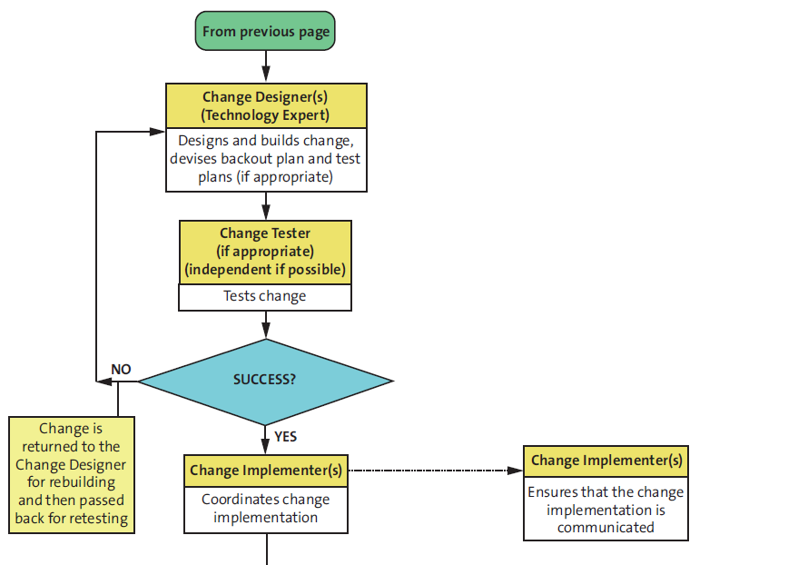

Slide 6
Activities of change building
building a new production module
creating a new version of one or more software modules
purchasing equipment or services externally
preparing a hardware modification
producing new or amended documentation showing the components of the change build
devising a backout plan
devising testing requirements, as appropriate
documenting required resources for the change implementation

Slide 7
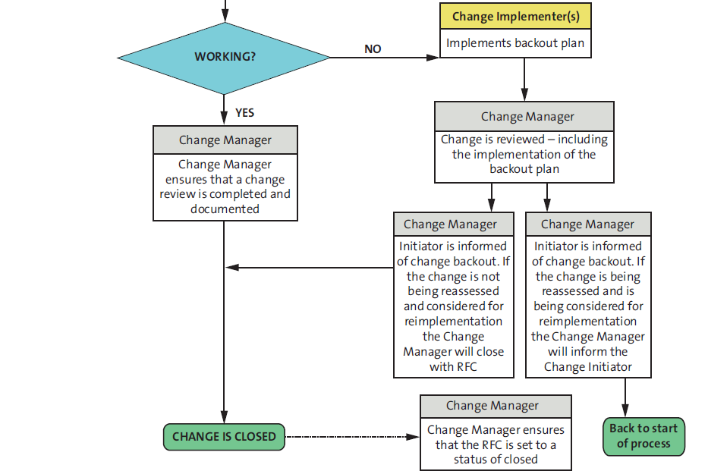

Slide 8
Change review
The change has had the desired effect and met its objectives
Users and customers are content with the results, or to identify any shortcomings
There have been no unexpected or undesirable side effects to functionality, availability, capacity/performance, security, maintainability etc.
The resources used to implement the change were as planned
The implementation plan worked correctly (so include comments from the implementers)
The change was implemented on time and to cost
The backout plan functioned correctly, if the backout plan was implemented

Slide 9
RUP –(Rational Unified Process) Configuration and Change Management
CCM is one of RUP’s 9 Disciplines
  Analysis and Design, Business Modeling, Configuration and Change Management, Deployment, Environment, Implementation, Project Management. Requirements, Test

Slide 10
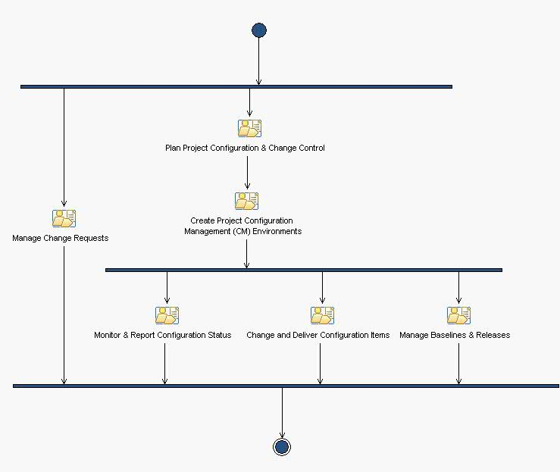
CCM Workflow

Slide 11
Role: Configuration Manager[1]
Manages the overall Configuration Management (CM) infrastructure and environment for the product development team
Role is often shared by a Configuration (or Change) Control Board (CCB)

Slide 12
Role: Configuration Manager[2]
Consists of representatives from all interested parties, including customers, developers, and users
In a small project, a single team member, such as the project manager or software architect, may play this role

Slide 13
Role: Configuration Manager[3]
Should understand configuration management principles
Should be skilled in estimating cost and schedule impacts of change requests
Should be able to communicate effectively in order to negotiate scope changes and in order to determine how each change request should be handled and by whom

Slide 14
Role: Change Control Manager[1]
This role defines and oversees the change control process.
This role is often shared by a Configuration (or Change) Control Board (CCB) and consists of representatives from all interested parties like customers, developers, and users
In a small project the project manager or software architect, may play this role

Slide 15
Role: Change Control Manager[2]
Should understand change management principles
Should be skilled in estimating cost and schedule impacts of change requests
Should be able to communicate effectively in order to negotiate scope changes and in order to determine how each change request should be handled and by whom

Slide 16
Plan Project Configuration & Change Control[1]
Establishes an appropriate plan for managing and controlling change to the artifacts that are developed as work products of the software development process
Contains 3 Tasks

Slide 17
Plan Project Configuration & Change Control[2]
Establish Configuration Management (CM) Policies
  Define Configuration Identification Practices
  Define Baseline Practices
  Define Archiving Practices
  Define Configuration Status Reporting Requirements

Slide 18
Plan Project Configuration & Change Control[3]
Write Configuration Management (CM) Plan
  Write the CM Plan
  Review and Approve the CM Plan
  Maintain the CM Plan

Slide 19
Plan Project Configuration & Change Control[4]
Establish Change Control Process
  Establish the Change Request Process
  Establish the Change Control Board
  Define Change Review Notification Protocols

Slide 20
Create Project Configuration Management (CM) Environments[1]
This activity establishes an environment where the overall product can be developed, built, and made available for stakeholders.
Contains 2 Tasks

Slide 21
Create Project Configuration Management (CM) Environments[2]
Set up the CM Hardware Environment
  Set up the CM Hardware Environment
  Map the Architecture to the Repository
  Create Initial Set of Versioned Elements
  Define Baseline Promotion Levels

Slide 22
Create Project Configuration Management (CM) Environments[3]
Create Integration Workspaces
  The integration workspace is where subsystem and system integrators convince themselves that separately developed and tested components can indeed work together as a product.
  Integrators combine the elements delivered to the integration workspace to produce a Build.

Slide 23
Manage Change Requests [1]
This activity ensures that due consideration is given to the impact of change on the project and that approved changes are made within a project in a consistent manner.
Contains 6 Tasks

Slide 24
Manage Change Requests [2]
Submit Change Request
  Complete CR Form
  Submit the Change Request
Example:
  Sample Change Request Form.doc
  Change Request Form.doc

Slide 25
Manage Change Requests [3]
Update Change Request
  Retrieve the Change Request Form
  Update and Resubmit the Change Request Form

Slide 26
Manage Change Requests [4]
Review Change Requests
  Schedule CCB Control Meeting
  Retrieve Change Requests for Review
  Review Submitted Change Requests

Slide 27
Manage Change Requests [5]
Confirm Duplicated or Rejected CR
  Retrieve the Change Request Form
  Confirm Duplication or Validity
  Update the Change Request Status

Slide 28
Manage Change Requests [6]
Schedule and Assign Work
  Allocate Change Request to an Iteration
  Assign Responsibility
  Describe Work and Expected Outputs
  Budget Effort and other Resources
  Set Schedule
  Re-plan
  Issue Work Order

Slide 29
Manage Change Requests [7]
Verify Changes in Build
  Resolve Change Request
  Verify Changes in Test Build
  Verify Changes in Release Build

Slide 30
Monitor & Report Configuration Status [1]
This activity provides visibility to configuration change activity through ongoing monitoring and reporting.
Contains 2 Tasks

Slide 31
Monitor & Report Configuration Status [2]
Report on Configuration Status goals:
  Support project Configuration Status Accounting tasks.
  Facilitate product review through defect tracking and reporting tasks.
  Ensure that data is 'rolled-up' and reported for the purposes of tracking progress and trends.

Slide 32
Monitor & Report Configuration Status [3]
Perform Configuration Audit
  Perform Physical Configuration Audit (check if baseline contains all required work products)
  Perform Functional Configuration Audit (check that a baseline meets requirements)
  Report Findings

Slide 33
Change and Deliver Configuration Items[1]
This activity manages project artifacts and the work involved from their initial creation as private artifacts through to their delivery and general availability to the project team and other stakeholders.
Contains 6 Tasks

Slide 34
Change and Deliver Configuration Items[2]
Create Development Workspace
  A development workspace is a private development area that provides an environment in which a team member can make changes to work products without the changes becoming immediately visible to other team members.

Slide 35
Change and Deliver Configuration Items[3]
Make changes
  Checks out the files that need to be changed.
  Makes the changes.
  Performs unit tests to verify the changes.
  Gets the changes approved.
  Checks in the changes.
  Promote the changes.

Slide 36
Change and Deliver Configuration Items[4]
Deliver Changes
  Prepare for Delivery
  Deliver Changes
  Update Work Order Status

Slide 37
Change and Deliver Configuration Items[5]
Update Workspace
  Ensure team members are working on the most recent versions of the project files
  Update the files displayed in the development view (workspace) with those in the recommended baseline

Slide 38
Change and Deliver Configuration Items[6]
Create Baselines
  Ensure that all developed work products are captured and archived, at given points in time, as a basis for further product development
  Good candidates for a baseline are the sets of files and directories under version control that are developed, integrated and released together

Slide 39
Change and Deliver Configuration Items[7]
Promote Baseline
  Establish when the creation of a Baseline is completed, and how a completed Baseline must be labeled
  Baselines (individually tested components from various implementers, and development teams, combined together to work together as a product) are 'tagged' to reflect the level of software maturity, stability and quality they may have achieved

Slide 40
Manage Baselines & Releases [1]
This activity ensures that consistent sets of related or dependent artifacts can be identified as part of a "baseline" for various purposes, such as the identification of release candidates, product versions, artifact maturity or completeness.
Contains 3 Tasks

Slide 41
Manage Baselines & Releases [2]
Create Deployment Unit
  Focuses on the creation of the media for the solution that allows it to be deployed in the target environment
  The deployment unit contains all the deliverable items, and these are listed in the Bill of Materials.

Slide 42
Manage Baselines & Releases [2]
Create Baseline
  <done>
Promote Baseline
  <done>

Slide 43
Final Conclusions
What are CCM objectives?
  Managing change is more than just checking-in and checking-out files. It includes management of workspaces, parallel development, integration, and builds.
Which are the main topics for CCM?
  Coordinating the Activities and Artifacts
  Coordinating Iterations and Releases
  Coordinating Changes to Software

Slide 44
Final Conclusions
When CCM is established?
  Often institutionalized or established early on in the project lifecycle
  CRs, can be raised at any time during the course of the project
Who is responsible for CCM?
  Change Control Manager/Configuration Manager
  Anyone on the project staff should be able to raise a Change Request

Slide 45
Final Conclusions
Who tells us how CCM can be done?
  In PMBOK it is ICC
  In CMMI it is CM
  In the Rational Unified Process, the Configuration & Change Management Discipline

Slide 46
Control Project Scope

Slide 47
Scope monitoring and control
At the planning stage the project scope was identified with the help of:
  Scope definition (in and out)
  Requirements
  Deliverables
  WBS

Slide 48
Scope Control
Scope control involves controlling changes to the project scope
Goals of scope control are to:
  Influence the factors that cause scope changes
  Assure changes are processed according to procedures developed as part of integrated change control
  Manage changes when they occur
Variance is the difference between planned and actual performance. Control variances

Slide 49
The factors of scope change
Time is shorter than planned
Human resources not available
Material resources shortage
Requirements changed

Slide 50
Progress tracking
Tracking is the process of comparing actual with plan
Help to understand the project issues and justify requests for changes
With actual in hands you will operate with facts
Planned characteristics are recorded with the help of baseline

Slide 51
Baselines
MS Project allow storing the project baseline
Baseline should be stored first when the planning stage is completed
It can be updated during the project implementation to reflect changes
Baseline is a snapshot of:
  Tasks
  Resources
  Assignments

Slide 52
Tasks baseline
For each task it will show planned characteristics of
  Duration
  Start and finish date
  Resources assigned
  Cost
  Dependencies

Slide 53
Use of baseline
Planned data are used to calculate
  Critical Path
  Free and float slack
  Early and late start and finish date
They also are used to monitor the project performance in terms of timeline and cost

Slide 54
Baseline options
For entire project
For selected tasks
For a part of the project that starts from selected task

Slide 55
How to track
Specify the work completed in %
Use the Tracking Gantt table to record actual information
Use other tables to see the project state from different perspectives

Slide 56
Using tables
View – Table – Variance
  Show variances in task timing between baseline and actual
View – Table – Work
  Show differences between baseline and actual work efforts
View – Table – Cost
  Show differences in cost between baseline and actual

