Slide 1
Quick Recap

Slide 2
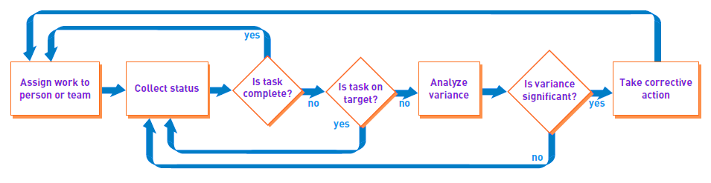
Monitor Project Progress and Make Corrections

Slide 3
When to monitor and evaluate ?
Monitoring and evaluation of a project is done throughout its entire life cycle
There four major types of project evaluation:
1. Preproject evaluation
2. Ongoing project evaluation
3. Project completion evaluation
4. Postproject evaluation

Slide 4
Lesson 11: Monitoring and Controlling Project Work
Topic 11A: Identify the Monitor and Control Project Work Process
Topic 11B: Develop an Integrated Change Control System
Topic 11C: Utilize the Integrated Change Control System
Topic 11D: Review Deliverables and Work Results
Topic 11E: Control the Project Scope

Slide 5
“Change Control”
System for Implementing Monitoring and Controlling

Slide 6
References
PMBOK
CMMI

Slide 7
PMBOK - Integrated Change Control
Part of the Project Integration Management Knowledge Area:
  Develop Project Charter, Develop Preliminary Project Scope Statement, Develop Project Management Plan, Direct and Manage Project Execution, Monitor and Control Project Work, Integrated Change Control, and Close Project

Slide 8
"It must be considered that there is nothing more difficult to carry out nor more doubtful of success nor more dangerous to handle than to initiate a new order of things."
Machiavelli (1446-1507)

Slide 9
PM Process Group
Integrated Change Control and all processes in the Project Integration Area are coordinated within the Project Management Process Groups

Slide 10
Definition
ICC is the process necessary for controlling factors that create changes to make sure those changes are beneficial, determining whether a change has occurred, and managing the approved changes, including when they occur.
ICC process is performed throughout the project, from project initiation through project closure.

Slide 11
Activities [1]
Identifying that a change needs to occur or has occurred.
Influencing the factors that circumvent integrated change control so that only approved changes are implemented.
Reviewing and approving requested changes.

Slide 12
Activities [2]
Managing the approved changes when and as they occur, by regulating the flow of requested changes.
Maintaining the integrity of baselines by releasing only approved changes for incorporation into project products or services, and maintaining their related configuration and planning documentation.

Slide 13
Activities[3]
Reviewing and approving all recommended corrective and preventive actions.
Controlling and updating the scope, cost, budget, schedule and quality requirements based upon approved changes, by coordinating changes across the entire project.

Slide 14
Activities[4]
Documenting the complete impact of requested changes.
Validating defect repair.
Controlling project quality to standards based on quality reports

Slide 15
Types of control

Slide 16

Three types of control
Feedforward control
Concurrent control
Feedback control

Slide 17
Feedforward Control
Definition:
  Process control in which changes are detected at the process input and an anticipating correction signal is applied before process output is affected.
Notes:
A temperature sensor outside of a room to indicate a drop of temperature so people can start heating the room
Speed limit on highway.

Slide 18
Feedforward Control
Characteristic:
  Future oriented
  Limiting activities in advance
  prevent the problems before they arise

Slide 19
Advantages and disadvantages
Advantages:
  Prevents accidents before they occur.
  Easy to be accepted and implemented.
Disadvantages:
  Need massive accurate information.
  Hard to estimate the new situation and the question.

Slide 20
Examples
Inspection of raw materials
Proper selection and training of employees
Unique cost management system

Slide 21
Concurrent control
Definition:
  Take place while plans are carried out ,
  is the heart of any control system.
Characteristic:
  While plans are being carried out
  Directing , monitoring and fine-tuning activities

Slide 22
Advantages and disadvantages
Advantages:
  Is helpful to improve staff's working ability and the self-control ability.
  Reduce loss quickly
Disadvantages:
  The cost is high
  hard to be accepted

Slide 23


Examples
Supervisors monitor the employees
Production line
Question:
How does Information technology affect the concurrent control?

Slide 24
Feedback control
Definition:
Feedback control implies that performance data were gathered and analyzed and the results returned to someone (or something) in the process to make corrections.

Slide 25
Feedback control
Characteristic:
  Waiting for results and comparing them with goals
  analyzing the reason
  taking corrective action

Slide 26
Advantages and disadvantages
Advantages:
  Summarizing the rule for further implementation, creating the condition , realizing the positive cycle, enhancing the efficiency and so on.
Disadvantages:
  The deviation has produced before the implementation measure.
  cannot control the process in time

Slide 27
Important aspect—Timing
If feedback on performance is not timely, managers cannot quickly identify and eliminate the problem and prevent more serious harm.

Slide 28

Examples
The product quality checks
Evaluate an accomplishment

Slide 29
Difference and connection
In put
Transformation processes
Out put
Concurrent control
Feedback control
Feedforward control

Slide 30
Difference
 | Feedfordward control | Concurrent control | Feedback control
The time they take place
Focus on in a control system
Function
Control type
Aspect
Can you tell more difference?

Slide 31
Difference
 | Feedfordward control | Concurrent control | Feedback control
The time they take place | Before operations begin | While plans are being carried out | After the fact
Focus on in a control system | input | Transformation processes | Out put
Function | Prevent problems before they arise | Monitor behavior | Point out and correct improper performance
Control type
Aspect
Can you tell more difference?

Slide 32
Connection
Three type of control Compose a control system .
They mutually affect.
Preliminary control sets antecedents
Concurrent control monitor behavior According to the antecedents and find the information results.
Feedback control analyze the results in order to correct improper performance or revised the antecedents.

Slide 33
which type of control do they belong to?
Rocket launching
Legislation
sign contract
Work summary
Directing working
reduce the staff
revises the law

Slide 34
Question
Analyzes the control types of your organization and their connection during the appraisal stage.

Slide 35
Inputs
Project Management Plan
Requested Changes
Work Performance Information
Recommended Preventive Actions
Recommended Corrective Actions
Recommended Defect Repair
Deliverables

Slide 36
Tools and Techniques
Project Management Methodology
Project Management Information System
Expert Judgment

Slide 37
Outputs[1]
Approved Change Requests
Rejected Change Requests
Project Management Plan (Updates)
Project Scope Statement (Updates)
Approved Corrective Actions
Approved Preventive Actions

Slide 38
Outputs[2]
Approved Defect Repair
Deliverables

Slide 39
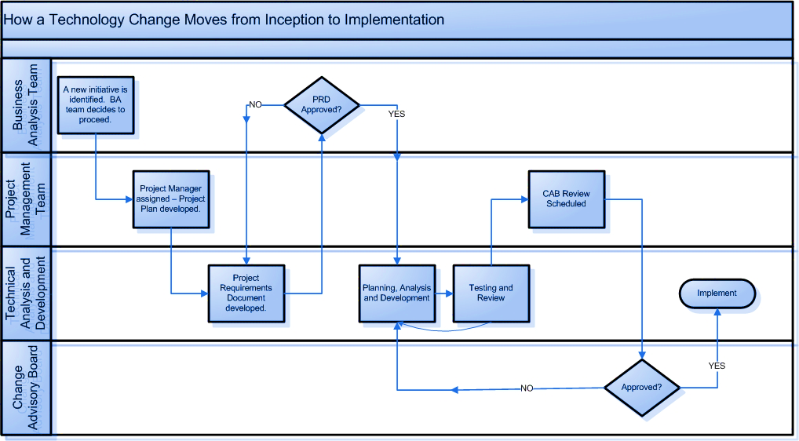
Example

Slide 40
Examples
Procedures should be subject to Change Management. If there is a change in system backup scheduling, that must go through Change Management.
Standard periodic maintenance should be preapproved. If it is a normal process to reboot a server on Sunday morning at 2:00 AM, it is not necessary to submit an RFC each time, but that process must be approved in advance.
Ad-hoc maintenance must adhere to the CMP. Include such things as testing the fire suppression systems, cleaning sub-flooring in the data center, etc.

Slide 41
CMMI – Configuration Management
The purpose of Configuration Management (CM) is to establish and maintain the integrity of work products using configuration identification, configuration control, configuration status accounting, and configuration audits.

Slide 42
CMMI Specific Goals and Practices [1]
SG 1 Establish Baselines
  SP 1.1 Identify Configuration Items
  SP 1.2 Establish a Configuration Management System
  SP 1.3 Create or Release Baselines

Slide 43
CMMI Specific Goals and Practices [2]
SG 2 Track and Control Changes
  SP 2.1 Track Change Requests
  SP 2.2 Control Configuration Items

Slide 44
CMMI Specific Goals and Practices [3]
SG 3 Establish Integrity
  SP 3.1 Establish Configuration Management Records
  SP 3.2 Perform Configuration Audits

Slide 45
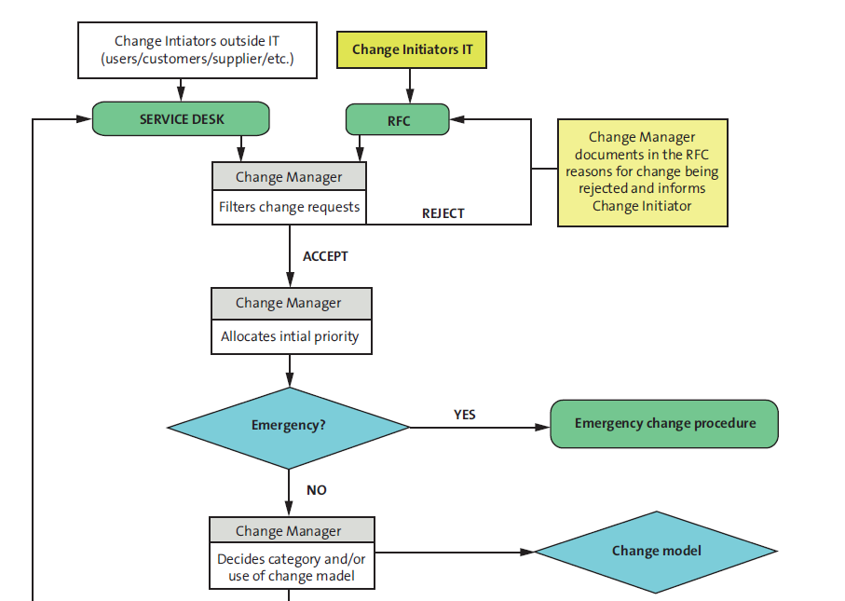
Example

Slide 46
Change Request
Change information should include the following:
  The reason/business justification for the change
  Why the change is needed –implications of not implementing the change
  Known risks or impact to the business of implementing the change
  Required resources

Slide 47
Change attributes
Priority
  Emergency – needs doing immediately (emergency change process)
  High – needs doing within 48 hours.
  Medium – needs doing within five days.
  Low – needs doing by the indicated date

Slide 48
Change attributes [2]
Category
  Standard change – using a procedure – pre-authorised
  IT change model – using a procedure – may need some level of authorisation
  Minor change – authorised by Change Manager alone (low risk and low impact to the business)
  Significant change – authorised by a CAB (medium risk and/or medium impact to the business)
  Major change – authorised by a CAB (senior level) (high risk and/or high impact to the business)

Slide 49
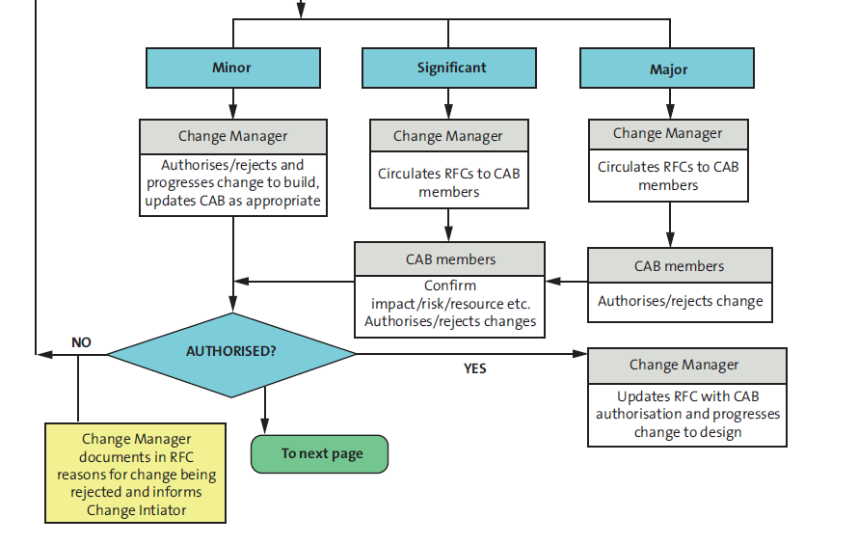

Slide 50
Authorisation of a change by the Change Advisory Board
A standard CAB agenda
  Failed changes
  Backed out changes
  RFCs to be assessed by CAB members
  RFCs that have been assessed by CAB members
  Implemented change are reviewed
  The change management process – including any amendments made to the process, as well as proposed changes to the process (as appropriate)
  Change management successes for the period under discussion

Slide 51
CAB considerations for each change (prior to authorisation)
Impact assessment (on the business)
Risk assessment (on the business)
Effect upon the infrastructure and customer service, as defined in the SLA, and upon the capacity and performance, reliability and resilience, contingency plans, and security
Impact on other services that run on the same infrastructure (or on software development projects)
Resource assessment – the IT, business and other resources required to implement the change, covering the likely costs, the number and availability of people required, the elapsed time, and any new infrastructure elements required

