Slide 1
Quick Recap

Slide 2
Continuation of….
Execution Process Group
“Monitoring and Controlling Approach”

Slide 3
Lesson 9: Executing Project Work
Topic 9A: Identify the Direct and Manage Project Execution Process
Topic 9B: Execute a Quality Assurance Plan
Topic 9C: Acquire the Project Team
Topic 9D: Develop the Project Team
Topic 9E: Manage the Project Team

Slide 4
Executing Tasks for Project Quality Management
Quality assurance
  includes all the activities
    related to satisfying the relevant quality standards for a project.
  Another goal of quality assurance
    is continual quality improvement.
  Key outputs of quality assurance
    include recommended corrective actions
      and project plan updates.

Slide 5
Quality Improvement Techniques
Benchmarking
  generates ideas for quality improvements
  by comparing specific project practices or product characteristics
    to those of other projects or products within or outside of the organization itself
    for example, training costs per employee and course ratings
      Comparing to other firms
        are benchmarks
A quality audit
  is a structured review of specific quality management activities
    that helps identify lessons learned,
      which could improve performance on current or future projects
    Ex) Sending out a monthly survey asking employees
      When they need the training?
      Is it helping improve their product?
      If the survey result rate is decreased
        Need to take corrective actions

Slide 6
Quality Improvement Techniques (Cont’d)
Cause-and-effect diagrams
  also called fishbone diagrams
    (because their structure resembles a fishbone)
  or Ishikawa diagrams (named after their founder)
  can assist in ensuring and improving quality
    by finding the root causes of quality problems.

Slide 7
Sample Recommended Corrective Actions
Problem: The prototype supplier management course had less than 3.5 ratings.
Approach:
  Kristin’s team reviewed the course evaluations
  and contacted some course participants
    to find that the CD/ROM course was the source of the low ratings
    They created a cause-and-effect diagram (next slide)
      to find the root cause of those low ratings.
Solution:
  They recommended that the discussion board and chat room features of the Web-based course
    be integrated into the CD-ROM course to improve interactivity.

Slide 8
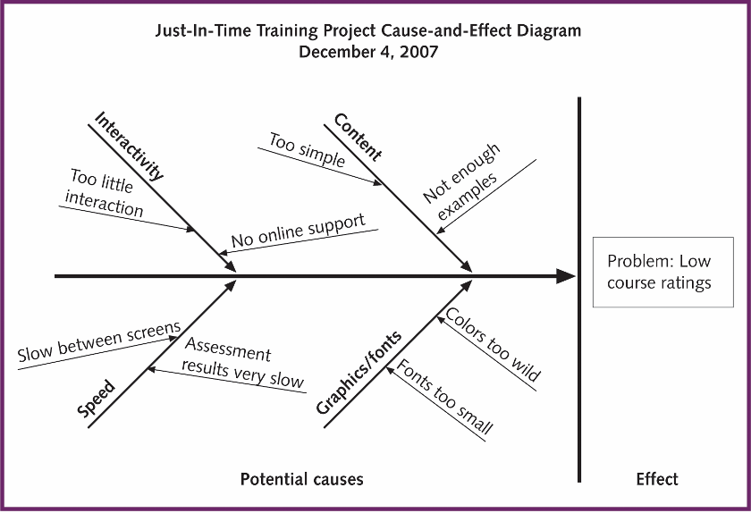
Figure 6-5. Sample Cause and Effect Diagram

Slide 9
Executing Tasks for Project Human Resource Management
Effective project human resource management
  is crucial to project execution.
  The two main tasks project managers perform include
    acquiring the project team
    and developing the project team.
Key outputs include
  staffing updates
  and team performance assessments.

Slide 10
Motivation
Project managers must understand motivation theories
  to effectively execute projects.
Psychologists, managers, coworkers, teachers, parents, and most people in general still struggle
  to understand what motivates people, or why they do what they do.
Intrinsic motivation
  causes people to participate in an activity for their own enjoyment.
Extrinsic motivation
  causes people to do something for a reward or to avoid a penalty.
Maslow suggested that
  people’s behaviors are guided or motivated by a sequence of needs.

Slide 11
Maslow’s Hierarchy of Needs
Human has unique qualities of human behavior
  Love, self-esteem, belonging, self-expression, and creativity
  These enable people to make independent choices
People’s behaviors are guided or motivated
  by sequence of needs
    Physiological needs
      Air, water, food
    Safety needs
      Having friends, belonging to groups, having a sense of community
    Social needs
    Esteem needs
      Personal achievement, recognition, and respect
    Self-Actualization needs
      Sense of fulfillment
      belief that one is working to his or her potential
  Each level of hierarchy is a prerequisite for the level above

Slide 12
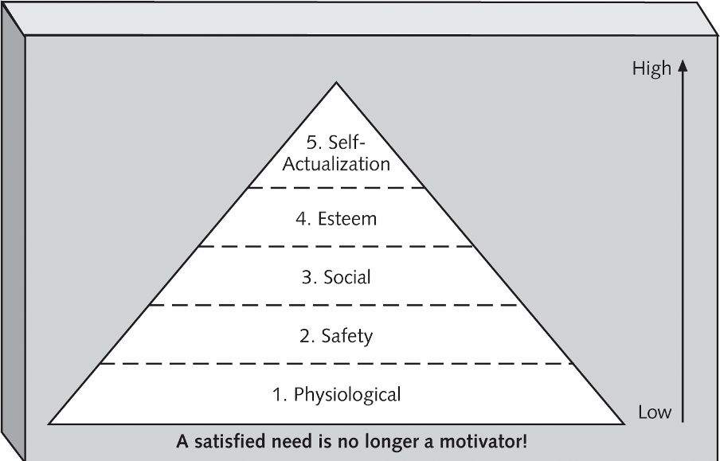
Figure 6-6. Maslow’s Hierarchy of Needs

Slide 13
Herzberg’s Motivational and Hygiene Factors
Frederick Herzberg wrote several famous books and articles
  about worker motivation.
He distinguished between the following:
  Hygiene factors:
    Factors that cause dissatisfaction if not present,
      but do not motivate workers to do more.
        Does not instill motivation
    Examples include larger salaries, more supervision, and a more attractive work environment.
  Motivational factors:
    Factors that cause job satisfaction,
      such as achievement, recognition, the work itself, responsibility, advancement, and growth.
      People want to actualize themselves in accordance with Maslow’s Hierarchy of Needs
        Need stimuli for their growth and advancement needs

Slide 14
McClelland’s Acquired-Needs Theory
Specific needs are acquired or learned over time
  and shaped by life experiences,
including:
  Achievement (nAch):
    People with a high need for achievement
      like challenging projects with achievable goals and lots of feedback.
  Affiliation (nAff):
    People with high nAff
      desire harmonious relationships and need to feel accepted by others,
    so managers should try to create a cooperative work environment for them.

Slide 15
McClelland’s Acquired-Needs Theory (Cont’d)
  Power: (nPow):
    People with a need for power
      desire either personal power (not good) or institutional power (good for the organization).
    Managers should provide institutional power seekers with management opportunities.
TAT (The Thematic Apperception Test)
  Is a tool to measure the individual needs of different people using McClelland’s categories

Slide 16
McGregor’s Theory X and Y
Douglas McGregor popularized
  the human relations approach to management in the 1960s.
Theory X (Classical Systems Theory):
  Assumes workers dislike and avoid work,
    so managers must use coercion, threats and various control schemes
      to get workers to meet objectives.
  Not valid
Theory Y (Human relation theory):
  Assumes individuals do not like works but
    consider work as natural as play or rest
    and enjoy the satisfaction of esteem and self-actualization needs
    Valid
      Manager needs to motivate people based on the Theory Y

Slide 17
Thamhain and Wilemon’s Ways to Have Influence on Projects
Approaches that
  Project managers need to use to deal with workers
    And how the approaches relate to project success
Nine influences available to project managers are defined
  Authority:
    The legitimate hierarchical right to issue orders.
  2. Assignment:
    The project manager's perceived ability to influence a worker's later work assignments.
  3. Budget:
    The project manager's perceived ability to authorize the use of discretionary funds.
  4. Promotion:
    The ability to improve a worker's position.
  5. Money:
    The ability to increase a worker's pay and benefits.

Slide 18
Thamhain and Wilemon’s Ways to Have Influence on Projects (continued)
6. Penalty:
  The project manager's ability to cause punishment.
7. Work challenge:
  The ability to assign work
    that capitalizes on a worker's enjoyment of doing a particular task.
8. Expertise:
  The project manager's perceived special knowledge
    that others deem important.
9. Friendship:
  The ability to establish friendly personal relationships
    between the project manager and others.

Slide 19
Ways to Influence that Help and Hurt Projects
Projects are more likely to succeed
  when project managers influence with the following:
    Expertise
    Work challenge
Projects are more likely to fail
  when project managers rely too heavily on the following:
    Authority
    Money
    Penalty

Slide 20
Effectiveness
Project managers can apply
  to improve effectiveness on projects
  Stephen Covey’s 7 habits
    Be proactive
      Also encourage team members to be proactive
    Begin with the end in mind
      People focus on their values
        What they want to accomplish; How to be remembered in their lives
      Need Mission statement
        That help them focus on their main purpose
    Put first things first
      Need to focus on important but not urgent
        Planning, reading, and exercising
      Avoid focusing only on important and urgent activities

Slide 21
Effectiveness (Cont’d)
Think win/win
  Best choice in most situations
    Parties in potential conflict
      Work together to develop new solutions
        To be all winners
  In competitive situations
    Win/lose paradigm
Seek first to understand, then to be understood
  Focus on others first
    Feel what your stakeholders are feeling
      What they need and expect
Synergize
  Create collaborative products
    Better than collecting individual efforts
  One idea of a person prompts an idea of another and so on
Sharpen the saw.
  Self-renewal
    Physically, spiritually, mentally, and socially

Slide 22
Empathic Listening and Rapport
Good project managers are empathic listeners
  they listen with the intent to understand.
  Before you can communicate with others,
    you have to have rapport—a relation of harmony, conformity, accord, or affinity.
Mirroring
  is the matching of certain behaviors of the other person,
  a technique to help establish rapport.

Slide 23
What Went Right?
A young business consultant who worked in the IT department of a major aerospace firm met with a senior project manager and his core team.
  The project involved providing updated electronic kits for a major aircraft program.
  The company was losing money on the project because the upgrade kits were not being delivered on time.
    Most buyers had written severe late-penalty fees into their contracts, and other customers were threatening to take their business elsewhere.
    The project manager blamed it all on the IT department for not letting his staff access the information system directly to track the status of kit development and delivery.
      The tracking system was old and difficult to use.
  The business consultant was warned that this project manager was very difficult to work with.
    When the project manager entered the meeting room with three of his staff, all older men, he threw his books on the table and started yelling at the young consultant and her even younger assistant.
    Instead of backing down, the consultant mirrored the project manager’s behavior and started yelling right back at him.
    He stood back, paused, and said, “You’re the first person who’s had the guts to stand up to me. I like that!”
After that brief introduction, rapport was established, and everyone began communicating and working together as a team to solve the problem at hand.

Slide 24
Acquiring the Project Team and Making Staffing Updates
There’s a saying that
  the project manager who is the smartest person on the team has done a poor job of recruiting!
After developing a staffing management plan during project planning,
  project managers must work with other managers in their organizations
    to assign personnel to their project or to acquire additional human resources.
  Managers must also motivate their staff
    and remember why people choose to leave their jobs.

Slide 25
Top Three Reasons People Leave Their Jobs (from Fast Company Study)
They feel they do not make a difference.
They do not get proper recognition.
They are not learning anything new or growing as a person.
Managers can ensure
  these reasons do not occur
  by doing a good job of motivating
    and managing their people.

Slide 26
Best Practice
Best practices can also be applied to include the best places for people to work. Quotes from employees often show why certain companies made the lists:
  “It is a friendly, courteous, caring hospital. We generally care about our co-workers and our patients. I can always get the help and support that I need to function in this hospital. This goes from the top all the way down to the cleaning people.”
  “This is the best place I have ever worked. There’s an open door policy. Every one is allowed to voice their opinion.”
  “I get information about everything—profits, losses, problems. Relationships with people are easier here. It’s more direct and open.”*
*Great Place to Work Institute, Best Companies Lists, (www.greatplacetowork.com) (June 2005).

Slide 27
Resource Loading
Resource loading refers to the amount of individual resources an existing schedule requires during specific time periods.
Helps project managers develop a general understanding of the demands a project will make on the organization’s resources and individual people’s schedules.
Over-allocation means more resources than are available are assigned to perform work at a given time.

Slide 28
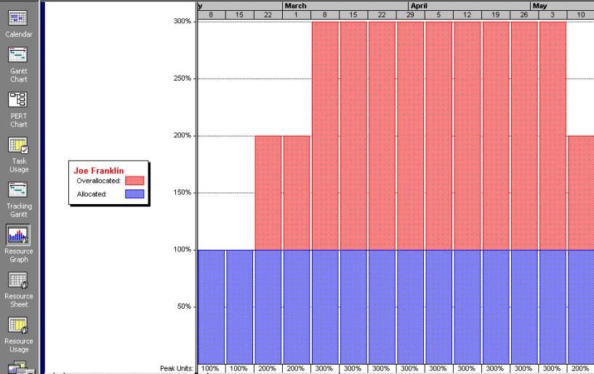
Figure 6-7. Sample Histogram Showing an Overallocated Individual

Slide 29
Resource Leveling
Resource leveling is a technique for resolving resource conflicts by delaying tasks.
The main purpose of resource leveling is to create a smoother distribution of resource usage and reduce overallocation.

Slide 30
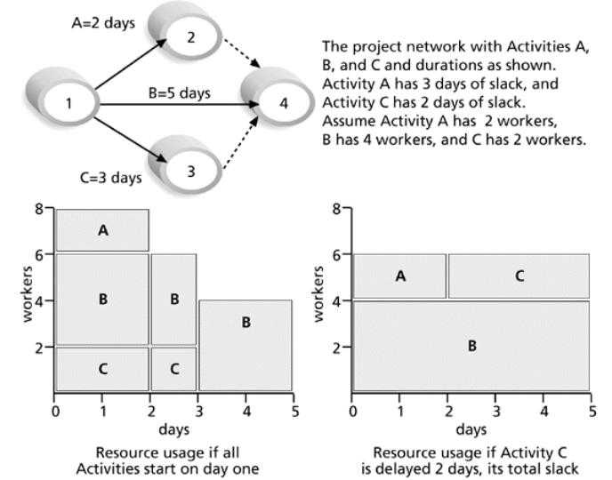
Figure 6-8. Resource Leveling Example

Slide 31
Benefits of Resource Leveling
When resources are used on a more constant basis, they require less management.
It may enable project managers to use a just-in-time inventory type of policy for using subcontractors or other expensive resources.
It results in fewer problems for project personnel and accounting department.
It often improves morale.

Slide 32
Sample Staffing Updates
To keep everyone up-to-date on current project staffing assignments,
  Kristin provided a current team roster on the project Web site
    and included team member names, roles, and contact information.
  As suppliers were added to the project,
    she included supplier staff information as well.

Slide 33
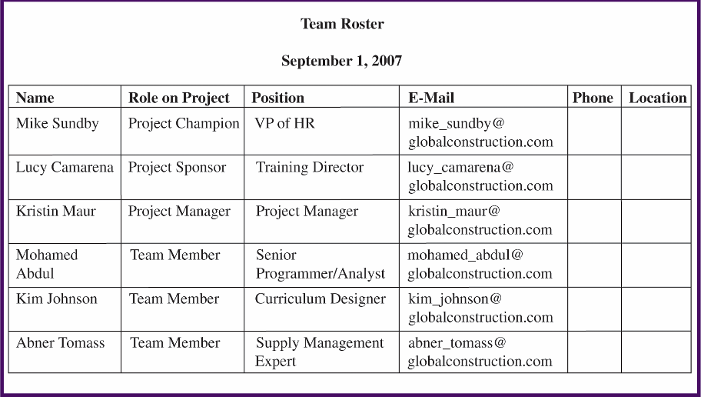
Figure 6-9. Sample Team Roster

Slide 34
Developing the Project Team and Assessing Team Performance
Many failed projects have been staffed
  by highly talented individuals;
  however, it takes teamwork to complete projects successfully.
The main goal of team development
  is to help people work together more effectively
    to improve project performance.
Project managers should understand and apply good team-building practices
  because it takes teamwork to successfully execute most projects.

Slide 35
Tuckman Model of Team Development
Forming
  Introduction of team members
    Including New members
  Little work is actually achieved
Storming
  People test each other with different opinions
Norming
  Cooperation and collaboration replace the conflicts and mistrust
Performing
  Relations are settled for team members
    And build royalty each other
  Focus on reaching the team goals rather than on team process
  The team can manage tasks
    That are more complex and updates
Adjourning
  Break up the team after success
    Or failure

Slide 36
Training
to improve individual and team development.
  Project managers often recommend that people take specific training courses
Team-building activities
  include using physical challenges and psychological preference indicator tools,
    such as the Meyers-Briggs Type Indicator and the Wilson Learning Social Styles Profile.

Slide 37
Meyers-Briggs Type Indicator (MBTI)
determining personality preferences
  and helping teammates understand each other
  MBTI is a popular tool
Four dimensions include:
  Extrovert/Introvert (E/I)
    Whether people draw their energy from other people (E, 75% in general population)
      or from inside themselves (I)
  Sensation/Intuition (S/N)
    Gather information
      From facts, details, and reality (S: Practical, 75% in general population)
      Imaginative and ingenious (N: Innovative and Conceptual)

Slide 38
Meyers-Briggs Type Indicator (MBTI) Cont’d
  Thinking/Feeling (T/F)
    Judgment by thinking or feeling
      T: objective and logical (50% in general population)
      F: subjective and personal
  Judgment/Perception (J/P)
    People’s attitude toward structure
      J: establish deadlines seriously; expect others to do the same (50% in general population)
      P: Regard deadline as a signal to start not to complete a project
Ex: NTs or rationals are attracted to technology fields
  N for a project Manager
    Spend time to provide more concrete and detailed information
      Before assigning task
    Not easy to work with stakeholders (E)
      If IT people (I) vary most from the general population in not being extroverted (E) or sensing (S).
  T for a team member

Slide 39
Wilson Learning’s Social Styles Profile
People are perceived as behaving primarily in one of four zones,
  based on their assertiveness and responsiveness:
  Drivers
    Proactive and task oriented
      Pushy, severe, tough, dominating, harsh, strong-willed, independent, practical, decisive, and efficient
  Expressives
    Proactive and people-oriented
      Future oriented
        Manipulating, excitable, undisciplined, reacting, egotistical, ambitious, stimulating, wacky, enthusiastic, dramatic, and, friendly

Slide 40
Wilson Learning’s Social Styles Profile (Cont’d)
  Analyticals
    Reactive and task oriented
    Past oriented and string thinkers
      Critical, indecisive, stuffy, picky, moralistc, industrious, persistent, serious, expecting, and orderly
  Amiables
    Reactive and People oriented
    Their time orientation varies depending on whom they are with at the time
      Strongly value relationships
        Conforming, unsure, ingratiating, dependent, awkward, supportive, respectful, willing, dependable, and agreeable
People on opposite corners (drivers and amiables, analyticals and expressives) may have difficulties getting along.

Slide 41
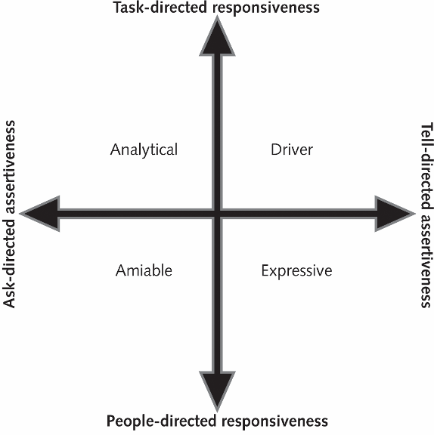
Figure 6-10. Social Styles of Wilson Learning

Slide 42
Reward and Recognition Systems
Team-based reward and recognition systems can promote teamwork.
  Focus on rewarding teams for achieving specific goals
    Overtime payment for individual is not good for teamwork project
  Allow time for team members to mentor and help each other to meet project goals and develop human resources.

Slide 43
Sample Team Performance Assessment
Project managers assess team performance in several ways.
  Kristin believed in management by wandering around,
    and she liked to have many short, informal discussions
      with various stakeholders, especially her project team members.
  She also observed people working alone and as a team,
    and assessed the quality of deliverables they produced.
  Kristin periodically asked her project team members
    to fill out self-assessments to assist in performance assessment;
      she discussed each person’s assessment and took corrective actions as needed.
  Kristin and other project managers at Global Construction
    also filled out performance appraisals for each team member
    once a year or when a project was completed.

Slide 44
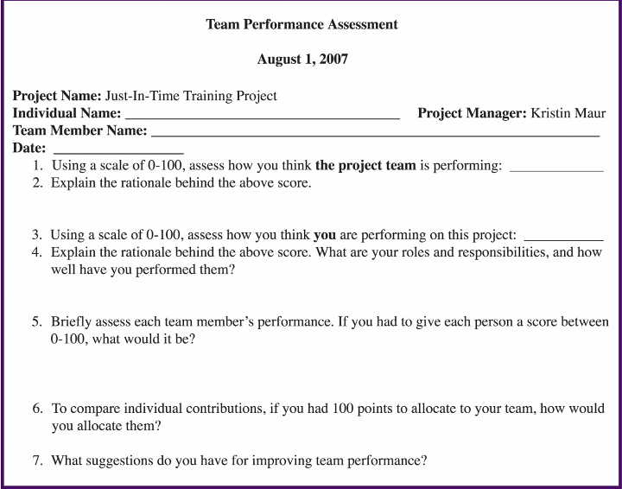
Figure 6-11. Sample Team Performance Assessment

Slide 45
Executing Tasks for Project Communications Management
Good communications management
  is also crucial to project execution.
the main communications management task
  Information distribution
    performed during project execution.
The main output of this task is
  updating business processes.

Slide 46
Important Project Communications Concepts
Some project managers say
  that 90 percent of their job is communicating;
    therefore, it is important to address important concepts
      related to improving project communications.
Key concepts include:
  Formal and informal communications
    Two way communication is the most important
      Empathic listening skills needed
      Formal status report is not enough
  Nonverbal communications
    Person’s tone of voice and body language
      are often more important than the words being used
  Using the appropriate communications medium
    Depends on communication needs
  Understanding individual and group communication needs
  The impact of team size on project communications

Slide 47
Formal and Informal Communications
It is not enough for project team members
  to submit formal status reports to their project managers and other stakeholders
    and assume that everyone who needs to know that information will read the reports.
In fact, many people may prefer to have an informal, two-way conversation about project information.
Project managers must be good
  at nurturing relationships through good communication.

Slide 48
Nonverbal Communications
Research poses the theory that
  in a face-to-face interaction,
    58 percent of communication is through body language,
      35 percent is through how the words are said,
      and a mere 7 percent is through the content or words that are spoken.
    The author of this information (see Silent Messages by Albert Mehrabian, 1980) was careful to note
      that these percentages were specific findings for a specific set of variables.
Even if the actual percentages are different in verbal project communications today,
  it is safe to say that it is important to pay attention to
    more than just the actual words someone is saying.
  Nonverbal communications,
    such as a person’s tone of voice and body language,
      are often more important than the words being used.

Slide 49
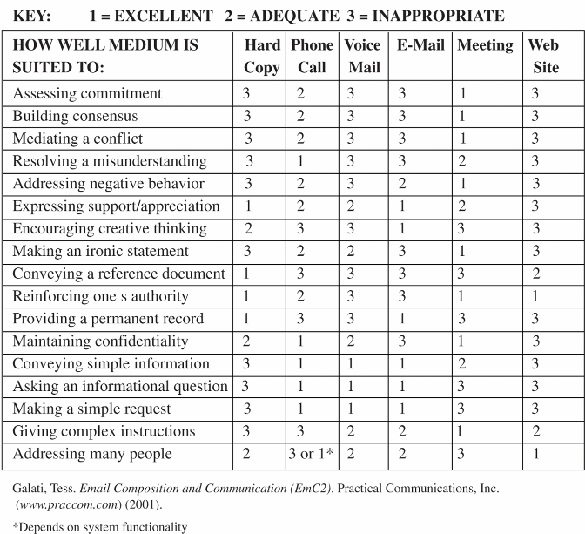
Figure 6-12. Media Choice Table

Slide 50
Media Snapshot
Microsoft had been experimenting with its new video conferencing product, Livemeeting. Anoop Gupta, a vice president of Microsoft’s real-time collaboration group, says that one in every five face-to-face meetings can be replaced with Web conferencing tools, and Microsoft estimates that it will save $70 million in reduced travel for organizations worldwide in one year alone.*
Web-based meeting tools can also help the environment. For example, in May 2007, WebEx, the leading provider of on-demand Web collaboration applications, kicked off the WebEx Experience Online Forum. They say they saved over one million pounds of carbon dioxide by not requiring the more than 650 attendees to travel to participate in sessions.**
However, any live communication broadcast can also backfire, like Janet Jackson’s “wardrobe malfunction” during the 2004 Super Bowl in the United States.
*Steve Lohr, “Ambitious Package to Raise Productivity (and Microsoft’s Profit),” The New York Times (August 16, 2004).
**Colin Smith, “WebEx Experience Online Forum Saves Over 1 Million Pounds of Carbon Dioxide Emissions in First Week,” (www.webex.com) (May 22, 2007).

Slide 51
Understanding Individual and Group Communication Needs
People are not interchangeable parts.
As illustrated in Brooks’ book, The Mythical Man-Month,
  you cannot assume that a task originally scheduled to take two months of one person’s time
    can be done in one month by two people; nine women cannot produce a baby in one month!
Individuals prefer different ways to communicate.
  Important to understand individual's personal preferences for communication
    I, N, S, etc
Geographic location and cultural backgrounds also affect communications.

Slide 52
The Impact of Team Size on Project Communications
As the number of people involved increases,
  the complexity of communications increases
    because there are more communications channels, or pathways,
      through which people can communicate.
Number of communications channels = n(n-1)
2
where n is the number of people involved.
  For example, two people have one communications channel: (2(2–1))/2 = 1.
    Five people have ten channels (5(5-1))/2=10.
As the number of people communicating increases,
    1, 3, 6, 10…
  the number of communications channels increases rapidly,
  so it is often helpful to form several smaller teams
    within a large project team to help improve project communications.

Slide 53
Information Distribution and Updating Business Processes
Getting project information
  to the right people at the right time and in a useful format
  is just as important as developing the information in the first place.
During execution, project teams must address important considerations
  for information distribution.
The main output of information distribution is
  updating business processes,
    such as policies and procedures, guidelines, information systems, financial systems, management systems, lessons learned, and historical documents.

Slide 54
Sample Updates to Business Processes
Kristin and her team used instant messaging
  on a regular basis both within their team and with suppliers.
Several suppliers used Webcasts to communicate information
  in a more dynamic way without incurring travel expenses.
The Web-based courses that suppliers were developing for the project
  included discussion threads and an “Ask the Expert” feature,
    in which learners could ask specific questions of the instructor
    or experts within the company on various topics related to the course.
Kristin kept her own personal project blog
  to document important events and lessons
    she was learning while managing the project.
The project steering committee asked Kristin
  to prepare guidelines for using these new technologies effectively.

Slide 55
Executing Tasks for Project Procurement Management
The main executing tasks performed as part of project procurement
  include requesting seller responses
    and selecting sellers.
Key outputs include procurement document packages,
  contracts, and contract management plans.

Slide 56
Requesting Seller Responses, Qualified Sellers Lists, and Procurement Document Packages
Organizations can use several different methods to approach and select qualified sellers or suppliers:
  Approaching a preferred supplier
    Only to a certain supplier
      who have had good relationship
  Approaching several qualified suppliers
    To potential sellers and evaluate the results
  Advertising to many potential suppliers
    Buyer does not know who the suppliers are in advance
      Receive proposal from them
    In competitive business environment
A procurement document package
  generally includes a summary letter,
    a request for proposal or quote,
    and a contract statement of work.

Slide 57
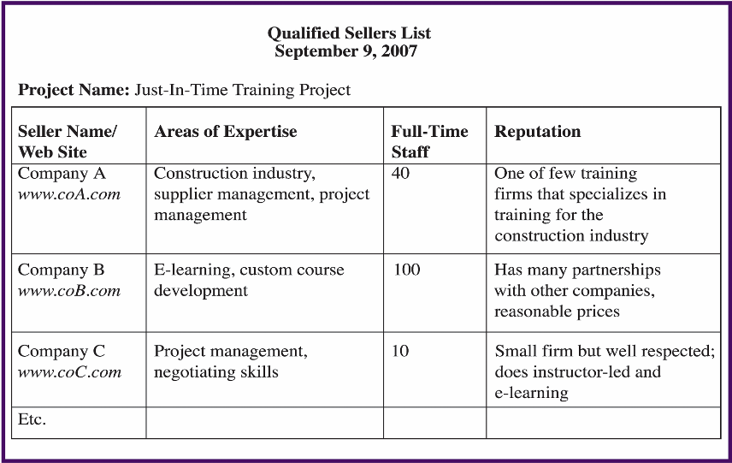
Figure 6-13. Sample Qualified Sellers List

Slide 58
Selecting Sellers and Writing Contracts
Selecting sellers, often called source selection,
  involves evaluating proposals or bids from sellers,
    choosing the best one, negotiating the contract, and awarding the contract.
Often, buyers develop a short list of the top three to five suppliers
  to reduce the work involved in selecting a source,
  and they are often asked to prepare a best and final offer (BAFO).
Contract
  Final output of the seller selection process
  It is good practice to include a detailed statement of work
    and schedule as part of the contract
      to clarify exactly what work the seller will perform and when.

Slide 59

Figure 6-14. Sample Contract

Slide 60
Figure 6-14. Sample Contract

Slide 61
Chapter Summary
Executing outputs related to integration management includes deliverables, implemented solutions to problems, work performance information, and requested changes.
Executing outputs related to quality management includes recommended corrective actions and project plan updates.
Executing outputs related to human resource management includes staffing updates and team performance assessments. Project managers must also apply concepts related to motivation, influence, and effectiveness to lead people during project execution.
Executing outputs related to communications management consist of business process updates. Project managers must apply important concepts related to communications, such as formal and informal communications, nonverbal communications, the appropriate communications medium, individual and group communication needs, and the impact of team size on project communications.

