Slide 1
Quick Recap

Slide 2
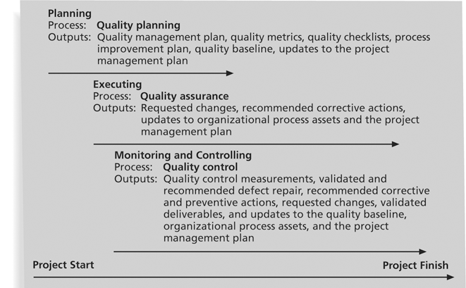
Project Quality Management Summary

Slide 3
Lesson 6: Planning Project Quality, Staffing, and Communications
Topic 6B: Document the Project Roles, Responsibilities, and Reporting
Relationships
Topic 6C: Create a Communications Management Plan

Slide 4
“Roles and Responsibility” as
Monitoring and Controlling Approach

Slide 5
Organizational Planning
Involves identifying and documenting project roles, responsibilities, and reporting relationships.
Outputs include:
  Project organizational charts
  Staffing management plans
  Responsibility assignment matrixes
  Resource histograms

Slide 6
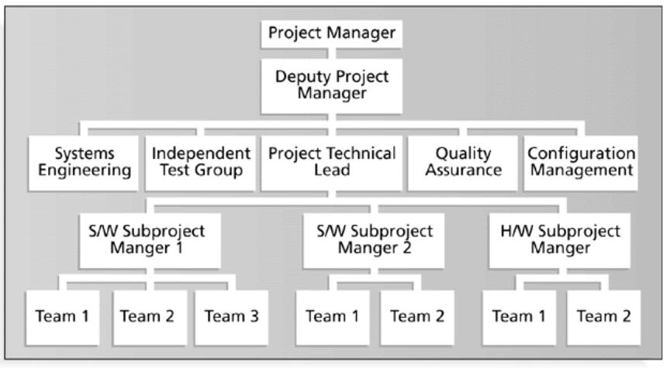
Figure 9-2. Sample Organizational Chart for a Large IT Project

Slide 7
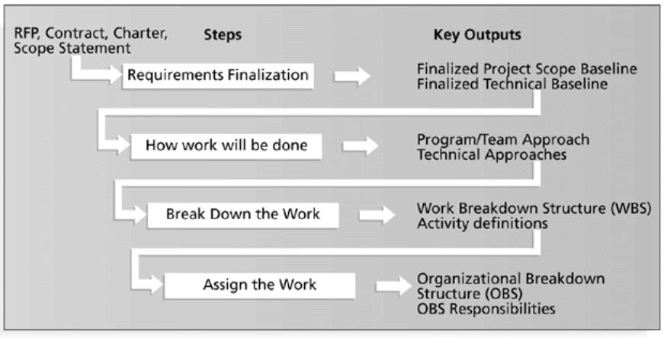
Figure 9-3. Work Definition and Assignment Process

Slide 8
Responsibility Assignment Matrixes
A responsibility assignment matrix (RAM) is a matrix that maps the work of the project, as described in the WBS, to the people responsible for performing the work, as described in the OBS.
Can be created in different ways to meet unique project needs.

Slide 9
Roles and Responsibilities
Role | Responsibility
Initiator | Initiates the workflow. Responsible for defining the workflow and identifying the reviewer(s) and approver. Attaches draft version of document(s) to be approved.
Reviewer | Reviews the approval documents, saves the document locally, makes changes directly to the documents (using WORD track changes), and uploads the updated document into the shared repository. Modifies data fields and enters notes, as appropriate. Accepts document, when complete, to send workflow to remaining reviewers or for approval.
Delegated Resource | Executes the workflow as directed by the reviewer or approver. Delegates the workflow back to the reviewer or approver when complete.
Approver | Reviews the execution of the workflow by each reviewer. Reviews the final approval document. Either accepts the workflow to close it or requests further review.
Program Owner | Views, tracks progress, and reports on workflows within the respective program.
Administrator | Views, tracks progress, and reports on all workflows
Super User | Administers workflows as appropriate, including reassignment, cancellation, and deletion.

Slide 10
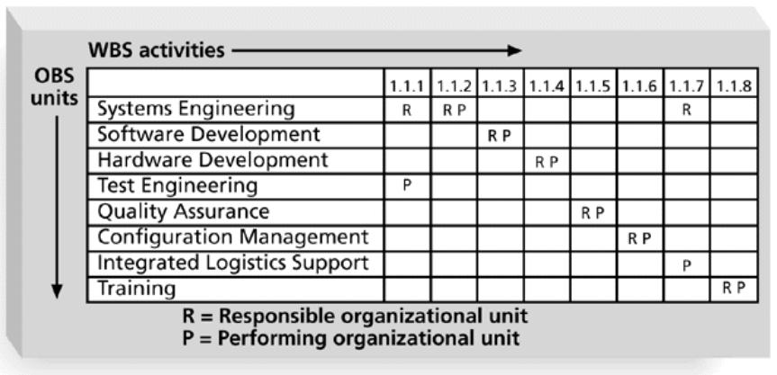
Figure 9-4. Sample Responsibility Assignment Matrix (RAM)

Slide 11
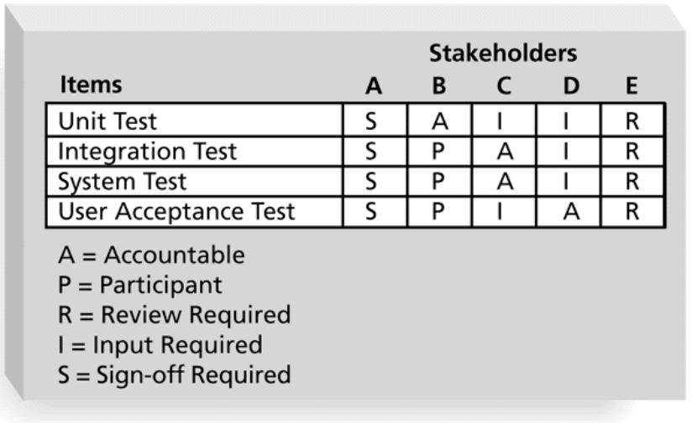
Figure 9-5. RAM Showing Stakeholder Roles

Slide 12
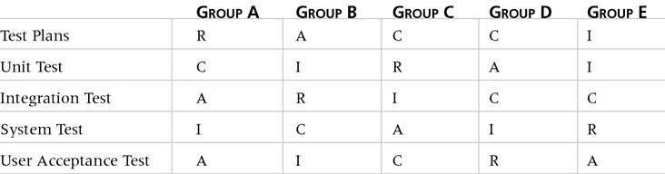
Table 9-1. Sample RACI Chart
R = Responsibility, only one R per task
A = Accountability
C = Consultation
I = Informed

Slide 13
Staffing Management Plans and Resource Histograms
A staffing management plan describes when and how people will be added to and taken off the project team.
A resource histogram is a column chart that shows the number of resources assigned to a project over time.

Slide 14
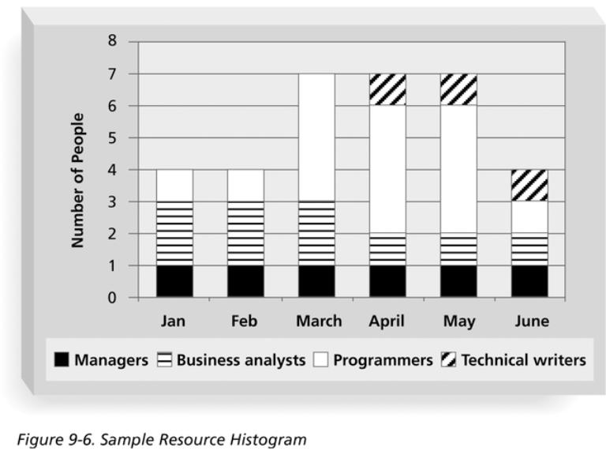
Figure 9-6. Sample Resource Histogram

Slide 15
Acquiring the Project Team
Acquiring qualified people for teams is crucial.
The project manager who is the smartest person on the team has done a poor job of recruiting!
Staffing plans and good hiring procedures are important, as are incentives for recruiting and retention.
  Some companies give their employees one dollar for every hour that a new person who they helped hire works.
  Some organizations allow people to work from home as an incentive.

Slide 16
Why People Leave Their Jobs
They feel they do not make a difference.
They do not get proper recognition.
They are not learning anything new or growing as a person.
They do not like their coworkers.
They want to earn more money.

Slide 17
Resource Loading
Resource loading refers to the amount of individual resources an existing schedule requires during specific time periods.
Helps project managers develop a general understanding of the demands a project will make on the organization’s resources and individual people’s schedules.
Overallocation means more resources than are available are assigned to perform work at a given time.

Slide 18
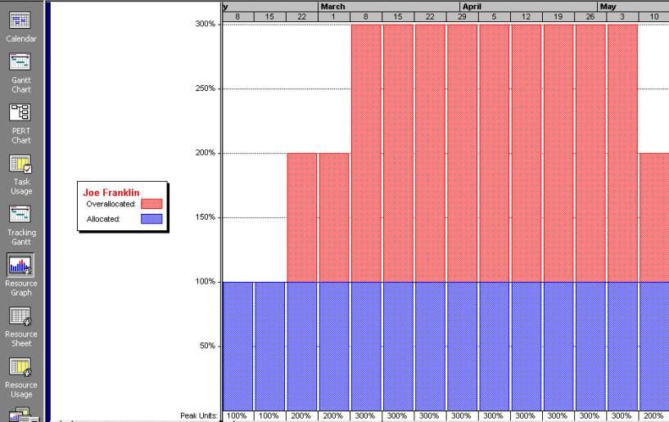
Figure 9-7. Sample Histogram Showing an Overallocated Individual
What’s wrong with this picture? Assume 100 percent means Joe is working eight hours per day.

Slide 19
Resource Leveling
Resource leveling is a technique for resolving resource conflicts by delaying tasks.
The main purpose of resource leveling is to create a smoother distribution of resource use and reduce overallocation.

Slide 20
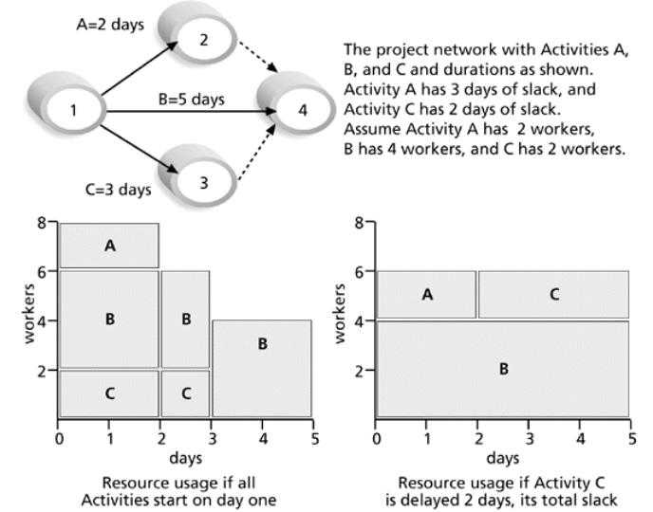
Figure 9-8. Resource Leveling Example

Slide 21
Benefits of Resource Leveling
When resources are used on a more constant basis, they require less management.
It may enable project managers to use a just-in-time inventory type of policy for using subcontractors or other expensive resources.
It results in fewer problems for project personnel and the accounting department.
It often improves morale.

Slide 22
Developing the Project Team
The main goal of team development is to help people work together more effectively to improve project performance.
It takes teamwork to successfully complete most projects.

Slide 23
Tuckman Model of Team Development
Forming
Storming
Norming
Performing
Adjourning

Slide 24
Training
Training can help people understand themselves and each other, and understand how to work better in teams.
Team building activities include:
  Physical challenges
  Psychological preference indicator tools

Slide 25
Myers-Briggs Type Indicator (MBTI)
MBTI is a popular tool for determining personality preferences and helping teammates understand each other.
Four dimensions include:
  Extrovert/Introvert (E/I)
  Sensation/Intuition (S/N)
  Thinking/Feeling (T/F)
  Judgment/Perception (J/P)
NTs, or rationals, are attracted to technology fields.
IT people vary most from the general population in their tendency to not be extroverted or sensing.

Slide 26
Wideman and Shenhar’s Views on MBTI and Project Management*
Most suited for project leadership:
  100 percent: INTJ, ENTJ, ISTJ, ESTJ
  50 percent: INTP, ENTP, ENFP, ENFJ
Best suited as followers:
  100 percent: INFJ, ISFJ
  50 percent: INTP, ENTP, ENFP, ENFJ, ESFJ
Not suited for project work:
  100 percent: INFP, ISFP, ESFP, ISTP
  50 percent: ENFP, ESTP
*Wideman, R. Max and Aaron J. Shenhar, “Professional and Personal Development: A Practical Approach to Education and Training,” Project Management for Business Professionals, edited by Joan Knutson, 2001, p. 375.

Slide 27
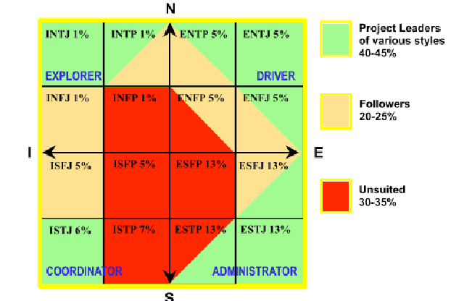
MBTI and Suitability to Project Work*
What do you think about these views?
*Wideman, R. Max. “Project Teamwork, Personality Profiles and the Population at Large: Do we
have enough of the right kind of people?” (http://www.maxwideman.com/papers/profiles/profiles.pdf ).

Slide 28
Social Styles Profile
People are perceived as behaving primarily in one of four zones, based on their assertiveness and responsiveness:
  Drivers
  Expressives
  Analyticals
  Amiables
People on opposite corners (drivers and amiables, analyticals and expressives) may have difficulty getting along.

Slide 29
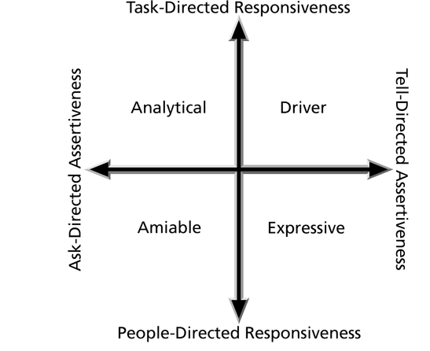
Figure 9-9. Social Styles

Slide 30
Reward and Recognition Systems
Team-based reward and recognition systems can promote teamwork.
Focus on rewarding teams for achieving specific goals.
Allow time for team members to mentor and help each other to meet project goals and develop human resources.

Slide 31
Managing the Project Team
Project managers must lead their teams in performing various project activities.
After assessing team performance and related information, the project manager must decide:
  If changes should be requested to the project.
  If corrective or preventive actions should be recommended.
  If updates are needed to the project management plan or organizational process assets.

Slide 32
Tools and Techniques for Managing Project Teams
Observation and conversation
Project performance appraisals
Conflict management
Issue logs

Slide 33
General Advice on Teams
Be patient and kind with your team.
Fix the problem instead of blaming people.
Establish regular, effective meetings.
Allow time for teams to go through the basic team-building stages.
Limit the size of work teams to three to seven members.

Slide 34
General Advice on Teams (cont’d)
Plan some social activities to help project team members and other stakeholders get to know each other better.
Stress team identity.
Nurture team members and encourage them to help each other.
Take additional actions to work with virtual team members.

Slide 35
Using Software to Assist in Human Resource Management
Software can help produce RAMS and resource histograms.
By using project management software for human resource management, you can:
  Assign resources.
  Identify potential resource shortages or underutilization.
  Level resources.

Slide 36
Project Resource Management Involves Much More Than Using Software
Project managers must:
  Treat people with consideration and respect.
  Understand what motivates people.
  Communicate carefully with people.
Focus on your goal of enabling project team members to deliver their best work.

Slide 37
Topic 6C: Create a Communications Management Plan

Slide 38

What is Project Communication
Exchange of Project-specific information
communication

Slide 39
What’s in it for you?
Three reasons you need to manage project communication
Meet the information needs of your project stakeholders (Communication Planning and Information Distribution)
Track and report on project performance (Performance Reporting)
Formally document project results (Administrative Closure)

Slide 40
Project Communication Management
Communication Planning
Information Distribution
Initiating
Processes
Planning
Processes
Executing
Processes
View Project Communication in the context of the five PM process groups.
Controlling
Processes
Administrative Closure
Closing
Processes
Performance Reporting
Notes:
Communication Planning is a facilitating process for Planning processes.
Information Distribution is a facilitating process for Executing processes.
Performance Reporting is a core process for Controlling processes.
Administrative Closure is a core process for Closing processes.
Reference the PMBOK.

Slide 41
Communication Planning
Inputs
  Project Charter and WBS Product List
Process
  Identify stakeholders and their information needs
  Identify WBS Products
  Complete Project Communication Plans
Outputs
  Project Communication Plan
  Conflict Management Plan
Tools
  Project Communication Handbook and Project Communication Planning Website

Slide 42
Project Communication Plan
Identifies the project team
Explains methods of communication including community involvement
Provides project reporting information
Stakeholders analysis
Communication Matrix

Slide 43
Communication Matrix
WBS Products by WBS Number
Identifies the Uniform Filing System Location for each product listed (an X indicates it belongs in the permanent project history file)
Completed for each phase
Can be downloaded from the Intranet (Available on PM Website)
The Communication Matrix provides a roadmap for the project

Slide 44
Conflict Management Plan
Provides guidelines for resolving conflicts during the life of a project
Developed with project stakeholders
Record decisions made
Design interest-based conflict management strategies with stakeholders, not for them
Notes:
In an interest-based conflict management process, stakeholders have an active role in designing the process. If they have input to the process, they will be more likely to use it.

Slide 45
Information Distribution
Communication skills are used to exchange project information
  Senders are responsible for ensuring messages are clear and understood
Project team members are suppliers and customers
  Suppliers provide inputs
  Task managers deliver WBS elements
  Customers receive the products
Track product deliverables with the Communication Matrix

Slide 46
What Project Team Members Need to know
If you are working on a project, you need to know:
  Why your customers want your product
  What features your customers want
  How your customers want to receive it
  How long it will take
Tell your customers exactly when deliverables will arrive - extremely important for critical path elements
Project Team members ensure successful product delivery

Slide 47
Performance Reporting
Status Reporting
  Where the project stands at a given point
Progress Reports/Work Results
  What the project team has accomplished to date
Change Requests
  Analysis may result in request for a change
Important to keep workplans and project databases current for accurate project reporting

Slide 48
Administrative Closure
Each project phase requires closure
Close-out Processes - Verify and document project results (Available on PM Website)
Uniform Filing Systems
  Project Development and Construction maintain permanent history files
Lessons Learned - Provide feedback to continuously improve Project Delivery (Available on PM Website)

