Slide 1
Quick Recap

Slide 2
Continuation of…….
“Project Cost”
Monitoring and Controlling Approach

Slide 3
Project Mgmt Process Groups
Monitoring & Controlling
Planning
Initiating
Closing
Executing
Source: PMI Guide to Project Management Body of Knowledge

Slide 4
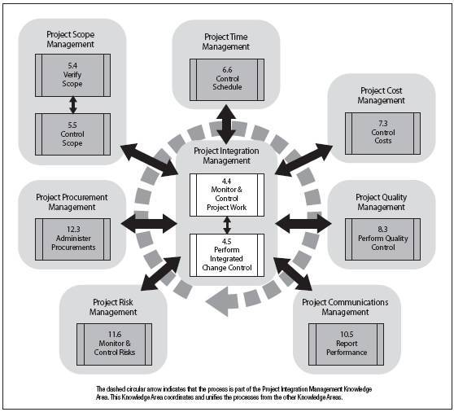
Process group identification

Slide 5
Learning Objectives
Understand the importance of project cost management.
Explain basic project cost management principles, concepts, and terms.
Discuss different types of cost estimates and methods for preparing them.

Slide 6
Learning Objectives
Understand the processes involved in cost budgeting and preparing a cost estimate and budget for an information technology project.
Understand the benefits of earned value management and project portfolio management to assist in cost control.
Describe how project management software can assist in project cost management.

Slide 7
The Importance of Project Cost Management
IT projects have a poor track record for meeting budget goals.
The 2003 CHAOS studies showed the average cost overrun (the additional percentage or dollar amount by which actual costs exceed estimates) was 43 percent.
U.S. lost $55 billion in IT projects in 2002 from cancelled projects and overruns compared to $140 billion in 1994.*
*The Standish Group, “Latest Standish Group CHAOS Report Shows Project Success Rates Have Improved by 50%,” A Standish Group Research Note (3/25/03).

Slide 8
What is Cost and Project Cost Management?
Cost is a resource sacrificed or foregone to achieve a specific objective, or something given up in exchange.
Costs are usually measured in monetary units, such as dollars.
Project cost management includes the processes required to ensure that the project is completed within an approved budget.

Slide 9
Project Cost Management Processes
Cost estimating: Developing an approximation or estimate of the costs of the resources needed to complete a project.
Cost budgeting: Allocating the overall cost estimate to individual work items to establish a baseline for measuring performance.
Cost control: Controlling changes to the project budget.

Slide 10
Basic Principles of Cost Management
Most members of an executive board have a better understanding and are more interested in financial terms than IT terms, so IT project managers must speak their language.
  Profits are revenues minus expenses.
  Life cycle costing considers the total cost of ownership, or development plus support costs, for a project.
  Cash flow analysis determines the estimated annual costs and benefits for a project and the resulting annual cash flow.

Slide 11
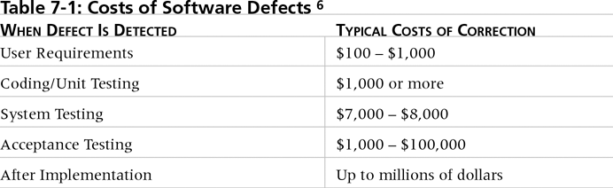
Table 7-1. Cost of Software Defects*
It is important to spend money up-front on IT projects to avoid spending a lot more later.
*Collard, Ross, Software Testing and Quality Assurance, working paper (1997).

Slide 12
Basic Principles of Cost Management
Tangible costs or benefits are those costs or benefits that an organization can easily measure in dollars.
Intangible costs or benefits are costs or benefits that are difficult to measure in monetary terms.
Direct costs are costs that can be directly related to producing the products and services of the project.
Indirect costs are costs that are not directly related to the products or services of the project, but are indirectly related to performing the project.
Sunk cost is money that has been spent in the past; when deciding what projects to invest in or continue, you should not include sunk costs.

Slide 13
Basic Principles of Cost Management
Learning curve theory states that when many items are produced repetitively, the unit cost of those items decreases in a regular pattern as more units are produced.
Reserves are dollars included in a cost estimate to mitigate cost risk by allowing for future situations that are difficult to predict.
  Contingency reserves allow for future situations that may be partially planned for (sometimes called known unknowns) and are included in the project cost baseline.
  Management reserves allow for future situations that are unpredictable (sometimes called unknown unknowns).

Slide 14
Cost Estimating
Project managers must take cost estimates seriously if they want to complete projects within budget constraints.
It’s important to know the types of cost estimates, how to prepare cost estimates, and typical problems associated with IT cost estimates.

Slide 15
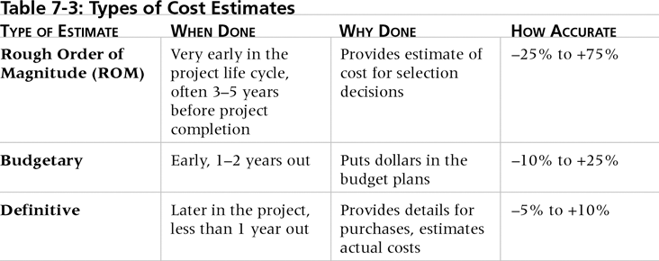
Table 7-2. Types of Cost Estimates

Slide 16
Cost Management Plan
A cost management plan is a document that describes how the organization will manage cost variances on the project.
A large percentage of total project costs are often labor costs, so project managers must develop and track estimates for labor.

Slide 17
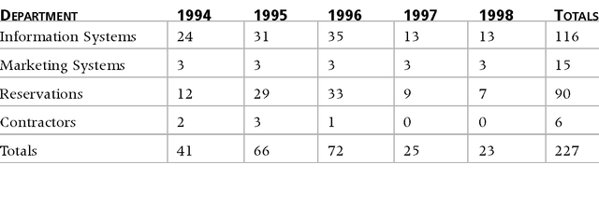
Table 7-3. Maximum Departmental Headcounts by Year
A large percentage of the costs of many IT projects are
human resource costs.

Slide 18
Cost Estimation Tools & Techniques
Basic tools and techniques for cost estimates:
  Analogous or top-down estimates: Use the actual cost of a previous, similar project as the basis for estimating the cost of the current project.
  Bottom-up estimates: Involve estimating individual work items or activities and summing them to get a project total.
  Parametric modeling: Uses project characteristics (parameters) in a mathematical model to estimate project costs.
  Computerized tools: Tools, such as spreadsheets and project management software, that can make working with different cost estimates and cost estimation tools easier.

Slide 19
Constructive Cost Model (COCOMO)
Barry Boehm helped develop the COCOMO models for estimating software development costs.
Parameters include:
  Function points: Technology-independent assessments of the functions involved in developing a system.
  Source Lines of Code (SLOC): A human-written line of code that is not a blank line or comment.
Boehm suggests that only parametric models do not suffer from the limits of human decision-making.

Slide 20
Typical Problems with IT
Cost Estimates
Developing an estimate for a large software project is a complex task that requires a significant amount of effort.
People who develop estimates often do not have much experience.
Human beings are biased toward underestimation.
Management might ask for an estimate, but really desire a bid to win a major contract or get internal funding.

Slide 21
Sample Cost Estimate
See pages 262-266 for a detailed example that describes how to create a cost estimate for the Surveyor Pro project described in the opening case.
Before creating an estimate, know what it will be used for, gather as much information about the project as possible, and clarify the ground rules and assumptions for the estimate.
If possible, estimate costs by major WBS categories.
Create a cost model to make it easy to change and document the estimate.

Slide 22
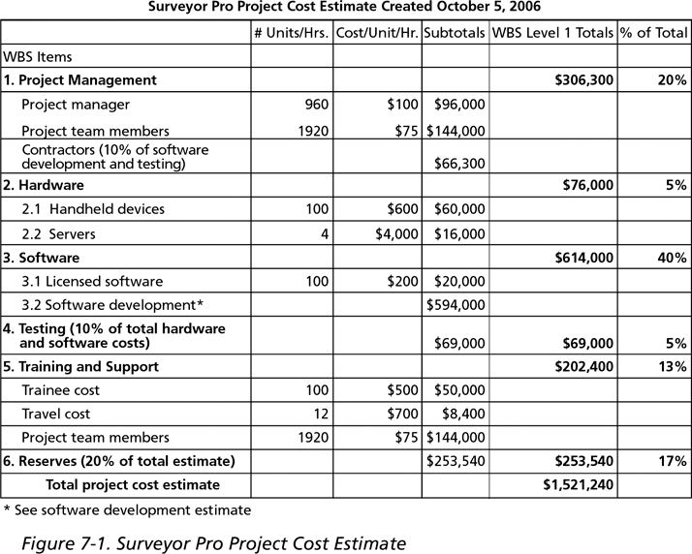
Figure 7-1. Surveyor Pro Project Cost Estimate

Slide 23
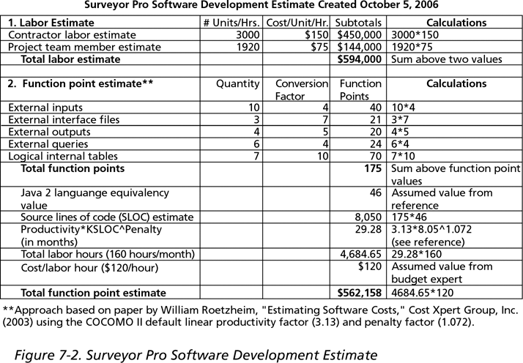
Figure 7-2. Surveyor Pro Software Development Estimate

Slide 24
Cost Budgeting
Cost budgeting involves allocating the project cost estimate to individual work items over time.
The WBS is a required input for the cost budgeting process because it defines the work items.
Important goal is to produce a cost baseline:
  A time-phased budget that project managers use to measure and monitor cost performance.

Slide 25
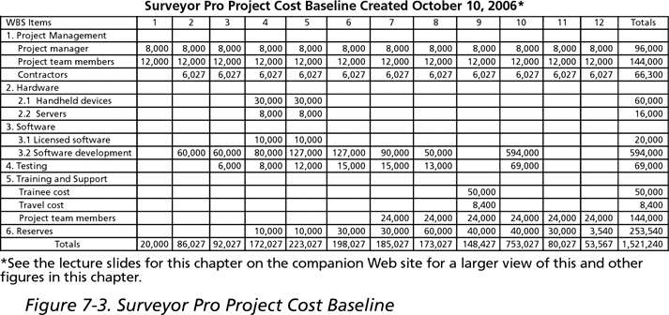
Figure 7-3. Surveyor Pro Project
Cost Baseline

Slide 26
Cost Control
Project cost control includes:
  Monitoring cost performance.
  Ensuring that only appropriate project changes are included in a revised cost baseline.
  Informing project stakeholders of authorized changes to the project that will affect costs.
Many organizations around the globe have problems with cost control.

Slide 27
Earned Value Management (EVM)
EVM is a project performance measurement technique that integrates scope, time, and cost data.
Given a baseline (original plan plus approved changes), you can determine how well the project is meeting its goals.
You must enter actual information periodically to use EVM.
More and more organizations around the world are using EVM to help control project costs.

Slide 28
Earned Value Management Terms
The planned value (PV), formerly called the budgeted cost of work scheduled (BCWS), also called the budget, is that portion of the approved total cost estimate planned to be spent on an activity during a given period.
Actual cost (AC), formerly called actual cost of work performed (ACWP), is the total of direct and indirect costs incurred in accomplishing work on an activity during a given period.
The earned value (EV), formerly called the budgeted cost of work performed (BCWP), is an estimate of the value of the physical work actually completed.
EV is based on the original planned costs for the project or activity and the rate at which the team is completing work on the project or activity to date.

Slide 29
Rate of Performance
Rate of performance (RP) is the ratio of actual work completed to the percentage of work planned to have been completed at any given time during the life of the project or activity.
Brenda Taylor, Senior Project Manager in South Africa, suggests using this approach for estimating earned value.
For example, suppose the server installation was halfway completed by the end of week 1. The rate of performance would be 50 percent (50/100) because by the end of week 1, the planned schedule reflects that the task should be 100 percent complete and only 50 percent of that work has been completed.

Slide 30
Earned Value
Suppose you just signed a contract with a consulting firm called X, Y, and Zfor developing an IS.
Project Budget, Schedule, Tasks
  $40,000
  4 months
  20 Tasks (evenly divided over 4 months)
    $2,000 per task
    5 tasks per month
  Therefore , you plan to pay $10,000/month. This is called budgeted cost of work scheduled (BCWS).

Slide 31
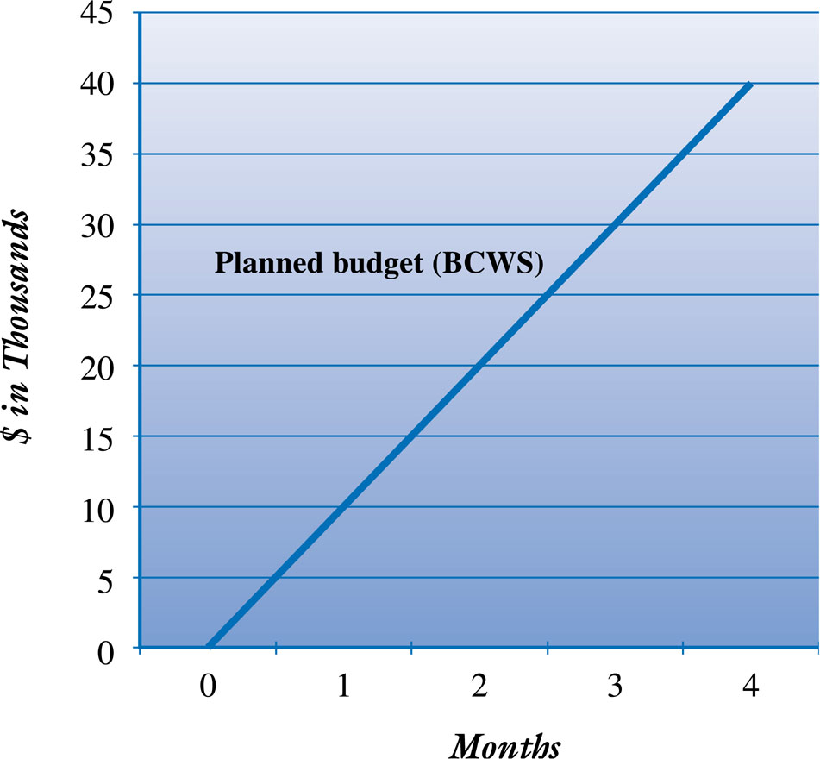
Planned Budget-Budgeted Cost of Work Scheduled (BCWS)

Slide 32
Invoice
End of Month 1
X, Y, & Z
Amount Due: $8,000
Payment due immediately!
page 1 of 2
Actual Cost of Work Performances (ACWP)

Slide 33
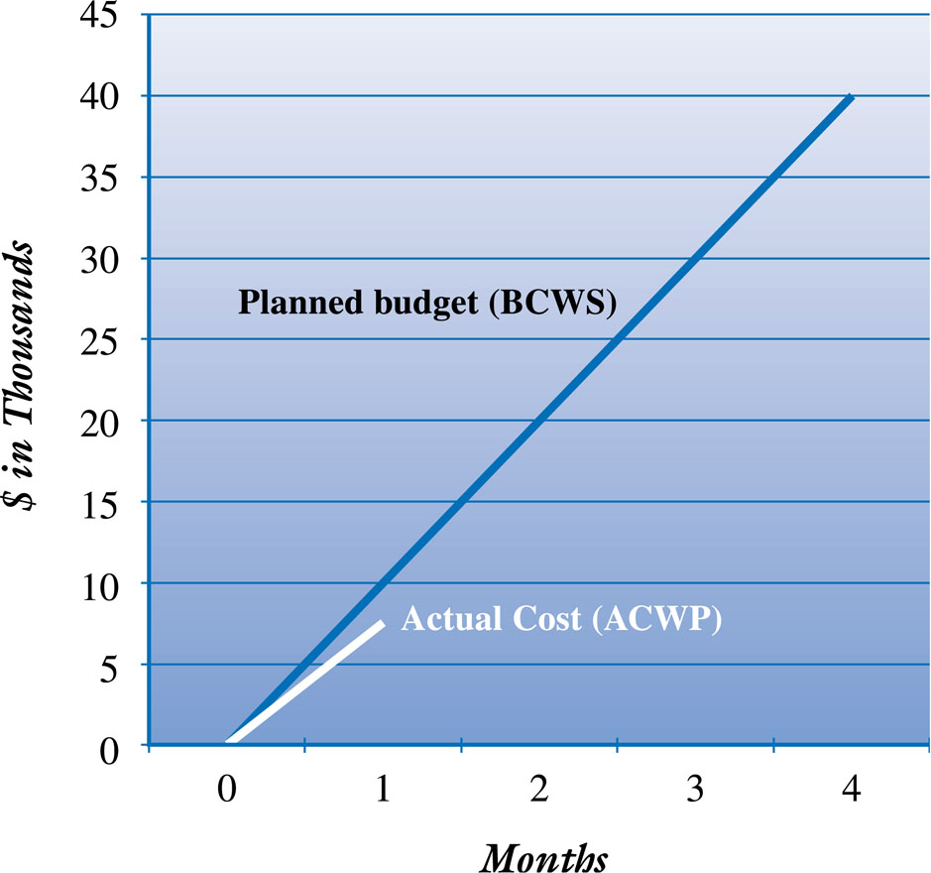
BCWS Versus ACWP
Is your project ahead of budget $2,000 ?

Slide 34
Invoice
X, Y, & Z
Work Completed for Month 1
Task A - $2,000
Task B - $3,000
Task C - $3,000
page 2 of 2
Complete only 3 from 5 tasks
Spent $8,000 to achieve only $6,000 of actual work
6,000 is Earned Value

Slide 35
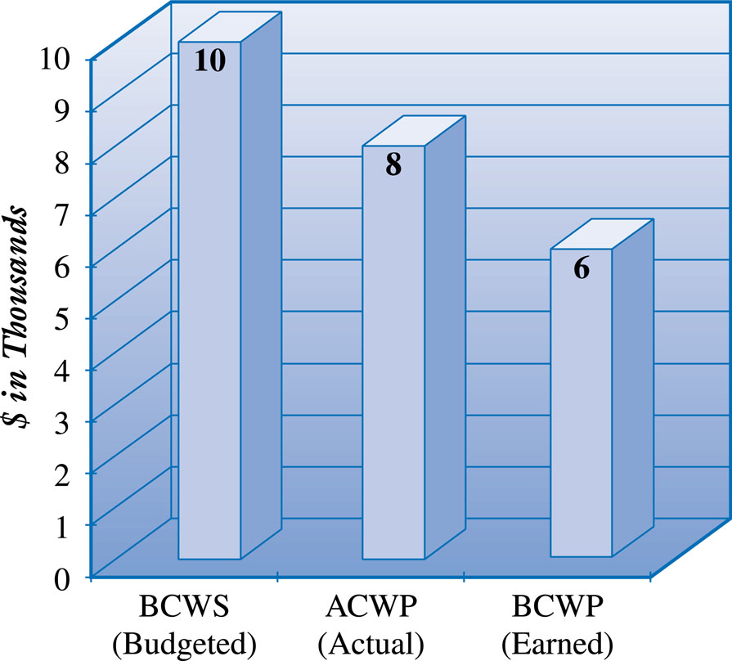
Comparison of BCWS, ACWP, and Budgeted Cost of Work Performed (BCWP)

Slide 36
Cost Variance

Slide 37
Schedule Variance

Slide 38
The Full Story

Slide 39
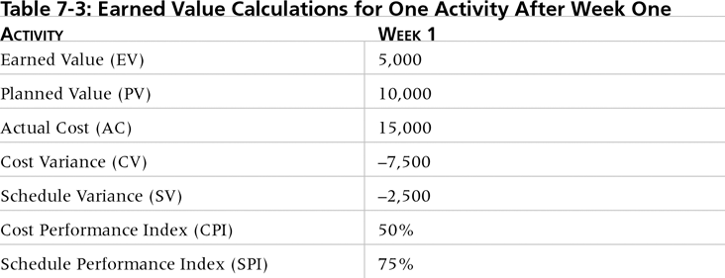
Table 7-4. Earned Value Calculations for One Activity After Week One

Slide 40
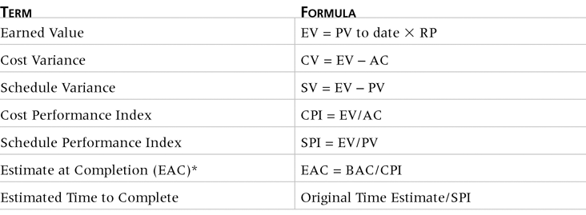
Table 7-5. Earned Value Formulas

Slide 41
Definitions
Budgeted Cost of Work Scheduled (BCWS)
  Planned expenditure cash flows based on the completion of tasks in accordance with the project’s budget and schedule
Actual Cost of Work Performed (ACWP)
  Actual Project Expense based on completed tasks
Earned Value or Budgeted Cost of Work Performed (BCWP)
  The amount of the budget that we should have spent for a given amount of work completed

Slide 42
Cost/Performance Indicators

Slide 43
Cost Metrics
Cost Variance (CV)-The difference between a task’s estimated cost and its actual cost:
  CV = BCWP - ACWP
  Negative Value = over budget and/or behind schedule
  Positive Value = under budget and/or ahead of schedule
Cost Performance Index (CPI)-percentage of work completed per dollar spent
  CPI = BCWP ÷ ACWP
  ratio > 1 = ahead of schedule and/or under budget
  ratio < 1 = behind schedule and/or over budget

Slide 44
Schedule Metrics
Schedule Variance (SV) – the difference in terms of cost between the current progress and our originally scheduled progress
  SV = BCWP – BCWS
Schedule Performance Index (SPI) – a ratio of the work performed to the work scheduled.
  SPI = BCWP ÷ BCWS
  ratio > 1 = ahead of schedule and/or under budget
  ratio < 1 = behind schedule and/or over budget

Slide 45
Earned Value Metrics
Minimum Funds Needed if things do not get worse
  Minimum funds = Original total budget ÷ CPI
Funds Needed if things continue to get worse at the same level of slippage
  Funds Needed = Original total budget ÷ (CPI x SPI)

Slide 46
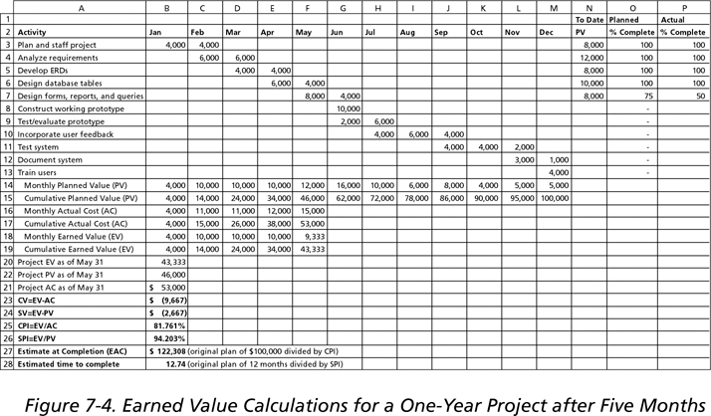
Figure 7-4. Earned Value Calculations for a One-Year Project After Five Months

Slide 47
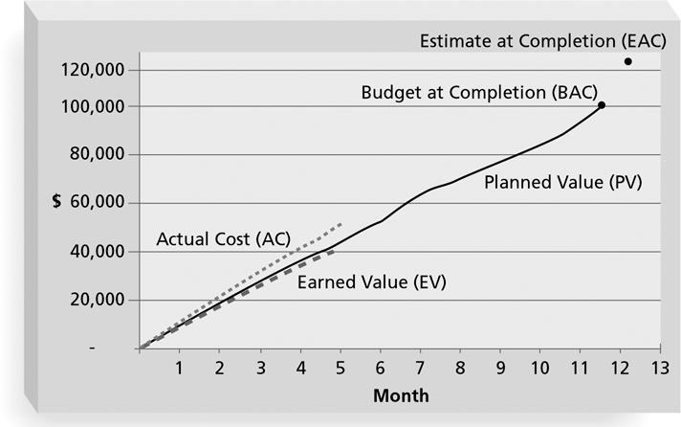
Figure 7-5. Earned Value Chart for Project after Five Months
If the EV line is below the AC or PV line, there are problems in those areas.

Slide 48
Project Portfolio Management
Many organizations collect and control an entire suite of projects or investments as one set of interrelated activities in a portfolio.
Project portfolio management has five levels:
  Put all your projects in one database.
  Prioritize the projects in your database.
  Divide your projects into two or three budgets based on type of investment.
  Automate the repository.
  Apply modern portfolio theory, including risk-return tools that map project risk on a curve.

Slide 49
Benefits of Portfolio Management
Schlumberger saved $3 million in one year by organizing 120 information technology projects into a portfolio.
META Group research shows that:
  Organizations that evaluate information technology projects by what their business impacts are and what their potential business values will be implement projects that result in 25 percent more improvement to the bottom line.
  By 2005-2006, more than 50 percent of the CIOs for Global 2000 companies will adopt project portfolio management tools and techniques for IT projects, asset management, and budget planning and monitoring.
  Business executives state that using project portfolio management allows managers to make decisions faster and with more confidence.*
*META Group, “IT Investment Management: Portfolio Management Lessons Learned,” A META Group White Paper (www.metagroup.com) (2002).

Slide 50
Using Software to Assist in Cost Management
Spreadsheets are a common tool for resource planning, cost estimating, cost budgeting, and cost control.
Many companies use more sophisticated and centralized financial applications software for cost information.
Project management software has many cost-related features, especially enterprise PM software.

Slide 51
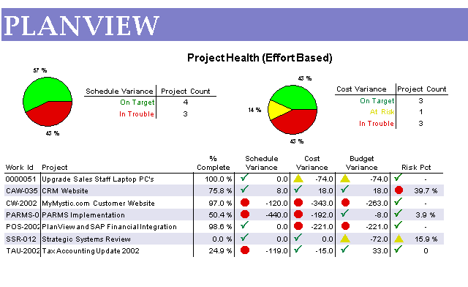
Figure 7-6. Sample Project Portfolio Management Screen Showing Project Health

Slide 52
Chapter Summary
Project cost management is traditionally a weak area in IT projects, and project managers must work to improve their ability to deliver projects within approved budgets.
Main processes include:
  Cost estimating
  Cost budgeting
  Cost control

