Slide 1
Quick Recap

Slide 2
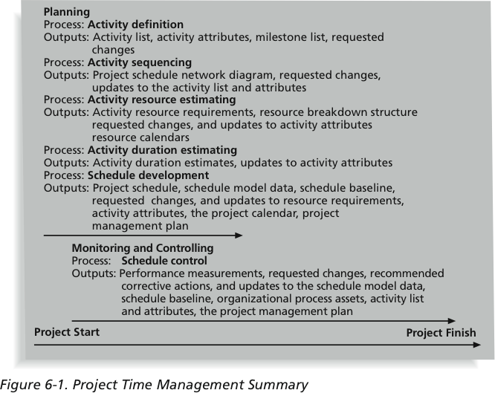
Project Time Management Summary

Slide 3
Lesson 5: Developing Cost Estimates and Budgets
Topic 5A: Estimate Project Costs
Topic 5B: Estimate the Cost Baseline
Topic 5C: Reconcile Funding and Costs

Slide 4
Budgeting
An important Project Monitoring & Controlling
Tool

Slide 5
Project Mgmt Process Groups
Monitoring & Controlling
Planning
Initiating
Closing
Executing
Source: PMI Guide to Project Management Body of Knowledge

Slide 6
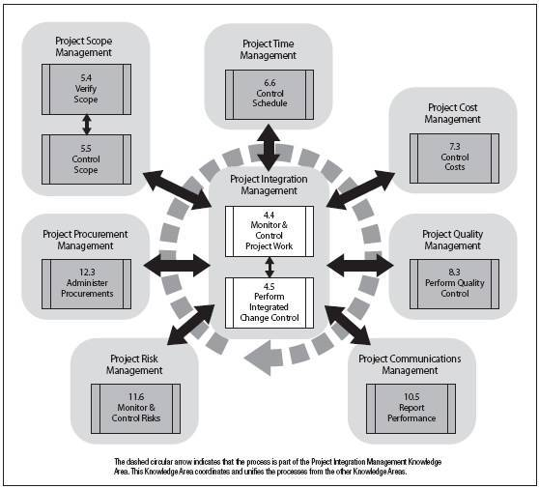
Process group identification

Slide 7
What is a budget?
A Plan
A Limit
A Schedule
A Reality Check
An Allocation

Slide 8
Budget – a definition
“A planned expression of money”
Wright.D 1994 “A practical foundation in costing” Routledge
For a defined activity
Shows;
Income & Expenditure
Total estimated costs
Defined period of time

Slide 9
Another definition
A budget process is a system of rules governing the decision-making that leads to a budget, from its formulation, through its legislative approval, to its execution.
Karl-Martin, Ehrhart, Roy Gardner, Jürgen von Hagen, and Claudia Keser Budget Processes: Theory and Experimental Evidence, November 2000

Slide 10
More definitions
Budget = Quantitative expression of a plan
Budgets involve – Planning
&
Control
Forecasting & Planning
Control & Evaluation

Slide 11
Budgeting in Context
Historic Information
Plus Effects of Outside Environment
Forecasting & Planning
Evaluating Performance
Future Information
Current Information
Current Operating Data
Controlling operations

Slide 12
A budget helps
Want
Need
Budget
can

Slide 13
Why use a budget?
Stay within a limit
Control
Forecasting
Delegate
Prioritise Wants, Organise Needs,
Within the realm of what we Can

Slide 14
Types of budgeting
There are three common budgeting methods:
Top-down Budgeting
Bottom-up Budgeting
Iterative Budgeting

Slide 15
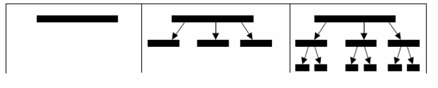
Top Down Budgeting
Top-Down Budgeting is the term given to a budgeting process based on estimating the cost of higher level tasks first and using these estimates to constrain the estimates for lower level tasks

Slide 16
Top Down Budgeting
A crucial factor for successfully implementing this method for estimating budgets is the experience and judgement of those involved in producing the overall budget estimate.

Slide 17
Top Down Budgeting
Organisations need the ability to allow:
  Financial Managers to establish centralised budgets to control organisation spending.
  Project Managers to establish projects budgets that consume the centralised organisation budget and control project spending.

Slide 18
Top Down Budgeting
Takes less time
Promotes upper-level commitment
Involves no multilevel participation
Lower management better understands what upper management expects
Presented down the ladder

Slide 19
Top Down Budgeting
Disadvantages
Translating long-range budgets into short-range budgets.
Problems scheduling projects in a "sub-optimal way" to meet the strategic goals
Result of top management's limited knowledge of specifics of project tasks and activities

Slide 20
Top Down Budgeting
Disadvantages
Competition for funds among lower-level managers, try to secure adequate funding for their operations.
May cause unhealthy competition.
This process is a zero sum game--one person's or area's gain is another's loss.
Subordinate managers often feel that they have insufficient budget allocations to achieve the objectives

Slide 21
Top Down Budgeting
Advantages
Aggregate budget is quite accurate, even though some individual activities subject to large error
Budgets are stable as a percent of total allocation and the statistical distribution of the budget is also stable leading to high predictability
Small costly tasks don’t need to be identified early in this process - factored into overall estimate

Slide 22
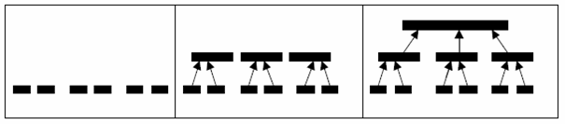
Bottom Up Budgeting
Sometimes called Zero Based Budgeting
Bottom-up budgeting begins with identifying all the constituent tasks that are involved in implementing a project and working out the resources and funding required by each

Slide 23
Bottom Up Budgeting
Provides the opportunity to create organisation level budgets by rolling up project budgets
Create centralised project level budgets from their sub-project budgets (WBS)

Slide 24
Bottom Up Budgeting
This method of budgeting provides the following benefits:
  Project Managers have the flexibility to define their project budgets independently
  Financial Managers have the ability to centrally review the total project budget/s

Slide 25
Bottom up budgeting
Takes more time
Involves cross-section of the organisation
Presented up the ladder
Seeks participation at all levels
Encourages commitment to the plan

Slide 26
Bottom Up Budgeting
Disadvantage
Top management has limited influence over the budgeting process,
Individual tend to overstate their resource needs because they suspect that higher management will probably cut all budgets by the same percentage

Slide 27
Bottom Up Budgeting
Disadvantage
More persuasive managers sometimes get a disproportionate share of resources
A significant portion of budget building is in the hands of the junior personnel in the organisation
Sometimes critical activities are missed and left unbudgeted

Slide 28
Bottom Up Budgeting
Advantage
Is in the accuracy of the budgets for individual tasks
Clear flow of information
Use of detailed data available at project management level as basic source of cost, schedule, and resource requirement information.
Participation in the process leads to ownership and acceptance

Slide 29
Iterative Budgeting
Iterative – to repeat or do again
A combination of top-down and bottom-up
budget building
Higher project level estimated (top down)
Lower level costed (bottom up)
The two costs negotiated and reconciled

Slide 30
Iterative Budgeting
Disadvantage
Is in the relative inefficiency and time consuming nature of the negotiations over the budgets.
Process may not work well when communication channels are either informal or blocked between lower-level managers and senior management

Slide 31
Iterative Budgeting
Advantage
It promotes employee involvement and stimulates a high degree of information flow between those involved in the project at different levels
Both senior management and lower level managers closer to the actual process participate in the budgeting process

Slide 32
Top Down vs. Bottom Up
Top-down Bottom-up
Problems of Bottom-up Budgeting
  Difficult to control aggregate spending
  Allocations may not be optimal
  Hard to keep multi-year perspective

Slide 33
Top Down & Bottom Up Compared
• Bottom-up • Top-down
- Annual - Multi-year
- Time consuming - Delegated authority
- Ownership of proposals is - Creates joint ownership of
specific proposals
- Reactive - Proactive

Slide 34
Activity Orientated Budget
The traditional budget is activity based
Individual expenses classified and assigned to basic budget lines e.g. phone, materials, personnel, clerical, utilities, direct labour, etc
Diffused control so widely that it was frequently non-existent

Slide 35
Task Orientated Budget
Also known as Program Budgeting
Aggregates income and expenditures across programs (projects)
The project has its own budget

Slide 36
Task Orientated Budget
Pure project organisation, the budgets of all projects are aggregated to the highest organisational level
Functional organisation income/expense for each project are shown

Slide 37
Planning Programming Budgeting System (PPBS)
The system focuses on funding those projects that will bring the greatest progress toward organisational goals for the least cost
Basically a Program and Planning Budgeting System

Slide 38
Planning Programming Budgeting System (PPBS)
Identification of goals and objectives for each major area of activity - planning
Analysis of the programs proposed to obtain organizational objectives - programming
Estimation of the total costs for each project, including indirect costs. Time phasing of costs is detailed.

Slide 39
Planning Programming Budgeting System (PPBS)
Final analysis of alternative projects in terms of costs, expected costs, expected benefits, and expected project lives.
Cost/benefit analyses are performed for each program so programs can be compared with each other and a portfolio of projects can be selected for funding

Slide 40
Budget Planning linked to Project Activity
Only way a detailed budget can be produced
Can monitor budget usage against project activity
Can be done when the project schedule has been determined

Slide 41
Completion Times, Project Activities, Costs
Direct relationship of these items
Will affect the final budgeted figure
Is a “trade off”

Slide 42
Budgetary Control
The ability to control anticipated
expenditures for your project using a
project cost budget.

Slide 43
Budgetary Control
The Projects Budgetary Controls feature includes the following:
  Flexible Setup of Controls
    Defines Control Amounts
    Defines Control Levels
  Funds Check - Performs the available funds verifications.
  Maintenance of Available Balances - Maintains the available balance for each project budget line.

Slide 44
Budgetary Controls
Actual Transactions;
are recorded project costs.
Examples include labour, expense report, usage and miscellaneous costs.
Commitment Transactions;
are anticipated project costs.
Examples include purchase requisitions and purchase orders or contract commitments.

Slide 45
Features of an effective budget
Accurate forecasting
Based on organisational goals
Information is timely and accurate
Formed with multilevel input
Regular reviews are built-in

Slide 46
Problems with budgeting
The process is too long
There is a lot of game playing
Business decisions change but the budget does not
People in charge of budget are held accountable in areas where they have no responsibility
Applying an arbitrary percentage to prior period actual

Slide 47
Analysing Variance
Budget deviation analysis (variance analysis) regularly compares what you expected or planned to earn and spend with what you actually spent and earned.
Variation analysis can help greatly when detecting how well you’re tracking your plans, how much to accurately budget in the future, where there might be upcoming problems in spending.

Slide 48
Example of a variance report
Date: June 30, 2006
Account: Product Development MONTH TO DATE
ACCOUNT REF. ACTUAL BUDGET VARIANCE %
SALARIES 5025 £48,000 £43,750 - £4,375 - 10
TRAVEL 6442 £1,500 £1,200 - £300 - 25
SUPPLIES 5320 £500 £700 £200 28.5

Slide 49
Benefits to checking variance
Understand the reason for the differences
Prepare a more accurate budget in the future
Evaluate budget goals
Isolate problems
Identify weak areas
Motivate managers
Communicate with all levels
Forecast

Slide 50
Response to budget warnings
Freeze spending
Freeze activity
Put off “unnecessary” projects activity
Re-schedule/cost your project
Downsize your project

