Slide 1
Quick Recap

Slide 2
Continuation of…….
“Project Schedule”
Monitoring and Controlling Approach

Slide 3
Lesson 4: Developing Project Schedules
Topic 4A: Create an Activity List
Topic 4B: Create a Project Schedule Network Diagram
Topic 4C: Estimate Activity Resources
Topic 4D: Estimate Duration for Project Activities
Topic 4E: Develop a Project Schedule
Topic 4F: Identify the Critical Path
Topic 4G: Optimize the Project Schedule
Topic 4H: Establish a Schedule Baseline

Slide 4
Importance of Updating
Critical Path Data
It is important to update project schedule information to meet time goals for a project
The critical path may change as you enter actual start and finish dates
If you know the project completion date will slip, be proactive and negotiate with the project sponsor and stakeholders

Slide 5
Critical Chain Scheduling
Critical chain scheduling
  A method of scheduling that considers limited resources when creating a project schedule and includes buffers to protect the project completion date
Based on the Theory of Constraints (TOC)
  A management philosophy developed by Eli Goldratt and introduced in his book The Goal and Critical Chain
    Like a chain with its weakest link, any complex system at any point in time often has only one aspect or constraint that limits its ability to achieve more of its goal
    For the system to attain any significant improvements, that constraint must be identified and the whole system must be managed with it in mind
      For example, two tasks originally scheduled to be done in parallel, require the same resource 100% of the time. CCS acknowledges that either one of the tasks must be delayed or a similar resource must be found in order to keep to the original schedule

Slide 6
Critical Chain Scheduling
Attempts to minimize multitasking
  When a resource works on more than one task at a time – people are assigned to multiple tasks within the same project or different tasks on multiple projects
  Someone assigned to three tasks, tries to please everyone and works a little on each task and then goes back to finish the first one
    This can actually delay the completion of tasks as compared to working on each task in sequence
    Multitasking also often involves wasted setup time, which increases total duration

Slide 7
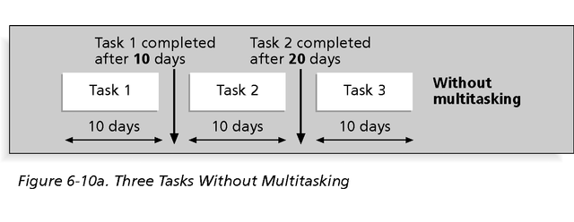
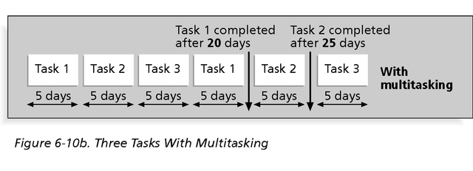
Multitasking Example

Slide 8
Critical Chain Scheduling
Critical Chain Project Management (CCPM), developed by Eliyahu M. Goldratt, is a method of planning and managing projects that puts more emphasis on the resources required to execute project tasks.
This is in contrast to the more traditional Critical Path and PERT methods, which emphasize task order and rigid scheduling.
A Critical Chain project network will tend to keep the resources levelly loaded, but will require them to be flexible in their start times and to quickly switch between tasks and task chains to keep the whole project on schedule.
  Typically, CCPM case studies report 95% on-time and on-budget completion when CCPM is applied correctly.

Slide 9
Buffers and Critical Chain
In traditional estimates, people often add a buffer to each task and use it if it’s needed or not
A buffer is additional time to complete a task
  This time is added to when there is multitasking, distractions, interruptions, fear that estimates will be reduced and Murphy’s Law
    Murphy’s Law states that if something can go wrong, it will

Slide 10
Buffers and Critical Chain
Critical chain scheduling removes buffers from individual tasks and instead creates:
  A project buffer or additional time added before the project’s due date
  Feeding buffers or additional time added before tasks on the critical path that are preceded by non-critical-path tasks
The tasks estimates in critical chain scheduling should be shorter than traditional estimates because they do not include their own buffers
  Not having tasks buffers should mean less occurrence of Parkinson’s Law - work expands to fill the time allowed
  Feeding and project buffers protect the date that really needs to be met – the project completion date

Slide 11
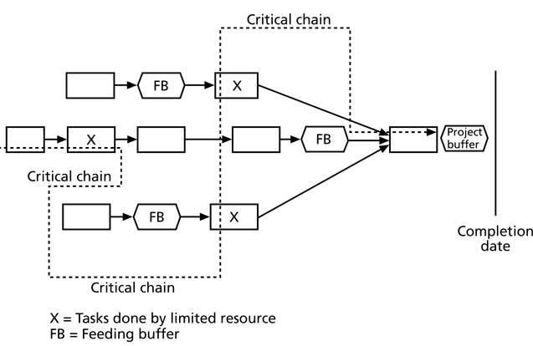
Example of Critical Chain Scheduling

Slide 12
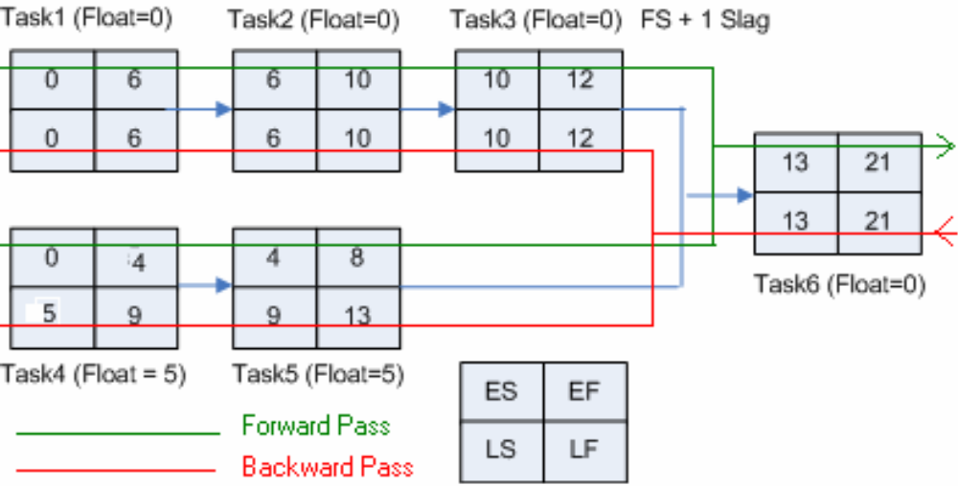
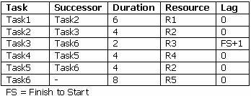
Example of Critical Chain Scheduling
Critical Path = Task1+Task2+Task3+ Lag+ Task6 =
5+4+2+1+8 = 21 Days.

Slide 13
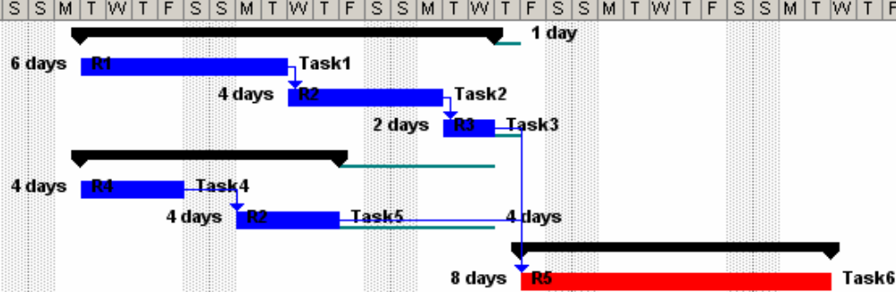
Example of Critical Chain Scheduling
Critical Path = Task1+Task2+Task3+ Lag+ Task6 =
5+4+2+1+8 = 21 Days.

Slide 14
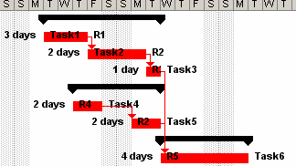
Example of Critical Chain Scheduling
Remove safety time and reduce tasks durations by 50%.
Project Duration = Task1+Task2+Task3+ Task6 = 3+2+1+4 = 10 Days.
Note:
• All safety time durations are removed. For example 1 day lag after Task 2 and 4 days after Task5 are removed.
• All tasks durations are reduced to half (50%). For example Task 1 is 3 Days instead of 6 days.

Slide 15
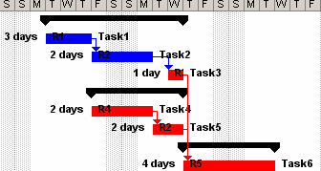
Example of Critical Chain Scheduling
Create schedule on Late Finish dates and Remove resource constraints and identify critical chain.
Project Duration = Task1+Task2+Task5+ Task6 = 3+2+2+4 = 11 Days.
Note:
• Task3, Task4 and Task 5 are moved to start from Late Finish dates.
• Task2 and Task5 are to be done by resource R2 and so that aligned to remove resource constraints.

Slide 16
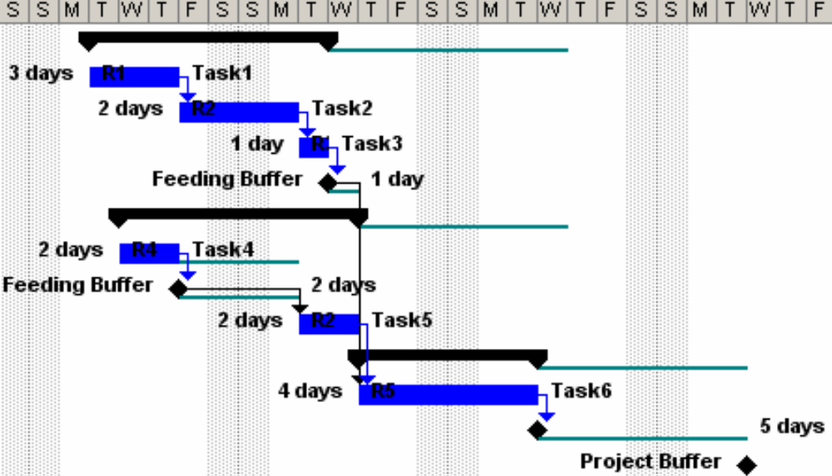
Example of Critical Chain Scheduling
Add Project Buffer of 50% of the tasks duration and add Feeder buffer to non critical chain.
Project Duration = Task1+Task2+Task5+ Task6 + PB = 3+2+2+4+5 = 16 Days.
Note:
• Project Buffer (PB) = 50% of Project Duration (11 Days) = 5.5 Days = 5 Days (Rounded).
• Feeder Buffer (FB) for non critical tasks on chain. For example Task 4 is added 2 days FB.

Slide 17
Comparison of CPM and CCPM results
According to the results we found above, project duration by CPM traditional approach is 21 days and the project duration for the same amount of work by using CCPM is 16 Days.
Using CCPM:
  Project Duration can be reduced by 25-40%.
  Resources can be utilized effectively.
  Project is fully focused on both critical and non critical tasks

Slide 18
Program Evaluation and Review Technique (PERT)
PERT is a network analysis technique used to estimate project duration when there is a high degree of uncertainty about the individual activity duration estimates
PERT uses probabilistic time estimates
  Duration estimates based on using optimistic, most likely, and pessimistic estimates of activity durations, or a three-point estimate
  PERT attempts to address the risk associated with duration estimates by developing schedules that are more realistic
    It involves more work than CPM since it requires several duration estimates

Slide 19
PERT Formula and Example
PERT weighted average =
optimistic time + 4X most likely time + pessimistic time
6
Example:
PERT weighted average =
8 workdays + 4 X 10 workdays + 24 workdays = 12 days 6
where optimistic time= 8 days,
most likely time = 10 days, and
pessimistic time = 24 days
Therefore, you’d use 12 days on the network diagram instead of 10 when using PERT for the above example

Slide 20
Schedule Control
Perform reality checks on schedules
Allow for contingencies
Don’t plan for everyone to work at 100% capacity all the time
Hold progress meetings with stakeholders and be clear and honest in communicating schedule issues

Slide 21
Schedule Control (continued)
Goals are to know the status of the schedule, influence factors that cause schedule changes, determine that the schedule has changed, and manage changes when they occur
Tools and techniques include:
  Progress reports
  A schedule change control system
  Project management software, including schedule comparison charts like the tracking Gantt chart
  Variance analysis, such as analyzing float or slack
  Performance management, such as earned value

Slide 22
Reality Checks on Scheduling
First review the draft schedule or estimated completion date in the project charter
Prepare a more detailed schedule with the project team
Make sure the schedule is realistic and followed
Alert top management well in advance if there are schedule problems
Verify schedule progress – just because a team member says a task was completed on time doesn’t always mean that it was

Slide 23
Working with People Issues
Strong leadership helps projects succeed more than good PERT charts
Project managers should use:
  Empowerment
  Incentives
  Discipline
  Negotiation

Slide 24
Using Software to Assist in Time Management
Software for facilitating communications helps people exchange schedule-related information
Decision support models help analyze trade-offs that can be made
Project management software can help in various time management areas

Slide 25
Words of Caution on Using Project Management Software
Many people misuse project management software because they don’t understand important concepts and have not had training
You must enter dependencies to have dates adjust automatically and to determine the critical path
You must enter actual schedule information to compare planned and actual progress

