Slide 1
Quick Recap

Slide 2
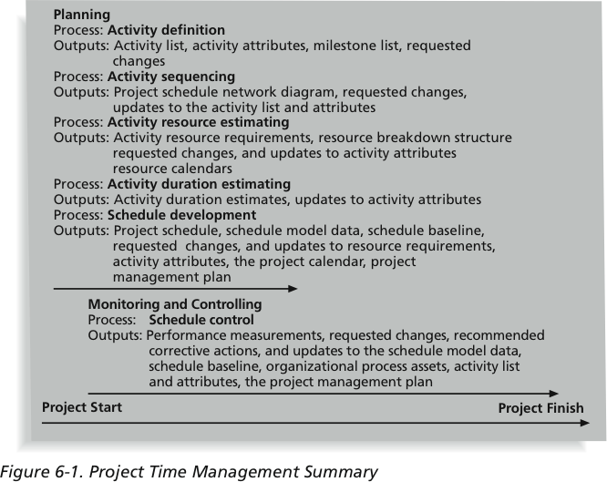
Project Time Management Summary

Slide 3
Continuation of…….
“Project Schedule”
Monitoring and Controlling Approach

Slide 4
Schedule Development
Uses results of the other time management processes to determine the start and end date of the project
Ultimate goal is to create a realistic project schedule that provides a basis for monitoring project progress for the time dimension of the project
Important tools and techniques include Gantt charts, critical path analysis, critical chain scheduling, and PERT analysis

Slide 5
Gantt Charts
Gantt charts provide a standard format for displaying project schedule information by listing project activities and their corresponding start and finish dates in a calendar format
Symbols include:
  Black diamonds: milestones
  Thick black bars: summary tasks
  Lighter horizontal bars: durations of tasks
  Arrows: dependencies between tasks

Slide 6
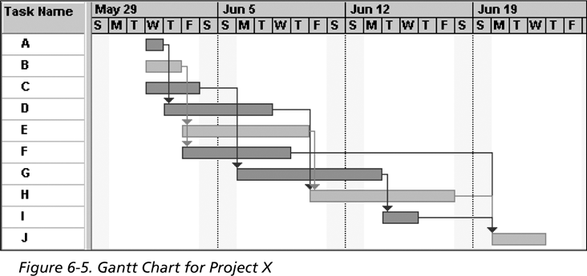
Figure 6-5: Gantt Chart for Project X
Note: Darker bars would be red in Project 2007 to represent critical tasks

Slide 7
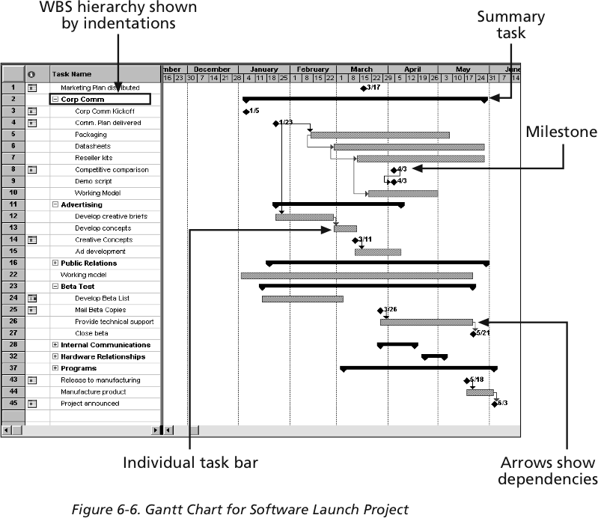
Gantt Chart for Software Launch Project

Slide 8
Adding Milestones to Gantt Charts
Many people like to focus on meeting milestones, especially for large projects
Milestones emphasize important events or accomplishments on projects
Normally create milestone by entering tasks with a zero duration, or you can mark any task as a milestone

Slide 9
SMART Criteria
Milestones should be:
  Specific
  Measurable
  Assignable
  Realistic
  Time-framed

Slide 10
Best Practice
Schedule risk is inherent in the development of complex systems
Luc Richard, the founder of www.projectmangler.com, suggests that project managers can reduce schedule risk through project milestones, a best practice that involves identifying and tracking significant points or achievements in the project

Slide 11
Best Practice (continued)
The five key points of using project milestones include the following:
  Define milestones early in the project and include them in the Gantt chart to provide a visual guide
  Keep milestones small and frequent
  The set of milestones must be all-encompassing
  4. Each milestone must be binary, meaning it is either complete or
  incomplete
  5. Carefully monitor the critical path

Slide 12
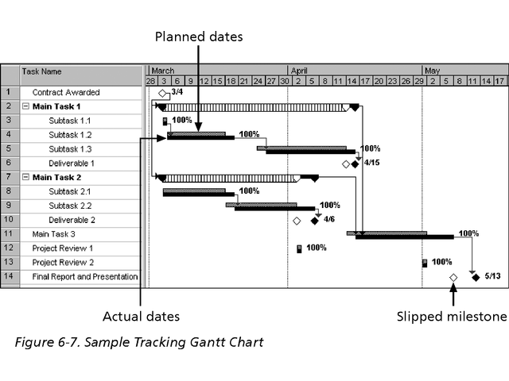
Sample Tracking Gantt Chart

Slide 13
Critical Path Method (CPM)
CPM is a network diagramming technique used to predict total project duration
A critical path for a project is the series of activities that determines the earliest time by which the project can be completed
The critical path is the longest path through the network diagram and has the least amount of slack or float
Slack or float is the amount of time an activity may be delayed without delaying a succeeding activity or the project finish date

Slide 14
Calculating the Critical Path
First develop a good network diagram
Add the duration estimates for all activities on each path through the network diagram
The longest path is the critical path
If one or more of the activities on the critical path takes longer than planned, the whole project schedule will slip unless the project manager takes corrective action

Slide 15
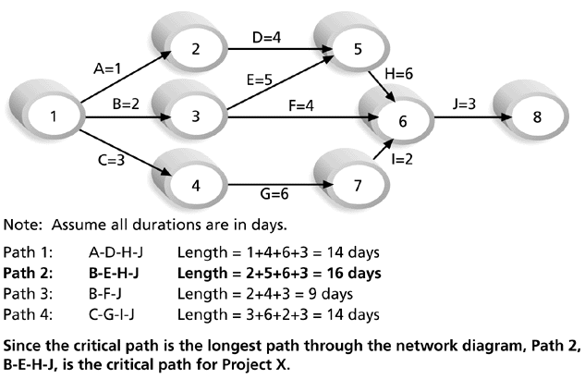
Determining the Critical Path for Project X

Slide 16
More on the Critical Path
A project team at Apple computer put a stuffed gorilla on the top of the cubicle of the person currently managing a critical task
The critical path is not the one with all the critical activities; it only accounts for time
  Remember the example of growing grass being on the critical path for Disney’s Animal Kingdom
There can be more than one critical path if the lengths of two or more paths are the same
The critical path can change as the project progresses

Slide 17
Using Critical Path Analysis to Make Schedule Trade-offs
Free slack or free float is the amount of time an activity can be delayed without delaying the early start of any immediately following activities
Total slack or total float is the amount of time an activity may be delayed from its early start without delaying the planned project finish date
A forward pass through the network diagram determines the early start and finish dates
A backward pass determines the late start and finish dates

Slide 18
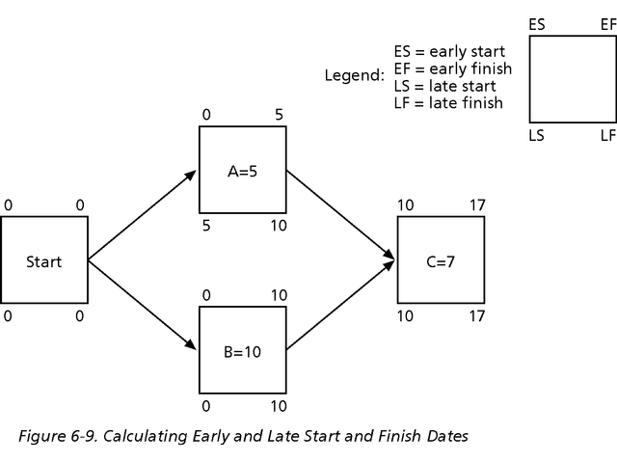
Calculating Early and Late Start and Finish Dates

Slide 19
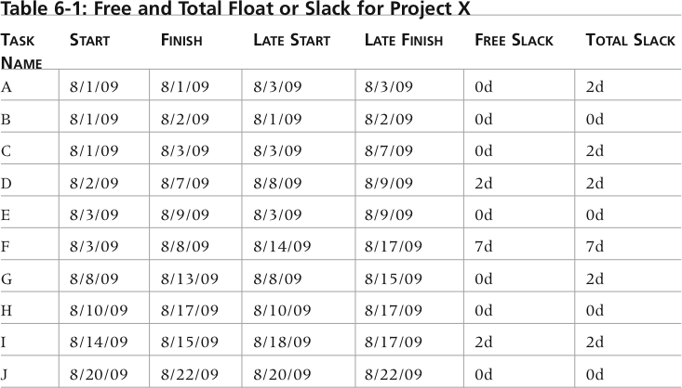
Free and Total Float or Slack for Project X

Slide 20
How to Find the Critical Path
General Foundry’s network with expected activity times
A 2
C 2
F 3
E 4
H 2
Start
Finish
B 3
D 4
G 5
Figure 13.3

Slide 21
How to Find the Critical Path
To find the critical path, need to determine the following quantities for each activity in the network
Earliest start time (ES): the earliest time an activity can begin without violation of immediate predecessor requirements
Earliest finish time (EF): the earliest time at which an activity can end
Latest start time (LS): the latest time an activity can begin without delaying the entire project
Latest finish time (LF): the latest time an activity can end without delaying the entire project

Slide 22
How to Find the Critical Path
In the nodes, the activity time and the early and late start and finish times are represented in the following manner
ACTIVITY t
ES EF
LS LF
Earliest times are computed as
Earliest finish time = Earliest start time
+ Expected activity time
EF = ES + t
Earliest start = Largest of the earliest finish times of
immediate predecessors
ES = Largest EF of immediate predecessors

Slide 23
How to Find the Critical Path
At the start of the project we set the time to zero
Thus ES = 0 for both A and B
A t = 2
ES = 0 EF = 0 + 2 = 2
Start
B t = 3
ES = 0 EF = 0 + 3 = 3

Slide 24
How to Find the Critical Path
General Foundry’s ES and EF times
A 2
0 2
C 2
2 4
F 3
4 7
E 4
4 8
H 2
13 15
Start
Finish
B 3
0 3
D 4
3 7
G 5
8 13
Figure 13.4

Slide 25
How to Find the Critical Path
Latest times are computed as
Latest start time = Latest finish time
– Expected activity time
LS = LF – t
Latest finish time = Smallest of latest start times
for following activities
LF = Smallest LS of following activities
For activity H
LS = LF – t = 15 – 2 = 13 weeks

Slide 26
How to Find the Critical Path
General Foundry’s LS and LF times
A 2
0 2
0 2
C 2
2 4
2 4
F 3
4 7
10 13
E 4
4 8
4 8
H 2
13 15
13 15
Start
Finish
B 3
0 3
1 4
D 4
3 7
4 8
G 5
8 13
8 13
Figure 13.5

Slide 27
How to Find the Critical Path
Once ES, LS, EF, and LF have been determined, it is a simple matter to find the amount of slack time that each activity has
Slack = LS – ES, or Slack = LF – EF
From Table 13.3 we see activities A, C, E, G, and H have no slack time
These are called critical activities and they are said to be on the critical path
The total project completion time is 15 weeks
Industrial managers call this a boundary timetable

Slide 28
How to Find the Critical Path
General Foundry’s schedule and slack times
ACTIVITY | EARLIEST START, ES | EARLIEST FINISH, EF | LATEST START, LS | LATEST FINISH, LF | SLACK, LS – ES | ON CRITICAL PATH?
A | 0 | 2 | 0 | 2 | 0 | Yes
B | 0 | 3 | 1 | 4 | 1 | No
C | 2 | 4 | 2 | 4 | 0 | Yes
D | 3 | 7 | 4 | 8 | 1 | No
E | 4 | 8 | 4 | 8 | 0 | Yes
F | 4 | 7 | 10 | 13 | 6 | No
G | 8 | 13 | 8 | 13 | 0 | Yes
H | 13 | 15 | 13 | 15 | 0 | Yes
Table 13.3

Slide 29
How to Find the Critical Path
General Foundry’s critical path
A 2
0 2
0 2
C 2
2 4
2 4
F 3
4 7
10 13
E 4
4 8
4 8
H 2
13 15
13 15
Start
Finish
B 3
0 3
1 4
D 4
3 7
4 8
G 5
8 13
8 13
Figure 13.6

Slide 30
Using the Critical Path to Shorten a Project Schedule
Three main techniques for shortening schedules
  Shortening durations of critical activities/tasks by adding more resources or changing their scope
  Crashing activities by obtaining the greatest amount of schedule compression for the least incremental cost
    A 2 week task with one person working 50% could be shortened to 1 week if the person is assigned 100% - no increase in cost
    Or, a temporary worker could be hired to work in parallel with the other worker to speed up the task (at a cost)

Slide 31
Project Crashing
Projects will sometimes have deadlines that are impossible to meet using normal procedures
By using exceptional methods it may be possible to finish the project in less time than normally required
However, this usually increases the cost of the project
Reducing a project’s completion time is called crashing

Slide 32
Project Crashing
Crashing a project starts with using the normal time to create the critical path
The normal cost is the cost for completing the activity using normal procedures
If the project will not meet the required deadline, extraordinary measures must be taken
The crash time is the shortest possible activity time and will require additional resources
The crash cost is the price of completing the activity in the earlier-than-normal time

Slide 33
Four Steps to Project Crashing
Find the normal critical path and identify the critical activities
Compute the crash cost per week (or other time period) for all activities in the network using the formula
Crash cost – Normal cost
Normal time – Crash time
Crash cost/Time period =

Slide 34
Four Steps to Project Crashing
Select the activity on the critical path with the smallest crash cost per week and crash this activity to the maximum extent possible or to the point at which your desired deadline has been reached
Check to be sure that the critical path you were crashing is still critical. If the critical path is still the longest path through the network, return to step 3. If not, find the new critical path and return to step 2.

Slide 35
General Foundry Example
General Foundry has been given 14 weeks instead of 16 weeks to install the new equipment
The critical path for the project is 15 weeks
What options do they have?
The normal and crash times and costs are shown in Table 13.9
Crash costs are assumed to be linear and Figure 13.11 shows the crash cost for activity B
Crashing activity A will shorten the completion time to 14 but it creates a second critical path B,D,G,H because when you recalculate the LF and LS times for B and D they now match the EF and ES
Any further crashing must be done to both critical paths

Slide 36
General Foundry Example
Normal and crash data for General Foundry
ACTIVITY | TIME (WEEKS) |  | COST ($) |  | CRASH COST PER WEEK ($) | CRITICAL PATH?
 | NORMAL | CRASH | NORMAL | CRASH
A | 2 | 1 | 22,000 | 23,000 | 1,000 | Yes
B | 3 | 1 | 30,000 | 34,000 | 2,000 | No
C | 2 | 1 | 26,000 | 27,000 | 1,000 | Yes
D | 4 | 3 | 48,000 | 49,000 | 1,000 | No
E | 4 | 2 | 56,000 | 58,000 | 1,000 | Yes
F | 3 | 2 | 30,000 | 30,500 | 500 | No
G | 5 | 2 | 80,000 | 86,000 | 2,000 | Yes
H | 2 | 1 | 16,000 | 19,000 | 3,000 | Yes
Table 13.9

Slide 37
General Foundry Example
Crash and normal times and costs for activity B
Activity Cost
Crash
$34,000 –
$33,000 –
$32,000 –
$31,000 –
$30,000 –
–
Crash Cost – Normal Cost
Normal Time – Crash Time
Crash Cost/Week =
Crash Cost
$34,000 – $30,000
3 – 1
=
$4,000
2 Weeks
= = $2,000/Week
Normal
Normal Cost
| | | |
0 1 2 3
Time (Weeks)
Figure 13.11
Crash Time
Normal Time

Slide 38
Using the Critical Path to Shorten a Project Schedule
  Fast tracking activities by doing them in parallel or overlapping them instead of doing them in sequence
    Instead of waiting for all analysis to be completed before starting coding, some coding could begin for those tasks that have been fully analyzed
    Drawback – starting a task too soon could lengthen the project because other tasks whose analysis has not been completed could impact this task and cause rework

