Slide 1
Quick Recap

Slide 2
Work Breakdown Structure (WBS): Set of activities to do (“use cases”)
Formats of WBS
Risk associated WBS
Approaches for WBS
Dependency Graph: Identification of dependency relationships between activities identified in the WBS
Schedule: Dependency graph decorated with time estimates for each activity

Slide 3
“Project Schedule”
Monitoring and Controlling Approach

Slide 4
Lesson 4: Developing Project Schedules
Topic 4A: Create an Activity List
Topic 4B: Create a Project Schedule Network Diagram
Topic 4C: Estimate Activity Resources
Topic 4D: Estimate Duration for Project Activities
Topic 4E: Develop a Project Schedule
Topic 4F: Identify the Critical Path
Topic 4G: Optimize the Project Schedule
Topic 4H: Establish a Schedule Baseline

Slide 5
Importance of Project Schedules
Managers often cite delivering projects on time as one of their biggest challenges
Time has the least amount of flexibility; it passes no matter what happens on a project
Schedule issues are the main reason for conflicts on projects, especially during the second half of projects

Slide 6
Individual Work Styles and Cultural Differences Cause Schedule Conflicts
One dimension of the Meyers-Briggs Type Indicator focuses on peoples’ attitudes toward structure and deadline
Judgment type people prefer to follow schedules, meet deadlines and have closure. Perception types prefer to keep things open and flexible; deadlines are a signal to start rather than to complete a project
Different cultures and even entire countries have different attitudes about schedules

Slide 7
Media Snapshot
In contrast to the 2002 Salt Lake City Winter Olympic Games, planning and scheduling was very different for the 2004 Summer Olympic Games held in Athens, Greece
Many articles were written before the opening ceremonies predicting that the facilities would not be ready in time
Many people were pleasantly surprised by the amazing opening ceremonies, beautiful new buildings, and state-of-the-art security and transportation systems in Athens
The Greeks even made fun of critics by having construction workers pretend to still be working as the ceremonies began

Slide 8
Project Time Management Processes
Activity definition: identifying the specific activities/tasks that the project team members and stakeholders must perform to produce the project deliverables
Activity sequencing: identifying and documenting the relationships between project activities
Activity resource estimating: estimating how many resources a project team should use to perform project activities
Activity duration estimating: estimating the number of work periods that are needed to complete individual activities
Schedule development: analyzing activity sequences, activity resource estimates, and activity duration estimates to create the project schedule
Schedule control: controlling and managing changes to the project schedule

Slide 9
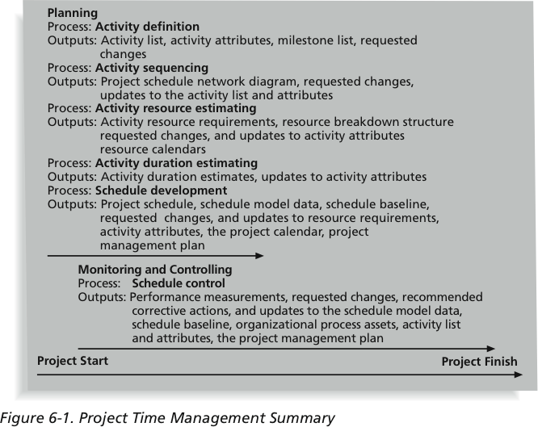
Project Time Management Summary

Slide 10
Activity Definition
Project schedules grow out of the basic documents that initiate a project
  Project charter includes start and end dates and budget information
  Scope statement and WBS help define what will be done
Activity definition involves developing a more detailed WBS and supporting explanations to understand all the work to be done so you can develop realistic cost and duration estimates

Slide 11
Activity Definition
The basis for creating a project schedule is derived from four project time management processes
  Activity definition – further defining the scope
  Activity sequencing – further defining the time
  Activity resource and activity duration (further defining the time and cost)

Slide 12
Activity Lists and Attributes
An activity list is a tabulation of activities to be included on a project schedule that includes:
  The activity name
  An activity identifier or number
  A brief description of the activity
Activity attributes provide more information such as predecessors, successors, logical relationships, leads and lags, resource requirements, constraints, imposed dates, and assumptions related to the activity

Slide 13
Milestones
A milestone is a significant event that normally has no duration
  Not every deliverable or output created for a project is a milestone
It often takes several activities and a lot of work to complete a milestone
They’re useful tools for setting schedule goals and monitoring progress
Examples include obtaining customer sign-off on key documents or completion of specific products such as software modules or the installation of new hardware

Slide 14
Activity Sequencing
After defining project activities, the next step is activity sequencing
  Involves reviewing the activity list and attributes, project scope statement, milestone list and approved change requests to determine the relationships between activities
A dependency or relationship is the sequencing of project activities or tasks
You must determine dependencies in order to use critical path analysis

Slide 15
Three Types of Dependencies
Mandatory dependencies: inherent in the nature of the work being performed on a project, sometimes referred to as hard logic
Discretionary dependencies: defined by the project team; sometimes referred to as soft logic and should be used with care since they may limit later scheduling options
  Don’t start detailed design work until users sign-off on all the analysis – good practice but can delay project
External dependencies: involve relationships between project and non-project activities
  Delivery of new hardware; if delayed can impact project schedule

Slide 16
Network Diagrams
Network diagrams are the preferred technique for showing activity sequencing
A network diagram is a schematic display of the logical relationships among, or sequencing of, project activities
Two main formats are the arrow and precedence diagramming methods

Slide 17
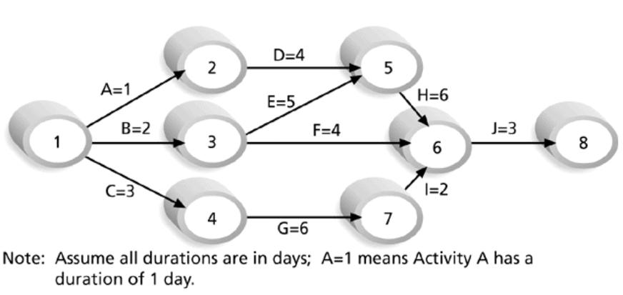
Sample Activity-on-Arrow (AOA) Network Diagram for Project X

Slide 18
Arrow Diagramming Method (ADM)
Also called activity-on-arrow (AOA) network diagrams
Activities are represented by arrows
Nodes or circles are the starting and ending points of activities
Can only show finish-to-start dependencies
Can omit activities that have no dependencies

Slide 19
Process for Creating AOA Diagrams
1. Find all of the activities that start at node 1: Draw their finish nodes and draw arrows between node 1 and those finish nodes; put the activity letter or name and duration estimate on the associated arrow
2. Continue drawing the network diagram, working from left to right: Look for bursts and merges
  Bursts occur when a single node is followed by two or more activities
  A merge occurs when two or more nodes precede a single node
3. Continue drawing the project network diagram until all activities are included on the diagram that have dependencies
4. As a rule of thumb, all arrowheads should face toward the right, and no arrows should cross on an AOA network diagram

Slide 20
Precedence Diagramming Method (PDM)
More popular than ADM method and used by project management software
Activities are represented by boxes
Arrows show relationships between activities
Better at showing different types of dependencies

Slide 21
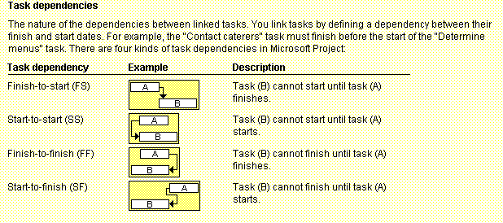
Task Dependency Types
Notes:
Finish to finish – two processes that go on in parallel. When one finishes so does the other. Quality control goes on the entire time production is underway
Start to finish – rarely used; JIT inventory restock as long as manufacturing process is underway. Manufacturing delayed, stocking is dealyed

Slide 22
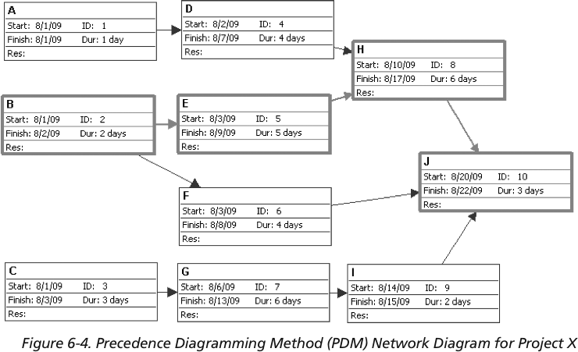
Sample PDM Network Diagram

Slide 23
Activity Resource Estimating
Before estimating activity durations, you must have a good idea of the quantity and type of resources that will be assigned to each activity
Consider important issues in estimating resources
  How difficult will it be to do specific activities on this project?
  What is the organization’s history in doing similar activities?
  Are the required resources available or need to be acquired?
A resource breakdown structure is a hierarchical structure that identifies the project’s resources by category and type

Slide 24
Activity Duration Estimating
Duration includes the actual amount of time worked on an activity plus elapsed time
Effort is the number of workdays or work hours required to complete a task
Effort does not normally equal duration
People doing the work should help create estimates, and an expert should review them

Slide 25
Three-Point Estimates
Instead of providing activity estimates as a discrete number, such as four weeks, it’s often helpful to create a three-point estimate
  An estimate that includes an optimistic, most likely, and pessimistic estimate, such as three weeks for the optimistic, four weeks for the most likely, and five weeks for the pessimistic estimate
Three-point estimates are needed for PERT and Monte Carlo simulations

