Slide 1
Project Monitoring and Control by
Hateem Ghafoor, PMP

Slide 2
Course Introduction
This course, Project Monitoring and Control, covers the 5 process areas and 9 knowledge areas of project management specifically with reference to Project Monitoring and Control. Since this is the specialized course, so, the project management methodologies will be handled in a way to understand monitoring and control measures and systems to effectively manage a project.

Slide 3
Course Objective
The object of this course is to furnish you with the skills and knowledge you need to effectively monitor and control a project, and to understand the techniques used in these areas. Once the work is underway, you will use the control systems to monitor, forecast, and solve problems as they occur. You will learn the elements of project monitoring and control and ways to set up meaningful control systems that can help assure the user a successfully completed project

Slide 4
Reference Material
PMBoK Fourth Edition, by PMI USA
Construction Project Management by JHA
  Pearson education USA
Course material

Slide 5
Assessment and Grading
Exam No | Exam Type | Due after Lecture No. | Total Marks
1 | Quiz 1 | 5 | 5%
2 | Quiz 2 | 12 | 10%
3 | Assignment 1 | 21 | 10%
4 | Midterm Exam | 18 | 25%
5 | Final Exam | 32 | 50%
Marks scheme:
Quizzes + assignments = 25%
Mid Term Exam = 25%
Final = 50%

Slide 6
Course Contents
Lesson 1: Examining Professional Project Management
Topic 1A: Identify Project Management Processes
Topic 1B: Identify Professional and Social Responsibilities
Topic 1C: Identify the Interpersonal Skills Required for a Project Manager
Lesson 2: Initiating a Project
Topic 2A: Examine the Project Management Context
Topic 2B: Examine Project Selection
Topic 2C: Prepare a Project Statement of Work
Topic 2D: Create a Project Charter
Topic 2E: Identify Project Stakeholders

Slide 7
Contd..
Lesson 3: Planning Project Work
Topic 3A: Identify the Elements of a Project Management Plan
Topic 3B: Document Stakeholder Requirements
Topic 3C: Create a Scope Statement
Topic 3D: Develop a Work Breakdown Structure
Lesson 4: Developing Project Schedules
Topic 4A: Create an Activity List
Topic 4B: Create a Project Schedule Network Diagram
Topic 4C: Estimate Activity Resources
Topic 4D: Estimate Duration for Project Activities
Topic 4E: Develop a Project Schedule
Topic 4F: Identify the Critical Path
Topic 4G: Optimize the Project Schedule
Topic 4H: Establish a Schedule Baseline

Slide 8
Contd..
Lesson 5: Developing Cost Estimates and Budgets
Topic 5A: Estimate Project Costs
Topic 5B: Estimate the Cost Baseline
Topic 5C: Reconcile Funding and Costs
Lesson 6: Planning Project Quality, Staffing, and Communications
Topic 6A: Create a Quality Management Plan
Topic 6B: Document the Project Roles, Responsibilities, and Reporting Relationships
Topic 6C: Create a Communications Management Plan

Slide 9
Contd..
Lesson 7: Analyzing Risks and Planning Risk Responses
Topic 7A: Examine a Risk Management Plan
Topic 7B: Identify Project Risks and Triggers
Topic 7C: Perform Qualitative Risk Analysis
Topic 7D: Perform Quantitative Risk Analysis
Topic 7E: Develop a Risk Response Plan
Lesson 8: Planning Project Procurements
Topic 8A: Plan Project Procurements
Topic 8B: Prepare a Procurement Statement Of Work
Topic 8C: Prepare a Procurement Document

Slide 10
Contd..
Lesson 9: Executing Project Work
Topic 9A: Identify the Direct and Manage Project Execution Process
Topic 9B: Execute a Quality Assurance Plan
Topic 9C: Acquire the Project Team
Topic 9D: Develop the Project Team
Topic 9E: Manage the Project Team
Topic 9F: Distribute Project Information
Topic 9G: Manage Stakeholder Relationships and Expectations
Lesson 10: Managing Project Procurement
Topic 10A: Examine the Project Procurements Process
Topic 10B: Obtain Responses from Sellers
Topic 10C: Determine Project Sellers

Slide 11
Contd..
Lesson 11: Monitoring and Controlling Project Work
Topic 11A: Identify the Monitor and Control Project Work Process
Topic 11B: Develop an Integrated Change Control System
Topic 11C: Utilize the Integrated Change Control System
Topic 11D: Review Deliverables and Work Results
Topic 11E: Control the Project Scope
Lesson 12: Monitoring and Controlling Project Schedule and Costs
Topic 12A: Control the Project Schedule
Topic 12B: Control Project Costs

Slide 12
Contd..
Lesson 13: Monitoring and Controlling Project Performance and Quality
Topic 13A: Perform Quality Control
Topic 13B: Report on Project Performance
Lesson 14: Monitoring and Controlling Project Risks and Procurements
Topic 14A: Monitor and Control Project Risks
Topic 14B: Administer Project Procurements
Lesson 15: Closing the Project
Topic 15A: Close Project Procurements
Topic 15B: Close the Project or Phase Administratively

Slide 13
Competencies
Initiation
Cost Budgeting
Scope Planning
Quality Planning
Quality Control
Schedule Control
Scope Definition
Quality Assurance
Cost Control
Activity Definition
Cost Estimating
Team Development
Activity Sequencing
Resource Planning
Change Control
Risk Identification
Risk Analysis
Schedule Development
Performance Reporting
Project Plan Execution
Scope Change Control
Risk Response Planning
Administrative Closure
Information Distribution
Risk Monitoring and Control
Communications Planning
Risk Management Planning
Project Plan Development
Activity Duration Estimating

Slide 14

Course is “Project Monitoring and Control” then why to start with “project management basics”
Let me tell you why…………..

Slide 15
Critical Role of a Feedback System
Is the Feedback system necessary?
Why not just carry out “totally static planning” or “forward ever”?
In real world, planning is never perfectly deterministic
Nothing always goes perfectly according to the original plan
Why/How?
  Physical: Inclement weather, unforeseen geotechnical conditions, unforeseen utility location problems, etc.
  Early or late delivery of procured items
  Changes in Owner requirements
  Changes in worker and equipment productivity
  Community opposition to project conditions (noise, dust, etc.
  Design and planning errors (inappropriate assumptions)

Slide 16
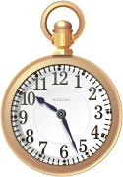


Definition of Project Monitoring
  Procedures
  collecting data
  project performance (achieved or forecasted)
Again, note that:
  Performance could be in terms of time, money, or quality
  2. Forecast performance = “program”
Achieved performance = “progress”
3. Technology helps greatly in project monitoring

Slide 17
Avoiding Deviations in Project Cost, Time, and Quality – Common Challenges Faced by Project Managers
Rank
Order Challenge Frequency
1 Coping with end-date-driven schedules 85%
2 Coping with resource limitations 83%
3 Communicating effectively among task groups 80%
4 Gaining commitment from team members 74%
5 Establishing measurable milestones 70%
6 Coping with changes 60%
7 Working out project plan agreement with team 57%
8 Gaining commitment from management 45%
9 Dealing with conflict 42%
10 Managing vendors and subcontractors 38%
11 Other challenges 35%

Slide 18
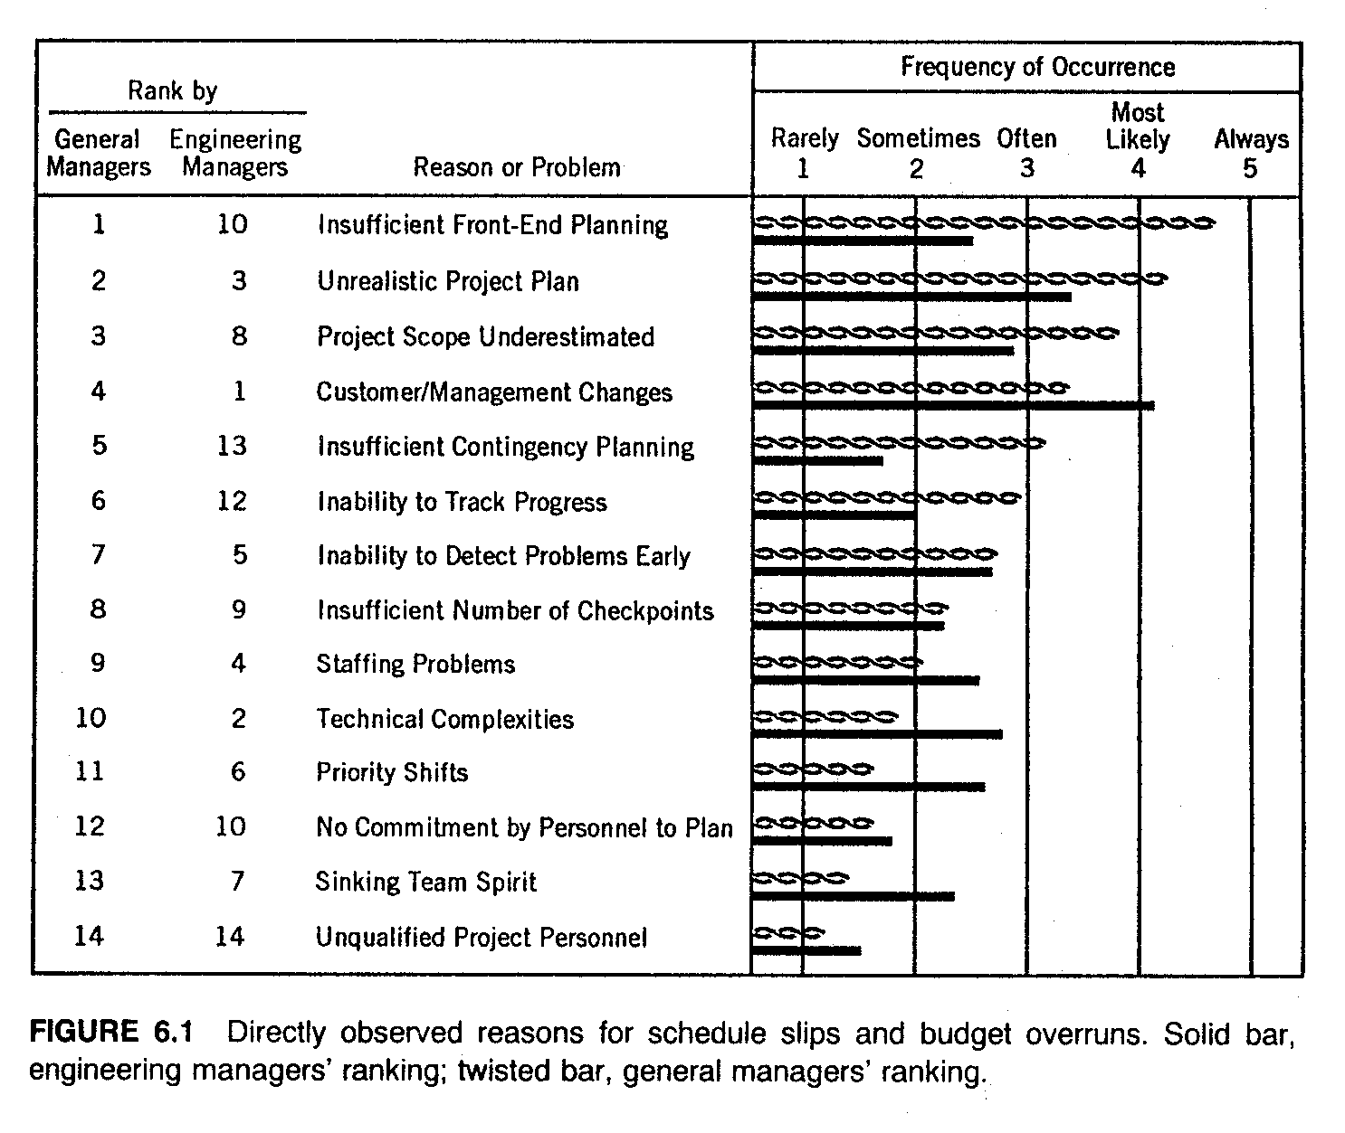
Reasons Often Cited for Deviations

Slide 19
Monitoring & Control: A Feedback Process
  Detect deviations
Monitoring
1. Measurement
2. Performance Analysis)
Control
1. Actions
2. Revised Plans, Cash Flows, Schedules, etc.
  Correct Deviations

Slide 20
Project Control: The Big Picture
Project is Off-track
Monitoring indicates that:
- Project is behind time-schedule, and/or
- Project has exceeded budget, and/or
- Quality of materials or finished work is below standard
- Productivity is lower than as planned, etc…..

Slide 21



Project Control: The Big Picture …
Resources for PC (the 4-M’s)
Given
Project is Off-track
Resources available to the Project Manager for Project Control:
- Money
- Manpower (labor)
- Materials
- Machinery (Equipment)

Slide 22
Project Control: The Big Picture …
Resources for PC (the 4-M’s)
Given
Mechanism and Elements of PC
Project is Off-track
Adjust the resources
Adjust the project characteristics: size, scope, etc
More labor? Better labor?
Better supervision?
More materials? Better materials?
More equipment? Better equipment?
More money?
resources
Reduce project size? Reduce project scope?
Terminate project?
project

Slide 23

Output
Happy Project Manager

Slide 24
Have a Good Day….

