Slide 1
Master of Science in
Project Management
Project Stakeholder
AND COMMUNICATION Management
LECTURE 09: STAKES AND RELATIONSHIPS OF PROJECT SECONDARY STAKEHOLDERS

Slide 2

Project Secondary Stakeholders
(Competitors)
Are competitors stakeholders? Yes, they certainly are because through their projects companies may, in favourable circumstances, gain a (perhaps significant) comparative advantage over their rivals.
Software development is a case in point. Suppose there are four firms on the market which offer consumers high-end image editing software of approximately compa-rable standard.
Competitors are always keeping a close and con-stant watch on their rivals for the simple reason that they don’t want a nasty surprise!
Business Intelligence and Corporate or Industrial Espionage / State Espionage
Notes:
Projects of one company may, in the extreme case, constitute an existential threat for other companies if they don’t anticipate the threat and devise an appropriate mitigation strategy or measures.

Slide 3
Project Secondary Stakeholders
(Competitors)
Firm A initiates a project to develop an upgraded version with consider-ably improved functionality which it intends to market at a price marginally higher than its current offering.
Without initiating software upgrade projects of their own - its three competitor Firms B, C and D may lose heavily in lost sales and market share as buyer demand diverts to Firm A‘s new software.
Many companies have been accused over the course of time of “steal-ing” trade secrets from their competitors or luring away employees to work for them and pass on their acquired know-how.

Slide 4
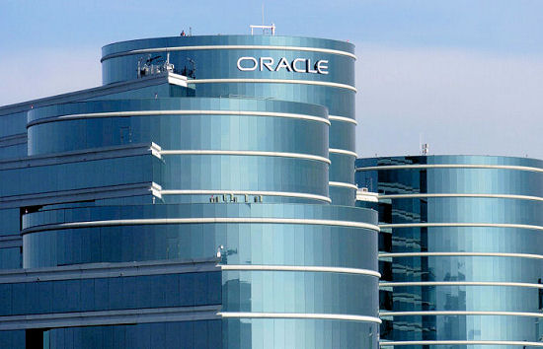
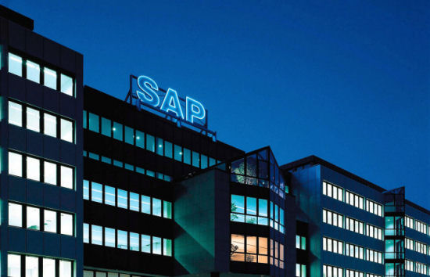
Project Secondary Stakeholders
(Competitors)
In November 2010, a jury fined German software giant SAP USD 1.3 billion because one of its subsidiaries illegaly downloaded from the internet millions of files from its US competitor Oracle Corporation.

Slide 5

Project Secondary Stakeholders
(Civic and Professional Organizations)
Modern economies and the socie-ties which underlie them are highly complex entities.
Countless organizations/institu-tions with diverse missions, goals and objectives, operating in diver-se fields and representing diverse interests exist and interact in this complex and dynamic environ-ment.
Without them, society would not be able to function.
Organizations are as diverse as people and so are there interests and concerns as far as projects are concerned.

Slide 6
Project Secondary Stakeholders
(Civic and Professional Organizations)
Civic and professional organiza-tions influence and are influenced by projects in many ways.
Examples of such organizations: Educational and medical establish-ments, vocational training institu-tes, consumer interest and advo-cacy groups, trade and manufac-turers associations, chambers of industry and commerce, govern-ment regulatory agencies and de-partments, and service-oriented non-governmental organizations.
Organizations are as diverse as people and so are there interests and concerns as far as projects are concerned.

Slide 7
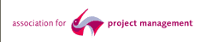











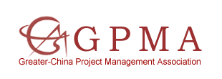

Professional Project Mgt. Associations
Selected Examples

Slide 8

Project Secondary Stakeholders
(The Environmentalists)
Since the 1960s, the environmen-talist movement has emerged on the global scene as a highly vocal and influential entity.
Organizations like Greenpeace periodically make world headlines with their campaigns aimed at generating public awareness against actions ranging from the cruel practice of whaling in the world‘s oceans to the plans of the nuclear industry to construct new power stations.
Environmentalists will fiercely contest projects, particularly big civil en-gineering type ones.
Good advice to Project Owners/Planners/Implementers: Always try to keep them happy!

Slide 9
Project Secondary Stakeholders
(The Environmentalists)
Many projects across the globe regularly come under the critical scrutiny of the environmentalists.
Of special concern to them are large projects such as dam, road and airport construction, and pro-jects in the energy sector (oil and gas terminals and pipelines, ther-mal, hydro and nuclear power sta-tions), all of which involve substan-tive damage to the physical envi-ronment, its fauna and flora, and soil, air and water pollution.
Environmentalists often form coalitions to con-test projects. Through this arrangement, their resources and influence are bundled which makes them a very potent adversary for project proponents.

Slide 10

Project Secondary Stakeholders
(Tourists)
Tourists are a force to be reckoned with in today’s world!
With globalization, personal mobi-lity and a booming travel industry which constitutes a pillar of the global economy there’s hardly a place on the planet that they have not discovered. People are taking to the roads and skies in ever in-creasing numbers to visit destina-tions both within and beyond national borders.
Construction Projects in the superlative cate-gory – the biggest, tallest, longest, most luxurious, most expen-sive and so forth – often generate considerable interest among tourists.

Slide 11
Project Secondary Stakeholders
(Tourists)
Tourists spend lots of money where they go and in many regions they are the prime source of eco-nomic prosperity.
Thousands of projects across the globe in countries as diverse as Egypt and Thailand, Turkey and the Maldive Islands, Spain and the UAE are being undertaken by govern-ments and the private sector specifically to cater to the needs of tourists.
Attracting tourists is often one of the inten-ded outcomes of pro-jects aiming to im-prove infrastructure and cultural and re-creational facilities in towns, cities and loca-lities everywhere.

Slide 12
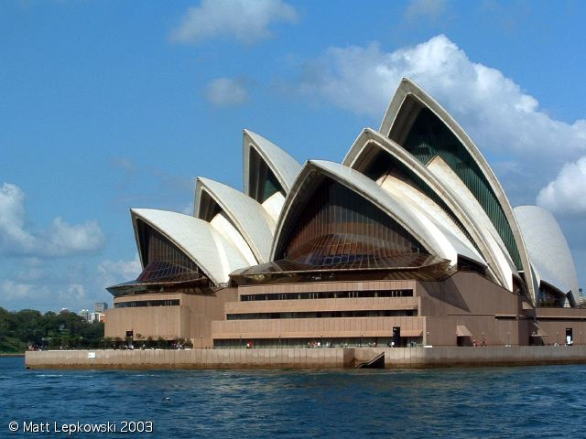
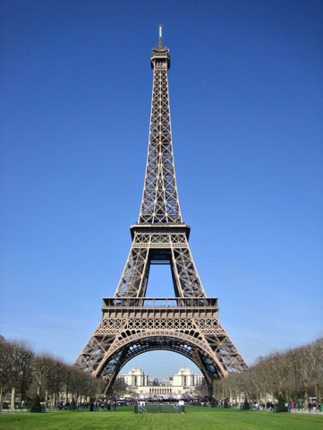
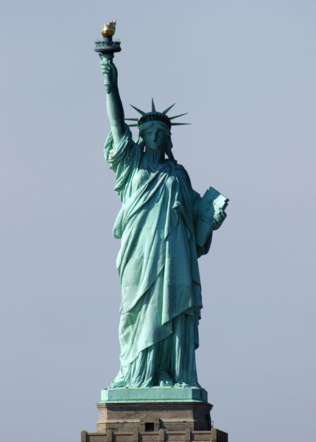
Project Secondary Stakeholders
(Tourists)
Some of the most visited build-ings and man-made structures in the world are shown in these three photos: the Opera House in Sydney, Australia, the Eiffel Tower in Paris, France, and the Statue of Liberty in New York city, USA.
Many more man-made structu-res scattered across our globe attract countless tourists every year.

Slide 13

Project Secondary Stakeholders
(The Media)
In its print, broadcast and web-based forms the media is a (very) powerful force and shaper of public opinion.
Through its reporting on projects, the media on numerous occasions has strongly influenced people‘s perceptions, sometimes in favour of projects and sometimes against them by respectively focussing more on the project‘s positive or negative points.
The print media has an economic interest in projects, for e.g., ten-der notices, RFPs and job advertisements for needed project staff. Many newspaper arti-cles and news items relate to projects.

Slide 14
Project Secondary Stakeholders
(The Media)
The first exposure people have to a project in which they are not direct-ly or indirectly involved is normally through the media.
The exposure may be ‚objective‘ or ‚biased‘ depending, inter alia, on the ideological underpinnings of the media source. By harnessing media support, Project Owners and Planners/Implementers would put themselves in a better position to manage their stakeholders.
Controversial projects, often draw media attention. Through the reporting (not neces-sarily accurate) many people draw their own conclusions about the project’s desirability/ undesirability.

Slide 15
TV Documentaries on Major Projects
A number of interesting and insightful television documentary series have been filmed about large and complex projects in construction and engineering which have been undertaken across the globe.
These can be viewed on popular cable educational television channels such as National Geographic, Discovery and History.

Slide 16
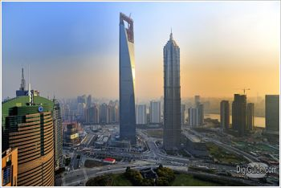

TV Documentary Series: Megastructures
More than fifty episodes of the documentary series Megastructures have been produced and broadcasted since 2004 by National Geographic, Channel Five (UK) and France 5 (France).
Click on the two images for further information.

Slide 17
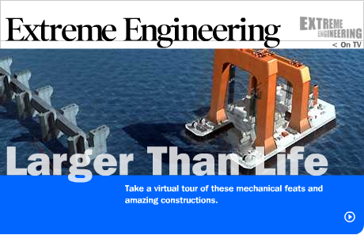
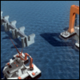
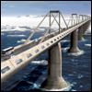
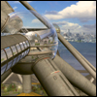
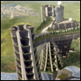

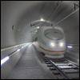
TV Documentary Series: Extreme Engineering
Extreme Engineering is a television docu-mentary series broad-cast by the Discovery Channel and the Science Channel. It has aired six seasons.
Click on the top image and the top left image for further information.

Slide 18





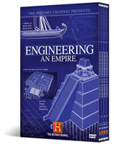
TV Documentary Series: Modern Marvels
Modern Marvels is a TV documentary series shown on the History Channel.
Over 520 episodes have been produced of this series which was first broadcast in Jan. 1995.
Click on the top image and the image on the bottom right for more information.

Slide 19

Project Secondary Stakeholders
(Academia and Research)
Interest among teachers and resear-chers in projects stems primarily from the valuable information com-pleted and on-going projects yield and which can be used in the class-room environment and for research projects.
For example, a project management teacher‘s or researcher‘s focus of interest may be the communication processes and tools used in large road construction projects.
Professors, lecturers and researchers are (usually) keen to know how things they teach in their classes or write about in their publica-tions are done in the “real world”.
Notes:
Educational background determines the focus of interest teachers and researchers have in projects: A teacher or researcher trained in civil engineering may, for example, be more interested in the project‘s technical aspects and its application of innovative materials and designs while a teacher or researcher with a social science background may want to gain insight into the perfor-mance of the project team and level of interaction and communication which occurs between the project stakeholders over the course of the project life-cycle.

Slide 20
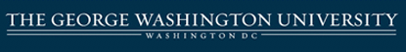


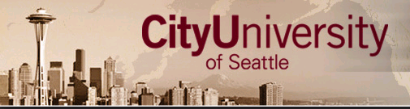

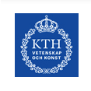


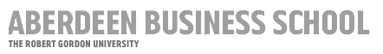
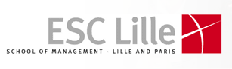
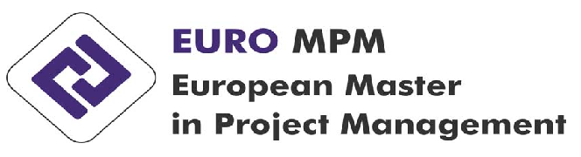
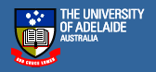


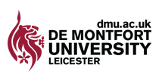

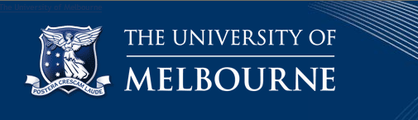

On-Campus PM Master Degree Programs
(Small Selection Only)

