Slide 1
Master of Project Management
Project Stakeholder
AND COMMUNICATION Management
Virtual Campus CIIT
LECTURE 08: STAKES, ROLES AND MAJOR RESPONSIBILITIES
OF THE PROJECT STAKEHOLDERS PART 2

Slide 2

A Project’s ‘Primary’ Stakeholder Community
Primary Stakeholders
Corporate Shareholders
Project Team
Senior Management
Project Partners
Project Sponsor
Project Client / Output
Users / Customers
Project Board /
Steering Committee
Project Input Suppliers
& Vendors (ext.)
Cleland/Ireland provide a fairly
comprehensive listing of a pro-
ject’s “primary” and “secondary”
Stakeholders, whereby primary stakeholders can be internal or external to the project-impleme-menting entity.
Managing all these stakeholders
Is challenging but “routine” for
the project manager and project
team.
Program or Project
Management Office
Project Contractors &
Subcontractors
Chief Project Officer /
Program Manager
Project Advisors
and Consultants
Functional &
Resource Managers
Project Financers (ext.)
Project Manager
Local, State and Federal
Government Entities
Notes:
Also: Distributors of products developed, e.g. new beverages

Slide 3

Project Primary Stakeholders
(The Project Manager)
The project manager is the key person who provides direction to the project team.
The Project Manager leads the project team through the crea-tion and execution of the pro-ject plan, obtains formal appro-val for it, monitors and reports on the progress of the project in relation to the project plan and initiates action to ensure that the project stays on track.
The Project Leader / Manager is (under normal circumstances) ultimately responsible for the project‘s
„success“ or „failure“

Slide 4
Project Primary Stakeholders
(The Project Manager)
The Project Manager responds to requests for changes to the project plan, faciliates the team process and team cohesion, re-moves obstacles facing the team and manages team con-flict, calls and manages team meetings, liaises with key pro-ject stakeholders, and issues the final project report.
A successful project manager requires excellent „hard“ and „soft“ skills.
The Project Manager‘s focus is more on mon-itoring, evaluating and controlling project work activities. Not supposed to „micro-manage“!

Slide 5

Project Primary Stakeholders
(The Project Team)
The project team is at the front-line of the project‘s initiation, planning, execution, closure and monitoring, evaluation and con-trol phases.
Project teams can be of the cross-functional, self-managed and virtual type. Through team effort, knowledge, collaboration, trust and communication, a synergy is evolved which is the driving force behind the project.
Team Members have many rea-sons for participating in a project. These can be financial, rewards and special incentives, anticipa-tion of promotions, acquisition of knowledge and skills, networking, satisfaction of contributing to-wards the creation of something new etc.

Slide 6
Project Primary Stakeholders
(The Project Team)
Through their participation in the project the team members pro-vide specialized expertise, expe-rience and innovative input that create quality deliverables within given budget, schedule and other constraints.
The Team ensures that project issues and progress updates are communicated to the Project Manager and that interaction with other project stakeholders to the required extent occurs.
Teams can be a powerful force if managed properly! There are many drivers and many barriers to team performance which must be understood and dealt with effectively to get the best out of project teams.

Slide 7
Forming a (Dedicated) Project Team
CORPORATION X
Human
Resources
Finance &
Administration
Other Areas
Marketing
Engineering
Manufacturing
Procurement
Project Manager
MA1
MA2
MA3
EN1
EN2
EN3
MF1
MF2
MF3
PR1
PR2
Staff are assigned away from various departments to work full-time on the project.
Project Team

Slide 8

Project Primary Stakeholders
(The Project Consultant)
Project Consultants are indispensa-ble for many projects!
Project Consultants range from inde-pendent individuals performing one, few or several specialized tasks on a project to highly reputable organisa-tions with vast expertise and expe-rience working on large and mega-projects across the globe and which remain involved in the project over its life-cycle which may extend over a period of years.
Consultants seek, off course, to reap financial benefits through their involvement in projects.
Besides this, they expect to reap the benefits of experience and the prestige which goes with working on high-profile projects.

Slide 9
Project Primary Stakeholders
(The Project Consultant)
Project Consultants offer all kinds of fee-based services.
Examples: Prefeasibility/Feasibility Studies, Architect. & Engineering De-sign, Proj. Planning, Cost Estimation, Proj. Scheduling, Quality Assurance & Control, Risk Assessment, Data & Documentation Management, Con-tract Management, Monitoring, Eval-uation & Auditing, Training (hard & soft skills), Liaising with Project Stake-holders, Trouble-shooting.

Slide 10
Project Primary Stakeholders
(The Project Consultant)
Consultants bring specialized ex-pertise to the project and often have extensive project experience.
Project consultancy is a challenging and innovative – and often highly lucrative - field of work.

Slide 11
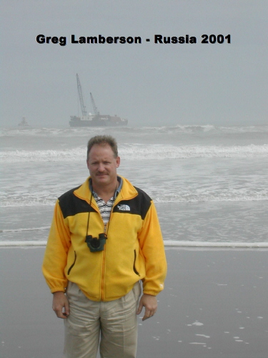

Project Primary Stakeholders
(The Project Consultant: Independent Consultants)
Greg Lamberson is an independent American consultant based in Tulsa, Okhlahoma.
Lamberson has worked as a consul-tant on several predominately ener-gy-related projects in and outside the United States.
Greg Lamberson generously provided informational support when I was set-ting up the Master of Project Manage-ment (MPM) program at my university CIIT in Islamabad, Pakistan, back in 2008.

Slide 12


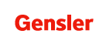


Project Primary Stakeholders
(The Project Consultant: Selected Arch. Design Firms)

Slide 13


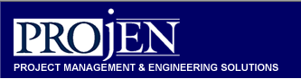



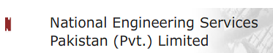
Project Primary Stakeholders
(The Project Consultant: Selected P-Mgmt. Consultants)

Slide 14

Project Primary Stakeholders
(The Project Contractor)
The Project Contractor is a key stakeholder who performs the main physical work on (typically construction) projects on behalf of the Project Owner during the pro-ject‘s execution phase.
Construction is a complex and challenging undertaking and Pro-ject Contractors often have to con-tend with many unforeseen prob-lems which surface in the course of project execution!
Notes:
Laws and regulations which are relevant for project contractors concern, for e.g., labour workforce, on-site safety, the environment, and waste disposal.
Ethical Issues need to be considered too. The disgraceful treatment of construction workers employed on many construction projects in Dubai, UAE, and against which the UAE authorities have taken no counter-measures whatsoever, vividly exemplify the humanitarian problems which may arise when project contractors display a total lack of ethics.

Slide 15
Project Primary Stakeholders
(The Project Contractor)
The Project Contractor‘s major res-ponsibilities include:
Adherence to the agreed construction schedule
Ensuring consistency of work perform-ed to requirements and specifications
Undertaking approved changes to the project scope
Adherence to agreed quality standards (incl. work done by Subcontractors)
Compliance with all laws, regulations
Notes:
Laws and regulations which are relevant for project contractors concern, for e.g., labour workforce, on-site safety, the environment, and waste disposal.
Ethical Issues need to be considered too. The disgraceful treatment of construction workers employed on many construction projects in Dubai, UAE, and against which the UAE authorities have taken no counter-measures whatsoever, vividly exemplify the humanitarian problems which may arise when project contractors display a total lack of ethics.

Slide 16
Project Primary Stakeholders
(The Project Contractor)
Acquisation of requisite licenses and permits
Regular monitoring of the construction process and progress reporting to the project owner, consultant, manager and other concerned stakeholders
Problem and conflict resolution
Communication with relevant stake-holders
Close coordination with Project Sup-pliers and Project Subcontractors for ensuring a smooth workflow
Notes:
Laws and regulations which are relevant for project contractors concern, for e.g., labour workforce, on-site safety, the environment, and waste disposal.
Ethical Issues need to be considered too. The disgraceful treatment of construction workers employed on many construction projects in Dubai, UAE, and against which the UAE authorities have taken no counter-measures whatsoever, vividly exemplify the humanitarian problems which may arise when project contractors display a total lack of ethics.

Slide 17
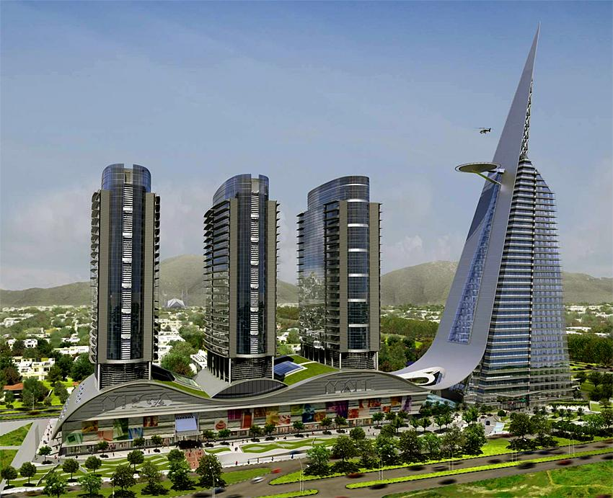
Project Primary Stakeholders
(The Project Contractor)
The Centaurus Project in Islamabad is one of the largest construction projects underway in Pakistan. With an estimated cost of Rupees 25 bill-ion, it will on completion comprise two residential and one office build-ings, a seven star hotel and a shop-ping mall.
Designed by the renowned UK archi-tect firm Atkins, China State Nation-al Construction Engineering Corpora-tion is spearheading the construction work as the lead contractor.

Slide 18






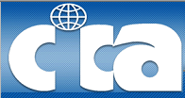


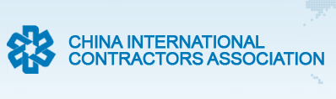
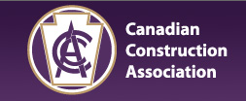

Project Primary Stakeholders
(The Project Contractor: Selected Associations)

Slide 19

Project Primary Stakeholders
(The Project Supplier/Vendor)
Project Suppliers or Vendors provide tangible (physical) inputs for the project which are acquired through a standard (usually competitive) pro-curement process.
Like Project Contractors, Project Sup-pliers/Vendors are key stakeholders in construction and many other catego-ries of projects.
Some manufactures perform supply functions, others use distributors.
Inputs come in all shapes and sizes - and costs! They can be as simple as nuts, bolts and iron beams needed on a project con-struction site and as complex as sophisticated medical diagnostic equipment for a newly opened hospital cancer ward.
Notes:
Dell Corporation for instance ships customized PCs and Laptops directly to clients.

Slide 20
Project Primary Stakeholders
(The Project Supplier/Vendor)
The prime responsibility of the Pro-ject Suppliers/Vendors lies in ensur-ing that all inputs of the contractually agreed specs, quality and quantity are delivered on time (regularly, pe-riodically, occasionally) to the project site/sites where they are needed.
The concept of JIT (Just in Time) de-livery of inputs has gained popularity in operations and project manage-ment in recent years for its efficiency-enhancing impact.
In supply chain management context JIT offers potentially sig-nificant cost and risk advanta-ges but requires in addition to interest, trust and commitment that good communicational and logistical infrastructures are in place and the supplier has the requisite capacity.
Notes:
JIT Cost Advantages: Inventory, Insurance, Storage etc.
JIT Risk Advantages: Less Chance of Damage (e.g. Fire, Floods) and Pilferage etc.

Slide 21
Project Primary Stakeholders
(The Project Supplier/Vendor)
Delays in the delivery of inputs to project sites may delay project work activities, resulting in costs which are avoidable.
Hence, it is imperative that Project Suppliers/Vendors closely coordinate with the Project Contractor and Sub-contractors, Project Manager and the Project Team, especially in the pro-ject‘s execution phase when streams of inputs are needed to perform the work activities.
Project Suppliers/Vendors are interested in winning orders and making profit, securing future orders, timely payment for goods provided, being involved in high-profile projects, building business relationships, having the client’s cooperation, and reducing their contractual risks.
Notes:
That is if the project work activities in question lie on the critical path.
Note that Project Suppliers/Vendors also want to be given proper notice in case inputs are needed by the client. They also want to outdo their competitors.

Slide 22
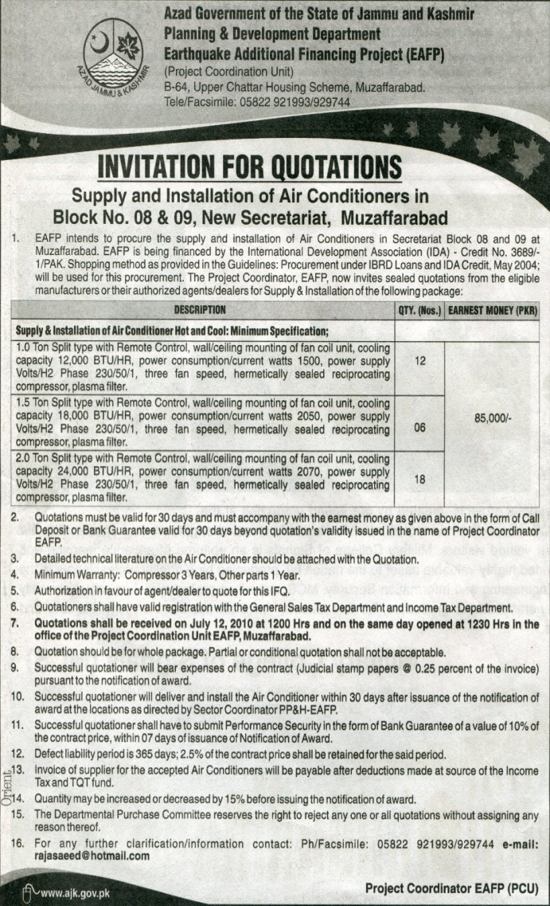
Project Primary Stakeholders
(The Project Supplier/Vendor)
Traditionally, contact between pros-pective Project Suppliers/Vendors and the project is established through the media interface.
This advertisement in a Pakistani daily newspaper (The News, June 26, 2010) invites prospective suppliers/vendors to provide airconditioners for a gov-ernment building in Muzaffarabad.
In recent years, eProcurement is being used for project input sourcing.
Notes:
Such advertisements appear regularly in newspapers across the globe.
Discuss briefly the different forms of procurement on projects and the difference between open tender and tender on the basis of pre-qualification.

Slide 23
Thank You for Your Patience!
Next week we shall continue look-ing at types of stakeholders, focus-ing our attention this time on the “secondary” stakeholders.
See you all next week!

