Slide 1
Master of Project Management
Project Stakeholder
AND COMMUNICATION Management
Virtual Campus CIIT
LECTURE 07: STAKES, ROLES AND MAJOR RESPONSIBILITIES
OF THE PROJECT STAKEHOLDERS PART 1

Slide 2

A Project’s ‘Primary’ Stakeholder Community
Primary Stakeholders
Corporate Shareholders
Project Team
Senior Management
Project Partners
Project Sponsor
Project Client / Output
Users / Customers
Project Board /
Steering Committee
Project Input Suppliers
& Vendors (ext.)
Cleland/Ireland provide a fairly
comprehensive listing of a pro-
ject’s “primary” and “secondary”
Stakeholders, whereby primary stakeholders can be internal or external to the project-impleme-menting entity.
Managing all these stakeholders
Is challenging but “routine” for
the project manager and project
team.
Program or Project
Management Office
Project Contractors &
Subcontractors
Chief Project Officer /
Program Manager
Project Advisors
and Consultants
Functional &
Resource Managers
Project Financers (ext.)
Project Manager
Local, State and Federal
Government Entities
Notes:
Also: Distributors of products developed, e.g. new beverages

Slide 3

Managing and Engaging Project Stakeholders
(Congruity of Interests)
Every stakeholder has by defini-tion some interest - or multiple in-terests - in a project.
The challenge for project stakehol-der management and engagement is to comprehensively identify and carefully analyze all these diverse interests and then come up with practical strategies and measures that seek to ensure that these in-terests are safeguarded (or conflict to the minimum possible extent).

Slide 4

Project Primary Stakeholders
(Senior Management)
Senior Management is (ultimately) responsible for the organization’s performance and accomplishment of its mission and key goals and objectives. To a large extent this depends on the choice of projects/ programs the organization selects and implements.
Without the interest, encourage-ment and sustained support of senior management, projects run a higher risk of failure.
Senior Mgmt.’s interests in shaping project/program port-folios would typically include financial (salary, bonus, perks, job security), material (office facilities and privileges), repu-tational (status in/outside the organization) in addition to other interests.

Slide 5

Project Primary Stakeholders
(Senior Management)
The responsibility lies with Sen-ior Management to create a cul-ture in their organizations which unequivocally recognizes the role and criticality of projects/prog-rams as „mission attainers“.
Senior Management can facili-tate projects immensely by creat-ing institutional, technological, informational and process infra-structures supportive of projects /programs in their organizations.
Senior Management can sometimes be overbearing in its approach to the point where it intervenes excessive-ly in a project’s operations and management, possibly causing confusion, uncertain-ty and demotivation. The fo-cus should be on monitoring.

Slide 6

Project Primary Stakeholders
(Senior Management)
Responsibility for the soundness of an organization‘s project/program portfolios and for ensuring that re-quisite resources are made availa-ble rests with Senior Management.
Senior Management must periodi-cally monitor and evaluate its or-ganization‘s project/program port-folios and, if necessary, terminate projects/programs which are, or which will be, adding no or insuffi-cient value to the organization.
Tools are available to assist managers in selecting the right projects and monitoring their progress. These include (for selection) simple to com-plex project scoring models and (for monitoring) software like Primavera and MS Project Enterprise.

Slide 7

Project Primary Stakeholders
(Senior Management)
Organization’s Mission
(long-term focus)
Goals & Objectives
(short, medium and long-term)
Strategies
(formulation, evaluation, selection)
Programs
(esp. mission-critical)
Projects
(esp. mission-critical)
Operations
Organizations Structure, Culture, Resources, Knowledge Assets, Institutional and Infrastructural Support Base, Processes etc.
Notes:
Mission-Critical Goals and Objectives.

Slide 8

Project Primary Stakeholders
(The Project Champion)
The the Project Champion per-forms a crucial supporting function on projects.
The Champion advocates the pro-ject to senior management.
His or her contribution includes en-suring that the project is consistent with the strategic direction, mission, objectives and goals of the organi-zation and that the project benefits exceed the project costs.
The Project Champion is usually a well-connected and powerful individual within the organization.
It is possible to have multiple Project Champions supporting a project.

Slide 9
Project Primary Stakeholders
(The Project Champion)
The Champion also helps in the selection of a project manager, provides direction to the project, and ensures that the project team has the requisite resources needed to succesfully complete the project.
The Project Champion obtains com-mittment from the Functional/Re-source Managers to support the project and periodically reviews the project status reports and project progress with the project manager.

Slide 10
Project Primary Stakeholders
(The Project Champion)
The Project Champion helps elimi-nate obstacles that cannot be over-come by the Project Manager or Project Team, and coaches and mentors the Project Manager.
A bad project can blot the Champ-ion‘s reputation. Its transfer, re-tirement or exit while the project is on-going can spell trouble for the project as can its lack of interest, cooperation, committment, attention, or time for the project.

Slide 11

Project Primary Stakeholders
(The Project Client)
The Project Client/Owner is the ulti-mate recipient of the project output or result. Client satisfaction (or dis-satisfaction) is a key project success or failure indicator.
Responsibility lies with the Project Client to indicate clearly to the Pro-ject Manager/Team the needs, re-quirements/specifications that the project must meet, and to approve and help develop the project scope, plan and implementation docs.
Note: The Project Client & End-Users. End-Users are the entities that will use the deli-verables upon completion. E.g.: Faculty and students are the End-Users of a classroom construction project, the Uni-versity is the Project Client.
Notes:
Project Users – They will use but client owns.

Slide 12
Project Primary Stakeholders
(The Project Client)
Responsibility also lies with the Project Client to interact closely and whenever necessary with the Project Manager and Project Team throughout the project life-cycle and - keeping the mutually agreed upon integrated change control processes in mind – communicate on time any desired alterations to the project scope to them as well as consider and, if accepted, approve changes suggested by the project team.

Slide 13
Project Primary Stakeholders
(The Project Client)
The Project Client is expected to provide periodic feedback to the Project Manager and Team, review submitted project status and eva-luation reports, verify that the pro-ject work has been completed ac-cording to agreement and evaluate the final project deliverables at the time of project conclusion.
Common issues: Lack of interest & sustained committment, changing priorities, and comm. deficiencies.

Slide 14
Project Primary Stakeholders
(Project Steering Committees)
Project Steering Committees (also called Project Boards) are often found on “complex” cost-intensive and longer-duration projects.
Usually comprising key project stakeholders, some having spec-ialist knowledge, expertise and experience, they often include the Project Manager and are chaired by the Project Sponsor or a senior official from the project-owning organization(s).
A Project Steering Committee should have in the range of 6-10 members.

Slide 15
Project Primary Stakeholders
(Project Steering Committees)
A project steering committee‘s typical functions include responsi-bility for successful achievement of the project goal and intended out-comes, ensuring the project‘s con-sistency with the objectives/goals of the project-owning and imple-menting organization(s) or entities, periodic monitoring and evaluation of the project and authorization of significant changes to its scope, cost and schedule.
Project Steering Committees have different mandates.
Some Committees may be quite restricted and act largely in an advisory capacity, others may be empowered to make all major decisions relating to the project, especially budget-based.

Slide 16
Project Primary Stakeholders
(Project Steering Committees)
The project steering committee‘s responsibilities also typically in-clude providing guidance to the project manager and team and resolving problems, conflicts and issues which are beyond their control, liaising when necessary with project stakeholders, and reporting on the project‘s progress to the project owner or client.
Project Steering Committees may ex-hibit shortcomings which can have an adverse impact on the project. Exam-ples:
- Bureacratic approach
- Micro-managing the project
Focus on politics, not on project
Large divergence of opinions
- Delayed decision-making.

Slide 17
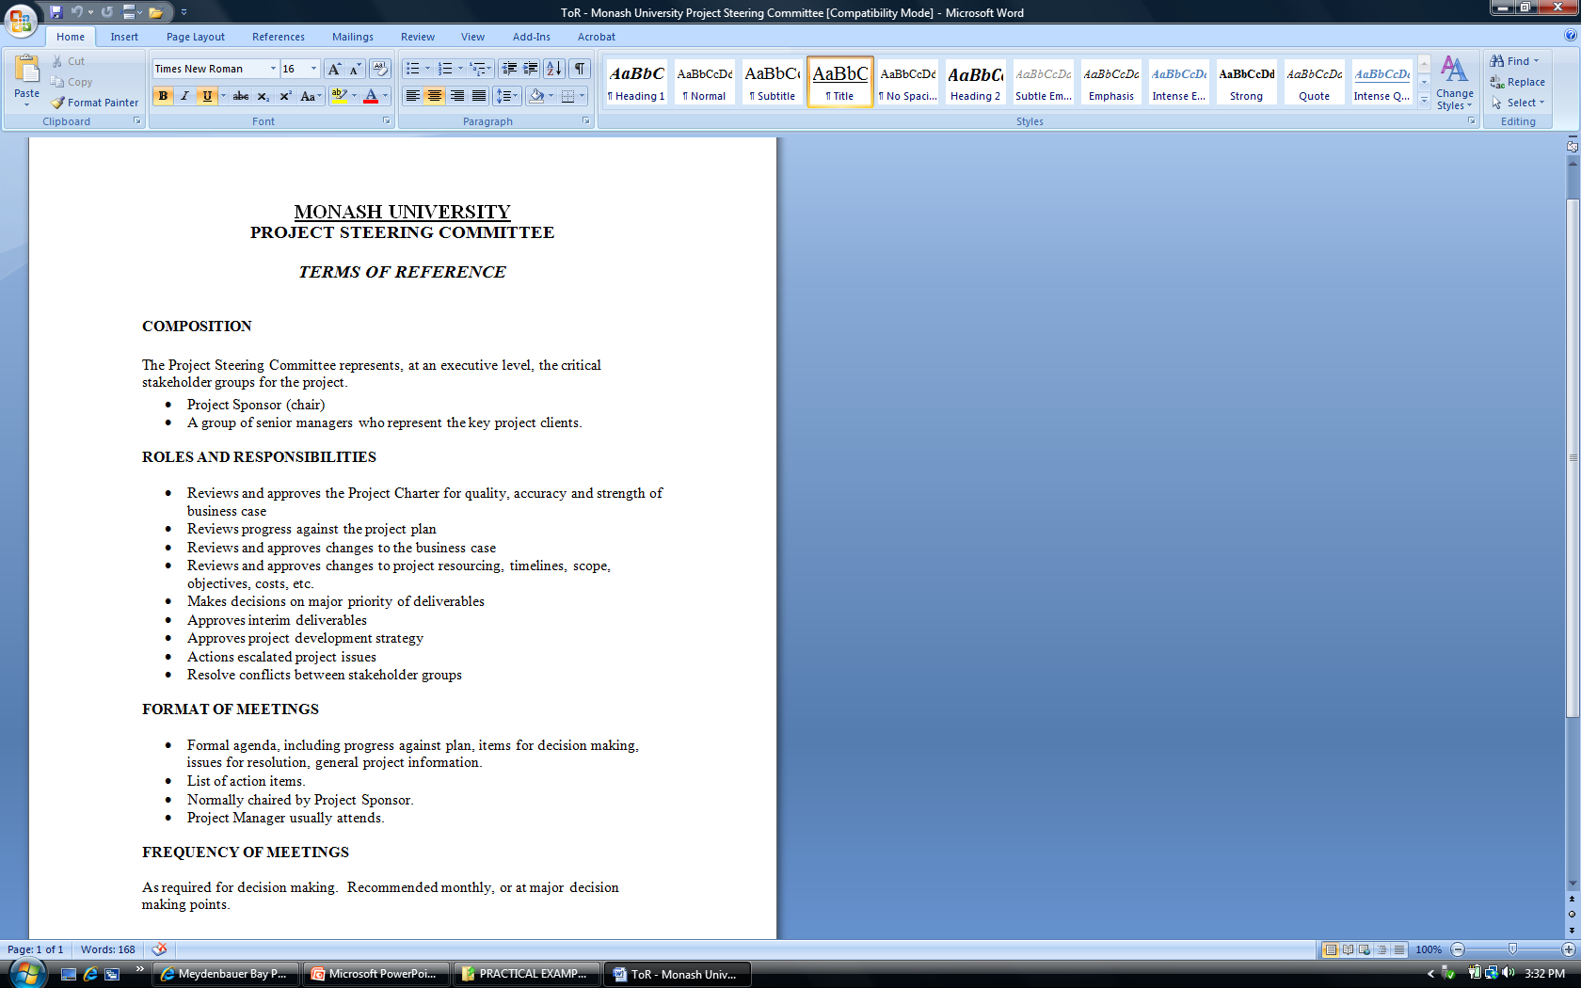
Project Primary Stakeholders
(Project Steering Committees: Sample Documents)
The one-page „Terms of Reference“ document on the left relates to a pro-ject being undertaken at Monash University in Australia.
REVIEW IT

Slide 18

Project Primary Stakeholders
(Project Steering Committees: Sample Documents)
A more complex „Terms of Reference“ document from a Community Client Health Profile Program from Tasmania, Australia, is given on the left.
REVIEW IT

Slide 19

Project Primary Stakeholders
(Project Financers)
There are many possible sources of project funding, e.g.:
  Annual budget allocations
  Municipal and district, state or provincial, national and regional development schemes & programs
  National, regional and internation-al development financing / imple- menting institutions and agencies
  Taxes and special purpose fonds
Project Financers are interested in a high return on their investment at a reasonable risk.
There are many (dynamic) risk s on a project and later cash inflows can be jeopardized as a result.
Notes:
Annual budget allocations (e.g. departmental, divisional, location-specific)
Sale of Tangible Assets (e.g. privatization of government entities to generate funds)

Slide 20
Project Primary Stakeholders
(Project Financers)
  Inter-governmental (bi-/multilateral) loans, EXIM and commercial bank lending, venture capital
  Securities markets (bonds, equity)
  Corp. earnings and financial reserves
  Sale of tangible assets
  Grants, donations and contributions from philantropic and other sources (e.g. under CSR programs), fund-raising events

Slide 21
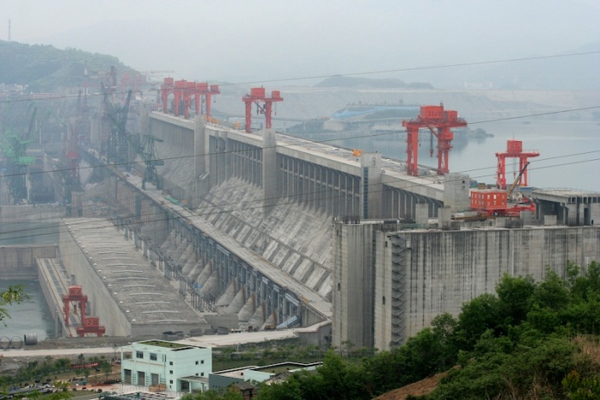
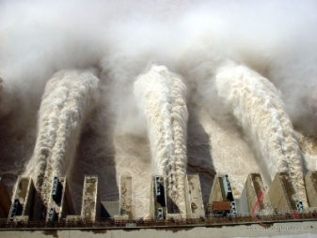
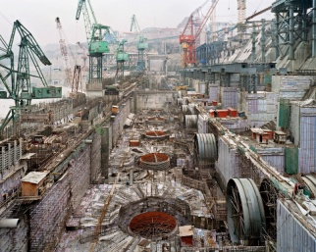
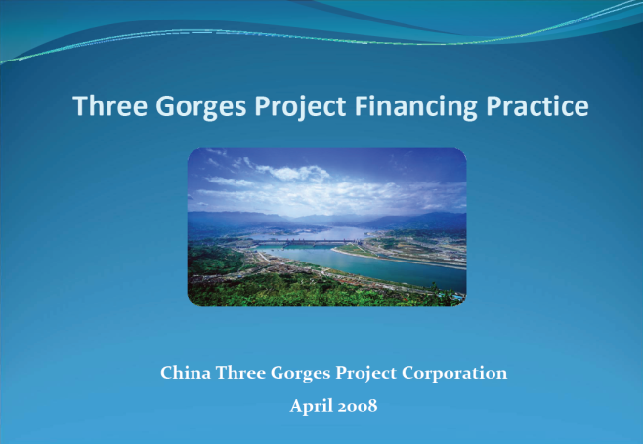
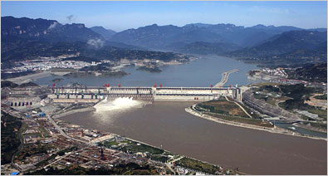
Project Primary Stakeholders
(Project Financers)
China‘s Three-Gorges-Dam was the largest hydropower project in the world. It has also been highly con-troversial inside and (especially) out-side China.
A complex financing scheme was used for the approx. USD 25 billion project.
Click to View

Slide 22

Project Primary Stakeholders
(Resource & Functional Managers)
The Functional Managers prima-rily serve as a project‘s resource suppliers.
They exert great influence over projects, especially in a (weak, balanced) matrix environment.
They have many responsibilities towards a project, one of which includes providing staff and re-sources from their respective de-partments to work full- or part-time on it as and when required.
Functional Managers have an in-terest in ensuring that the project work they are required to support does not interfere too much with their departments or areas routine operational activities or conflict with their own projects.

Slide 23
Project Primary Stakeholders
(Resource & Functional Managers)
Functional Managers review and approve the parts of the project plan which are relevant for their areas of work, and provide direc-tion to their staff members who are assigned to the project team.
Functional Managers are expect-ed to ensure that their staffers possess the requisite skills and expertise and are given time to complete their project work as indicated in project plan.

Slide 24
Project Primary Stakeholders
(Resource & Functional Managers)
Functional Managers are expect-ed to behave in a manner which facilitates the project and, where and when possible, help eliminate the obstacles facing it.
Due to competition for access to limited project resources in the functional areas, dealing with Functional Managers may require good negotiation, persu-asion and interpersonal skills on the Project Manager’s part.

Slide 25
The Project Matrix Organization Form
GENERAL MANAGER
Project
Level
Functional
Level A
Functional
Level B
Functional
Level C
Functional
Level D
Project 1
FI
FI
FI
FI
Project 2
FI
FI
FI
FI
Project 4
FI
FI
FI
FI
Project N
FI
FI
Functional
Interfaces
FI
FI

Slide 26
Example of a Strong Project Matrix System
Senior Management
Lead Project
Manager
ENGINEERING
(Functional Area)
MANUFACTURING
(Functional Area)
MARKETING
(Functional Area)
PA
E1
E2
E3
MA1
MA2
MA3
M1
M2
M3
PM X
1
2
1
1
3
0
2
0
0
1
PM Y
1
3
1
4
2
4
0
0,5
1
0
PM Z
0,5
1
3
7
2
0
0,5
2
0
0,5

