Slide 1
Master of Project Management
Project Stakeholder
AND COMMUNICATION Management
Virtual Campus CIIT
LECTURE 06: INTRODUCTION TO PROJECT STAKEHOLDER MANAGEMENT AND ENGAGEMENT PART 2

Slide 2
Projects: Goal, Subgoals, Objectives,
Output, Outcomes & Impacts
Economic
Subproject 1
Project Output
Social
Subproject 2
Ecological
Political
Subproject 3
Short, Medium & Long-term Costs & Benefits
(Fully, Partially & Non-Quantifiable)
Project Goal or Result
Project Objectives A, B, C ...
Technological
Subproject 4
Infrastructural
Subproject 5
Project Outcomes & Impacts
Legal
Subproject N
Institutional
Other Areas
Asssessment Methodology
Change (intended, unintended)
Notes:
Slide: Project Output, Outcomes & Impacts
Change: Inevitable on Each and Every Project. May be Intended or Unintended and Desirable or Undesirable.
Assessment Methodology: Qualitative and Quantitative

Slide 3

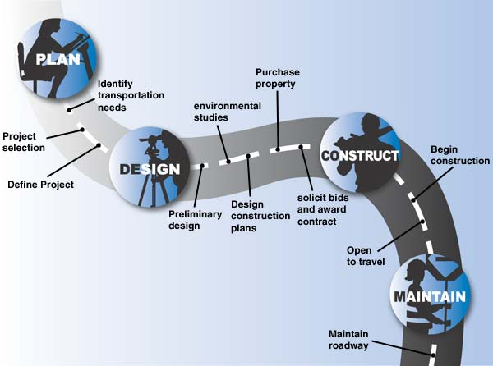

Highway Construction Project
(Post-Completion Outcomes/Impacts on Stakeholders)
Project Phase
Project Life-Cycle
Initiation, Planning, Execution and Closure of the Project
Project Output
Operations Phase
Short-term
ECONOMIC/FINANCIAL
Investment, trade, local businesses and the economy, tourism, employment, inflation, taxes, wealth accumulation and distribution
Possible Outcomes& Impacts
(+) and (-)
Medium-term
SOCIAL
Health and education, travel, migration, crime, social relations, communities‘ outlook and values, accidents and personal injury
Selected Fields
Not Projects: Routine main-tenance/repair
Long-term
ECOLOGICAL
Fauna and flora along the route, pollution (land, air, water, noise), waste accumulation, processing and disposal
Modification Projects: Highway extension, widening and re-carpeting, constructions of bridges, exit and entrance ramps, petrol stations and rest stops etc.
Notes:
Slide: Highway Construction Project – Post-Completion Impact on Stakeholders
There may be benefits in other areas (for e.g. political, institutional) also which are not shown here because of the space constraint.

Slide 4

Class Excercise
Government X wants to construct a large, multi-purpose dam.
Use two sheets of paper. On one sheet list the possible positive project outcomes/impacts and on the other sheet list the possible negative outcomes/impacts.
Discuss each entry from a stake-holder perspective.

Slide 5
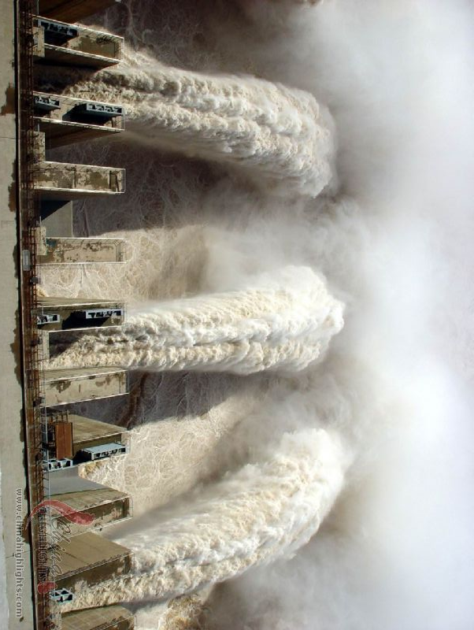
Large, Multi-Purpose Dam
(Possible Positive Outcomes/Impacts)
Provision of Water for Agriculture, Industries and Domestic Consumption
Flood Mitigation
Electricity Generation
Improved Inland Navigation
Opportunities for Contractors, Vendors, Project Employees and Labourers etc. over the Dam‘s Project and Operational Life-Cycle
Institutional Capacity-Building & Acquired Technical and Managerial Expertise and Experience
Information and Knowledge Genera-tion Useful for Future Dam Projects

Slide 6
Large, Multi-Purpose Dam
(Possible Positive Outcomes/Impacts)
New Income-Generating Opportunities (e.g. in Fisheries, Agro-based Industr.)
Tourism and Recreational Activities (e.g. Boating, Hiking, Swimming & Scuba-Diving, Camping, Picknicking)
Creation of New Ecological Systems and Sanctuaries
Prevention of Soil Erosion
National Pride Effect and Sense of Accomplishment
Notes:
Sense of Accomplishment: For e.g., Tarbela Dam in Pakistan, which is or was the world’s largest earth-filled dam, is considered one of Pakistan’s major achievements since independence in 1947 and has played a crucial role in the country’s development.

Slide 7
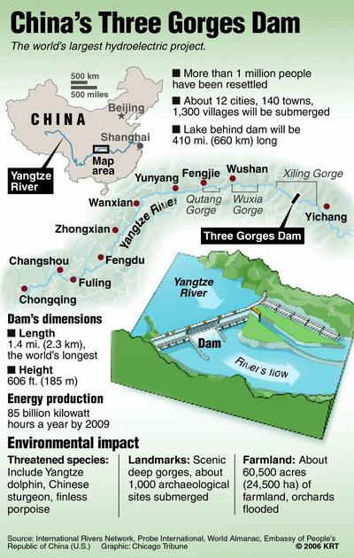
Large, Multi-Purpose Dam
(Possible Negative Outcomes/Impacts)
High Cost of Construction, Operations and Maintenance
Involuntary Dispossession of Land and Resettlement of Affected Communities
Economic Disruption and Loss Due to Submergence of Productive Land and Habited Settlements and Relocation of Communities
Emotional Traumatization of People Displaced from their Ancestral Lands
Difficulty Faced by the Displaced in Re-establishing their Lives and Livelihoods
Negative Economic Impact on Communities Upstream & Downstream
Notes:
Over the dam’s operational life-cycle there may be follow-up projects (e.g. sedimentation management) aimed at ensuring that it retains its capacity.

Slide 8
Large, Multi-Purpose Dam
(Possible Negative Outcomes/Impacts)
Damage to and/or Destruction of Eco-logical Systems (Fauna and Flora)
Destruction of Archeological Heritage
Negative Impact on Cultural Landscape
Danger of Dam Collapse or Breakage due to Construction Flaws, Earthquakes, Sabotage, War etc.
Enhanced Seismic Activity (Surmised)
Bitter Polarization between Dam Sup-porters and Opponents
Possibility of Human Rights Violations
Negative Media Publicity
Reduced Access to Water Downstream
Transboun. Water Disputes & Conflicts

Slide 9
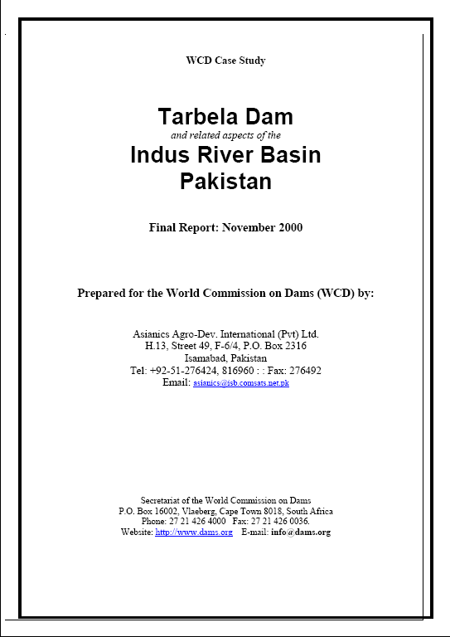
Projct Case Study from Pakistan
(Tarbela Dam and Related Aspects of the Indus River Basin)
Completed in November 2000, this insightful 181-page case study was produced by a consul-tant for the World Commission on Dams.
The case study contains detail-ed information about the construction, operations and multidimensional positive and negative impact of Pakistan’s largest dam at Tarbela.

Slide 10

Project Stakeholder Management “Best Practices”: Nine Suggestions

Slide 11

Project Stakeholder Mgmt. Best Practices
(Stakeholder Partnership Charters)
A Project Stakeholder Partnership Charter endorsed and respected by all key stakeholders is useful for genera-ting a sense of common purpose.
By identifying and comprehensively documenting the interests, expecta-tions and responsibilities of all key project stakeholders, it can serve as a valuable reference throughout the project life-cycle and help sustain stakeholder committment and coope-ration for the project.
Partnership charters of sorts are already being utilized in project management. For e.g., a project team charter documents roles, responsibilities and work targets of the project team members.

Slide 12

Project Stakeholder Mgmt. Best Practices
(Stakeholder Management Maturity Levels)
Stakeholder management on pro-jects range from the application of simple and crude to highly evolved and sophisticated frameworks.
As organizations become more adept and experienced over time at mana-ging and engaging their project stakeholders, and seek to systema-tically and continuously improve their policies, strategies, plans, pro-cesses and tools, they can expect to attain successively higher stakeholder management „maturity levels“.
Project management is already acquainted with the concept of maturity models or levels. Some already exist, e.g., CMMI, OPM3.

Slide 13

Project Stakeholder Mgmt. Best Practices
(The Project Stakeholder Handbook)
A Project Stakeholder Management Handbook can constitute a compre-hensive and very useful source of in-formation for educating project managers, project team members and other stakeholders about the ins and outs of project stakeholder management and engagement in organizational perspective and help them in their pursuit of fair, creative, flexible and mutually acceptable (hopefully win-win) solutions.
Notes:
Slide: Project Stakeholder Management Best Practices – The Project Stakeholder Handbook
Many commercial organizations and government agencies have developed their own project management handbooks and manuals (e.g. PROPS, CALTRANS). Project stakeholder management/engagement is a complex and challenging field which presents many opportunities for creative and flexible solutions and a project stakeholder management/engagement handbook, intended as a specialized handbook among a series of project management handbooks which would cover, inter alia, themes such as procurement, and monitoring, evaluation and control, would constitute a great source of help and a valuable framework of reference. It must, off course, be periodically updated as new insights and experiences are gained.

Slide 14
Project Stakeholder Mgmt. Best Practices
(The Project Stakeholder Handbook: Possible Outline)
Context and Foundation Knowledge
Importance of stakeholders for the organization and its projects and why they must be managed and engaged effectively and efficiently, definition and categorization of project stakeholders and indication of their project stakes, roles and responsibilities, and project relationship.
Stakeholder Management Methodology
Detailed information on all applicable project stakeholder management and engagement guidelines, policies, strategies, plans, processes and tools, stakeholder attributes, common stakeholder problems and their causes and impacts, lessons learned and best practices for building, maintaining and strengthening relationships and trust with stakeholders.
Case Studies
Past projects characterized by successful project stakeholder manage-ment and engagement throughout, examples of good leadership, negotiation and communication, opportunity management, defusing stakeholder conflicts and crises, innovative win-win approaches.
Appendix
Project stakeholder checklists, directories, forms, process diagrams and templates, samples (project stakeholder strategies and engagement plans, communication strategies and plans), stakeholder management principles and policy documents, project stakeholder-relevant laws and statutory requirements, ethical code of conduct, training opportunities.
Notes:
Appendices: Directories (e.g. of “permanent” stakeholders along with their attributes; mentors and experts in project stakeholder management), Process Diagrams (entire spectrum of project stakeholder management processes, i.e., identification, analysis and engagement as well as their monitoring, evaluation and control).
Laws: Full text if law is stakeholder-focused, otherwise only the relevant sections or clauses.

Slide 15

Project Stakeholder Mgmt. Best Practices
(Keeping a Diary)
Documenting the interactional expe-riences which occur throughout the project life-cycle between the project manager and team on the one hand, and the rest of the project stake-holder community on the other, can on subsequent analysis yield valuable insights which may help improve the quality (effectiveness, efficiency) of stakeholder management/engage-ment on both on-going projects as well as future projects.

Slide 16

Project Stakeholder Mgmt. Best Practices
(Stakeholder Management Performance Incentives)
Monetary and non-monetary per-formance rewards in the form of pay raises, bonuses and promotions, ack-nowledgements and commendations, assured contracts and so forth are an appropriate way for an organisation to reward its employees and other stakeholders for good project stake-holder management/engagement performance and devising superior strategies, plans, processes, tools and innovative solutions.

Slide 17

Project Stakeholder Mgmt. Best Practices
(Stakeholder Management and Engagement Audits)
Audits are effective project evalua-tion tools. They can also be used specifically to evaluate the „quality“ of stakeholder management and engagement on on-going and/or completed projects.
Project Stakeholder audits will have the twin advantage of (a) ensuring adherence to prescribed stakeholder management/engagement standards and (b) systematically pinpointing areas for possible improvement.

Slide 18

Project Stakeholder Mgmt. Best Practices
(Mobile Stakeholder Facilitation Groups)
Mobile Facilitation Groups comprising the project owners/implementers and (neutral) entities of high-standing may constitute a quick, fair, effective, integrated and acceptable way for monitoring, assessing and dealing comprehensively with myriad stake-holder issues, concerns and problems associated with more complex projects, especially when the internal and/or external stakeholder commu-nities are large, heterogenous and dispersed.
Notes:
Slide: Project Stakeholder Management Best Practices – Mobile Stakeholder Facilitation Groups
Group membership could include a project team member, representatives from the contractors and subcontractors, suppliers, academics, NGO officials, community leaders, public administration and government agencies. It could report directly to the project board/steering committee and be empowered by it under a specified “Terms of Reference” to take on-site action to address stakeholder issues and concerns and deal with problems. The group could be mobile and visit project sites and affected surrounding areas to ascertain whether there are any issues. The stakeholder engagement policy and ethical code of conduct could be used as references.

Slide 19

Project Stakeholder Mgmt. Best Practices
(Stakeholder Management Training Workshops)
Customized training workshops for all key stakeholders on a project can help in creating a common platform of awareness, knowledge and understanding, and apprecia-tion of the myriad complexities involved in project stake-holder management/engagement and the best ways and means for dealing with them effectively and efficiently.

