Slide 1
Master of Project Management
Project Stakeholder
AND COMMUNICATION Management
COMSATS Virtual University
LECTURE 04: INTRODUCTION TO PROJECT STAKEHOLDER MANAGEMENT AND ENGAGEMENT PART 2

Slide 2
Managing and Engaging Project Stakeholders
(A Cross-Disciplinary Subject Perspective)
Communications
Law
Culture
Management
Development Studies
Politics & Public Policy
Project
Stakeholder Management
Economics
Psychology
Ethics
Public Administration
Information Technology
Planning
(Urban, Regional, Environ. etc.)
International Relations
Sociology
Notes:
Slide: Project Stakeholder Management – A Cross-Disciplinary Subject Perspective
Information Systems: Data Mining, Software Applications, PMIS etc.
International Relations: Projects with trans-boundary ramifications, transnational disputes over projects and their causes and remedies.
Law: Competition, Compensation, Conservation (e.g.: Archeological, Old Buildings, Endangered Species), Construction, Contracts, Environment, Labor Laws (e.g.: Safety, Compensation), Land Acquisition, Corporate Merger & Acquisition, Competition, Privacy, Procurement, Import-Export, Product Liability.
Planning: Environmental, Regional, Urban etc.
Psychology: Applied, Behavioural, Group, Organizational etc.
Research Methodology: Stakeholder Surveying Tools, Descriptive and Inferential Data Analysis Methods

Slide 3

Communications and
Project Stakeholder Management

Slide 4

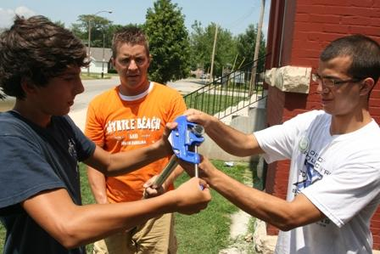
Role of Communication in Project Stakeholder Management and Engagement
Communications plays a funda-mental role in managing and en-gaging all stakeholder entities.
Every stakeholder mgmt. and engt. strategy on every project starts off with communications.
Communicational deficiencies have been acknowledged as being a key determining factor in project „failures“.

Slide 5
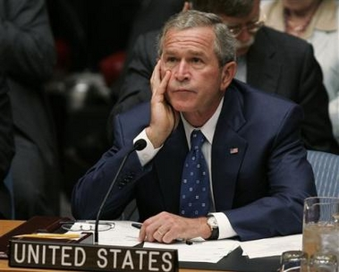

Role of Communication in Project Stakeholder Management and Engagement
Communications is very versa-tile.
It has many forms (speaking, writing, reading, listening, body language) and utilizes several mediums (e.g. briefings and pre-sentations, paper, technology).
There is no universal best appro-ach for communicating with pro-ject stakeholders.

Slide 6

Culture and
Project Stakeholder Management

Slide 7
Definition of “Culture”
Culture is difficult to define, easier to perceive. Basically, it is the set of distinguishing values, norms, ideals, beliefs and attitudes, conventions and traditions shared collectively by a group of entities and which are transmitted and develop-ed by them over time.
In a nutshell culture is
„the way we do things around here“.

Slide 8

Geert Hofstede’s Landmark Study on Culture
The renowned Dutch Sociologist Geert Hofstede has extensively researched national and organi-zational cultures. He discovered six dimensions of culture:
Small vs. Large Power Distance
Individualism vs. Collectivism
Masculinity vs. Femininity
Weak vs. Strong Uncertainty Avoidance
Long vs. Short-Term Orientation
Indulgence vs. Restraint
(Geert Hofstede, 1928 - )
Notes:
Note: Hofstede’s research findings are general in nature.

Slide 9
Managing and Engaging Project Stakeholders
(Relevant Dimensions of Culture)
NATIONAL/
SUBNATIONAL CULTURES
Culture is a highly complex and multi-faceted concept!
There is no single culture, rather there exists an amalgamation of different cultural layers which collectively determine the culture of the individual stakeholders across the stakeholder entity spec-trum.
It is important not to gene-ralize and place stakehol-ders in designated cultural brackets!
ORGANIZATIONAL/SUB-ORGANIZATIONAL CULTURES
INDIVIDUAL/GROUP CULTURES
PROJECT/SUBPROJECT CULTURES

Slide 10
Managing and Engaging Project Stakeholders
(Cultural Influences: Information & Communication)
Spoken and Written Language
Appearance, Body Language and Tones
Potential for Misinterpretation of Communication
Preferred Communication Mediums and Modes
Information Processing Patterns
Willingness of Stakeholders to Share Information
Directness/Straightforwardness
Communicating Acceptance and Rejection
Negotiating Styles
Signaling Consensus, Willingness or Agreement
Notes:
Slide: Project Stakeholder Management – Cultural Influences Affecting Projects. Information & Communication
Language: Different languages, e.g. English, Chinese, Arabic, Spanish, Russian and Turkish may be spoken on a project, particularly on large construction and civil engineering projects across the globe and to a lesser extent on outsourced projects. The project language may be the second or third language spoken by a stakeholder and consequently severe linguistic hurdles may arise to inter-stakeholder communication, also from the inconsistent use of expressions and vocabulary which exist within one language group, for e.g., US English, British English, Indian English (in US English the word rubber means condom, in Britain it means eraser. Ground floor in Britain means first floor in the US. Most interesting is the use of the term “rooting for” which in the US means supporting while in Australia it has a very vulgar connotation).
Body Language: Books have been written on this intricate subject! According to research by Mehrarabian, body language accounts for about 55% of a person’s communication, with tone and words jointly constituting the rest. It is possible for a stakeholder to communicate one thing in words but convey the exact opposite in his/her body language. Body language also includes facial expressions. Looking in the eye is considered appropriate in some cultures, too intense in others. Note how body language can communicate ego and pomp (body language of civilian/royal heads of state and high government officials. “Walk like an Officer”).
Preferred Mediums and Modes of Communication: Some like to put everything in writing, others seek to rely on verbal means by predisposition or simply because they lack expressive skills in writing or don’t want to be held to account at some point in time. Some like to use e-Mails to communicate, others just like to pick up the phone.
Willingness to Share Information: Determined by factors such as seniority, status etc. Also, more experienced stakeholders may be reluctant to take advice from less experienced junior counterparts, even if they are more qualified. Some staffers may be reluctant or scared to request information because they would feel exposed or appear ignorant to their colleagues.
Directness/Straightforwardness: Some expect a direct yes or no which means a yes or no. This is typical of western culture. Some other cultures may consider such directness impolite or inappropriate and prefer the use of indirect expressions (“not yes”) or say yes when the meaning is perhaps or in effect a no.
Communicating Acceptance and Rejection: Straightforwardness, meaning what one actually says, i.e. a ‘yes’ means ‘yes’ and a ‘no’ means ‘no’. Sometimes out of ‘politeness’ stakeholders say yes when what they really mean is no!
Signaling Consensus or Agreement: In the Dubai Metro Rail Project, the Egyptian project manager stated at the PMI Congress 2010 that he learned that he thought that the Japanese partner was in “agreement” when he moved his head up and down when actually all he meant was that he “understood” what was discussed in that meeting!
Note: What you say … what you don’t say!
A person’s level of confidence and how it affects information and communication with him/her.

Slide 11
Managing and Engaging Project Stakeholders
(Cultural Influences: Attitude & Behavior)
Biases and Prejudices (religious, racial, ethnic, age, status & gender-related)
Trust and Relationships: Formation and Development
Level of Formalism (e.g. Hierarchy, Protocols)
Honor, Dignity and Pride
Respect and Sensitivity
Apportioning Responsibility
Approach to Work
Individual vs. Group Orientation
Potential for Cooperation and Conflict
Psyche and Religion
Notes:
Slide: Project Stakeholder Management – Cultural Influences Affecting Projects. Attitudes & Behavior
Biases and Prejudices: Stakeholders may dislike each other because they are from different ethnic groups (e.g. Hutus and Tutsis in Rwanda, Israelis and Palestinians). Discrimination against women at workplaces in not uncommon and particularly more so in some cultures like the Middle East.
Trust & Relationships: Speed, Intensity, Fragility.
Respect and Sensitivity: Respect accorded to a stakeholder by virtue of his/her position, age, knowledge, function etc. Sensitivity means, for example, the adverse reaction of stakeholders to comments, remarks, jokes, insinuations and innuendos etc. by other stakeholders (e.g. stakeholder A feels insulted by explicit or implicit criticism by stakeholder B).
Formalism: Emphasis on contracts versus emphasis on personal relationships as the mechanism for dealing with project disputes and issues. Concentration of power at the top may also be indicative of a high level of formalism as would strict observance of policies, processes, procedures etc.
Psyche and Religion: Max Weber’s “Theory of Protestant Ethics”. Muslim Societies: Inshallah! (God Willing). Less religious societies appear to be (materially) more developed than their religious counterparts.
Approach to Work: Some stakeholders may not leave their workplaces until the tasks of the day are complete, others may “flee” as soon as the office time is up even if their tasks are incomplete.

Slide 12
Managing and Engaging Project Stakeholders
(Cultural Influences: Business & Social Etiquette)
The “Right & Wrong” Place/Time to Discuss Business
Family and Personal Issues
Taboo Topics
Concept of Time
Physical Space and Proximity
Appropriate and Inappropriate Physical Contact
Dress and Food Culture
Humor
Rituals and Customs
Notes:
Slide: Project Stakeholder Management – Cultural Influences Affecting Projects. Business & Social Etiquette
Concept of Time: Strict emphasis on punctuality (“Prussian Punctuality”) versus casual observance.
Physical Space and Proximity:
Dress Culture:
Food Culture: In Muslim countries pork and alcohol are taboo for most people and should as a rule not be served, even though many people admittedly do not observe these taboos.
Humor:
Rituals and Customs:

Slide 13
Managing and Engaging Project Stakeholders
(Cultural Influences: Ethics)
Concept of Right and Wrong Across Cultures
Course of Action to Adopt when Encountering Ethical Dilemmas
Notes:
Slide: Project Stakeholder Management – Cultural Influences Affecting Projects. Ethics

Slide 14
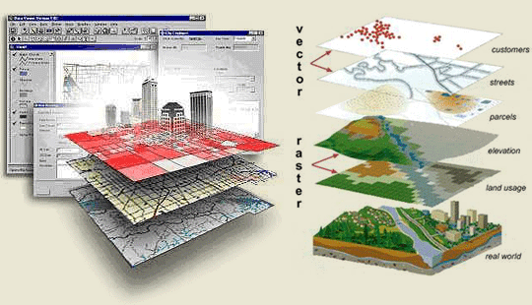
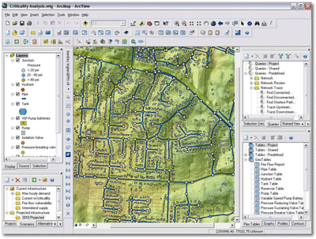

Information Technology and
Project Stakeholder Management

Slide 15

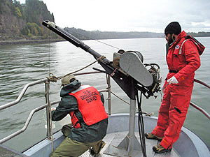
Information Technology and Project Stakeholder Management and Engagement
Information Technology plays a crucial role in managing and engaging project stakeholders. With the advent of the digital age, rapid technological advances and increased complexity of project environments, its importance has drastically increased.
Information Technology can be used both for and against projects.
Technology has its (inherent) limita-tions too which project planners and implementers must be cognizant of.

Slide 16
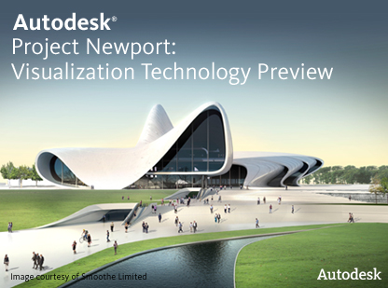
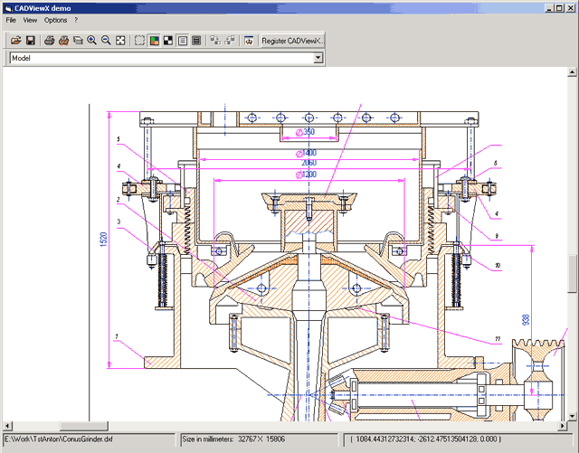
Selected Application Areas of
Information Technology in Projects
Modeling (e.g. buildings, factories)
Visualization (e.g. facilities)
Simulation (e.g. usage levels)
Optimization (e.g. project portfolios)
Charts and Illustrations (e.g. Gantt)
Data Storage
Analysis (e.g. forecasting)
Data Mining / Warehousing
Communication (e.g. virtual)
Collaboration (e.g. out-sourcing)
Supply Chain Management
Presentations (e.g. PowerPoint)

Slide 17
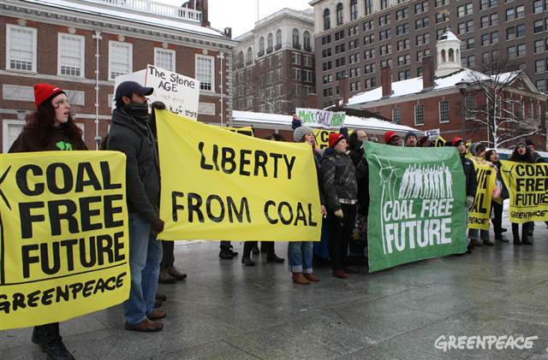

Information Technology and Project Stakeholder Management and Engagement
Besides finding application as an en-gine of project planning and imple-mentation activities, Information Technology is also being used exten-sively by entities which are opposed to projects, for example, local resi-dents, NGOs and environmentalists, and the media.
Through their use of technology, in-formation which portrays the project in a bad light can quickly spread with possible severe consequences for the project.

Slide 18

International Relations and
Project Stakeholder Management

Slide 19
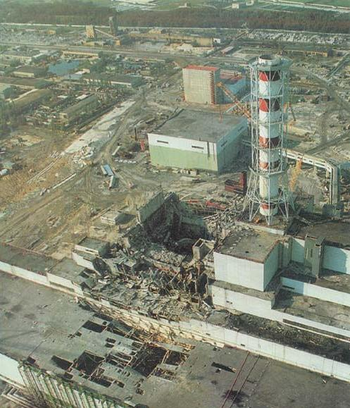
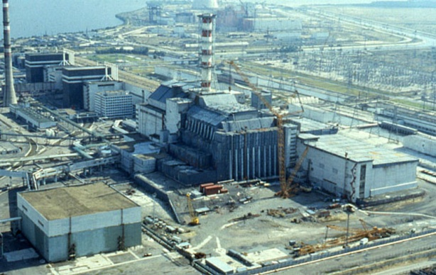
Projects: The Link to International Relations
The outcomes/impacts of some pro-jects do not stop at national borders but may have (intended/unintended, positive/negative) consequences ex-tending beyond them. This may seri-ously affect relations between states and their people.
A case in point is the Soviet Nuclear Power Plant at Tschernobyl (now in Ukraine) which exploded on April 26, 1986 sending a radioactive cloud over much of Europe.

Slide 20

The Law and
Project Stakeholder Management

Slide 21


Managing and Engaging Project Stakeholders
(Stakeholders and the Law)
Law is a universal occurence, as old as mankind. Complex, diverse and adaptive, laws regulate how we live, work and interact with each other. If unheeded by stakeholders, they may have an adverse impact on projects, possibly endangering their existence.
Project‘s are typically embedded in a highly complex regulatory framework encompassing a plethora of laws at the transnational, national, provincial or state and/or district and municipal and local levels.

Slide 22

Managing and Engaging Project Stakeholders
(Stakeholders and the Law: Contracts)
Contracts
Contracts are an inevitable feature of all projects. Contract Law profoundly influences the (primary) stakeholder relationship system.
Contract Law offers stakeholders pro-tection (legal enforceability of agree-ments) but also poses threats (penal-ties for non-compliance and breach of contractual obligations).
For stakeholders contracts present opportunities and impose constraints.
A project’s primary stakeholders (clients, consultants, contractors, subcontractors, suppliers, project employees etc.) are tied together in an (often very complex) system of contracts spelling out their obligations/responsibilities and entitlements.
Notes:
Slide: Project Stakeholder Management – Stakeholders and the Law (Contracts)
Contracts give a mission and purpose the relationship between stakeholders, legal protection entails an uncertainty-reducing or mitigating effect which is essential to ensure the interest of stakeholders and their commitment to provide resources and support for the project. Contracts may include dispute resolution mechanisms (Mediation, Arbitration, Litigation) in the event that disputes arise in future. Contracts may also specify the amount of compensation to be incurred in consequence of damages and negligence caused by one of the contracting entities.
Contracts can range from very simple (less than a page with a few clauses) versions to highly complex and lengthy documents drawn up by legal experts and containing numerous clauses and conditions and references to external documents (see mega construction project examples). Contracts may be terminated in certain circumstances (e.g. breach of terms by one or more contracting entities). Good contract administration and supervision is important.
Contract Constraints: Legality of the contracts which depends on place. Universally impermissible are, for example, contracts to indulge in criminal activities, such as, killing and maiming people, selling illicit drugs (heroin etc.), trafficking in human beings and slavery, and violation of “good morals”.
Contract Opportunities: Depending on their performance in meeting their contractual obligations, contract partners may benefit in terms of ease of being awarded future contracts. Through their role as contract partners, they may develop good relationships with other contract partners leading to more business ventures.
Some Important Contract Issues: risk allocation among the contract partners, cost, time and effort expended on enforcing contracts, complexity of enforcement process, judicial and administrative corruption.
For sample documents in various contract categories (Owner/Designer, Owner/Contractor, Owner/Consultant) see the website of the American Institute of Architects (www.aia.org). Also see the publications of the International Federation of Consulting Engineers FIDIC (www.fidic.org) and the European Construction Industry Federation FIEC (www.fiec.org).
Note: Fixed Sum Contracts, Variable Sum Contracts. Fixed Sum shifts risk to the contractor, variable sum reduces it for the contractor.

Slide 23

Managing and Engaging Project Stakeholders
(Stakeholders and the Law: Examples of Contracts)
Land Acquisition
Leasing (Movable, Immov. Items)
Procurement (Tangible Inputs)
Labor: Skilled, Semi- & Unskilled
Operation and Maintenance
Project Financing, Insurances
Consultancy Services (Architects, Engineers, Lawyers, Management)
Contractors and Specialty Subcon-tractors (Physical Work, Services)
Outsourcing (Part, Whole Project)
State Entities; PPP-mode Contracts
Many contract-related disputes between stakeholders can and in practice do occur which create problems - often serious ones - for projects. It is essential that contracts are formulated in a manner that ensures maximum clarity and discourages litigation.
Notes:
Slide: Project Stakeholder Management – Stakeholders and the Law (Examples of Contracts)
Acquisition of Land: Depending on location this usually entails a high initial cost outlay.
Leasing: Movable items include vehicles, construction equipment, computers. Immovable items include facilities and premises, land on lease for a long-term e.g. 99 years.
Operation and Maintenance: For example, for computer and other specialized equipment (e.g. sophisticated and expensive laboratory instrumentation) used on a project.
Insurances: For e.g., against damage caused by fire, storms, flooding, earthquakes and wanton acts, theft, medical support for project employees.
Consultants: Also IT-Consultants.
Contractors/Subcontractors: Services (e.g. catering, security, transportation).
State Entities: Sometimes contracts must be signed with state entities in order to proceed, for e.g., w.r.t conditions which must be fulfilled by the project.
The object of contracts is quite considerable. Examples: land purchase or acquisition, purchase of raw, semi-finished and finished material inputs through advertised tender notices, provision of an array of services (such as project management services, consultancy and architectural and engineering designing), and work packages allocated to contractors on the basis of a competitive bidding system.

Slide 24

Managing and Engaging Project Stakeholders
(Stakeholders and the Law: Human Resources)
Human Resources
Projects need the input of skilled, semi-skilled and/or unskilled input of human resources.
Laws which are relevant for the appli-cation of human resources on pro-jects usually relate to employee wor-king time and compensation, person-nel hiring and firing, workplace safety and hygiene, gender equality, discri-mination and harassment, and pro-visions for social welfare.

Slide 25

Project Stakeholder Management
(Stakeholders and the Law: Corporate Sector)
Commercial
Many projects are undertaken in the private (commercial) sector.
Many laws, too, are relevant for pro-jects undertaken by private entities. Examples: Product liability and war-ranty, intellectual property rights, competition, import and export, pro-curement, mergers and acquisitions, joint ventures, outsourcing, franchi-sing, privatization, and public-private-partnerships.

Slide 26


Managing and Engaging Project Stakeholders
(Stakeholders and the Law: Environment)
Conservation
Conservation ranks among the most most pre-eminent issues of our age.
Legislation enacted across our globe with the objective of protecting and preserving the natural environment, ecological/bio-systems and endanger-ed plant, animal and marine species, archeological and cultural heritage, and to facilitate use of the planet‘s limited natural resources in a sustain-able manner can and frequently does significantly affect projects.

Slide 27

Project Stakeholder Management
(Stakeholders and the Law: Information)
Information
Information is a core input in project (and stakeholder) management.
With the advent of the digital age, protecting information from misuse has become a major concern across the globe because of the possibly serious adverse consequences which may result therefrom.
Existing information laws – relating especially to privacy and its various facets - apply equally to projects.
Notes:
Data Collection and Storage
Reporting
Eavesdropping, economic/industrial espionage, snooping

Slide 28

Managing and Engaging Project Stakeholders
(Stakeholders and the Law: Beyond National Borders)
Transnational
Human Rights
Water Sharing
Sea Law
Human Rights
Child Labor
Slavery
Int. contractying
Foreign Direct Investment

Slide 29
Common Illegal Acts by Project Stakeholders
(Committed by Internal/Primary Stakeholders)
Use of Illicit Labour (i.e. Child, Bonded, Non-Documented)
Violation of Laws (e.g.: Contracts, Environmental, Safety)
Deception and Fraud
Bribery, Kickbacks and Corruption
Unlawful Seizure of and Damage to Property
Blackmail, Harassment, Intimidation
Strong-Arm Tactics and Physical Violence
Notes:
Illicit Labor: Very common in poor countries. In India, children as young as three were reportedly used in the building construction phase of the Asian Games which was held in Delhi in September/October 2010. In some countries bonded labor is common. Non-documented laborers (i.e. those who are in a country illegally) are used in projects in both developed and developing countries.
Deceit and Fraud: For example, the falsification of cost data to get undeserved subsidies, concessions or licenses from a state entity, or to conceal adverse project outcomes such as pollution and other hazards.
Bribery, Kickbacks and Corruption: For example, offering bribes to government officials in exchange for concessions, licenses etc. Corruption in the procurement process. See Transparency International. Many articles on the subject.

Slide 30
Common Illegal Acts by Project Stakeholders
(Committed by External/Secondary Stakeholders)
Blockage of Supply Routes
Theft and Pilferage of Project Assets
Sabotage at Project Sites
Blackmail, Harassment, Intimidation
Threats of Violence
Acts of Violence (e.g. Assault, Injury, Kidnapping & Murder)
Notes:
Illicit Labor: Very common in poor countries. In India, children as young as three were reportedly used in the building construction phase of the Asian Games which was held in Delhi in September/October 2010. In some countries bonded labor is common. Non-documented laborers (i.e. those who are in a country illegally) are used in projects in both developed and developing countries.
Deceit and Fraud: For example, the falsification of cost data to get undeserved subsidies, concessions or licenses from a state entity, or to conceal adverse project outcomes such as pollution and other hazards.
Bribery, Kickbacks and Corruption: For example, offering bribes to government officials in exchange for concessions, licenses etc. Corruption in the procurement process. See Transparency International. Many articles on the subject.

Slide 31

Politics, Public Policy and
Project Stakeholder Management

Slide 32


Project Stakeholder Management, Politics and Public Policy
Like death and taxes, politics often seem inescapable. Projects have plenty of it in the form of powerful stakeholders who see projects in relation to their interests and tend to behave accordingly.
Example: Corporate Executives invol-ved in an organizational restructuring project.
Example: Support for a development project will boost Candidate A‘s chan-ce of reelection in his constituency.

Slide 33
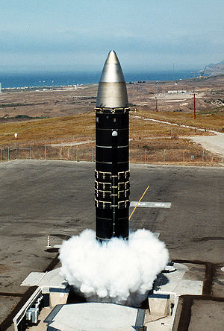

Project Stakeholder Management, Politics and Public Policy
Policies – whether at the corporate or public level - are usually not formed in vacuum but in consultation with (a possibly large and heterogenous) number of entities through all pro-cess phases (need awareness, resea-rch, consultation, assessment, formu-lation, implementation, outcome and impact evaluation, eventual modifi-cation).

Slide 34

Public Administration and
Project Stakeholder Management

Slide 35
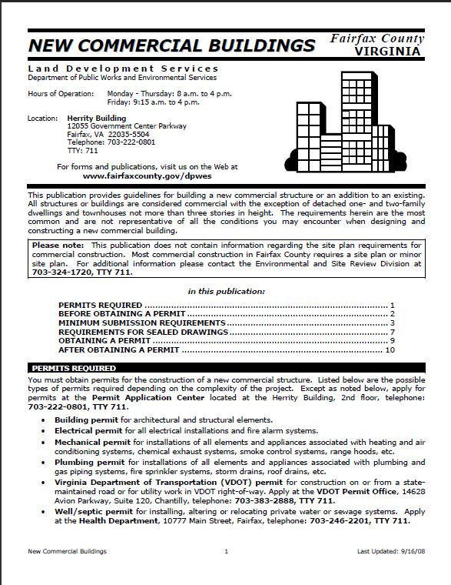
Project Stakeholder Management and Public Administration
Dealing with a host of public entities at the appropriate level (national, regional, state or provincial, district and municipal) is inevitable for many projects, particularly in the construc-tion and civil engineering sectors.
For example, for constructing a new facility project planners and imple-menters would require several per-mits from local authorities and agen-cies and may have to meet a number of conditions.
Sample document for new commercial building construc-tion published by the Fairfax County in Virginia. Click on image to view the document.

Slide 36

Psychology and
Project Stakeholder Management

Slide 37
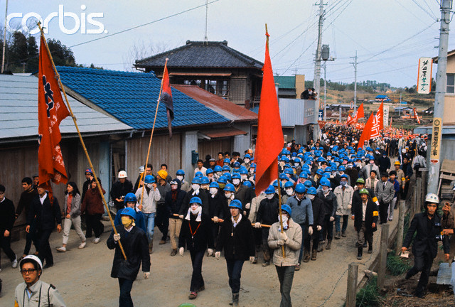

Project Stakeholder Management and Planning Science
Psychology has a far-reaching impact on project stakeholders. It is their attitudes and behaviours towards a project which determine the level of support – or resistance – that a pro-ject is likely to encounter and what its survival chances are.
Attitudes and behaviours – and the issues and concerns, expectations and perceptions which influence them – must be closely studied, ass-essed, monitored and addressed by project planners and implementers.

Slide 38

Sociology and
Project Stakeholder Management

Slide 39
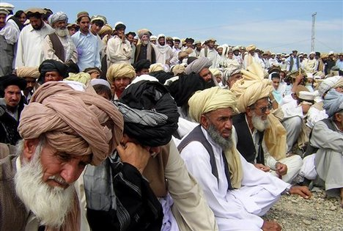
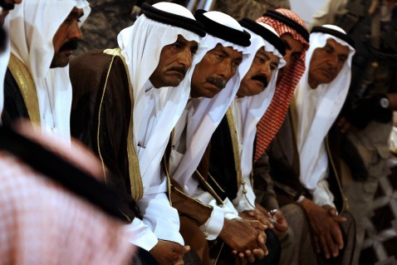
Project Stakeholder Management and Sociology
Sociology has a major bearing on projects. All projects are undertaken in a social context.
For project planners and implemen-ters, Sociology gives insight into the nature of relationships between stakeholders, the factors which condi-tion these relationships and how relationships can be influenced by stakeholders for or against the pro-ject.

