Slide 1
MASTER OF SCIENCE IN
PROJECT MANAGEMENT
PROJECT STAKEHOLDER AND Communication MANAGEMENT
LECTURE 32:
PROJECT MANAGEMENT INFORMATION SYSTEMS

Slide 2

The Computerized Project Management Information System: PMIS

Slide 3

Project Information: Quality Parameters
Accurate
Reliable
Adequate
Actionable
Relevant
Proactive
Current
Verifiable
Specific
Source Integrity
Notes:
Adequate or sufficient.
Specific=Precise?

Slide 4
Project Information: Quality Parameters
Comprehensible
Documentable
Affordable
Transferrable
Usable
Legal
Integratable
Duration

Slide 5
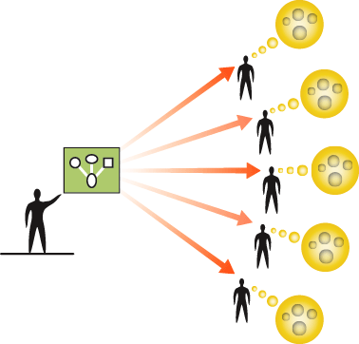

A Computerized Project Management Information System for Stakeholders
Technology – in particular – ICT has benefited projects immensely.
More and more project delivery org-anizations are making use of (com-puterized) Project Management In-formation Sytems (PMIS) to manage and communicate the vast pools of information which accumulate on their projects.
PMIS systems can be purchased „off-the-shelf“ or developed as in-house solutions.

Slide 6


A Computerized Project Management Information System for Stakeholders
The (computerized) PMIS is not to be equated with a project management software solution.
While PMIS do operate in a software environment and allow users to communicate and share information with each other via the internet or LAN systems, the function PMIS per-form on projects goes over and be-yond that of a typical project mana-gement software solution is capable of doing.

Slide 7

A Computerized Project Management Information System for Stakeholders
The basic function of a computerized PMIS is to ensure that information content about the project is commu-nicated electronically throughout its life-cycle in sufficient quantity to, and when needed by, all stakehol-ders involved in initiating, planning, implementing, winding up and/or monitoring, evaluating and control-ling the project so that they make the right decisions and take the right actions when required of them at the right time.

Slide 8

A Computerized Project Management Information System for Stakeholders
On large projects, it is common that thousands of files accumulate at different locations over time. Using a manual system to manage these files would be very costly and time-consuming.
A well-conceived computerized PMIS helps ensure that the project is undertaken smoothly and with a higher likelihood that it achieves its goal within budget and on time (efficiency function).

Slide 9

Advantages of a Computerized PMIS
Cost-Effective Solution (larger projects)
Mature Technology
Current Standard
Excellent for Communicating with Disp. Stakeholders
Immediate Access to Information
Content Diversity (text documents, ima-ges, videos, visualizations etc.)
Rapid Content Updateability by Users
Integration in Larger PMIS Systems
Not Difficult to Learn to Operate

Slide 10
Disadvantages of a Computerized PMIS
Not Suitable for Many (especially smaller) Projects
Possible High Cost of Infrastructure (hardware, software, networking) and User Training
Ensuring Information Quality
Resistance to Use by Some Persons
Consistent Use
Possible Technical Issues / Problems
“An End in Itself” instead of “Means to an End” Syndrome

Slide 11

The Computerized PMIS
(Recommended Technical, Concept & Design Standards)
Technological Compatibility with the Equipment and Network Infrastructure of the System Users (LAN, WAN, Intranet, Extranet, Internet, Operating System, Software)
Content is Accurate, Complete, Relevant, Clear, Current, Heterogenous, Timely etc.
Interactive Capability
(content uploading, download-ing and revision, searchability)
PMIS Administrator & Technical Maintenance Support Staff
User-Friendly and Flexible Design / Easily Navigateable Interface
Scalable, Reliable and Up-to-Date Technology
Technical Performance Standards
Content & Design Standards
Satisfies all Stakeholder (diverse) Informational Needs
Fast Access to Content
Confidentiality
(selective access to content where and when accessibility needs to be restricted)
Large Data Storage Capacity & Regular Data Back-Up (to prevent information loss in the event of a major system crash)
Usage Monitoring (content in-put & usage tracking capability)
Security (from hacking & unin-tentional & intentional data corruption by viruses, trojans, worms etc.)
Automatic Notification of Content Updates

Slide 12

Project Stakeholder Information:
(Quantity Vs. Quality)
Information in abundance does not mean that the information is appropriate for a rigorous stakeholder analysis and for de-signing and implementing effective stake-holder engagement strategies!
Before collecting information on project stakeholders, the project manager/team must have a clear idea exactly what infor-mation is required to avoid wasting time, cost and effort on amassing and process-ing “redundant” information.

Slide 13






The Computer-Based PMIS
(Concept Diagram for a Construction Project)
Project Management Information
Database
System
Project Manager & Team, Sponsors, Steering Committee, Client (Users), Con-sultants, Government Agencies, etc.
Internal Stakeholders
Suppliers & Vendors
Contractors
Subcontractors
External Stakeholders
Internet Access
(public webpage only)

Slide 14


Modules of a Computerized PMIS
(Initiation Phase Deliverables)
Project Business Case
Project Proposal
Project Feasibility Report
(Initial) Requirements and Specification Docs
(Preliminary) Scope Statement
Statement of Work
Contract with the client organization(s)
Project Charter
Minutes of meetings held between the project sponsor/manager/team and the customer and users
Miscellaneous Initiation-Relevant Documents

Slide 15


Modules of a Computerized PMIS
(Planning Phase Deliverables)
Planning documents are crucially important for any project. It is imperative that the stake-holders have access to all those documents and files which they need to effectively and efficiently perform their respective tasks.
The key planning phase document is the pro-ject management plan (which may be periodi-cally updated) and its constituent subsidiary plans (i.e. Cost, Schedule, Risk, Scope, Pro-curement, Human Resource, Communication Plans etc.)

Slide 16
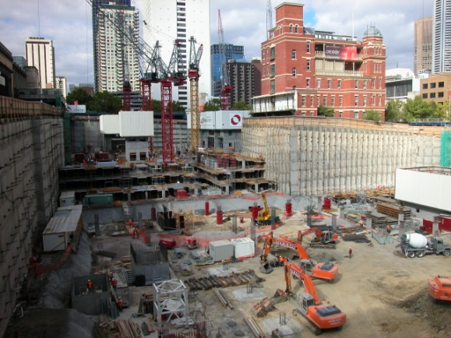

Modules of a Computerized PMIS
(Execution & Closing Phase Deliverables)
Most of the project‘s allocated time and resources are spent in executing and sub-sequently closing down the project.
A number of documents of files are generated here, including tenders, submitted bids and proposals, documentation on suppliers, sub-contractors etc., changes to the project scope and requirements/specifications, hiring of employees, various project reports, project winding up documentation etc.

Slide 17
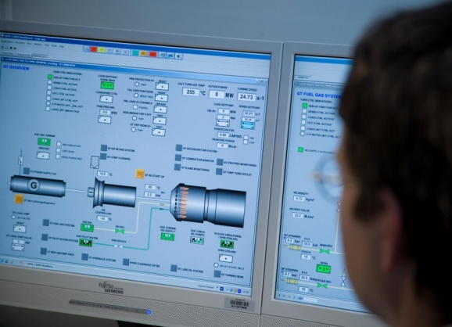

Modules of a Computerized PMIS
(Monitoring, Evaluation & Control Phase Deliverables)
A project‘s monitoring, evaluation and control (MEC) effort spans the project‘s entire life-cycle frm initiation through to completion, all aspects of the project‘s performance with regard to its baselines and standards are critically reviewed and, where deficiences are observed, corrective action is taken.
Project MEC is typically conducted observation mechanisms resulting in periodic reports, audits, meetings etc. which must be documented and compared for trends over the project life-cycle.

Slide 18


Modules of a Computerized PMIS
(Information on Project Stakeholders)
Basic Data (Name, Designation, Organization, Contact Details, Photos)
Experience and Qualifications
Reporting Relationships (on the project)
Availability for Project Work (timing)
Role and Responsibility in the Project (Int. Stk.)
Interest(s) in the Project (Ext. Stk.)
Mission, Goals, Objectives (for Organizations)
Miscellaneous Relevant Information
The information on the right is not exhaustive. More details can be collected, if the project demands.

Slide 19

Modules of a Computerized PMIS
(Visual Content)
„A picture is worth a thousand words“. Vis-ual and multimedia content can be an infor-mative, interesting and useful supplement to the text-based „core content“ project information contained in the PMIS modules.
Examples of relevant visual and multimedia content include drawings, sketches and Illustrations, (on construction projects) maps of the project site and surroundings, 3D architectural visualizations of buildings and facilities which are under design or construction, photographs and videos of the project site(s) in various stages of the project life-cycle, and of important events like the ground-breaking ceremony, inspection visits and public tours. Recorded audio messages can also be included.

Slide 20
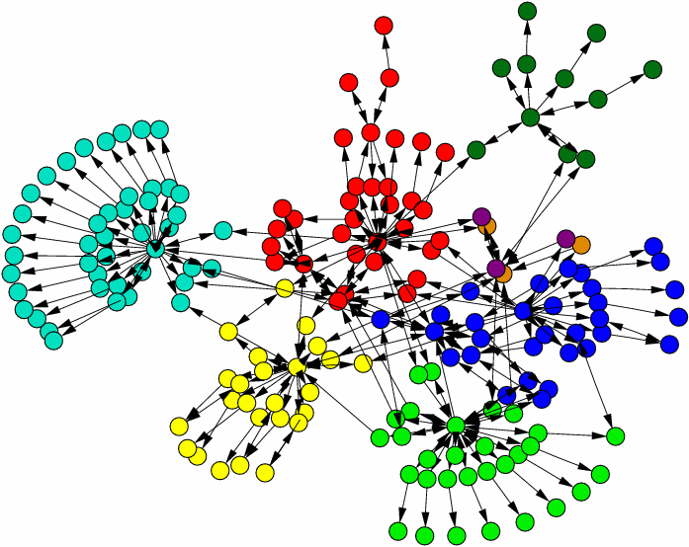

Modules of a Computerized PMIS
(The Help Forum)
A help forum can promote the exchange of information between project stake-holders. Highly interactive, it draws upon the „hidden knowledge“, expertise, expe-rience and solidarity of individual project stakeholders to help other stakeholders to (for e.g.) tackle problem situations, improve their work performance, address specific queries and issues, share appre-hensions and concerns, exchange ideas and tips, or simply to notify about up-coming events. Encouraging such commu-nication between users is indicative of a good project culture and enhances the chances of project success.

Slide 21

Modules of a Computerized PMIS
(The Project Manager’s Diary)
Maintaining a Project Manager‘s Project Diary is a good idea! Important observa-tions, thoughts, ideas, apprehensions and concerns raised by the project manager, and/or which have been communicated to the project manager by other stakeholders in the course of the project life-cycle, and which normally would not find entry in formal project documents or databases, can be recorded here.
With this information an organization can improve its project management standards and practices and boost its level of project effectiveness and efficiency.
Diary entries should be made regularly (at least once a week) with access restricted to certain key stakeholders such as the project sponsor and the PMO.

Slide 22

Modules of a Computerized PMIS
(The Knowledge Forum)
Completed projects may generate in-sights useful for similar on-going /future projects in various documents (proj. completion reports, reviews, articles, books, case studies, white papers etc.). A PMIS Knowledge Module can make this material available for reference.
Information on laws and regulations and economic, political, tech-nological and market factors which directly or indirectly may affect the project, on different countries and on prevailing cultural sen-sitivities and work related issues (especially where transnational projects are concerned), are some items which may be included in the Knowledge Forum.

Slide 23
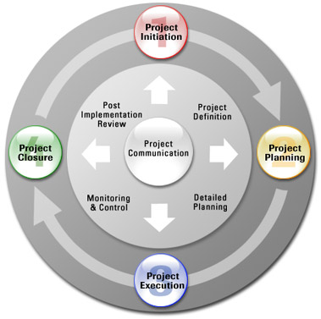
Modules of a Computerized PMIS
(The Project Standards)
All working on a project must be familiar with the standards, processes, tools etc. being applied on the project. If not, confusion and problems may result. To help overcome informational deficits here, a PMIS may contain information on all relevant aspects for all project phases.
For example, if a project is based on the PMBOK standard, information on all the nine project management knowledge areas and the policies, procedures and guidelines which are applicable to the project could be included.
Project docs such as templates, forms, registers, checklists etc. can be accessible here along with training material which aim to familiarize those involved in the project with the project mgmt. standard applied on the project.

Slide 24

Examples of PMIS Systems: US Army Corps
Click on Image to View Webpage

Slide 25

The Computer-Based PMIS
(Recommended Literature)
This 37 page publication from the year 2000 is based on a survey of US states and a Canadian province by the National Cooperative Highway Research Program.
Though somewhat outdated in light of current available tech-nologies, the survey gives in-sight into the features, streng-ths and limitations of PMIS at the time and the changing needs of users.

Slide 26
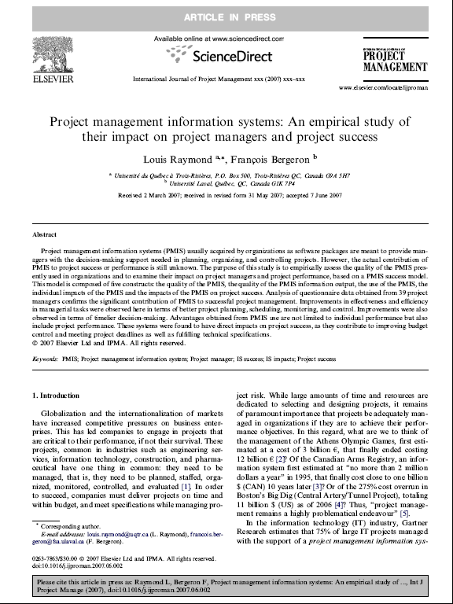
The Computer-Based PMIS
(What Does Empirical Research Say?)
An empirical research study publish-ed in the International Journal of Pro-ject Management in 2007 examines the impact of IT-based PMIS Systems on project managers and project per-formance. Data was collected for this purpose from 39 project managers.
The research discovered that the benefits of using IT-based PMIS Systems in practice include improved project planning, scheduling, moni-toring and control, timelier decision-making, better budget control, meet-ing project deadlines and fulfilling technical specifications.

