Slide 1
MASTER OF SCIENCE IN
PROJECT MANAGEMENT
PROJECT STAKEHOLDER AND Communication ManageMENT
LECTURE 31: THE COMMUNICATION MODEL, COMMUNICATING AT THE WORKPLACE & ETHICS IN COMMUNICATION

Slide 2


Importance of Communications for Organiz.
Globalization
Knowledge Economy
Trade and Investment
Growth in Competition
Workforce Diversity
Rapid Advances in IC-Technology
Team Focus & Employee Empowerment
Telecommuting, Outsourcing, Partnerships etc.
More Public Relations

Slide 3
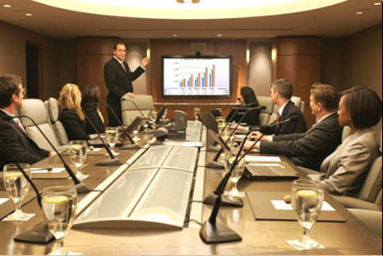

Communication: Formal, Informal
Formal communication is the flow of information through the hierarchy and chain of command prevalent in an organization (or project). Examples: Decisions, strategies and plans, policies, processes, instructions, technical data.
Informal communication is exchange of information which takes place between employees outside the formal channel. Also called “grapevine”, it is sometimes equated with “office gossip”. Much in-formation – sometimes factual, some-times hearsay – is exchanged informally.
May become exaggerated with time.

Slide 4
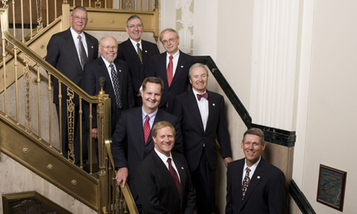

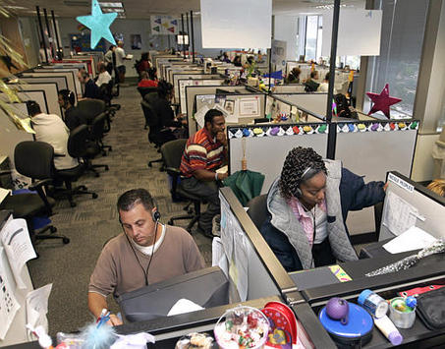
Intra-Organizational Communication
(Vertical, Horizontal)
Top-Down
Vertical communication
Vertical communication
Bottom-Up
Horizontal Communication

Slide 5

A Project’s ‘Primary’ Stakeholder Community
Primary Stakeholders
Corporate Shareholders
Project Team
Senior Management
Project Partners
Project Sponsor
Project Client / Output
Users / Customers
Project Board /
Steering Committee
Project Input Suppliers
& Vendors (ext.)
There are many defini-tions for/categoriza-tions of project stake-holders.
Primary and Secondary are quite common.
Program or Project
Management Office
Project Contractors &
Subcontractors
Chief Project Officer /
Program Manager
Project Advisors
and Consultants
Functional &
Resource Managers
Project Financers (ext.)
Project Manager
Local, State and Federal
Government Entities

Slide 6

A Project’s ‘Secondary’ Stakeholder Community
Secondary Stakeholders
Competitors
Tourists
Consumer Inter. Groups
Environmentalists and
Intervener Groups
Civic Organizations
Academia and Researchers
Professional Organizations
The Media
These are the more common secondary stakeholders.
The listing is not ex-haustive.
Political Organizations
Local, State and Federal
Government Entities
Religious Organizations
The General Public
Private Individuals and
Local Communities
Countries, Country Group-
Ings, World Community

Slide 7
Communication in Projects
Project Planning Phase
Project Initiation Phase
Communication with Stakeholders
Project Execution Phase
Project Monitoring, Evaluation & Control
External stakeholders
Project Closure Phase

Slide 8

Communicating Project Information
(Process & Intent)
Process of the
Communication
In what form and using which medium is the information being communicated?
Efficiency
Effectiveness
Goal or Purpose of the
Communication
Has the message been understood by the Recipient(s) as intended by the Sender(s) and has it brought about the desired result?

Slide 9

Information & Communication Process Quality
Information and communication go together hand in glove. Information is useless if it cannot be commu-nicated to the project stakeholders!
Adequate Information Content
Inadequate Communication Processes
Inadequate Information Content
Adequate Communication Processes
Inadequate Information Content
Inadequate Communication Processes
Adequate Information Content
Adequate Communication Processes
Ideal Situation on Projects

Slide 10

Big Problem in Communication
The main challenge in project (and non-pro-ject) communication, is to “get the message” across from the Sender (s) to the Recipient(s) so that the meaning or in-tent behind the commu-nication is achieved.

Slide 11
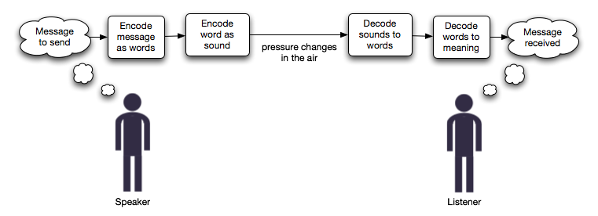
Basic Verbal Communication Model
Physical Factors
Language Comprehension
Mood
Individual Framework of Reference
Listening Ability
Choice of Verbal Medium

Slide 12

Typical Purposes of Project Communications
Inform
Decide
Warn
Clarify
Explain
Review
Instruct
Criticize
Request
Evaluate
Advise
Resolve
Approve
Decline

Slide 13
Typical Purposes of Project Communications
Assign
Revoke
Contest
Terminate
Confirm
Threaten

Slide 14

Relevance of Communication for Projects
(Empirical Findings)
Several studies have been con-ducted by consultants and others over the years to determine the causes of project “failures”.
Although the causes of project failure are complex and nume-rous, and are usually attributable to a number of factors, communi-cation inadequacies are often identified as one of the principal causes of project failures.

Slide 15

Consequences of Communication Shortcomings in Projects
Communicational shortcomings can cause a number of problems during the project life-cycle, for example:
Misunderstood or undocumented project requirements and specifications
Delays and extra cost caused by rework
Unavailability or provision of wrong inputs
Ommisions and mistakes in the creation of deliverables (e.g. project plans, products)
Poor quality of decision-making and prob-lem-solving, and
Dissatisfaction, frustration and demotiva-tion among project stakeholders.

Slide 16
Potential Communicational Inadequacies
Employees and Managers are provided with insufficient access to information when it is needed for them to make decisions.
This inhibits work effectiveness and efficiency.
- Time-wasting
- Costly
- Annoying
UNDER-COMMUNICATION

Slide 17
Potential Communicational Inadequacies
Employees and Managers are in-undated with information, much of which could be redundant and contributes little – if anything – to help improve effectiveness and efficiency of the work in pro-cess or in planning.
- Potentially Quite Costly
- Frustrating
OVER-COMMUNICATION

Slide 18
Potential Communicational Inadequacies
Normally a rare case. Context-specific. Here Employees and Managers receive no information or information which has insigni-ficant value for work and deci-sion-making processes.
- Potentially Very Costly
- Annoying and Frustrating
- Demotivating
NON-COMMUNICATION

Slide 19
Potential Communicational Inadequacies
Very common usually. Here meaning as intended is not con-veyed properly. Wrong decisions can be made and unnecessary work performed (or not perform-ed) as a result.
- Potentially Quite Costly
- Annoying and Frustrating
- Potentially Embarrasing
- Not Good for Image/Reputation
MIS-COMMUNICATION

Slide 20
Potential Communicational Inadequacies
This is a common communication problem.
Information may arrive too late to be useful or may be sent to the wrong recipients who may or may not promptly redirect it to the correct recipients.
- Potentially Quite Costly
- Annoying and Frustrating
- Not Good for Image/Reputation
UNTIMELY / MISDIRECTED
COMMUNICATION

Slide 21
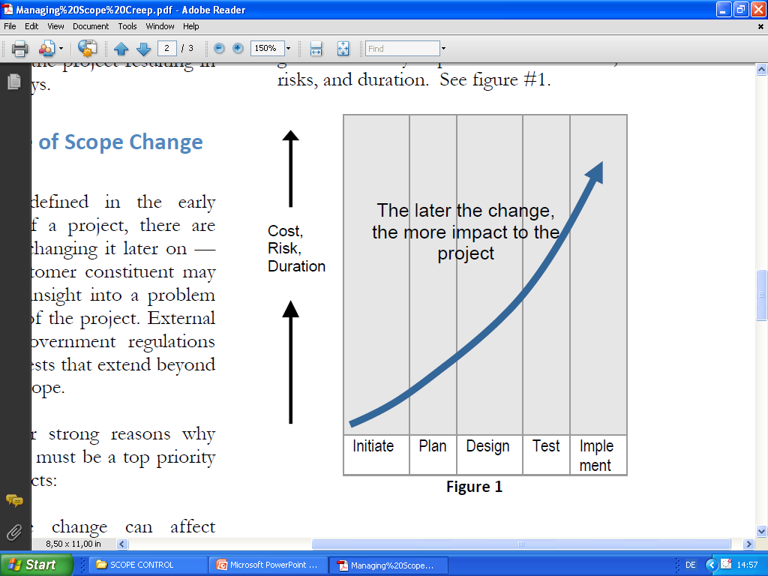
Consequences of Comm. Inadequacies

Slide 22
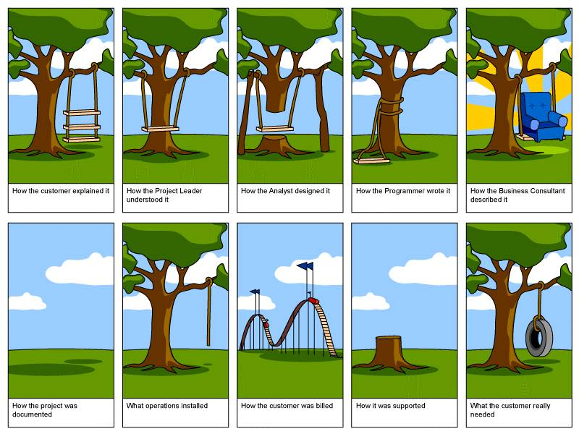
Consequences of Comm. Inadequacies

Slide 23
Lines of Communication
The number of possible lines of communication which can exist between stakeholders involved in a project can be calculated using the follow-ing simple formula:
LC = Max. Number of Lines of Communica-tion
N = number of project stakeholders
(1,2, 3 …………. X)
LC = n x (n – 1)
2

Slide 24
Lines of Communication: Simple Examples
Adam
Paul
Sara
John
Tina
Cindy
Albert
Number of Project Stakeholders = 3
Max. Possible Number of Lines of Project Stakeholder Communication:
= 3 x (3 – 1) / 2
= 6 / 2
= 3
Number of Project Stakeholders = 4
Max. Possible Number of Lines of Project Stakeholder Communication:
= 4 x (4 – 1) / 2
= 12 / 2
= 6

Slide 25



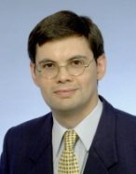






A “Complex” Communication Net
10 Project Colleagues =
45 Possible Lines of Communication

Slide 26
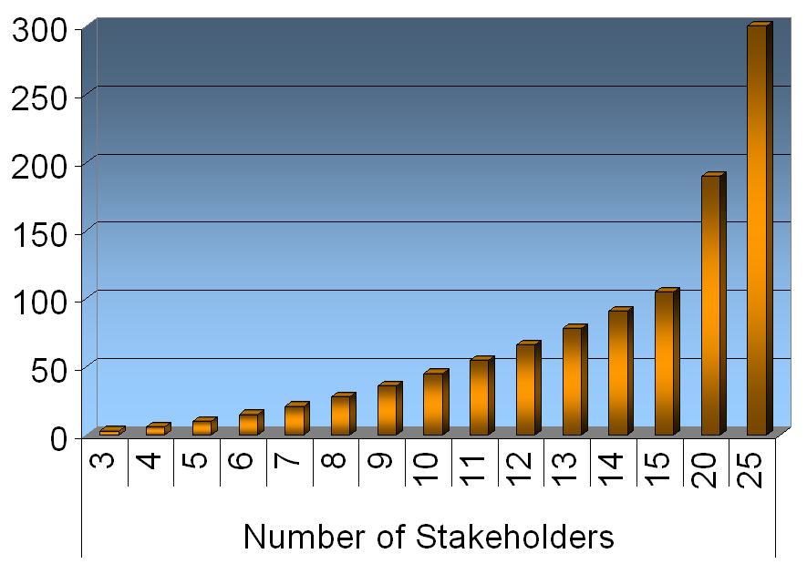
Lines of Communication: Exponential Curve
Stk. | Comm.
3 | 3
4 | 6
5 | 10
6 | 15
7 | 21
8 | 28
9 | 36
10 | 45
11 | 55
12 | 66
13 | 78
14 | 91
15 | 105
20 | 190
25 | 300

Slide 27
Trust and Communications
Trust is having confidence in someone or some entity to behave in a predictable manner which does not conflict with ones own interests.
It is hard and takes time – often a lot of it – to nurture and build trust between entities (peo-ple, groups, organizations, etc.).
One fateful decision or event can shatter it in an instant. Rebuilding lost trust can be an arduous, sometimes impossible, task.
Notes:
People often place trust in persons symbolizing institutions / professions which have evolved over a long period of time. Cultural indoctrination plays a big role in this. Typically, they would tend to trust a medical doctor, nurse, university professor, teacher, clergy man or banker over, say, an illegal immigrant, a street cleaner or a homeless person. Yet, on many occasions in our living memory, we can easily recall violations of this trust if we consider, for e.g., media accounts of the murders of patients in hospitals and care facilities, the molestation of children and students, and fraud perpetrated on Wall Street and by banks and corporations across the globe.

Slide 28


Improving Communication
The first step to improving com-munication in organizations (and projects) is to identify the existing communicational hur-dles and issues and develop a plan to overcome them.
There are potentially many hur-dles to communication, some of which are fairly easy to resolve, others which may be quite difficult.

Slide 29
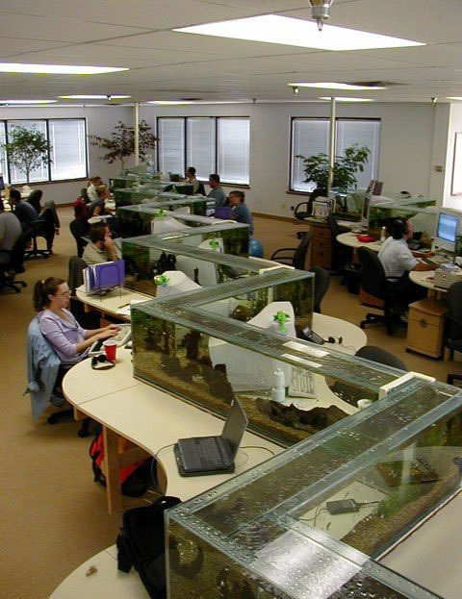
Some Problem Areas in Communication
Inadequate Communication Skills
Lack of Confidence & Fear of Ridicule
Heavy Work Pressure
Lack of Trust in Colleagues
Lack of Trust in Superiors
Fear of Drawing Unwanted Attention
Spatial Considerations
Seeking to Maintain Comp. Advantage
Lack of Encouragement to Communicate
No Training and Incentives
Not Aware of Comm. Expectations

Slide 30
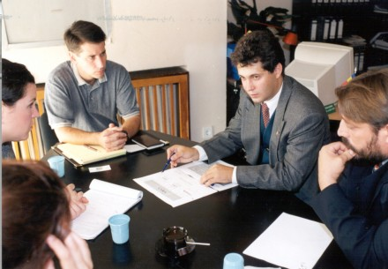

Overcoming Communication Problems
Open Communication Culture in Org. (Policy, Info-Sharing Mechanisms)
Encouragement by Management
Training (In-house, External Trainers)
System of Incentives and Rewards
Regular Meetings (Short Duration)
Set up Hotlines
Create “Positive” Workplaces
Diversify Communication Channels
Focus on Listening
Solicit Improvement Suggestions, Ideas
Communications Audits

