Slide 1
Master of Science in
Project Management
Project Stakeholder
AND COMMUNICATION Management
LECTURE 30: MANAGING & ENGAGING PROJECT STAKEHOLDERS (ENGAGEMENT TOOLKITS, STRATEGIES & PLANS) 2

Slide 2

Managing and Engaging Project Stakeholders
(Communication Strategies & Plans)
The PMI / PMBOK has not until recently acknowledged stakeholder management / engagement as a distinct knowledge area and hence has not yet advocated development of a stakeholder management / engagement subsidiary plan as a component of its project master plan.
However, the PMI / PMBOK does ad-vocate the creation of a project com-munications plan (and HR plan) which constitutes the basis for all stakehol-der management and engagement activities.

Slide 3
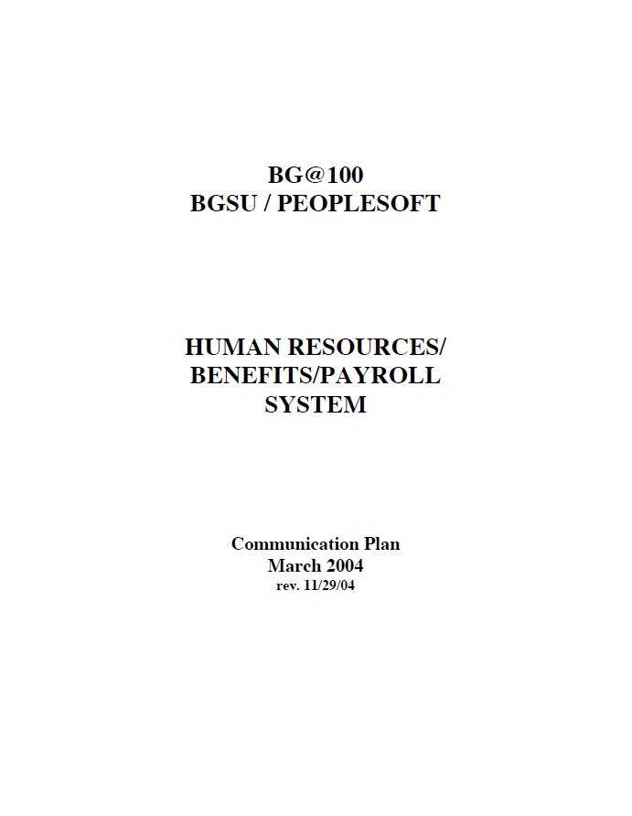
Managing and Engaging Project Stakeholders
(Communication Plan: BGSU / PeopleSoft)
Review with Class

Slide 4

Managing and Engaging Project Stakeholders
(Communication Plan: Cleveland Clean Air Campaign)
Review with Class

Slide 5
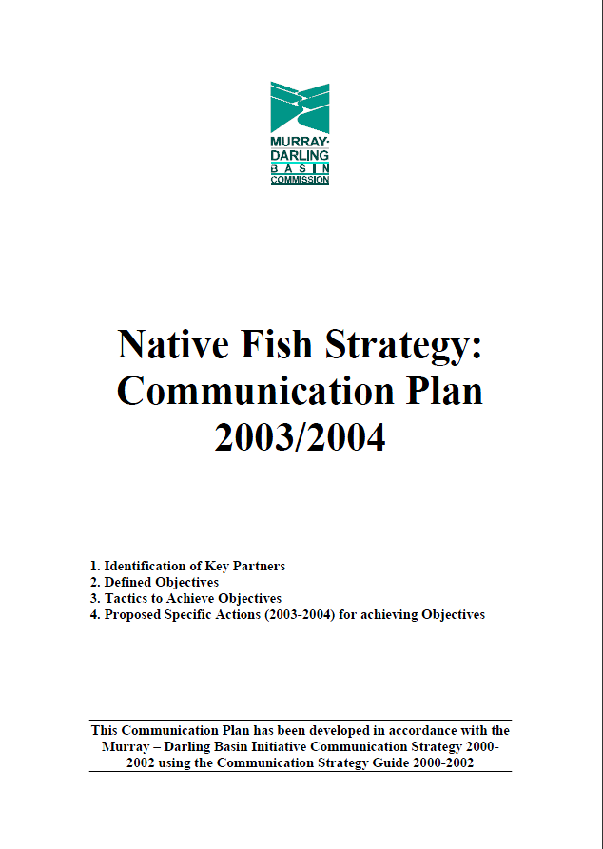
Managing and Engaging Project Stakeholders
(Communication Plan: Native Fish Strategy)
Review with Class

