Slide 1
Master of Science in Project Management
Project Stakeholder
AND COMMUNICATION Management
COMSATS VIRTUAL UNIVERSITY
LECTURE 3: INTRODUCTION TO PROJECT STAKEHOLDER MANAGEMENT AND ENGAGEMENT

Slide 2
Managing and Engaging Project Stakeholders
(Dimensions of Complexity)
C
Inter-Organizational
(Complex Int./Ext. Stakeholder Community)
Management & Engagement Complexity
Project Stakeholder Management & Engagement
B
Inter-Organizational
(Simple Int./Ext. Stakeholder Community)
A
Organization-Wide
Inter-Departmental
Department-Wide
Intra-Departmental
Notes:
Slide: Managing and Engaging Project Stakeholders – Dimensions of Complexity
With primary stakeholders (internal) the focus is on the exercise of traditional management functions (i.e. directing, planning, staffing, communicating, motivating, controlling) possibly with some level of engagement (for e.g. keeping the sponsor and client informed, consultations).
With primary stakeholders (external) the focus is on both management and engagement. Different entities independently manage their respective segments of the project but coordinate to ensure consistency and harmony w.r.t the achievement of the project goal and outcomes for which all stakeholders are (directly and indirectly, explicitly and implicitly) responsible. Engagement takes the form of relationship-building, seeking to motivate and retain commitment to the project and especially provision of information and communication to reduce risk.
With secondary stakeholders (external) the focus is not on “management” (these stakeholders are not subordinate to managers and do not take orders from them) but on “engagement strategies” (e.g.: information and communication, relationship-building, provision of incentives, partnering mechanisms, innovative approaches etc.).

Slide 3


Managing and Engaging Project Stakeholders
(Context A: Low Level of Stakeholder Complexity)
Project stakeholder management and engagement in its simplest form usually (but not always!) occurs on projects which are conducted inter-nally by an organization in one or more of its functional departments.
The focus here of management and engagement is to assign and coordi-nate project work among the stake-holders, overcome their resistance to change and motivate them to put in their best efforts to make the project a success.
Heavy Management
Moderate Engagement
Notes:
With primary stakeholders (internal) the focus is on the exercise of traditional management functions (i.e. directing, planning, staffing, communicating, motivating, controlling) possibly with some level of engagement (for e.g. proactively building a strong relationship with the project sponsor and client).
With primary stakeholders (external) the focus is on both management and engagement. Different entities independently manage their respective segments of the project but coordinate to ensure consistency and harmony w.r.t the achievement of the project goal and outcomes for which all stakeholders are (directly and indirectly, explicitly and implicitly) responsible. Engagement takes the form of relationship-building, seeking to motivate and retain commitment to the project and especially provision of information and communication to reduce risk.
With secondary stakeholders (external) the focus is not on “management” (these stakeholders are not subordinate to managers and do not take orders from them) but on “engagement strategies” (e.g.: information and communication, relationship-building, provision of incentives, partnering mechanisms, innovative approaches etc.).

Slide 4


Managing and Engaging Project Stakeholders
(Context B: High Level of Stakeholder Complexity)
More complex project stakeholder management and engagement nor-mally is found on projects undertaken in a collaborative environment by multiple contracting entities, for e.g. in partial ICT outsourcing projects.
Here stakeholder management and engagement is both intra- as well as inter-organizational. More importance is accorded to monitoring, communication, negotiation and trust and relationship-building between stakeholders.
Heavy Management
Moderate Engagement
Notes:
NPD projects too may fall under this category.

Slide 5
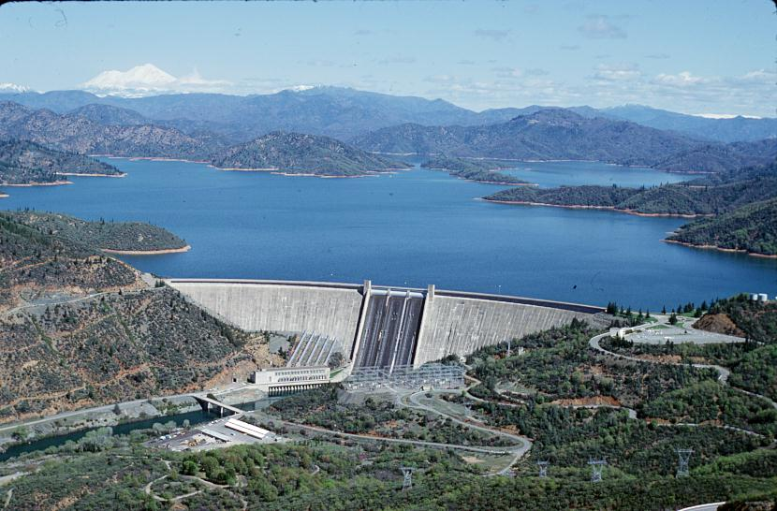
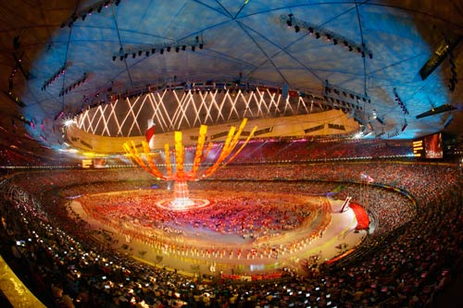
Managing and Engaging Project Stakeholders
(Context C: Highest Level of Stakeholder Complexity)
The most complex project stakeholder management/engagement occurs on large-scale projects as in construction and civil engineering, also major events and development initiatives.
Here stakeholder management/enga-gement not only has the complexity level of context B, but also must con-tend with engaging (many) external (non-contracting) stakeholders which may support or (often), oppose the project. Key Requirements are Caution, Consideration and Creativity.
Heavy Management
Heavy Engagement
Notes:
External stakeholders which, incidentally, may be quite powerful and have a spectrum of concerns in connection with the project.

Slide 6

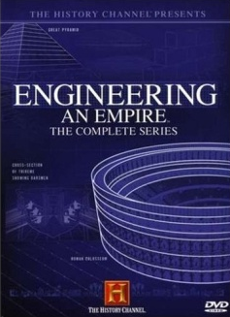
Ubiquitousness of Project Stakeholders
No project in history – from the dawn of man-kind down to the present era – has been „stakeholderless“.
Stakeholders are as na-tural to a project as are its conventional para-meters of goal/scope, cost and duration.
The History Channel’s acclaimed documentary series Engineering an Empire gives excellent insight on major projects undertaken by great civilizations, and sheds light on their “stakeholders”.

Slide 7

Project Stakeholder Management
(An Evolving Discipline)
Project Stakeholder Management is an evolving and specialized project mgmt. subject area. Lar-gely neglected in project mgmt. degree programs and text books, interest in it among researchers and practitioners has grown immensely in recent years and a voluminous body of lit. now exists.
Notes:
Neglected in the sense that courses on project stakeholder management are rare.

Slide 8
Involvement of Stakeholders in Projects
Pre-Project Phase
Need, Want, Opportunity, Legal Compulsion
Project Conceptualization & Feasibility Analysis
Project Pre-Initiation Activities
INT. & EXT. STAKEHOLDER INVOLVEMENT
(Direct, Indirect)
Project
Life-Cycle
Project Initiation
Project Planning
Project Monitoring, Evaluation, Control
Project Execution
Project Closure
Post-Project Phase
Monitoring/Evaluation of Project Outcomes & Impacts
Notes:
Slide: Involvement of Stakeholders in Projects
Pre-Project Phase: Every project starts with a Need (E.g.: to construct a road, bridge, sewage treatment facility, vocational training center), a Want (E.g.: to organize a sporting event such as the Olympics), an Opportunity (E.g.: to launch innovative feature-rich new products or services with high profit potential on the market based on research undertaken by the marketing department of a commercial organization) or when necessitated by a Legal Compulsion or Requirement (e.g. for installation of pollution emission control systems in factories, mandatory fireproofing of residential buildings). This presupposes a deficiency or a constraint which is preventing or obstructing the attainment of a desired state (goal, objective, target).
Note the difference between real, perceived or contrived needs (contrived indicates that some stakeholders want to unduly benefit). Needs can be classified according to their time horizon into (a) current or immediate period (b) the near or foreseeable future, and (c) the distant future. A need presupposes the existence of a deficiency or a constraint (or deficiencies/constraints) which is/are preventing/obstructing the attainment of existing or future desired goals and objectives, targets, conditions or situations, and which must be systematically addressed and overcome. For example, by using demographic forecasting tools, a need in five years time for additional secondary schools (and possibly also for primary schools as well as tertiary educational institutions) to cater to an expanding student population may be identified. A problem or sudden crisis situation may constitute the basis of an immediate need for action, for example, for initiating relief (and consequent rehabilitation) measures, projects and programs in the event of massive earthquakes, flooding or volcanic eruptions as have been witnessed several times in living memory.
Post-Project Phase:
Time-Frame: Short-Term, Medium-Term, Long-Term
Outcome and Impact Dimensions and Intensities: Economic, Financial, Social, Cultural, Political, Technological, Institutional, Legal etc.
Example (Social Development): Capacity-Building Project to Train Local Youth in Technical Skills (e.g. Carpentry, Welding, Mechanics)
Note: It should be kept in mind that often people get hooked on the notion of the project output as symbolizing the purpose of the project. It is not! The purpose is actually the outcomes and anticipated benefits for economy, society and natural environment which are often not tangible but perceivable.

Slide 9

Managing and Engaging Project Stakeholders
(Practical Value)
Project Stakeholder Manage-ment provides a sophisticated analytical and evaluative framework for a rigorous indi-vidualized analysis of stakehol-ders to an extent not possible in conventional management which tends to view stakehol-ders in a macro-perspective (shareholders, suppliers, etc.).
Notes:
Slide: Project Stakeholder Management – Practical Value
As a discipline which has now attained a reasonably high level of sophistication, project stakeholder management offers a robust framework which encompasses guidelines, principles, policies, strategies, plans, processes and tools etc. which within financial, time, informational and other given constraints permits a rigorous individualized analysis and assessment of a project’s identified stakeholder community. This gives it a clear advantage over conventional management (general management, strategic management) where stakeholders are usually “lumped together” in categories such as shareholders, suppliers, employees, customers and clients etc. and analyzed comparatively superficially.

Slide 10

Managing and Engaging Project Stakeholders
(Fundamental Limitations)
Just as medical science cannot heal all diseases of the body and psychiatry cannot cure all diseases of the mind, stake-holder management & enga-gement cannot always be ex-pected to successfully resolve all complications which may and likely will arise between stakeholders over the course of the project life-cycle.
It‘s Not Magic! (Don‘t expect miracles!)

Slide 11

Managing and Engaging Project Stakeholders
(Managing/Engaging Project Stakeholders Properly)
The key to „effective“ stake-holder management and en-gagement is to carefully iden-tify and understand the inte-rests and concerns shaping stakeholders‘ attitude and be-haviour towards the project, and to manage and engage these prudently & profession-ally over the project life-cycle.

Slide 12

Managing and Engaging Project Stakeholders
(The Logic Behind Stakeholder Management)
On all projects stakeholders must be carefully and professionally managed and engaged so that they can con-tribute to the project, under-stand the project decisions taken and accept them more readily and they will be pro-ject supporters instead of pro-ject adversaries.

Slide 13



Managing and Engaging Project Stakeholders
(The Centrality of Stakeholders on Projects)
Stake-holders
Project Goal
Project Duration
Project Cost
Stakeholders are central to all projects in every respect because they are the entities which are responsible for conceiving, defining and initi-ating, planning, executing, closing (or occasionally pre-maturely terminating), and monitoring, evaluating and controlling projects.
A project‘s ‚triple constraint‘ (goal/scope, cost and time) should be modified to depict the central role of its stakeholders.

Slide 14

Managing and Engaging Project Stakeholders
(The Criticality of Stakeholder Relationships)
Building, expanding, consoli-dating and sustaining relation-ships lie at the core of success-ful project stakeholder mana-gement and engagement.
Prerequisites: Trust, mutual respect, empathy, sincerity, in-tegrity, communication, ability to listen and pursue construc-tive dialogue, and willingness to cooperate and compromise.
Relationship management can sometimes work wonders – even to the extent that it can bring stakeholders with diver-ging objectives, priorities and perceptions into a dialogue for the purpose of devising mutu-ally acceptable workable solu-tions to problem or conflict situations.
Notes:
Slide: Project Stakeholder Management – The Importance of Relationships
Off course, this is possible only when all stakeholders are willing to interact and give and take on a fair basis. Additional prerequisites: Flexibility, Understanding, Humility, Courteousness. Symbiotic relationship?
Examples of behavioural attributes which are inappropriate/non-conducive for building relationships between stakeholders: condescending, discourteous, unfeeling or uncaring, arrogant.

Slide 15

Managing and Engaging Project Stakeholders
(A Collective Responsibility)
Managing and engaging stake-holders is NOT a „centralized“ responsibility entrusted to a single or few entities, such as the project sponsor, manager, team members or consultants.
It is a shared collective respon-sibility: All stakeholders must manage and engage each other over the project life-cycle.
A chain is acknowledgeably only as strong as its weakest link. Deficiencies within an otherwise good stakeholder management and engagement system at one or more inter-facing points may result in potentially serious consequen-ces for the project.
Notes:
Slide: Project Stakeholder Management – A Collective Responsibility
Example: The project team fails to appropriately engage a powerful external adversarial stakeholder which may result in that stakeholder pursuing a course of action which is detrimental to the achievement of the project output and/or its outcomes.

Slide 16


Managing and Engaging Project Stakeholders
(The Importance of Finding Win-Win Solutions)
Stakeholders normally support projects when they perceive they will gain therefrom, i.e., net benefits > net costs.
Stakeholder management and engagement involves creative pursuit of „win-win solutions“ that add net value to and are acceptable by (preferably) all or the largest number of stake-holders possible.
WIN/WIN
(Ideal, Best Case)
✓
✓
WIN/LOSE
(Typical Case)
✓
✗
LOSE/LOSE
(Frequent,
Worst Case)
✗
✗
Notes:
Slide: Project Stakeholder Management – The Importance of Finding Win-Win Solutions
Three scenarios shown in order of desirability from top to bottom: (1) Win/Win is the best case, (2) Win/Lose is the usual outcome on most projects, and (3) Lose/Lose is the worst case which may happen when project planners and implementers commit serious blunders in dealing with their stakeholders.

Slide 17

The Project Stakeholder Community
(Size, Dispersion, Complexity)
Depending on the project, the stakeholder community can range from being very small and homo-genous, easy to identify, analyze and manage/engage to being very large, diverse in terms of attribu-tes, spatially highly dispersed and very difficult and costly to iden-tify, analyze and manage/engage.

Slide 18

Managing and Engaging Project Stakeholders (BEWARE!)
NEVER UNDERESTIMATE THE PROJECT STAKEHOLDERS!
Ineffective or inadequate stakeholder management/en-gagement is widely acknowledged (and empirically pro-ven) as constituting a principal cause of project failure.
Projects which fail to manage/engage their stakeholders properly can expect to experience potentially serious consequences!

Slide 19

Managing and Engaging Project Stakeholders
(The Cost of Stakeholder Management & Engagement)
For projects there is a cost – or investment - involved in mana-ging and engaging project stake-holders.
There is also a return: A (much) higher likelihood that the pro-ject will be completed within set parameters (time, budget etc.).
A challenge is to ensure that the cost/investment on the project is commensurate with return.
Low investment in stake-holder management and engagement may result in avoidable complications which are costly to rectify subsequently.
On the other hand, exces-sive investment would constitute a waste of pro-ject resources.
Notes:
Care must be taken to avoid overspending project resources but at the same time to ensure that adequate funds and support are made available, failing which the consequential costs may be very high. Determining the appropriate level of spending can be very difficult and may increase dramatically if issues with stakeholders surface.

Slide 20

Managing and Engaging Project Stakeholders
(The Cost of Stakeholder Management & Engagement)
The main overhead cost (or investment) incurred by an organization on project stakeholder management & engagement is for creation, operation, coordination and supervision of the requisite infrastruc-ture for all its projects with modifications/ improvements to them over time:
Institutional (Committees)
Methodological (Processes, Tools)
Educational (Training)
Technical (Information System)
Overhead
Costs
(for all projects)
Notes:
This is from an organizational (not a project) perspective. The organization can be an entity in the public, private or not-for-profit sector.
Cost of operations here does not imply cost on individual projects which, off course, would fall under project-specific direct costs.

Slide 21

Managing and Engaging Project Stakeholders
(The Cost of Stakeholder Management & Engagement)
Stakeholder-focused PM Processes & Deliverables (e.g. Requirements, Scope Change and Contract Management)
Unplanned Modifications to the Project’s Scope based on (external) Stakeholder In-put and Suggestions
Process Modifications & Innovations (Responsiveness to Stakeholders)
Creating a stakeholder-friendly work, interaction & collaboration environment
Performance Incentives
Direct
Costs
(project-specific)
Fixed Cost
Variable Cost
Recurring Cost
Non-Recurring Cost
Notes:
Slide: Managing and Engaging Project Stakeholders – The Cost of Stakeholder Management & Engagement
Processes & Deliverables: These also include the process of requirements elicitation, integrated change processes, and procurement processes. Deliverables include training courses in non-technical and social/inter-personal skill-building for project team members, e.g. communication, negotiation, motivation, conflict and crisis management. Also, arranging meetings with the project team, sponsor, clients and end users etc., producing reports/audits for project steering committee and senior management, consultations with state entities entrusted with periodically monitoring and evaluating the project.
Performance Incentives: For e.g., for good effort and achievements in connection with managing and engaging stakeholders.
Note: The salaries of project employees who are engaged in stakeholder management and engagement responsibilities, but who have not been hired specifically for this purpose, must also be counted as cost. In this case the cost covers only that amount which can be attributed to stakeholder management and engagement activities.

Slide 22
Managing and Engaging Project Stakeholders
(The Cost of Stakeholder Management & Engagement)
Hiring Project Staff for Stakeholder Management & Engagement Activities
Training & Educating Project Staff in Stakeholder Management & Engagement
Infrastructure (tech., informational, etc.)
Information Collection, Identification & Analysis of the Project Stakeholders (Ap-plication of Processes, Tools)
Design, Periodic Review & Modification of Stakeholder Management & Engagement Strategies
Direct
Costs
(project-specific)
Fixed Cost
Variable Cost
Recurring Cost
Non-Recurring Cost
Notes:
Slide: Managing and Engaging Project Stakeholders – The Cost of Stakeholder Management & Engagement
Hiring Staff: Equal to the amount of salary paid to them while employed with the project.
Training & Educating: For example, for short-term general, customized or specific theme-centered stakeholder management and engagement courses, seminars or workshops.
Infrastructure: For example, for setting up, operating and maintaining a Stakeholder Information and Communication System for the project.

Slide 23
Managing and Engaging Project Stakeholders
(The Cost of Stakeholder Management & Engagement)
Provision of Information to Stakeholders (Internal, External)
Consultation Activities with Stakeholders (Internal, External)
Customized Incentives for Stakeholders (Financial, Material)
Direct
Costs
(project-specific)
Fixed Cost
Variable Cost
Recurring Cost
Non-Recurring Cost
Notes:
Slide: Managing and Engaging Project Stakeholders – The Cost of Stakeholder Management & Engagement
Customized Incentives: For e.g., donations to local community clubs and educational establishments.

Slide 24

Managing and Engaging Project Stakeholders
(The Cost of Stakeholder Management & Engagement)
Loss of Executive & Collegial Support
Unanticipated, Undesired or Excessive Changes to the Project’s Scope
Delayed Commencement and/or Exten-ded Duration of the Project, its Constitu-ent Phases or Work Activities
Overlooked Requirements/Specifications
Project Design and Execution Deficien-cies, Errors and Omissions
Stress, Demotivation, Dissatisfaction, Traumatisation and Emotional Distress for (Internal) Stakeholders
Some major costs (monetizable/ non-monetizable) of inadequate stakeholder management and engagement on projects

Slide 25
Managing and Engaging Project Stakeholders
(The Cost of Stakeholder Management & Engagement)
Safety and Security, Sabotage of Project Assets, Injuries/Deaths of Proj. Personnel
Damage to the Image/Reputation of Key Stakeholders (e.g. Project Owner, Con-tractors, Financers) and Consequent Cost for their Future Projects
Hiring Consultants (Trouble-Shooting)
Mediation, Arbitration, Litigation
Project Failure or Premature Termination
Reduction in the Real or Perceived Quality of Life of Local Communities and other External Stakeholders
Some major costs (monetizable/ non-monetizable) of inadequate stakeholder management and engagement on projects
Notes:
Project Cancellation: The Singur Car Factory project in the Indian state of West Bengal is a good case in point. Considerable expense was incurred on the project by the Tata company and a section of the local community which sold land to the company for a project that ultimately had to be prematurely terminated due to powerful resistance.

Slide 26









Stakeholders and PMBOK Project Management
Integration Management
Quality Management
Scope Management
Procurement
Management
Cost Management
Human Resource Management
Communication Management
Time Management
Stakeholders interface in a complex manner with each of these knowledge areas!
Risk Management

Slide 27
Managing and Engaging Project Stakeholders
(Stakeholders and Project Communication)
Communication is considered the „life blood“ of a project. It constitutes the basis for all stakeholder interactions.
Occuring throughout a pro-ject‘s life-cycle, project com-munication takes place in many forms: written and ver-bal, by listening and through body language.
Numerous surveys indicate that communication short-comings are a principal cause of project trouble or failure.

Slide 28
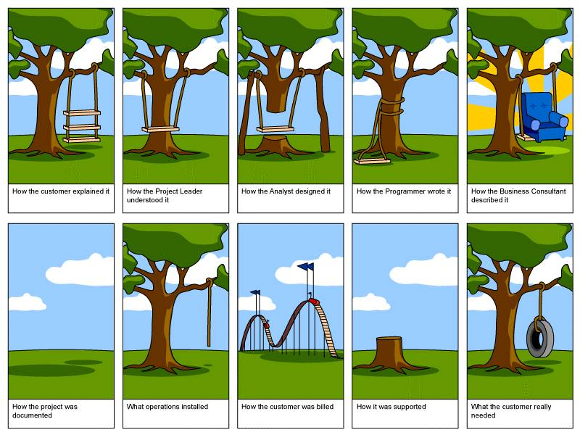
Consequences of Comm. Shortcomings

Slide 29
Managing and Engaging Project Stakeholders
(Stakeholders and Project Scope)
A project‘s goal along with its requirements & specifications primarily determine its scope of work.
Stakeholders define a project‘s scope of work and authorize the occasional changes/modi-fications to it which normally occur over the course of the project‘s life-cycle.
Precise scope definition, especially on complex pro-jects, can be quite challen-ging and stakeholder-induced shortcomings in this regard may prove costly for the project over time.

Slide 30
Managing and Engaging Project Stakeholders
(Stakeholders and Project Cost)
Cost is a key consideration in selecting a project.
Stakeholders determine, assess and revise a project‘s costs and benefits on the basis of available information using estimating tools and proces-ses, and monitor cost incurred in relation to project work performed.

Slide 31
Managing and Engaging Project Stakeholders
(Stakeholders and Project Duration)
Stakeholders determine the time a project will take to complete.
They define the project‘s act-ivities, estimate their dura-tions and identify their de-pendency relationships, de-velop the project schedule, and monitor and modify it when circumstances require.
Activity Managers (also Stakeholders) manage the project’s work activities which constitute the pro-ject’s schedule.
Their actions - and those of the other stakeholders who interface with them - determine whether or not the project ‘stays on track’.

Slide 32
Managing and Engaging Project Stakeholders
(Stakeholders and Project Risk)
Risk is inherent to most pro-jects. If unmanaged, project risks may threaten a project‘s existence.
Stakeholders identify, assess and prioritize a project‘s risks, and develop and imple-ment appropriate strategies to avoid, mitigate, transfer or eliminate them.
Stakeholder Management is - in the narrow sense - Risk Management because many risks encountered by pro-jects over their life-cycles are in fact stakeholder-induced.
Notes:
Slide: The Centrality of Stakeholders on Projects – Stakeholders and Project Risk
Note that besides constituting a source of danger or threat (i.e. negative risks) for projects, stakeholders also may present opportunities (i.e. positive risks) which can benefit projects, sometimes immensely, if appropriately managed.

Slide 33
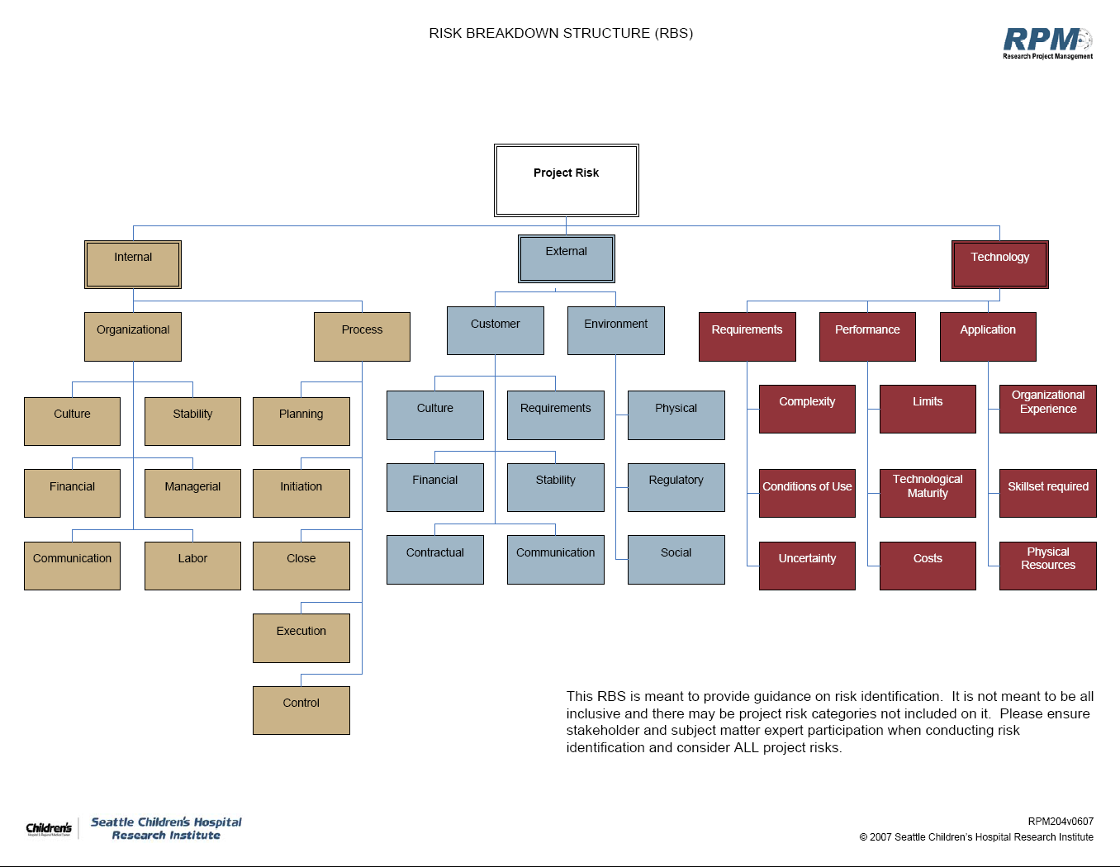
The Centrality of Stakeholders on Projects
(Stakeholders and Project Risk)

Slide 34
Managing and Engaging Project Stakeholders
(Stakeholders and Project Quality)
The acceptability of a project‘s deliverables hinges on meet-ing quality criteria which are set by its clients and users (i.e. stakeholders).
Stakeholders ensure that the (managerial, technical) proces-ses which create the project deliverables meet quality stan-dards and are continuously improved over time.
Quality Control and Qual-ity Assurance are crucial considerations in projects.

Slide 35
Managing and Engaging Project Stakeholders
(Stakeholders and Project Procurement)
Procurement management can be a highly complex un-dertaking on projects.
It typically entails inviting ten-ders and RFPs, evaluating and selecting prospective vendors and service providers (stake-holders), and administering procurement contracts over the course of the project life-cycle.
Many projects require a stream of tangible and in-tangible inputs over their life-cycles (especially in their execution phases), sourced from numerous suppliers (stakeholders) which may be spatially quite distributed (complex supply chains).
Notes:
Slide: The Centrality of Stakeholders on Projects – Stakeholders and Project Procurement
Construction -based projects are a very good example.

Slide 36
Managing and Engaging Project Stakeholders
(Stakeholders and Project Human Resources)
Human Resources – i.e. the project team and support staff – are key stakeholders.
They must be recruited, train-ed, motivated, appropriately compensated, performance-assessed, and given the requi-site authority / resources to pursue project tasks effective-ly and efficiently.
Human Resource Manage-ment is a subarea of stake-holder management. No project can be undertaken without human resources.

Slide 37

Managing and Engaging Project Stakeholders
(Stakeholders and Project Portfolios)
All organizations maintain a set or portfolio of projects and programs at any point in time.
Stakeholders (usually at a very senior level) are respon-sible for selecting projects for inclusion in their portfolios and, if the need arises, elimi-nating them prematurely.
All projects must be aligned with the owning organization‘s mission, goals and objectives, and strategies. Misaligned projects do not add value to the organization!
Notes:
Slide: The Centrality of Stakeholders on Projects – Stakeholders and Project Portfolios
Portfolios can be for programs and projects and they can be broken down into sub-portfolios and broken down further.

Slide 38



Managing and Engaging Project Stakeholders
(Stakeholders and Project Support Infrastructure)
To be undertaken effectively and efficiently, projects need a comprehensive organizat. support framework which would include:
Institutional (e.g.: PMO)
Standards (e.g.: PMI, PRINCE2)
Inform. Systems (e.g.: PMIS)
Incentives (e.g: monetary)
Supporting Organizat. Culture
Project and Program Sup-port frameworks are de-veloped by stakeholders.
Some may be rudimentary, others complex and continuously evolving over time.

