Slide 1
Master of Science in
Project Management
Project Stakeholder
AND COMMUNICATION Management
LECTURE 29: MANAGING & ENGAGING PROJECT STAKEHOLDERS (ENGAGEMENT TOOLKITS, STRATEGIES & PLANS) 1

Slide 2

Managing and Engaging Project Stakeholders
(Engagement Toolkits)
Many organizations, especially in the public and non-governmental sectors, have compiled „engagement toolkits“ which serve as a reference for their employees and outsiders in dealing with stakeholders in their respective fields of work.
The toolkits normally list several en-gagement measures and can be quite detailed and creative in their content.
Several of these toolkits are available online free of cost.

Slide 3
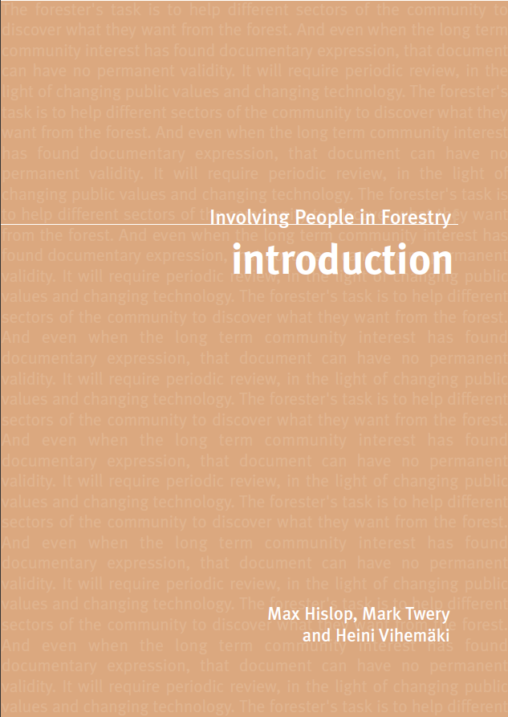

Managing and Engaging Project Stakeholders
(Toolkit: UK Forestry Commission)
Review with Class

Slide 4


Managing and Engaging Project Stakeholders
(Toolkit: Murray-Darling Basin, Australia)
Review with Class

Slide 5


Managing and Engaging Project Stakeholders
(Toolkit: REVIT, Europe)
Review with Class

Slide 6

Managing and Engaging Project Stakeholders
(Engagement Strategies & Plans)
In apparent recognition of the impor-tance of stakeholders, many project planners have developed stakeholder engagement strategies and plans for their projects and programs.
The management / engagement measures contained in such strategies and plans can range from very simple communication activities to complex resource-intensive activities.
Having a stakeholder management / engagement strategy or plan in place is a good, desirable practice.

Slide 7
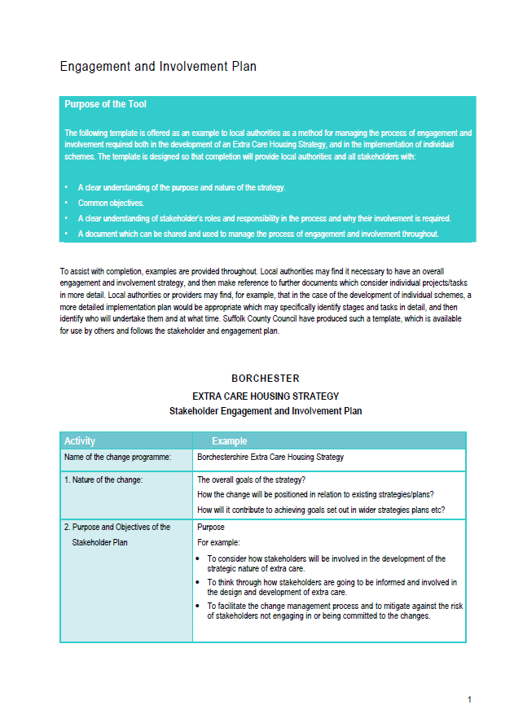
Managing and Engaging Project Stakeholders
(Engagement Plan: Borchester Housing Society, UK)
Review with Class

Slide 8
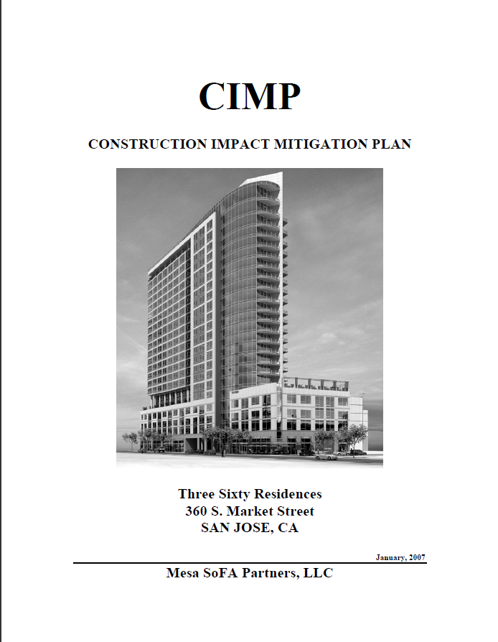
Managing and Engaging Project Stakeholders
(Engagement Plan: Three Sixty Residences, Seattle)
Review with Class

Slide 9

Managing and Engaging Project Stakeholders
(Engagement Plan: Gold Ridge Gold Mine, Solomon Isl.)
Review with Class

