Slide 1
Master of Science in
Project Management
Project Stakeholder
AND COMMUNICATION Management
LECTURE 28: MANAGING & ENGAGING PROJECT STAKEHOLDERS (SELECTED EXAMPLES AND CASE STUDIES)

Slide 2
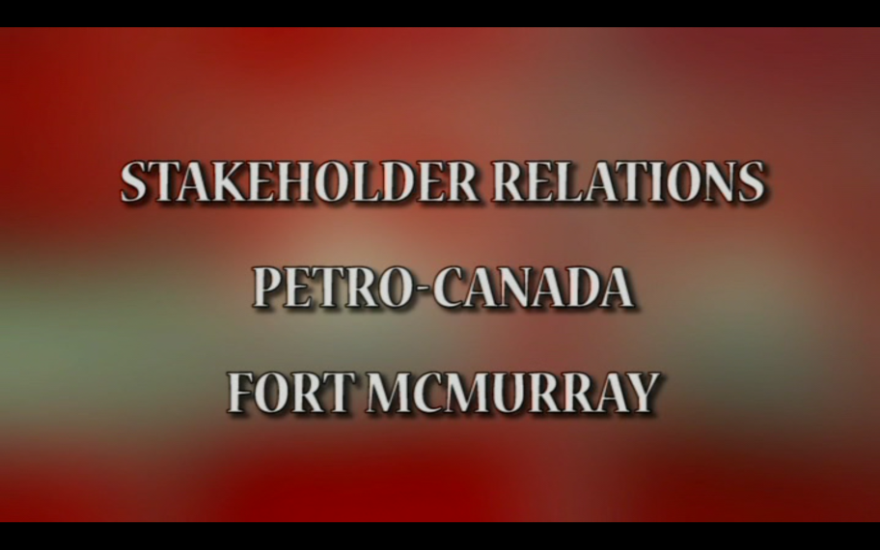
Video
Stakeholder Engagement at Petro-Canada
This 19-minute video produced by Petro-Canada informs viewers about this large Canadian energy cor-poration‘s specific stake-holder management and engagement approaches in the areas in which it is operating.

Slide 3
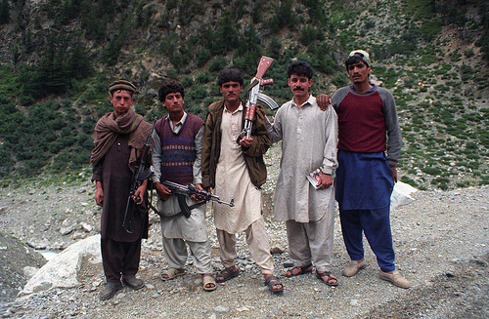
Stakeholder Engagement Examples
(In Pakistan: From One Of My Students Example 1)
One of my students told me about his engineering organization, the Nation-al Engineering Service of Pakistan (NESPAK‘s), approach to dealing with local communities on engineering projects in the hilly Kohistan region in northern Pakistan.
Measures of „engaging“ the locals by the organization‘s field employees included not shaving, wearing local-style clothing (and cap), speaking in Pashto and through a local mediator, and not going out during Azan (prayer time).

Slide 4
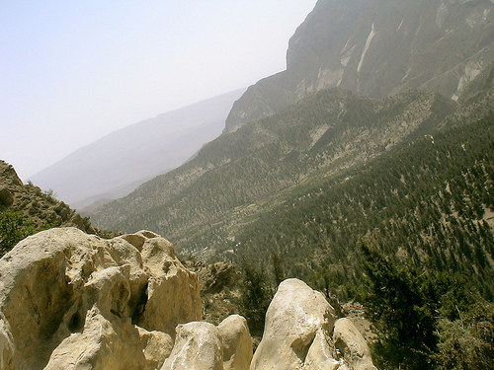
Stakeholder Engagement Examples
(In Pakistan: From One Of My Students Example 2)
In one of the World Wildlife Fund‘s (WWF) projects to protect wildlife in a habitat in northern Pakistan there was an influential local hunter who was undeterred by the WWF‘s work. Undetected because of his terrain knowledge, he continued to hunt ani-mals.
The WWF‘s engagement approach was to hire the hunter as „wildlife guard“. Consequently, he not only gave up hunting wildlife but his in-fluence among other hunters proved a major hunting deterrence.

Slide 5

Stakeholder Engagement Examples
(Greg Mortensen: An American In Pakistan)
The American climber-turned-philan-tropist Greg Mortensen gained int. acclaim for his projects to educate children in N. Pakistan. According to his Institute 171 schools have been constructed in neglected localities and basic education made available to over 64,000 std. (incl. 54,000 girls).
Mortensen‘s best-selling book Three Cups of Tea (2006) documents his effort spanning over ten years. Much of his success can be attributed to relationship building with influential local stakeholders.
Notes:
A sequel Stones into Schools: Promoting Peace with Books, not Bombs, in Afghanistan and Pakistan documenting his efforts primarily in Afghanistan was published in 2009.
Note: Mortensen‘s claims are presently under dispute and the subject of scrutiny.

Slide 6
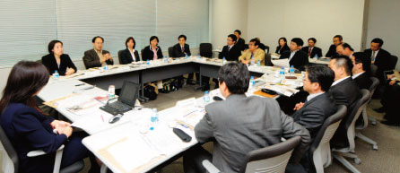

Engaging Stakeholders
(Dialogue Forums: Corporations & NGOs)
It‘s no secret that big corporations and NGOs don‘t see eye to eye on many issues, especially when they concern themes like the natural and ecological environments and rights of indigenous peoples in areas where corporations are operating.
To bridge the gulf, an initiative to bring corporations and NGOs together has emerged in recent years. These dialogues have created a platform where differences can be discussed, awareness promoted, and a search for mutually acceptable solutions sought.
It may be noted that dialogue has its share of critics who argue that through them NGOs may have given legitimacy to corporations’ actions and that the corporations lack genuine sincerity.

Slide 7
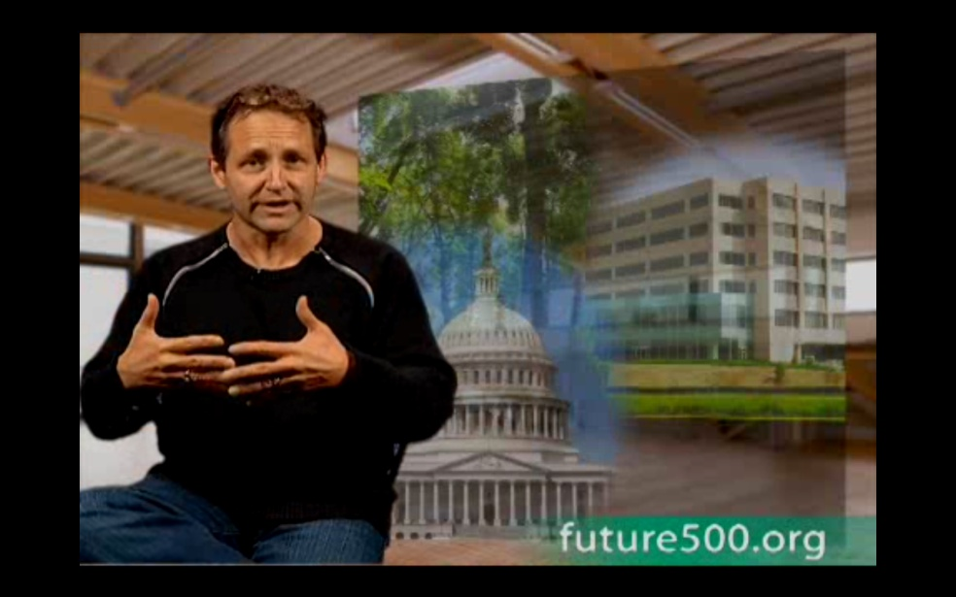

Video
Stakeholder Dialogue Forum
This brief 4-minute video produced by Future500 in-forms viewers about a dia-logue initiated between Japan‘s Mitsubishi Corpora-tion and an environmental-ist network, and the win-win outcome which result-ed from it.

Slide 8
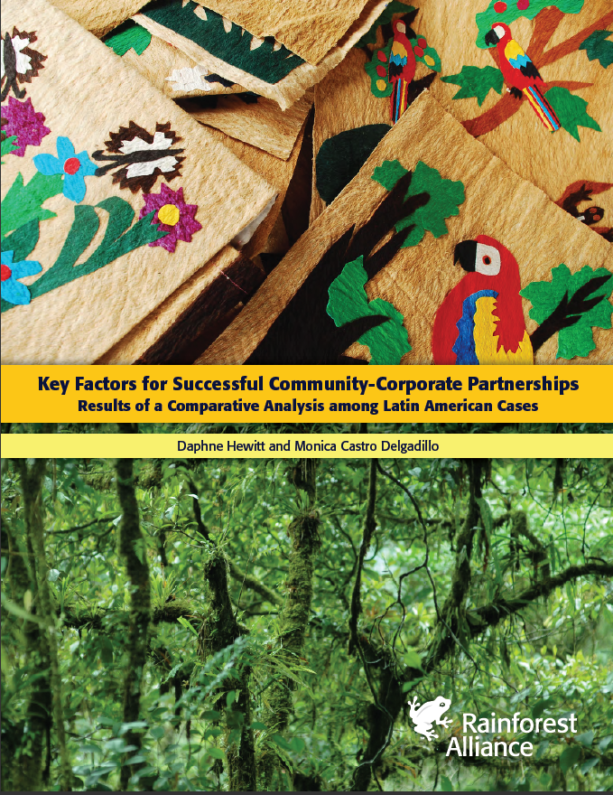
Managing and Engaging Project Stakeholders
(Corporate-Community Partnerships)
Much has been written in recent years about corporate-community relationships.
This 16-page document from the NGO Rainforest Alliance looks at what works and what doesn‘t in the context of rela-tionship building between corporations and communi-ties, emphasizing in particular the role of „trust“ as a prereq-uisite for such a relationship to develop and succeed.

Slide 9
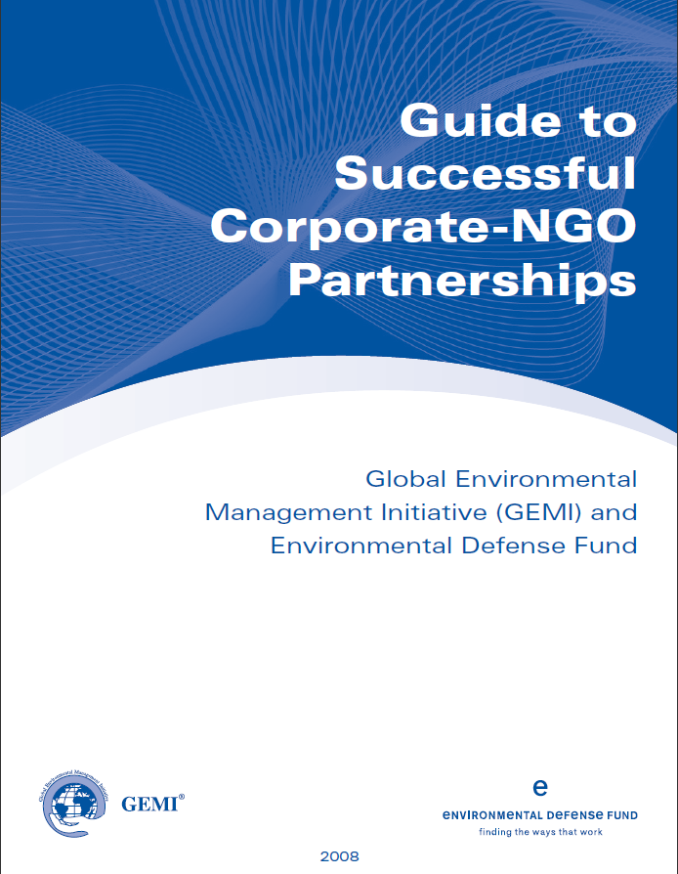
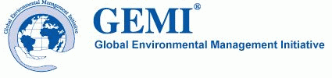
Managing and Engaging Project Stakeholders
(Corporate-Community Partnerships)
The Global Environmental Management Initiative (GEMI) is a forum of corporations helping each other with addressing environmental, health and safety, and sustain-ability considerations.

Slide 10
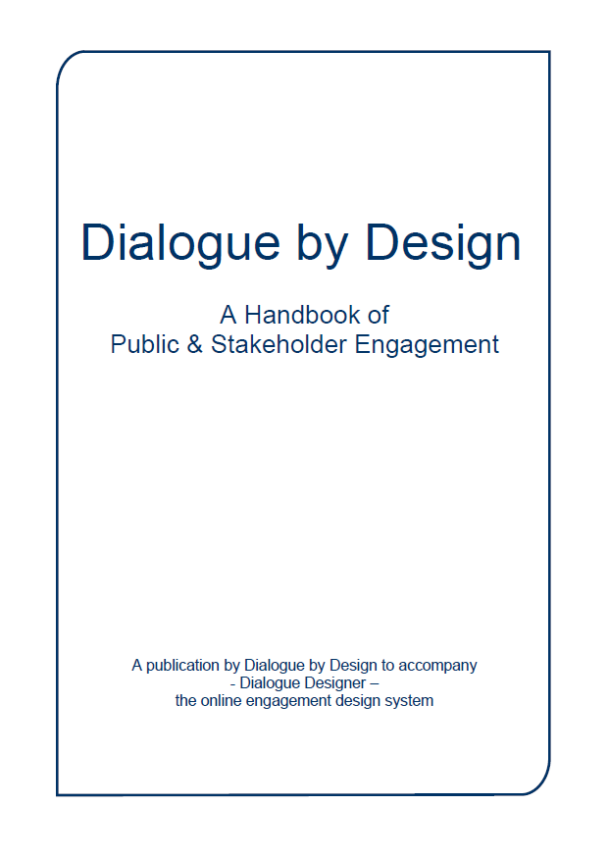

Managing and Engaging Project Stakeholders
(Dialogue by Design)
Published by the consulting firm Dialogue by Design, this insightful 116-page handbook gives insight into several themes concerning stakehol-der engagement and the tools used in pursuing it.

Slide 11
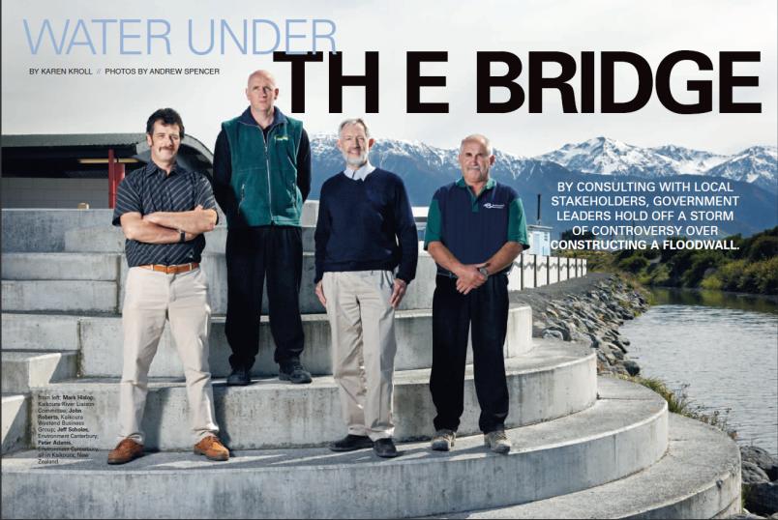
Case Study
(New Zealand: Water Under the Bridge)
An interesting case of stakeholder engagement occured on a project to construct a flood protection wall in the middle of the New Zealand town Koikoura.
This brief article documents the high-lights of the project planners‘ stake-holder engagement and establishes a clear link between the project‘s acceptance by the town‘s inhabitants and the engagement measures which were adopted.

Slide 12
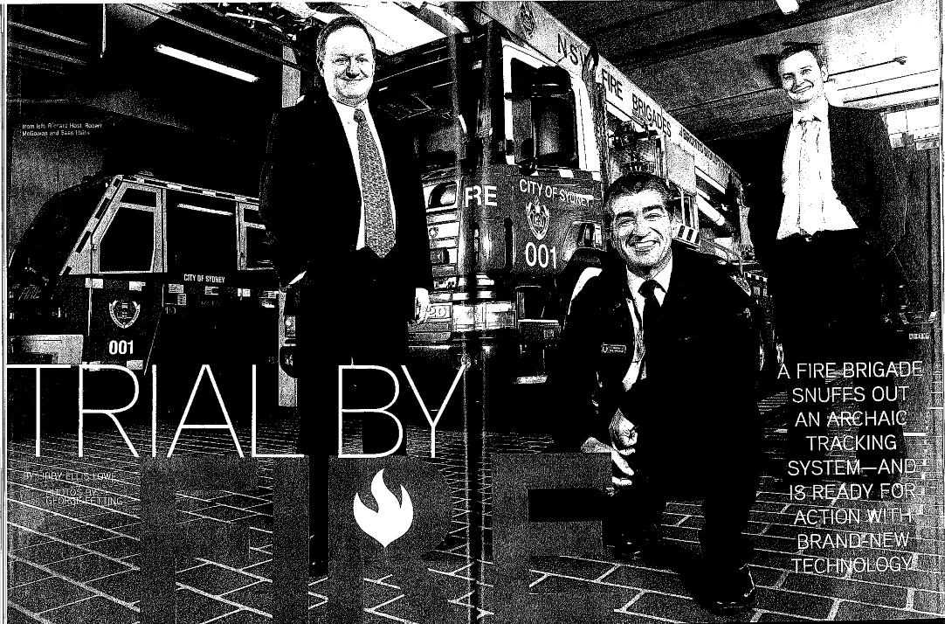
Case Study
(Australia: Computerized Data-filing System)
This case documents the transition from a paper-based to a high-tech digital filing system at the New South Wales Fire Brigade in New South Wales state in Australia.
In this project at the largest fire bri-gade in country, careful stakeholder engagement rather than orders and ultimatums from the top were instru-mental in mustering support among the several thousand employees working in the system.

Slide 13
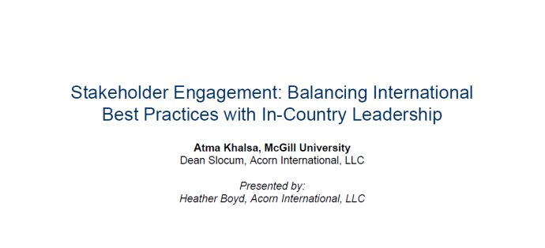
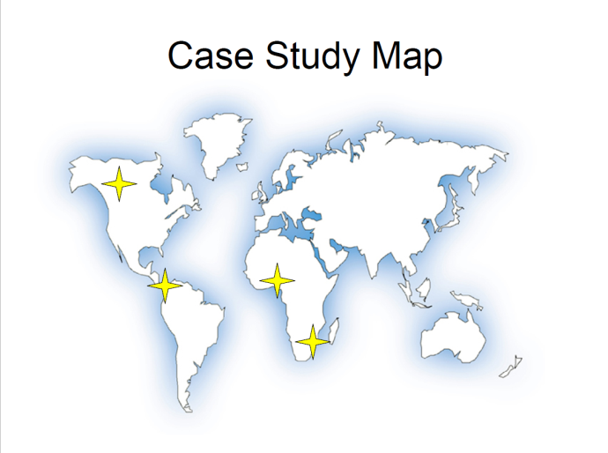
Managing and Engaging Project Stakeholders
(Supplementary Reading)
This interesting document Stakehol-der Engagement: Balancing International Best Practices with In-Country Leadership sheds light on stakeholder issues which surfaced on several projects across the globe and the lessons learned in terms of stake-holder engagement.
Review with Class.

