Slide 1
Master of Science in
Project Management
Project Stakeholder
AND COMMUNICATION Management
LECTURE 27: MANAGING & ENGAGING PROJECT STAKEHOLDERS (SELECTED EXAMPLES AND CASE STUDIES)

Slide 2

Engaging Project Stakeholders

Slide 3
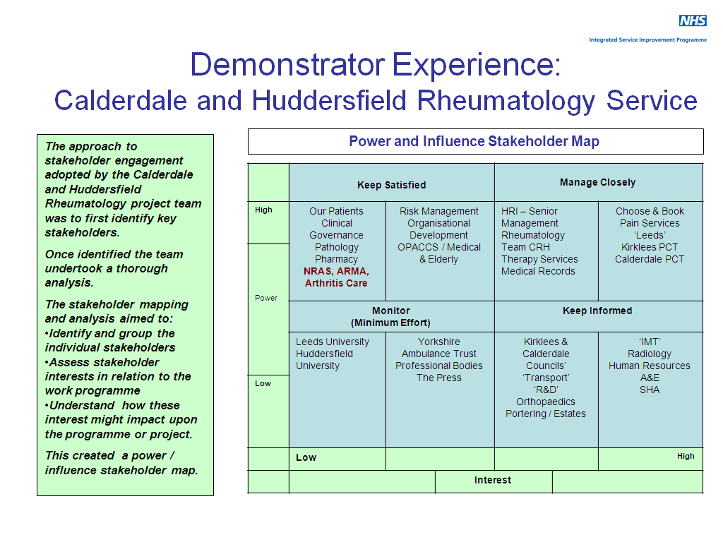

Slide 4
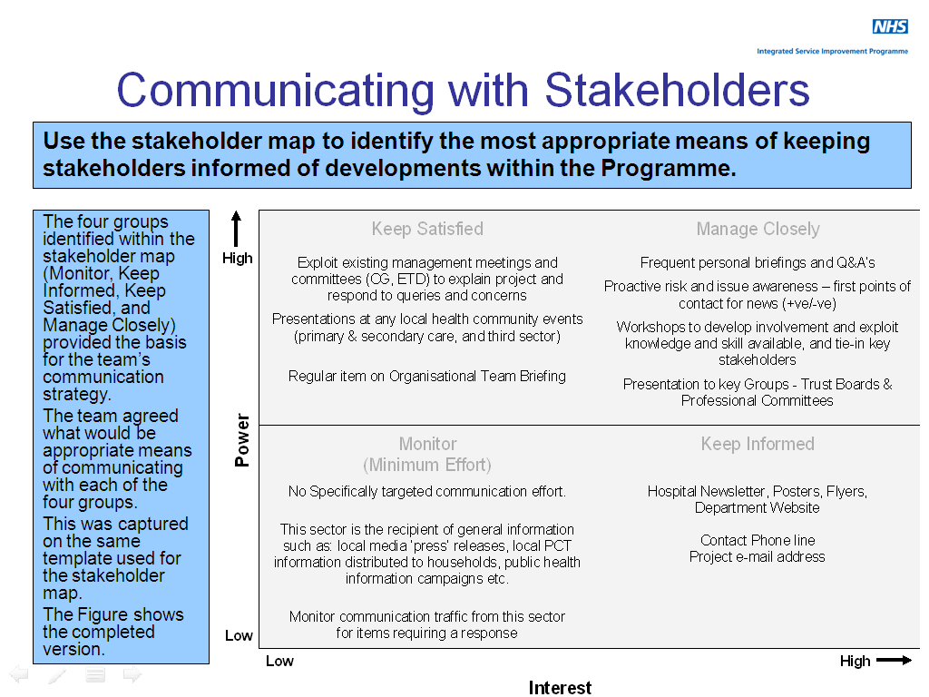

Slide 5
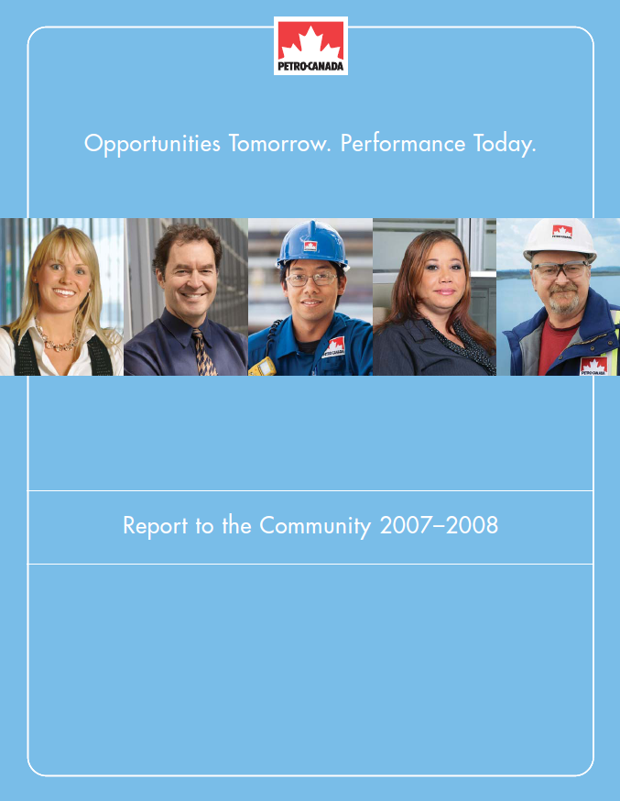
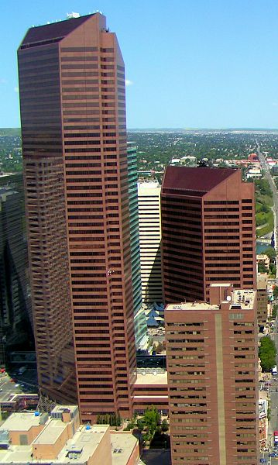
Managing and Engaging Project Stakeholders
(Stakeholder Engagement at Petro-Canada)
The Canadian Petro-Canada corporation is an acknow-ledged leader in terms of how it engages the communities in which it operates.
The company‘s annual reports shed light on its activities and policies.

Slide 6
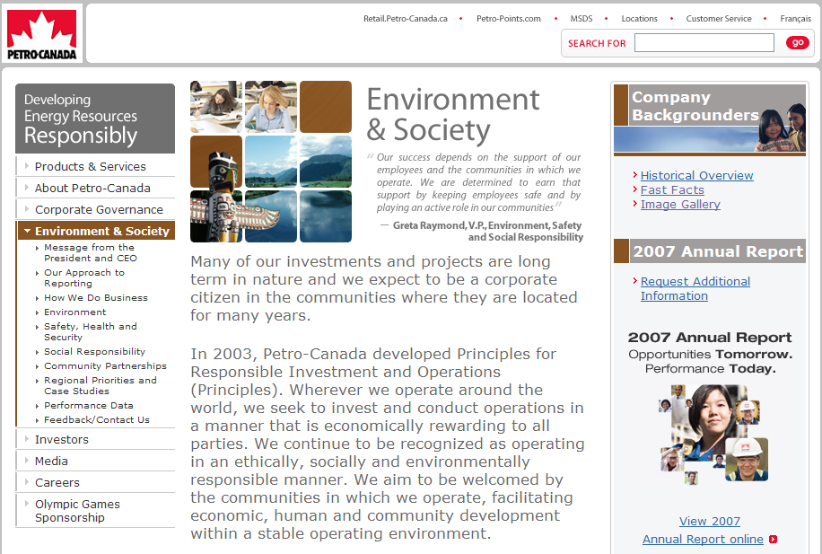
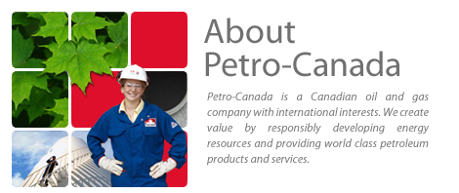
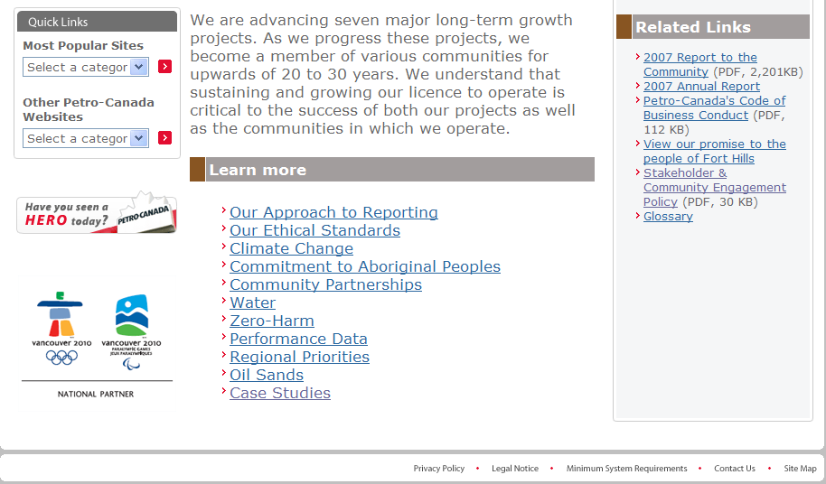
Petro-Canada is one of Canada’s largest oil and gas company’s. Headquarted in Calgary, Alberta, and with more than 5600 employees around the world, Petro-Canada’s operating earnings from continuing earnings amounted to USD 2.6 billion in 2007.

Slide 7
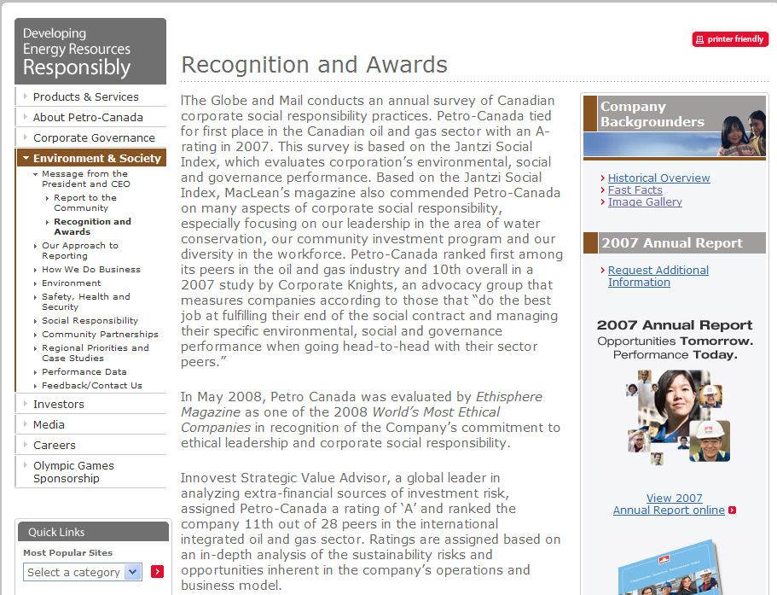
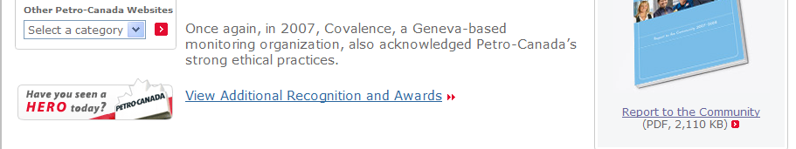

Slide 8
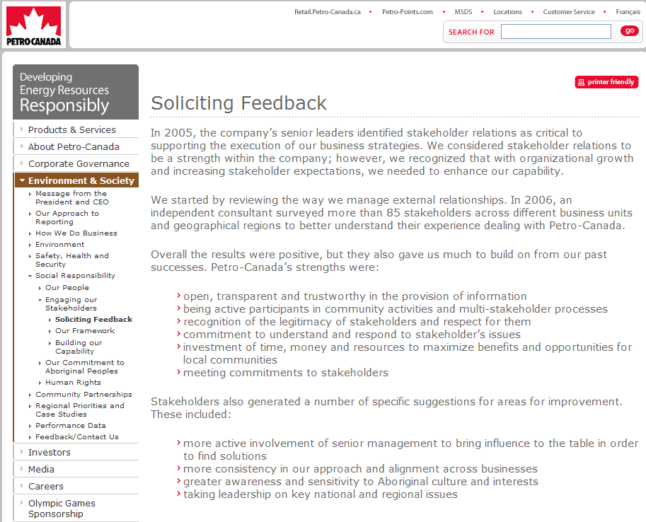

Slide 9
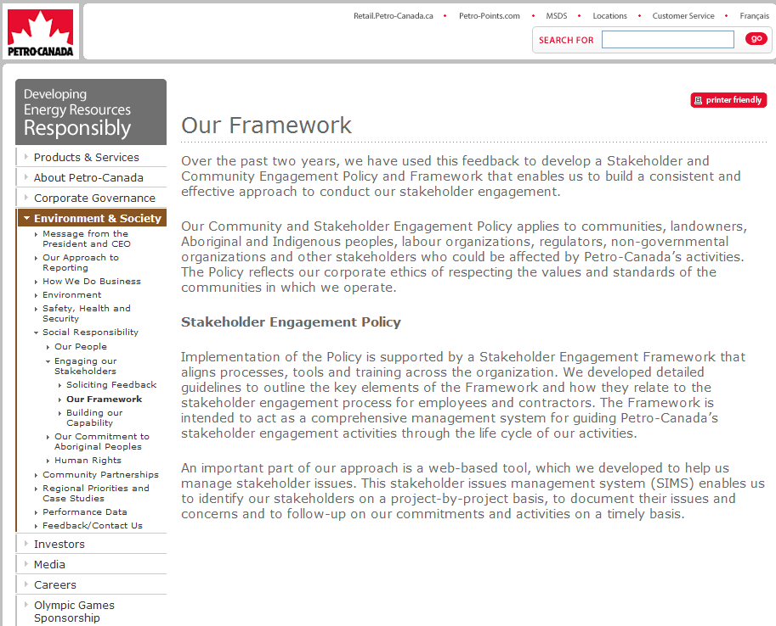

Slide 10
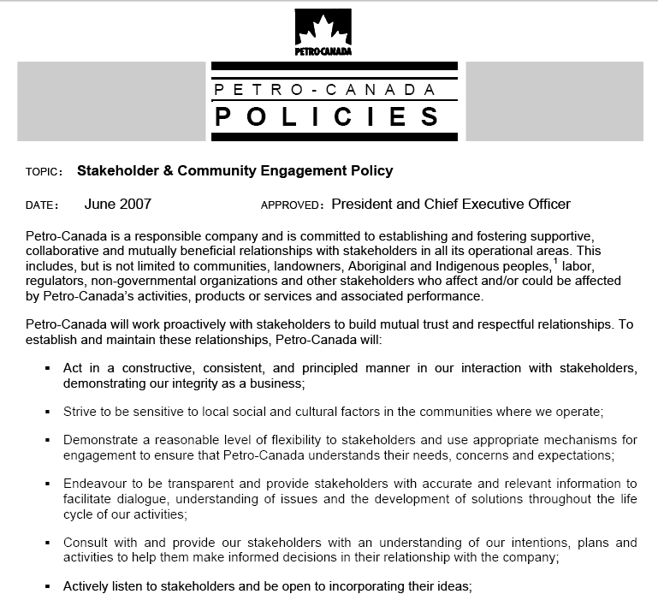
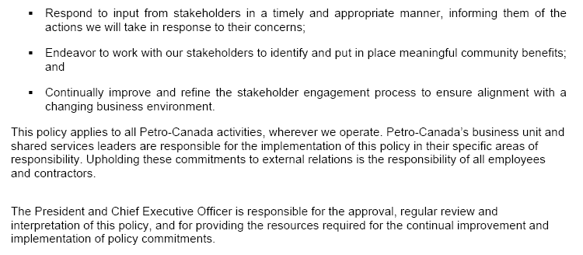
Note how Petro-Canada’s Stakeholder & Community Engagement Policy addresses issues which we discussed in last week’s class on Stake-holder Engagement Theory.

Slide 11
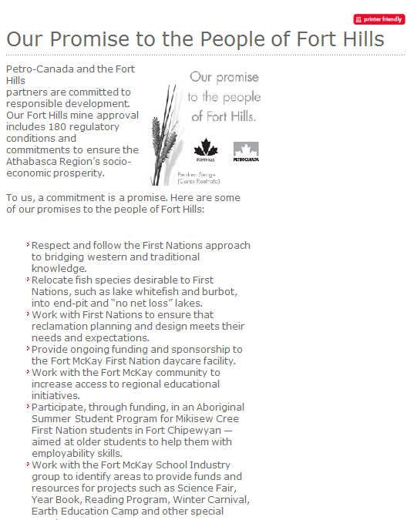
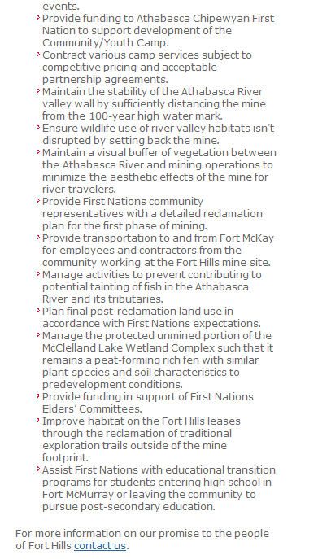

Slide 12
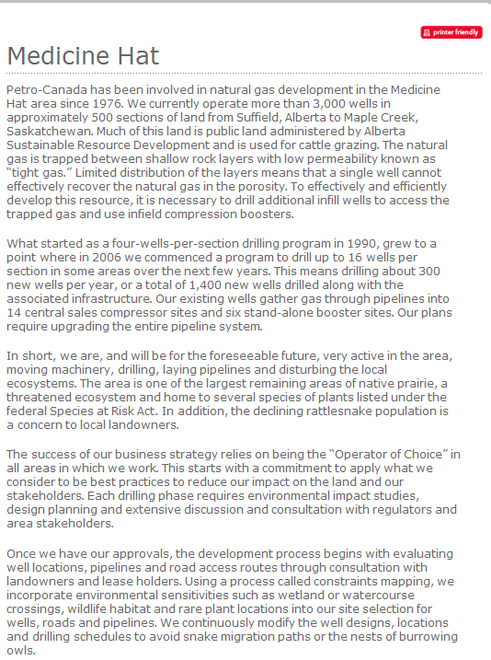
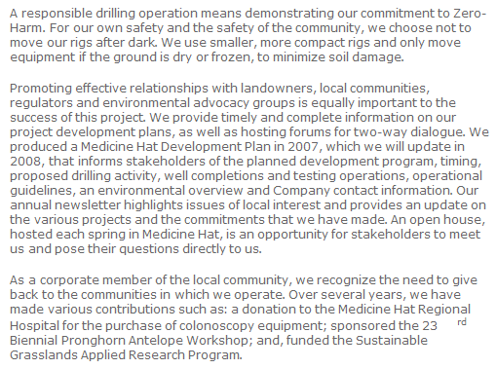

Slide 13
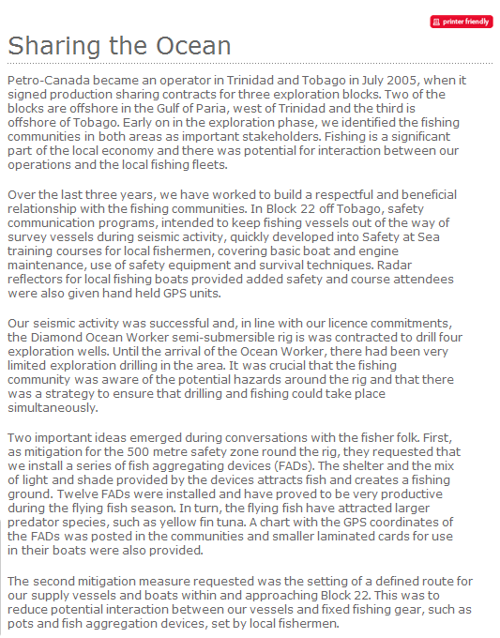

Slide 14
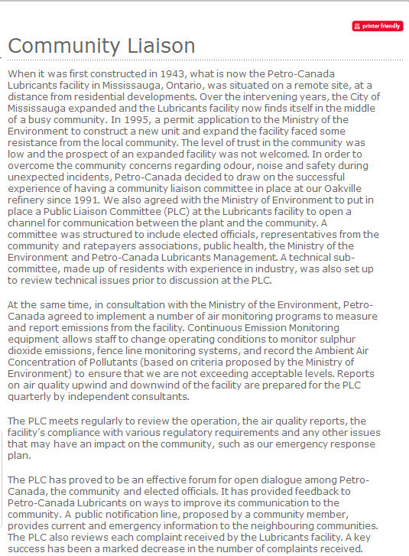

Slide 15
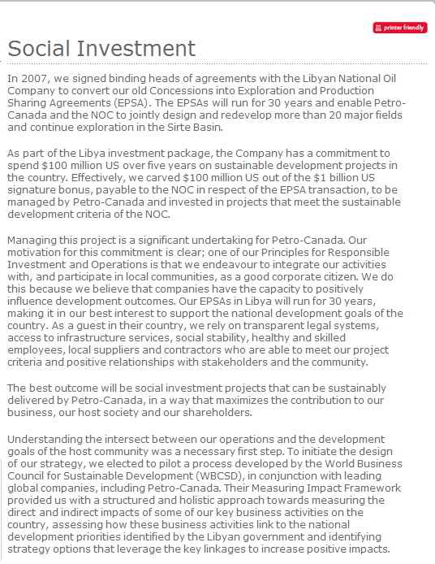
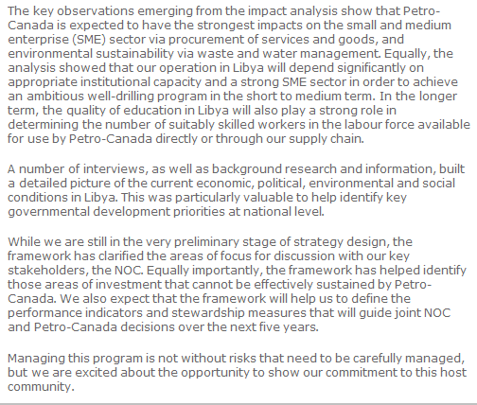

Slide 16
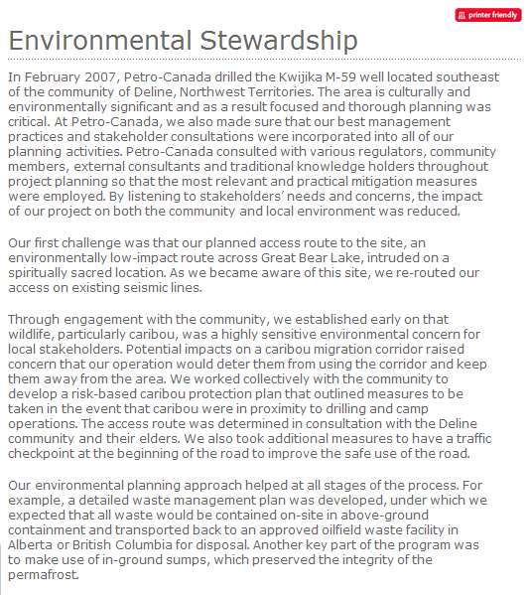

Slide 17
