Slide 1
Master of Science in
Project Management
Project Stakeholder
AND COMMUNICATION Management
LECTURE 26: MANAGING & ENGAGING PROJECT STAKEHOLDERS (CONCEPTUAL FOUNDATIONS) 12

Slide 2
Managing and Engaging Project Stakeholders
(The Importance of Trust)
Trust is defined in many ways. Usually, the concept revolves around reliability, predictability and confidence.
It is hard and takes time – and often a lot of it – to nurture and build trust between stakeholders. One fateful decision or event can shatter it in an instant.
Rebuilding trust lost between stakeholders can be an arduous, sometimes next to impossible task.
Notes:
People often place trust in persons symbolizing institutions / professions which have evolved over a long period of time. Cultural indoctrination plays a big role in this. Typically, they would tend to trust a medical doctor, nurse, university professor, teacher, clergy man or banker over, say, an illegal immigrant, a street cleaner or a homeless person. Yet, on many occasions in our living memory, we can easily recall violations of this trust if we consider, for e.g., media accounts of the murders of patients in hospitals and care facilities, the molestation of children and students, and fraud perpetrated on Wall Street and by banks and corporations across the globe.

Slide 3
Managing and Engaging Project Stakeholders
(Trust Determinants in Stakeholder Relationships)
INTRINSIC DETERMINANTS
The trust-inducing attributes & values possessed by stake-holder entities (individual, associational, institutional etc.).
TRUST
INTERACTIONAL / EXPERIENTIAL DETERMINANTS
The trust which forms in consequence of direct or indirect interaction which occurs over time between stakeholders.
CONTEXTUAL DETERMINANTS
The trust which is determined by the project’s specific context, circumstances and environment.

Slide 4
Managing and Engaging Project Stakeholders
(Trust: Intrinsic Determinants)
Contextual Determinants of Trust
Stakeholder A
(Intrinsic Determinants)
Stakeholder B
(Intrinsic Determinants)
Interactional Determinants
Honesty
Integrity
Decency
Honor
Fairness
Truthfulness
Credibility
Empathy
Image/Reput.
Flexibility
Dignity
Straightforward
Humility
Compassion
Ethics
Law Abidingness
Openness
Transparency
Commitment
Optimism
Responsibility
Perceptiveness
Receptiveness
Tenacity
Predictability
Cult. Sensitivity
Good Judgment
Notes:
Visibility?

Slide 5
Managing and Engaging Project Stakeholders
(Trust: Interactional/Experiential Determinants)
Pleasantness, Frequency & Time-Frame of Interaction
Being Accessible, Cooperative, Courteous & Respectful
Genuine Display of Interest & Concern for Stakeholders
Exhibiting Good Inter-Personal Skills
Taking Initiative in Creating & Nurturing Relationships
Observed Consistency & Dependability
Enduring Professional Behavior
Keeping Promises & Assurances
Responding Promptly & Effectively to Grievances
Facilitating, not Obstructing Resolution of Issues, Probs.
Showing Willingness to Accommodate, Compromise
Providing Desired Information etc. on a Timely Basis
Demonstrating Subject Competence
Notes:
Subject Competence: Subject-based, for e.g., mechanical engineering or computer programming competence.
Inter-Personal Skills: For e.g., communication (“at the same wavelength”) and the ability to listen, persuasiveness, resolving conflicts and crises.
Relationships: Systematically reaching out to build bridges of trust and understanding, for e.g., by being outward and trying to get to know stakeholders by inviting them to events, playing golf with them, chatting with them in the sauna, trying to learn about their culture, customs, rituals etc.
Action/Deeds speak louder than words.
Interactional attributes which are not good for fostering trust include being overbearing, condescending, patronizing, reserved etc.
Asking stakeholders for their help and support may be a good way of creating trust.

Slide 6
Managing and Engaging Project Stakeholders
(Trust: Contextual Determinants)
Shared Interests, Expectations, Concerns & Hopes
Convergent Perceptions of Value & Urgency (Decisions, Situations, Issues, Problems etc.)
Shared Culture, Value System & Language, Religion, Ethnicity, Kinship Ties, Loyalties
Social Standing & Institutional Affiliations
Common Friends & Allies
Influence Exerted by Other Stakeholders
Attitude to Risk
Possession of Requisite Authority & Influence (trust in intent vs. trust in ability to follow through)
Policies, Rules, Processes (Fairness, Transparency)
Notes:
Kinship: Family, Relations, Clan or Tribe. Also close friends.
Social Standing: Higher social standing usually implies a higher level of trust placement.
Institutional Affiliations: Membership of the same professional, recreational etc. organizations.
Decision-Making Authority: For e.g., the Governor of State M desires to eradicate unemployment in his state (people trust him on his intent to earnestly pursue this objective) but he can’t because this complex task is out of his control (he doesn’t possess the ability and/or wherewithal, i.e. resources, authority, support etc. to follow through on his intent).
Note that stakeholders may trust other stakeholders in terms of their intent and ability to follow through with commitments in some situations but not in others. Also note that stakeholders may place their trust other stakeholders but only up to a “threshold value” above which this trust may disappear. For e.g., stakeholder A trusts stakeholder B to administer project funds appropriately but to embezzle funds if the amount is suddenly increased five-fold.

Slide 7
Managing and Engaging Project Stakeholders
(The Importance of Handling Stakeholder Grievances)
On most/all projects there will be stakeholders who at some time have grievances against the project or the behavior of other stakeholders towards them.
Grievance is a resentment or feeling of having being wronged by the actions or behaviors of stakehol-ders. It may also result from situations and circum-stances which stakeholders consider unjust or intolerable.
Stakeholder grievances must be judiciously and sym-pathetically managed. Doing so is not only ethical and professional and reduces risk to the project stemming from stakeholder irritation.

Slide 8

Managing and Engaging Project Stakeholders
(Process Framework for Redressing Grievances)
Step 1:
INFORM
Ascertainment and Documentation of the Object of the Grievance(s), Cause, Circumstances, Complexity, Intensity and Duration through Careful Listening to both the Aggrieved & the Aggrieving Entity or Entities
Step 2:
ASSESS
Is Grievance Legitimate or Perceived?, Resolvability, Impact on Project (Actual, Projected), Resolution Priority and Hurdles, Additional Information, Cost-Benefit Evaluation of Acceptable Alternatives, Time Taken, Progress Updates, Recommendation for Action
Grievance Policy, Institutional Framework, Train-ing, Transparency & Fairness, Proportionality etc.
Step 3:
ACT
Implementation of Action and Monitoring of its Effec-tiveness and Impact on Project, Periodic Follow-Up Interaction with all Involved Entities, Lessons Learned, Measures Adopted to Prevent Repetition in Future
Notes:
Step 1. Inform
Circumstances: Broader situational context which led to the event/action or series of events/actions over time which caused the aggrievement. For e.g., stakeholder A claims that stakeholder B has become rude and uncooperative and unwilling to share information needed by A to complete his/her project tasks. Stakeholder B justifies this by saying that Stakeholder A is also rude and uncooperative and on occasions has in all probability willfully leaked sensitive information about the project to adversarial stakeholders and is not dependable. Interviews, one-on-one conversations etc. can be used to ascertain such information.
Method of Communication: Verbally (interview, conversation), submission (letter, report) in writing or by presentation before the grievance committee (for e.g., local businesses showing the financial losses they incurred or are likely to incur because of the project).
Step 3: Act
The action taken must be proportional to the grievance. It should (a) satisfy the aggrieved entity, (b) not overly antagonize the aggrieving entity or entities (if there are any), (c) not result in the creation of new grievances or the return of the original grievance in time, (d) have no or the minimum possible adverse impact on the project and (e) indicate where project processes, tools, interactions etc. can be modified and improved (i.e. made more effective, efficient).
Note: It is important to proceed in a manner whereby satisfying one or more aggrieved stakeholders does not result in aggrievement of other stakeholders. This would be counter-productive to the project. Ethics must be balanced with pragmatism. Also, when a stakeholder approaches the grievance committee, it is crucial that in that especially at that moment he/she/it is treated with utmost respect and experiences a display of genuine concern. Do not resort to expressions of disbelief, denial or taunting or mocking the stakeholder but thank it sincerely for bringing its grievance to the notice of the grievance committee and give an explicit assurance that the matter will be carefully investigated and, if appropriate, consequences will ensue. The committee should be headed by a senior project official to convey the impression that grievances are taken seriously.
The grievance redressal process must be inherently fair and transparent (this is ethical) and from the perspective of the aggrieved it also must be perceived by the entities concerned as being fair and transparent otherwise it is unlikely to have the intended effect.

Slide 9
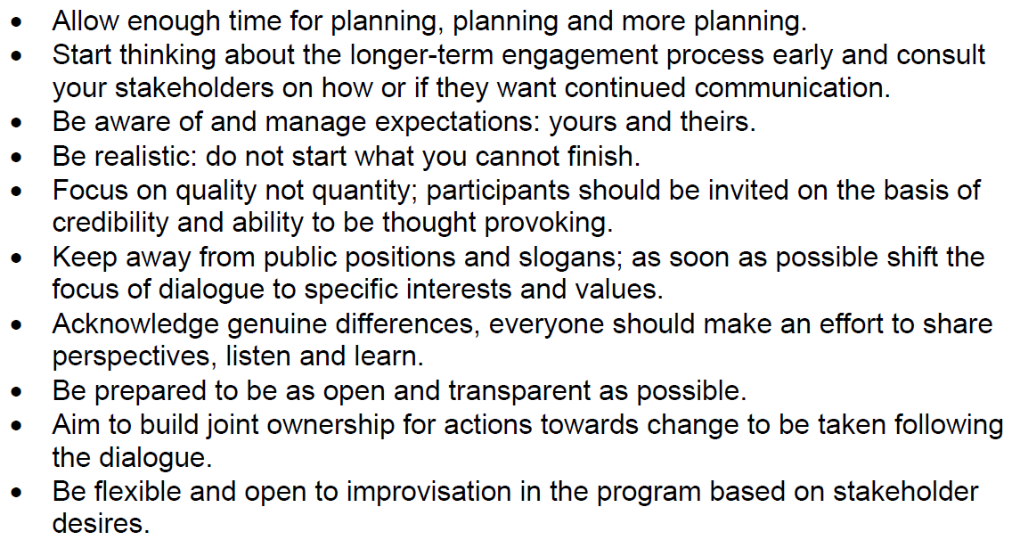
Managing and Engaging Project Stakeholders
(The WBCSD Ten Keys to Successful Engagement)
Stakeholder Dialogue: The WBSCD’s Approach to Engagement. Published by the WBCSD in November 2001.

Slide 10
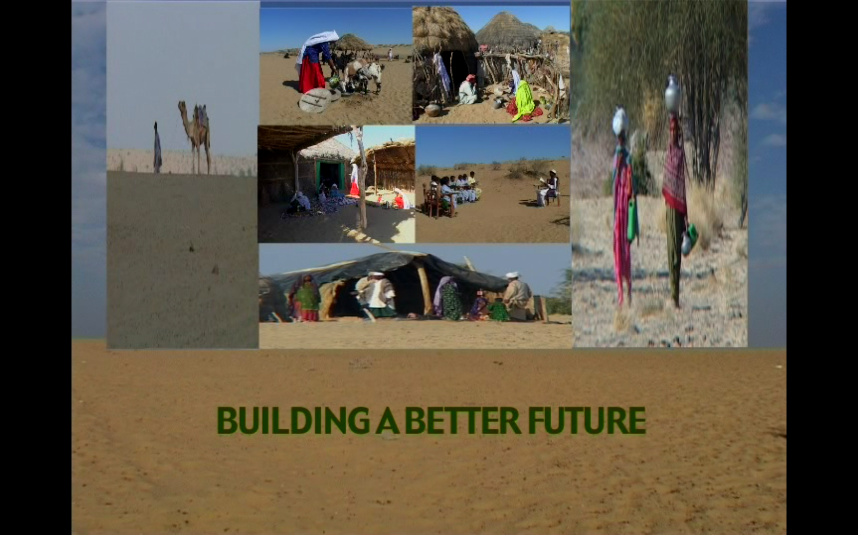
DOCUMENTARY VIDEO
Watch this 20 minute documentary video showing the develop-ment work of the Austrian Mining Company OMV for the bene-fit of the communities in its areas of operation in Pakistan.

