Slide 1
Master of Science in
Project Management
Project Stakeholder
AND COMMUNICATION Management
LECTURE 24: PROJECT STAKEHOLDER ANALYSIS

Slide 2

Models, Visual Tools, Software and Templates in
Project Stakeholder Management

Slide 3
Project Stakeholder Mapping Tools
(The Power-Interest Matrix)
Stakeholders in this category have little interest in the project. However, they may change their stance over time based on the information they are ex-posed to and become actively interested in the project. Therefore, it is essential to keep them informed and satisfied over time.
These are the key stakeholders in the project. The project manager must devote maximum attention to ensuring that they are not only kept informed and consulted, but that through a strategy of active and sustained engagement their input is taken into consideration in the project design and execution.
High
Power of Stakeholders
These relatively disinterested and less powerful stakeholders are unlikely to pose a risk for the project but they must be periodically monitored and kept informed about the project. The (com-paratively) „least effort„ needs to be focussed on these stakeholders.
These interested stakeholders should be kept informed about the project. Though less powerful, they may have contacts to powerful stakeholders whose support is desired and needed for project success. They may also form ‚powerful‘ groups whose support is important.
Low
Low
Interest of Stakeholders in the Project
High

Slide 4
Project Stakeholder Mapping Tools
(The Stakeholder Prioritisation Matrix)
High
Ability to Influence
Medium
Low
Medium
High
Degree of Interest

Slide 5
Project Stakeholder Mapping Tools
(The Power-Dynamism Matrix)
Dynamism
Low
High
Power
Fewer Problems
Unpredictable but manageable
Low
Powerful but Predictable
Greatest Danger or Opportunities
High

Slide 6
Project Stakeholder Mapping Tools
(3D: Influence – Impact – Attitude)
S4
S1
High
S2
S3
S7
S6
S10
Ability to Influence
Medium
S6
S5
S11
S12
S9
Low
S13
S13
Low
Medium
High
Impact of Change on Stakeholder

Slide 7
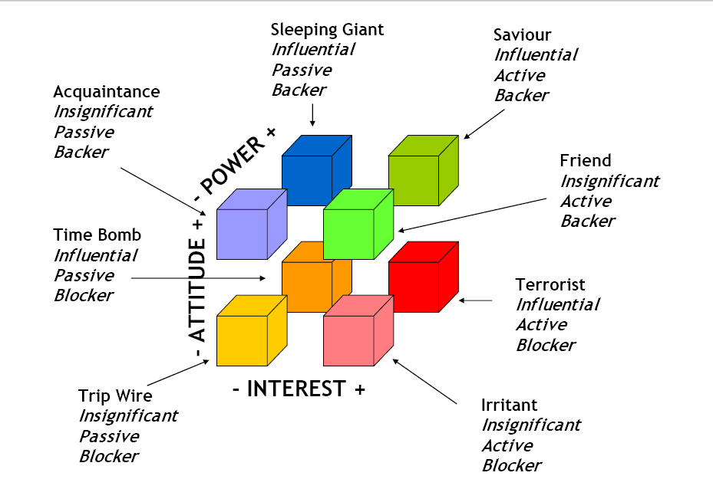
Project Stakeholder Mapping Tools
(3D: Power–Attitude – Interest)
www.lucidusconsulting.com

Slide 8
Stakeholder Visualization Case Study
(Project RYOGENS - Lewisham, UK)

Slide 9
Stakeholder Visualization Case Study
(Project RYOGENS - Lewisham, UK )

Slide 10

Project Stakeholder Attributes: Time Factor
Stakeholder Attribute Values usually do not remain constant over the course of the project. They change over time. Diverse factors determine the extent of change.
The visual mapping tools examined above have one key shortcoming, i.e., non-inclusion of the time factor.

Slide 11
Project Stakeholder Mapping Tools:
Tracking Changes To A Single Attribute Over Time
T = 4
5
T = 0
Quadrant Diagrams are excellent tools for map-ping project stakehol-ders using values for chosen attributes at a single point in time but they do not reveal chan-ges in attribute values over time which this simple and flexible tool does (3 time points).
Scale: 1 = no interest (or no power) of stake-holder in the project); 5 = high interest (or high power) of stakeholder in project).
1-5 can also be used to denote stakeholder ad-versity/supportiveness.
4
3
2
1
T = 3
T = 1
5
4
3
2
1
1
2
3
4
5
1
2
3
(constraint: one stakeholder and one attribute )
4
T = 2
5
T = 2

Slide 12
Project Stakeholder Mapping Tools:
Tracking Changes To Multiple Attributes Over Time
T = 4
5
T = 0
More complex versions of the tool permit the project manager and project team to track changes in the values of multiple attributes for multiple stakeholders over several (i.e. >3) points of time.
The scaling can also be adapted in accordance with the requirements of the project manager and project team. For exam-ple, 7 or 10 instead of 5 can be used for the nu-meric scale. Categorical scales, for example, very high to very low, can be used.
4
3
2
+1
+2
-2
+2
1
T = 3
T = 1
5
4
3
2
1
1
2
3
4
5
1
P = POWER
2
-2
I = INTEREST
+2
B = BEHAVIOUR
3
(constraint: one stakeholder and three attributes)
+1
-2
4
T = 2
5
T = 2

Slide 13
Project Stakeholder Mapping Tools
(More Complex Attribute Tracking Models)
1
2
Modifying the tool with the objective of track-ing changes in project stakeholder attributes over more than three points in time can be performed simply by drawing another one, two or more horizontal lines through the axes and inserting the scale on them.
6 X
6
3
5
4
8
1
2
8 X
7
3
6
4
5

Slide 14
Project Stakeholder Mapping Tools
(Tracking Changes in Stakeholder Attitudes Over Time)
Project Initiation
& Planning
Project Execution
Post-Project: Operations
Supportive
A
Neutral
B
Stakeholders’ Attitudes Towards the Project
The line bends indicate events or experiences which precipitate a per-ceptible change of atti-tude of the stakeholders towards the project.
Adversarial
C

Slide 15

Project Stakeholder Mapping Tools
(Tracking Changes in Stakeholder Power-Interest)
Stakeholder Level of Interest in Project, Phase or Activity
0 1 2 3 4 5 6
0 1 2 3 4 5 6
0 1 2 3 4 5 6
A
A
0 1 2 3 4 5 6 7 8 9 10
B
B
Stakeholder Power Over Project
A
C
B
C
C
Time Factor

Slide 16
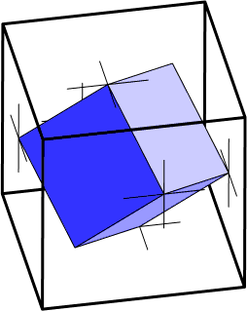
Project Stakeholder Mapping Tools
(Tracking Changes in Multiple Attributes)
A highly complex model which tracks changes in multiple attributes (e.g. interest, power, concerns, attitudes and behavior, expectations, relationships and alliances) of multiple stakeholders over the project life-cycle is presently being developed by me.
This model is based on the concept of the “node” which is being used in pro-ject time management in the develop-ment of project network diagrams.

Slide 17
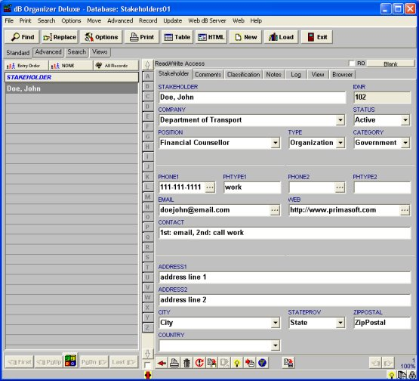
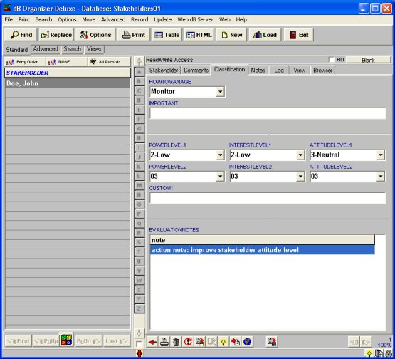

Project Stakeholder Management Software
(The Project Stakeholder Organizer)
The Project Stakeholder Organizer Deluxe version 3.6 is a simple database management system for recording information on project stakeholders. Click on image on the right to view product webpage.

Slide 18
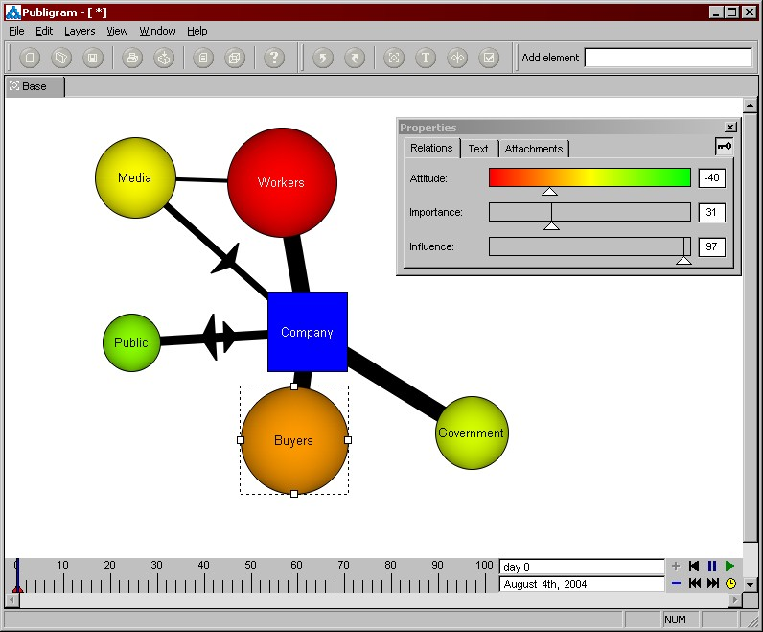
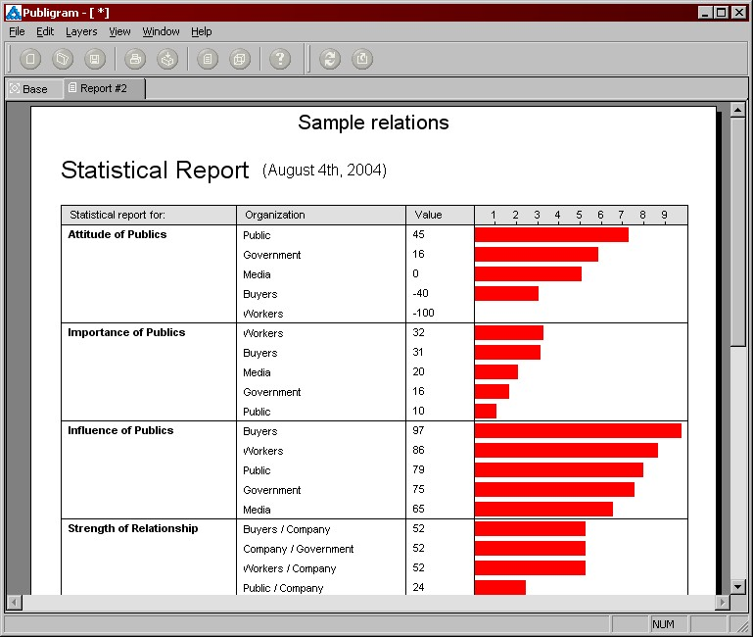
Project Stakeholder Management Software
(Publigram)
Publigram is a software developed by Sergej Marsnjak. Its main attraction lies in its visual depiction and “quantification” of the relationships between stakeholders. Click on any of the two images above to view product webpage.

Slide 19
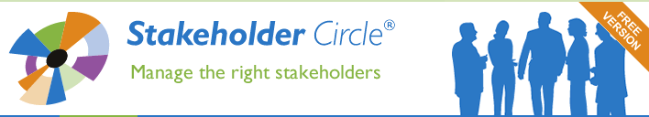
Project Stakeholder Management Software
(The Stakeholder Circle)
The Stakeholder Circle is one of the most powerful stake-holder visualization programs on the market.
Developed by the Australian Dr. Lynda Bourne, the Stake-holder Circle lends itself to a variety of projects, inclu-ding those of a complex nature.
Click on Image to View Product Webpage

Slide 20
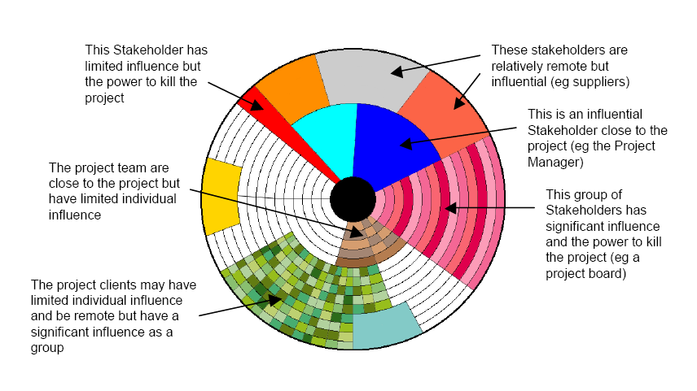
Project Stakeholder Management Software
(The Stakeholder Circle)

Slide 21
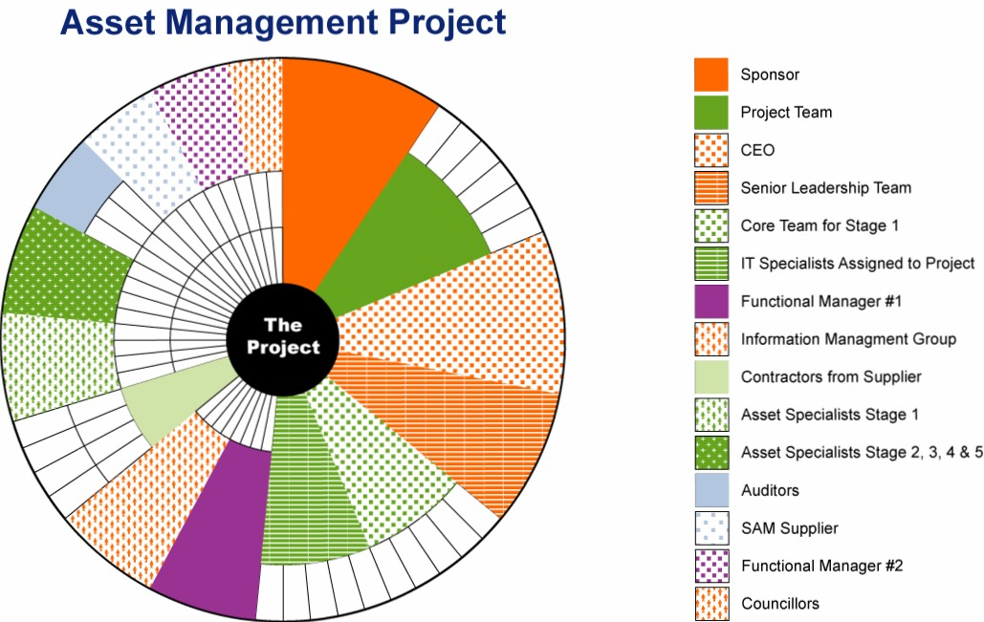
Project Stakeholder Management Software
(The Stakeholder Circle: Example 1)

Slide 22
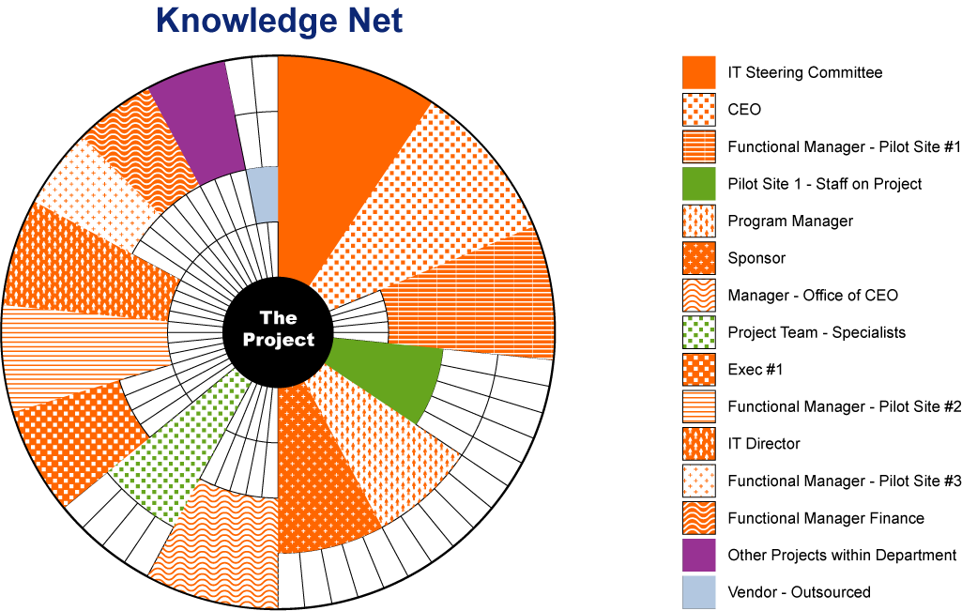
Project Stakeholder Management Software
(The Stakeholder Circle: Example 1)

Slide 23
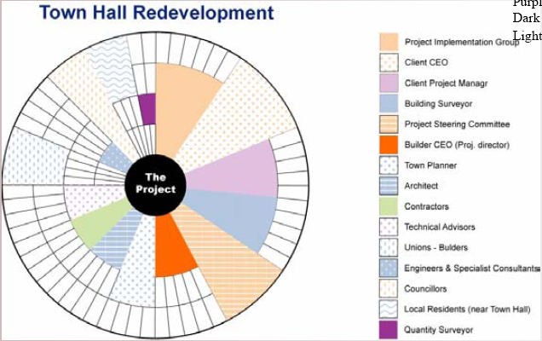
Project Stakeholder Management Software
(The Stakeholder Circle: Example 3)

Slide 24
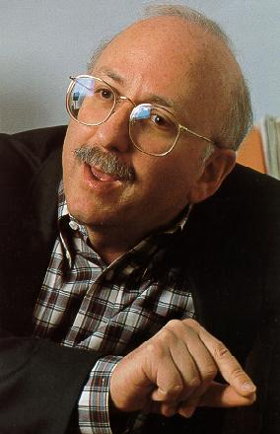
Project Stakeholder Management Software
(OUTRAGE: Prediction & Management Software)
An interesting software developed for the purpose of both predicting and managing stakeholders on projects was developed by the Australian consultant and risk com-munication specialist Peter M. Sandman.
Developed for the consulting firm QUEST and released in 1998, the OUTRAGE software was eventually discontinued after 2005 because of its complexity and replaced with a new software ENGAGE.
Click on photo to download the software.

Slide 25
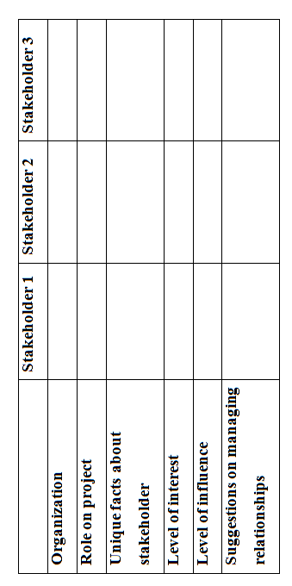
Project Stakeholder Management Templates
Stakeholder Management Templates are used frequently on projects.
Usually, the templates are in tabular form with specific items of information entered in columns. Structurally, templates range from very simple ones containing just a few basic items of information to quite complex ones containing numerous items of information.
Sample templates are given in the subse-quent slides.

Slide 26
