Slide 1
Master of Science in
Project Management
Project Stakeholder
AND COMMUNICATION Management
LECTURE 22: PROJECT STAKEHOLDER ANALYSIS
(STAKEHOLDER OPTIONS)

Slide 2

Options of Project Stakeholders
Options Commonly Excercized by Adversarial Stake-holders on Projects Across the Globe

Slide 3


Project Stakeholder Engagement Cycle
Supportive
Adversarial
B
Set of Options Available to the Project Stakeholders
Categories of Options:
Soft and Hard,
Legal and Illegal, Ethical and Unethical
Impact on Project Scope, Cost, Schedule, Reputation etc.
Project
A
Project Stakeholder Engagement Strategy

Slide 4

Options for Adversarial Project Stakeholders
(Individuals, Communities, Organizations)
Challenging Proj. Need, Outcomes
Requests to Key Stakeholders
Acceptable Alternatives Suggestions
Influencing Strategy (Direct, Indirect)
Forming Associations
Alliances and Networking
Non-Cooperation, Boycotts
Petitions
Media Publicity
Celebrity Endorsement
Political Pressure

Slide 5
Options for Adversarial Project Stakeholders
(Individuals, Communities, Organizations)
Intervention by the Administration
Intervention by the Courts
Electoral Process (e.g. Referendums)
Enactment of Legislation
Instigation of Police Action
Scandals (Create or Expose)
Information or Disinformation Cam.
Inciting Internal Stakeholders
Market-Based Strategies
Miscellaneous Innovative Options

Slide 6

Options for Adversarial Project Stakeholders
(Individuals, Communities, Organizations)
Physical Action Designed to Draw Public Attention to their Grievances and Positions vis-a-vis the Project:
  Sit-Ins and Blockades
  Rallies
  Marches
  Demonstrations
  Hunger Strikes
  Inflicting Self-Injury
  Suicides

Slide 7


Options for Adversarial Project Stakeholders
(Individuals, Communities, Organizations)
Property-centered Criminal Acts and Violence against project Sites, facilities and logistic infrastructure:
  Rioting
  Arson
  Bombing
  Sabotage
  Other Destructive Acts

Slide 8

Options for Adversarial Project Stakeholders
(Individuals, Communities, Organizations)
Person-centered Criminal Acts and Violence against project personnel and project supporters:
  Abuse
  Threats
  Blackmail
  Harassment and Intimidation
  Assault (with/without injury)
  Abduction
  Torture
  Murder
Notes:
Threats: Can be verbal or written, anonymous or traceable, direct or indirect and subtle/not-so-subtle. Can be sent through telephone, SMS, e-Mail or post directly or to a third party (e.g.: media).
Assault: Injury may be temporary or lasting. May require hospitalization.
Harassment/Intimidation:

Slide 9

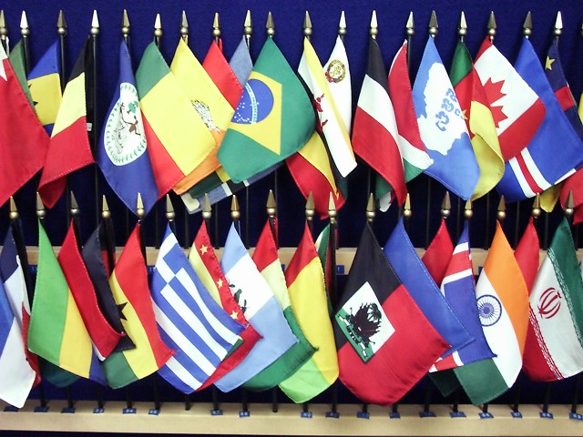
Options for Adversarial Project Stakeholders
(Options in the Transnational Context)
Appeals, Requests, Protestations
Warnings
Proposals
Dialogue and Negotiation
Resolutions
Incentives
Third Party Mediation
Arbitration and Litigation
Imposition of Sanctions, Embargoes
Sabotage
Threat of Military Action
Mililtary Action (broad range)
Notes:
Protestations: May be public or discretely in private.
Dialogues: The Six-Party Dialogue in the Korean Peninsula is an example. Also the EU-Iran dialogue preceding imposition of sanctions in 2010.
Negotiations: May be open or conducted in secret.
Resolutions: By various organizations, for example, UN, EU, OIC.
Incentives: Economic, trade etc. The incentives offered to Iran and North Korea in exchange for winding up their nuclear programs are recent examples.
Sanctions: Many options here, for example, diplomatic, political, trade, investment, financial, sport, technological, travel. Better: “smart sanctions”.
Embargoes: Like were used against South Africa’s Apartheid Government. Also, by the US against Cuba.
Military Action: Can be anything from a targeted raid to a full-scale prolonged conflict.
EXAMPLES:
India and Pakistan (Dams: Baghliar, Kishaganga)
Iran, N. Korea, Pakistan (Nuclear Weapon Programmes (perceived threat of destruction by adversarial states))
Israel (Jewish Settlements)
Israel (Iraq’s Osirak Reactor)
Turkey, Iraq and Syria (River Water Access)
Ethiopia and Egypt (Nile River Water Access)

Slide 10

Influencing Projects: Stakeholder Options
(Soft Options: Non-Cooperation)
At the very least actively adversarial stakeholders can be expected to adopt a „non-cooperative“ stance towards the project.
Non-Cooperation could entail, for example, refusing to sell land, goods and services to the project owners/im-plementors, refusing to work on the project, not providing information which could facilitate it and withhol-ding needed support for the project in the relevant public forums.
Example: Refusal by a farmer to sell his piece of land to Donald Trump to construct his golf course in Aberdeen, Scotland.

Slide 11

Influencing Projects: Stakeholder Options
(Soft Options: Boycotts)
To influence a project stakeholders may resort to boycott it. Compared to the option of non-cooperation, boy-cotts are collective and systematic in orientation.
Boycotting stakeholders may, for e.g., decline to supply inputs such as goods and services to the project during its execution phase and/or refuse to pur-chase the goods or services which will be available after the project‘s comple-tion.
Example: Protests in developing countries like India against MNCs establishing their presence in the country.

Slide 12

Influencing Projects: Stakeholder Options
(Enlisting Media Support)
The Media is a undeniably a powerful opinion-shaper and a convenient and fast means for generating awareness about projects - and for mobilizing support for or against them.
Adverse media coverage – even if based on misinformation - can cause serious complications for the project, attracting unwelcome attention, and making it (at the very least) expend resources unnecessarily on correcting stakeholder perceptions.

Slide 13

Influencing Projects: Stakeholder Options
(Soft Options: Influencing Other Stakeholders)
Stakeholders are not isolated entities but can under circumstances form „alliances“ with other stakeholders to promote their objectives which may include opposing a project or some aspects of it.
As individuals, stakeholders may be in a position to exert little influence but, collectively, they may be a powerful force to be reckoned with. Alliances of NGOs, for example, have succeeded in halting major projects.
Example: Alliances between NGOs to counter projects of mining and energy corporations in developing countries.

Slide 14

Influencing Projects: Stakeholder Options
(Soft Options: Petitions)
The Petition is an active and highly public option for stakeholders to show their approval or disapproval of a project.
Petitions have been used in a number of different contexts, such as infra-structure projects and projects where the private-sector wants to develop schemes in localities. In some instan-ces, petitions have prevented the im-plementation of projects.

Slide 15

Influencing Projects: Stakeholder Options
(Withdrawal of Recognition)
In some instances, project stakehol-ders can resort to the option of deny-ing or withdrawing official recognition as a means of effecting modification or abandonment of a project.
An interesting case in point was UNESCO‘s threat to strike the Eastern German city of Dresden off its coveted world heritage list because of the City‘s intent to construct a visually unappealing bridge across the River Elbe.

Slide 16

Influencing Projects: Stakeholder Options
(Soft Options: Peaceful Rallies and Demonstrations)
A highly public means of showing opposition against (or support for) a project is to organize public rallies and demonstrations, often with extensive media coverage.
Through such events, a common sen-timent towards a project, or aspects thereof, is conveyed to a wider audi-ence which other external stakholders – for example, political ones - may seek to exploit for self-benefit at the expense of the project.

Slide 17


Influencing Projects: Stakeholder Options
(Lobbying Politicians and Legislators)
To oppose projects stakeholders may attempt to mobilize the supportof politicians and legislators. Both are powerful forces which can obstruct the course of projects.
Politicians, concerned at their chances of election or re-election, may adopt populist stances on some controversial projects. Legislation, enacted because of public pressure, have in many in-stances resulted in the prohibition of certain projects.

Slide 18

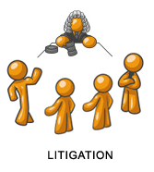
Influencing Projects: Stakeholder Options
(Intervention of the Courts)
Intervention of the Courts (through, for e.g., stay orders and injunctions) is a very powerful tool for influencing projects in the options arsenal of pro-ject stakeholders.
As all projects exist in a legal environ-ment, court intervention is especially effective when the law leaves room for discretionary interpretation and where projects exhibit shortcomings in regard to the implementation of the various laws which they are required to follow.

Slide 19
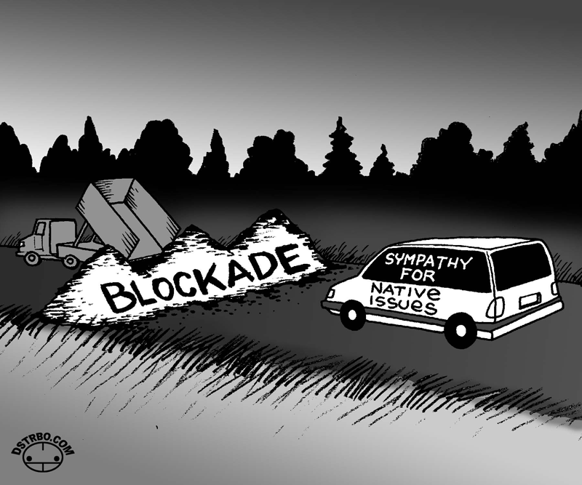
Influencing Projects: Stakeholder Options
(Hard Options: Sit-Ins and Blockades)
Project sites, facilities & supply routes are occassionally subject to Blockades and Sit-ins by project stakeholders.
Preventing people and supplies from reaching their project destinations or working there usually causes both a delay and increase in cost to the pro-ject, besides having an intimidating effect on the project personell.
Blockades and Sit-ins may result in vio-lent clashes with injuries and deaths.
Example: Many cases have been documented in projects concern-ing indigenous tribes and people being displaced from their land in the Amazon Jungle and other forested areas of the globe.

Slide 20

Influencing Projects: Stakeholder Options
(Hard Options: Threats)
Threats are one of the „milder“ illegal hard options stakeholders have in their arsenal for influencing the course of projects they oppose.
Threats may be verbal or written, anonymous or traceable, and may hint, directly or indirectly, at some ‚unplea-sant event or events‘ that may occur at a future point in time and through which may result physical/ material damage to the project and/or the stakeholders working for it.
Notes:
Threats may be sent, for example, via post, e-Mail, SMS, telephone (landline, cell). Some terrorist organizations use the radio to broadcast threats.

Slide 21

Influencing Projects: Stakeholder Options
(Hard Options: Acts of Violence Against Property)
Criminal acts by stakeholders may assume many different manifestations including violence which is directed against property of the project, for instance, random or systematic sabo-tage of project sites, facilities and machinery, arson, and rioting with the intention of vandalizing and pilfering project resources.
Such acts can delay the project and possibly frighten the owners or devel-opers into abandoning it completely.

Slide 22

Influencing Projects: Stakeholder Options
(Hard Options: Criminal Violence Against People)
To resist or prevent the implementation of certain projects stakeholders occasion-ally indulge in acts of violence against other stakeholders.
Such acts of violence may assume many forms including assault, injury, abduction and, in the extreme case, even murder of project employees or project supporters.
Violence, off course, is a two-edged sword and may also be directed against adversarial stakeholders.

Slide 23
Influencing Projects: Stakeholder Options
(Hard Options: Criminal Violence Against People)
Stakeholders resort to extreme measures against projects usually out of despera-tion or fury because they:
perceive the projects as constituting an imminent and existential threat to them and no alternative and less vio-lent options are available to prevent the prjects, or
because they believe the projects re-present the interests of the state with which they are in a prolonged conflict.

Slide 24
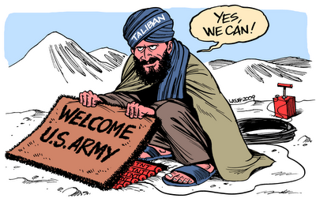
Influencing Projects: Stakeholder Options
(Hard Options: Criminal Violence Against People)
Several incidents of premeditated and recurring violence against project staff have been documented around the world in recent years. Most of these incidents occurred in regions experiencing severe civil conflicts and upheavals.
Examples: Violence against oil companies operating in the Nigerian Oil Delta, against companies involved in the (re-) construction and in social development projects in Afghanistan, Pakistan and Iraq, and in the strife-torn island of Jolo in the Phillippines.

Slide 25

Examples from Across the Globe:
Options by Project Stakeholders

Slide 26
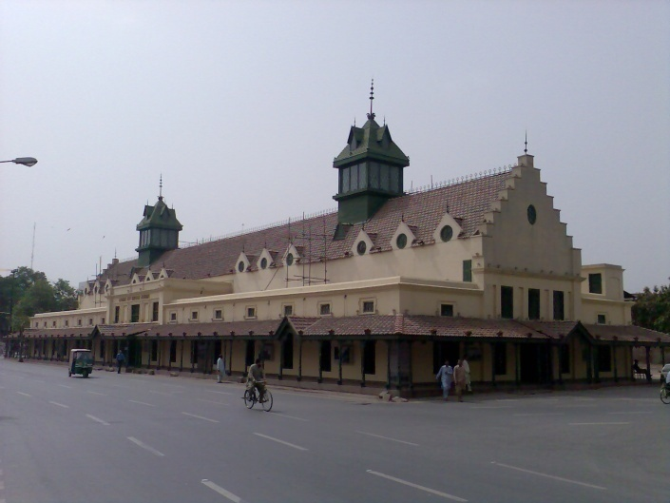
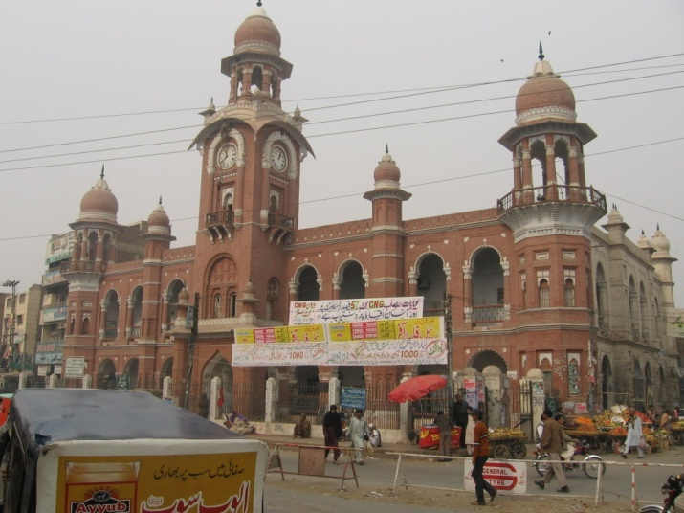
Influencing Projects: Stakeholder Options
(Peaceful Protests by Civil Society)
Many historical architectural jewels in Pakistan’s cities and towns have over the years, sadly, succumbed either to official apathy, sheer neglect or to the wrecking ball of greedy project developers.
Two splendid historical edifices from the British colonial era saved from demolition by the intervention of civic organizations, conservationists, public officials and con-cerned citizens are the Tollinton Market (built 1864) in Lahore (photo above) and the Clock Tower Building (built 1884) in Multan (photo below).

Slide 27
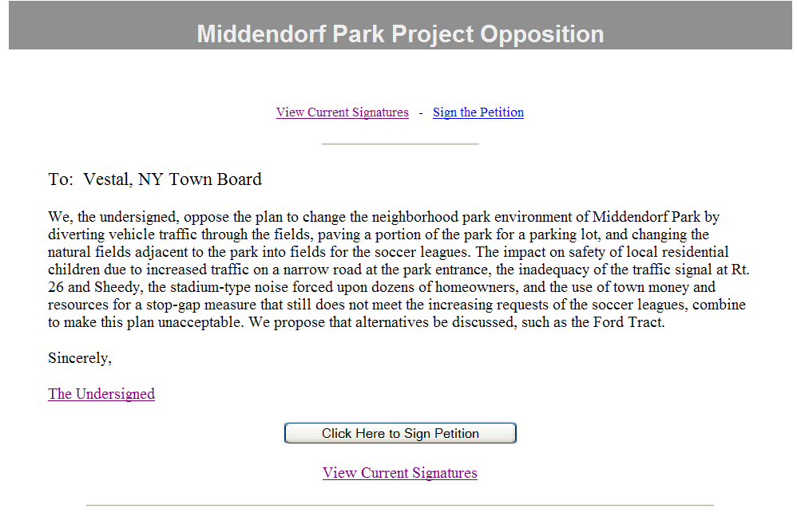
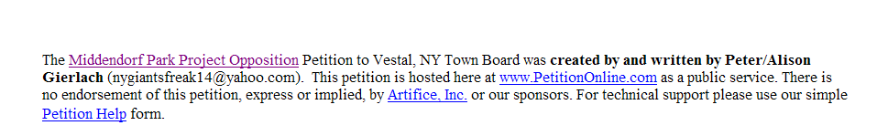

Slide 28
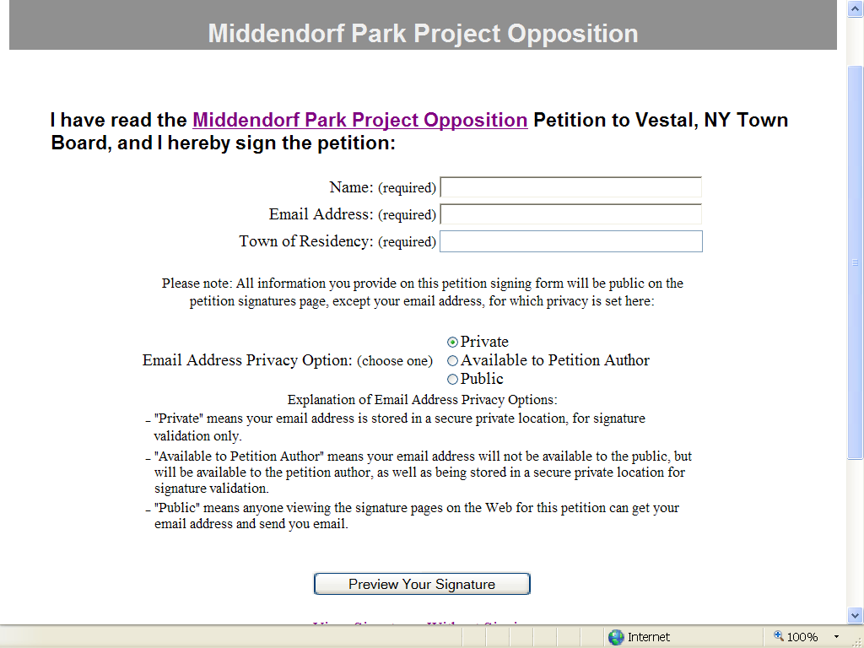
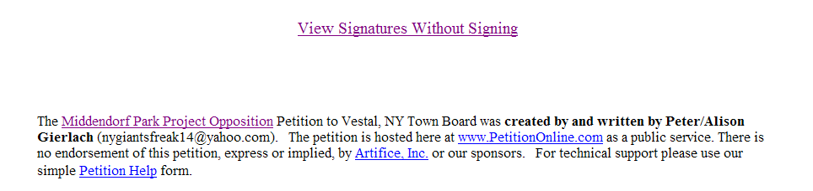

Slide 29
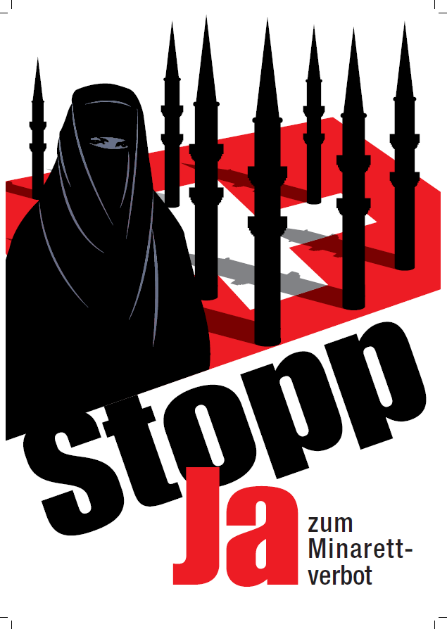
Influencing Projects: Stakeholder Options
(Swiss National Referendum on Minarets)
On November 29, 2009, the people of Switzerland voted in a national referen-dum on the question of whether to amend their constitution to prohibit the construction of minarets. The referendum was passed with a majority of 57.5% of the votes casted.
Widely criticized by the international community and human rights organiza-tions, the referendum came on the heels of a massive public campaign sponsored by the Swiss Peoples Party against the perceived “Islamization of Switzerland”.

Slide 30
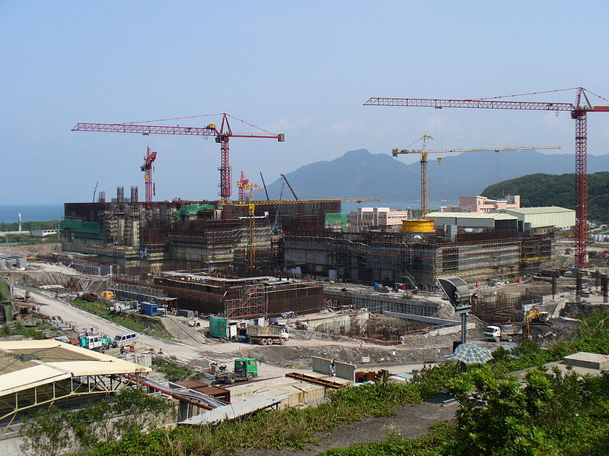
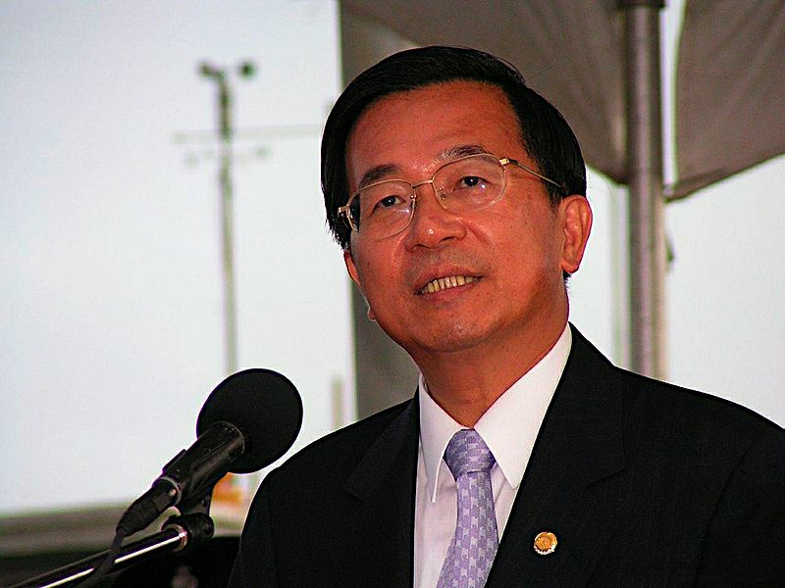
Influencing Projects: Stakeholder Options
(National Elections)
Construction of the controversial Kung-liao Nuclear Power Plant (2700 MW) near Taiwan’s capital city became an election issue in 2000. The Democratic Progressive Party (then in opposition) and headed by Chen Shui-Ben gave a public pledge to scrap the project if elected to office.
On assuming power Chen announced the project’s scrapping in October 2000. Strong pressure from the administration, courts and political opposition compelled Chen’s government to resume the project in February 2001.

Slide 31
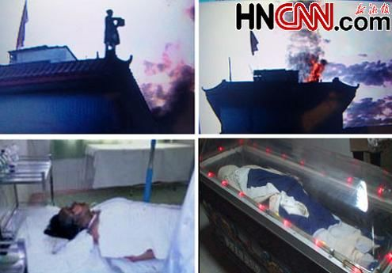
Influencing Projects: Stakeholder Options
(Self-Immolation)
Desperate stakeholders sometimes resort to drastic actions to show their vehement opposition to projects. Self-immolation is a horrific case in point. Several such cases have been documented.
For instance, a three hour stand-off with officials in the Chinese city of Chengdu (Sichuan province) climaxed on 13. Nov-ember 2009 when a 47-year old woman, Tang Fuzhen, doused herself with gasoline and set herself alight in protest against the forced demolition of her house. She died in hospital on 29. November.
Tang Fuzhen’s self-immolation was captured on video by a by-stander using a cell phone and broadcast on TV and on internet websites. It provoked wide-spread anger at and criticism of China’s eviction policy and approach.

Slide 32
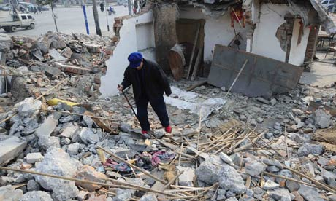
Influencing Projects: Stakeholder Options
(Self-Immolation)
Fuzhen’s self-immolation is not an isola-ted case in totalitarian China where rapid economic development often leads to forced evictions and displacement of people and communities on a large scale.
In December 2009 Xi Xinzhu, resident of a Beijing suburb, set himself alight in protest at his forced eviction from his home under a “Village Improvement Scheme”.
Xi Xinzhu received burns on over 10% of his body and was critically ill at a hospital in Beijing.
Following Tang Fuzhen’s high pro-file self-immolation, public con-cern over forced evictions in China reached a peak and preci-pitated much domestic criticism, especially over the discrepancy between the Housing Demolition and Relocation Management Regulation of 2001 and the national Property Law of 2007.

Slide 33

Influencing Projects: Stakeholder Options
(Violence and Intimidation)
Widespread opposition by local farmers and other stakeholders led India’s Tata Company to cancel its project to con-struct a car making factory in Singur, West Bengal state.
Though many stakeholders were suppor-tive of the project because of its percei-ved economic advantages, others were unwilling to sell their land for the project.
Tata’s decision to pull out of the project came after weeks of physical threats to project staff and rioting at the project site.
"You cannot run a plant when bombs are being thrown at the site. You cannot run a plant when workers are being intimidated and threatened“
Tata Group Chairman Ratan Tata

Slide 34
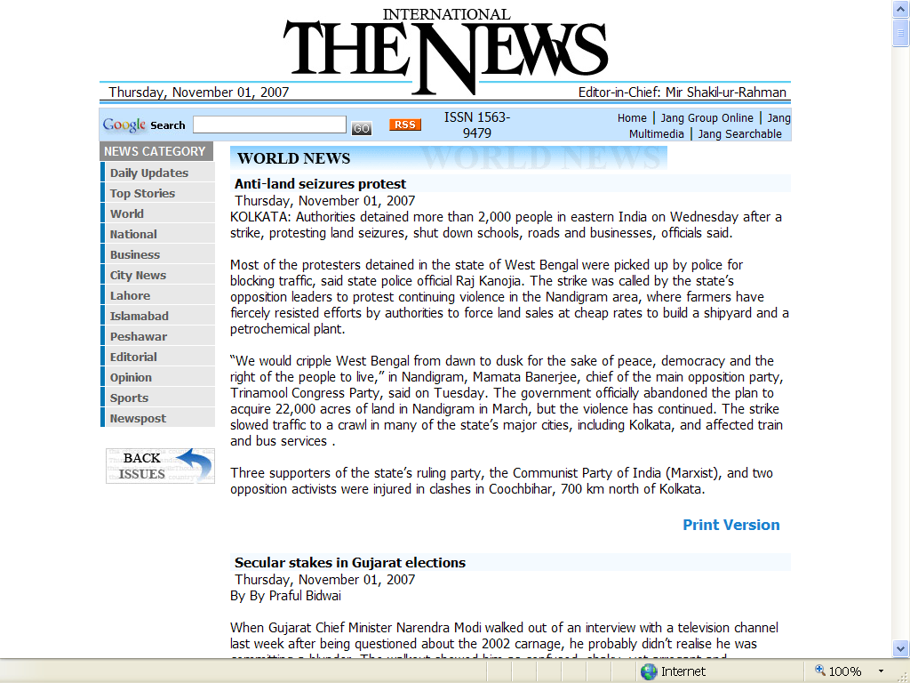

Slide 35
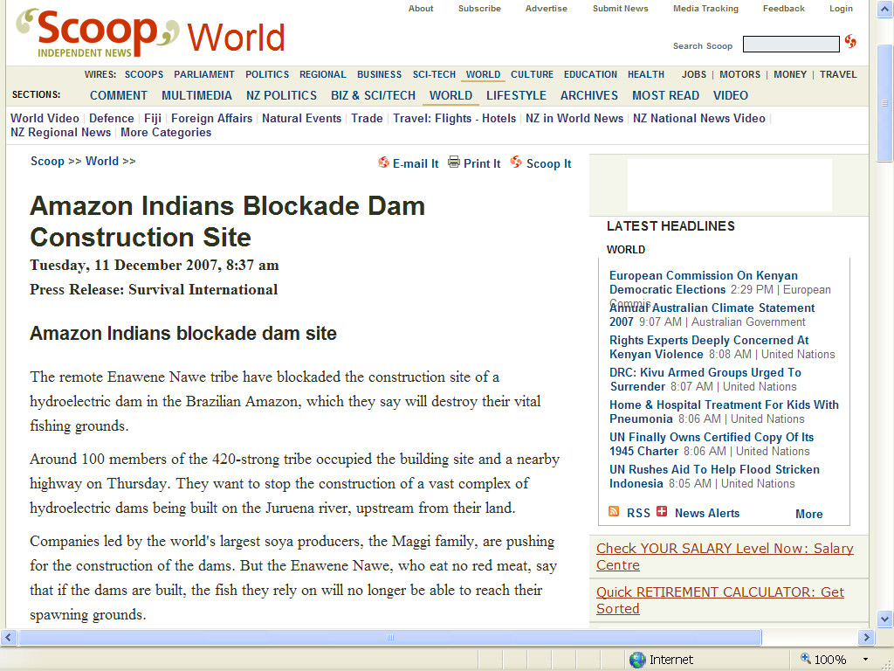
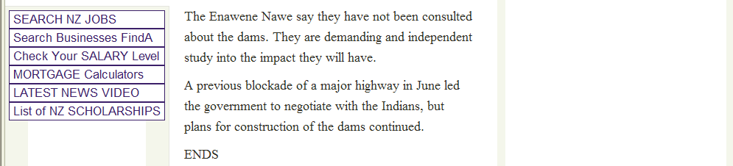

Slide 36
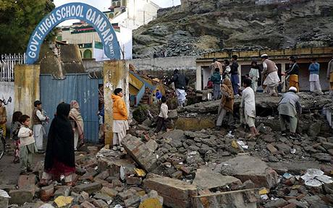
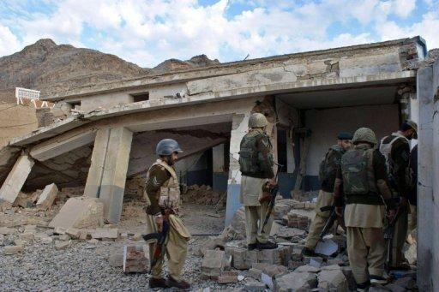
Influencing Projects: Stakeholder Options
(Terrorism)
Education is universally seen as a path to development and enlightenment and is prized the world over. In Pakistan, sadly, a deeply conservative and reactionary section of society profoundly opposes it and has clearly demonstrated its willing-ness to use violent means to obstruct and prevent the education of children – both boys and especially girls.
Since 2007 hundreds of schools have been attacked, damaged and destroyed in North-West Pakistan by Taliban thugs in their war against the government.

Slide 37
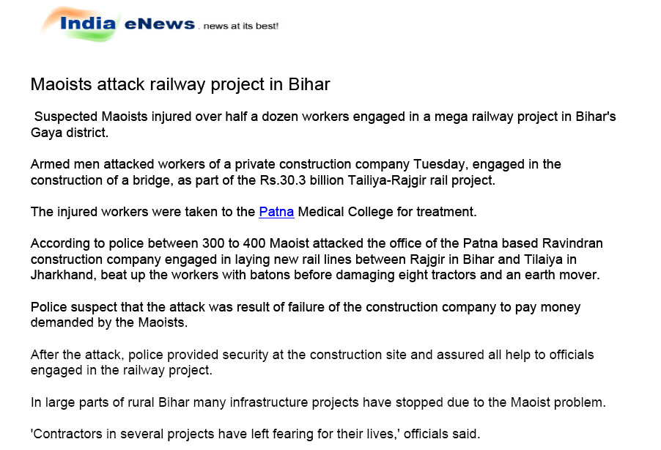
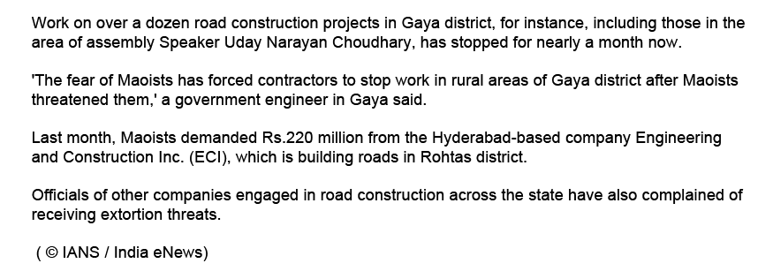

Slide 38
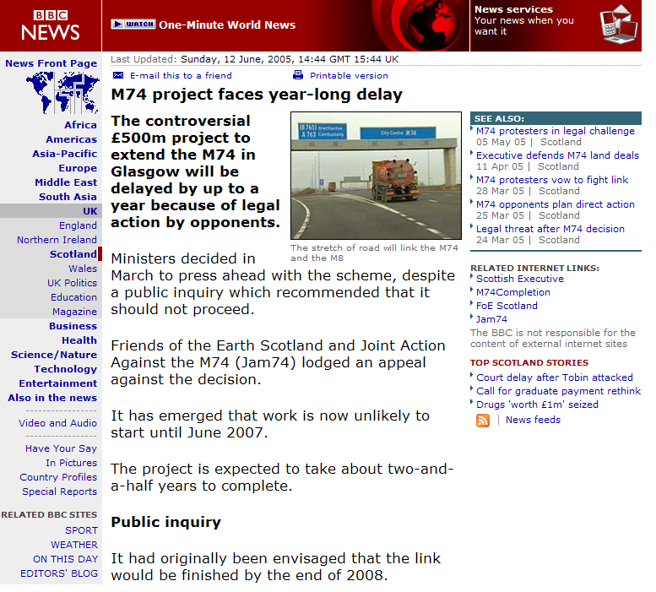
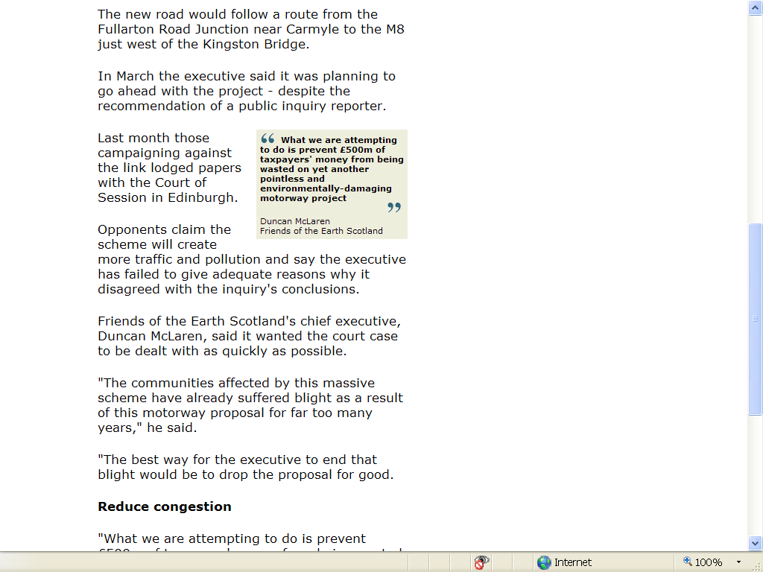
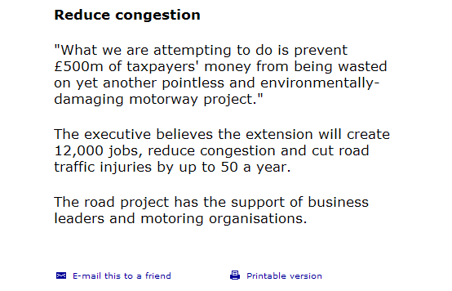

Slide 39
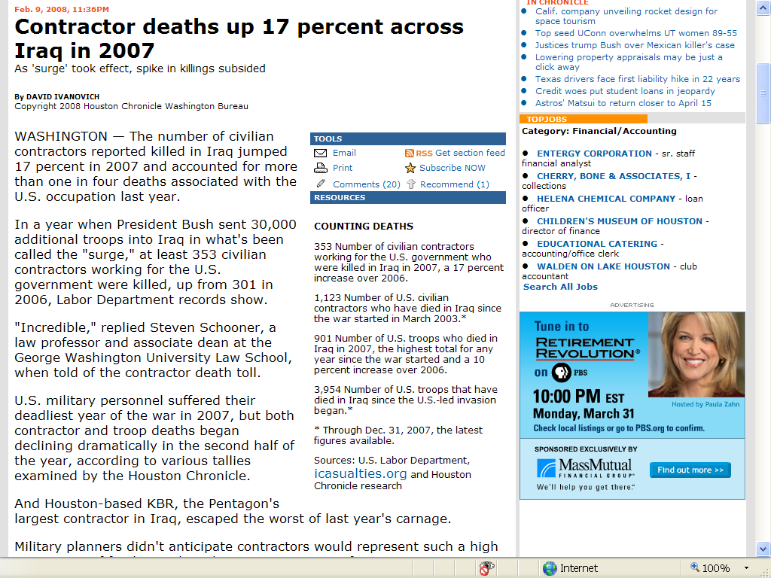
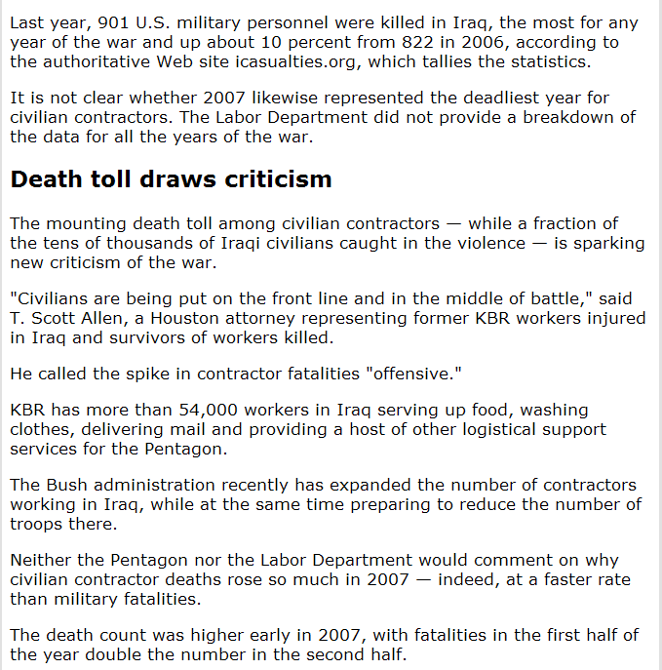
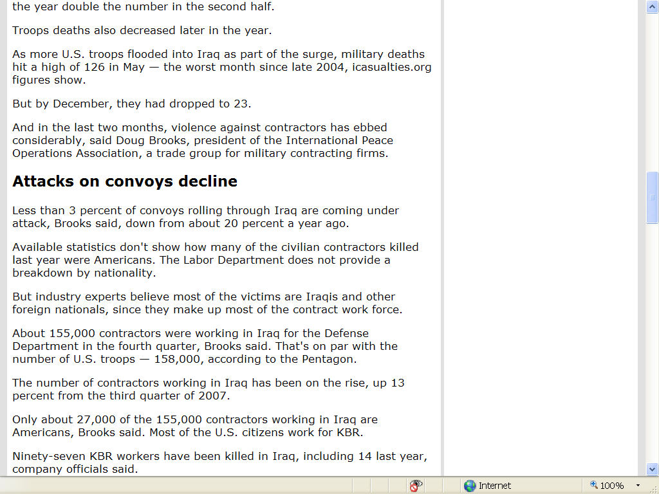
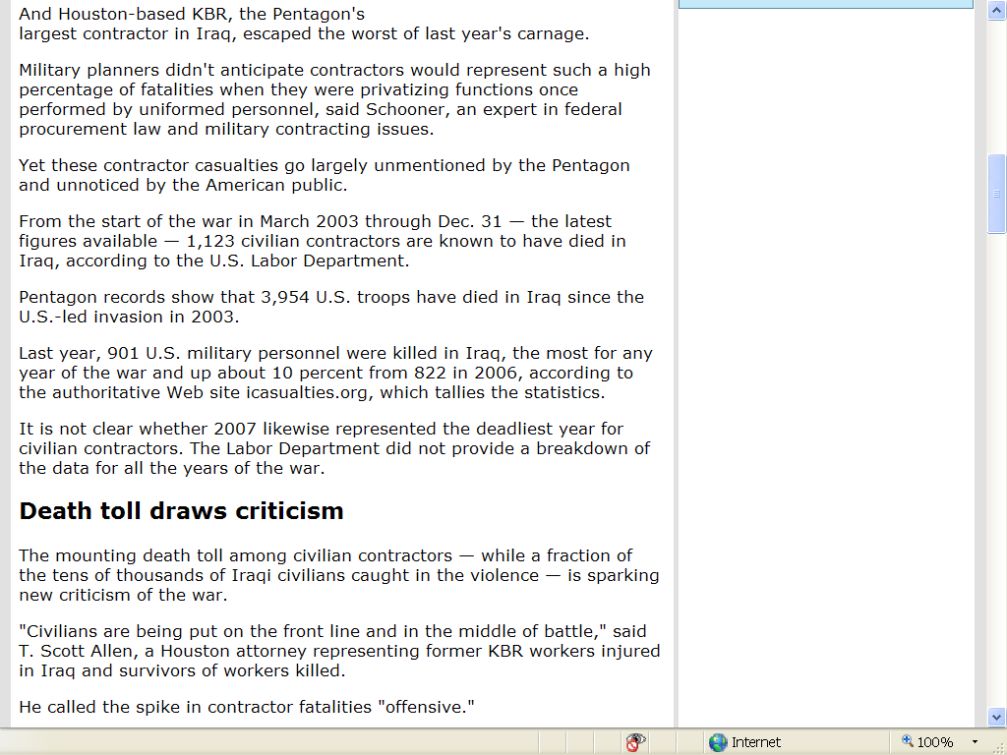

Slide 40
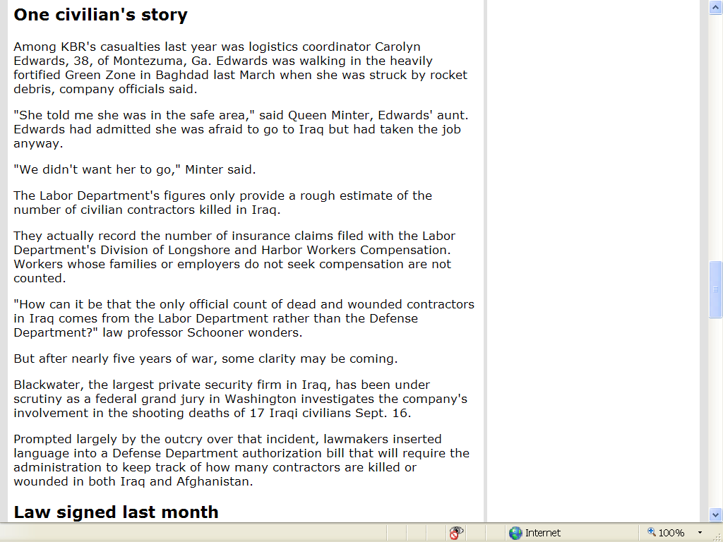
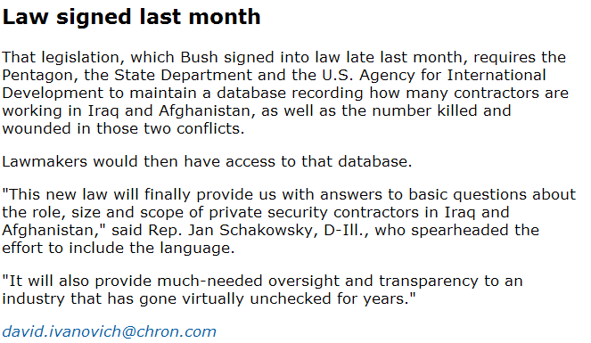
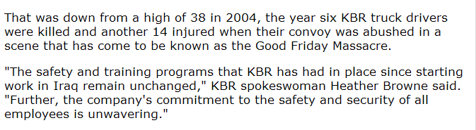
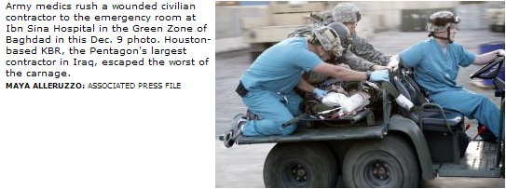
The Houston Chronicle, 9th February 2008

Slide 41
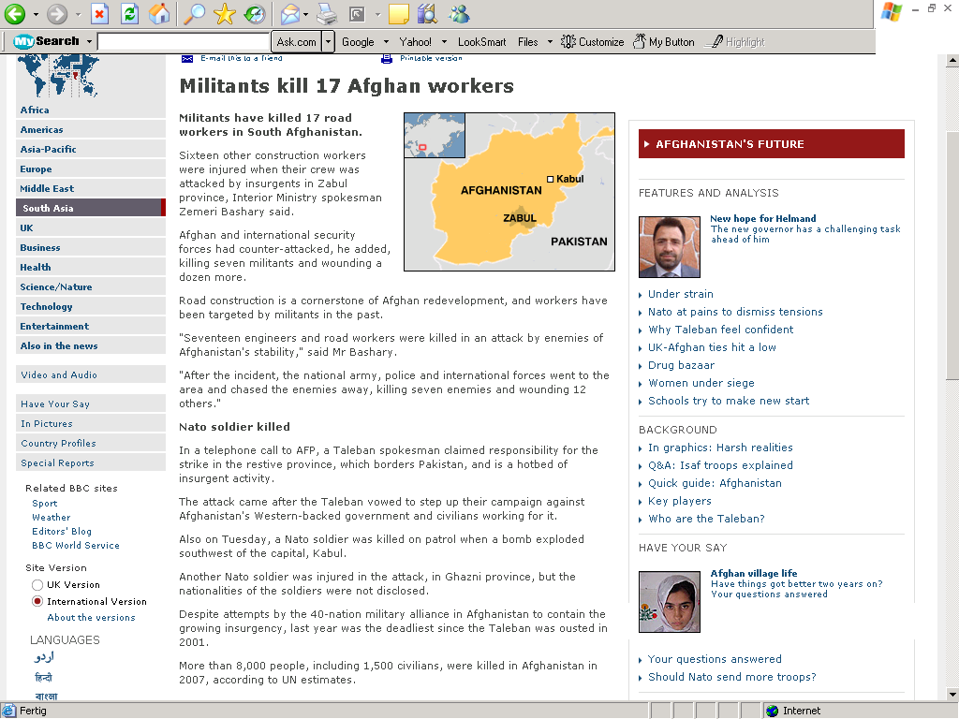
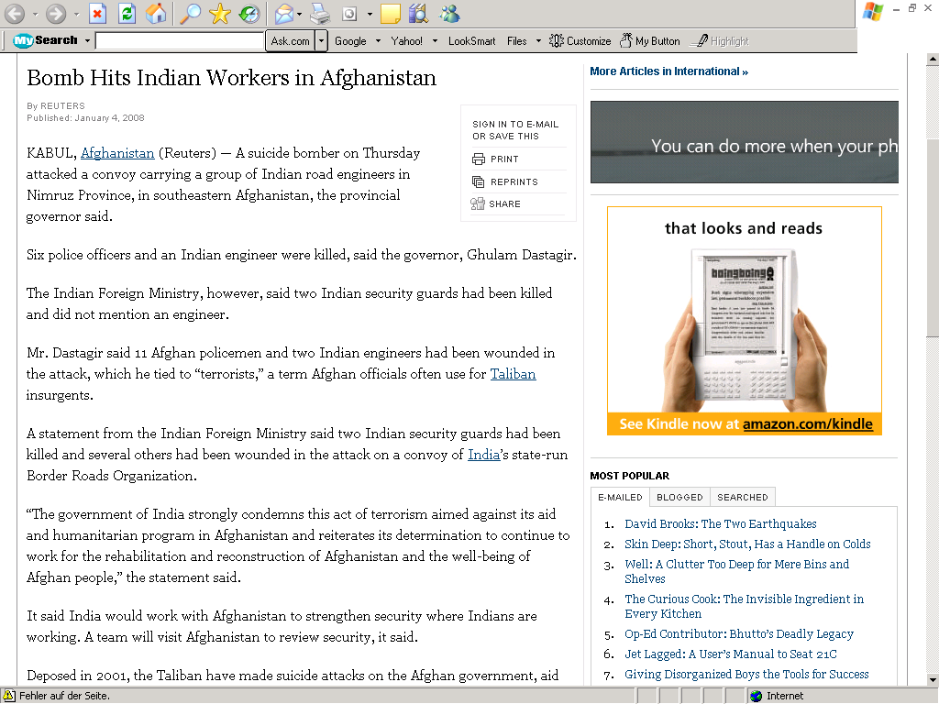
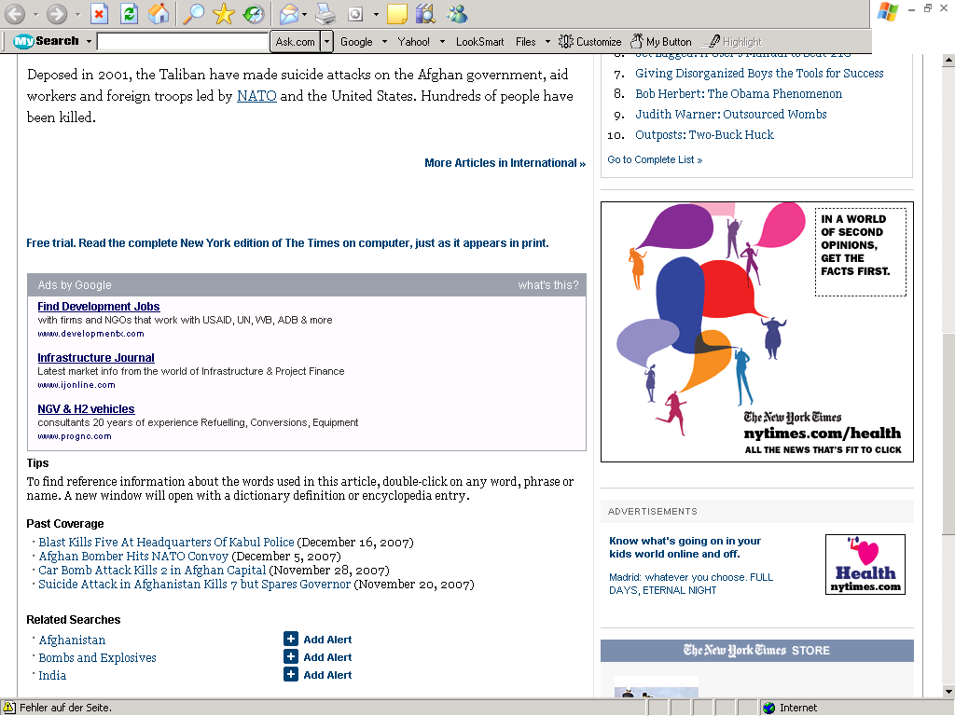
Notes:
Bomb Hits Indian Workers in Afghanistan: The New York Times (Online), 4th January 2008

Slide 42
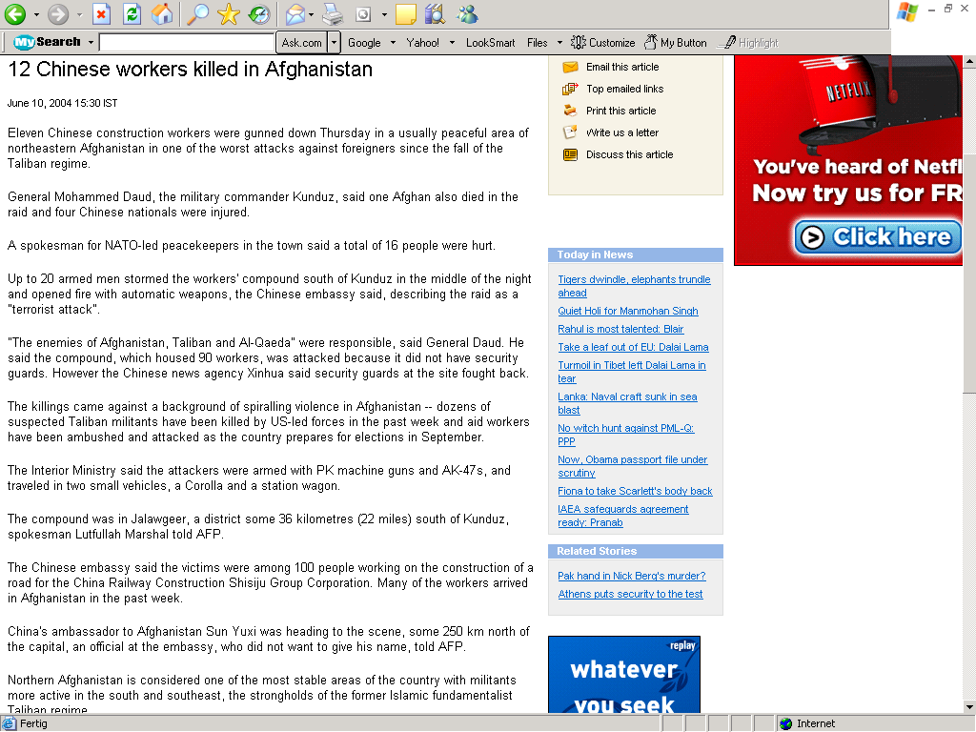
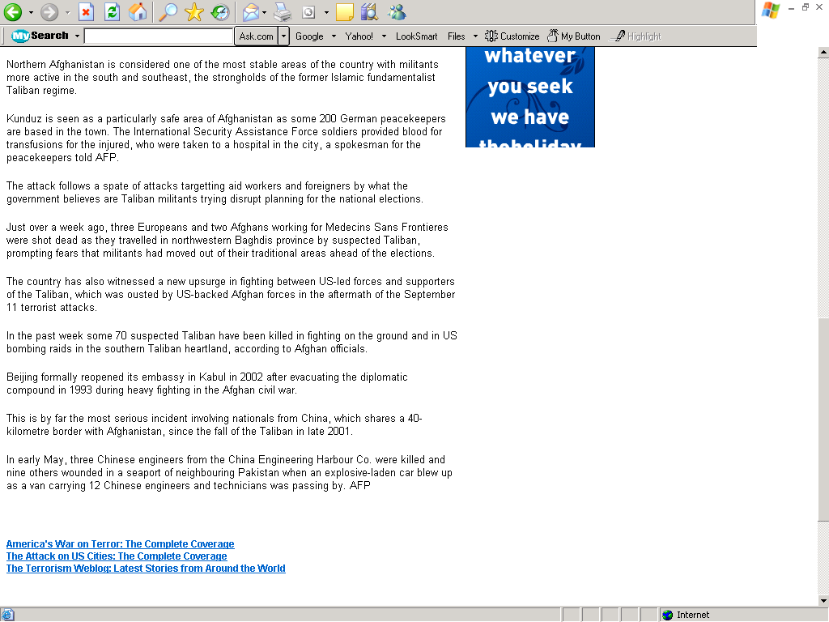

Slide 43
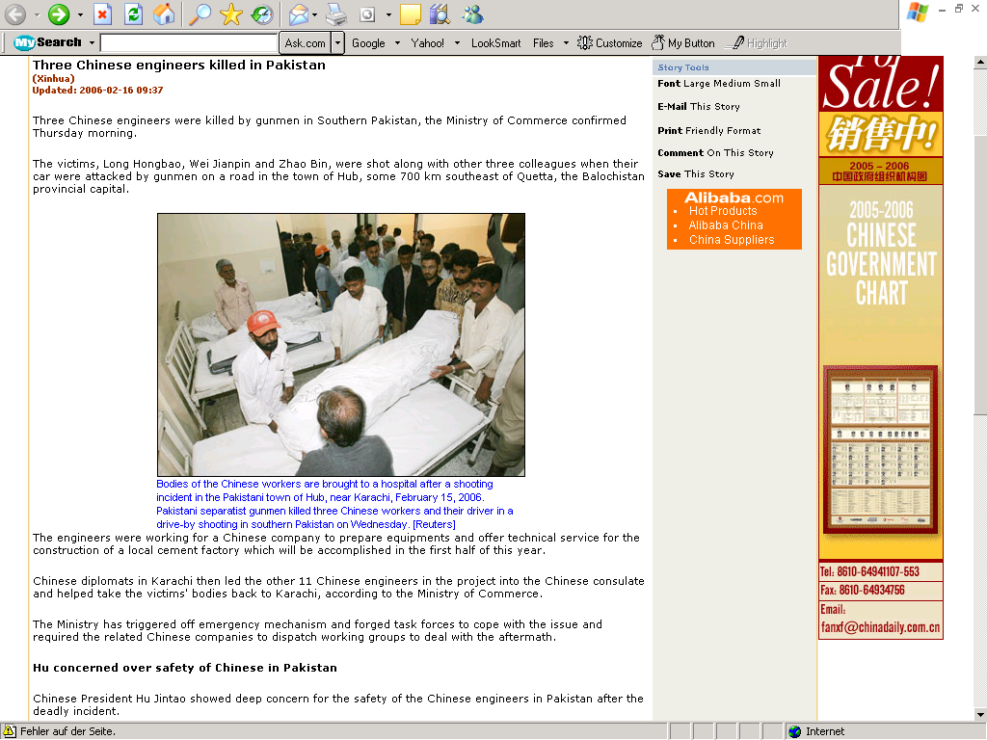
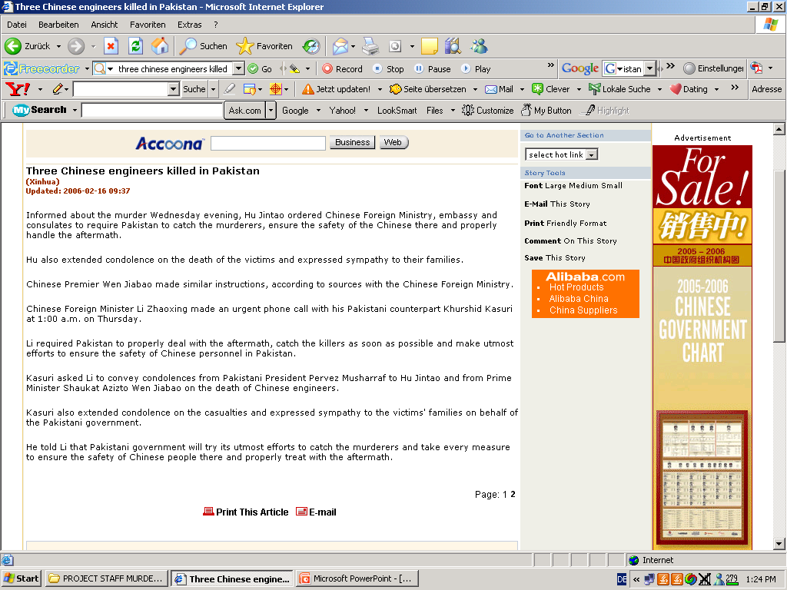

Slide 44
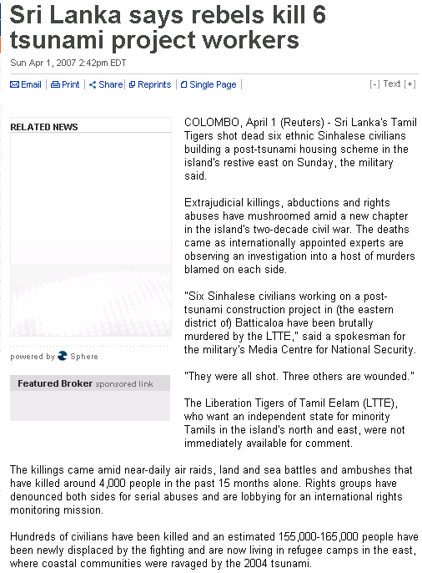
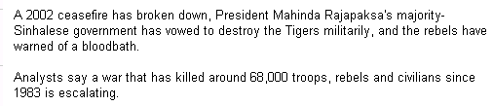

Slide 45
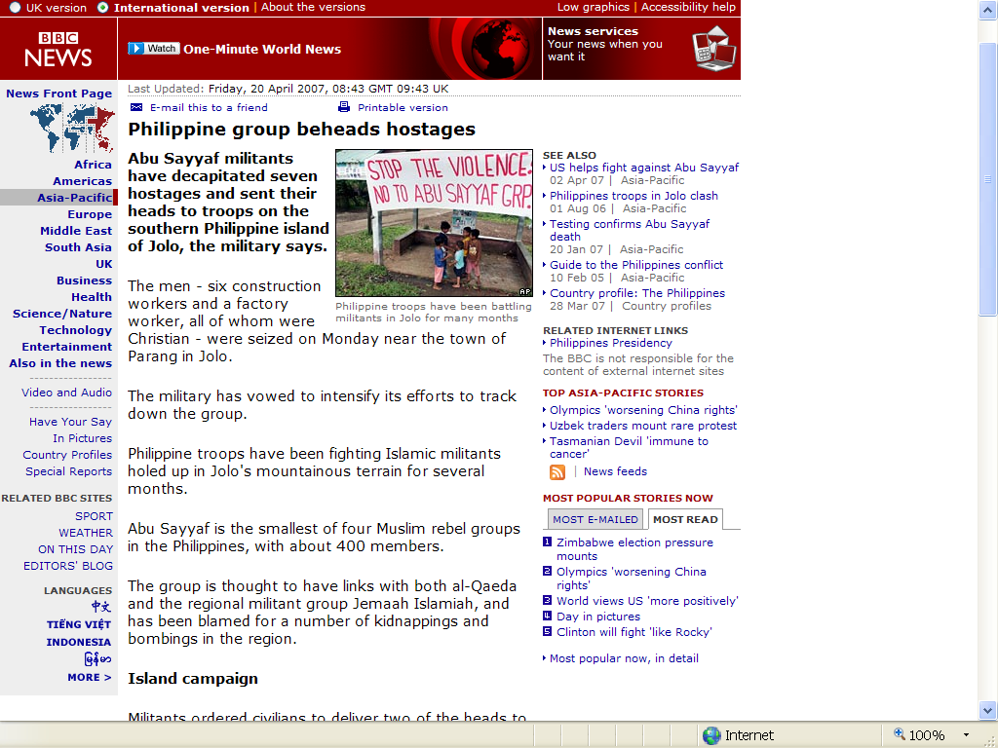
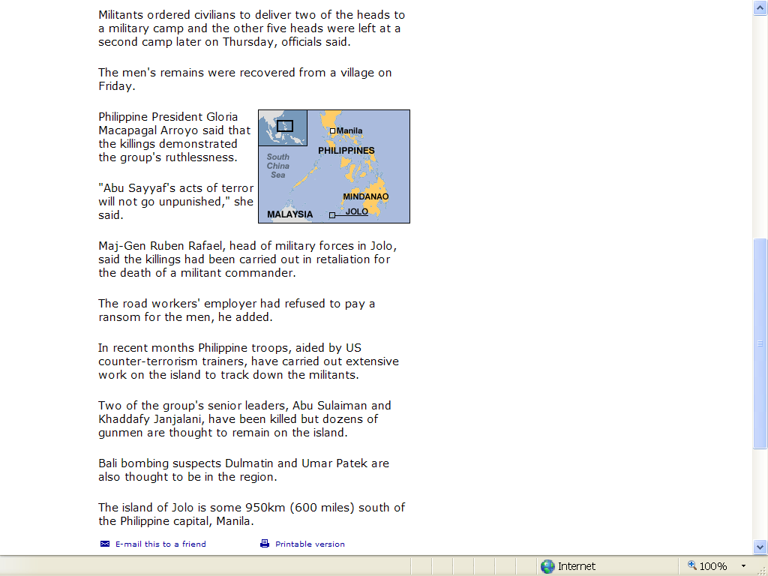

Slide 46
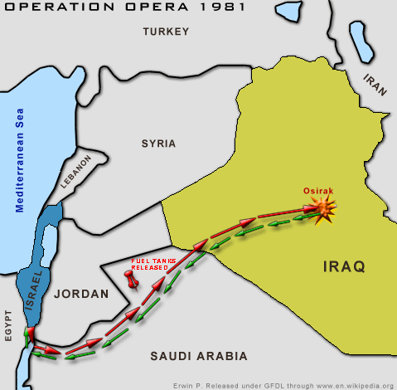
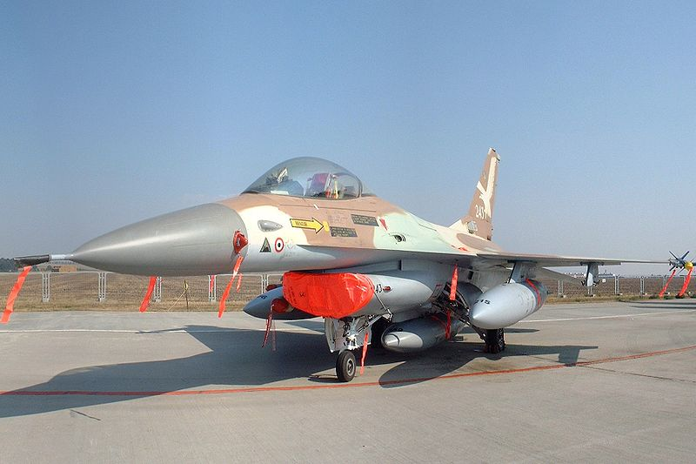
Options for Adversarial Project Stakeholders
(Transboundary Context: Millitary Attack)
Occasionally, stakeholders may excer-cize drastic options to safeguard them-selves from a perceived threat – exis-tential or otherwise. The destruction of Iraq‘s Osirak (Tammuz 1) nuclear reactor facility near Baghdad by Israeli F-15/F-16 combat aircraft on 7. June 1981 is an excellent case in point.
Israel feared that the facility could in time give Saddam Hussain‘s regime the opportunity to develop nuclear wea-pons for use against it.

