Slide 1
Master of Science in
Project Management
Project Stakeholder
AND COMMUNICATION Management
LECTURE 21:
VIDEO CASE STUDY: CHAD-CAMEROON PIPELINE PROJECT

Slide 2
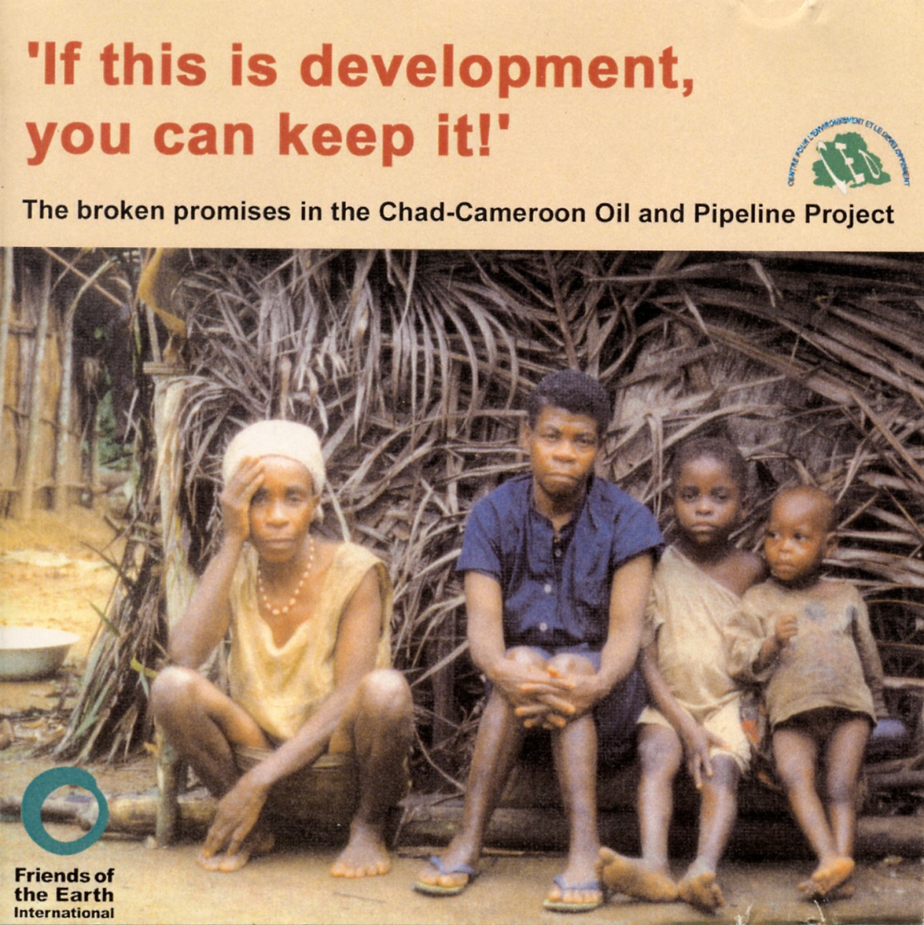
Video Case Studies: Chad-Cameroon Pipeline
(Project‘s Anticipated Impact on Economy and Society)
Three videos produced by the International Finance Corporation and People Television, by EssoChad and by Friends of the Earth International will now be viewed. They pre-sent different perceptions of the pipeline project which is one of the largest undertaken to date in Africa and which, though technically a „success“ has been internationally criti-cized for its social impact.

Slide 3

Book on the Chad-Cameroon Pipeline
Authored by Joyce B. Mbongo Endeley and Fondo Sikod from the University of Buea in Cameroon, this 207 page book based on aca-demic research examines in 12 chapters in detail the pipeline pro-ject‘s impact on its stakeholders.
Topics covered include the pipeline‘s im-pact on the political economy, livelihoods, gender relations and land resources of the affected communities, community participation in the project, compensa-tion issues, and the relationship between the communities and the construction companies and service providers.

Slide 4
INSERT VIDEO 1
IFC

Slide 5
INSERT VIDEO 2&3
Crowning Achievement & Land of Promise

Slide 6
INSERT VIDEO 4
Views & Voices

Slide 7
INSERT VIDEO 5
FoE

