Slide 1
Master of Project Management
(MPM) Degree Programme
Project Stakeholder
AND COMMUNICATION Management
LECTURE 20: PROJECT STAKEHOLDER ANALYSIS PART 4

Slide 2

What Makes Project Stakeholders „Supportive“ and „Adversarial“?
Based on Review and Analysis of Several Dozen Projects Across the Globe
(An External Stakeholders‘ Perspective)

Slide 3

What Makes Project Stakeholders Supportive?
(Need Acknowledgement)
Stakeholders tend to support projects which meet their needs (current, anti-cipated) – and wants.
Needs can be very versatile. Examples: Additional Kindergartens, widening of roads, expansion of power generation infrastructure, creation of waste dispo-sal and sewerage treatment facilities, uban regeneration schemes, upgrading of hospitals and launching of health awareness promotion and poverty alleviation projects.

Slide 4

What Makes Project Stakeholders Supportive?
(Employment Opportunities)
Many projects, especially in construc-tion / infrastructure development, re-quire substantial (skilled, semi-skilled, unskilled) input of labour, especially in their execution phase. Employment opportunities are created after project completion too.
In poor communities, where jobs are usually scarce, unemployment is chronically high and the economy is weak, projects can financially benefit many people.

Slide 5

What Makes Project Stakeholders Supportive?
(Business Opportunities)
Besides human resources, projects often require (large) inputs of raw materials, finished and semi-finished items, and a host of services provided on- and off-site.
Projects can, hence, generate substan-tial revenue for the (local) business community (e.g. suppliers, contractors) extending over the entire (or part of the) project life-cycle and possibly be-yond project completion when it ‚goes into operation‘.

Slide 6

What Makes Project Stakeholders Supportive?
(Investment Inflows)
Some projects may facilitate an increase in the volume of investment which flows into (and generated within) the community after their completion.
Example: A project to establish an IT training institute in a small town may prompt IT businesses to set up offices and facilities there where the man-power needed for their operations can be recruited.

Slide 7

What Makes Project Stakeholders Supportive?
(Property Values and Rents)
Some projects may significantly boost the ‚perceived attractiveness‘ of the localities where they are undertaken. Over time this may translate into an increase in property values and rents due to an influx of people and organi-zations seeking to avail opportunities open to them while projects are on-going and/or after their completion.
Examples: Corporate Offices, Banks, Hi-tech Industries, Educational and Cultural Institutions.

Slide 8

What Makes Project Stakeholders Supportive?
(More Tourism)
Tourism is big business nowadays - in fact, it is a pillar of the global economy.
Tourists the world over like to flock to places offering fun and adventure, sightseeing and recreation, and cultu-ral learning experiences.
Tourism is the main source of income for many communities and countries. Projects in the tourism industry usually tend to attract broad support from the concerned stakeholders.

Slide 9
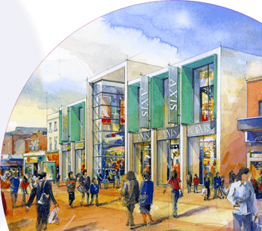
What Makes Project Stakeholders Supportive?
(Improvement in the Quality of Life)
Many projects offer their stakeholders an „improved quality of life“ on com-pletion: Provision of access to a larger and superior range of goods, services, comforts and experiences, and a clean-er, safer, healthier and more enjoyable environment to live in.
Examples: Shopping Malls, Cinemas, Entertainment Centers, Museums, Ex-hibition Halls, Libraries, Art Galleries, Sport Facilities, Public and Amusement Parks, Urban Regeneration, NPD/NSD.

Slide 10

What Makes Project Stakeholders Supportive?
(Aspirations and Pride: Community to National Level)
Some projects attract across-the-board endorsement simply because the com-munity, or at a macro-level, the majo-rity of people in the provinces/states, regions or countries in which such pro-jects are being undertaken or are plan-ned to be undertaken at a future point in time perceive them as being of over-riding importance.
Examples: The Beijing Olympic Games 2008, India-Pakistan Arms Race.

Slide 11
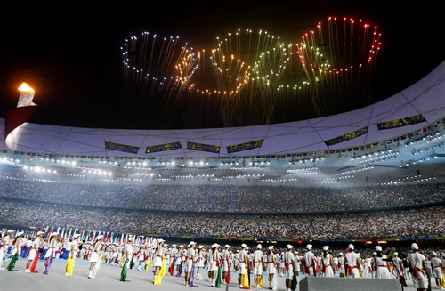

What Makes Project Stakeholders Supportive?
(National Aspirations and Pride)
The Olympic Games 2008, which was held in the Chinese capital Beijing, generated tremendous support among most Chinese people who saw it as a symbol of China‘s coming of age.
A string of projects, including major construction schemes and a massive operation to clean up the city prece-ded the ceremonies which, in addition to the Chinese people, were attended by tens of thousands of visitors from across the globe.

Slide 12
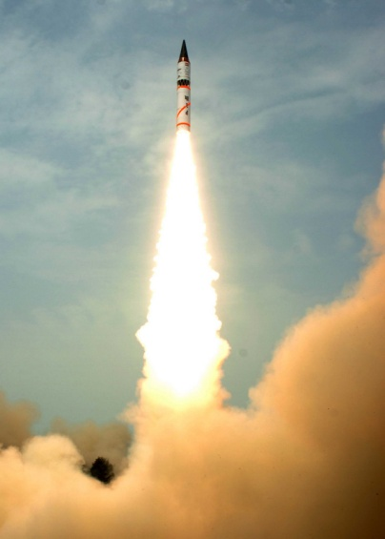
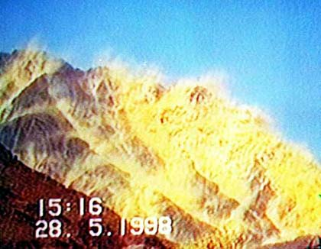
What Makes Project Stakeholders Supportive?
(National Aspirations and Pride)
An overwhelming majority of Indian and Pakistani citizens endorse their countrys‘ conventional, nuclear and missile weaponization programmes and projects.
Though India and Pakistan rank amongst the world‘s poorest countries in terms of their per capita incomes and social indicators, this predicament has not discouraged them from con-tinuously spending disproportionately vast sums on their defence.

Slide 13

Major Concerns of Project Stakeholders

Slide 14

Why Are Project Stakeholders Adversarial?
(Expropriation of Property, Compensation Regime)
A major cause of concern for stakehol-ders the world over is the possibility of forced acquisition of their land and dwellings and eviction from their (an-cestral) villages, townships and cities with conseq. involuntary resettlement.
Stakeholders who live at places for generations tend to develop a strong emotional attachment to them and community spirit and may experience severe traumatization when compelled to resettle elsewhere.
According to a report, tens of millions of people have been displaced by dams since WWII.

Slide 15
Why Are Project Stakeholders Adversarial?
(Expropriation of Property, Compensation Regime)
Experience with projects involving substantive displacements of commu-nities (e.g.: dams, highways, mines) shows that resettled stakeholders often have comparatively less econo-mic opportunities, are usually under-compensated and may be compelled to wait for a long time (years in some cases) before receiving their compen-sation, are not properly consulted about their eviction during the project and are frequently harassed by project developers.

Slide 16
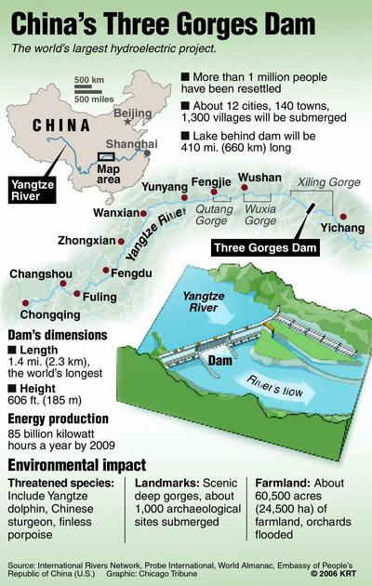
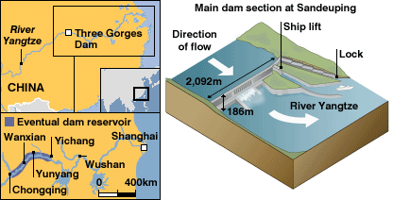
Why Are Project Stakeholders Adversarial?
(Apprehension over Loss of Property)
The mammoth Three-Gorges Dam in China is an excellent example of the massive forced displacement of a large number of people caused by large-scale dam projects.

Slide 17

Why Are Project Stakeholders Adversarial?
(Negative Impact on Property Values)
A frequent concern of stakeholders in the context of certain projects - nuclear power stations, mines and factories causing extensive pollution to name a few prominent categories - being undertaken in their proximity is the consequent decline in the value of their property.
The impact on property values of pro-jects has been empirically researched in several studies.

Slide 18
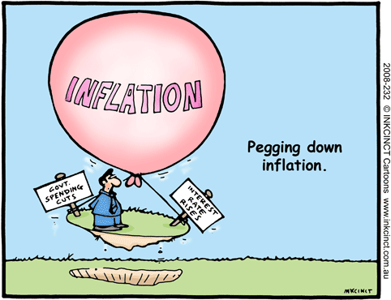
Why Are Project Stakeholders Adversarial?
(Adverse Economic Consequences)
Stakeholders may oppose some pro-jects because they expect them to have a negative economic or financial impact on themselves and/or their community.
Some stakeholders may apprehend an increase in the prices of goods and ser-vices they require and increase in the cost of their rent payments, others may anticipate business losses or be concerned over a possible or definitive threat to their livelihoods.

Slide 19

Why Are Project Stakeholders Adversarial?
(Adverse Impact on Health)
Some projects are associated in the general public‘s perception with having adverse health effects. Examples in-clude nuclear power plants, chemical factories, mines, cell phone towers and wind farms.
The existence and/or extent of such adverse health impacts are a topic of considerable disagreement between stakeholders. Scientific research often is inconclusive and can produce widely varying results.

Slide 20
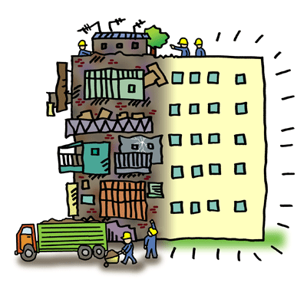
Why Are Project Stakeholders Adversarial?
(Unsightliness and Visual Obstruction)
Some stakeholders oppose projects because they perceive them as un-sightly additions which are in dishar-mony with the natural or urban land-scape of their localities, or because they are concerned that the project will result in visual obstruction of their surroundings.
Several projects have encountered stiff opposition from stakeholders for this reason.

Slide 21

Why Are Project Stakeholders Adversarial?
(Distrust of the Project Purpose)
Projects occasionally encounter consi-derable suspicion among stakeholders. This may be fuelled by some hostile stakeholders who incite other stake-holders into believing that the project has been conceived or is being under-taken with the concealed intent of causing them harm.
For example, concerns were voiced in some developing countries that vacci-nation programs were being pursued to promote infertility.

Slide 22

Why Are Project Stakeholders Adversarial?
(Loss of Privacy)
Privacy has emerged as a major con-cern of citizens in the information age. Countries across the globe have passed laws to safequard peoples right to privacy – a right which in the post 9/11 world is being increasingly challenged by governments and their intelligence and law enforcement agencies.
Much critical scrutiny has been direct-ed towards projects – such as creation of large databases - which may com-promise individual privacy.

Slide 23

Why Are Project Stakeholders Adversarial?
(Moral Outrage)
Staeholders may oppose a project be-cause they deem it to be „morally offensive“ or inconsistent with their cherished cultural and societal values.
Moal opposition to projects is culture –specific: what is considered innocuous and acceptable by stakeholders in one society may be considered wholly un-acceptable by stakeholders in another (less enlightened) society. The level of opposition may intensify or decrease over time.
Notes:
Opposition may vary not only between societies and countries but within them too.
Examples: Nudist colony, casinos, sex shops and sex-themed parks in Muslim and conservative countries.

Slide 24

Why Are Project Stakeholders Adversarial?
(Pollution)
Countless projects across our globe share an issue of common concern to stakeholders: pollution.
Pollution comes in different forms: atmospheric, soil, water and acoustic. Over time it may severely affect the health of individuals and communities with a high attendant cost.
Visual degradation of pristine environ-ments is also a frequent cause of con-cern among stakeholders.

Slide 25

Why Are Project Stakeholders Adversarial?
(Damage to Ecological Systems)
Stakeholders the world over have be-come highly conscious of the poten-tially adverse and long-term impact which some projects may have on ecological systems (fauna and flora) and often oppose them for this reason.
Many globally and locally active and powerful non-governmental organiza-tions champion ecological causes and may cast a very negative spotlight on projects through well coordinated pub-lic awareness campaigns.

Slide 26


Why Are Project Stakeholders Adversarial?
(Traffic Headache)
During their execution phase, construc-tion projects may cause considerable traffic obstruction, congestion and diversion which may increase the risk of vehicle accidents and consequent damage, and injury or death. Business activity in the affected zone may also be severely disrupted for some time.
Stakeholders tend to dislike the incon-venience, excitement, and stress which ensues over time by having a construc-tion site in proximity.

Slide 27

Why Are Project Stakeholders Adversarial?
(Damage to Archeological and Historical Assets)
Work on some infrastructure projects, notably dams and roads, physically ex-tend over a large space and may cause damage to or destruction of sites and artifacts of archeological and historical significance which are located at or in close proximity of the project construc-tion sites.
Several projects worldwide have en-countered stiff stakeholder opposition for this reason.

Slide 28

Why Are Project Stakeholders Adversarial?
(Cultural and Religious Xenophobia)
Some stakeholders oppose projects because the project owners are either foreigners or hail from an ethnic or re-ligious minority and are, hence, percei-ved as „culturally alien“.
For example, projects by MNCs in some developing countries have cau-sed concern that local cultural values, norms and traditions may be „under-mined“. Minorities often find it extra-ordinarily hard to set up their own schools or places of worship.

Slide 29

Why Are Project Stakeholders Adversarial?
(Scepticism About the Need for the Project)
Some stakeholders perceive that there is no „genuine need“ for undertaking certain projects.
Stakeholders may think that the inten-ded outcomes are not realizable or worthwhile and the projects are a waste of resources which could be utilized productively on other „needed projects“, or that they are based on a „contrived“ need and are actually designed to benefit the project owners at their expense.

Slide 30

Why Are Project Stakeholders Adversarial?
(Lack of Consultation)
Many projects are undertaken without adequately identifying and analyzing the stakeholder community and enga-ging them with respect to their project -specific concerns.
Some stakeholders may resent not having been adequately informed and/ or consulted and engaged by the project owners or implementers, and hence may not support the projects in question to the extent that they may have otherwise done.

Slide 31

Why Are Project Stakeholders Adversarial?
(Application of Strong-Arm Tactics)
The media occasionally reports about heavy-handed, often brutal methods used by project owners and implemen-ters to get project work done.
Such methods may entail the harass-ment and intimidation of adversarial stakeholders and – as has been wit-nessed and documented in several projects - can extend to include serious and targetted acts of violence such as abduction and murder.
Notes:
Needless to say, the ensuing climate of fear caused by the use of violence and intimidation in turn engenders greater opposition to the project, though not necessarily overtly shown due to the fear factor.

Slide 32

Why Are Project Stakeholders Adversarial?
(Apprehension Over Crime)
Large projects may require the influx of project employees from outside the locality if these human resources are unavailable on site.
Tensions between non-local project employees and the community of the project locality may occasionally sur-face over diverse issues, incl. criminal acts committed by the outsiders. The project may also attract criminals after its completion.

Slide 33
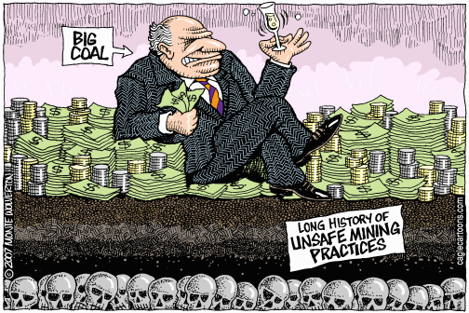
Why Are Project Stakeholders Adversarial?
(Conduct of the Project Owners/Implementers)
Many stakeholders oppose some pro-jects because of the undesirable repu-tation, policies and practices of the organizations owning and/or under-taking them.
This is especially true for projects un-dertaken by energy and mining compa-nies in developing countries where environmental and human rights standards are comparatively lower and corruption in the administration and government is rife.
Notes:
This has been observed in developing countries the case of projects being undertaken there by mining and energy companies.

Slide 34

Why Are Project Stakeholders Adversarial?
(Negative Publicity)
Some controversial projects which attract considerable opposition may find it difficult to find a place where they can be implemented.
Some stakeholders may oppose pro-jects over concern that allowing con-troversial projects to be undertaken in their locality may tarnish their reputa-tion in the eyes of other communities given the negative publicity about the projects.

Slide 35

Why Are Project Stakeholders Adversarial?
(Negative Attitude to Change)
Most people tend to be content with their way of life provided it meets all their basic needs and wants.
As projects inevitably go hand in hand with „change“, and because stakehol-ders cannot always accuratey envision the multi-dimensional ramifications of the change on them prior to project completion, they may be hesitant to support the project. They may also not like the intended change and oppose it on this ground.

Slide 36

Why Are Project Stakeholders Adversarial?
(Fear of Terrorism)
The shocking events of 9/11 changed our world fundamentally, making „security“ a priority concern for many countries.
Some stakeholders are concerned at the possibility of terrorist attacks on nuclear power stations, chemical and weapon factories, and other facilities which may result in considerable loss of life and damage to property and are reluctant to support such projects in their localities.

Slide 37

Why Are Project Stakeholders Adversarial?
(Civil Strife Situations)
We live in a violent world plagued by numerous intra- as well as interstate conflicts.
In countries facing local insurrections (such as Iraq, Afghanistan, India, Pakis-tan, Nigeria and the Phillippines) many projects and the staff employed to work on them have been deliberately targetted for attack by insurgents who perceive these projects as representing the interests of the state.

