Slide 1
Master of Science in Project Management
Project Stakeholder
AND COMMUNICATION Management
COMSATS VIRTUAL UNIVERSITY
PART I: INTRODUCTION TO PROJECT STAKEHOLDER MANAGEMENT AND ENGAGEMENT

Slide 2
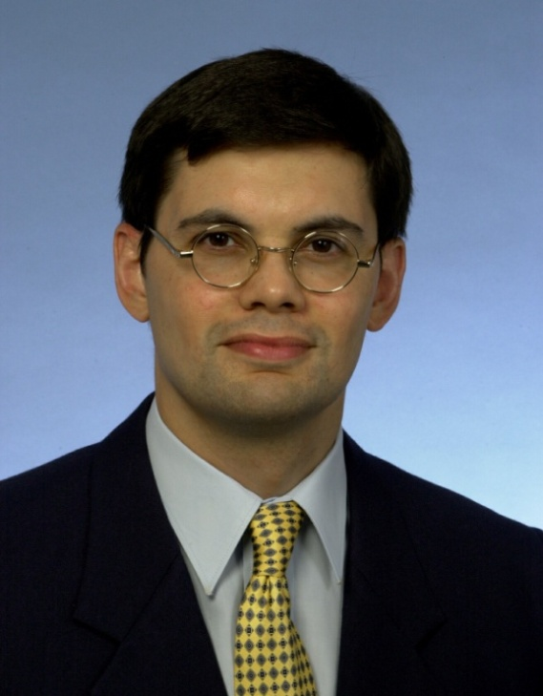
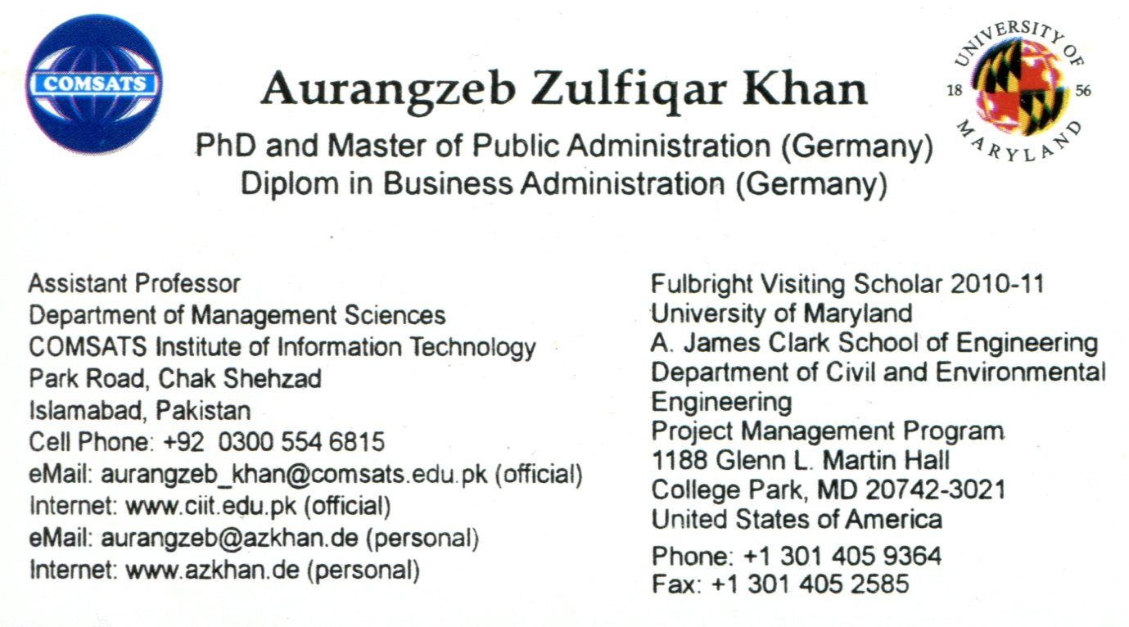
Your Course Instructor
Professional Work Experience
  1992: Executive Assistant at Hilal Consultants Pvt. Ltd., Islamabad
  1993-96: Programme Coordinator at the Hanns-Seidel Foundation, Islamabad
  1997-98: Research Fellow at the Institute of Strategic Studies, Islamabad
  Since 2005: Asst. Prof. in the Dept. of Management Sciences, CIIT Islamabad
Notes:
Slide: Your Course Instructor
Briefly explain my main responsibilities in each of these organizations, especially with regard to projects.

Slide 3

Subjects I Taught at CIIT Islamabad
(Period: Spring Semester 2005 – Spring Semester 2010)
Business Research Methods (MBA)
International Human Resource Management (MBA)
Operations Management (MBA, MS)
Project Management (MBA, MS)
Seminar in Human Resource Management (MBO)
Total Quality Management (MS)
MS
MBA MBO
MPM
Fundamentals of Project Management
Project Stakeholder and Communication Management
Project Controlling
Seminar in Project Management
Notes:
Slide: Subjects I Taught At CIIT Islamabad
MS = Master of Science. Three semester graduate program with first two semesters consisting of coursework followed by one semester for research thesis. Prerequisite for admission to the PhD program.
MBA = Master of Business Administration. Previously four semesters long “undergraduate” degree program at CIIT which, as of fall semester 2010, was increased to seven semesters (three and a half years).
MBO = Master of Business Administration. Two semester degree program at CIIT open to students with a four year bachelor degree.
MPM = Master of Project Management. Previously a two semester professional degree program offered only at CIIT Islamabad which was increased as of fall semester 2010 to three semesters.
No. of Semesters Courses Taught:
MBA, MBO, MS:
Business Research Methods (MBA: Taught Once in Fall Semester 2005)
International Human Resources Management (MBA: Taught Once in Fall Semester 2005)
Operations Management (MBA, MS: Taught Twice, Once to MBA and Once to MS)
Project Management (MBA, MS: Taught Seven Times in Total)
Seminar in Human Resource Management (MBO: Taught Once in Spring Semester 2008)
Total Quality Management (MS: Taught Once)
MPM:
Fundamentals of Project Management (3)
Project Stakeholder and Communication Management (5)
Project Controlling (2)
Seminar in Project Management (1)

Slide 4


Slide 5
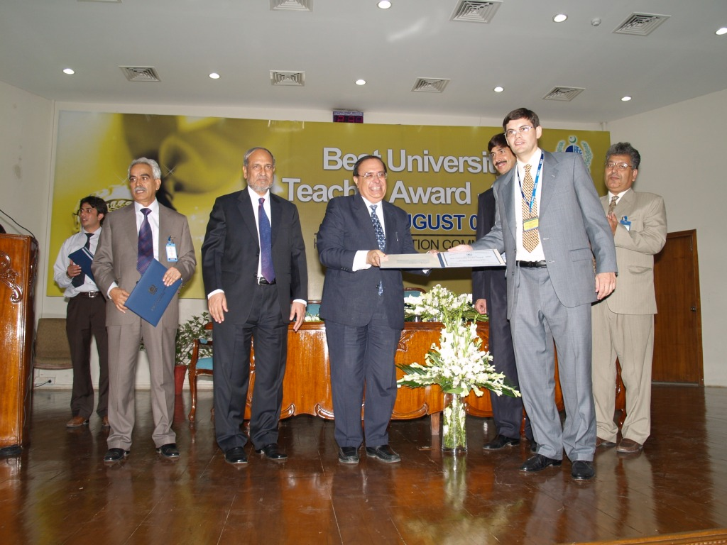
Presentation of the National Award
“Best University Teacher” for the Year 2007
Notes:
Slide: Presentation of the National Award Best University Teacher for the Year 2007
Presentation of the Award Certificate to me by the former Chairman of the Higher Education Commission of Pakistan Professor Dr. Ata-ur-Rehman on August 13, 2008.

Slide 6
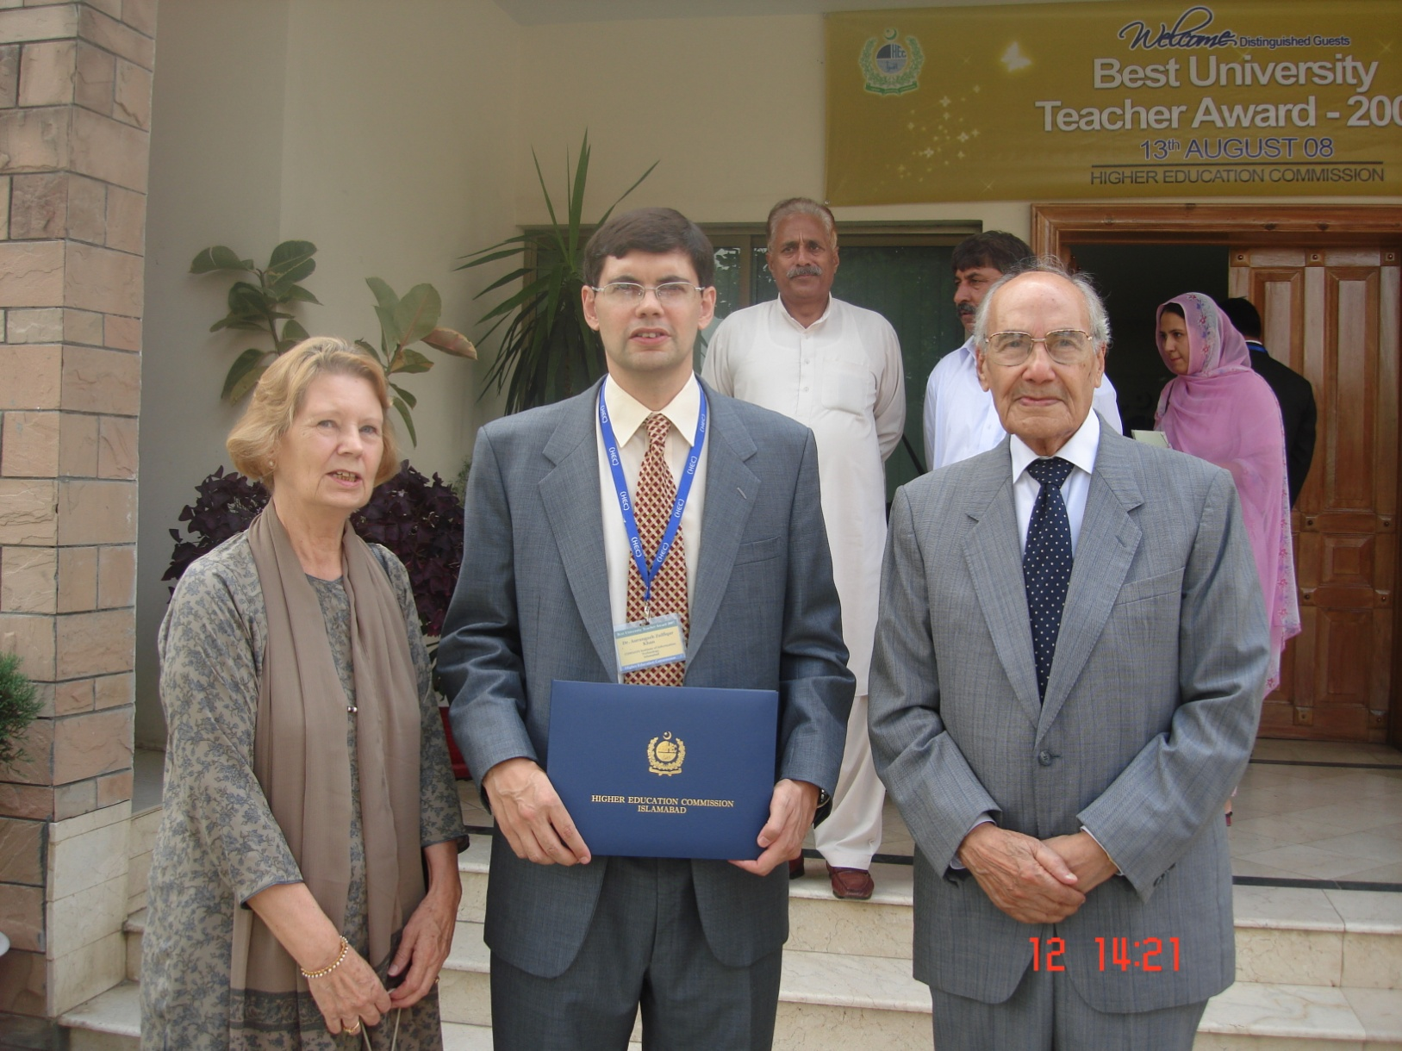
With My Parents After The Award Ceremony
Notes:
Slide: With My Parents After The Award Ceremony
Flanked by my happy parents, this photo was taken outside the HEC auditorium building after the Best Teacher Award Ceremony on August 13, 2008.

Slide 7
Self-Introduction by the Course Participants
All course participants are requested to introduce
themselves, individually and briefly, stating their:
Full Name
Higher Education and Professional Background
Designation and Name of Employing Organization
Experience Managing/Engaging Project Stakeholders
Stakeholder and Project Mgmt. Courses Attended
Reason(s) for Interest in this Course
Expectations from this Course

Slide 8
How This Course Will Be Conducted
15 Classes @ 2.5 Hours = 37.5 Hours
Holistic & Integrated Teaching Approach
Entire Course Material Available on the ELMS On-Line Blackboard System
Subject Exposure:
Comprehensive and Insightful
Original MS PowerPoint Presentations
Real-Life Examples and Case Studies
Excellent Course Literature
Supplemented by Occasional Handouts
Encourage Analytical, Critical and Creative Thinking (Cramming Severely Penalized!)
Two Examinations (Midterm, Final)
One Group Assignment & Periodic Mini-Assignments
Extensive Class Interaction: Vertical and Horizontal!
Notes:
Slide: How This Course Will Be Conducted
Holistic and Integrated Teaching Model: The Oxford Advanced Learners Dictionary defines holistic as „having regard to the whole of something rather than just to the parts of it“. In other words, having a holistic perspective means seeing the „larger picture“ of something which, in this case, is the subject of project stakeholder management. Students must disaccustom themselves from the narrow tunnel vision they frequently come to my class with and learn to view project stakeholder management as a highly complex, vast and multifaceted pool of knowledge in which all its constituent areas have their place and functions and are interrelated like the organs of the human body. Hence, I shall be reviewing not only the individual project stakeholder management processes and tools, but also throw light on their interrelationship and how changes occuring on one knowledge area (for e.g. project scope) can effect other knowledge areas (for e.g. project cost and schedule). Furthermore, students must be made aware of how individual projects compete with each other for an organization‘s resources and why and how they are closely integrated with the organization‘s goals, objectives and mission. Finally, the link between projects and the external environment of the organization owning and/or implementing them must be considered.
Detailed Subject Exposure: An advanced course in project stakeholder management necessitates an in-depth study not only of the respective interests, responsibilities, expectations and concerns etc. of project stakeholders, but also the fundamental forces which have generated interest among researchers and practitioners in the subject (nine have been identified through my research) and, very importantly, the project stakeholder governance model I developed independently which offers a comprehensive framework for managing and engaging project stakeholders in any project category.
Course Syllabus: I do not finish the semester without teaching all the material outlined in my course syllabus. It‘s as simple as that! It is unprofessional at best, dangerous at worse. This course on project stakeholder management has been carefully designed from scatch and it appears it is not being currently offered elsewhere in the world in this comprehensive form. Consequentlty, and given my style of working, the course syllabus has been developed entirely by me. Each of the four course sections have direct and practical relevance for managing/engaging stakeholders on projects. The ommission of any topics, which may be quite important for students who will later on lead or be involved in projects, and it would be grossly irresponsible on my part not to acquaint them with this subject material.
Course Literature: In teaching project stakeholder management I use only the literature which, after careful review and assessment, I consider the best and which are of a standard comparable to project management literature used in MPM and similar programs at good foreign universities. As the course project stakeholder management is innovative and very few courses on the subject are being offered worldwide, selecting appropriate course literature poses more a significant challenge. For the list of basic course literature and supplementary reading material see my student handbook. All the books are presently (September 2010) unavailable in Pakistan and have to be imported into the country. Students are expected to carefully read regularly over the entire semester and FROM THE FIRST WEEK starting after commencement of classes. Note that copies of research articles, selected passages from books and other material in printed and/or electronic form will also be recommended periodically as as when the need arises.
A number of videos and documentaries supplement the course reading material. Examples: The documentary videos from the interesting television series Megastructures, Extreme Engineering, and Engineering an Empire. Students are encouraged to watch these and view them in the light of project stakeholders. I have some of these videos and can make them available to students on request.
MS Powerpoint Presentations: All my classes will be conducted entirely with MS PowerPoint 2007 presentations which cover the entire course material and which I developed myself. The number of slides is growing continuously (as of October 2010 they number about 550 which excludes 130 slides on communication management). I have opted for MS PowerPoint as my prime teaching aid because of three significant benefits it brings: (1) it provides a lot of room for design creativity and allows me to create visually stimulating presentations which I know from my years-long teaching experience attracts and maintains the attention of my students throught the duration of each class, (2) it displays not only text but also embedded cliparts and photos (with or without embedded web hyperlinks) and also can be linked with video and audio files, (3) when distributed as handouts it permits my students to fully concentrate on my presentations instead of making notes of everything I am discussing, and (4) it saves me a tremendous amount of time as I don‘t have to write out everything on the whiteboard.
The downside with PowerPoint which I have observed with my classes is that some students tend to rely only on the slides and simply do not bother to read the prescribed course literature which is absolutely essential.
Students should note that I follow a theme approach in teaching project management and that my slides are not aligned with any text book.
Creative Thinking & Cramming: Creative or innovative thinking is absolutely essential in the academic environment. As mature, well educated and professionally experienced adults, I expect my students to be able to understand, analyse and make value judgments in given situations. Cramming is a big No-No in my class. I certainly don‘t expect my students to absorb each and every detail taught by me in class or contained in the course literature, rather, I expect them to be able to judiciously apply their knowledge acquired in class and come up with value-adding solutions.
Course Material on Website: During the semester, my PowerPoint slides will be uploaded on to the teaching section of my website www.azkhan.de from where they can be downloaded by my students and by anyone anywhere who is interested in viewing them. Students are expected study them carefully in preparation of their class assignments and their examinations. In addition to the slides, students can download from my website the student handbook which contains, inter alia, the course syllabus and project stakeholder management examination papers from previous semesters which they may find useful in preparation for their examinations in this course.
Examples/Case Studies: The course will frequently refer to project stakeholder management examples and case studies, some of which will be distributed as hand-outs in class, some uploaded onto my website. Examples/Case studies are essential part of the course because they supplement the theoretical material and concepts presented and discussed in class. In essense, they are the link between the theory and practice of project stakeholder management. Students may note, though, that examples/case studies are – contrary to what many people mistakenly believe – NOT A SUBSTITUTE for acquiring an indepth theoretical or concept knowledge of the project stakeholder management, nor will or can they ever be.
Assignments & Examinations: I will set assignments on a periodic basis which all students are expected to submit in class in both printed and electronic form within the given deadline. There is no limit on the number of pages, but please note that quality takes precedence over quantity! The purpose of the assignments are to relate the subject material taught in class to the students‘ professional work at their offices. Students are NOT permitted to set their own assignments.
Two written examinations will be held in the semester. The midterm examination is held approximately in the middle of the semester. It is for 90 minutes or 2 hours and I will ask three or four questiuons from different subject areas taught in class, each carrying equal marks and designed to be answered in roughly the same amount of time. The final examination is of 3 hours duration. I will give relevant information from a (real or fictitious) case study which will be followed by three to five mandatory questions, possibly with subquestions. Students will have to apply all their analytical, critical, creative and holistic thinking skills to perform well in this examination!
Quizzes will be set during the course but they carry no marks. Students may note that NO Multiple Choice Questions will be asked in either the midterm or final examination.
Class Interaction: I accord immense importance to interaction with my class! Communication occurs at two levels, namely, (a) between my students and me and (b) between the students among themselves. Course participants are, therefore, encouraged to ask questions, give their comments and voice constructive criticism in every class. Topics raised in my presentation should be openly discussed. Class interaction rather than passive listening provides a good opportunity for students who are mostly working professionals to share knowledge with their peers based on their own experience managing projects in diverse environments.
English Language: The English language is now (thank goodness!) the lingua franca of the world. This suits me - and not least because my first language is English - since all the project stakeholder management literature my students are required to read for this course is in English as are their assignments and midterm/final examinations. There is a downside too. I realize that many of my students do not speak English as their first language but I believe that using English exclusively in class will give them an opportunity to improve their language skills over the course of time and this in turn will benefit them professionally and personally.
Guest Speaker: It is a tradition of mine to invite at the end of the semester a project management practitioner from government, private industry or a development organization to give a talk on his/her personal insight of, and experience with, professional project management on projects the person in question has worked on previously or is presently working on. The talk will be approximately 45 minutes long followed by a discussion of 45 – 60 minutes. The objective is to show the students to what extent the project stakeholder management knowledge acquired by them in class can be directly applied in real projects they may be involved in in their professional life.
Miscellaneous: Websites will occasionally be accessed via the CIIT high-speed cable connection in class and shown to students using the digital projector. Course participants are not required to come to class equipped with laptops but these can be a useful learning aid in some classes.
As part of my course quality improvement excercize, I will circulate an anonymous content assessment form at the end of the course requesting all my students to provide objective feedback about the quality of my course, my relevant knowledge and skills, my style of content delivery, and whether the course has benefitted or whether they think it can benefit them professionally and personally in time. This is a desirable initiative which I recommend all teachers of project management and its specialized areas follow.
Though I am keen to develop and maintain a very good line of communication to each of my students, and to be always available for them to support them through the course, at the same time I am cognizant of the need to maintain a „professional teacher-student distance“. I do not compromise on this requirement under any circumstances and I request all students to please be cognizant of this.
Teamwork is one of the most demanded skills by employers! It is, off copurse, also indispensible for projects. Therefore, for the purpose of working on their project assignments, I will permit the formation of teams comprising a maximum 4 course participants. I expect that all team members contribute to their assignments to the best of their abilities and cooperate, communicate and coordinate excellently with each other. No free riders please!

Slide 9
The „Formula for Success“ In This Course
Success in this course can be attained by following a simple formula:
Success = f(ABL, INT, INQ, ABS, CRIT, ALY, CRE, CS)
ABL: General Ability
INT: Interest
INQ: Inquisitiveness
ABS: Absorption Capacity
CRIT: Critical Thinking
ALY: Analytical Skill
CRE: Creative Skill
CS: Common Sense
Notes:
Slide: The Formula For Success In This Course
ABL: General Ability
A basic assumption I make when I hold this course is that every student attending it comes equipped with the basic level of intelligence and skills (e.g. communicational, cognitive, interactional) expected in a graduate level project management program designed specifically for professionals from engineering and other fields.
INT: Interest
Interest means that the student feels motivated to attend, participate in and learn from this course. No amount of teacher instruction and support can compensate if the student is unwilling to make a concentrated and systematic effort to learn about the subject of project stakeholder management/engagement and invest the requisite time and energy.
INQ: Inquisitiveness
Actively seeking information and knowledge of project stakeholder management/engagement and all that is related to it from diverse sources of high quality.
ABS: How much the student can take in and process mentally.
CRIT: Critical Thinking Ability
The student is capable of thoroughly analyzing a situation or scenario and pinpoint shortcomings or deficiencies which need to be overcome in order to manage the situation in question in a better (i.e. more effective or efficient) manner.
ALY: Analytical Skill
The student is capable of carefully studying, comprehending and dissecting a given project stakeholder management situation or scenario of comparative complexity into its constituent causes and effects, elements, factors, issues, shortcomings, interrelationships etc.
CRE: Creativeness
The student is capable of suggesting new and/or better ideas, approaches and strategies which can be applied to a given project stakeholder management situation or scenario and which would enable the project manager or team to achieve their goal of managing/engaging more effectively and/or efficiently in a manner results in higher value attainment for more stakeholders.
CS: Common Sense
Nothing in this world it seems is more uncommon than common sense! Project Stakeholder Management and Engagement is, in large part, really nothing more than plain common sense and if students can‘t excercize their basic mental faculties in this regard, then ... [no comment]!

Slide 10

The Essence of Knowledge
Is Having It To Apply It
(Chinese Philosopher Confucious)
(551 B.C – 479 B.C)
Notes:
My favorite phrase! I print it on all my terminal examination papers.

Slide 11

Course Objectives

Slide 12

Prime Objectives of this Course
This course aims to acquaint the stu-dents comprehensively and in-depth with the subject of project stakehol-der management and engagement from a theoreticians as well as prac-titioner‘s perspective using high-quality textual/visual material and numerous real-life examples drawn from across the globe on this exci-ting, challenging, fast evolving and increasingly important specialized field of project management.
Notes:
An image says a thousand words! That is why extensive use is made of visual components (clipart, photographs and videographic material) in my PowerPoint presentations. Based on my years-long academic teaching experience with management science students at CIIT, this approach is highly effective and makes the learning process both fun and entertaining too.

Slide 13

Prime Objectives of this Course
It aims to motivate the students to deepen their insight of project stake-holder management and engage-ment after course completion and to apply their class-acquired knowledge creatively for the systematic, effec-tive and efficient management and engagement of stakeholders on pre-sent and future projects of varying complexity in their professional work environments.

Slide 14

Prime Objectives of this Course
This course furthermore aims to en-courage organizations through their current and future employees who are participating in it to put their project stakeholder management and engagement policies, strategies, plans, processes and tools on a more stakeholder-responsive footing which in time will bring more „win-win solutions“ for both them and their stakeholders.

Slide 15

Prime Objectives of this Course
Through the awareness and interest generated by this course, which at the present point in time is one of just a handful offered at universities across the world, it is hoped that more focussed research on project stakeholder management and engagement practices in public, for-profit and not-for-profit organiza-tions will be encouraged and spon-sored in future.

Slide 16

Rules for the Course Participants

Slide 17


Rules for Course Participants: The Do‘s
Do listen to my lectures very attentively and carefully! Listening is the basis for comprehension which is the prerequisite for performing well in this course. If you are having comprehension problems, inform me imme-diately. Do not hesitate otherwise it may be too late for me to help you.
Do ask questions or bring up relevant points for discussion in the classroom! You will not be punished for this! There is no such thing as a stupid question or discussion and I am very patient with students.
Always be inquisitive, analytical, critical and creative in your approach to learning project management!

Slide 18

Rules for Course Participants: The Do‘s
Do read the prescribed course literature! It is the basic requirement for comprehending project stakeholder management and the prerequisite for performing well in this demanding course!
Please note that using only my PowerPoint slides for your examination preparation is NOT sufficient! YOU MAY FAIL IF YOU DO SO! Some or all of the questions in all your examinations over the semester may relate to material in the recommended course text books and handouts which in class may not have been dis-cussed in detail or at all! An excellent piece of advice for you: Read from the beginning of the course and NOT towards the end! You won‘t regret it.

Slide 19


Rules for Course Participants: The Do‘s
Do visit me at my office (room 0147B in the Glenn Martin Hall) individually or as a group, if you have a course-related problem or problems and desire counseling! I am in office everyday from 9 AM to evenings. Mondays to Fridays are class evenings. My e-Mail is azkhan@umd.edu
Do fill out the anonymous course evaluation and course instructor evaluation forms at our online blackboard system at the end of the semester! All instructors have worked very hard to provide you with the best possible insights into project management and its specialized areas and over time we want to continuously and significantly improve the quality of our modules. Your honest and constructive criticism is very valuable for us and we certainly welcome it!

Slide 20

Rules for Course Participants: The Dont‘s
Don‘t be late to class! 6 PM means 6 PM sharp and not a second later! Two roll calls will be taken (at the beginning of class and after the break). Students who are late will be marked absent!
Don‘t ask me to mark you present if you are going to be absent in that class! I don‘t care what events in your personal or professional lives prevent you from coming to my class. Visiting family and friends, engagements, weddings, hospitalizations, funerals, official committ-ments etc. are your issues, not mine. If you are absent in my class, you‘ll simply be marked absent. Period!
Don‘t come to class just to get marked present and then wander of to the can-teen for gossip or refreshments, or leave the campus, outside the 20-minute customary pause. Anyone caught doing this will have their attendance revoked.

Slide 21


Rules for Course Participants: The Dont‘s
Don‘t use cell phones in class! Switch them off or put on silent mode prior to entering the classroom. Do not run in and out for making or taking calls and do not send SMS messages while the class is in progress. Such behaviour distracts the class and disrupts my presen-tation. If making or answering calls is so important to you, stay at your home or office and do them there, but do not come to my class!
Don‘t chit-chat among yourselves, distract the atten-tion of other course participants or behave immaturely in the class! You are only hurting yourself and your colleagues, not me. As educated adults, I expect you all without exception to behave as such from the minute you enter my class to the minute you leave it!

Slide 22
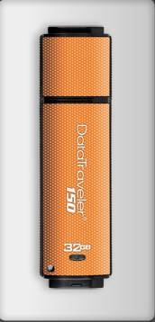
Rules for Course Participants: The Dont‘s
Don‘t come to me before, during or after classes with the request that I permit you to transfer data files from my laptop onto your USB flash or external hard drives!
From experience, students‘ flash drives often contain a number of very nasty viruses, worms, trojans etc. and their use entails a high risk of file infection and data corruption on my system which is unacceptable.
Class PowerPoint Presentations and supple-mentary files will be uploaded by me every week onto our online blackboard system for easy accessibility.

Slide 23


Rules for Course Participants: The Dont‘s
Don‘t procrastinate on your project assignments! Start work immediately after receiving your topics. Many students do nothing until the submission deadline is around the corner and then run frantically to me at the eleventh hour complaining about the problems they are having in getting information for their assignments. If you start working early you won‘t stress yourself out.
Don‘t pester me for more marks! I evaluate my students objectively and actually devote considerable time to read line by line through each examination paper and project assignment. From nothing comes nothing – if your work is crap, be prepared to get a crappy evaluation from me! And please don‘t whine about it.

Slide 24

Rules for Course Participants: The Dont‘s
Don‘t follow the „rote“ (Learning by Memorization) approach which you may have grown accustomed to since your schooldays. It is the worst thing you can do in my class – apart from outright misbehaviour, cheating or plagiarism.
My PowerPoint slides are designed as a subject guideline only and are NOT meant to be memorized. DO NOT reproduce the contents of my or someone elses slides in your project assignments/examinations.
In case of reproduction, marks will be heavily deducted and your grade in this course will drop like a stone from the sky.

Slide 25

Rules for Course Participants: The Dont‘s
Don‘t miss out on your project assignment and your examinations! Setting repeat examinations is a big nuisance for me and some marks are normally man-datorily deducted by our department as a disincen-tive for being absent! In the event that you have mis-sed out on your midterm examination due to com-pelling circumstances, I will – if department policy permits - schedule one repeat examination, but no additional repeats. If you also fail to show up for the repeat examination, you will be given zero marks which this will then be considered as final.
Note that as per CIIT rules absolutely NO RETAKE OF FINAL EXAMINATIONS IS ALLOWED!
It is your responsibility to immediately contact me if you missed a class assign-ment or examination!

Slide 26


Rules for Course Participants: The Dont‘s
Don‘t cheat in the midterm or final examinations! Your paper may be cancelled by the department or, at the very least, you will lose a percen-tage of your marks.
If your project assignments have, in full or in part, been plagiarized or simply copy-pasted from the World Wide Web without referencing, you will get zero marks and be reassigned another topic. Plagiarism can be de-termined using specialized software on material submitted electronically to me for evaluation.
NO CHEATING & PLAGIARISM!
ZERO
TOLERANCE!

Slide 27

Course Structure and Student Assessment

Slide 28

Course Structure and Materials
Weeks 1-2: Introduction to Project Stake-holder Management and Engagement.
Weeks 3-4: Stakeholders: Their Interests (Stakes), Roles and Responsibilities, and Relationship to Projects.
Week 5: Brief Overview of the Nine Principal “Drivers” of Project Stakeholder Management and Engagement.
Weeks 6–15: Managing and Engaging Project Stakeholders Professionally: The Project Stakeholder Governance Model (Institutional, Directional, Methodological, Technical, and Educational Components).
Students can access all course-related material through the University of Maryland’s online Blackboard System.

Slide 29

The Team-Based Class Assignment
The Team-Based Class Assign-ment is a mandatory part of the course. It carries 25% of the total course marks.
The class assignment‘s purpose is to determine if, how and to what extent the concepts, processes, tools etc. studied in this course have been, or can be, applied in projects which the students un-dertook in the past or which they are presently undertaking.
Assignments have a bridging function, directly linking classroom learning with on-the-job work.

Slide 30
The Assignment Guidelines
Think Carefully Before Attempting.
Quality and Original Work Only.
Contribution by all Team Members.
Relate to Your Work Experience.
Late Submissions, Voluminous Sub-missions, and Resubmissions will not be accepted.
Submit Hard Copy and eDocument.
Use Assignment Structure Template.
No Copy-Pasting from the Internet (assignment gets zero marks for this!).
No Arguing Over Marks!
Time flies! Therefore, do not procrastinate over your assignments.
You may find them to be more demanding than they seem at first glance.

Slide 31
The Assignment Structure Template
EXECUTIVE SUMMARY
One-page summarization of your class assignment.
ToC, LIST OF TABLES, FIGURES & ABB.
INTRODUCTION
Context, justification, scope, objectives, methodology and value of the assignment.
ANALYSIS
Application of class-acquired knowledge and personal experience to the given situation; holistic, analytical, critical, creative and thorough.
CONCLUSION & RECOMMENDATIONS
Restrict to a maximum of three pages.
APPENDIX
Include only relevant assignment-supporting documents.
BIBLIOGRAPHY & WEBLIOGRAPHY
Alphabetical listing of all documents (books, articles, reports etc.) and websites used in the assignment.
Quality takes precedence over quantity!
Class assignments must show originality and the ability to apply know-ledge learned in class.

Slide 32

The Midterm & Final Examinations
All students must sit through a mid-term examination (1 hour in duration, 25% total course marks) and a final examination (3 hours, 50% total course marks).
The examinations cover the material studied in class from the beginning of the course until the respective exami-nation date.
Students who can holistically and crea-tively apply their knowledge to given situations can expect to perform well in all the examinations.
Do not underestimate the difficulty level of these two examinations. You will be challenged!
USE YOUR MINDS AND READ THE QUESTIONS VERY CAREFULLY!

Slide 33
Guidelines for Midterm & Final Examinations
Mid-term Examination (two mandatory questions); Final Examination (three or four mandatory questions max.).
Questions may contain subquestions which must be answered. Questions do not necessarily carry equal marks.
Quality of answers, not quantity is the main criteria of evaluation.
Zero marks for irrelevant material or „reproducing“ my PPT-slides.
Laptops, digital diaries, calculators, cell phones, books, notes etc. are not per-mitted in the examinations.
All questions are essay-style (conceptual, applica-tive) in nature.
Often not much writing is expected – but definitely plenty of thinking!
NO MCQ’s WILL BE ASKED!

Slide 34


Samples of Examination Papers
(Project Stakeholder and Communication Management)
Midterm Examination (Fall 2008)
First Sessional Examination (Spring 2009)
Second Sessional Examination (Spring 2009)
First Sessional Examination (Fall 2009)
Second Sessional Examination (Fall 2009)
First Sessional Examination (Spring 2010)
Final Examination (Fall 2008)
Final Examination (Spring 2009)
Final Examination (Fall 2009)
Final Examination (Spring 2010)

Slide 35
Interest in Project Stakeholder Management
Project Stakeholder Management is an evolving subject which has risen to prominence as a specialized area of project management in the past twenty or so years. Several factors have contributed to the surge in interest in this field.
Much work remains to be done in spreading awareness in the project management community about stakeholder management.

Slide 36

Managing and Engaging Project Stakeholders
(Neglect in Project Management Degree Programs)
Not Well Understood Specialized Field of Project Management
Dearth of Qualified Faculty and Lack of Subject Text Books
Dominating Influence of PMI’s PMBOK Standard
Tendency to Focus Teaching on “Hard” (Technical) Aspects of PM
Confusion with Project-HRM
Academic Disinterest
Perceived Subject Vastness and Complexity
There exists a considerable body of published research on project stakeholder management and engagement but not a single comprehensive textbook on the subject is available at this point in time.
Notes:
Slide: Project Stakeholder Management – Neglect in Project Management Degree Programs
The PMBOK does not yet include a separate knowledge area for project stakeholder management among its nine knowledge areas. However, it does include two distinct knowledge areas – project human resource management and project communication – exhibit a particularly strong relationship to project stakeholder management. Moreover, stakeholder management is implicitly evident in all the other seven knowledge areas in which it occupies a more or less crucial role. For example, project scope management revolves around defining, documenting and ensuring adherence to the project requirements and specifications which are set by the project owner or client (stakeholders) and progressively elaborated over the course of the project life-cycle. Project procurement management is focused on the relationship between the project and its suppliers or vendors which are also key stakeholders.

Slide 37

Managing and Engaging Project Stakeholders
(Neglect by Project Managers and Practitioners)
Fear of Critical Awareness and Scrutiny by Project Stakeholders
Reluctance to Add Another Layer of Managerial Complexity
Limited Time, Resources, Subject Knowledge and Standards
Focus on the “Triple Constraint”
(Mis-)Perception that Stake-holder Issues are Routine and Usually Easy to Resolve
Belief that Stakeholder Manage-ment is not their Responsibility
Many project managers have technical (e.g. engineering) backgrounds and often are unaware of the need for and intricacies of complex stakehol-der management/engagement.
Notes:
Slide: Project Stakeholder Management – Neglect by Project Managers and Practitioners
Managers of construction and other technical projects (who incidentally are usually persons having technical backgrounds such as civil, construction, mechanical, electrical engineering) where the focus is on the creation of “tangibles” normally prefer to focus their energies thereon. Managing/Engaging stakeholders is often erroneously thought of as being trivial in compared to dealing with the difficult technical complexities inherent to projects. Some project planners, implementers and managers may think that stakeholder issues can be resolved as and when they appear or that the costs incurred on stakeholder management/engagement would be disproportionate to the benefits expected therefrom and offer no guarantee of success. Empirical evidence does show, however, that stakeholder management/engagement is assuming more importance with growing awareness and knowledge of the subject. For projects where the focus is at least to a large extent directed towards the creation of “intangibles” (e.g.: social development schemes such as vocational training, micro-credit financing, HIV awareness generation) for a potentially large number of stakeholders more systematic effort would normally be directed towards managing/engaging the stakeholders.

Slide 38

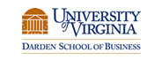

Professor R. Edward Freeman’s Contribution
Though „Stakeholder Management“ has been practised for a long time, academic interest in it surged after the American R. Edward Freeman published his highly acclaimed book Strategic Management: A Stakeholder Approach in 1984. He has since authored numerous publications on stakeholder management.
One of the world‘s foremost experts on business ethics and CSR, Freeman is a Professor of Business Administration at the University of Virginia‘s Darden School of Business in Charlottesville.
Click to read about Freeman’s latest book.

Slide 39

Defining Project Stakeholders
The literature on project manage-ment offers numerous definitions of the term project stakeholder, ranging from the very narrow to the very broad.
Some definitions restrict stakehol-ders to entities which have an in-terest in the successful completion of the project, are actively involved in it and/or are directly affected by it and/or can influence it.

Slide 40
Defining Project Stakeholders
Broader definitions of the term project stakeholder extend the con-cept to include any entity which may directly or indirectly, positively or negatively, be affected by the project, may or may not be able to influence it or which has some in-terest in the project during its life-cycle and/or subsequent to its com-pletion. Though more realistic and inclusive, it raises complications from a practical standpoint.

Slide 41
Project Stakeholders
(The Project Management Institute‘s Definition)
The Project Management Institute PMI defines stakeholders as:
„individuals and organizations that are actively involved in the project, or whose interests may be affected as a result of project execution or project completion“.
[Project Management Body of Knowledge, 2004, p.24]

Slide 42
Project Stakeholders
(Dr. Aurangzeb Z. Khan‘s Definition)
Project Stakeholders are:
„individuals, groups or associations of indivi-duals, communities, commercial and not-for-profit organizations, government institutions, and countries who/which have – or believe they have – some „stake“ (i.e. interest) in the project which is being undertaken (or which is proposed to be undertaken at a future point in time), and/or in the project‘s outcomes/ impacts subsequent to its completion“.
Notes:
Stakes can be diverse, for e.g., economic, financial, technological, political, social, cultural, environmental. A stakeholder may also have multiple stakes.

Slide 43


Project Stakeholders
(Non-Human and Non-Organizational Entities)
Some researchers and activists have (rightly) extended the concept of project stakeholders to include non-human entities, i.e., fauna and flora.
Many projects have caused exten-sive damage to our world‘s fauna and flora over time, resulting in the endangerment and sometimes the near extinction of once thriving animal and plant species.

Slide 44

Project Stakeholders
(Non-Human and Non-Organizational Entities)
A case in point for the damage cau-sed by projects is the Indus Dolphin (see endangered species list).
The construction of barrages, canals and dams on Pakistan‘s Indus river before and after independence in 1947 has severely curtailed the Dol-phins‘ mobility and jeopardized their survivability, which is already under threat from fisherfolk, pollution, depleting water levels and myriad other factors.
The Indus Dolphin is one of the rarest mammals in the world. Once found throughout Pakistan’s Indus river, supposedly only about 1200 remain alive today.

Slide 45


Project Stakeholders
(Non-Human and Non-Organizational Entities)
There are those who claim that some project stakeholders may not even (yet) be living entities!
Such would apply to the „unborn generations“ which stand to gain or lose from projects undertaken in the past/present - for example, factories and coal/oil-fired power generation plants which are major sources of global warming which is profoundly negatively affecting our planet.

Slide 46



Managing and Engaging Project Stakeholders
(Types of Project Stakeholders)
TYPE A
Stakeholder is very cooperative and receptive to management & engagement strategies
Project Stakeholders exhibit varying degrees of cooperativeness and receptiveness to management and engagement strategies directed at them. Many factors determine this.
Most stakeholders would usually fit somewhere in this space.
TYPES B-Y
TYPE Z
Stakeholder is totally uncooperative/unrecep-tive to management & engagement strategies
Notes:
Slide: Types of Project Stakeholders
Types A & Z constitute the “extreme types” on the spectrum of cooperativeness and receptiveness. Type A constitute a source of opportunities while Type Z constitute a source of threats/dangers for the project which must be identified and assessed. The clock clipart indicates that attitudes/behaviors may change over time. They are dynamic, not static and are influenced by many factors which include access to information, personal experience, cognitive processes, interaction with other stakeholders etc.
Behavior is off course, a complicated thing and it can change not inconsiderably over time. It is possible that a stakeholder may be quite cooperative and receptive today but due to some event, information intake, influence by other stakeholders etc. the opposite tomorrow.
“Rational Behavior” means that the project stakeholders are cognizant of their interests, capable of carefully processing the available information and assessing the positive and/or negative impacts the project will have on their interests and which outweighs the other, and then deciding whether to support or oppose the project. Can a rational stakeholder adopt a stance towards a project which may be contrary to its interests? Absolutely! This would be the case, for example, if the stakeholder is denied access to crucial information or is intentionally or unintentionally misled into thinking that the project may be beneficial when in fact it is harmful and vice versa.
“Irrational Behavior” would imply that the stakeholder consciously adopts an approach towards the project which is at odds with its interests, i.e., a stakeholder may support a project which may or will result in more costs than benefits for it and vice versa.

Slide 47

Managing and Engaging Project Stakeholders
(Categorizing Project Stakeholders)
Several stakeholder categorization systems are encountered in the litera-ture. Examples:
- Primary , Secondary, Tertiary
- Internal and External
- Direct and Indirect
- Supportive and Adversarial
Fixed and Variable
Actual, Potential
Key Stakeholders
Power, Legitimacy, Urgency
S

Slide 48


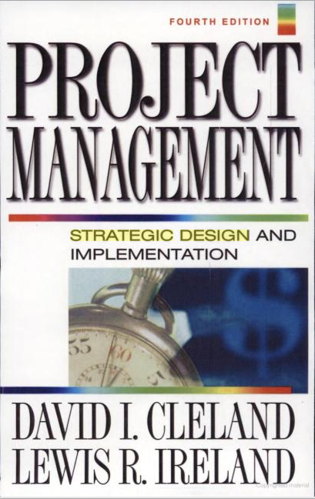
Project Primary & Secondary Stakeholders
According to Cleland/Ireland [Strategic Design and Implemen-tation, 2002]: „Project primary stakeholders are those individuals or organizational entities who or which have a contractual or legal obligation to the project team and have the responsibility and authority to manage and commit resources according to schedule, cost and technical performance objectives.“

Slide 49
Project Primary & Secondary Stakeholders
Using Cleland/Ireland‘s definition of primary stakeholders as a refer-ence, project secondary stakehol-ders are those individuals, groups of individuals and organizational entities [and, as we shall see, com-munities and even countries] who/ which have no formal contractual relationship or legal obligation to the project in question, but believe they have a stake in it because it can affect them some way or other.

Slide 50
The Project Primary Stakeholders
(Cleland / Ireland)
According to Cleland/Ireland, the project primary stakeholders have:
„direct and operational roles through their par-ticipation in the design, engineering, develop-ment and production, and after-sales logistical support of the project output/outcomes“.
Cleland/Ireland view project stakeholders from a corporate / business perspective.

Slide 51
Project Primary & Secondary Stakeholders:
Perspective from Development Programmes & Projects
Development Financing Institutions and Implementing Agencies, and Non-Governmental Organizations’ per-ception of a project’s primary and secondary stakehol-ders differs from Cleland/Ireland.
According to the African Development Bank’s Hand-book on Stakeholder Consultation and Participation in ADB Operations, Stakeholders are people/communi-ties who may - directly or indirectly, positively or negatively – affect or be affected by the outcomes of projects or programmes, whereby:

Slide 52

Project Primary & Secondary Stakeholders:
Perspective from Development Programmes & Projects
“Primary Stakeholders are the beneficiaries of a development intervention or those directly affected (positively or negative-ly) by it. They include local popu-lations (individuals and commu-nity based organizations) in the project/program area, in par-ticular, poor and marginalized groups who have traditionally been excluded from participa-ting in development efforts, and …
A USAID funded development project in West Africa.

Slide 53
Project Primary & Secondary Stakeholders:
Perspective from Development Programmes & Projects
“… Secondary Stakeholders are those who influence a develop-ment intervention or are indi-rectly affected by it.
They include the borrowing gov-ernment, line ministry and pro-ject staff, implementing agen-cies, local governments, civil society organizations, private sector firms, the Bank and its shareholders and other develop-ment agencies”.
A USAID funded development project in West Africa.

Slide 54

A Project’s ‘Primary’ Stakeholder Community
Primary Stakeholders
Corporate Shareholders
Project Team
Senior Management
Project Partners
Project Sponsor
Project Client / Output
Users / Customers
Project Board /
Steering Committee
Project Input Suppliers
& Vendors (ext.)
Cleland/Ireland provide a fairly
comprehensive listing of a pro-
ject’s “primary” and “secondary”
Stakeholders, whereby primary stakeholders can be internal or external to the project-impleme-menting entity.
Managing all these stakeholders
Is challenging but “routine” for
the project manager and project
team.
Program or Project
Management Office
Project Contractors &
Subcontractors
Chief Project Officer /
Program Manager
Project Advisors
and Consultants
Functional &
Resource Managers
Project Financers (ext.)
Project Manager
Local, State and Federal
Government Entities
Notes:
Also: Distributors of products developed, e.g. new beverages

Slide 55
Roles & Responsibilities of the Project Primary Stakeholders
Project Primary Stakeholders are typically entrusted with:
Providing leadership to the project team
Allocating resources to be used in the design, development and production of project results
Building and maintaining relationships with all stakeholders
Managing the decision context in the design and execution of strategies to commit project resources
Motivating the project team members
Assessing the project‘s progress and initiate corrective measures, if and when necessary
Periodically assessing the proj. team‘s effectiveness and efficiency

Slide 56

A Project’s ‘Secondary’ Stakeholder Community
Secondary Stakeholders
Competitors
Tourists
Consumer Inter. Groups
Environmentalists and
Intervener Groups
Civic Organizations
Academia and Researchers
Professional Organizations
The Media
Cleland/Ireland show that secon-
dary stakeholders are typically
external to the project organization
and can be numerous and unpre-
dictable.
Managing secondary stakeholders
can be especially complex and
challenging for the project manager
and project team.
Political Organizations
Local, State and Federal
Government Entities
Religious Organizations
The General Public
Private Individuals and
Local Communities
Countries, Country Group-
Ings, World Community

Slide 57

The Project Primary Stakeholders
(Primary Stakeholder Community: Shared Attributes)
Sense of Purpose/Direction & Pursuit of Common Overarching Goal
Contract-Based Relationship System
Voluntary Participation in a Uni- or Multi-Organizational Context
Expected Net Benefits (Financial, Re-putational, Relational etc.)
Legal/Moral Obligation to Cooperate
Mutual Dependence & Need for Close Coordination
Assigned Responsibilities for Project Phases, Tasks and Activities
Primary / Internal Stakeholders share a collective responsibility to achieve the project goal within its given framework of constraints.
Notes:
Slide: The Project Primary Stakeholders – Attributes of the Primary Stakeholder Relationship System
(16) Sense of Direction: All stakeholders must know where they are heading. It’s like a vision.
(2) Overarching Goal: All primary stakeholder efforts are individually and collectively undertaken with the sole ultimate purpose of achieving the project goal which is the foundation of their relationship.
Contract-Based Stakeholder Relationship System: Stakeholders usually enter into a large number of contracts - some short and simple, others detailed and complex - outlining their respective commitments/responsibilities and obligations to each other in the context of the project.
(3) Multi-Organizational Entity: Primary stakeholders on a project typically come from diverse organizations, e.g., in construction-related projects they would include the owner, consultant, contractor, financer.
(4) Voluntary Participation: Freedom to enter into contracts. However, sometimes stakeholder involvement is not purely voluntary but mandatory because their mission requires (e.g. policing of controversial events with high risk of violence).
(5) Expected Net Benefits: Financial, Non-Financial. Experience, Exposure, Image, Contacts, Relationships and Networking etc.
(6) Legal and Moral Obligation to Cooperate: Contractual, hence legal. Also there is an ethical component.
(7) Mutual Dependence: All Primary Stakeholders share the responsibility (directly, indirectly, explicitly, implicitly) to achieve the project goal and outcomes. This cannot be done individually.
(8) Assigned Task Responsibilities: Depends on specialization (technical, managerial). Given time-frame and requirements/quality standards for executing project activities. Coordination required.
(9) Distribution of Risk: In principle, risk is allocated to the stakeholder best equipped to manage it.
(10) Specialized Knowledge, Expertise, Experience and Resources: For e.g.: Labor, Equipment, Managerial Skills, Finance, Contacts and Networks.
(11) Technical and Managerial Processes and Tools: All projects have two components: technical and managerial. These can be quite complex. Managerial processes include, for instance, feasibility analyses, scope determination and change control, costing and scheduling, quality assurance and control, risk management, stakeholder management and engagement, information and systems (specialized application of knowledge and content-based flow of information to coordinate and get work done within required parameters, varying intensity) etc.
(13) System of Reporting Relationships: Who reports to whom, about what and when, in what format etc.
14) Professionalism: This is expected of all primary/internal stakeholders so that the project can proceed smoothly according to plan.
(15) Performance Monitoring and Evaluation Accountability: Meeting contractual obligations and quality standards and taking responsibility when work does not meet the agreed standards/specifications. Complex monitoring, evaluation and control processes may be needed in order to assure this.
Other Factors: Knowledge System, project organization and system of authority relationships.

Slide 58
The Project Primary Stakeholders
(Primary Stakeholder Community: Shared Attributes)
Distribution of Risks
Inputs: Material, Labor and Financial, Specialized Knowledge & Skills, Exper-tise and Experience
Application of (Complex) Technical & Managerial Systems, Processes, Tools etc.
System of Reporting Relationships
Performance Monitoring, Evaluation and Accountability
Standards of Professionalism
Good relationships between all primary stakeholders are a pre-requisite for project success.

Slide 59
Managing and Engaging Project Stakeholders
(Dimensions of Complexity)
C
Inter-Organizational
(Complex Int./Ext. Stakeholder Community)
Management & Engagement Complexity
Project Stakeholder Management & Engagement
B
Inter-Organizational
(Simple Int./Ext. Stakeholder Community)
A
Organization-Wide
Inter-Departmental
Department-Wide
Intra-Departmental
Notes:
Slide: Managing and Engaging Project Stakeholders – Dimensions of Complexity
With primary stakeholders (internal) the focus is on the exercise of traditional management functions (i.e. directing, planning, staffing, communicating, motivating, controlling) possibly with some level of engagement (for e.g. keeping the sponsor and client informed, consultations).
With primary stakeholders (external) the focus is on both management and engagement. Different entities independently manage their respective segments of the project but coordinate to ensure consistency and harmony w.r.t the achievement of the project goal and outcomes for which all stakeholders are (directly and indirectly, explicitly and implicitly) responsible. Engagement takes the form of relationship-building, seeking to motivate and retain commitment to the project and especially provision of information and communication to reduce risk.
With secondary stakeholders (external) the focus is not on “management” (these stakeholders are not subordinate to managers and do not take orders from them) but on “engagement strategies” (e.g.: information and communication, relationship-building, provision of incentives, partnering mechanisms, innovative approaches etc.).

Slide 60


Managing and Engaging Project Stakeholders
(Context A: Low Level of Stakeholder Complexity)
Project stakeholder management and engagement in its simplest form usually (but not always!) occurs on projects which are conducted inter-nally by an organization in one or more of its functional departments.
The focus here of management and engagement is to assign and coordi-nate project work among the stake-holders, overcome their resistance to change and motivate them to put in their best efforts to make the project a success.
Heavy Management
Moderate Engagement
Notes:
With primary stakeholders (internal) the focus is on the exercise of traditional management functions (i.e. directing, planning, staffing, communicating, motivating, controlling) possibly with some level of engagement (for e.g. proactively building a strong relationship with the project sponsor and client).
With primary stakeholders (external) the focus is on both management and engagement. Different entities independently manage their respective segments of the project but coordinate to ensure consistency and harmony w.r.t the achievement of the project goal and outcomes for which all stakeholders are (directly and indirectly, explicitly and implicitly) responsible. Engagement takes the form of relationship-building, seeking to motivate and retain commitment to the project and especially provision of information and communication to reduce risk.
With secondary stakeholders (external) the focus is not on “management” (these stakeholders are not subordinate to managers and do not take orders from them) but on “engagement strategies” (e.g.: information and communication, relationship-building, provision of incentives, partnering mechanisms, innovative approaches etc.).

Slide 61


Managing and Engaging Project Stakeholders
(Context B: High Level of Stakeholder Complexity)
More complex project stakeholder management and engagement nor-mally is found on projects undertaken in a collaborative environment by multiple contracting entities, for e.g. in partial ICT outsourcing projects.
Here stakeholder management and engagement is both intra- as well as inter-organizational. More importance is accorded to monitoring, communication, negotiation and trust and relationship-building between stakeholders.
Heavy Management
Moderate Engagement
Notes:
NPD projects too may fall under this category.

Slide 62
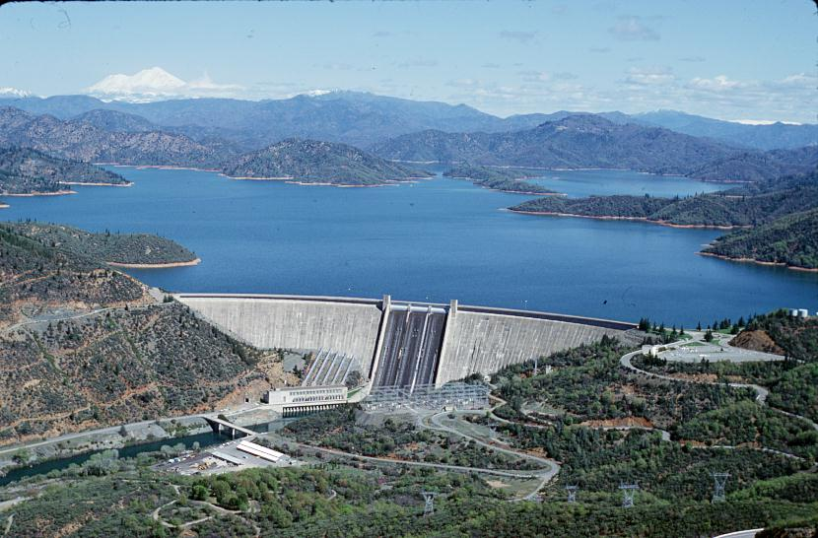
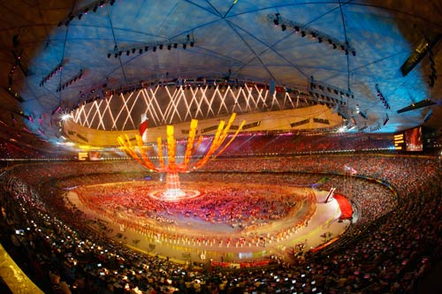
Managing and Engaging Project Stakeholders
(Context C: Highest Level of Stakeholder Complexity)
The most complex project stakeholder management/engagement occurs on large-scale projects as in construction and civil engineering, also major events and development initiatives.
Here stakeholder management/enga-gement not only has the complexity level of context B, but also must con-tend with engaging (many) external (non-contracting) stakeholders which may support or (often), oppose the project. Key Requirements are Caution, Consideration and Creativity.
Heavy Management
Heavy Engagement
Notes:
External stakeholders which, incidentally, may be quite powerful and have a spectrum of concerns in connection with the project.

Slide 63

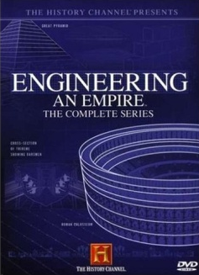
Ubiquitousness of Project Stakeholders
No project in history – from the dawn of man-kind down to the present era – has been „stakeholderless“.
Stakeholders are as na-tural to a project as are its conventional para-meters of goal/scope, cost and duration.
The History Channel’s acclaimed documentary series Engineering an Empire gives excellent insight on major projects undertaken by great civilizations, and sheds light on their “stakeholders”.

Slide 64

Project Stakeholder Management
(An Evolving Discipline)
Project Stakeholder Management is an evolving and specialized project mgmt. subject area. Lar-gely neglected in project mgmt. degree programs and text books, interest in it among researchers and practitioners has grown immensely in recent years and a voluminous body of lit. now exists.
Notes:
Neglected in the sense that courses on project stakeholder management are rare.

Slide 65
Involvement of Stakeholders in Projects
Pre-Project Phase
Need, Want, Opportunity, Legal Compulsion
Project Conceptualization & Feasibility Analysis
Project Pre-Initiation Activities
INT. & EXT. STAKEHOLDER INVOLVEMENT
(Direct, Indirect)
Project
Life-Cycle
Project Initiation
Project Planning
Project Monitoring, Evaluation, Control
Project Execution
Project Closure
Post-Project Phase
Monitoring/Evaluation of Project Outcomes & Impacts
Notes:
Slide: Involvement of Stakeholders in Projects
Pre-Project Phase: Every project starts with a Need (E.g.: to construct a road, bridge, sewage treatment facility, vocational training center), a Want (E.g.: to organize a sporting event such as the Olympics), an Opportunity (E.g.: to launch innovative feature-rich new products or services with high profit potential on the market based on research undertaken by the marketing department of a commercial organization) or when necessitated by a Legal Compulsion or Requirement (e.g. for installation of pollution emission control systems in factories, mandatory fireproofing of residential buildings). This presupposes a deficiency or a constraint which is preventing or obstructing the attainment of a desired state (goal, objective, target).
Note the difference between real, perceived or contrived needs (contrived indicates that some stakeholders want to unduly benefit). Needs can be classified according to their time horizon into (a) current or immediate period (b) the near or foreseeable future, and (c) the distant future. A need presupposes the existence of a deficiency or a constraint (or deficiencies/constraints) which is/are preventing/obstructing the attainment of existing or future desired goals and objectives, targets, conditions or situations, and which must be systematically addressed and overcome. For example, by using demographic forecasting tools, a need in five years time for additional secondary schools (and possibly also for primary schools as well as tertiary educational institutions) to cater to an expanding student population may be identified. A problem or sudden crisis situation may constitute the basis of an immediate need for action, for example, for initiating relief (and consequent rehabilitation) measures, projects and programs in the event of massive earthquakes, flooding or volcanic eruptions as have been witnessed several times in living memory.
Post-Project Phase:
Time-Frame: Short-Term, Medium-Term, Long-Term
Outcome and Impact Dimensions and Intensities: Economic, Financial, Social, Cultural, Political, Technological, Institutional, Legal etc.
Example (Social Development): Capacity-Building Project to Train Local Youth in Technical Skills (e.g. Carpentry, Welding, Mechanics)
Note: It should be kept in mind that often people get hooked on the notion of the project output as symbolizing the purpose of the project. It is not! The purpose is actually the outcomes and anticipated benefits for economy, society and natural environment which are often not tangible but perceivable.

Slide 66

Managing and Engaging Project Stakeholders
(Practical Value)
Project Stakeholder Manage-ment provides a sophisticated analytical and evaluative framework for a rigorous indi-vidualized analysis of stakehol-ders to an extent not possible in conventional management which tends to view stakehol-ders in a macro-perspective (shareholders, suppliers, etc.).
Notes:
Slide: Project Stakeholder Management – Practical Value
As a discipline which has now attained a reasonably high level of sophistication, project stakeholder management offers a robust framework which encompasses guidelines, principles, policies, strategies, plans, processes and tools etc. which within financial, time, informational and other given constraints permits a rigorous individualized analysis and assessment of a project’s identified stakeholder community. This gives it a clear advantage over conventional management (general management, strategic management) where stakeholders are usually “lumped together” in categories such as shareholders, suppliers, employees, customers and clients etc. and analyzed comparatively superficially.

Slide 67

Managing and Engaging Project Stakeholders
(Fundamental Limitations)
Just as medical science cannot heal all diseases of the body and psychiatry cannot cure all diseases of the mind, stake-holder management & enga-gement cannot always be ex-pected to successfully resolve all complications which may and likely will arise between stakeholders over the course of the project life-cycle.
It‘s Not Magic! (Don‘t expect miracles!)

Slide 68

Managing and Engaging Project Stakeholders
(Managing/Engaging Project Stakeholders Properly)
The key to „effective“ stake-holder management and en-gagement is to carefully iden-tify and understand the inte-rests and concerns shaping stakeholders‘ attitude and be-haviour towards the project, and to manage and engage these prudently & profession-ally over the project life-cycle.

Slide 69

Managing and Engaging Project Stakeholders
(The Logic Behind Stakeholder Management)
On all projects stakeholders must be carefully and professionally managed and engaged so that they can con-tribute to the project, under-stand the project decisions taken and accept them more readily and they will be pro-ject supporters instead of pro-ject adversaries.

Slide 70



Managing and Engaging Project Stakeholders
(The Centrality of Stakeholders on Projects)
Stake-holders
Project Goal
Project Duration
Project Cost
Stakeholders are central to all projects in every respect because they are the entities which are responsible for conceiving, defining and initi-ating, planning, executing, closing (or occasionally pre-maturely terminating), and monitoring, evaluating and controlling projects.
A project‘s ‚triple constraint‘ (goal/scope, cost and time) should be modified to depict the central role of its stakeholders.

Slide 71

Managing and Engaging Project Stakeholders
(The Criticality of Stakeholder Relationships)
Building, expanding, consoli-dating and sustaining relation-ships lie at the core of success-ful project stakeholder mana-gement and engagement.
Prerequisites: Trust, mutual respect, empathy, sincerity, in-tegrity, communication, ability to listen and pursue construc-tive dialogue, and willingness to cooperate and compromise.
Relationship management can sometimes work wonders – even to the extent that it can bring stakeholders with diver-ging objectives, priorities and perceptions into a dialogue for the purpose of devising mutu-ally acceptable workable solu-tions to problem or conflict situations.
Notes:
Slide: Project Stakeholder Management – The Importance of Relationships
Off course, this is possible only when all stakeholders are willing to interact and give and take on a fair basis. Additional prerequisites: Flexibility, Understanding, Humility, Courteousness. Symbiotic relationship?
Examples of behavioural attributes which are inappropriate/non-conducive for building relationships between stakeholders: condescending, discourteous, unfeeling or uncaring, arrogant.

Slide 72

Managing and Engaging Project Stakeholders
(A Collective Responsibility)
Managing and engaging stake-holders is NOT a „centralized“ responsibility entrusted to a single or few entities, such as the project sponsor, manager, team members or consultants.
It is a shared collective respon-sibility: All stakeholders must manage and engage each other over the project life-cycle.
A chain is acknowledgeably only as strong as its weakest link. Deficiencies within an otherwise good stakeholder management and engagement system at one or more inter-facing points may result in potentially serious consequen-ces for the project.
Notes:
Slide: Project Stakeholder Management – A Collective Responsibility
Example: The project team fails to appropriately engage a powerful external adversarial stakeholder which may result in that stakeholder pursuing a course of action which is detrimental to the achievement of the project output and/or its outcomes.

Slide 73


Managing and Engaging Project Stakeholders
(The Importance of Finding Win-Win Solutions)
Stakeholders normally support projects when they perceive they will gain therefrom, i.e., net benefits > net costs.
Stakeholder management and engagement involves creative pursuit of „win-win solutions“ that add net value to and are acceptable by (preferably) all or the largest number of stake-holders possible.
WIN/WIN
(Ideal, Best Case)
✓
✓
WIN/LOSE
(Typical Case)
✓
✗
LOSE/LOSE
(Frequent,
Worst Case)
✗
✗
Notes:
Slide: Project Stakeholder Management – The Importance of Finding Win-Win Solutions
Three scenarios shown in order of desirability from top to bottom: (1) Win/Win is the best case, (2) Win/Lose is the usual outcome on most projects, and (3) Lose/Lose is the worst case which may happen when project planners and implementers commit serious blunders in dealing with their stakeholders.

Slide 74

The Project Stakeholder Community
(Size, Dispersion, Complexity)
Depending on the project, the stakeholder community can range from being very small and homo-genous, easy to identify, analyze and manage/engage to being very large, diverse in terms of attribu-tes, spatially highly dispersed and very difficult and costly to iden-tify, analyze and manage/engage.

Slide 75

Managing and Engaging Project Stakeholders (BEWARE!)
NEVER UNDERESTIMATE THE PROJECT STAKEHOLDERS!
Ineffective or inadequate stakeholder management/en-gagement is widely acknowledged (and empirically pro-ven) as constituting a principal cause of project failure.
Projects which fail to manage/engage their stakeholders properly can expect to experience potentially serious consequences!

Slide 76

Managing and Engaging Project Stakeholders
(The Cost of Stakeholder Management & Engagement)
For projects there is a cost – or investment - involved in mana-ging and engaging project stake-holders.
There is also a return: A (much) higher likelihood that the pro-ject will be completed within set parameters (time, budget etc.).
A challenge is to ensure that the cost/investment on the project is commensurate with return.
Low investment in stake-holder management and engagement may result in avoidable complications which are costly to rectify subsequently.
On the other hand, exces-sive investment would constitute a waste of pro-ject resources.
Notes:
Care must be taken to avoid overspending project resources but at the same time to ensure that adequate funds and support are made available, failing which the consequential costs may be very high. Determining the appropriate level of spending can be very difficult and may increase dramatically if issues with stakeholders surface.

Slide 77

Managing and Engaging Project Stakeholders
(The Cost of Stakeholder Management & Engagement)
The main overhead cost (or investment) incurred by an organization on project stakeholder management & engagement is for creation, operation, coordination and supervision of the requisite infrastruc-ture for all its projects with modifications/ improvements to them over time:
Institutional (Committees)
Methodological (Processes, Tools)
Educational (Training)
Technical (Information System)
Overhead
Costs
(for all projects)
Notes:
This is from an organizational (not a project) perspective. The organization can be an entity in the public, private or not-for-profit sector.
Cost of operations here does not imply cost on individual projects which, off course, would fall under project-specific direct costs.

Slide 78

Managing and Engaging Project Stakeholders
(The Cost of Stakeholder Management & Engagement)
Stakeholder-focused PM Processes & Deliverables (e.g. Requirements, Scope Change and Contract Management)
Unplanned Modifications to the Project’s Scope based on (external) Stakeholder In-put and Suggestions
Process Modifications & Innovations (Responsiveness to Stakeholders)
Creating a stakeholder-friendly work, interaction & collaboration environment
Performance Incentives
Direct
Costs
(project-specific)
Fixed Cost
Variable Cost
Recurring Cost
Non-Recurring Cost
Notes:
Slide: Managing and Engaging Project Stakeholders – The Cost of Stakeholder Management & Engagement
Processes & Deliverables: These also include the process of requirements elicitation, integrated change processes, and procurement processes. Deliverables include training courses in non-technical and social/inter-personal skill-building for project team members, e.g. communication, negotiation, motivation, conflict and crisis management. Also, arranging meetings with the project team, sponsor, clients and end users etc., producing reports/audits for project steering committee and senior management, consultations with state entities entrusted with periodically monitoring and evaluating the project.
Performance Incentives: For e.g., for good effort and achievements in connection with managing and engaging stakeholders.
Note: The salaries of project employees who are engaged in stakeholder management and engagement responsibilities, but who have not been hired specifically for this purpose, must also be counted as cost. In this case the cost covers only that amount which can be attributed to stakeholder management and engagement activities.

Slide 79
Managing and Engaging Project Stakeholders
(The Cost of Stakeholder Management & Engagement)
Hiring Project Staff for Stakeholder Management & Engagement Activities
Training & Educating Project Staff in Stakeholder Management & Engagement
Infrastructure (tech., informational, etc.)
Information Collection, Identification & Analysis of the Project Stakeholders (Ap-plication of Processes, Tools)
Design, Periodic Review & Modification of Stakeholder Management & Engagement Strategies
Direct
Costs
(project-specific)
Fixed Cost
Variable Cost
Recurring Cost
Non-Recurring Cost
Notes:
Slide: Managing and Engaging Project Stakeholders – The Cost of Stakeholder Management & Engagement
Hiring Staff: Equal to the amount of salary paid to them while employed with the project.
Training & Educating: For example, for short-term general, customized or specific theme-centered stakeholder management and engagement courses, seminars or workshops.
Infrastructure: For example, for setting up, operating and maintaining a Stakeholder Information and Communication System for the project.

Slide 80
Managing and Engaging Project Stakeholders
(The Cost of Stakeholder Management & Engagement)
Provision of Information to Stakeholders (Internal, External)
Consultation Activities with Stakeholders (Internal, External)
Customized Incentives for Stakeholders (Financial, Material)
Direct
Costs
(project-specific)
Fixed Cost
Variable Cost
Recurring Cost
Non-Recurring Cost
Notes:
Slide: Managing and Engaging Project Stakeholders – The Cost of Stakeholder Management & Engagement
Customized Incentives: For e.g., donations to local community clubs and educational establishments.

Slide 81

Managing and Engaging Project Stakeholders
(The Cost of Stakeholder Management & Engagement)
Loss of Executive & Collegial Support
Unanticipated, Undesired or Excessive Changes to the Project’s Scope
Delayed Commencement and/or Exten-ded Duration of the Project, its Constitu-ent Phases or Work Activities
Overlooked Requirements/Specifications
Project Design and Execution Deficien-cies, Errors and Omissions
Stress, Demotivation, Dissatisfaction, Traumatisation and Emotional Distress for (Internal) Stakeholders
Some major costs (monetizable/ non-monetizable) of inadequate stakeholder management and engagement on projects

Slide 82
Managing and Engaging Project Stakeholders
(The Cost of Stakeholder Management & Engagement)
Safety and Security, Sabotage of Project Assets, Injuries/Deaths of Proj. Personnel
Damage to the Image/Reputation of Key Stakeholders (e.g. Project Owner, Con-tractors, Financers) and Consequent Cost for their Future Projects
Hiring Consultants (Trouble-Shooting)
Mediation, Arbitration, Litigation
Project Failure or Premature Termination
Reduction in the Real or Perceived Quality of Life of Local Communities and other External Stakeholders
Some major costs (monetizable/ non-monetizable) of inadequate stakeholder management and engagement on projects
Notes:
Project Cancellation: The Singur Car Factory project in the Indian state of West Bengal is a good case in point. Considerable expense was incurred on the project by the Tata company and a section of the local community which sold land to the company for a project that ultimately had to be prematurely terminated due to powerful resistance.

Slide 83









Stakeholders and PMBOK Project Management
Integration Management
Quality Management
Scope Management
Procurement
Management
Cost Management
Human Resource Management
Communication Management
Time Management
Stakeholders interface in a complex manner with each of these knowledge areas!
Risk Management

Slide 84
Managing and Engaging Project Stakeholders
(Stakeholders and Project Communication)
Communication is considered the „life blood“ of a project. It constitutes the basis for all stakeholder interactions.
Occuring throughout a pro-ject‘s life-cycle, project com-munication takes place in many forms: written and ver-bal, by listening and through body language.
Numerous surveys indicate that communication short-comings are a principal cause of project trouble or failure.

Slide 85
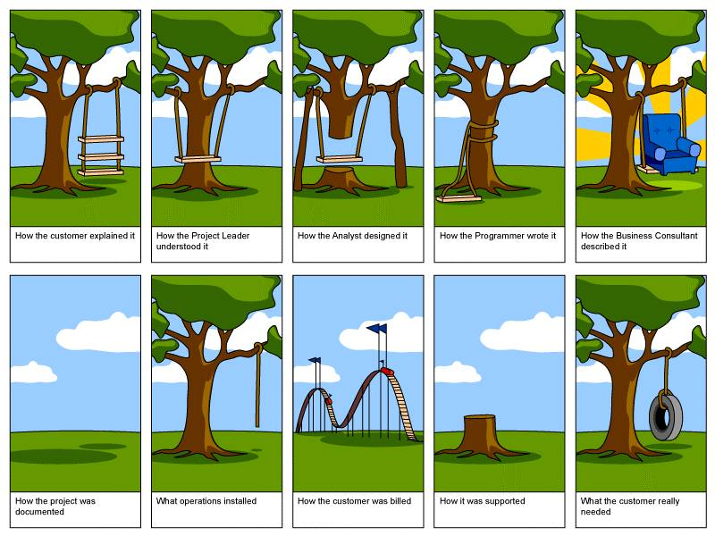
Consequences of Comm. Shortcomings

Slide 86
Managing and Engaging Project Stakeholders
(Stakeholders and Project Scope)
A project‘s goal along with its requirements & specifications primarily determine its scope of work.
Stakeholders define a project‘s scope of work and authorize the occasional changes/modi-fications to it which normally occur over the course of the project‘s life-cycle.
Precise scope definition, especially on complex pro-jects, can be quite challen-ging and stakeholder-induced shortcomings in this regard may prove costly for the project over time.

Slide 87
Managing and Engaging Project Stakeholders
(Stakeholders and Project Cost)
Cost is a key consideration in selecting a project.
Stakeholders determine, assess and revise a project‘s costs and benefits on the basis of available information using estimating tools and proces-ses, and monitor cost incurred in relation to project work performed.

Slide 88
Managing and Engaging Project Stakeholders
(Stakeholders and Project Duration)
Stakeholders determine the time a project will take to complete.
They define the project‘s act-ivities, estimate their dura-tions and identify their de-pendency relationships, de-velop the project schedule, and monitor and modify it when circumstances require.
Activity Managers (also Stakeholders) manage the project’s work activities which constitute the pro-ject’s schedule.
Their actions - and those of the other stakeholders who interface with them - determine whether or not the project ‘stays on track’.

Slide 89

Managing and Engaging Project Stakeholders
(Stakeholders and Project Risk)
Risk is inherent to most pro-jects. If unmanaged, project risks may threaten a project‘s existence.
Stakeholders identify, assess and prioritize a project‘s risks, and develop and imple-ment appropriate strategies to avoid, mitigate, transfer or eliminate them.
Stakeholder Management is - in the narrow sense - Risk Management because many risks encountered by pro-jects over their life-cycles are in fact stakeholder-induced.
Notes:
Slide: The Centrality of Stakeholders on Projects – Stakeholders and Project Risk
Note that besides constituting a source of danger or threat (i.e. negative risks) for projects, stakeholders also may present opportunities (i.e. positive risks) which can benefit projects, sometimes immensely, if appropriately managed.

Slide 90
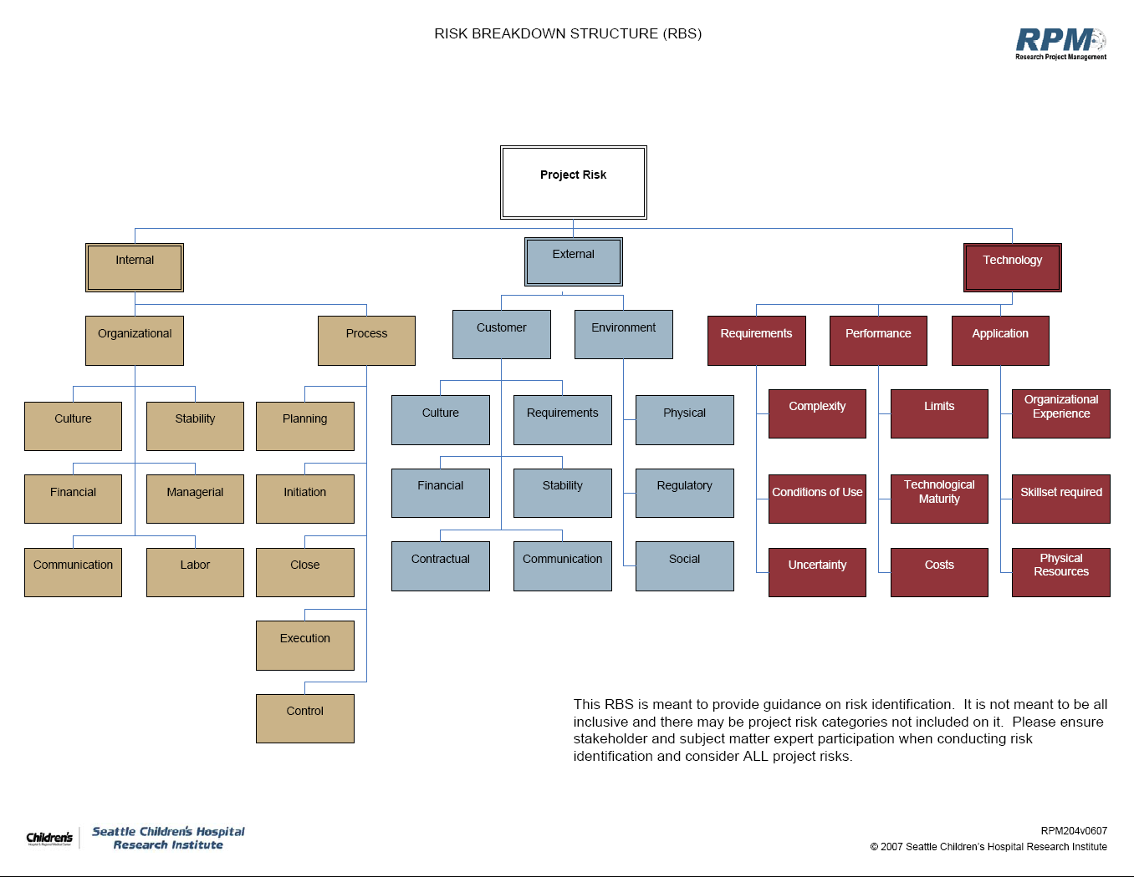
The Centrality of Stakeholders on Projects
(Stakeholders and Project Risk)

Slide 91

Managing and Engaging Project Stakeholders
(Stakeholders and Project Quality)
The acceptability of a project‘s deliverables hinges on meet-ing quality criteria which are set by its clients and users (i.e. stakeholders).
Stakeholders ensure that the (managerial, technical) proces-ses which create the project deliverables meet quality stan-dards and are continuously improved over time.
Quality Control and Qual-ity Assurance are crucial considerations in projects.

Slide 92
Managing and Engaging Project Stakeholders
(Stakeholders and Project Procurement)
Procurement management can be a highly complex un-dertaking on projects.
It typically entails inviting ten-ders and RFPs, evaluating and selecting prospective vendors and service providers (stake-holders), and administering procurement contracts over the course of the project life-cycle.
Many projects require a stream of tangible and in-tangible inputs over their life-cycles (especially in their execution phases), sourced from numerous suppliers (stakeholders) which may be spatially quite distributed (complex supply chains).
Notes:
Slide: The Centrality of Stakeholders on Projects – Stakeholders and Project Procurement
Construction -based projects are a very good example.

Slide 93
Managing and Engaging Project Stakeholders
(Stakeholders and Project Human Resources)
Human Resources – i.e. the project team and support staff – are key stakeholders.
They must be recruited, train-ed, motivated, appropriately compensated, performance-assessed, and given the requi-site authority / resources to pursue project tasks effective-ly and efficiently.
Human Resource Manage-ment is a subarea of stake-holder management. No project can be undertaken without human resources.

Slide 94

Managing and Engaging Project Stakeholders
(Stakeholders and Project Portfolios)
All organizations maintain a set or portfolio of projects and programs at any point in time.
Stakeholders (usually at a very senior level) are respon-sible for selecting projects for inclusion in their portfolios and, if the need arises, elimi-nating them prematurely.
All projects must be aligned with the owning organization‘s mission, goals and objectives, and strategies. Misaligned projects do not add value to the organization!
Notes:
Slide: The Centrality of Stakeholders on Projects – Stakeholders and Project Portfolios
Portfolios can be for programs and projects and they can be broken down into sub-portfolios and broken down further.

Slide 95



Managing and Engaging Project Stakeholders
(Stakeholders and Project Support Infrastructure)
To be undertaken effectively and efficiently, projects need a comprehensive organizat. support framework which would include:
Institutional (e.g.: PMO)
Standards (e.g.: PMI, PRINCE2)
Inform. Systems (e.g.: PMIS)
Incentives (e.g: monetary)
Supporting Organizat. Culture
Project and Program Sup-port frameworks are de-veloped by stakeholders.
Some may be rudimentary, others complex and continuously evolving over time.

