Slide 1
Master of Science in
Project Management
Project Stakeholder
AND COMMUNICATION Management
LECTURE 16: IDENTIFYING PROJECT STAKEHOLDERS

Slide 2

Project Stakeholder Management Process Framework
STEP 2:
Identification of all Project Stakeholders

Slide 3

Identification of All Project Stakeholders
(Some Basic Questions for Consideration)
How will the project stakeholders be categorized and who will identify the project stakeholders?
Which methods and tools can (and will) be used to identify the project stakeholders and what are their comparative advantages and limita-tions?
Can (and how) will the comprehen-siveness of the stakeholder identifi-cation be assured?

Slide 4
Identification of All Project Stakeholders
(Some Basic Questions for Consideration)
What will the identification of the stakeholders cost, how long will the identification process take and how will the accuracy of the identifica-tion result be ensured?
Will the stakeholder directory be up-dated periodically and, if affirma-tive, when?
Who is responsible for updating the stakeholder directory and what items of information will it contain?

Slide 5

Identification of All Project Stakeholders
(Tools of Stakeholder Identification: Documentation)
Organizations undertaking projects (presumably) would have documentation on their stakeholders, in-cluding „stakeholder regis-ters“.
This is a quick and reliable method for identifying stakeholders, especially on „similar“ projects.

Slide 6

Identification of All Project Stakeholders
(Tools of Stakeholder Identification: Proj. Mgrs. and Teams)
Project Managers and team members are a valuable source of information for identifying project stakehol-ders.
This tool works well for projects being undertaken by a Project Manager and Team for the first time. It can be used along with the stakeholder register.

Slide 7

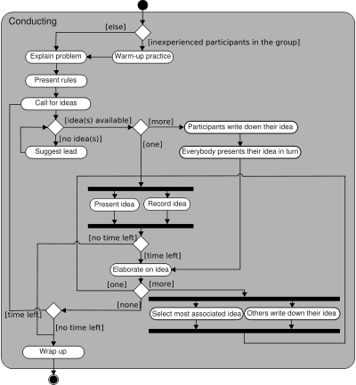
Identification of All Project Stakeholders
(Tools of Stakeholder Identification: Brainstorming)
Brainstorming is a popular and effective tool for gene-rating creative ideas and sol-ving problems.
Brainstorming can be indivi-dual or group-based. Very effective in the group envi-ronment, it has many appli-cations, including in project management and engineer-ing disciplines.

Slide 8

Identification of All Project Stakeholders
(Tool of Stakeholder Identification: Surveying)
Surveying is a useful and universally used data/infor-mation-gathering tool for identifying project stakehol-ders and (within limits) to determine their interests, concerns and expectations.
May not be practical (time, resources, effort) with very large and heterogenous stakeholder populations.

Slide 9

Identification of All Project Stakeholders
(Tools of Stakeholder Identification: Ask the Consultants)
Consultants have considera-ble exposure to projects and, based on their (often) years-long experience, can provide advice as to who the Stakeholders of a pro-ject are.
Consultant input does, off course, come with a price which can be quite substan-tial.

Slide 10

Identification of All Project Stakeholders
(Tools of Stakeholder Identification: Case Studies)
Case Studies of (similar) projects can be a useful source of information for identifying stakeholders in a current project. There are many sources where such studies can be obtained.
When using case studies it is important not to forget the unique context of the project in hand.

Slide 11


Identification of All Project Stakeholders
(Tools of Stakeholder Identification: The Media)
By appealing to the stake-holders of a project to come forward, the print media can help in identify-ing them.
This would be the case, for example, when a public hearing for a civil engineer-ing project is announced in the newspaper.
Notes:
Published in The News, October 18, 2008.

Slide 12

The Project Stakeholder Directory
(Identification Only)
Name
Office or Residential Address
Organization
Office or Residential Tel. Number
Department
Fax & Cell Phone Number
Designation
eMail Addresse
Role in the Project
Website

Slide 13
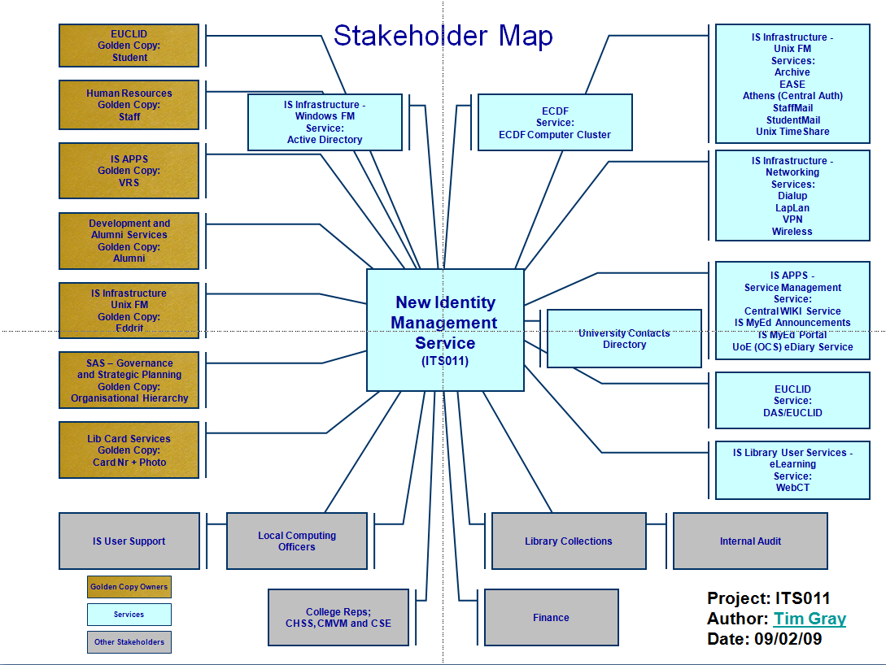

Slide 14

Project Stakeholder Identification
(Targeted Youth Support, UK)
REVIEW THIS EXAMPLE WITH CLASS
Information-Sharing Index Project: Wigan Borough, UK

Slide 15
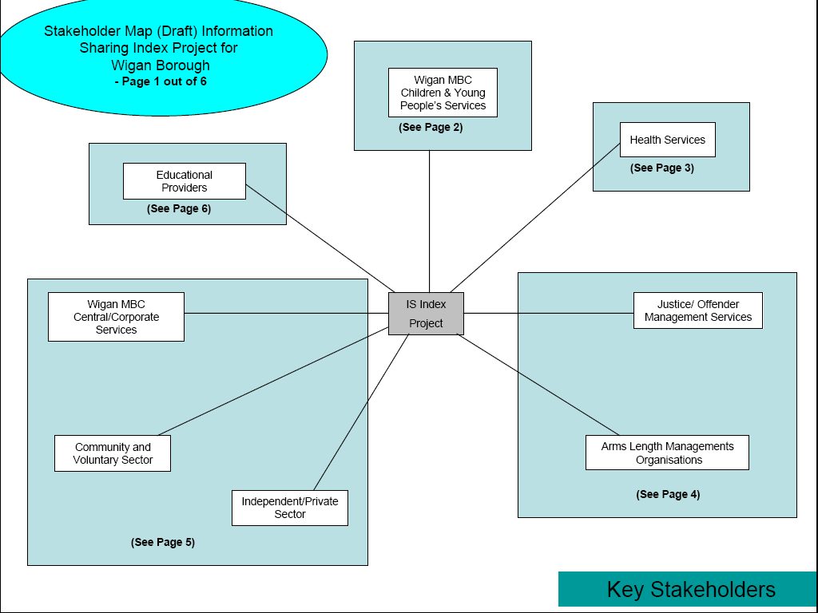
Project Stakeholder Identification
Information Sharing Index Project (Wigan, UK)

Slide 16
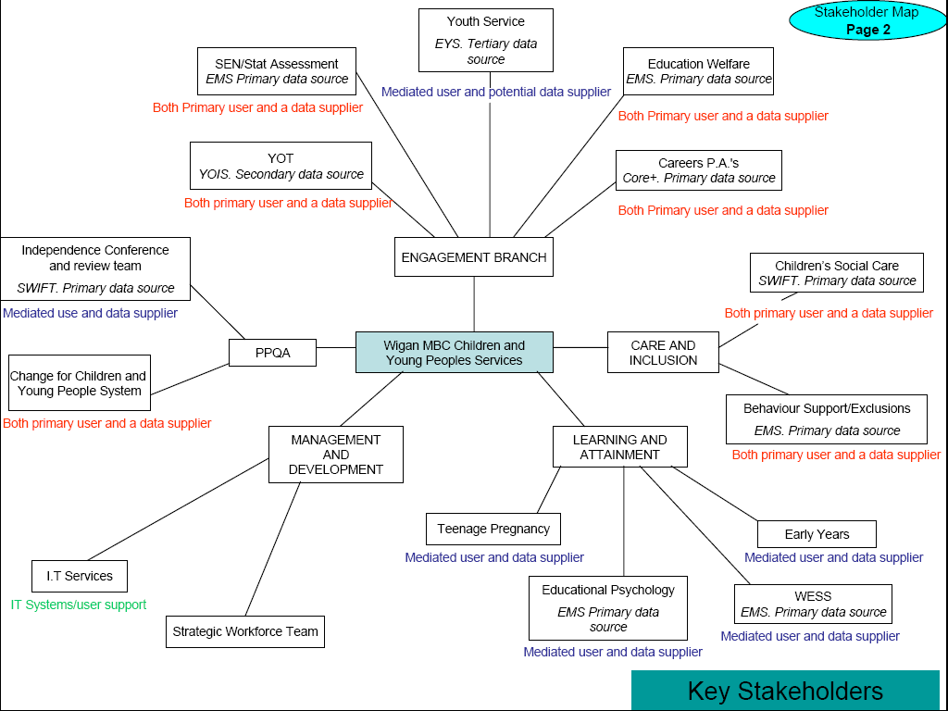
Project Stakeholder Identification
Information Sharing Index Project (Wigan, UK)

Slide 17
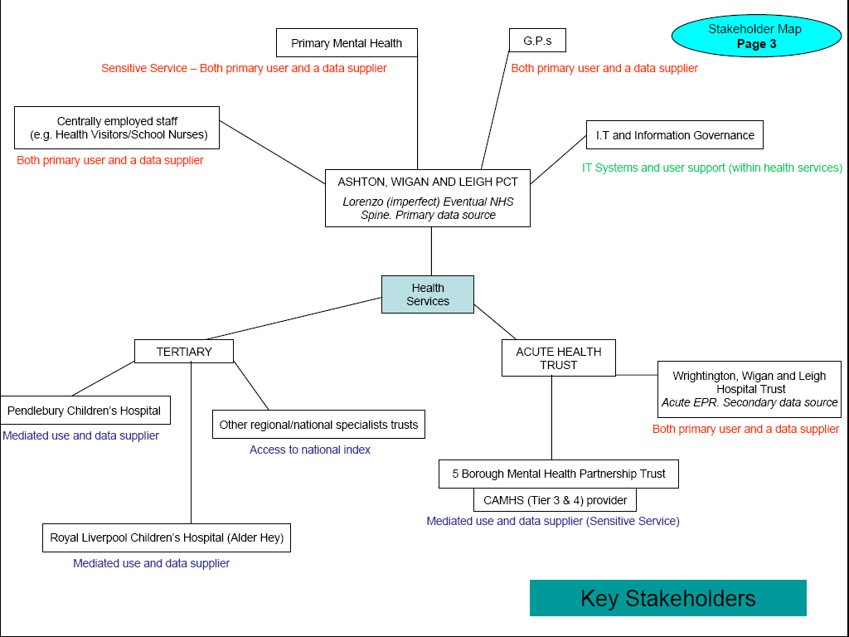
Project Stakeholder Identification
Information Sharing Index Project (Wigan, UK)

Slide 18
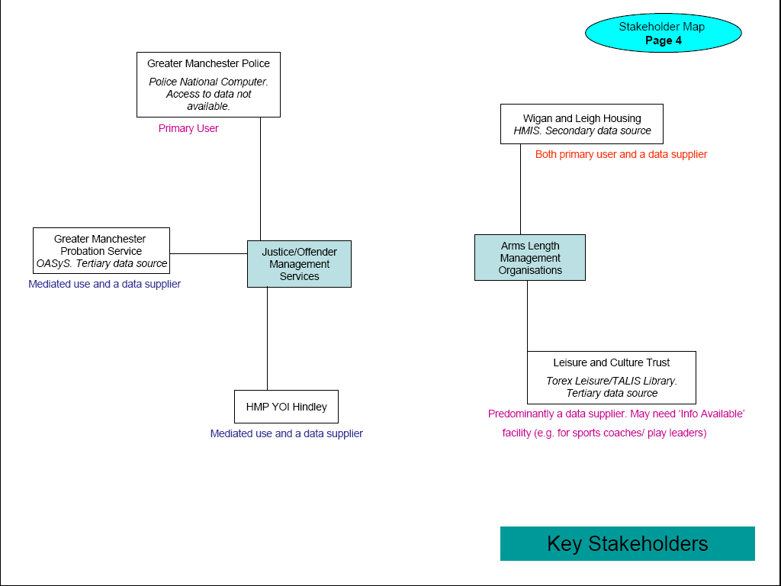
Project Stakeholder Identification
Information Sharing Index Project (Wigan, UK)

Slide 19
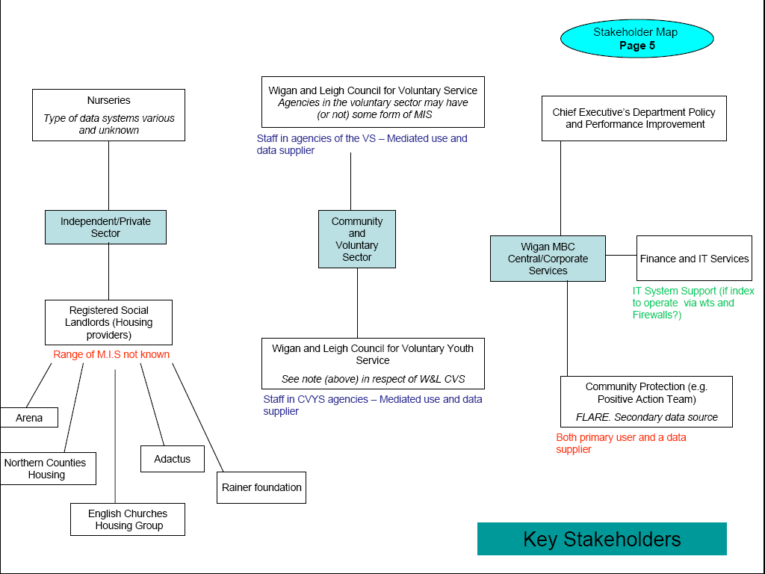
Project Stakeholder Identification
Information Sharing Index Project (Wigan, UK)

Slide 20
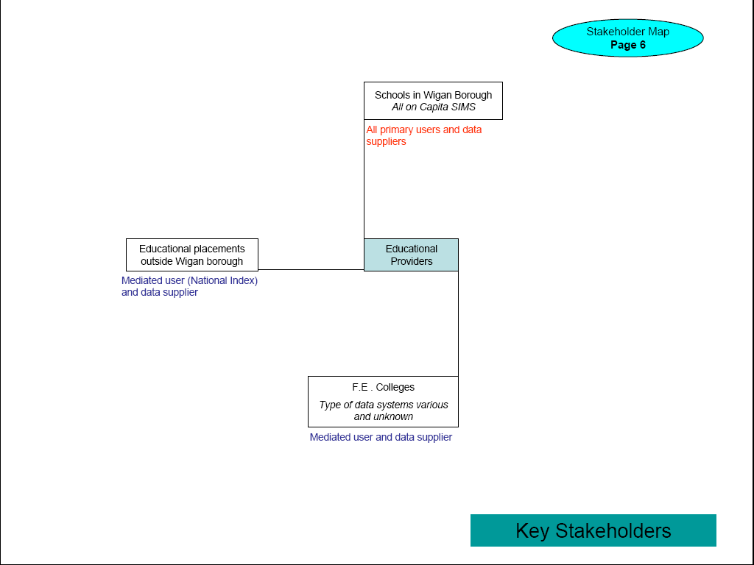
Project Stakeholder Identification
Information Sharing Index Project (Wigan, UK)

Slide 21

Project Stakeholder Identification
UK Youth Support Project
See MS Excel Datasheet of the project stake-holders

