Slide 1
Master of Science in
Project Management
Project Stakeholder
AND COMMUNICATION Management
LECTURE 15: THE PROJECT CONTEXT

Slide 2

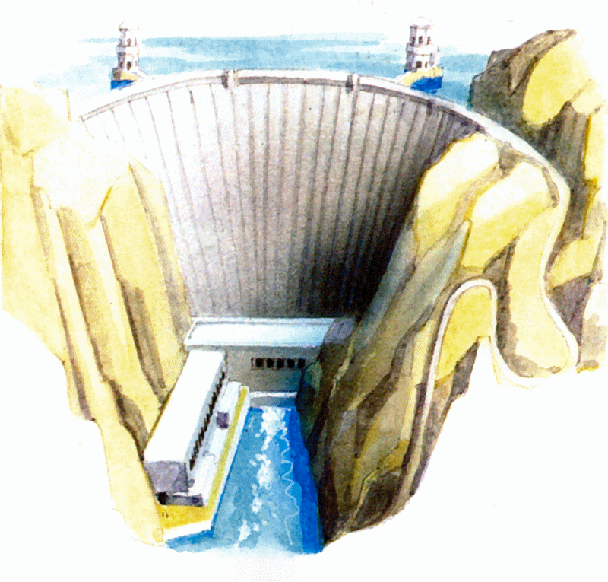
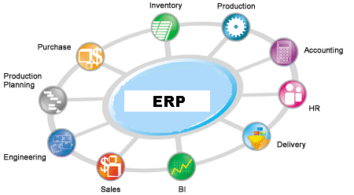



Project Stakeholder Management Process Framework
STEP 1:
Understand the Project Context
Notes:
Suppliers and Vendors who provided inputs for one phase of the project only, not for others.
A Consultant who was commissioned to undertake a feasibility study.
A Contractor who was initially undertaking building work but was replaced due to shortcomings in the work.

Slide 3
Understand the Project Context
The first step in managing/engaging project stake-holders is to identify, carefully study and under-stand the context in which the project takes place - in other words, to look at its broader picture.
All projects are unique, and even if two projects appear very similar, contextual differences may necessitate quite different approaches for managing/engaging their respective stakeholders.
There is no universal stakeholder management/ engagement model that fits all projects!

Slide 4

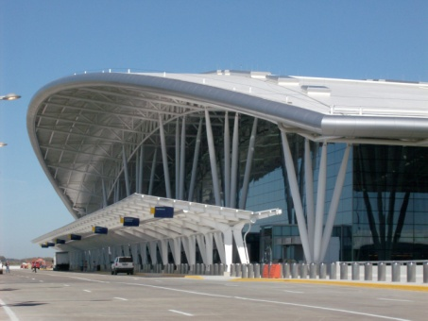
Understand the Project Context
Projects come in many shapes and sizes in many categories. Each category may have different implications for the way project stakeholders are managed/engaged.
Example: Stakeholder management/ engagement on a corporation‘s project to introduce a computerized human resource information system would be (presumably far) less complex than the stakeholder management/engagement required on a project for constructing a new airport.

Slide 5


Project Categorization Scheme
(Based on Russel Archibald)
Aerospace / Defence Projects:
Defense Systems
Space
Military Projects
Examples:
New Weapon System, Major Weapon System Upgrade, Satellite Development Launch, Space Station Mod, Task Force Invasion.
Business & Organization Change Projects:
Acquisition / Merger
Mgmt. Process Improvement
New Business Venture
Organization Restructuring
Legal Proceeding
Examples:
Acquire and Integrate Competing Company, Major Improvement in Project Management, Form and Launch New Company, Consolidate Divisions and Downsize Company, Major Litigation Case.

Slide 6



Project Categorization Scheme
(Based on Russel Archibald)
Communication Systems Projects:
Network Communication Systems
Switching Communication Systems
Examples:
Microwave Communications Network, 3rd Generation Wireless Communication System.
Examples:
2004 Summer Olympics, 2006 World Cup Match, 2005 U.S. Super Bowl, 2004 Political Conventions.
Event Projects:
International Events
National Events
Examples:
New Project Management Informa-tion System (IS Hardware is in the Product Development Category).
Information Systems (software) Projects:

Slide 7



Project Categorization Scheme
(Based on Russel Archibald)
Facilities Projects:
Facility Decommissioning
Facility Demolition
Facility Maintenance & Modification
Facility Design/Procurement/
Construction
  Civil
  Energy
  Environmental
  High-rise
  Industrial
  Commercial
  Residential
  Ships
Examples:
Closure of Nuclear Power Stations, Demolition of High-Rise Buildings, Process Plant Maintenance Turn-around, Conversion of Plant for New Products/ Market.
Flood Control Dam, Highway Inter-change, New Gas-fired Power Generation Plant, Pipeline, Chemical Waste Cleanup, 40 Story Office Building, New Manufacturing Plant, New Shopping Center, Office Building, New Housing Sub-division, New Tanker, Container or Passenger Ship.

Slide 8


Project Categorization Scheme
(Based on Russel Archibald)
International Development Projects:
Agriculture/Rural Develop.
Education
Health
Nutrition
Population
Small-Scale Enterprise
Infrastructure
  Energy (Oil, Gas, Coal, Power Generation and Distribution)
  Industrial
  Telecommunications
  Transportation
  Urbanization
  Water Supply and Sewage
  Irrigation
Examples:
People and Process Intensive Projects in developing countries funded by the World Bank, Regional Development Banks, US Agency for International Development (USAID), UNIDO, and other UN and Government Agencies.
Capital/ Civil Works Intensive Projects, which are often different from Facilities Projects (see previous slide) in that they include, as part of the project, creating an organizational entity to operate and maintain the Facility, and Lending Agencies impose their Project Life-Cycle and Reporting Requirements.

Slide 9


Project Categorization Scheme
(Based on Russel Archibald)
Media and Entertainment Projects:
Motion Picture
TV Segment
Live Play or Music Event
Examples:
New Motion Picture (Film or Digital), New TV Episode, New Opera Premiere.
Product and Service Development Projects:
Information Technology Hardware
Industrial Product/Process
Consumer Product/Process
Pharmaceutical Product/Process
Service (Financial, Other)
Examples:
New Desktop Computer, New Earth-Moving Machine, New Automobile and New Food Product, New Cholesterol-Lowering Drug, New Life Insurance or Annuity Offering.

Slide 10

Project Categorization Scheme
(Based on Russel Archibald)
Research and Development Projects:
Environmental
Industrial
Economic Development
Medical
Scientific
Examples:
Measure Changes in the Ozone Layer, How to Reduce Pollutant Emission, Determine Best Crop for Sub-Sahara Africa, Test New Treatment for Breast Cancer, Determine the Possibility of Life on Mars.
Examples:
As yet undefined.
Other Categories of Projects:
Notes:
Undefined: Relief and Rehabilitation Projects (Crises), Mining, Law Enforcement (Crime Prevention, Reaction), Urban Regeneration, Community Cohesion, Museums, Parks etc.

Slide 11
Understand the Project Context
(Importance of Project)
High
As a project’s importance increases, more effort and resources need to be invested by the project planners and implementers in managing and engaging the project stakeholders. In case of project failure due to issues with stakeholder , the fallout in terms of lost resources, damage to reputation etc. may be immense.
Importance of Project
On projects, the level of atten-tion given to managing and engaging the stakeholders will vary. On smaller, less significant projects comparatively smaller effort and resources may be invested in it.
Low
Low
Criticality of Effectively Managing & Engaging
Project Stakeholders
High

Slide 12









Understand the Project Context
(Categorizing Stakeholders by Number, Diversity and Complexity)
Stakeholders Category A:
Few in Number and Relatively Homogenous, Easy to Manage
Stakeholders Category D:
Very Numerous and Heterogeneous, Very Difficult to Manage
Stakeholders Category B:
Numerous and Heterogeneous, Relatively Easy to Manage
Stakeholders Category C:
Numerous and Heterogeneous,
Sometimes Difficult to Manage

Slide 13
Project Stakeholders Category A
Comparatively smaller projects being executed within or across departments/divisions in organi-zations.
Cat. A project stakeholders are usually few in number, easy to identify, and their roles and res-ponsibilities in the projects clearly defined. On the difficulty spectrum they are (usually) the easiest to manage.

Slide 14
Project Stakeholders Category B
Projects usually tending to recur over time: New Product/Service Development Projects or modifi-cations to existing product or service offerings. Also: Larger IT projects, and military, scientific and movie projects.
Cat. B project stakeholders may be numerous and heterogeneous but are usually (relatively) easily managed.

Slide 15
Project Stakeholders Category C
Projects undertaken by NGOs (e.g.: small/medium-sized social development type projects), small construction and urban projects, and joint ventures.
Cat. C project stakeholders can be numerous and heterogene-ous. Though mostly supportive, careful management of them is required to avoid complications over the project life-cycle.

Slide 16
Project Stakeholders Category D
Highly complex, time- and cost-intensive projects: Dams, power stations, oil and gas pipelines, big factories, mines, highways, airports, major events and large social development projects.
Cat. D project stakeholders are usually difficult to comprehensive-ly identify and effectively manage. Some exhibit unpredictable and very hostile behavior.

