Slide 1
Master of Science in
Project Management
Project Stakeholder
AND COMMUNICATION Management
LECTURE 14: THE PROJECT STAKEHOLDER MANAGEMENT AND ENGAGEMENT GOVERNANCE MODEL

Slide 2
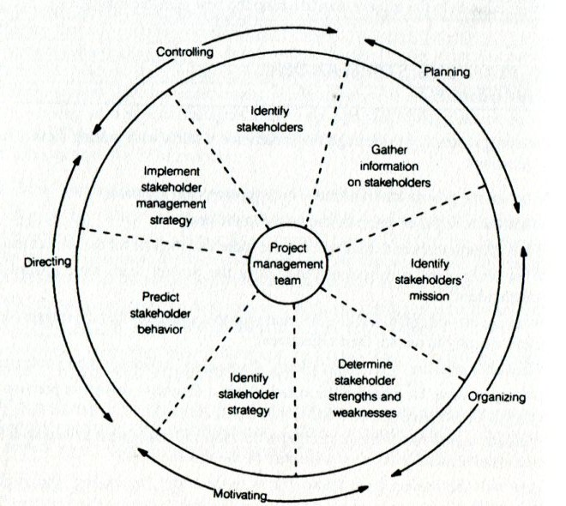
Managing and Engaging Project Stakeholders
(The Cleland/Ireland Framework)
Stakeholder management and engagement frameworks have appeared in the project management literature over time, such as the one on the left which was proposed by David Cleland and Lewis Ireland in their insightful book Project Management: Strategic Design and Imple-mentation.
Cleland & Ireland take a centric approach w.r.t stakeholder management and engagement, making it a project management team respon-sibility. Though centralization is necessary to some extent, it must not be overlooked that ALL (internal/primary) stakeholders must prac-tice stakeholder management & engagement.

Slide 3
Some Basic Functions of the Project Stake-holder Management Process Framework
provide a deep understanding of the project‘s stakeholder community and its distinguishing attributes – identity, heterogenity, spatial dis-persion, power-interest constellations, attitu-des and behaviors, expectations and options etc.
help the internal project stakeholders design and implement an effective strategy to try to manage and engage the stakeholder commu-nity systematically and efficiently in the best interest of the project

Slide 4
Some Basic Functions of the Project Stake-holder Management Process Framework
reduce/minimize the risk to the project stem-ming from possible neg. intervention actions by project stakeholders
provide insight into opportunities for project through interaction with its stakeholders
show the project stakeholder situation at any point in time during the project and its consti-tuent phases
facilitate proactive project stakeholder mana-gement and engagement

Slide 5
Some Basic Functions of the Project Stake-holder Management Process Framework
ensure adherence to laws, regulations and policies which are applicable w.r.t the project stakeholders
track transparency, accountability and the up-holding of the project‘s ethical standards
Gain insights which can benefit future projects
constitutes the basis for research studies
demonstrate a professional approach and is a „best project management practice“

Slide 6

Proj. Stakeholder Mgmt. Process Framework: (Strengths & Limitations)
The Framework offers a systema-tic, customizable, practical & pro-fessional knowledge platform, in-ter alia, for identifying the project stakeholder community, analyzing it‘s diverse concerns, expectations, power constellation, relationships, supportive and adversarial atti-tude and behaviour towards the project, and effectively engaging stakeholders so that the project stays on track.
Notes:
Effective and actionable platform too!

Slide 7
Proj. Stakeholder Mgmt. Process Framework: (Strengths & Limitations)
The Framework provides the means for designing and imple-menting customized and modifia-ble strategies of management/ engagement towards the project stakeholders.
It helps create better understan-ding of (and therewith increase the level of support for) the pro-ject among its stakeholders.

Slide 8
Proj. Stakeholder Mgmt. Process Framework: (Strengths & Limitations)
The Framework permits periodic revision of the stakeholder analy-sis with consequent modification of the stakeholder engagement strategies if and when the need for improvements are observed over time.
The Framework ensures trans-parency and accountability which is a good project management practice.

Slide 9
Proj. Stakeholder Mgmt. Process Framework: (Strengths & Limitations)
The Framework does not guaran-tee that all issues and complica-tions encountered with stakehol-ders, especially those of serious nature, can and will be resolved.
Its application requires sustained commitment, and can be complex, time-consuming and costly espe-cially if the stakeholder communi-ty is large, heterogenous and spa-tially dispersed.

Slide 10
Proj. Stakeholder Mgmt. Process Framework: (Strengths & Limitations)
The quality of stakeholder identi-fication, analysis & management /engagement strategies depends on the informational input, and skill, experience and creativity of (trained) project staff.
Crucial information about the project stakeholders may be im-possible, difficult or too costly or take too long to obtain.

Slide 11
Proj. Stakeholder Mgmt. Process Framework: (Strengths & Limitations)
Stakeholder interest, concerns, ex-pectations, power/influence, per-ceptions, and support for or oppo-sition to the project may change considerably over (even very short periods of) time. Recording and documenting rapid changes may not be possible.
It may not be possible to devise management/engagement strate-gies satisfying all the stakeholders.

Slide 12


Managing and Engaging Project Stakeholders
(Project Stakeholder Information Systems)
Modern and popular way of storing, pro-cessing and distributing project informa-tion. Has several significant advantages over the paper-based method but also some drawbacks.
Electronic
(PC, Software, Databases, Networking Infrastructure)
PMIS
Project Management Information System
PSIS
Project Stakeholder Information System
Paper-Based
(Filing Cabinets, Achives, Cataloguing Systems)
Traditional but still widely used way of storing project information. Many paper documents, e.g. feasibility study, project charter, contracts and various reports are generated by a project.

Slide 13

Information About Project Stakeholders
(Parameters of Information Quality)
Accurate
Reliable
Adequate
Actionable
Relevant
Proactive
Current
Verifiable
Specific
Source Integrity

Slide 14
Information About Project Stakeholders
(Parameters of Information Quality)
Comprehensible
Documentable
Affordable
Transferrable
Usable
Legal
Integratable
Duration

Slide 15


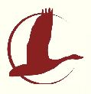

Managing and Engaging Project Stakeholders
(Training and Education)
Project stakeholder manage-ment & engagement needs to be learned. This is the function of education and training.
Education and training can be in-sourced or out-sourced (e.g. to consultants or experienced prac-titioners conducting short-term generic or customized compre-hensive or subject-specific cour-ses/seminars/workshops).
Examples of Short Courses:

Slide 16
Thank You for Your Patience!
In the next lecture we shall start looking at Steps 1 & 2 of the Project Stakeholder Management & Engagement Process Framework:
Understanding the Project Context & Identifying Project Stakeholders.
See you all soon!

