Slide 1
Master of Science in
Project Management
Project Stakeholder
AND COMMUNICATION Management
LECTURE 13: THE PROJECT STAKEHOLDER MANAGEMENT AND ENGAGEMENT GOVERNANCE MODEL

Slide 2
Projects & Organizations: Holistic Perspective
Economic
Organization‘s Internal Environment
Financial
Organization‘s mission, goals, object-
ives & strategies, priorities, current
programme and project portfolio, project
organization, resource base, competency,
Experience, culture, policies, project-focussed
knowledge, process, informational , In-
stitutional & infrastructural assets
Political
Life-Cycle Modal
PROJ
ECTS
Social
Regulatory
Organization‘s External Environment
Security
Infrastructure
Integration, Scope, Cost, Sche-
duling, Risk, Quality, Procurement,
Human Resources, Stakeholders,
Communications
Bodies of Knowledge,
Standards & Methodologies
(Off-the-shelf: (e.g.: PMI, PRINCE2,
IPMA, APMBOK, P2M, BS 6079), or
developed inhouse by organizations)
Markets
H-Resources
Project Management Knowledge Framework
O-Resources
Notes:
Add “Technological” and “Policies” to the list of external considerations.

Slide 3


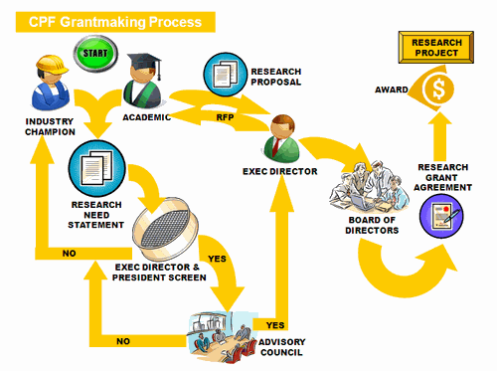


Managing and Engaging Project Stakeholders (Suggested 5-Step Governance Model)
INSTITUTIONAL
Project Stakeholder Management
and Engagement Executive Committee
DIRECTIONAL
Project Stakeholder Management & En-gagement Policy and Strategy Framework
INSTRUMENTAL
Project Stakeholder Management & Engagement Process Framework
TECHNICAL
Project Stakeholder Information
and Communication System
EDUCATIONAL
Project Stakeholder Management
and Engagement Training Framework

Slide 4
Managing and Engaging Project Stakeholders
(Creating an Institutional Framework)
Project stakeholder manage-ment & engagement obviously needs to be taken seriously!
An institutional support frame-work (e.g. Committee) created specifically and permanently for this as the first step at the orga-nizational level and with direct access to top-level management demonstrates committment and can help a lot.

Slide 5

Managing and Engaging Project Stakeholders
(Institutional Framework: Committee Functions)
Principles, Policies, Strategy
Standards & Best Practices
Technical Infrastructure
Education & Training
Research & Evaluation
Oversight & Grievances
Administrative and Financial Support
Some typical functions a stakeholder management and engagement commit-tee would be expected to perform itself or through constituted purpose-specific subcommittees.

Slide 6
Managing and Engaging Project Stakeholders
(Policy and Strategy Framework)
Committment at the highest level is needed for project stake-holder management & engage-ment activities to work.
A written and meticulously ob-served policy & strategy frame-work for dealing with project stakeholders is an expression of such commitment. Some orga-nizations have developed and are implementing these.

Slide 7
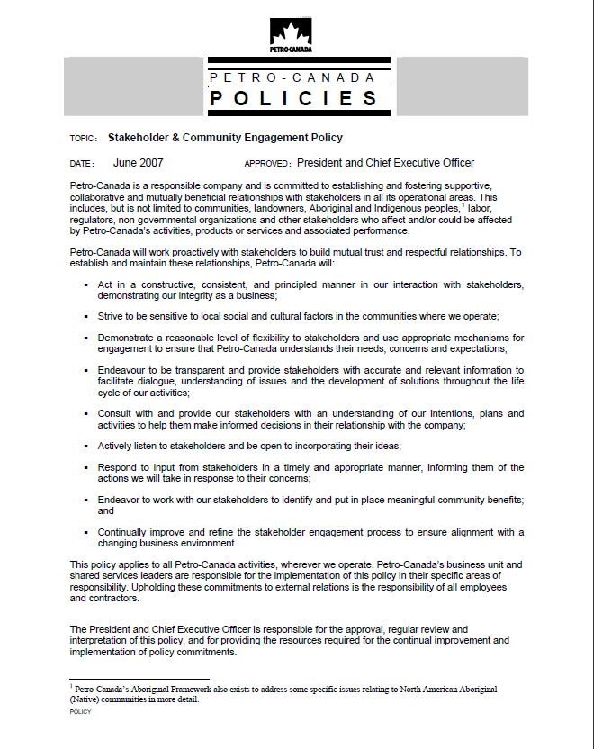
Managing and Engaging Project Stakeholders
(Policy and Strategy Framework)
Review PetroCanada‘s Stakeholder & Commu-nity Engagement Policy document (one page) with the class.

Slide 8

Managing and Engaging Project Stakeholders (The Project Stakeholder Mgmt. & Engt. Process Framework)
Project Stakeholder Management Process Framework
Stakeholder Management Maturity Levels
(Evolution)
Understand the Project Context
External Factors: Laws, Culture, Politics etc.; Internal Factors: Principles, Policies, Experience, Information, Knowledge Project Complexity, Cost & Time Constraints, Innovation, etc.
Process
Framework Influencing Factors
1
Identification of All Project Stakeholders
2
MONITORING
EVALUATION
& CONTROL
Periodic Revision and Modification When and Where Appropriate
Stakeholder Analysis & Impact Evaluation
(PSIS)
Project
Stakeholder
Information
System
3
4
Design Management & Engagement Strategy
5
Implement Management & Engagement Strategy
Proactive Focus
The Project Life-Cycle (Initiation to Completion)
Notes:
Slide: Managing Project Stakeholders Professionally: The Project Stakeholder Management Process Framework
Understand the Project Context: The most basic and frequently ignored step in the project stakeholder management process. All projects are unique and hence their context must likewise be viewed as unique. Context is a framework term which encompasses, inter alia, economic, financial, social, political, ecological, ideological, and institutional facets.
Identify All Project Stakeholders: Determing with the appropriate tools who the stakeholders are. Often this is a straightforward excercise, sometimes it can be quite difficult to achieve. The number of stakeholders can range from a few in number on simple projects to many millions with great diversity of interests and power on very complex projects. Overlooking stakeholders can pose problems later on, especially if they are powerful, unpredictable and possibly disinclined towards the project.
Note: Identification of some “overlooked“ stakeholders is possible in the analysis phase which itself may require review and reevaluation when the engagement strategy is being developed and implemented.
Periodic monitoring and evaluation of effectiveness and efficiency of the stakeholder engagement strategy must take place along with consequent appropriate revision or modification if this is deemed necessary and feasible.
8

Slide 9


Managing and Engaging Project Stakeholders (The Central Role of Processes)
PROCESS INPUTS
(Managerial)
Process Structure and Maturity, Optimization and Benchmarking, Templates, Constraints, Policies etc.
PROCESS OUTPUTS
(Selected Examples)
Information and Documentation
Project Stakeholder Register
Technology
INTER-RELATED PROCESS STEPS / TASKS
Project Stakeholder
SWOT-Analysis
Tools
(Qualitative, Quantitative)
Project Communication Plan
1
2
3
N
Outputs of Other Project Management Processes
Project Stakeholder Map
Material Inputs
Transformation of Inputs to Outputs
Project Responsibility Assignment Matrix
Stakeholder Interaction
TIME & COST
Project Team Charter
Need, Requests, Instructions
Process Effectiveness and Efficiency
Project Stakeholder Engagement Plan
Quality of Information, Tool Effectiveness, Stakeholder Ability, Knowledge, Competence, Experi-ence, Insight, Communication, Cooperation and Coordination.
The output of one project management process normally becomes input in another (or other) process(es). Deficiencies in one or more of the processes may consequently reverberate across the entire project management pro-cess chain, giving rise to problems and issues in the project life-cycle.
Project management uses processes extensively to produce “deliverables” (sample above). Some processes are quite complex and have a high risk of error.
Notes:
Slide: Project Stakeholder Management: Processes
Some considerations when designing / redesigning / optimizing a project process: Simplicity, Scalability, Flexibility, Improvability, Minimization of Requisite Cost and Time, Minimization of Risk, Monitoring, Evaluation and Control.

