Slide 1
Master of Science in
Project Management
Project Stakeholder
and Communication
Management
LECTURE 12: THE PRINCIPAL INTEREST DRIVERS OF PROJECT STAKEHOLDER MANAGEMENT AND ENGAGEMENT Pt. 2

Slide 2
Managing and Engaging Project Stakeholders
(The Nine Principal “Interest Drivers”)
DRIVERS
Law & Public Participation
NGOs
The Media
Information & Communication Technology
Project Environment Complexity
Corporations, Society and the Environment
Stakeholder Theory
DFIs & DIAs
Awareness
My research has iden-tified nine basic and mutually influencing drivers which over the last two to three decades have been instrumental in gene-rating interest among academics and practi-tioners in proj. stake-holder management and engagement.
Notes:
(1) Awareness : Widespread and increasing awareness of the impact which stakeholders have on projects (project surveys, project success factors). Also, knowledge about project stakeholder management imparted through education (project management degree programs and stakeholder management courses at universities and outside (consultants)) and documented knowledge (books, research articles, doctoral and master theses, reports, blogs etc.). Consider also undocumented knowledge.
(2) Stakeholder Theory: Emergence and Development Since 1984
(3) Corporations, Society and the Environment (Corporate-Society Interfaces, Social Capital, CSR (Corporate Social Responsibility))
(4) Project Complexification: Complexification of the Project Environment (Internal, External)
(5) Laws and Public Participation: Laws at the Global, National, and Sub-national Levels; Empowerment Impact on People and Communities
(6) DFIs & DIIs: Development Financing Institutions and Implementing Agencies
(7) NGOs: Non-Governmental Organizations (Advocacy Factor)
(8) Media: Broadcast (TV, Radio) & Print (Newspapers, Magazines) Media
(9) ICT: Information and Communication Technology (incl. PMIS, World Wide Web, e-Mail)

Slide 3
Managing and Engaging Project Stakeholders
(Driver: Complexification of the Project Environment)
Environmental Complexity
Dimensions of Complexity
(selected)
Transformational Complexity
Associational Complexity
Complexity at Project Level

Slide 4


Managing and Engaging Project Stakeholders
(Environmental Complexity)
Projects today take place in an (ext.) environment of far greater complexity than they did in past.
For example, in NPD/NSD projects these include heavy competition for products and services against the backdrop of globalization, pro-duct life-cycle compression, rapidly changing consumer preferences and demand for customized pro-ducts and services.
Notes:
Slide: Project Stakeholder Management (Environmental Complexity)
Discuss globalization with the class if there is ample time. What is globalization and how does it manifest itself in its economic/financial, political, institutional, legal, social, cultural, technological etc. forms? Some observers claim it is a “process” but I don’t agree with this viewpoint because a process in the scientific sense defines a set pattern of pre-defined steps with resource inputs going in and deliverables coming out which I don’t think holds true in the case of globalization unless one greatly stretches the definition of a process.

Slide 5
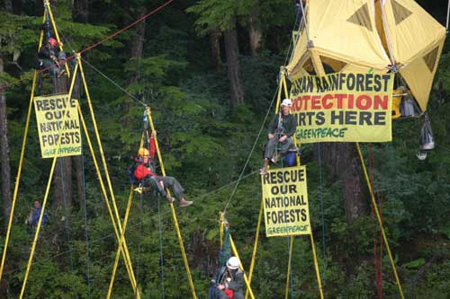
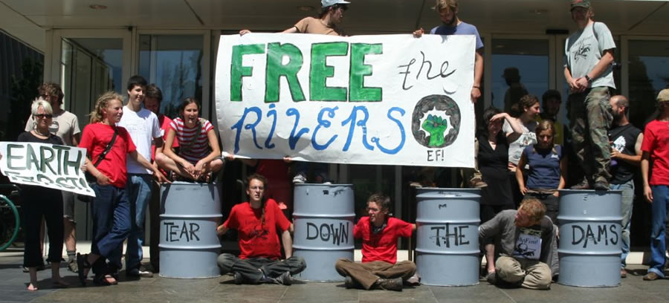
Managing and Engaging Project Stakeholders
(Environmental Complexity)
Furthermore, the emergence of a powerful NGO sector, public con-cern over and politicization of a host of issues (e.g. natural environ-ment, human rights), critical media spotlight and ICT have added to the pressures experienced by pro-jects (especially in construction and civil engineering), resulting frequently in a diversion of project resources, time and energy into defensive measures.

Slide 6
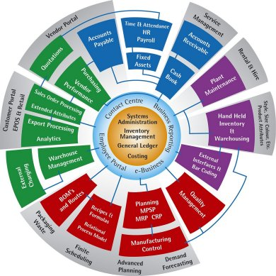

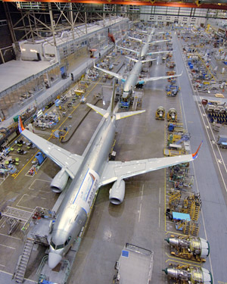
Managing and Engaging Project Stakeholders
(Transformational Complexity)
For years all organizations – private, public and not-for-profit - have been exposed to internal transformational (change) forces on an unprecedented level. Key drivers, inter alia, are pressure for cost reduction and efficient or optimal use of available resources, introduction of IT infrastructure, diversification, organizational restructuring, process reengineer-ing, total quality management.
Notes:
Slide: Project Stakeholder Management (Transformational Complexity)
Pressure for organizations to reduce costs has been brought about by many intrinsic and extrinsic factors, such as, the growth in competition, increased cost of production inputs and R&D, modernization of infrastructure, cutbacks in budget allocations etc.

Slide 7


Managing and Engaging Project Stakeholders
(Associational Complexity)
The last two to three decades have witnessed a significant growth in the level of associational complex-ity in connection with projects caused, inter alia, by an increase in the number of Joint Ventures (nat-ional, international), Strategic Alliances, Public-Private-Partner-ships, Mergers and Acquisitions, and the Outsourcing of projects/ project activities.
Notes:
Slide: Project Stakeholder Management (Associational Complexity)
Complexity spans many attributes including, for example, legal and contract-related issues and disputes between stakeholders, inter-cultural diversity, communication, cooperation and management/engagement, organizational alignment, ensuring adherence to required quality standards, supply chain management and logistics, information mobility and sharing, risk of project failure.
Outsourcing has emerged as a big industry.

Slide 8
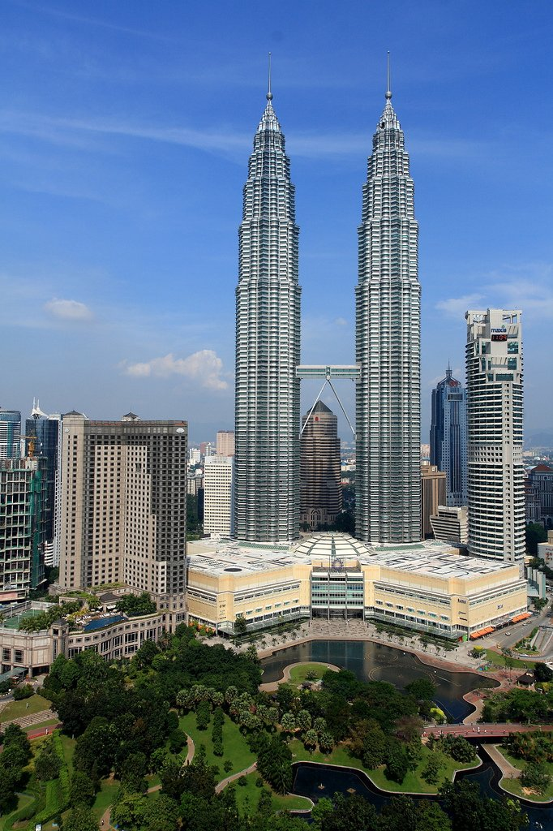
Managing and Engaging Project Stakeholders
(Increasing Complexity at the Project Level)
Today’s projects tend to be inhe-rently more complex than their forbearers.
An increasing number of projects, especially in construction/civil en-gineering, require astronomical sums of capital, take longer time to complete, and utilize inputs, technologies, processes and exper-tise supplied by numerous stake-holders from across the globe.

Slide 9

Managing and Engaging Project Stakeholders
(Corporations, Society & The Environment)
Commercial organizations do not operate in a vacuum but are tight-ly embedded in a social and natu-ral environment for which they bear some responsibility.
Corporations worldwide now spend countless billions every year on CSR programs.
Many corporations are engaged in dialogues on sustainability and other themes with civil society.
The Triple Bottom Line (3 P’s):
Profit, Planet, People

Slide 10
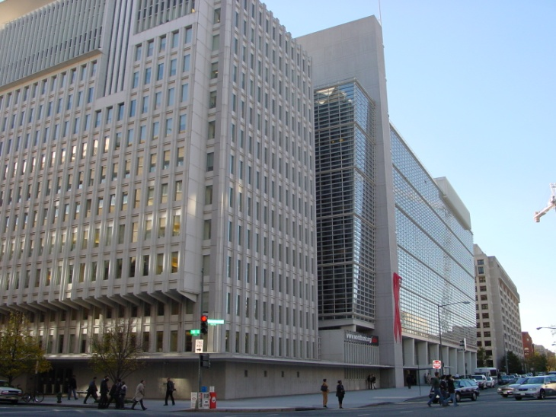
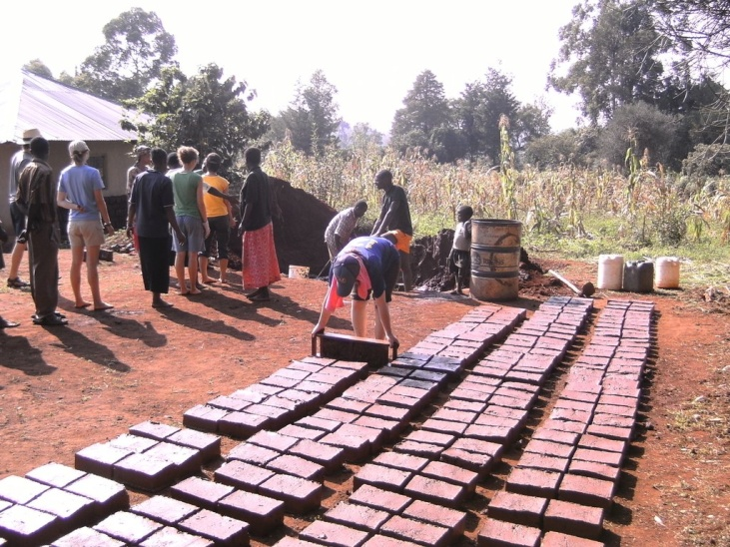
Managing and Engaging Project Stakeholders
(Development Financing & Implementing Institutions)
Vast sums of money are channeled into “developmental” programs & projects by a multitude of institu-tions and agencies every year.
A sophisticated level of stakehol-der management and engagement by funding recipients has now be-come an essential precondition for disbursement of development funds by these institutions and agencies.

Slide 11
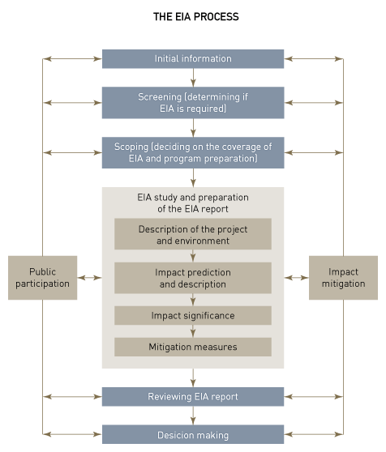

Managing and Engaging Project Stakeholders
(Development Financing & Implementing Institutions)
Two tools used by development program & project funding and im-plementing institutions and agen-cies which are especially relevant from a stakeholder perspective are environmental impact assessment and social impact assessment.
Other forms include the economic impact assessment and archeolo-gical heritage impact assessment.

Slide 12





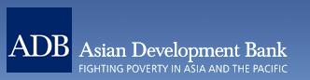
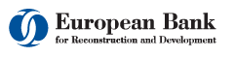
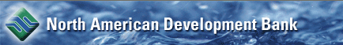
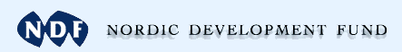

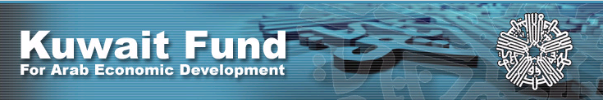
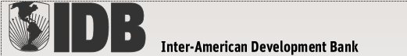

Major National, Regional & International
Development Project-Financing Institutions
These development project-financing institutions offer public access on their websites to detailed project stakeholder-relevant documents:

Slide 13




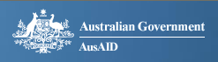
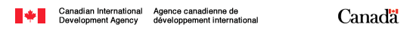
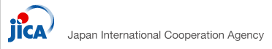


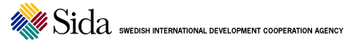
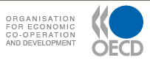


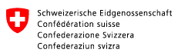


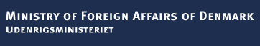

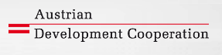

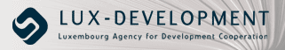

Major Development Implementing Agencies
Notes:
Slide: Major Development Implementing Agencies 1
Most international development agencies offer access on their public websites to detailed information (includes publications, reports, case studies etc.) in connection with projects which were funded and/or implemented or assisted by them.

Slide 14

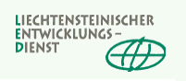

Major Development Implementing Agencies

Slide 15

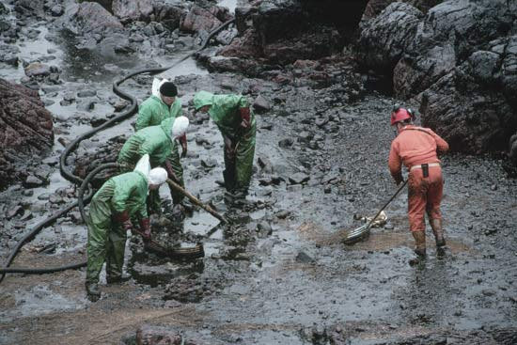
Managing and Engaging Project Stakeholders
(Law and Public Participation)
The law can be used for and against projects. Over time, laws relevant for projects have changed. Environmental law, in particular, has evolved con-siderably. From a project per-spective these changes consti-tute a potentially serious chal-lenge because any infringe-ment thereof can be used by project adversaries to adversely impact the project.

Slide 16
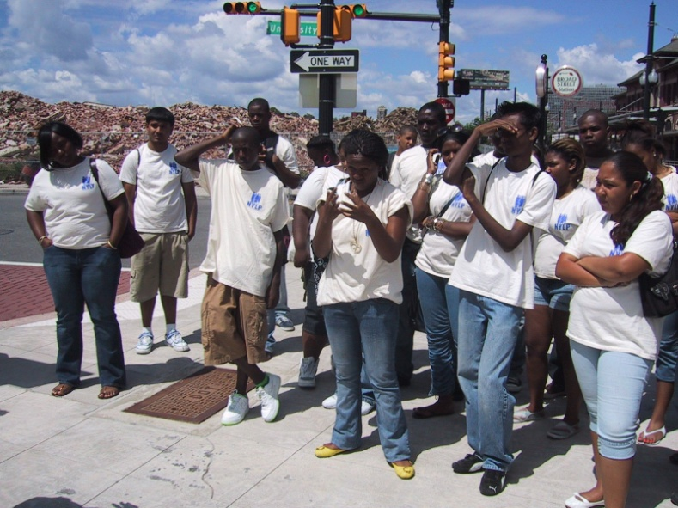
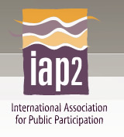
Managing and Engaging Project Stakeholders
(Law and Public Participation)
Public participation in admini-strative decision-making pro-cesses (e.g. for issuance of project permits) has increased significantly over time in both developed and developing countries.
From a project perspective, community and citizen empo-werment means that there is added pressure of “satisfying” the project stakeholders.
Notes:
Community empowerment in a project in Newark.

Slide 17

Managing and Engaging Project Stakeholders
(Non-Governmental Organizations)
NGOs have emerged over time as a major influencing force on many categories of projects being undertaken across our globe (especially construction and civil engineering projects).
NGOs are Issue-Driven in their approach. From the project perspective their impact is usually seen as negative. Many big projects have been severe-ly affected by NGO action.

Slide 18
Managing and Engaging Project Stakeholders
(Non-Governmental Organizations)
Major contemporary issues for NGOs include protection of the natural environment, defense of human rights and the rights of indigenous communities and children, and archeological and cultural conservation.
Some (rel. few) NGOs have an international scope; others (the majority) are localized. Temporary alliances are often formed to challenge projects.

Slide 19

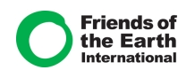
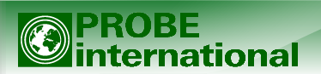
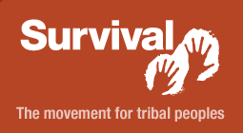
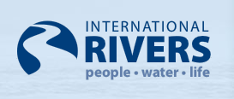
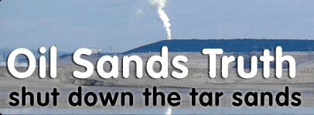
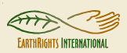
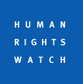
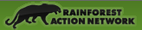
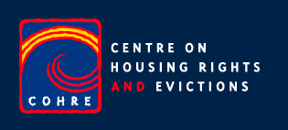
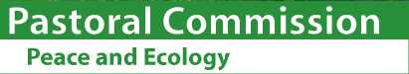

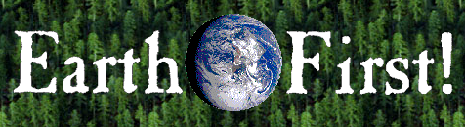
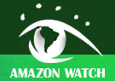
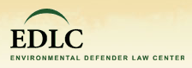
Examples of Non-Governmental Organizations
(With a Critical Eye on Projects!)

Slide 20
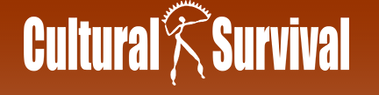
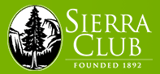

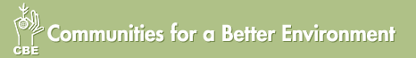
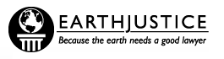

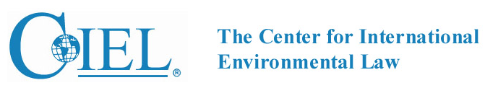

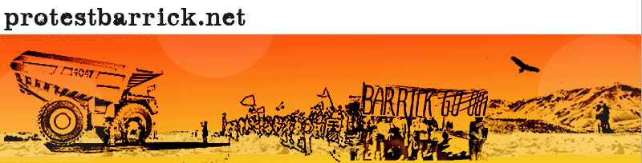
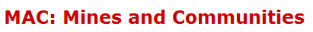
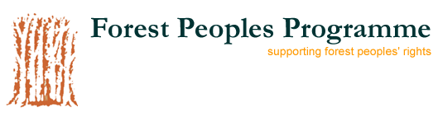

Examples of Non-Governmental Organizations
(With a Critical Eye on Projects!)

Slide 21





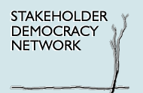




Examples of Non-Governmental Organizations
(With a Critical Eye on Projects!)

Slide 22

Managing and Engaging Project Stakeholders
(Information and Communication Technology)
Advances in ICT over the past 25 years have revolutionized the way we live and work. Pro-jects are no exception.
ICT has brought (internal) pro-ject stakeholders numerous and enormous benefits.
It has also brought risks and dangers which sometimes can spell doom for projects.
Notes:
Advances manifest themselves in many ways. The processing power of today’s personal computers (desktops, laptops) greatly exceeds the processing power of the mainframes used in the 1960s and 1970s. Nowadays a 1 TB data storage drive sits in the palm of a hand. The internet and networking technology has revolutionized the way information is communicated across space.

Slide 23
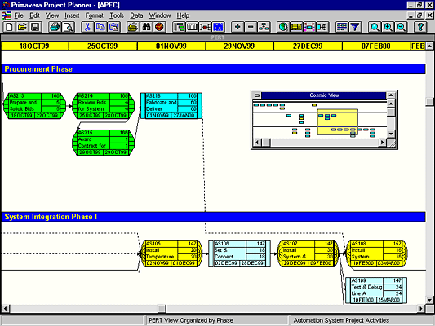

Managing and Engaging Project Stakeholders
(ICT: Major Benefits for Internal Project Stakeholders)
Project Management
Project Informatization & Analysis
Project Design, Modeling, Visualization & Simulation
Project Communication
Project Collaboration
Project Monitoring, Evaluation & Control
Project Input Procurement
Project Publicity
Notes:
Administration: Database software (e.g. relational). MS Office software, esp. Word, Excel, PowerPoint. Data warehousing for archival purposes.
Analysis & Management: Project management software programs of which there are a large number ranging from the highly sophisticated, functionally comprehensive and costly (e.g. Primavera) to cost-free simple ones. There are many specialized software programs now available which are used for specific project management functions, such as, scheduling and stakeholder management (e.g. Pertmaster, Stakeholder Circle). Enterprise-wide editions of software programs such as MS Project and Primavera help manage/administer portfolios of projects.
Collaboration: Group Support Systems. Enabling of cooperation between stakeholders in a dispersed (i.e. not co-located) work environment. Project Websites (restricted access). PMIS systems. MS SharePoint and other web-based collaboration software programs and systems.
Communication & Coordination: Intranet, VPN, Internet, World Wide Web, e-Mail, web- and video-conferencing technology (the latter now having evolved to the extent where immersive experience is a possibility). Internet-based services such as Skype, Instant Messenger, SMS. Cell and satellite phones, walkie talkies.
Design & Visualization: CAD/CAM. Software used for designing new products (e.g. automobiles, airplanes, textiles, shoes), construction and civil engineering (e.g. buildings, factories, airports, power stations, bridges). Visualization software programs like 3DS Max, Mind Mapping.
Modeling & Simulation: Software programs like STELLA.
Monitoring & Transparency: Satellite monitoring (of civil engineering projects), overt or surreptitious video surveillance of project sites, facilities and assets, SCADA software for pipelines, issues and incidents involving internal and external stakeholders (e.g. number of complaints received about the project, staff absenteeism from work). Transparency in the sense that all project documents are accessible which reduces the element of concealment.
Publicity: Internet websites to inform external stakeholders. E-Mailing external stakeholders to keep them informed about the project.

Slide 24

Managing and Engaging Project Stakeholders
(ICT: Common Issues for Intern. Project Stakeholders)
INFORMATION SECURITY
INFORMATION OVERLOAD
INFORMATION QUALITY
OVER-RELIANCE ON ICT
ADVERSE PUBLICITY ABOUT PROJECT
Notes:
Information Security: Loss of information caused by inadequate data back-up systems, intentional leaking of information to hostile external stakeholders, cyber-attacks.
Information Overload: Accumulation of too much information to process and analyze. Decision paralysis may result as a result of stakeholders being inundated with information.
Over-Reliance on ICT: The project revolves around ICT and stakeholders forget that ICT is just an instrument meant to facilitate.
Adverse Publicity: Propagated by individuals/groups who/which are opposed to the project on internet websites (e.g. NGOs, blogs) and video channels (e.g. YouTube), CDs & DVDs, TV documentaries (e.g. Ilisu Dam, Chevron Corp. in the Amazon, Sweetcrude in Nigeria, Chad-Cameroon Pipeline Project, Lyari Highway Project), e-Mail mailing lists and newsletters, online petitions.

Slide 25
Thank You for Your Patience!
In the next lecture we shall move on to Part IV of our course in which we will look at the strategies, processes and tools in project stakeholder management and engagement.
See you all soon!

