Slide 1
Master of Science in
Project Management
Project Stakeholder
and Communication
Management
LECTURE 11: THE PRINCIPAL INTEREST DRIVERS OF PROJECT STAKEHOLDER MANAGEMENT AND ENGAGEMENT Pt. 1

Slide 2
Managing and Engaging Project Stakeholders
(The Nine Principal “Interest Drivers”)
DRIVERS
Law & Public Participation
NGOs
The Media
Information & Communication Technology
Project Environment Complexity
Corporations, Society and the Environment
Stakeholder Theory
DFIs & DIAs
Awareness
My research has iden-tified nine basic and mutually influencing drivers which over the last two to three decades have been instrumental in gene-rating interest among academics and practi-tioners in proj. stake-holder management and engagement.
Notes:
(1) Awareness : Widespread and increasing awareness of the impact which stakeholders have on projects (project surveys, project success factors). Also, knowledge about project stakeholder management imparted through education (project management degree programs and stakeholder management courses at universities and outside (consultants)) and documented knowledge (books, research articles, doctoral and master theses, reports, blogs etc.). Consider also undocumented knowledge.
(2) Stakeholder Theory: Emergence and Development Since 1984
(3) Corporations, Society and the Environment (Corporate-Society Interfaces, Social Capital, CSR (Corporate Social Responsibility))
(4) Project Complexification: Complexification of the Project Environment (Internal, External)
(5) Laws and Public Participation: Laws at the Global, National, and Sub-national Levels; Empowerment Impact on People and Communities
(6) DFIs & DIIs: Development Financing Institutions and Implementing Agencies
(7) NGOs: Non-Governmental Organizations (Advocacy Factor)
(8) Media: Broadcast (TV, Radio) & Print (Newspapers, Magazines) Media
(9) ICT: Information and Communication Technology (incl. PMIS, World Wide Web, e-Mail)

Slide 3
Managing and Engaging Project Stakeholders
(Driver: Stakeholder Theory)
DESCRIPTIVE
Stakeholder Theory
INSTRUMENTAL
NORMATIVE
Stakeholder Theory has evolved extensively since the mid-1980’s. Many of the article contributions contained in leading management and affiliated journals, such as the Journal of Business Ethics, discuss it.
Though stakeholder theory tends to focus on the corporate context, its princi-ples are highly relevant for managing/engaging stakeholders on all projects.

Slide 4


Managing and Engaging Project Stakeholders
(Stakeholder Theory: Descriptive Dimension)
The descriptive dimension of stakeholder theory is basically concerned with identifying and analyzing an organization’s – or project’s - set of stakeholders.
This presupposes the existence of a definition or understanding (which may range from being quite narrow to quite broad) of who the stakeholders are as the basis for the identification exercise.

Slide 5


Managing and Engaging Project Stakeholders
(Stakeholder Theory: Instrumental Dimension)
The instrumental dimension of stakeholder theory basically states that managers must deal with their stakeholders because failing to do so can result in neg-ative impacts for their organiza-tions - or their projects.
Stakeholder management and engagement is considered an “in-strument” whose dividends are higher project efficiency and less risk of project failure.

Slide 6
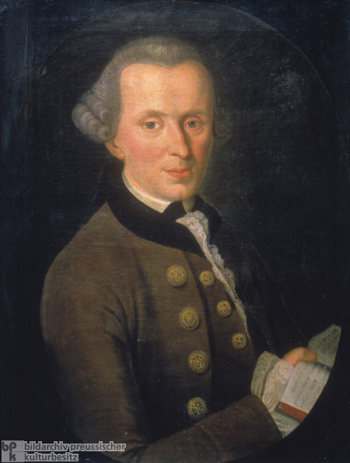
Managing and Engaging Project Stakeholders
(Stakeholder Theory: Normative Dimension)
The normative dimension is the moral philosophical foundation of stakeholder theory.
Issues under debate include de-termining who the stakeholders are and whether they should include non-human entities, the responsibilities of organizations towards their stakeholders, and whether a corporation should focus more on its shareholders or other stakeholder categories.
German Philosopher Immanuel Kant (1724-1804)

Slide 7

Managing and Engaging Project Stakeholders
(Good Literature on Stakeholder Theory)
An excellent reference work on stakeholder theory.
The book contains twenty-five collected articles on the subject published in prestigious aca-demic journals.
A must read for all interested in this subject!
Click on image for book details.

Slide 8

Managing and Engaging Project Stakeholders
(Good Literature on Stakeholder Theory)
In the first half of their insight-ful book (2005), British Professors Friedman and Miles have comprehensively and systematically discussed various stakeholder theories spanning a twenty year period.
Click on image for book details.

Slide 9

Managing and Engaging Project Stakeholders
(Good Literature on Stakeholder Theory)
The most recent (2010) publica-tion on the subject of stakehol-der theory, co-written by Pro-fessor R. Edward Freeman who spurred the surge in interest in the subject of stakeholders.
This book looks, among other themes, at the evolution of stakeholder theory over the past 25 years in several key applica-tion areas.
Click on image for book details.

Slide 10





Managing and Engaging Project Stakeholders
(Driver: Awareness)
Education, Training, Documentation
Project Experience
The Print &
Electronic Media
Information & Communication Tech.

Slide 11

Managing and Engaging Project Stakeholders
(Awareness: Information and Knowledge Sources)
Books and Chapters in Books
Articles in Research Journals
Theses (Master, Doctoral)
Publications by Organizations (e.g. DFIs, DIAs, UN Agencies, NGOs, Corporations, Government Agencies, Research Institutes, Consultants)
Documentation from Projects
Internet Websites
Newspapers and Magazines
TV (Conventional and Web-based)
CDs and DVDs
Notes:
These are public sources and encompass:
Books and Chapters in Books (<60)
Articles in Research Journals (thousands)
Publications by Organizations (hundreds): Manuals, Handbooks, Reports, Toolkits etc.
Doctoral & Master Theses (<30)
Internet Websites (hundreds)
Project Documentations (hundreds)
Newspapers and Magazines (hundreds)
TV (dozens)
CDs and DVDs (<10)
Information and knowledge about project stakeholder management is also communicated in training courses, workshops, etc.

Slide 12



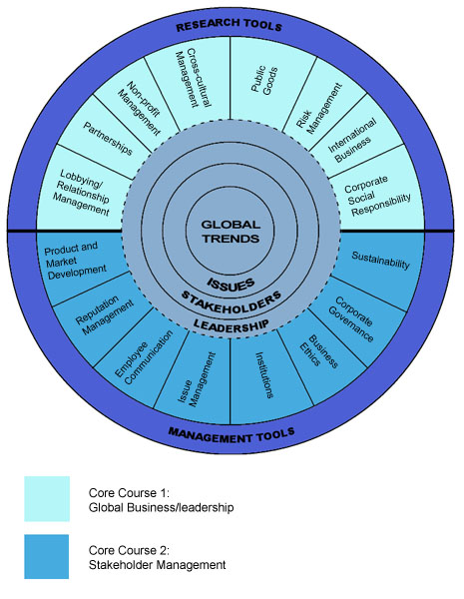
Managing and Engaging Project Stakeholders
(Awareness: Degree Programs)
Erasmus University‘s School of Management in Rotterdam, Nether-lands, is the only institution in the world known to offer an advanced degree in Stakeholder Management: The MSc in Business Administration with specialization in Global Busi-ness and Stakeholder Management.
Predictably, stakeholder manage-ment practices and issues are the focus of the program‘s teaching and research components.

Slide 13
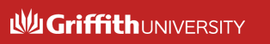




Managing and Engaging Project Stakeholders
(Awareness: Courses in Degree Programs)
Several universities are offering cour-ses or workshops specifically on stake-holder management and engagement. However, such courses are few and far between. Most project mgmt. degree programs include core and/or elective courses on project human resource & team management.
Some knowledge on stakeholder management and engagement will, off course, be discussed in probably every project mgmt. degree program.

Slide 14
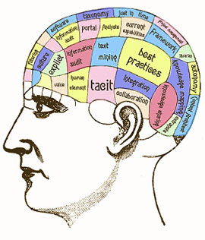
Managing and Engaging Project Stakeholders
(Tacit Sources of Information and Knowledge)
Some knowledge on the intricacies of project stakeholder management and engagement never finds its way into books, articles or other docu-mentation, namely, the experential knowledge which has accumulated over time in the minds of countless project managers and other stake-holders across our planet who rou-tinely interact and deal with each other to accomplish proj. work and resolve myriad issues/problems.
Notes:
The valuable knowledge may be systematically accessed through interaction with these practitioners and discussions, interviews, focus groups etc.

Slide 15
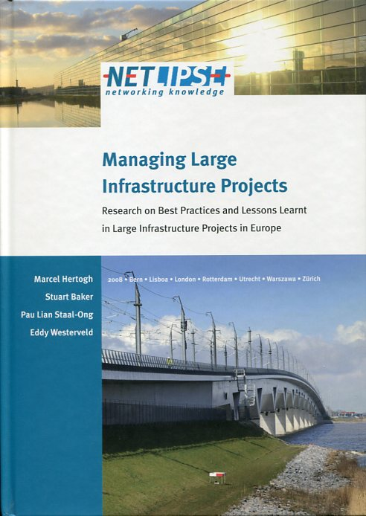
Managing and Engaging Project Stakeholders
(Awareness of Stakeholder Impacts on Eur. Projects)
NETLIPSE = Network for Know-ledge Dissemination on the Management and Organization of Large Infrastructure Projects in Europe.
NETLIPSE is a consortium of 8 org. from 5 EU states. This pub-lication (2008) analyzed 15 large transportation projects highlighting the lessons learn-ed from their planning and execution.

Slide 16
Managing and Engaging Project Stakeholders
(Awareness of Stakeholder Impacts on Eur. Projects)
Among its main findings the research found that (p. 45)
“Stakeholder Management in a project is critical … the need for continuing the dialogue with stakeholders at a meaning-ful level, once consents are given for construction, has however been rarely appreciated … sustaining the relationships and measuring the effectiveness of com-munication with stakeholders can yield strong benefits for a disproportionately low amount of time and expenditure”.

Slide 17
Managing and Engaging Project Stakeholders
(Awareness of Stakeholder Impacts on Eur. Projects)
The research also discovered that (p. 73)
“The essential lesson learnt in the NETLIPSE project is that dialogue, commu-nication and cooperation are as useful as focusing on technique, contracts and other internal concerns … When comparing the NETLIPSE projects, it seems that those pro-jects which dealt with stakeholders on an ad hoc basis experienced far more prob-lems with their stakeholders than those projects which developed a stakeholder strategy early on in the project”.

Slide 18
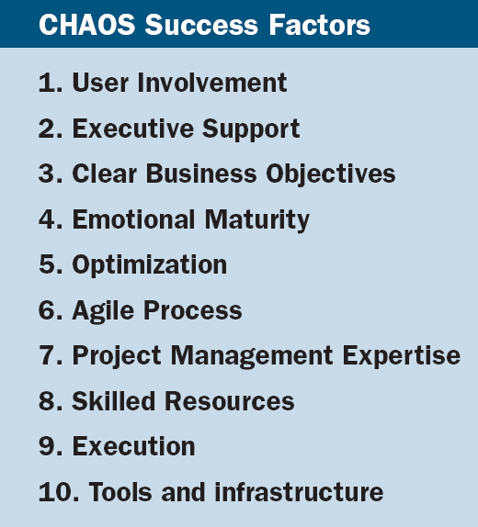
Managing and Engaging Project Stakeholders
(Success Factors in ICT Projects)
Source: CHAOS Group Summary 2009, p. 3.
The CHAOS Success Factors list the factors in order of priority which contribute towards the success of ICT projects according to the Standish Group’s research based on a sample of ICT – Projects undertaken in government and commercial organizations mainly in the US.

Slide 19
Managing and Engaging Project Stakeholders
(Survey of Two Project Manager Groups)
Project Leadership Skills | Ranking by “Excellent” Project Managers | Ranking by Other Project Managers
To assume ownership for the mission, and to refer to it at all times | 1 | 17
To have long-term vision and the ability to anticipate problems | 2 | 6
To know how to delegate and how to lead the team | 3 | 2
To be conscious of the political aspects, to know the major players and their interests and to be able to work with them | 4 | 21
To know how to analyze and to select the best alternative | 5 | 5
To manage by results | 6 | 8
To know how to analyze problems methodically | 7 | 3
To encourage innovation and personal initiative | 8 | 11
To demand excellent individual performance | 9 | 9
To be action-oriented and to stress urgency | 10 | 10
To develop good relations with the major stakeholders: clients, users, suppliers | 10 | 14
To be a good coach and mentor | 12 | 12
To know how to find and manage information | 13 | 15

Slide 20
Managing and Engaging Project Stakeholders
(Survey of Two Project Manager Groups)
Project Leadership Skills | Ranking by “Excellent” Project Managers | Ranking by Other Project Managers
To be persuasive in order to overcome obstacles and obtain support | 14 | 23
To be imaginative and creative | 15 | 3
To show self-control | 15 | 13
To be able to assess the motivation and commitment of people | 17 | 18
To know how to manage | 18 | 16
To establish one’s authority and to defend the project in all circumstances | 18 | 24
To be positive and optimistic | 20 | 24
To have a sound technical knowledge | 21 | 1
To be sensitive to other people’s needs | 22 | 22
To pay attention to detail | 22 | 7
To concentrate on the critical aspects | 24 | 20
To have a good sense of priorities | 25 | 18
To be competitive | 26 | 26

Slide 21
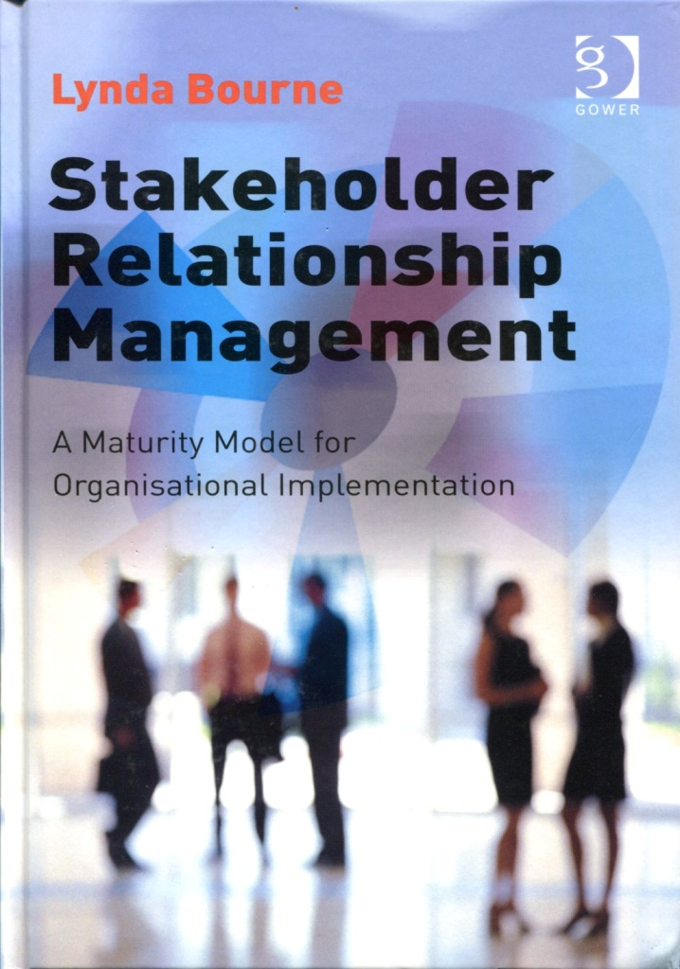

Managing and Engaging Project Stakeholders
(Stakeholder Maturity Management)
Written by one of the world’s foremost experts on stakeholder management and engagement, the Australian Dr. Lynda M. Bourne, this book (2010) provides guidance for organization’s seeking to put their stakeholder management and engagement on a professional and systematic footing.

Slide 22
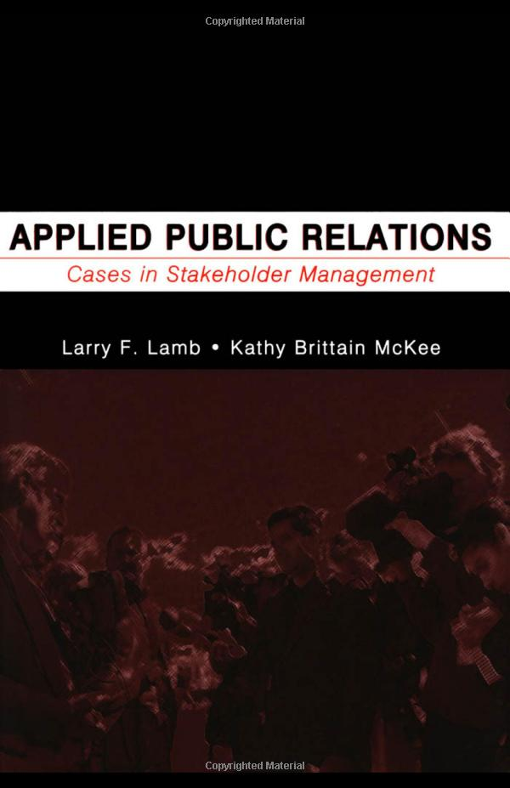
Managing and Engaging Project Stakeholders
(Public Relations by Organizations)
An excellent publication (2009) which contains 45 case studies on stakeholder relationship manage-ment approaches by various orga-nizations from a public relations perspective.
Click on image for book details.

Slide 23
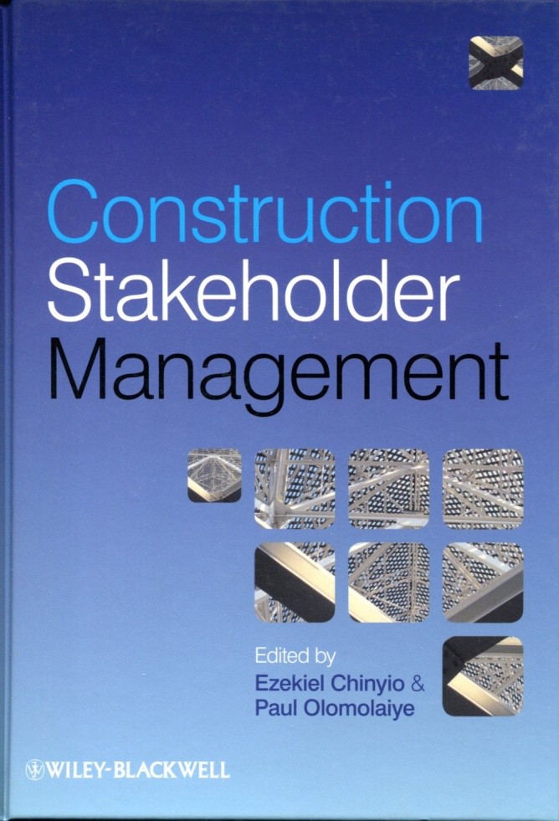









Managing and Engaging Project Stakeholders
(Construction and Civil Engineering)

Slide 24

Managing and Engaging Project Stakeholders (Construction Project Case Study)
An interesting publication which provides insight into one of the major airport projects undertaken in recent years in the United Kingdom.
Click on image for book details.

Slide 25
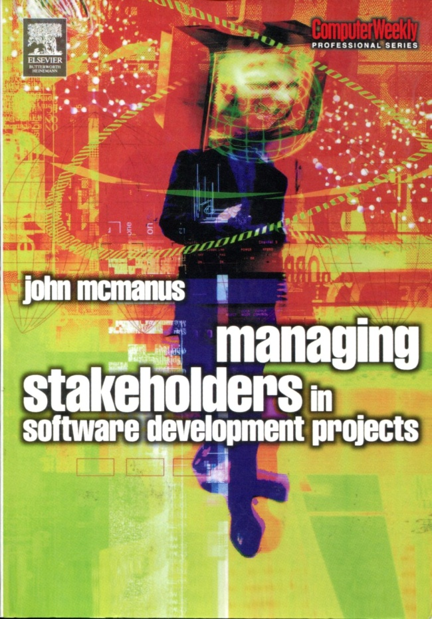
Managing and Engaging Project Stakeholders (Information and Communication Technology)
Books on IT Project Stakeholder Management and Engagement appear to be a rarity at the moment.
Possibly the best (and sole) book which presently exists on this subject is by John McManus (2004) titled Managing Stakehol-ders in Software Development Projects.
Click on image for book details.

Slide 26



Managing and Engaging Project Stakeholders
(Urban Design and Planning)

Slide 27

Managing and Engaging Project Stakeholders (Dealing With Conflicts on Projects)
Conflicts are inevitable on pro-jects. While conflict can often be useful, there is always the possi-bility that it gets out of hand causing serious problems for the project and stakeholders.
This insightful book (2008) looks at preventative and reactive con-flict handling mechanisms on international technical projects from the Client’s & Contractor’s perspective.

Slide 28

Books on Project Stakeholder Management (Natural Resources Management)
This book (2006) contains twelve articles and case studies from around the world on stakeholder dialogues and participation in natural resource management and is an excellent reference work on this subject area which is becoming more relevant with time.
Click on image for book details.

Slide 29


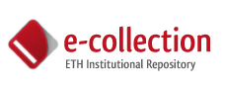
Project Stakeholder Management
(Academic Dissertations)
Many dissertations at the master and doctoral level have been writ-ten on the subject of stakeholder management and engagement in connection with projects.
An example is the doctoral disser-tation (in German, 2008) by Johanna Gerum (Swiss Federal Institute of Technology, Zuerich) on “Stakeholder Management in Project Developing Organizations in the Construction Industry”.

Slide 30













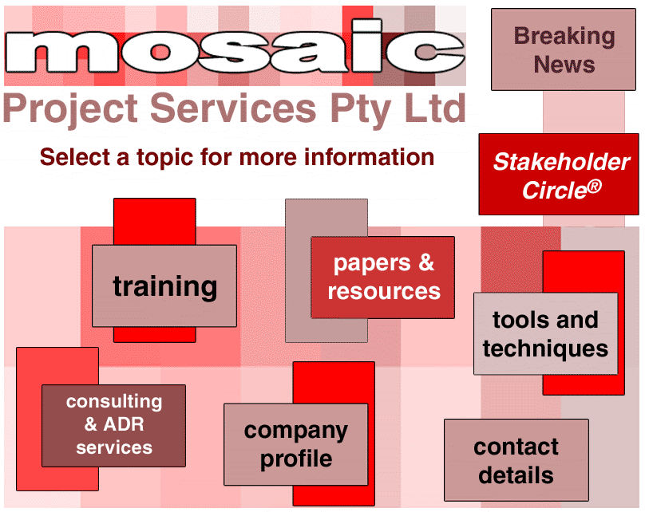

Managing and Engaging Project Stakeholders
(Resources on the Internet)
A HUGE number of websites provide a wealth of information on pro-ject management, incl. project stakeholder management. Sample:
Notes:
http://www.visitask.com/

Slide 31
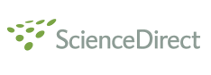



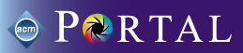

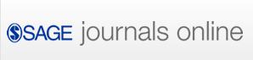
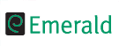




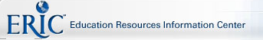


Managing and Engaging Project Stakeholders
(Digital Research Databases)
Note: Enter the words project stakeholder and stakeholder in the respective search fields using their singular and plural forms.

Slide 32




Managing and Engaging Project Stakeholders
(Master and Doctoral Dissertation Databases)
Note: Enter the words project stakeholder and stakeholder in the respective search fields using their singular and plural forms.

Slide 33
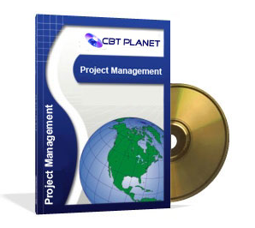
Managing and Engaging Project Stakeholders
(Project Stakeholder Management Training CD)
CBT Planet offers a training CD on Advanced Project Management Training: Building Productive Stakeholder Relationships.
Using simulation excercises, the course teaches how to classify stakeholders and determine their needs and expectations, create a formal communication plan, resolve conflicts with stakeholders, and control changes. Quality issues and concerns from a stakeholder perspective are also discussed.
Click on image to view CD webpage.

