Slide 1
Master of Science in
Project Management
Project Stakeholder
AND COMMUNICATION Management
LECTURE 10: STAKES AND RELATIONSHIPS OF PROJECT SECONDARY STAKEHOLDERS

Slide 2

Project Secondary Stakeholders
(Families)
Families share a fundamental desire – to live in a comfortable, peaceful, clean, healthy, secure and child-friendly environment.
Families understandably tend to be concerned about the impact on them of some projects being undertaken in their neighborhoods and communi-ties as such projects may have consequences which conflict to some extent with this fundamental desire.

Slide 3
Project Secondary Stakeholders
(Families)
Construction projects, in particular, can be a considerable and enduring nuisance, inconvenience and poten-tial danger for families due to the noise, dust and dirt, pollution and the diversion of road traffic which they cause.
Other projects – such as creation of playgrounds, parks, day care centers, sport and recreational facilities, nur-series and schools – would usually generate a higher level of interest and support among families (users).

Slide 4

Project Secondary Stakeholders
(Local Communities)
Like the families which form their basis, local communities are affect-ed by and, hence, have an interest in the projects being implemented in their respective localities.
Projects may bring numerous ben-efits for local communities, such as employment generation, business and investment opportunities, access to more goods and services, appreciation of property values, and enhancement in quality of life.
Local communities tend, by and large, to be recep-tive to change as long as they perceive its benefits are greater than its costs. The higher the perceived benefit differential, the more likely they are to support the project.

Slide 5
Project Secondary Stakeholders
(Local Communities)
Projects have, off course, a down-side too in community perspective.
Some projects, especially those in-volving construction of buildings, roads, public facilities and infra-structure, can have a nuisance effect in terms of (among other irritants) the noise, dust and dirt, pollution, traffic diversion and safety hazards during the project‘s construction phase and may endure after project completion.
Local communities can normally excercize various options to support or oppose projects through their local administration or other measures.

Slide 6

Project Secondary Stakeholders
(The General Public)
Most projects have a limited stake-holder outreach. There are some projects, however, that because of their magnitude may interest and effect the general public.
Examples: Construction of a high-way linking a country‘s major cities would make traveling more conve-nient for the public. The construct-ion of power stations to overcome a country‘s chronic electricity outa-ges would effect everyone.
The general public wants to be assured that a project will not cause problems for it in that, for example, it causes an untenable economic burden for them in future.

Slide 7
Project Secondary Stakeholders
(The General Public)
Building large new food and beve-rage factories would also interest the general public by giving them access to a broader (and possibly cheaper) selection of products.
Some projects can be a source of major concern for the general pub-lic. Example: Creating databases to enable governments to store infor-mation on their citizens have been vehemently opposed by the public in some countries.
The general public is not privy to the actual goings-on in projects and its perceptions are bases largely on what it reads/hears from the media. Engaging the general public can be daunting.

Slide 8
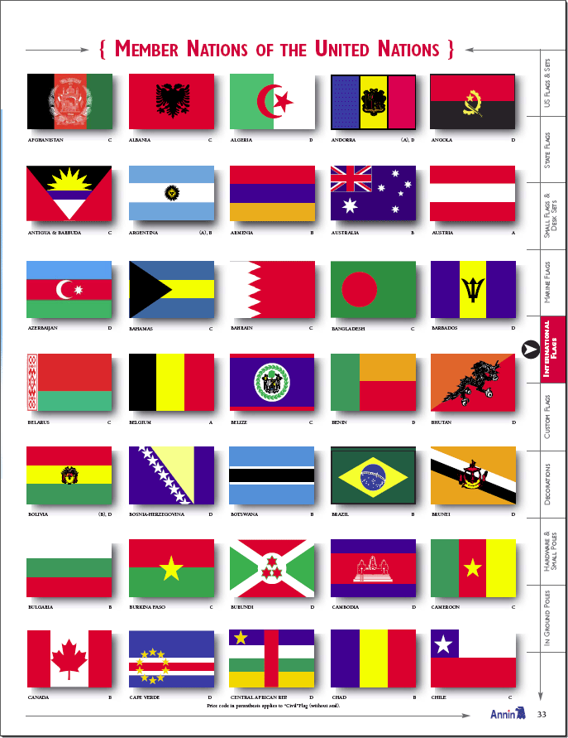
Secondary Stakeholders: Countries
Countries too can, on occasions, be stakeholders to a project.
All projects have an impact. In the case of large projects, these impacts sometimes do not halt at national borders but transcend them and effect surrounding countries–possibly negatively – as well.
A case in point are water management projects at major rivers. Since rivers usually flow through more than one country, a project to store or divert river water in one upstream country may conse-quently result in a reduction of water flows to its downstream neighbours. Reduced water flows may damage their agriculture and economies besides having a social fall-out. If uncontrolled, a situation may arise whereby countries are willing to engage in armed conflict.
Turkey almost went to war with its neigh-bours Iraq and Syria several years back. The cause for this near conflict was Turkey’s construction of a series of dams on a river shared by all three countries.

Slide 9
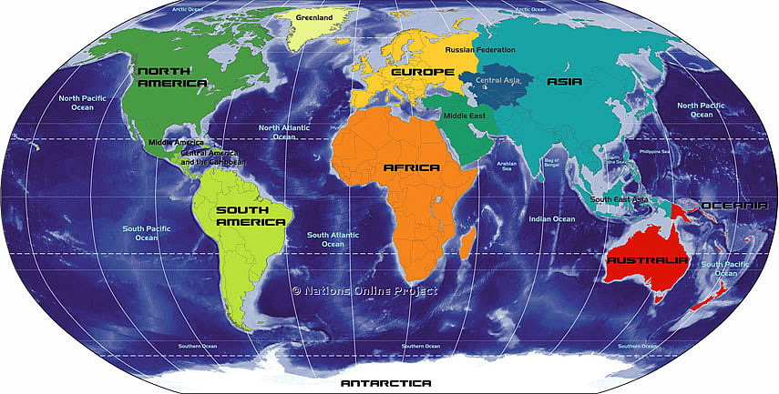
Secondary Stakeholders:
Stakeholders Without Borders
Single Countries, Groups of Countries - even the whole international community - can be stakeholders in some projects! In particular, infrastructure megaprojects and wars may have millions of stakeholders transcending national, regional and continental borders.

Slide 10

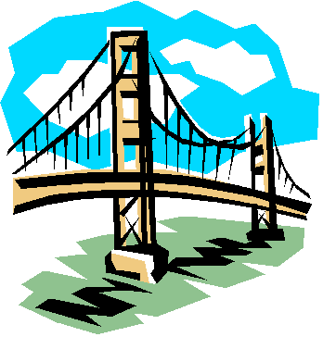
Stakeholders in Transnational Context
(Project Categorizations)
Most projects are typically confin-ed within national borders but their impacts – positive and nega-tive - may be felt well beyond. Some projects actually transcend national borders. In both instan-ces, the states (and their citizens) affected by these projects are stakeholders.
From a stakeholder perspective, „transnational“ projects can fall in any of three categories – divisive, collaborative, and integrative.

Slide 11


Stakeholders in Transnational Context
(Major Benefits and Limitations)
Transnational projects, esp. in in-frastructure (e.g. in energy, trans-portation), can entail substantive and long-term mutual assured gains – usually economic, finan-cial, political, social, technological, institutional, informational - for all states involved.
The perception that one or more states are not adequately benefit-ing may, however, cause complica-tions!

Slide 12

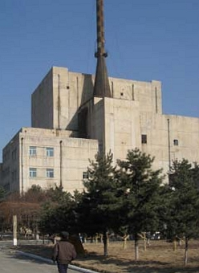
Stakeholders in Transnational Context
(Project Categorizations: Divisive)
Divisive – These projects cause friction between states. Adverse consequences (e.g. econ., pol.) may result therefrom. In extreme circumstances, inter-state conflict is a possibility.
Examples: Wars, Nuclear Weapon Programs of N. Korea and Iran, Expansion of Jewish Settlements in E. Jerusalem, India‘s Dam Cons-truction Projects on the Indus River System, the Spratley Islands.

Slide 13
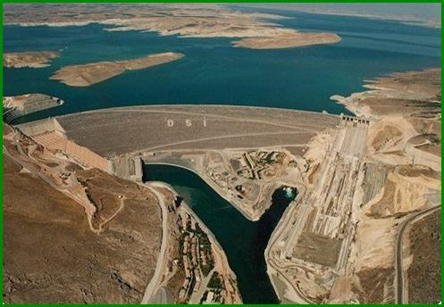
Stakeholders in Transnational Context
(Divisive: Water Resource Projects)
21st century – The era of „Water Wars“.
Proposed dam construction and river diversion projects are pre-sently at the center of several transboundary water resource conflicts around the world be-cause they can cause severe dis-ruption to the agriculture, eco-nomy and society of countries downstream.
Example: The mammoth „Great Anatolian Project“ in south-east Turkey precipitated acute political tension between Turkey on the one hand, and its affected neighbours Syria and Iraq, which get their water from these rivers, on the other. Syria and Iraq once had even hinted at a possible military conflict with Turkey over the construction of the Ataturk Dam (see photo).

Slide 14
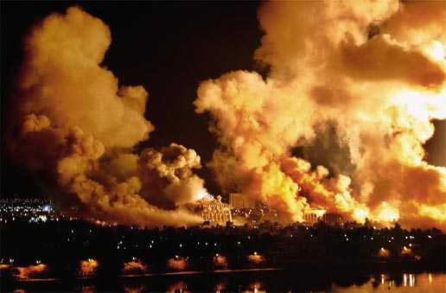
Stakeholders in Transnational Context
(Divisive: Military Conflict Between States)
Wars and military expeditions exhibit the same characteristics (goal, cost, time-frame) as projects do – provid-ed that they do not occur spontan-eously. Usually they have a very large number of stakeholders too.
The US-led allied invasion of Iraq in March 2003 is an excellent case in point (like the earlier Gulf of 1990).
Needless to say, the Iraq conflict‘s global impact has been tremendous and is one of the great tragedies of our time.
The most affected stakeholders in-clude not only the citizens of Iraq who paid an astronomical price, inter alia, in terms of lives lost, economic ruina-tion and a massive erosion in their quality of life, but also the US and its allies (enorm. financial, human and material costs, threat of terrorist reprisals), as well as Iraq‘s neighbours Syria and Jordan (insecurity, flood of refugees, economic fallout).

Slide 15
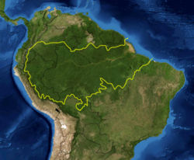
Stakeholders in Transnational Context
(Divisive (Hypothetical) Example: The Amazon Basin)
In the (very unlikely) event that the countries of the Amazon basin initiate a joint „project“ to clear the entire Amazon Rain Forest, the whole world would be stakehol-ders.
The devastating climatological con-sequences for our planet caused by the Forest‘s destruction, and its adverse impact on the world eco-nomy, would affect virtually every-one across the globe.

Slide 16

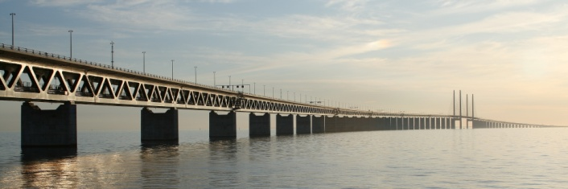
Stakeholders in Transnational Context
(Project Categorizations: Collaborative)
Collaborative – The projects help bring states closer together poli-tically, economically or in other spheres. They are relationship drivers and facilitators.
Examples: Transnational Oil- and Gas Pipeline Projects in Central Asia and the Caucusus, the Pakis-tan-China Friendship Highway, Projects Undertaken by Develop-ment Implementing Agencies such as US-AID, CIDA, GTZ.
Notes:
Closer together - Intentionally or Incidentally.

Slide 17
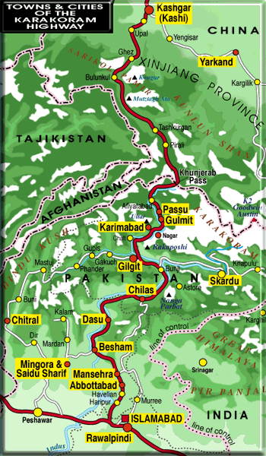
Stakeholders in Transnational Context
(Collaborative: The Karakorum Highway)
The Karakorum Highway is the highest asphalted road in the world. Also called the “friendship highway”, it was constructed by China and Pakistan in partnership.
Commissioned in 1986 after 20 years of con-struction work, the Highway runs about 1300 kilometers from Havelian near Islamabad, passes through the Khunjerab Pass at the Chinese-Pakistan border (4800 meters) and ends at Kashgar in China’s Xinjiang province.
More than 800 Pakistani and 50 Chinese wor-kers died in the construction effort.
A project to expand the width of the highway was signed by the Governments of Pakistan and China in 2006.

Slide 18
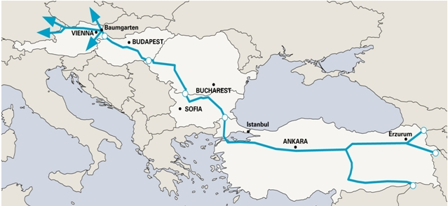

Stakeholders in Transnational Context
(Collaborative: The NABUCCO Pipeline)
The proposed NABUCCO pipeline system, extending from Turkey‘s eastern frontier and passing through Bulgaria, Romania and Hungary, and terminating at the gas distribution hub Baumgarten in Austria, will enable the sale of gas from Azerbaijan (and through feeder pipe-lines possibly Iran, Iraq and Egypt) to Western Europe.
Costing an estimated 7.9 billion Euros, the 3,300 Km pipeline which is scheduled for completion in 2015, will reduce Western Europe‘s de-pendence on risky Russian gas supplies.

Slide 19
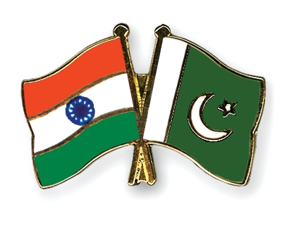
Stakeholders in Transnational Context
(Projects as Relationship Drivers)
For relationship-building and con-flict resolution between countries which traditionally are at ‚logger-heads‘ with each other there are projects which seek to build bridges of understanding between peoples.
Examples: The Track II dialogues which have been organized to bring together citizens from India and Pakistan and in the Middle East.

Slide 20

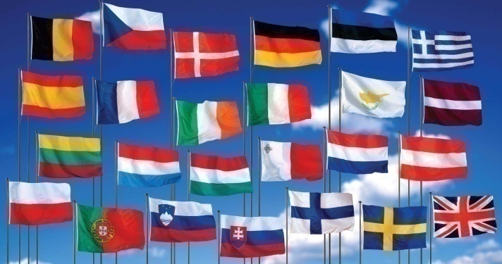
Stakeholders in Transnational Context
(Project Categorizations: Integrative)
Integrative – These projects serve as constituting elements of a long-term transnational grand strategy intending to integrate the econo-mies, infrastructure and institutio-nal, political, legal and other systems of states and bring their societies close together.
Examples: The European Union and other emerging „regional blocs“ (e.g.: ASEAN, MERCOSUR, GCC).

Slide 21
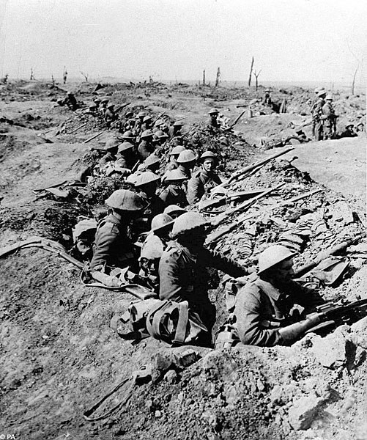
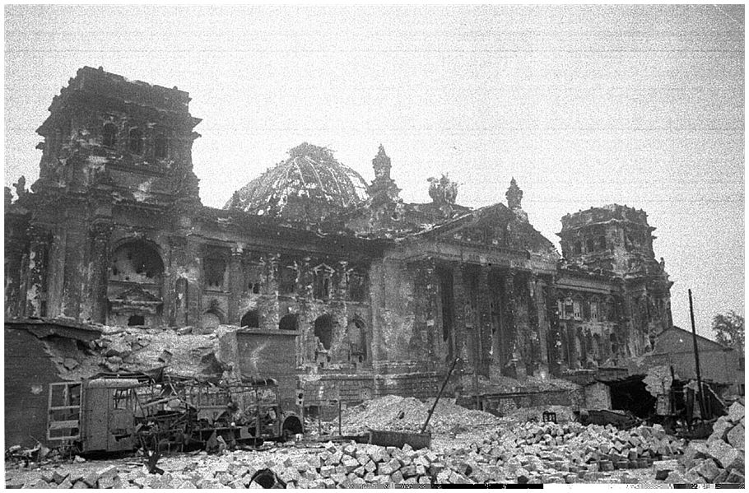
Stakeholders in Transnational Context
(Integrative: The European Union)
For centuries, the major western European states aggressively com-peted with each other for power, climaxing in the dreadful calami-ties of two World Wars (1914-18 & 1939-45).
After 1945, relations between the European nations were redefined in the spirit of peaceful coexisten-ce and cooperation in pursuit of common goals. The European Union gradually evolved from this.

Slide 22
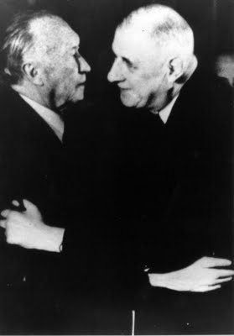
Stakeholders in Transnational Context
(Integrative: The European Union)
Under its patronage, numerous integrative programs/projects in diverse areas and on a massive scale were initiated over time.
Influenced by these (and by other) developments, the threat of armed conflict in Western Europe has receeded into obli-vion and most Europeans now acknowledge that they share a common future with common goals and aspirations.
Germany‘s Chancellor Konrad-Adenauer and French Presi-dent Charles de Gaulle embrace at the occasion of the historic signing ceremony of the Elysees Treaty in 1963.

Slide 23
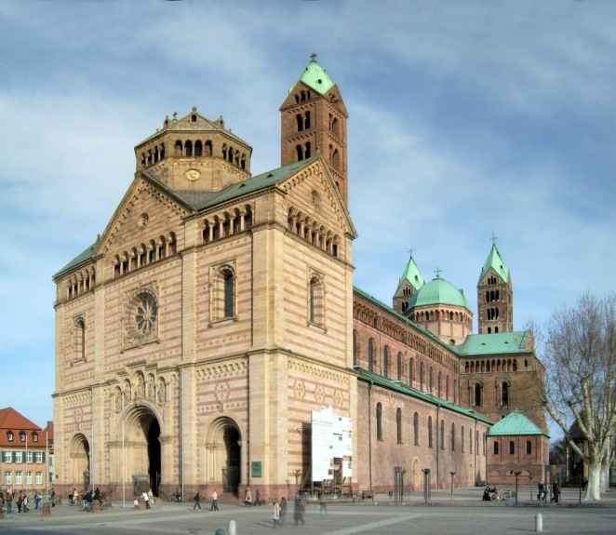
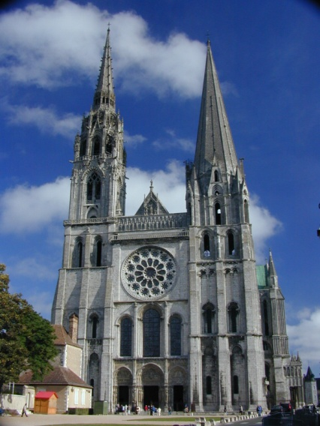
Stakeholders in Transnational Context
(Integrative: The European Union)
A core feature of the European Union‘s integration strategy is its emphasis on promoting contacts between its citizens by sponsor-ing many programs and projects in this regard.
Examples are the ERASMUS ex-change program for European Union students, and the city and town twinning schemes.
Many common institutions have also been established by the European Union.

Slide 24
Thank You for Your Patience!
In the next lecture we shall move on to part III of our course in which we will look at nine “factors” which are creating interest in project stakeholder management among academics as well as practitioners.
See you all in the next lesson!

