Slide 1
Master of Project Management
Project Stakeholder
AND COMMUNICATION Management
VIRTUAL CAMPUS CIIT
LECTURE 1: INTRODUCTION TO PROJECT STAKEHOLDER MANAGEMENT AND ENGAGEMENT

Slide 2
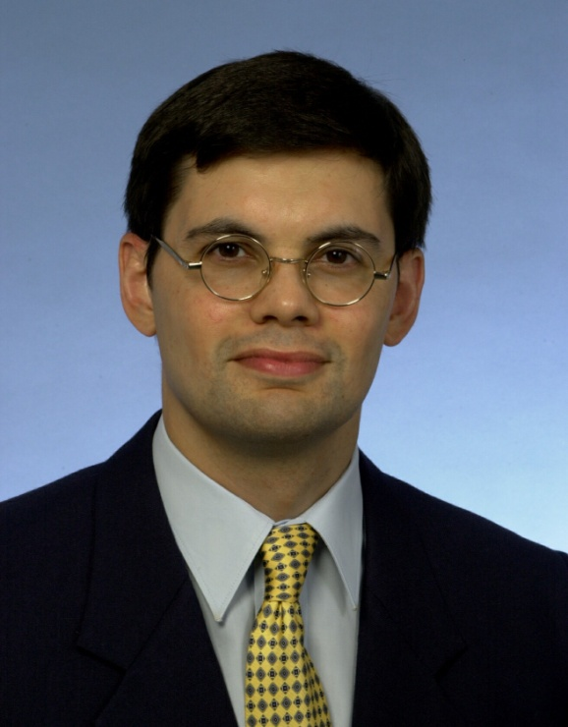
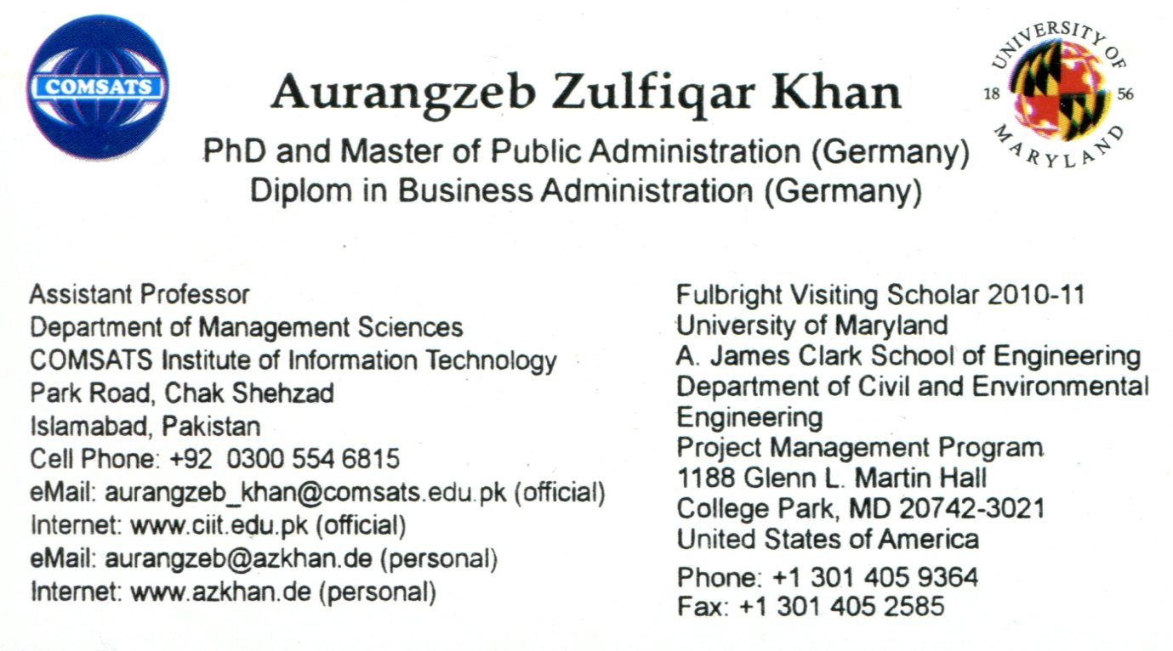
Your Course Instructor
Professional Work Experience
  1992: Executive Assistant at Hilal Consultants Pvt. Ltd., Islamabad
  1993-96: Programme Coordinator at the Hanns-Seidel Foundation, Islamabad
  1997-98: Research Fellow at the Institute of Strategic Studies, Islamabad
  Since 2005: Asst. Prof. in the Dept. of Management Sciences, CIIT Islamabad
Notes:
Slide: Your Course Instructor
Briefly explain my main responsibilities in each of these organizations, especially with regard to projects.

Slide 3

Subjects I Taught at CIIT Islamabad
(Period: Spring Semester 2005 – Spring Semester 2010)
Business Research Methods (MBA)
International Human Resource Management (MBA)
Operations Management (MBA, MS)
Project Management (MBA, MS)
Seminar in Human Resource Management (MBO)
Total Quality Management (MS)
MS
MBA MBO
MPM
Fundamentals of Project Management
Project Stakeholder and Communication Management
Project Controlling
Seminar in Project Management
Notes:
Slide: Subjects I Taught At CIIT Islamabad
MS = Master of Science. Three semester graduate program with first two semesters consisting of coursework followed by one semester for research thesis. Prerequisite for admission to the PhD program.
MBA = Master of Business Administration. Previously four semesters long “undergraduate” degree program at CIIT which, as of fall semester 2010, was increased to seven semesters (three and a half years).
MBO = Master of Business Administration. Two semester degree program at CIIT open to students with a four year bachelor degree.
MPM = Master of Project Management. Previously a two semester professional degree program offered only at CIIT Islamabad which was increased as of fall semester 2010 to three semesters.
No. of Semesters Courses Taught:
MBA, MBO, MS:
Business Research Methods (MBA: Taught Once in Fall Semester 2005)
International Human Resources Management (MBA: Taught Once in Fall Semester 2005)
Operations Management (MBA, MS: Taught Twice, Once to MBA and Once to MS)
Project Management (MBA, MS: Taught Seven Times in Total)
Seminar in Human Resource Management (MBO: Taught Once in Spring Semester 2008)
Total Quality Management (MS: Taught Once)
MPM:
Fundamentals of Project Management (3)
Project Stakeholder and Communication Management (5)
Project Controlling (2)
Seminar in Project Management (1)

Slide 4
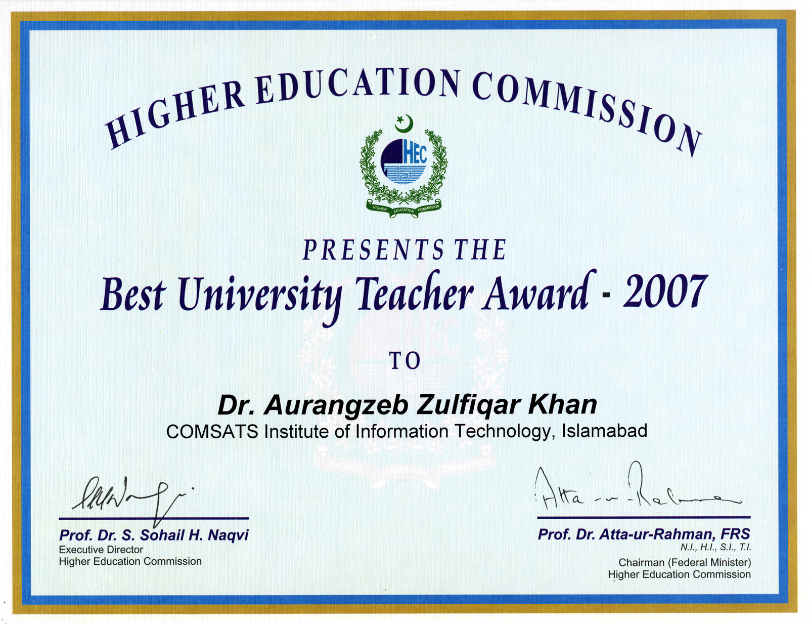

Slide 5
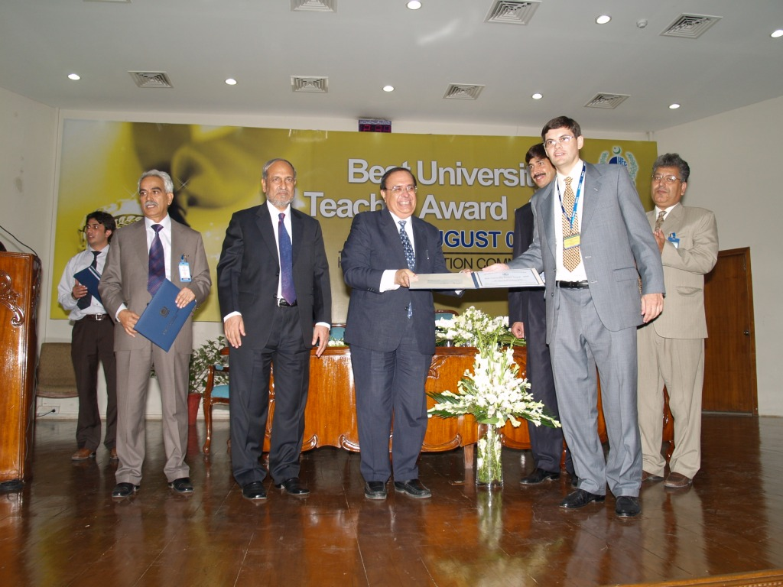
Presentation of the National Award
“Best University Teacher” for the Year 2007
Notes:
Slide: Presentation of the National Award Best University Teacher for the Year 2007
Presentation of the Award Certificate to me by the former Chairman of the Higher Education Commission of Pakistan Professor Dr. Ata-ur-Rehman on August 13, 2008.

Slide 6
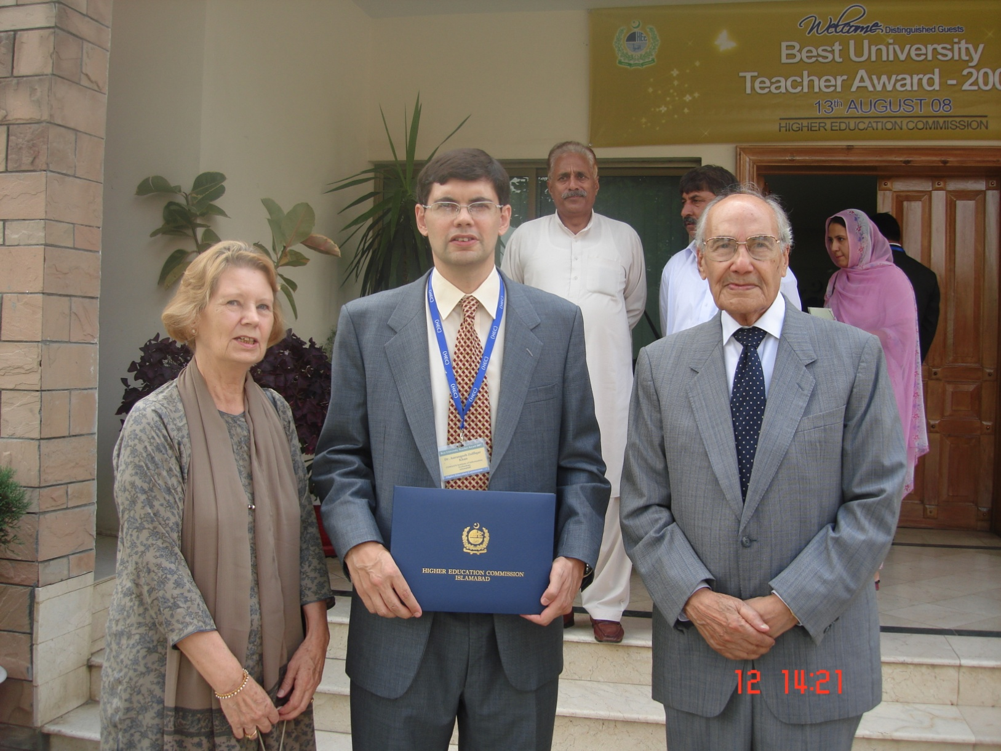
With My Parents After The Award Ceremony
Notes:
Slide: With My Parents After The Award Ceremony
Flanked by my happy parents, this photo was taken outside the HEC auditorium building after the Best Teacher Award Ceremony on August 13, 2008.

Slide 7
Self-Introduction by the Course Participants
All course participants are requested to introduce
themselves, individually and briefly, stating their:
Full Name
Higher Education and Professional Background
Designation and Name of Employing Organization
Experience Managing/Engaging Project Stakeholders
Stakeholder and Project Mgmt. Courses Attended
Reason(s) for Interest in this Course
Expectations from this Course

Slide 8
How This Course Will Be Conducted
15 Classes @ 2.5 Hours = 37.5 Hours
Holistic & Integrated Teaching Approach
Entire Course Material Available on the ELMS On-Line Blackboard System
Subject Exposure:
Comprehensive and Insightful
Original MS PowerPoint Presentations
Real-Life Examples and Case Studies
Excellent Course Literature
Supplemented by Occasional Handouts
Encourage Analytical, Critical and Creative Thinking (Cramming Severely Penalized!)
Two Examinations (Midterm, Final)
One Group Assignment & Periodic Mini-Assignments
Extensive Class Interaction: Vertical and Horizontal!
Notes:
Slide: How This Course Will Be Conducted
Holistic and Integrated Teaching Model: The Oxford Advanced Learners Dictionary defines holistic as „having regard to the whole of something rather than just to the parts of it“. In other words, having a holistic perspective means seeing the „larger picture“ of something which, in this case, is the subject of project stakeholder management. Students must disaccustom themselves from the narrow tunnel vision they frequently come to my class with and learn to view project stakeholder management as a highly complex, vast and multifaceted pool of knowledge in which all its constituent areas have their place and functions and are interrelated like the organs of the human body. Hence, I shall be reviewing not only the individual project stakeholder management processes and tools, but also throw light on their interrelationship and how changes occuring on one knowledge area (for e.g. project scope) can effect other knowledge areas (for e.g. project cost and schedule). Furthermore, students must be made aware of how individual projects compete with each other for an organization‘s resources and why and how they are closely integrated with the organization‘s goals, objectives and mission. Finally, the link between projects and the external environment of the organization owning and/or implementing them must be considered.
Detailed Subject Exposure: An advanced course in project stakeholder management necessitates an in-depth study not only of the respective interests, responsibilities, expectations and concerns etc. of project stakeholders, but also the fundamental forces which have generated interest among researchers and practitioners in the subject (nine have been identified through my research) and, very importantly, the project stakeholder governance model I developed independently which offers a comprehensive framework for managing and engaging project stakeholders in any project category.
Course Syllabus: I do not finish the semester without teaching all the material outlined in my course syllabus. It‘s as simple as that! It is unprofessional at best, dangerous at worse. This course on project stakeholder management has been carefully designed from scatch and it appears it is not being currently offered elsewhere in the world in this comprehensive form. Consequentlty, and given my style of working, the course syllabus has been developed entirely by me. Each of the four course sections have direct and practical relevance for managing/engaging stakeholders on projects. The ommission of any topics, which may be quite important for students who will later on lead or be involved in projects, and it would be grossly irresponsible on my part not to acquaint them with this subject material.
Course Literature: In teaching project stakeholder management I use only the literature which, after careful review and assessment, I consider the best and which are of a standard comparable to project management literature used in MPM and similar programs at good foreign universities. As the course project stakeholder management is innovative and very few courses on the subject are being offered worldwide, selecting appropriate course literature poses more a significant challenge. For the list of basic course literature and supplementary reading material see my student handbook. All the books are presently (September 2010) unavailable in Pakistan and have to be imported into the country. Students are expected to carefully read regularly over the entire semester and FROM THE FIRST WEEK starting after commencement of classes. Note that copies of research articles, selected passages from books and other material in printed and/or electronic form will also be recommended periodically as as when the need arises.
A number of videos and documentaries supplement the course reading material. Examples: The documentary videos from the interesting television series Megastructures, Extreme Engineering, and Engineering an Empire. Students are encouraged to watch these and view them in the light of project stakeholders. I have some of these videos and can make them available to students on request.
MS Powerpoint Presentations: All my classes will be conducted entirely with MS PowerPoint 2007 presentations which cover the entire course material and which I developed myself. The number of slides is growing continuously (as of October 2010 they number about 550 which excludes 130 slides on communication management). I have opted for MS PowerPoint as my prime teaching aid because of three significant benefits it brings: (1) it provides a lot of room for design creativity and allows me to create visually stimulating presentations which I know from my years-long teaching experience attracts and maintains the attention of my students throught the duration of each class, (2) it displays not only text but also embedded cliparts and photos (with or without embedded web hyperlinks) and also can be linked with video and audio files, (3) when distributed as handouts it permits my students to fully concentrate on my presentations instead of making notes of everything I am discussing, and (4) it saves me a tremendous amount of time as I don‘t have to write out everything on the whiteboard.
The downside with PowerPoint which I have observed with my classes is that some students tend to rely only on the slides and simply do not bother to read the prescribed course literature which is absolutely essential.
Students should note that I follow a theme approach in teaching project management and that my slides are not aligned with any text book.
Creative Thinking & Cramming: Creative or innovative thinking is absolutely essential in the academic environment. As mature, well educated and professionally experienced adults, I expect my students to be able to understand, analyse and make value judgments in given situations. Cramming is a big No-No in my class. I certainly don‘t expect my students to absorb each and every detail taught by me in class or contained in the course literature, rather, I expect them to be able to judiciously apply their knowledge acquired in class and come up with value-adding solutions.
Course Material on Website: During the semester, my PowerPoint slides will be uploaded on to the teaching section of my website www.azkhan.de from where they can be downloaded by my students and by anyone anywhere who is interested in viewing them. Students are expected study them carefully in preparation of their class assignments and their examinations. In addition to the slides, students can download from my website the student handbook which contains, inter alia, the course syllabus and project stakeholder management examination papers from previous semesters which they may find useful in preparation for their examinations in this course.
Examples/Case Studies: The course will frequently refer to project stakeholder management examples and case studies, some of which will be distributed as hand-outs in class, some uploaded onto my website. Examples/Case studies are essential part of the course because they supplement the theoretical material and concepts presented and discussed in class. In essense, they are the link between the theory and practice of project stakeholder management. Students may note, though, that examples/case studies are – contrary to what many people mistakenly believe – NOT A SUBSTITUTE for acquiring an indepth theoretical or concept knowledge of the project stakeholder management, nor will or can they ever be.
Assignments & Examinations: I will set assignments on a periodic basis which all students are expected to submit in class in both printed and electronic form within the given deadline. There is no limit on the number of pages, but please note that quality takes precedence over quantity! The purpose of the assignments are to relate the subject material taught in class to the students‘ professional work at their offices. Students are NOT permitted to set their own assignments.
Two written examinations will be held in the semester. The midterm examination is held approximately in the middle of the semester. It is for 90 minutes or 2 hours and I will ask three or four questiuons from different subject areas taught in class, each carrying equal marks and designed to be answered in roughly the same amount of time. The final examination is of 3 hours duration. I will give relevant information from a (real or fictitious) case study which will be followed by three to five mandatory questions, possibly with subquestions. Students will have to apply all their analytical, critical, creative and holistic thinking skills to perform well in this examination!
Quizzes will be set during the course but they carry no marks. Students may note that NO Multiple Choice Questions will be asked in either the midterm or final examination.
Class Interaction: I accord immense importance to interaction with my class! Communication occurs at two levels, namely, (a) between my students and me and (b) between the students among themselves. Course participants are, therefore, encouraged to ask questions, give their comments and voice constructive criticism in every class. Topics raised in my presentation should be openly discussed. Class interaction rather than passive listening provides a good opportunity for students who are mostly working professionals to share knowledge with their peers based on their own experience managing projects in diverse environments.
English Language: The English language is now (thank goodness!) the lingua franca of the world. This suits me - and not least because my first language is English - since all the project stakeholder management literature my students are required to read for this course is in English as are their assignments and midterm/final examinations. There is a downside too. I realize that many of my students do not speak English as their first language but I believe that using English exclusively in class will give them an opportunity to improve their language skills over the course of time and this in turn will benefit them professionally and personally.
Guest Speaker: It is a tradition of mine to invite at the end of the semester a project management practitioner from government, private industry or a development organization to give a talk on his/her personal insight of, and experience with, professional project management on projects the person in question has worked on previously or is presently working on. The talk will be approximately 45 minutes long followed by a discussion of 45 – 60 minutes. The objective is to show the students to what extent the project stakeholder management knowledge acquired by them in class can be directly applied in real projects they may be involved in in their professional life.
Miscellaneous: Websites will occasionally be accessed via the CIIT high-speed cable connection in class and shown to students using the digital projector. Course participants are not required to come to class equipped with laptops but these can be a useful learning aid in some classes.
As part of my course quality improvement excercize, I will circulate an anonymous content assessment form at the end of the course requesting all my students to provide objective feedback about the quality of my course, my relevant knowledge and skills, my style of content delivery, and whether the course has benefitted or whether they think it can benefit them professionally and personally in time. This is a desirable initiative which I recommend all teachers of project management and its specialized areas follow.
Though I am keen to develop and maintain a very good line of communication to each of my students, and to be always available for them to support them through the course, at the same time I am cognizant of the need to maintain a „professional teacher-student distance“. I do not compromise on this requirement under any circumstances and I request all students to please be cognizant of this.
Teamwork is one of the most demanded skills by employers! It is, off copurse, also indispensible for projects. Therefore, for the purpose of working on their project assignments, I will permit the formation of teams comprising a maximum 4 course participants. I expect that all team members contribute to their assignments to the best of their abilities and cooperate, communicate and coordinate excellently with each other. No free riders please!

Slide 9
The „Formula for Success“ In This Course
Success in this course can be attained by following a simple formula:
Success = f(ABL, INT, INQ, ABS, CRIT, ALY, CRE, CS)
ABL: General Ability
INT: Interest
INQ: Inquisitiveness
ABS: Absorption Capacity
CRIT: Critical Thinking
ALY: Analytical Skill
CRE: Creative Skill
CS: Common Sense
Notes:
Slide: The Formula For Success In This Course
ABL: General Ability
A basic assumption I make when I hold this course is that every student attending it comes equipped with the basic level of intelligence and skills (e.g. communicational, cognitive, interactional) expected in a graduate level project management program designed specifically for professionals from engineering and other fields.
INT: Interest
Interest means that the student feels motivated to attend, participate in and learn from this course. No amount of teacher instruction and support can compensate if the student is unwilling to make a concentrated and systematic effort to learn about the subject of project stakeholder management/engagement and invest the requisite time and energy.
INQ: Inquisitiveness
Actively seeking information and knowledge of project stakeholder management/engagement and all that is related to it from diverse sources of high quality.
ABS: How much the student can take in and process mentally.
CRIT: Critical Thinking Ability
The student is capable of thoroughly analyzing a situation or scenario and pinpoint shortcomings or deficiencies which need to be overcome in order to manage the situation in question in a better (i.e. more effective or efficient) manner.
ALY: Analytical Skill
The student is capable of carefully studying, comprehending and dissecting a given project stakeholder management situation or scenario of comparative complexity into its constituent causes and effects, elements, factors, issues, shortcomings, interrelationships etc.
CRE: Creativeness
The student is capable of suggesting new and/or better ideas, approaches and strategies which can be applied to a given project stakeholder management situation or scenario and which would enable the project manager or team to achieve their goal of managing/engaging more effectively and/or efficiently in a manner results in higher value attainment for more stakeholders.
CS: Common Sense
Nothing in this world it seems is more uncommon than common sense! Project Stakeholder Management and Engagement is, in large part, really nothing more than plain common sense and if students can‘t excercize their basic mental faculties in this regard, then ... [no comment]!

Slide 10
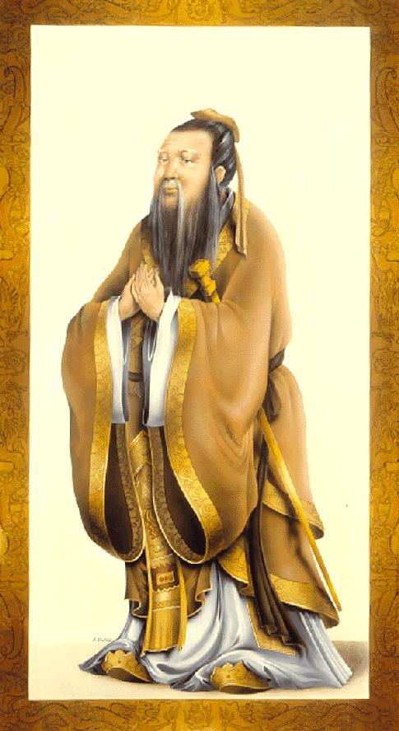
The Essence of Knowledge
Is Having It To Apply It
(Chinese Philosopher Confucious)
(551 B.C – 479 B.C)
Notes:
My favorite phrase! I print it on all my terminal examination papers.

Slide 11

Course Objectives

Slide 12

Prime Objectives of this Course
This course aims to acquaint the stu-dents comprehensively and in-depth with the subject of project stakehol-der management and engagement from a theoreticians as well as prac-titioner‘s perspective using high-quality textual/visual material and numerous real-life examples drawn from across the globe on this exci-ting, challenging, fast evolving and increasingly important specialized field of project management.
Notes:
An image says a thousand words! That is why extensive use is made of visual components (clipart, photographs and videographic material) in my PowerPoint presentations. Based on my years-long academic teaching experience with management science students at CIIT, this approach is highly effective and makes the learning process both fun and entertaining too.

Slide 13

Prime Objectives of this Course
It aims to motivate the students to deepen their insight of project stake-holder management and engage-ment after course completion and to apply their class-acquired knowledge creatively for the systematic, effec-tive and efficient management and engagement of stakeholders on pre-sent and future projects of varying complexity in their professional work environments.

Slide 14

Prime Objectives of this Course
This course furthermore aims to en-courage organizations through their current and future employees who are participating in it to put their project stakeholder management and engagement policies, strategies, plans, processes and tools on a more stakeholder-responsive footing which in time will bring more „win-win solutions“ for both them and their stakeholders.

Slide 15

Prime Objectives of this Course
Through the awareness and interest generated by this course, which at the present point in time is one of just a handful offered at universities across the world, it is hoped that more focussed research on project stakeholder management and engagement practices in public, for-profit and not-for-profit organiza-tions will be encouraged and spon-sored in future.

Slide 16

Rules for the Course Participants

Slide 17


Rules for Course Participants: The Do‘s
Do listen to my lectures very attentively and carefully! Listening is the basis for comprehension which is the prerequisite for performing well in this course. If you are having comprehension problems, inform me imme-diately. Do not hesitate otherwise it may be too late for me to help you.
Do ask questions or bring up relevant points for discussion in the classroom! You will not be punished for this! There is no such thing as a stupid question or discussion and I am very patient with students.
Always be inquisitive, analytical, critical and creative in your approach to learning project management!

Slide 18

Rules for Course Participants: The Do‘s
Do read the prescribed course literature! It is the basic requirement for comprehending project stakeholder management and the prerequisite for performing well in this demanding course!
Please note that using only my PowerPoint slides for your examination preparation is NOT sufficient! YOU MAY FAIL IF YOU DO SO! Some or all of the questions in all your examinations over the semester may relate to material in the recommended course text books and handouts which in class may not have been dis-cussed in detail or at all! An excellent piece of advice for you: Read from the beginning of the course and NOT towards the end! You won‘t regret it.

Slide 19


Rules for Course Participants: The Do‘s
Do visit me at my office (room 0147B in the Glenn Martin Hall) individually or as a group, if you have a course-related problem or problems and desire counseling! I am in office everyday from 9 AM to evenings. Mondays to Fridays are class evenings. My e-Mail is azkhan@umd.edu
Do fill out the anonymous course evaluation and course instructor evaluation forms at our online blackboard system at the end of the semester! All instructors have worked very hard to provide you with the best possible insights into project management and its specialized areas and over time we want to continuously and significantly improve the quality of our modules. Your honest and constructive criticism is very valuable for us and we certainly welcome it!

Slide 20

Rules for Course Participants: The Dont‘s
Don‘t be late to class! 6 PM means 6 PM sharp and not a second later! Two roll calls will be taken (at the beginning of class and after the break). Students who are late will be marked absent!
Don‘t ask me to mark you present if you are going to be absent in that class! I don‘t care what events in your personal or professional lives prevent you from coming to my class. Visiting family and friends, engagements, weddings, hospitalizations, funerals, official committ-ments etc. are your issues, not mine. If you are absent in my class, you‘ll simply be marked absent. Period!
Don‘t come to class just to get marked present and then wander of to the can-teen for gossip or refreshments, or leave the campus, outside the 20-minute customary pause. Anyone caught doing this will have their attendance revoked.

Slide 21


Rules for Course Participants: The Dont‘s
Don‘t use cell phones in class! Switch them off or put on silent mode prior to entering the classroom. Do not run in and out for making or taking calls and do not send SMS messages while the class is in progress. Such behaviour distracts the class and disrupts my presen-tation. If making or answering calls is so important to you, stay at your home or office and do them there, but do not come to my class!
Don‘t chit-chat among yourselves, distract the atten-tion of other course participants or behave immaturely in the class! You are only hurting yourself and your colleagues, not me. As educated adults, I expect you all without exception to behave as such from the minute you enter my class to the minute you leave it!

Slide 22
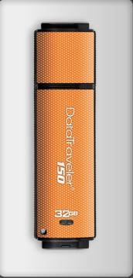
Rules for Course Participants: The Dont‘s
Don‘t come to me before, during or after classes with the request that I permit you to transfer data files from my laptop onto your USB flash or external hard drives!
From experience, students‘ flash drives often contain a number of very nasty viruses, worms, trojans etc. and their use entails a high risk of file infection and data corruption on my system which is unacceptable.
Class PowerPoint Presentations and supple-mentary files will be uploaded by me every week onto our online blackboard system for easy accessibility.

Slide 23


Rules for Course Participants: The Dont‘s
Don‘t procrastinate on your project assignments! Start work immediately after receiving your topics. Many students do nothing until the submission deadline is around the corner and then run frantically to me at the eleventh hour complaining about the problems they are having in getting information for their assignments. If you start working early you won‘t stress yourself out.
Don‘t pester me for more marks! I evaluate my students objectively and actually devote considerable time to read line by line through each examination paper and project assignment. From nothing comes nothing – if your work is crap, be prepared to get a crappy evaluation from me! And please don‘t whine about it.

Slide 24

Rules for Course Participants: The Dont‘s
Don‘t follow the „rote“ (Learning by Memorization) approach which you may have grown accustomed to since your schooldays. It is the worst thing you can do in my class – apart from outright misbehaviour, cheating or plagiarism.
My PowerPoint slides are designed as a subject guideline only and are NOT meant to be memorized. DO NOT reproduce the contents of my or someone elses slides in your project assignments/examinations.
In case of reproduction, marks will be heavily deducted and your grade in this course will drop like a stone from the sky.

Slide 25

Rules for Course Participants: The Dont‘s
Don‘t miss out on your project assignment and your examinations! Setting repeat examinations is a big nuisance for me and some marks are normally man-datorily deducted by our department as a disincen-tive for being absent! In the event that you have mis-sed out on your midterm examination due to com-pelling circumstances, I will – if department policy permits - schedule one repeat examination, but no additional repeats. If you also fail to show up for the repeat examination, you will be given zero marks which this will then be considered as final.
Note that as per CIIT rules absolutely NO RETAKE OF FINAL EXAMINATIONS IS ALLOWED!
It is your responsibility to immediately contact me if you missed a class assign-ment or examination!

Slide 26


Rules for Course Participants: The Dont‘s
Don‘t cheat in the midterm or final examinations! Your paper may be cancelled by the department or, at the very least, you will lose a percen-tage of your marks.
If your project assignments have, in full or in part, been plagiarized or simply copy-pasted from the World Wide Web without referencing, you will get zero marks and be reassigned another topic. Plagiarism can be de-termined using specialized software on material submitted electronically to me for evaluation.
NO CHEATING & PLAGIARISM!
ZERO
TOLERANCE!

Slide 27

Course Structure and Student Assessment

Slide 28
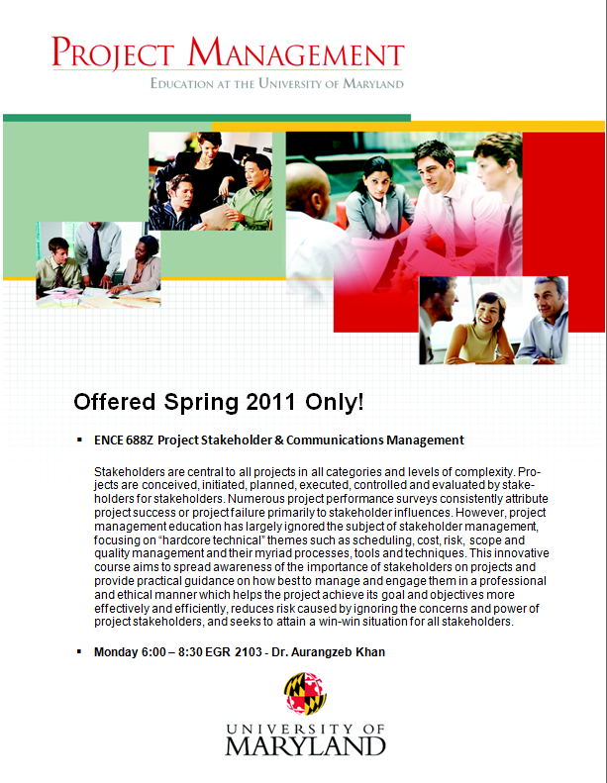
Course Structure and Materials
Lectures 01-06: Introduction to Project Stake-holder Management and Engagement.
Lectures 07-10: Stakeholders: Their Interests (Stakes), Roles and Responsi-bilities, and Relationship to Projects.
Lectures 11 & 12: Brief Overview of the Nine Principal Drivers of Project Stake-holder Management and Engagement.
Lectures 13-32: Managing and Engaging Project Stakeholders Professionally: The Project Stakeholder Governance Model (Institutional, Directional, Methodological, Technical, and Educational Components).
Students can access all course-related material through the University of Maryland’s online Blackboard System.

Slide 29

The Class Assignments
Assignments are a mandatory part of the course. There are 4 of them in total.
The assignments‘ purpose is to determine if, how and to what extent students can apply the concepts, processes, tools etc. they learn in this course, prefe-rably projects which the students may have undertaken in the past or which they are presently undertaking.
Assignments have a bridging function, directly linking classroom learning with on-the-job work.

Slide 30
The Assignment Guidelines
Think Carefully Before Attempting each assignment.
Quality and Original Work Only.
Relate to Your Work Experience (if you have it).
Late Submissions, Voluminous Sub-missions, and Resubmissions will not be accepted.
No Copy-Pasting from the Internet (assignment gets zero marks for this!).
No Arguing Over Marks!
Time flies! Therefore, do not procrastinate over your assignments.
You may find them to be more demanding than they seem at first glance.

Slide 31
The Assignment Structure Template
(For Research-based Assignments)
EXECUTIVE SUMMARY
One-page summarization of your class assignment.
ToC, LIST OF TABLES, FIGURES & ABB.
INTRODUCTION
Context, justification, scope, objectives, methodology and value of the assignment.
ANALYSIS
Application of class-acquired knowledge and personal experience to the given situation; holistic, analytical, critical, creative and thorough.
CONCLUSION & RECOMMENDATIONS
Restrict to a maximum of three pages.
APPENDIX
Include only relevant assignment-supporting documents.
BIBLIOGRAPHY & WEBLIOGRAPHY
Alphabetical listing of all documents (books, articles, reports etc.) and websites used in the assignment.
Quality takes precedence over quantity!
Class assignments must show originality and the ability to apply know-ledge learned in class.

Slide 32
The Class Quizzes
?
Like assignments, quizzes are a mandatory part of the course. There are 4 of them in total too for the course.
Each Quiz will consist of 25 MCQs (Multiple-Choice Questions), each containing five possble answers. Students will have to select one or more of these answers.

Slide 33
Graded Discussion Topics
Like assignments and quizzes, the Graded Discussion Topics are a mandatory part of the course. There are also 4 of them in total for the course.
Graded Discussion Topics are set by the Course Instructor; topics can cover the content of multiple lectures or a single lecture. Students are permitted to comment on their course mates‘ answers and comments.

Slide 34

The Midterm & Final Examinations
All students must sit through a mid-term examination (2 hours in duration, 25% total course marks) and a final examination (3 hours, 50% total course marks).
The examinations cover the material studied in class from the beginning of the course until the respective exami-nation date.
Students who can holistically and crea-tively apply their knowledge to given situations can expect to perform well in all the examinations.
Do not underestimate the difficulty level of these two examinations. You will be challenged!
USE YOUR MINDS AND READ THE QUESTIONS VERY CAREFULLY!

Slide 35
Guidelines for Midterm & Final Examinations
Mid-term Examination (two mandatory questions); Final Examination (three or four mandatory questions max.).
Questions may contain subquestions which must be answered. Questions do not necessarily carry equal marks.
Quality of answers, not quantity is the main criteria of evaluation.
Zero marks for irrelevant material or „reproducing“ my PPT-slides.
Laptops, digital diaries, calculators, cell phones, books, notes etc. are not per-mitted in the examinations.
All questions are essay-style (conceptual, applica-tive) in nature.
Often not much writing is expected – but definitely plenty of thinking!
NO MCQ’s WILL BE ASKED!

Slide 36


Samples of Examination Papers
(Project Stakeholder and Communication Management)
Refer to Module Handbook (Appendix I)
Final Examination (Fall 2008)
Final Examination (Spring 2009)
Final Examination (Fall 2009)
Final Examination (Spring 2010)

