Slide 1
Advanced Project Management
Project Organization and Integration
Lecture #6
Ghazala Amin
Notes:
1

Slide 2
PM Framework and Integration
Project Life Cycle
Team Development
Managing Project Human Resources
Processes
Project Initiation Planning
Executing/Control Closeout
WBS
Project
Monitoring
Project
Closeout
Project
Organizing
Control
Meetings
Project
Scheduling
Activities
Change and Risk Management
Contract and Customer Relationship Management

Slide 3

Project Parameter: Goal
All projects have one prime goal – for e.g., the development of a new camera, construction of a railway station, regeneration of a derelict neighbourhood, or process re-engineering for a large organization.
The goal must be as specific as possible so that there is no ambiguity about what the project intends to achieve.
In addition to the prime goal, projects may have subgoals and sub-sidiary goals (objectives).
The project goal and project deliverables along with all the requirements and specifications, which must be met by the project for it to be considered complete, determine the project‘s scope.
A project which does not achieve its goal is seen as failed.
Notes:
3

Slide 4
Project Parameters: Important Topics
Project Proposal
Project Contract
Project Charter
Elicitation of Project Requirements and Specifications
Project Statement of Work
Project Scope Statement
Project Work Breakdown Structure
Scope Creep, Control and Verification
Project Change Management
Project Integration Management
Notes:
4

Slide 5


Project Output & Outcome: Highway:Example
Project Phase
Project Life-Cycle
Initiation, Planning, Implementation and Closure of the Project
Project Output
Operations Phase
Short-term
Economic – Impact on investment, trade, local businesses, tourism, employment, inflation, wealth accumulation and distribution
Selected
Project Outcomes
(+ and -)
Medium-term
Social – Impact on services like health and education, travel, crime, social relations, communities‘ out-look and values
Not Projects: Routine main-tenance & repair
Long-term
Environmental – Impact on fauna and flora, pollution levels, waste accumulation and disposal
Projects: Highway extension, widening, recarpeting, con-struction of bridges, additional exit and entrance ramps, petrol stations and rest stops etc.
Notes:
Slide: „.....“
There may be benefits in other areas (for e.g. political) also which are not reviewed here.
5

Slide 6
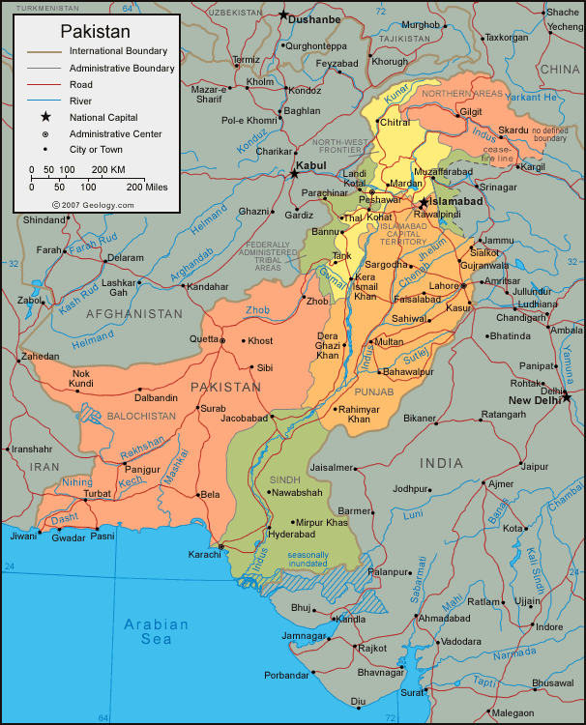

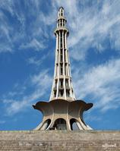






Major Projects in Pakistan (Examples)
Tarbela Dam
Mangla Dam
Ghazi-Barotha
HUBCO
Kot Addu
Chashma Nuclear Power Station
Islamabad-Lahore Motorway
Islamabad-Peshawar Motorway
Karakorum Highway
Jinnah International Airport
Allama Iqbal International Airport
Muslim Commercial Bank
National Stadium Karachi
Shah Faisal Mosque
Shaukat Khanum Memorial Hospital
JF-17 Sino-Pakistan Combat Aircraft
Notes:
6

Slide 7
What Projects Are Not
Projects must not be confused with an organization‘s on-going and recurring operations. For example:
Customer invoicing and billing
Fabrication or assembly of automobiles
Airline flights
Advising a bank client of stock market investment opportunities
Treatment of patients in a hospital emergency ward, and
Counselling of soldiers on a tour of wartime duty
are not projects even though they may exhibit project characteris-tics (goal, time-frame, cost).
Notes:
7

Slide 8
Project Organization Structure
Project Based Organization
    Organizations that drive their revenue primarily from performing projects
      Construction contractors, consultants, engineering firms etc.
    Organization that have adopted management by projects
      Have management systems and PMO with financial, reporting and performance tracking process in place.
Non Project Organization
    Often lack Mgmt system designed to support project needs effectively and efficiently
      Manufacturing companies, financial service providers etc.

Slide 9
Project Organization Structure
Functional
    An organization structure in which staff are grouped hierarchically by function and may be assigned to projects in a team.
Matrixed
    Project Manager shares responsibility with functional manager to assign priorities and direct work of assigned human resources ;
    a blend of functional and projectized organization. (PMBOK)
Projectized
    Project manager maintains complete authority over the entire project resources. Manages and leads the team till project closure.

Slide 10
The Functional Form of Organization
In the functional form of organization, work activities are structurally segmented according to their “function’ – i.e. their similarity of purpose. For example:
- Accounting & Finance
- Production
- Research & Development
- Marketing
IT Support
Procurement
- General Administration
These are the typical functions one would expect to find in most commercial organizations.
Project managers in functional organization must ensure that team understands
that conflicting orders will be given by other managers
Notes:
10

Slide 11
Project Coordination in Functional Organizations
Corporation X
Project Coordination
Human
Resources
Finance &
Administration
Marketing
Engineering
Manufacturing
Procurement
Electronics
Engineering
Software
Engineering
Mechanical
Engineering
Design
Purchasing
Receiving
& Inspection
Customer
Service
Domestic
Sales
International
Sales
Fabrication
Assembly
Testing
Production
Scheduling
Notes:
11

Slide 12
What is the Project Matrix Organization?
The Matrix organization is a form of project organization within the framework of which temporary horizontal (project) levels are applied over the permanent vertical (functional) levels of the organization.
Project Management defines three basic project matrix forms: the Functional Matrix, Balanced Matrix, and Project Matrix.
In practice, the matrix structure can assume many different manifestations and these may change over the course of the project life-cycle.
A weak matrix organization complicates team development process and activities
Notes:
12

Slide 13
The Balanced Project Matrix
Functional
Manager
Functional
Manager
Functional
Manager
Staff
Staff
Staff
Staff
Staff
Staff
PM
Staff
Staff
Staff
Staff
Staff
Project Coordination
Notes:
13

Slide 14
About the Project-Based Organization
In a project-based organization, most of the work performed is project work and this is reflected in the organization‘s structure which is not based on the functional paradigm but changes acccording to the projects which the organization has in its portfolio.
Project-based organizations are often found in the defence and construction industries, in the movie industry, in some NGOs and in some outsourced industries.
A strong or project matrix organization is best for handling cross-functional project needs for a large complex project.
Notes:
14

Slide 15
Structure of a Project-Based Organization
Corporation X
Marketing
Human
Resources
Other Projects
Other Projects
Finance and
Administration
Legal
Project Manager
(Project A)
Project Manager
(Project B)
Engineering
Manufacturing
Procurement
Engineering
Subcontractors
(X, Y, Z)
Manufacturing
Procurement
Notes:
15

