Slide 1
Advanced Project Management
PM Processes and Framework
Lecture #5
Ghazala Amin
Notes:
1

Slide 2
About Project Management
Project Management is a formalized and structured method comprising a set of interrelated processes and tools, ranging from simple to complex, and is based on the accepted principles of management used for planning, estimating and controlling work activities with a view to developing specifically defined outputs that are to be delivered by a certain time, to a defined quality standard and with a given level of resources so that the project goal and outcomes/benefits are realized.
Effective project management is essential for the success of any project – whether in the private or public sectors – and irrespective of its category, size and complexity.
Management by projects treats many aspects of ongoing operations as projects in order to apply project management techniques to them.
Notes:
2

Slide 3
Project Management Context
Representative Project Life Cycle (typical)
  Initiation/Concept/Feasibility
  Planning/Development
  Execution/Implementation
  Control/Monitoring
  Close-out/Termination/Finish

Slide 4
Project Management Context
Human resource and project cost need is greatest in the execution phase
Project Cost and
Project Staffing
Initiation Planning Execution Closeout
Control

Slide 5
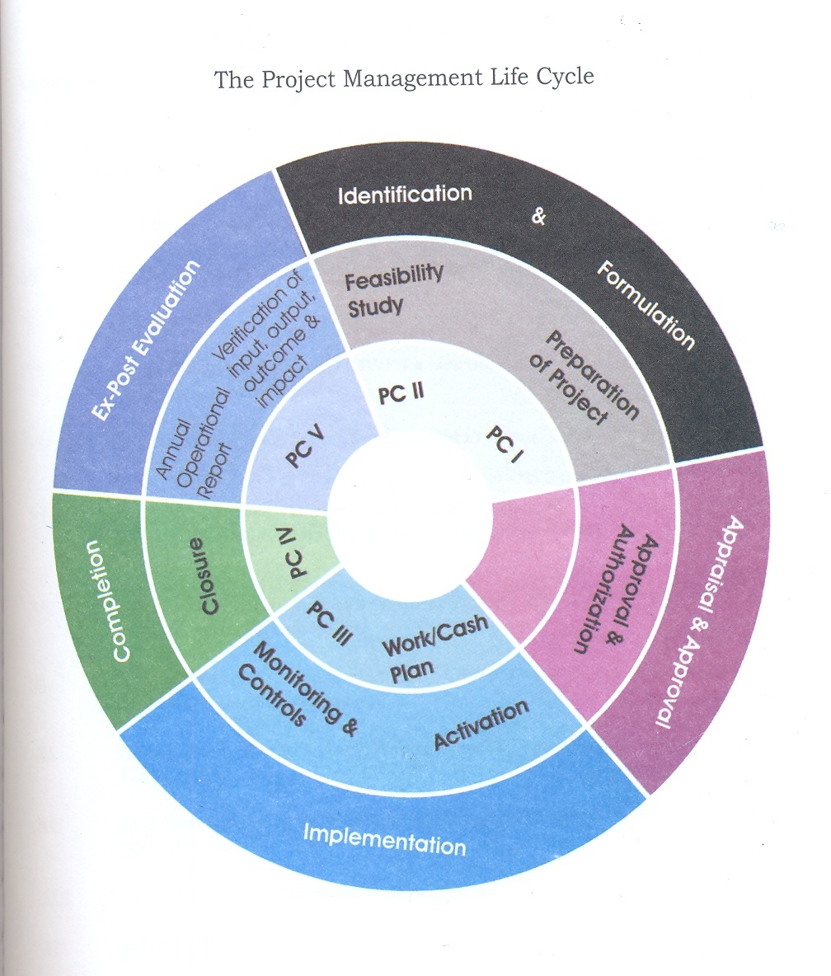
Project Management Life Cycle: Planning Commission of Pakistan

Slide 6
The Project Management Context
Characteristics of Project Phases or Process group
  Each project phase is marked by completion of one or more deliverables (a tangible piece of work)
  Phase End reviews determine if the project should continue to the next phase.
Characteristics of the Project Life Cycle
  Serves to define the beginning and the end of a project
  Project Life cycle is collection of project phases

Slide 7
Process Interactions
Process – Series of actions bringing about a result.
Individual processes within a process group are linked by their inputs and outputs
Each process is defined by
  Inputs: Documents or documentable items that will be acted upon
  Tools and Techniques: Mechanisms applied to the inputs to create the outputs
  Outputs: Documents or documentable items that are a result of the process

Slide 8
Project Management Processes
Core Processes
  Have clear dependencies that require them to be performed in essentially the same order on most projects
  Example : planning, estimating, development, test etc.
Facilitating Processes
  Dependent on the nature of the project
  Performed intermittently as needed but are not optional
  Example: Quality assurance, CCB Meetings, sponsor review etc.

Slide 9
Major Project Management Standards
(Conventional Types and Customized)
“Off-the-Shelf” Project Management Standards
“In-House” Project Management Standards and Methodology
Developed in Organizations based on their own specific requirements, policies and environment and may incorporate processes and tools from one or more off-the-shelf standards
PMBOK, Prince 2, IMPA Baseline, APMBOK, P2M, BS 6079, AGILE, Sofware Process Models
Examples:
Notes:
9

Slide 10
Project Management Methodology
A methodology is a framework of processes and tools tested on diverse projects.
Some of the reputable International organizations for maintaining world wide standards and certifications for project management are;
PMI – Project Management Institute (www.pmi.org)
PRINCE2 – PRojects IN Controlled Environments
IPMA - The International Project Management Association
APM - The Association of Project Management
Notes:
10

Slide 11
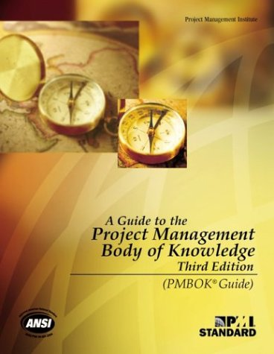
The Project Management Body of Knowledge
The Project Management Institute’s Body of Knowledge – PMBOK – is perhaps the most widely acknowledged and popular project management standard in existence. It is the basis for the PMI’s coveted PMP certification examinations.
Presently in its fourth version (2008), PMBOK offers a comprehensive and sophisticated best practices and process-based standard which can be applied to different categories of projects. At the heart of the PMBOK are the nine areas of knowledge and five process groups which find application over the project life-cycle.
Notes:
11

Slide 12
Introduction to Project Management
Project Management Knowledge Areas – Per PMI (Project Management Institute)
  Describe Project Management knowledge and practice in terms of its component processes
  Mapping of the 9 knowledge areas to the five process groups.

Slide 13
PMBOK Knowledge Areas
Project Integration Management
Project Scope Management
Project Time Management
Project Cost Management
Project Quality Management
Project Human Resource Management
Project Communications Management
Project Risk Management
Project Procurement Management

Slide 14
The 9 PMBOK Areas & 5 Process Groups
Integration Management
Initiation
Scope Management
PROCESSES
42
Time Management
Planning
Cost Management
Implementation/
Execution
Quality Management
Project Management Knowledge Areas (PMBOK)
Human Resource Management
Monitoring, Evaluation & Control
Communication Management
Risk Management
Closure
Procurement Management
Notes:
14

Slide 15
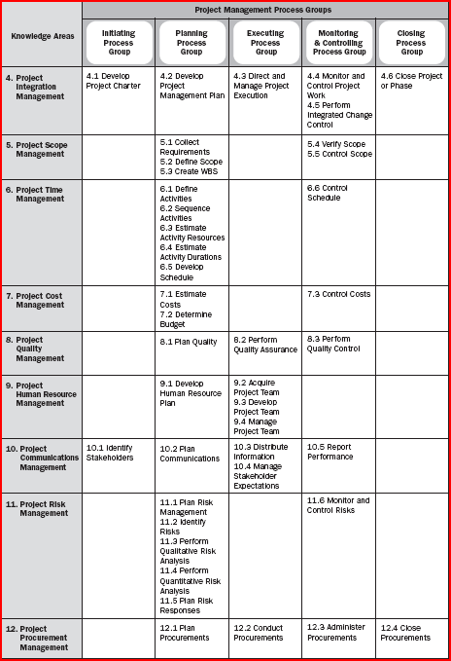
42 Processes
9 Knowledge Areas
5
Process Groups

