Slide 1
Sampling Design and Analysis
MTH 494
Ossam Chohan
Assistant Professor
CIIT Abbottabad

Slide 2
LECTURE-6

Slide 3
So far we have done…..

Slide 4
Sampling Techniques

Slide 5
Important statistical terms
Population:
a set which includes all
measurements of interest
to the researcher
(The collection of all responses, measurements, or counts
that are of interest)
Sample:
A subset of the population

Slide 6
Why sampling?
Get information about large populations
Less costs
Less field time
More accuracy i.e. Can Do A Better Job of Data Collection
When it’s impossible to study the whole population

Slide 7
Target Population:
The population to be studied/ to which the investigator wants to generalize his results
Sampling Unit:
smallest unit from which sample can be selected
Sampling frame
List of all the sampling units from which sample is drawn
Sampling scheme
Method of selecting sampling units from sampling frame

Slide 8
Types of sampling
Non-probability samples
Probability samples

Slide 9
Non probability samples
Convenience samples (ease of access)
sample is selected from elements of a population that are easily accessible
Snowball sampling (friend of friend….etc.)
Purposive sampling (judgemental)
    You chose who you think should be in the study
  Quota sample

Slide 10
Non probability samples
Probability of being chosen is unknown
Cheaper- but unable to generalise
potential for bias

Slide 11
Probability samples
Random sampling
  Each subject has a known probability of being selected
Allows application of statistical sampling theory to results to:
  Generalise
  Test hypotheses

Slide 12
Conclusions
Probability samples are the best
Ensure
  Representativeness
  Precision

Slide 13
Methods used in probability samples
Simple random sampling
Systematic sampling
Stratified sampling
Multi-stage sampling
Cluster sampling

Slide 14
Simple random sampling

Slide 15
Table of random numbers
6 8 4 2 5 7 9 5 4 1 2 5 6 3 2 1 4 0
5 8 2 0 3 2 1 5 4 7 8 5 9 6 2 0 2 4
3 6 2 3 3 3 2 5 4 7 8 9 1 2 0 3 2 5
9 8 5 2 6 3 0 1 7 4 2 4 5 0 3 6 8 6

Slide 16
Systematic sampling
Sampling fraction
Ratio between sample size and population size

Slide 17
Systematic sampling

Slide 18
Cluster sampling
Cluster: a group of sampling units close to each other i.e. crowding together in the same area or neighborhood

Slide 19
Cluster sampling
Section 1
Section 2
Section 3
Section 5
Section 4

Slide 20
Stratified sampling
Multi-stage sampling

Slide 21
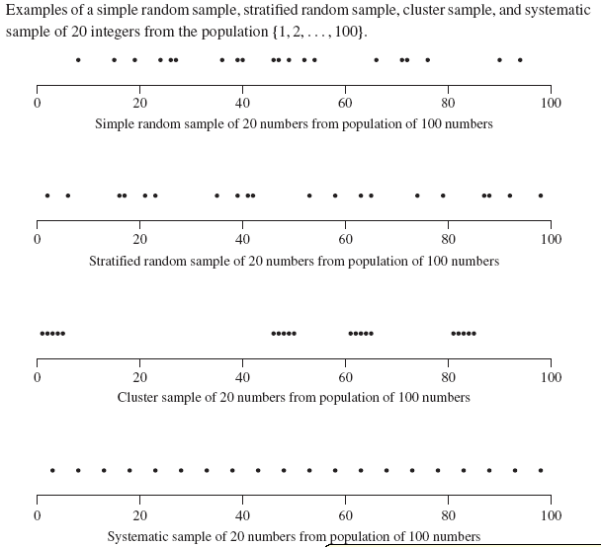

Slide 22
Explanation of figure
In the above we tried to illustrate the differences among simple random, stratified, cluster, and systematic sampling for selecting a sample of 20 integers from the population {1, 2, . . . , 100}. For the stratified sample, the population was divided into the 10 strata {1, 2, . . . , 10}, {11, 12, . . . , 20}, . . . , {91, 92, . . . , 100}, and an SRS of 2 numbers was drawn from each of the 10 strata. This ensures that each stratum is represented in the sample.
For the cluster sample, the population was divided into 20 clusters {1, 2, 3, 4, 5}, {6, 7, 8, 9, 10}, . . . , {96, 97, 98, 99, 100}; an SRS of 4 of these clusters was selected.
For the systematic sample, the random starting point was 3, so the sample contains units 3, 8, 13, 18, and so on. !

Slide 23
All of these methods—simple random sampling, stratified random sampling, cluster sampling, and systematic sampling—involve random selection of units to be in the sample. In an SRS, the observation units themselves are selected at random from the population of observation units; in a stratified random sample, observation units within each stratum are randomly selected; in a cluster sample, the clusters are randomly selected from the population of all clusters. Each method is a form of probability sampling, which we discuss in the next section.

Slide 24
Recall-------------Errors in sample
Systematic error (or bias)
Inaccurate response (information bias)
  Selection bias
Sampling error (random error)

Slide 25
Simple Random Sampling
Everyone talks about Simple Random Sampling (SRS), but very few pay attention to its roots.
There are two segments of this technique, Random Sampling and Simple Random Sampling.

Slide 26
Random Sampling
The simplest type of random sample is a simple random sample, often called an SRS. Moore and McCabe define a simple random sample as follows:
"A simple random sample (SRS) of size n consists of n individuals from the population chosen in such a way that every set of n individuals has an equal chance to be the sample actually selected.“
Here, population refers to the collection of people, animals, locations, etc. that the study is focusing on.

Slide 27
Some examples
In a medical study, the population might be all adults over age 50 who have high blood pressure.
In another study, the population might be all hospitals in the U.S. that perform heart bypass surgery.
If we are studying whether a certain die is fair or weighted, the population would be all possible tosses of the die.

Slide 28
In Example 3, it is fairly easy to get a simple random sample: Just toss the die n times, and record each outcome.
Selecting a simple random sample in examples 1 and 2 is much harder. A good way to select a simple random sample for Example 2 would proceed as follows:
First, obtain or make a list of all hospitals in the U.S. that perform heart bypass surgery. Number them 1, 2, ... up to the total number M of hospitals in the population. (Such a list is called a sampling frame.)
Then use some sort of random number generating process to obtain a simple random sample of size n from the population of integers 1, 2, ..., M. The simple random sample of hospitals would consist of the hospitals in the list that correspond to the numbers in the SRS of numbers.

Slide 29
Sampling Distribution
Transition from Data Analysis and Probability to Statistics

Slide 30
Sampling Distributions
Population parameter: a numerical descriptive measure of a population.
(for example: μ, σ , p (a population proportion); the numerical value of a population parameter is usually not known)
Example: μ = mean height of all NCSU students
p=proportion of Raleigh residents who favor stricter gun control laws
Sample statistic: a numerical descriptive measure calculated from sample data.
(e.g, x, s, p (sample proportion))

Slide 31
Parameters; Statistics
In real life parameters of populations are unknown and unknowable.
  For example, the mean height of US adult (18+) men is unknown and unknowable
Rather than investigating the whole population, we take a sample, calculate a statistic related to the parameter of interest, and make an inference.
The sampling distribution of the statistic is the tool that tells us how close the value of the statistic is to the unknown value of the parameter.

Slide 32
DEF: Sampling Distribution
The sampling distribution of a sample statistic calculated from a sample of n measurements is the probability distribution of values taken by the statistic in all possible samples of size n taken from the same population.
Based on all possible samples of size n

Slide 33
Important concepts about sampling distributions:
If a sample is representative of the population, the mean (on a variable of interest) for the sample and the population should be the same.
However, there will be some variation in the value of sample means due to random or sampling error. This refers to things you can’t necessarily control in a study or when you collect a sample.
The amount of variation that exists among sample means from a population is called the standard error of the mean.
Standard error decreases as sample size increases.

Slide 34
Sampling in Research???

Slide 35
Important topics to discuss
What is sampling?
  A representative sample
Various sampling designs
The role of sampling in quantitative research
Example of the dangers of convenience sampling in relations to quantitative research
  With a focus on Business
Concluding remarks

Slide 36
What is sampling?
A sample in the very general sense is a set of units observed from the all possible units.
  The desire in taking a sample is to learn about a larger group, the population.
The sampling frame is the set of units the researcher will take the sample from.
  Ideally the sampling frame is the same as the population of interest.
  In reality this is often not possible.
The sampling design is the methodology in which the data is collected.
  The sampling design can aid in obtaining a representative sample of the population. That is a sample that’s attributes are similar to the population of interest.

Slide 37
Type 1 error
The probability of finding a difference with our sample compared to population, and there really isn’t one….
Known as the α (or “type 1 error”)
Usually set at 5% (or 0.05)

Slide 38
Type 2 error
The probability of not finding a difference that actually exists between our sample compared to the population…
Known as the β (or “type 2 error”)
Power is (1- β) and is usually 80%

