Slide 1
Sampling Design and Analysis
MTH 494
Ossam Chohan
Assistant Professor
CIIT Abbottabad

Slide 2
Course proceedings
We would like to dedicate few lectures to understand the basics of Statistics.
We will avoid to go in deep discussions as our course is not to address basics but Sampling design issues.
You should know the core concepts so that in future work we can understand the concepts in true sense.

Slide 3
Review of Lecture-1
So far we have learned-
Statistics and data presentation/data summarization
Graphical Presentation: Bar Chart, Pie Chart, Histogram, and Box Plot
Numerical Presentation: Measuring Central value of data (mean, median, mode etc.), measuring dispersion (standard deviation, variance, co-efficient of variation, range, inter-quartile range etc), quartiles, percentiles, and five number summary

Slide 4
Objective of Lecture-2
Probability……………………………………………

Slide 5
Probability is a measure of the likelihood of a random phenomenon or chance behavior. Probability describes the long-term proportion with which a certain outcome will occur in situations with short-term uncertainty.
EXAMPLE
Simulate flipping a coin 100 times. Plot the proportion of heads against the number of flips. Repeat the simulation.

Slide 6
Probability deals with experiments that yield random short-term results or outcomes, yet reveal long-term predictability.
The long-term proportion with which a certain outcome is observed is the probability of that outcome.

Slide 7
The Law of Large Numbers
As the number of repetitions of a probability experiment increases, the proportion with which a certain outcome is observed gets closer to the probability of the outcome.

Slide 8
In probability, an experiment is any process that can be repeated in which the results are uncertain.
A simple event is any single outcome from a probability experiment. Each simple event is denoted e_{i}.

Slide 9
The sample space, S, of a probability experiment is the collection of all possible simple events. In other words, the sample space is a list of all possible outcomes of a probability experiment.

Slide 10
An event is any collection of outcomes from a probability experiment. An event may consist of one or more simple events. Events are denoted using capital letters such as E.

Slide 11
EXAMPLE Identifying Events and the Sample Space of a Probability Experiment
Consider the probability experiment of having two children.
(a) Identify the simple events of the probability experiment.
(b) Determine the sample space.
(c) Define the event E = “have one boy”.
Notes:
Answer:
a) (boy, girl), (girl, girl), (boy, boy)
b) (boy, girl), (girl, girl), (boy, boy)
c) (boy, girl), (boy, boy)

Slide 12
The probability of an event, denoted P(E), is the likelihood of that event occurring.

Slide 13
  Properties of Probabilities
The probability of any event E, P(E), must be between 0 and 1 inclusive. That is,
0 < P(E) < 1.
2. If an event is impossible, the probability of the event is 0.
3. If an event is a certainty, the probability of the event is 1.
4. If S = {e₁, e₂, …, e_{n}}, then
P(e₁) + P(e₂) + … + P(e_{n}) = 1.

Slide 14
An unusual event is an event that has a low probability of occurring.

Slide 15
Three methods for determining the probability of an event:
(1) the classical method

Slide 16
Three methods for determining the probability of an event:
(1) the classical method
(2) the empirical method

Slide 17
Three methods for determining the probability of an event:
(1) the classical method
(2) the empirical method
(3) the subjective method

Slide 18
The classical method of computing probabilities requires equally likely outcomes.
An experiment is said to have equally likely outcomes when each simple event has the same probability of occurring.

Slide 19

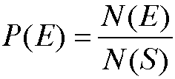
Computing Probability Using the Classical Method
If an experiment has n equally likely simple events and if the number of ways that an event E can occur is m, then the probability of E, P(E), is
So, if S is the sample space of this experiment, then

Slide 20
EXAMPLE Computing Probabilities Using the Classical Method
Suppose a “fun size” bag of M&Ms contains 9 brown candies, 6 yellow candies, 7 red candies, 4 orange candies, 2 blue candies, and 2 green candies. Suppose that a candy is randomly selected.
(a) What is the probability that it is brown?
(b) What is the probability that it is blue?
(c) Comment on the likelihood of the candy being brown versus blue.

Slide 21
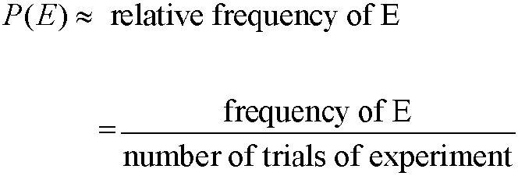
Computing Probability Using the Empirical Method
The probability of an event E is approximately the number of times event E is observed divided by the number of repetitions of the experiment.

Slide 22
EXAMPLE Using Relative Frequencies to Approximate Probabilities
The following data represent the number of homes with various types of home heating fuels based on a survey of 1,000 homes.
(a) Approximate the probability that a randomly selected home uses electricity as its home heating fuel.
(b) Would it be unusual to select a home that uses coal or coke as its home heating fuel?

Slide 23
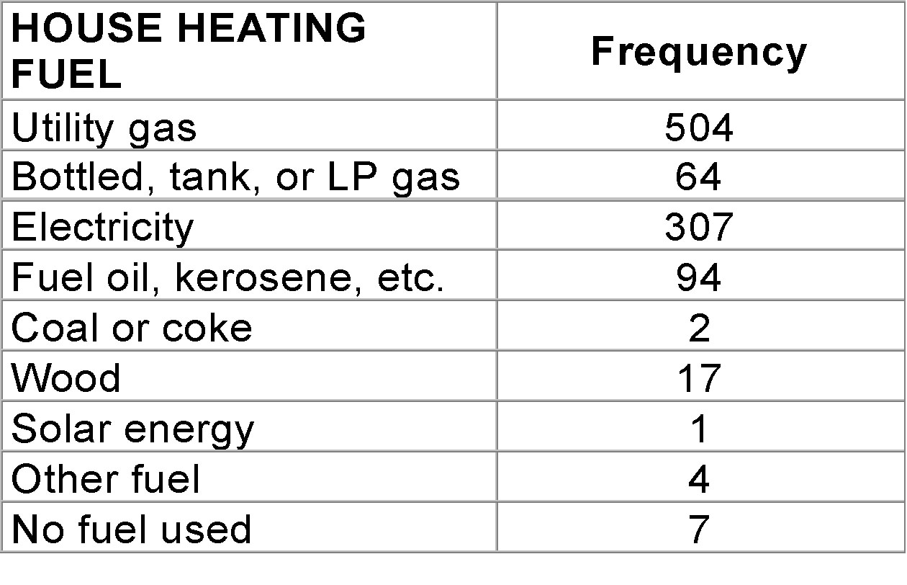

Slide 24
EXAMPLE Using Simulation
Simulate throwing a 6-sided die 100 times. Approximate the probability of rolling a 4. How does this compare to the classical probability?

Slide 25
Subjective probabilities are probabilities obtained based upon an educated guess.
For example, there is a 40% chance of rain tomorrow.

Slide 26
Let E and F be two events.
E and F is the event consisting of simple events that belong to both E and F.
E or F is the event consisting of simple events that belong to either E or F or both.

Slide 27
EXAMPLE Illustrating the Addition Rule
Suppose that a pair of fair dice are thrown.
Let E=“rolling a seven”, compute the probability of rolling a seven, i.e., P(E).
b) Let E=“rolling a two ” (called ‘snake eyes’), compute the probability of rolling “snake eyes”, i.e., P(E).
Let E = “the first die is a two” and let F = “the sum of the dice is less than or equal to 5”. Find P(E or F) directly by counting the number of ways E or F could occur and dividing this result by the number of possible outcomes.
Notes:
P(E) = N(E)/N(S) = 6/36 = 1/6
1/6
P(E or F) = P(E) + P(F) –P(E and F)
=

Slide 28
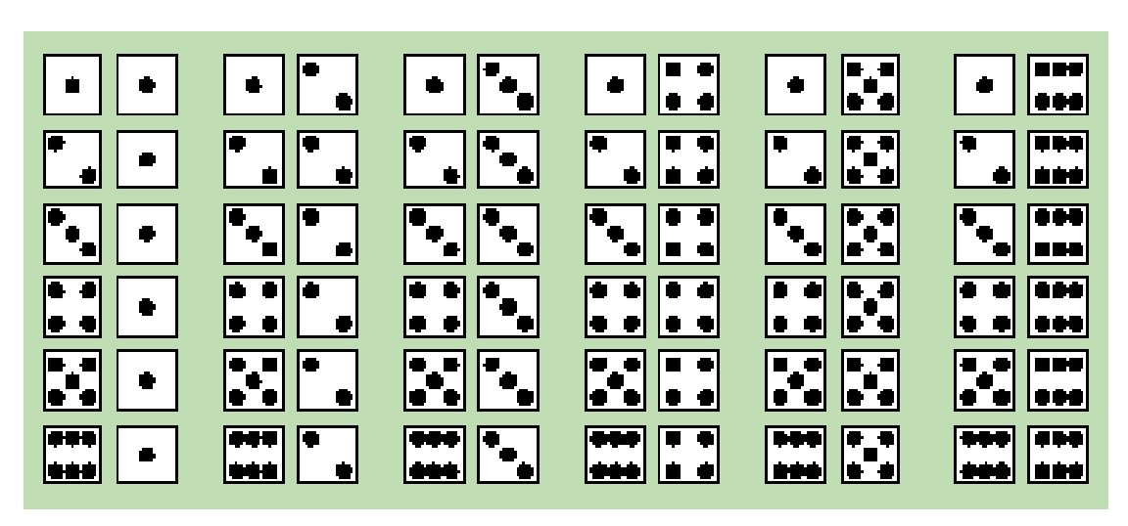

Slide 29
  Addition Rule
For any two events E and F,
P(E or F) = P(E) + P(F) – P(E and F)

Slide 30
Answer:
a) P(E) = N(E)/N(S) = 6/36 = 1/6
b) 1/6
c) N(E) = 6, N(F)=4+3+2+1 =10,
N(E and F) =3 , so N(E or F) =13

Slide 31
EXAMPLE The Addition Rule
Redo the last example using the Addition Rule.

Slide 32
Venn diagrams represent events as circles enclosed in a rectangle. The rectangle represents the sample space and each circle represents an event.

Slide 33
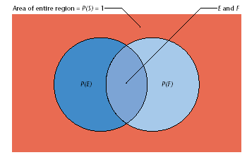

Slide 34
If events E and F have no simple events in common or cannot occur simultaneously, they are said to be disjoint or mutually exclusive.

Slide 35
  Addition Rule for Mutually Exclusive Events
If E and F are mutually exclusive events, then
P(E or F) = P(E) + P(F)
In general, if E, F, G, … are mutually exclusive events, then
P(E or F or G or …) = P(E) + P(F) + P(G) + …

Slide 36
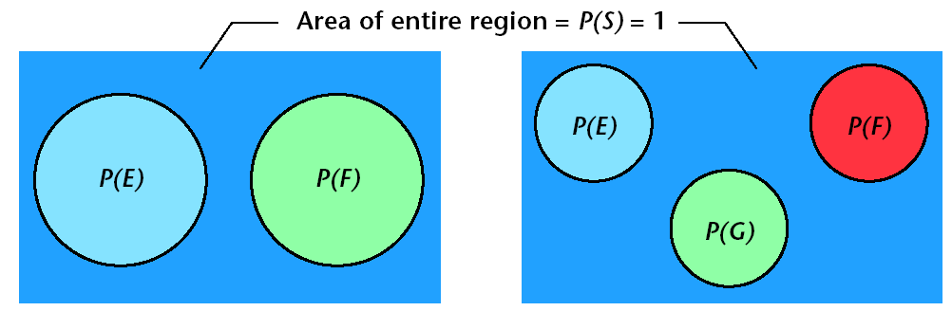
Events E and F are Mutually Exclusive
Events E, F and G are Mutually Exclusive

Slide 37
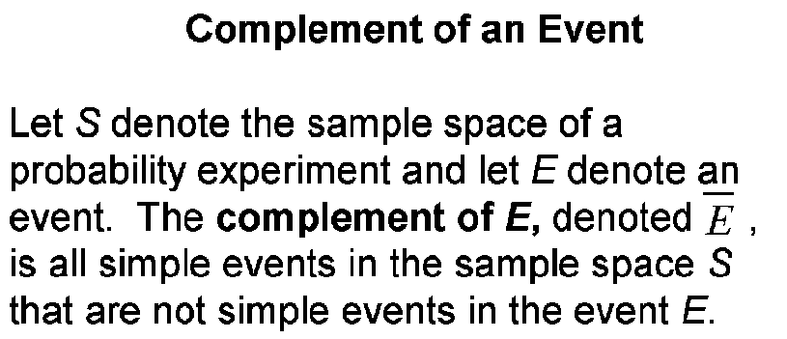

Slide 38
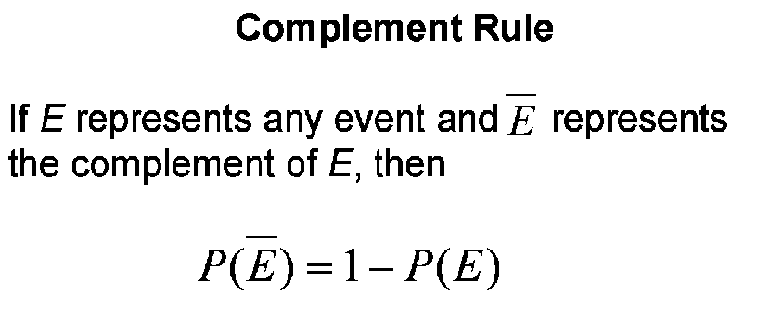

Slide 39
EXAMPLE Illustrating the Complement Rule
According to the American Veterinary Medical Association, 31.6% of American households own a dog. What is the probability that a randomly selected household does not own a dog?
E= Own a dog
P(E) =31.6%

Slide 40
EXAMPLE Illustrating the Complement Rule
The data on the following page represent the travel time to work for residents of Hartford County, CT.
(a) What is the probability a randomly selected resident has a travel time of 90 or more minutes?
(b) What is the probability a randomly selected resident has a travel time less than 90 minutes?

Slide 41
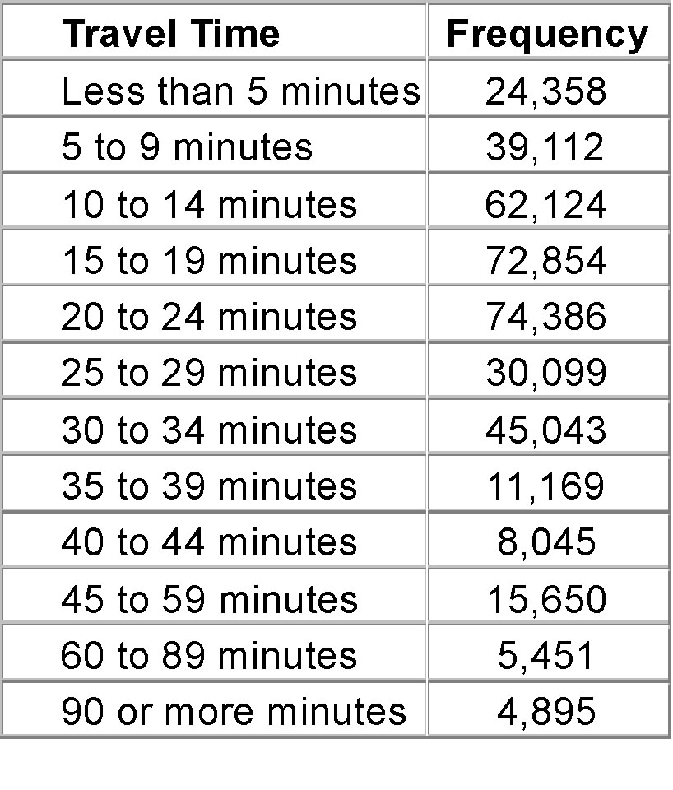
Source: United States Census Bureau, 2000 Supplementary Survey

Slide 42
EXAMPLE Illustrating the Multiplication Rule
Suppose a jar has 2 yellow M&Ms, 1 green M&M, 2 brown M&Ms, and 1 blue M&Ms. Suppose that two M&Ms are randomly selected. Use a tree diagram to compute the probability that the first M&M selected is brown and the second is blue.
NOTE: Let the first yellow M&M be Y₁, the second yellow M&M be Y₂, the green M&M be G, and so on.

Slide 43
  Conditional Probability
The notation P(F | E) is read “the probability of event F given event E”. It is the probability of an event F given the occurrence of the event E.

Slide 44
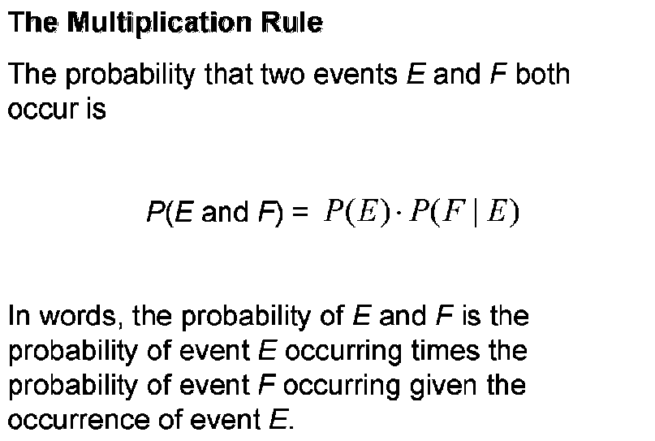

Slide 45
EXAMPLE Computing Probabilities Using the Multiplication Rule
Redo the first example using the Multiplication Rule.

Slide 46
EXAMPLE Using the Multiplication Rule
The probability that a randomly selected murder victim was male is 0.7515. The probability that a randomly selected murder victim was less than 18 years old given that he was male was 0.1020. What is the probability that a randomly selected murder victim is male and is less than 18 years old?
Data based on information obtained from the United States Federal Bureau of Investigation.
P(male and <18)=p(<18)*P(male|<18)
P(male and <18)=p(male)*P(<18|male) =0.7515*0.1020=0.076653

Slide 47
Two events E and F are independent if the occurrence of event E in a probability experiment does not affect the probability of event F. Two events are dependent if the occurrence of event E in a probability experiment affects the probability of event F.

Slide 48
Definition of Independent Events
Two events E and F are independent if and only if
P(F | E) = P(F) or P(E | F) = P(E)

Slide 49
EXAMPLE Illustrating Independent Events
The probability a randomly selected murder victim is male is 0.7515. The probability a randomly selected murder victim is male given that they are less than 18 years old is 0.6751.
Since P(male) = 0.7515 and
P(male | < 18 years old) = 0.6751,
the events “male” and “less than 18 years old” are not independent. In fact, knowing the victim is less than 18 years old decreases the probability that the victim is male.

Slide 50
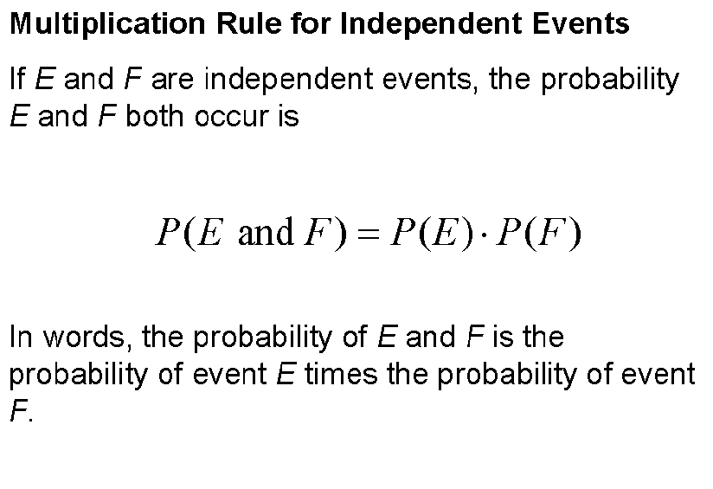

Slide 51
EXAMPLE Illustrating the Multiplication Principle for Independent Events
The probability that a randomly selected female aged 60 years old will survive the year is 99.186% according to the National Vital Statistics Report, Vol. 47, No. 28. What is the probability that two randomly selected 60 year old females will survive the year?
99.186% * 99.186% =98.38%

Slide 52
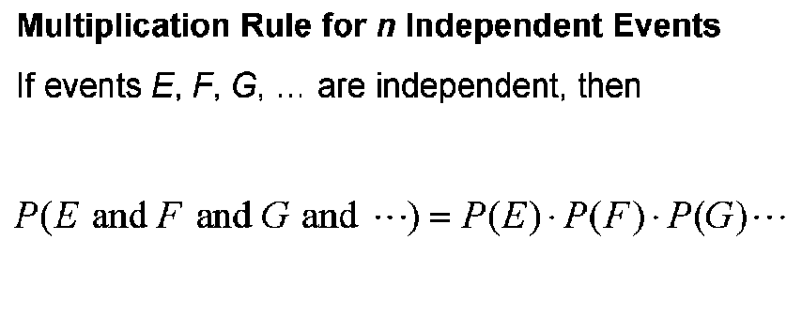

Slide 53
EXAMPLE Illustrating the Multiplication Principle for Independent Events
The probability that a randomly selected female aged 60 years old will survive the year is 99.186% according to the National Vital Statistics Report, Vol. 47, No. 28. What is the probability that four randomly selected 60 year old females will survive the year?
0.99186* 0.99186* 0.99186* 0.99186=96.78%

Slide 54
Suppose we have a box full of 500 golf balls. In the box, there are 50 Titleist golf balls.
(a) Suppose two golf balls are selected randomly without replacement. What is the probability they are both Titleists?
(b) Suppose a golf ball is selected at random and then replaced. A second golf ball is then selected. What is the probability they are both Titleists? NOTE: When sampling with replacement, the events are independent.

Slide 55
If small random samples are taken from large populations without replacement, it is reasonable to assume independence of the events. Typically, if the sample size is less than 5% of the population size, then we treat the events as independent.

Slide 56
EXAMPLE Computing “at least” Probabilities
The probability that a randomly selected female aged 60 years old will survive the year is 99.186% according to the National Vital Statistics Report, Vol. 47, No. 28. What is the probability that at least one of 500 randomly selected 60 year old females will die during the course of the year?
1-P(All Survived)=1-0.99186^500=50.4%

Slide 57
Summary of Lecture-2
We just discussed probability and its related topics.

