Slide 1
Sampling Design and Analysis
MTH 494
LECTURE-12
Ossam Chohan
Assistant Professor
CIIT Abbottabad

Slide 2
Confidence Intervals
Confidence Interval: An interval of values computed from the sample, that is almost sure to cover the true population value.
We make confidence intervals using values computed from the sample, not the known values from the population
Interpretation: In 95% of the samples we take, the true population proportion (or mean) will be in the interval.
This is also the same as saying we are 95% confident that the true population proportion (or mean) will be in the interval

Slide 3
Sample Size Estimation
An investigator might have number of goals while handling samplings issue.
Deciding amount of sampling error and balance the precision of estimates with the cost of survey especially in SRS.
Estimating a sample size is one of the major goal of surveys.

Slide 4
A wrong approach
  Many people usually ask “what percentage of the population should I include in my sample”.
  Ideally focus should be on precision of estimates.
Precision is obtained through the absolute size of the sample, not the proportion of the population covered (except in very small populations)

Slide 5
When should a Simple Random Sample Be Used?
Avoid SRS in such situations
  Before taking an SRS, you should consider whether a survey sample is the best method for studying your research question.
  You may not have a list of the observation units, or it may be expensive in terms of travel time to take an SRS.
  You may have additional information that can be used to design a more cost effective sampling scheme.

Slide 6
SRS should be used in following situations
Little extra information is available that can be used when designing the survey like sampling frame.
Person using the data insist on using SRS formula, whether they are appropriate or not.
The primary interest is in multivariate relationships such as regression equations that hold for the whole population, and there are no compelling reasons to take a stratified or cluster sample.

Slide 7
Key Terms Used in SRS Unit
Cluster sample: A probability sample in which each population unit belongs to a group, or cluster, and the clusters are sampled according to the sampling design.
Confidence interval (CI): An interval estimate for a population quantity, for which the probability that the random interval contains the true value of the population quantity is known.
Design-based inference: Inference for finite population characteristics based on the survey design, also called randomization inference.
Finite population correction (fpc): A correction factor which, when multiplied by the with-replacement variance, gives the without-replacement variance. For an SRS of size n from a population of size N, the fpc is 1 − n/N.

Slide 8
Inclusion probability: π_{i} = probability that unit i is included in the sample.
Margin of error: Half of the width of a 95% CI.
Model-based inference: Inference for finite population characteristics based on a model for the population, also called prediction inference.
Probability sampling: Method of sampling in which every subset of the population
has a known probability of being included in the sample.
Sampling distribution: The probability distribution of a statistic generated by the
sampling design.

Slide 9
Sampling weight: Reciprocal of the inclusion probability; w _{i} =1/π_{i}.
Self-weighting sample: A sample in which all probabilities of inclusion π_{i} are equal, so that all sampling weights wi are the same.
Simple random sample with replacement (SRSWR): A probability sample in which the first unit is selected from the population with probability 1/N; then the unit is replaced and the second unit is selected from the set of N units with probability 1/N, and so on until n units are selected.

Slide 10
Simple random sample without replacement (SRS): An SRS of size n is a probability sample in which any possible subset of n units from the population has the same probability = (n!(N −n)!/N!) of being the sample selected.
Standard error (SE): The square root of the estimated variance of a statistic.
Stratified sample: A probability sample in which population units are partitioned
into strata, and then a probability sample of units is taken from each stratum.
Systematic sample: A probability sample in which every k^{th} unit in the population
is selected to be in the sample, starting with a randomly chosen value R. Systematic
sampling is a special case of cluster sampling.

Slide 11
STRATIFIED SAMPLING

Slide 12
STRATIFIED SAMPLING
1. Stratification: The elements in the population are divided into layers/groups/ strata based on their values on one/several auxiliary variables. The strata must be non-overlapping and together constitute the whole population.
2. Sampling within strata: Samples are selected independently from each stratum. Different selection methods can be used in different strata.

Slide 13
Ex. Stratification of individuals by age group
Stratum | Age group
1 | 17 or younger
2 | 18-24
3 | 25-34
4 | 35-44
5 | 45-54
6 | 55-64
7 | 65 or older

Slide 14
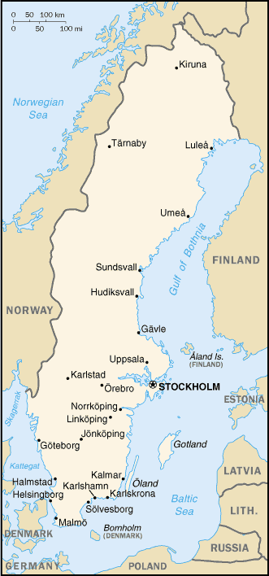
Ex. Regional
stratification
Stratum 1: Northern Sweden
Stratum 2: Mid-Sweden
Stratum 3: Southern Sweden

Slide 15
Ex. Stratification of individuals by age group and region
Stratum | Age group | Region
1 | 17 or younger | Northern
2 | 17 or younger | Mid
3 | 17 or younger | Southern
4 | 18-24 | Northern
5 | 18-24 | Mid
6 | 18-24 | Southern
etc. | etc. | etc.

Slide 16
WHY STRATIFY?
Gain in precision. If the strata are more homogenous with respect to the study variable(s) than the population as a whole, the precision of the estimates will improve.
Strata = domains of study. Precision requirements of estimates for certain subpopulations/domains can be assured by using domains as strata.

Slide 17
WHY STRATIFY?, cont’d
Practical reasons. For instance nonresponse rates, method of measurement and the quality of auxiliary information may differ between subpopulations, and can be efficiently handled by stratification.
Administrative reasons. The survey organization may be divided into geographical districts that makes it natural to let each district be a stratum.

Slide 18
IMPORTANT DESIGN CHOICES IN STRATIFIED SAMPLING
Stratification variable(s)
Number of strata
Sample size in each stratum (allocation)
Sampling design in each stratum
Estimator for each stratum

Slide 19
Review concepts example 2.1
Suppose a population of N=9 is stratified into 3 strata with the following measurements.
If two measurements are drawn from each stratum form the sample, state how many samples of size 6 could be chosen from this population.
List these samples and compute the mean for each sample
Stratum-1 | X₁₁ = 1, X₁₂ = 2, X₁₃ = 4
Stratum-2 | X₂₁ = 6, X₂₂ = 8
Stratum-3 | X₃₁ = 11, X₃₂ = 15, X₃₃ = 16, X₃₄ = 19

Slide 20
Solution

Slide 22
STRATIFIED SAMPLING
Where population embraces a number of distinct categories, the frame can be organized into separate "strata." Each stratum is then sampled as an independent sub-population, out of which individual elements can be randomly selected.
Every unit in a stratum has same chance of being selected.
Using same sampling fraction for all strata ensures proportionate representation in the sample.
Adequate representation of minority subgroups of interest can be ensured by stratification & varying sampling fraction between strata as required.

Slide 23
STRATIFIED SAMPLING……
Finally, since each stratum is treated as an independent population, different sampling approaches can be applied to different strata.
Drawbacks to using stratified sampling.
First, sampling frame of entire population has to be prepared separately for each stratum
Second, when examining multiple criteria, stratifying variables may be related to some, but not to others, further complicating the design, and potentially reducing the utility of the strata.
Finally, in some cases (such as designs with a large number of strata, or those with a specified minimum sample size per group), stratified sampling can potentially require a larger sample than would other methods

Slide 24
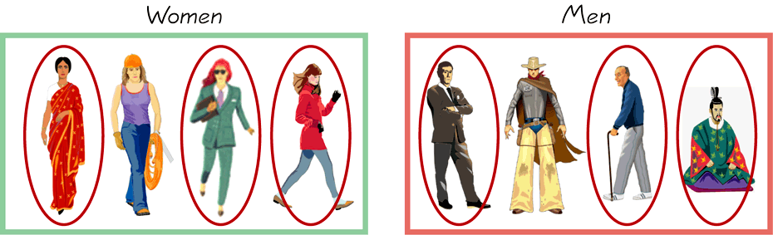
STRATIFIED SAMPLING…….
        Draw a sample from each stratum

