Slide 1
Sampling Design and Analysis
MTH 494
Ossam Chohan
Assistant Professor
CIIT Abbottabad

Slide 2
Review

Slide 3
Sampling with probabilities proportional to size
So far we have discussed all cases depended on samples being a simple random sample.
In real life probabilities cannot be same for all samples.
Varying the probabilities with which different sampling units are selected is sometimes advantageous.

Slide 4
Discussion example
Suppose we wish to estimate the number of jobs openings in a city by sampling industrial firms within the city.
Many firms will be quite small while some firms will be very large.
In SRS size of firm is not taken into account.
While large firms will have more job openings as compare to small firms.
Jobs openings are highly influenced by large firms.

Slide 5
Discussion example
Therefore there should be mechanism to improve the simple random sampling by giving the large firms a greater chance to appear in the sample.
A method is called sampling with probabilities proportional to size, or pps sampling.
For a sample y₁, y₂, y₃, … , y_{n}, from a population of size N, Let π_{i}= probability that y_{i} appear in the sample
Unbiased estimators of τ and µ, along with their estimated variances and bounds on the error of estimation, are as follows:

Slide 6
Estimators
Estimator of the population Total τ
Estimation variance of

Slide 7
Bound on the error of estimation

Slide 8
Estimators
Estimator of the population mean µ:
Estimated variance of :

Slide 9
Bound on the error of estimation:

Slide 10
Important discussions
The estimators and are unbiased for any choices of π_{i}, but it is clearly in the best interest of the experimenter to choose these π_{i} ‘s so that the variances of the estimators are as small as possible.
Suppose for the moment that the value of y_{i} is known for each of the N units in the population. Thus the population total τ is also known. Under these conditions we can select each unit for the sample with probability proportional to its actual measured value y_{i}, assuming all measurements are positive. That is we can make π_{i}= y_{i}/τ
With π _{i} = y_{i}/τ for each sampled item, becomes

Slide 11
Cont….

Slide 12
Cont…..
Now to know the values y for every unit in the population before sampling is impossible. (if they were known, no sampling would be necessary). Hence the choice π _{i} = y _{i} /τ is not possible, but it does provide a criterion for selecting π _{i}’s that can be used in sampling.
The best practical way to choose the π _{i}’s is to choose them proportional to a known measurement that is highly correlated with y _{i}.

Slide 13
Old Example with new dimension
Let us get back to the example in which population N= 4 element {1,2,3,4}
Recall that for simple random samples of size n=2, E( )= 2.5 and variance = 5/12=0.417
Suppose that we decide to sample n=2 elements with varying probabilities and choose π₁= 0.1, π₂= 0.1, π₃=0.4, and π₄= 0.4
To accomplish this sampling, we can choose a random digit from the random number table and take our first sampled element to be:

Slide 14
1 if the random digit is 0,
2 if the random digit is 1,
3 if the random digit is 2,3,4, or 5,
4 if the random digit is 6,7,8, or 9
Note these probabilities are not exactly proportional to size but they do tend in that direction.
Listing ten possible sample

Slide 15
Sampling with varying probabilites
Sample | Probability of obtaining sample
{1,2} [2*0.1*0.1] | 0.02 | 15
{1,3} [2*0.1*0.4] | 0.08 | 35/4
{1,4} | 0.08 | 10
{2,3} | 0.08 | 55/4
{2,4} | 0.08 | 15
{3,4} | 0.32 | 35/4
{1,1} | 0.01 | 10
{2,2} | 0.01 | 20
{3,3} | 0.16 | 15/2
{4,4} | 0.16 | 10
……Where 2 is size

Slide 18
Important discussion
Sampling with varying probabilities will lower the variance of an estimator that leads for more precise estimator, if the probabilities are proportional, or approximately proportional to the size of the sample measurements. If, however, the probabilities are improperly chosen, then and can have larger variance than the corresponding τ and µ from simple random sampling.

Slide 19
Summary
Pps sampling involves sampling with replacement. Not remove sample item from population.
Particular sampling unit can be selected more than once.
A repeatable selection is usually undesirable, but it will not happen often if n/N is small.
The pps estimators of τ and µ only produce smaller variances if the probability π_{i} are proportional or approximately proportional, to the size of the y_{i} ‘s under investigation.

Slide 20
Example
An investigator wishes to estimate the average number of defects per board on boards of electronic component manufactured for installation in computers. The boards contain varying numbers of components, and the investigator feels that the number of defects should be positively correlated with the number of components on a board.
Thus pps sampling is used, with the probability of selecting any one board for the sample being proportional to the number of components on that board. A sample of n=4 boards is to be selected from the N=10 boards one day’s production. The number of components on the 1- boards are, respectively
10, 12, 22, 8, 16, 24, 9, 10, 8, 31
Show how to select n=4 boards with probabilities proportional to size.

Slide 21
Solution
Board | No of Components | Cumulative range | π_{i}
1 | 10 | 1-10 | 10/150
2 | 12 | 11-22 | 12/150
3 | 22 | 23-44 | 22/150
4 | 8 | 45-52 | 8/150
5 | 16 | 53-68 | 16/150
6 | 24 | 69-92 | 24/150
7 | 9 | 93-101 | 9/150
8 | 10 | 102-111 | 10/150
9 | 8 | 112-119 | 8/150
10 | 31 | 120-150 | 31/150

Slide 22
Solution
There are 150 components in the population to be sampled. We can think of these components as being numbered from 1 to 150.
The cumulative range column keeps track of the interval of numbered components on each board. Board number 1 has the first 10 components, board number 2 has components 11 through 22, and so on..

Slide 23
solution
The π’s are simply the number of components per board divided by the total number of components.
The boards having greater numbers of components have larger probabilities of selection.

Slide 24
solution
To choose the sample of n=4 boards, we enter the random number table and select four random numbers between 1 and 150.
Suppose the numbers we selected were 14, 56, 94 and 25.
We locate these numbers in the cumulative range column. The boards corresponding to those range intervals constitute the sample.

Slide 25
solution
Since 14 lies in the range of board 2, that board enters the sample. Similarly, 56 lies in the range of board 5, 94 lies in the range of board 7, and 25 lies in the range of board 3.
Thus the sample consists of boards 2,3,5,7.
These boards have been selected with probabilities proportional to their numbers of components.
With this method we could have sampled a particular board more than once.

Slide 26
Example
With reference to previous example, the number of defects found on boards 2,3,5,7 were, respectively, 1, 3, 2, 1. estimate the average number of defects per board, and place a bound on the error of estimation.

Slide 29
Sampling Weights

Slide 30
What is meant by sampling weights?
Real surveys are generally multi-stage
At each stage, probabilities of selecting units at that stage are not generally equal
When population parameters like a mean or proportion is to be estimated, results from lower levels need to be scaled-up from the sample to the population
This scaling-up factor, applied to each unit in the sample is called its sampling weight.

Slide 31
A simple example
Suppose for example, a simple random sample of 500 HHs in a rural district (having 7349 HHs in total) showed 140 were living below the poverty line
Hence total in population living below the poverty line = (140/500)*7349 =2058
Data for each HH was a 0,1 variable, 1 being allocated if HH was below poverty line.
Multiplying this variable by 7349/500=14.7 & summing would lead to the same answer.
i.e. sampling weight for each HH = 14.7

Slide 32
Why are weights needed?
Above was a trivial example with equal probabilities of selection
In general, units in the sample have very differing probabilities of selection, i.e. rare to get a self-weighting design
To allow for unequal probabilities of selection, each unit is weighted by the reciprocal of its probability of selection
Thus sampling weight=(1/prob of selection)

Slide 33
Other uses of weight
Weights are also used to deal with non-responses and missing values
If measurements on all units are not available for some reason, may re-compute the sampling weights to allow for this.
e.g. In conducting the Household Budget Survey 2000/2001 in Tanzania, not all rural areas planned in the sampling scheme were visited. As a result, sampling weights had to be re-calculated and used in the analysis.

Slide 34
Difficulties in computations
Standard methods as illustrated in textbooks on sampling, often do not apply in real surveys
Complex sampling designs are common
Computing correct probabilities of selection can then be very challenging
Usually professional assistance is needed to determine the correct sampling weights and to use in correctly in the analysis

Slide 35
Software for dealing with weights
When analysing data from complex survey designs, it is important to check that the software can deal with sampling weights
Packages such as Stata, SAS, Epi-info have facilities for dealing with sampling weights
However, need to be careful that the approaches used are appropriate for your own survey design

Slide 36
Confidence Intervals
Confidence Interval: An interval of values computed from the sample, that is almost sure to cover the true population value.
We make confidence intervals using values computed from the sample, not the known values from the population
Interpretation: In 95% of the samples we take, the true population proportion (or mean) will be in the interval.
This is also the same as saying we are 95% confident that the true population proportion (or mean) will be in the interval

Slide 37
Confidence in General

Slide 38
Role of information in data

Slide 39
Degree of Confidence

Slide 40
Simple General Construction of CI

Slide 41
Generalization

Slide 42
How do we compute the intervals?
We know that in 95% of the samples, the true population proportion(or mean) will fall within in 2 standard errors of the sample mean.
Where does the 2 come from:
For a bell curve 95% of the data will be between +/- 1.96 standard deviations.
What is the standard error:
This is not the standard deviation of the sample, it is the standard
deviation of the sample proportion (or mean)

Slide 43
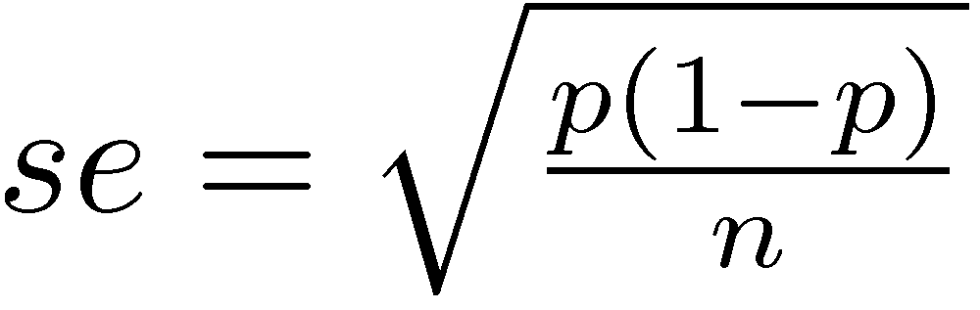
Confidence Intervals for Proportions
(Sample for a categorical variable)
If numerous samples are taken of size n (n>30), then the sample proportion will have a standard error of:
Where p is the sample proportion
Find the 95% confidence interval for the sample proportion:
CI: sample proportion +/- 2(se)

Slide 44
Example (Proportion)
A study was done on the proportion of males and females who participate in athletics. 480 females and 530 males participated in the study, where 170 females participated in athletics and 208 males.
What is the sample of females participating in athletics?
What is the standard error of the sample proportion of athletes?
Construct a 95% confidence interval for the population proportion of females that would participate in athletics.
Notes:
se = 4

Slide 45
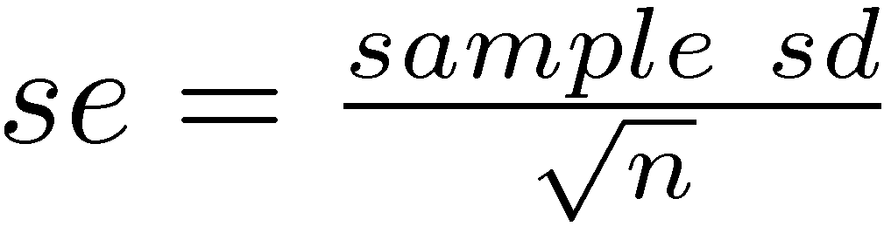
Confidence Intervals for Mean
(Sample for a measurement variable)
If numerous samples are taken of size n (n>30), then the sample mean will have a standard error of:
Find the 95% confidence interval for the sample mean:
CI: sample mean +/- 2(se)

Slide 46
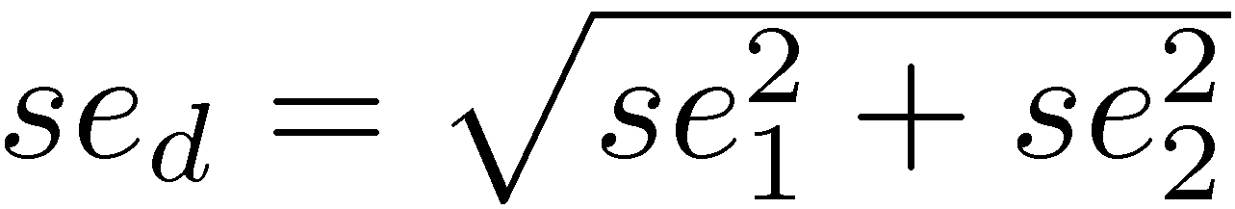
Confidence Intervals for Difference in Mean
The standard error for the difference in means is:
Find the 95% confidence interval for the difference in sample means:
CI: difference sample mean +/- 2(se_{d})

Slide 47
Example (mean)
We look at a study of males versus females mean SAT scores. The mean SAT score for females is 1180 with a standard deviation of 5 and for males, the mean SAT score is 1160 with a standard deviation of 6.
What is the standard error for the mean SAT score for females,
for males, for the difference between the two?
Form a 95% confidence interval for the mean SAT score for females.
Form a 95% confidence interval for the difference in mean SAT scores between males and females.

