Slide 1
MTH-471
Integral Equations
Sheikh Irfan Ullah Khan
Assistant Professor
Department of Mathematics
COMSTAS Institute of Information Technology

Slide 2
Recall

Slide 3
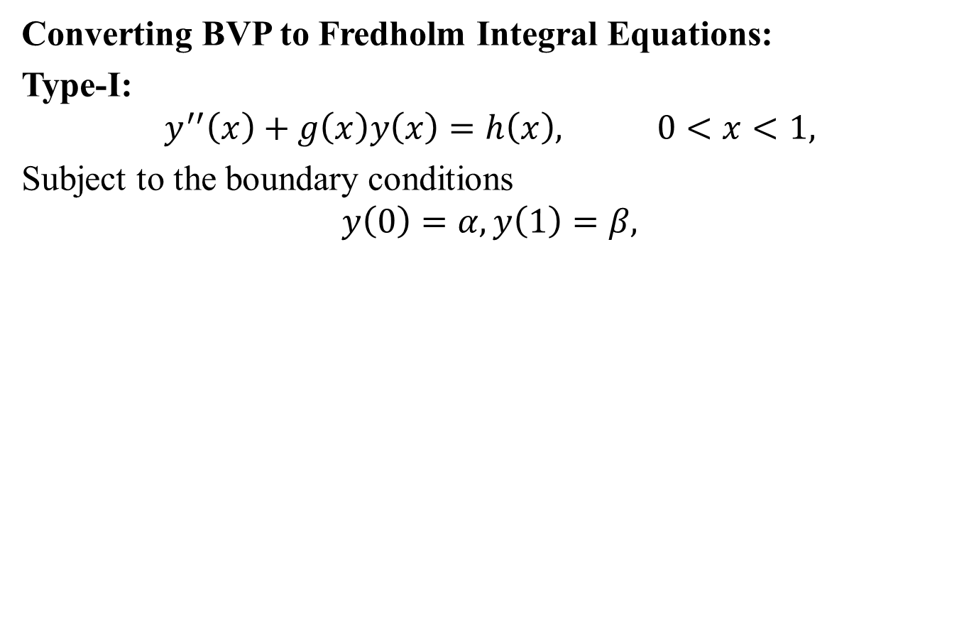

Slide 7
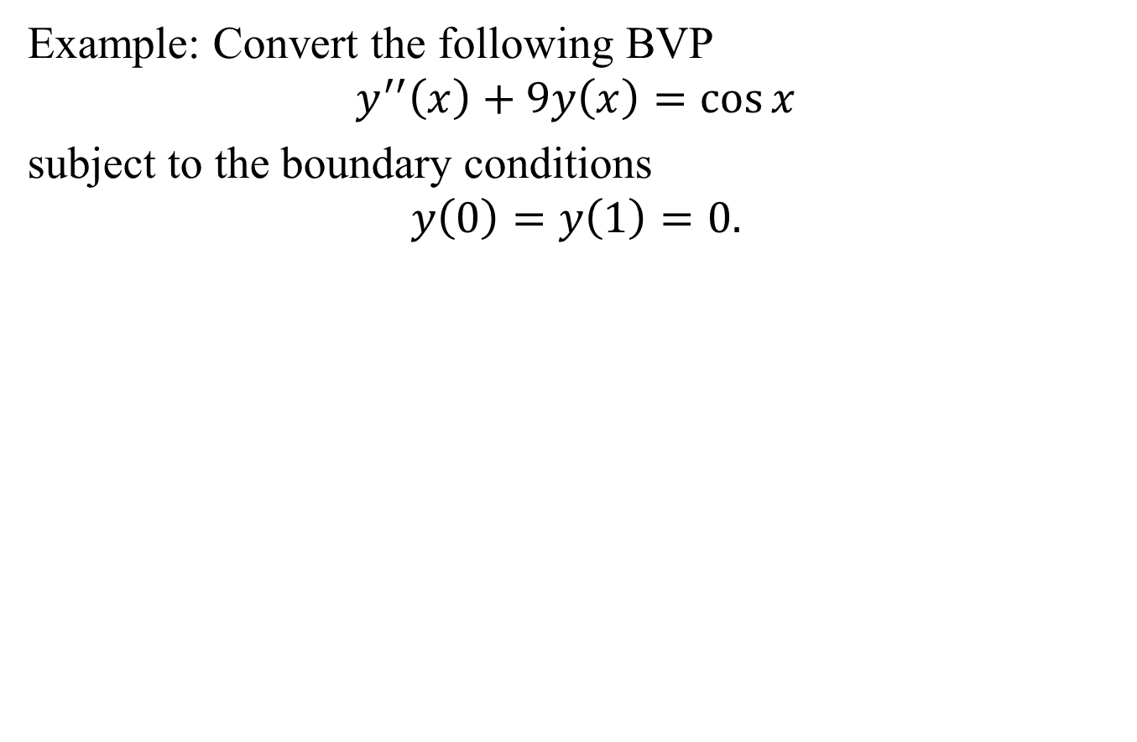

Slide 10
