Slide 1
MTH-471
Integral Equations
Sheikh Irfan Ullah Khan
Assistant Professor
Department of Mathematics
COMSTAS Institute of Information Technology

Slide 2
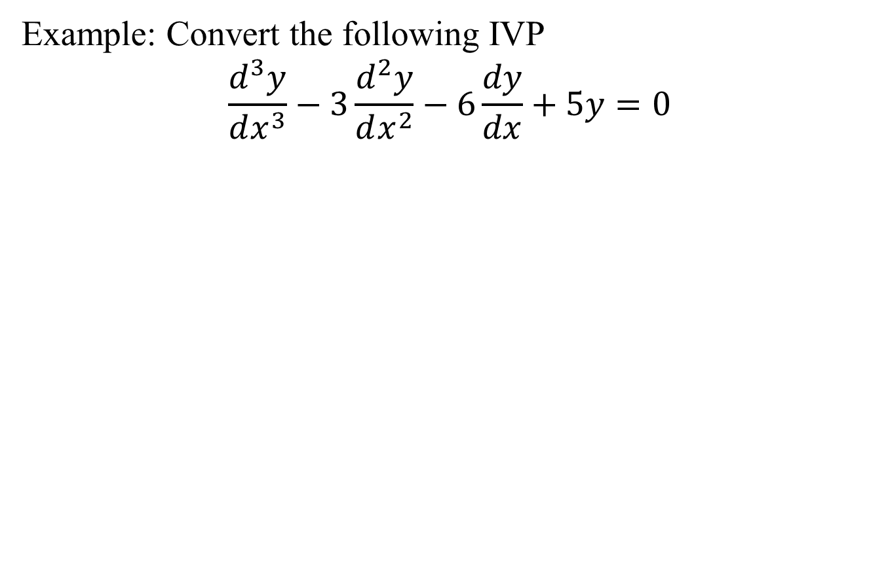

Slide 6
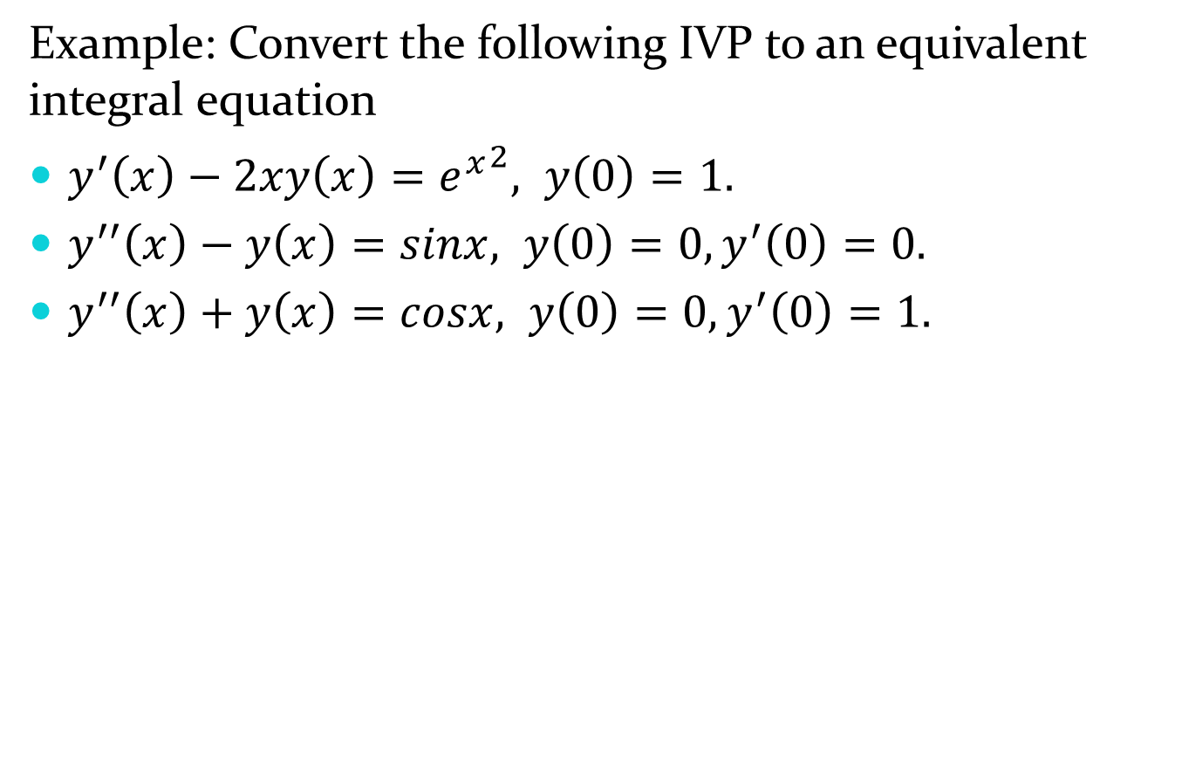
Example: Convert the following IVP to an equivalent integral equation
$y^{′}\left(x\right)−2xy\left(x\right)={e^{x}}^{2}, y\left(0\right)=1.$
$y^{′′}\left(x\right)−y\left(x\right)=sinx, y\left(0\right)=0, y^{′}\left(0\right)=0.$
$y^{′′}\left(x\right)+y\left(x\right)=cosx, y\left(0\right)=0, y^{′}\left(0\right)=1.$

Slide 7
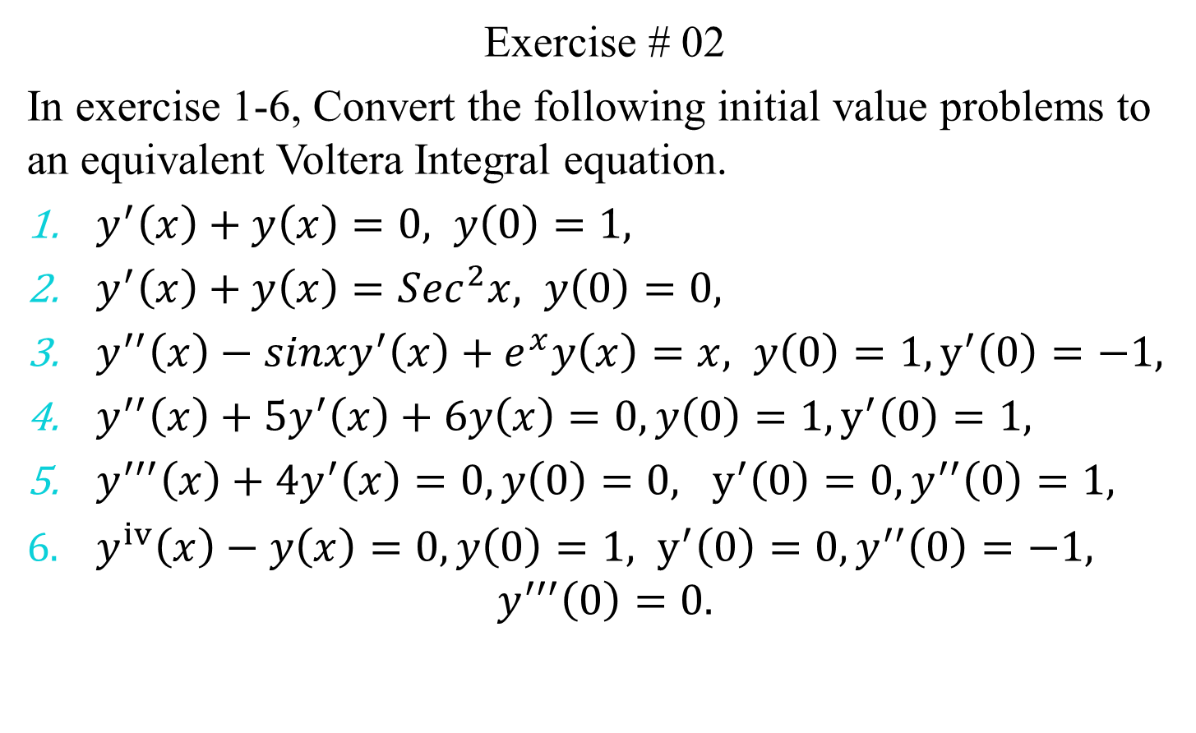
Exercise # 02
In exercise 1-6, Convert the following initial value problems to an equivalent Voltera Integral equation.
$y^{′}\left(x\right)+y\left(x\right)=0, y\left(0\right)=1,$
$y^{′}\left(x\right)+y\left(x\right)=Sec^{2}x, y\left(0\right)=0,$
$y^{′′}\left(x\right)−sinxy^{′}\left(x\right)+e^{x}y\left(x\right)=x, y\left(0\right)=1, y^{′}\left(0\right)=−1,$
$y^{′′}\left(x\right)+5y^{′}\left(x\right)+6y\left(x\right)=0,y\left(0\right)=1, y^{′}\left(0\right)=1,$
$y^{′′′}\left(x\right)+4y^{′}\left(x\right)=0,y\left(0\right)=0, y^{′}\left(0\right)=0, y^{′′}\left(0\right)=1,$
$y^{iv}\left(x\right)−y\left(x\right)=0,y\left(0\right)=1, y^{′}\left(0\right)=0, y^{′′}\left(0\right)=−1,$
$$y^{′′′}\left(0\right)=0.$$

Slide 8
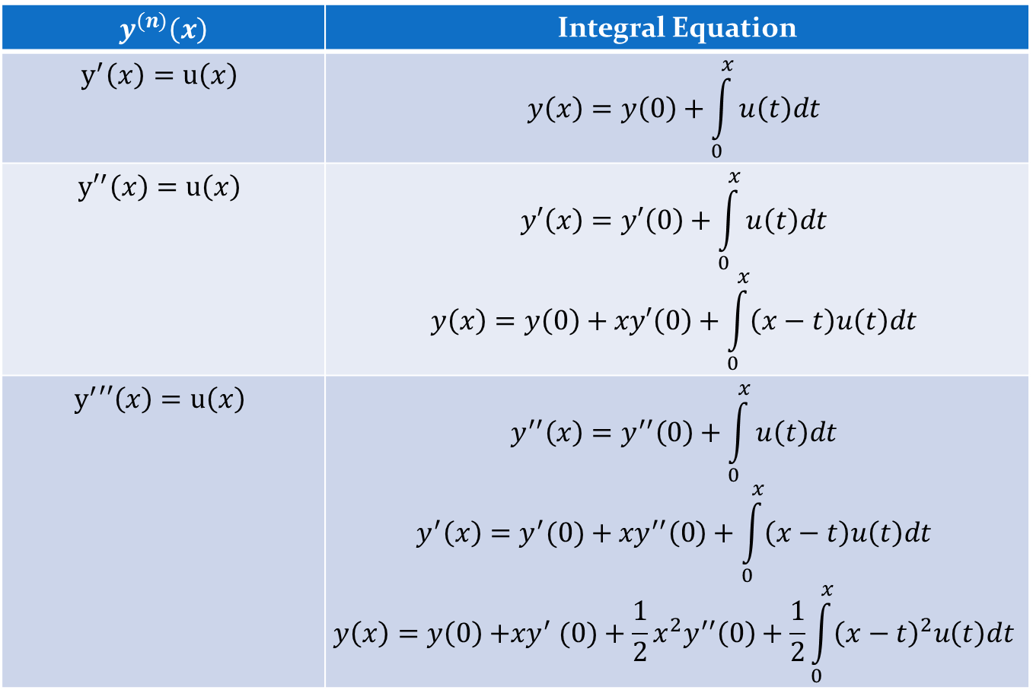
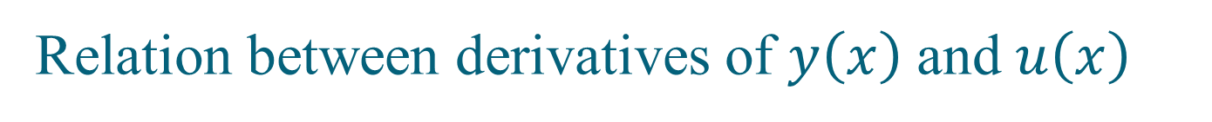
Relation between derivatives of $y\left(x\right)$ and $u\left(x\right)$
$$y^{(n)}\left(x\right)$$ | Integral Equation
$$y^{′}\left(x\right)=u\left(x\right)$$ | $$y\left(x\right)=y\left(0\right)+\int_{0}^{x}{u\left(t\right)dt}$$
$${y′}^{′}\left(x\right)=u\left(x\right)$$ | $$y′\left(x\right)=y′\left(0\right)+\int_{0}^{x}{u\left(t\right)dt}$$ $$y\left(x\right)=y\left(0\right)+xy′\left(0\right)+\int_{0}^{x}{\left(x−t\right)u\left(t\right)dt}$$
$$y^{′}′′\left(x\right)=u\left(x\right)$$ | $$y^{′′}\left(x\right)=y^{′′}\left(0\right)+\int_{0}^{x}{u\left(t\right)dt}$$ $$y^{′}\left(x\right)={y^{′}(0)+xy}^{′′}\left(0\right)+\int_{0}^{x}{\left(x−t\right)u\left(t\right)dt}$$ $$y\left(x\right)={y\left(0\right){+xy}^{′}(0)+\frac{1}{2}x^{2}y}^{′′}\left(0\right)+\frac{1}{2}\int_{0}^{x}{{\left(x−t\right)}^{2}u\left(t\right)dt}$$

Slide 9
Converting BVP to Fedholm integal equation:

Slide 12
